Slide 1
SQL Server 2008 R2 Parallel Data Warehouse

Slide 2
Agenda
Microsoft Data Warehousing Vision
SQL Server 2008 R2 Parallel Data Warehouse
Hub & Spoke Architecture
Technology Previews
Data Warehousing Roadmap Service
Summary

Slide 3
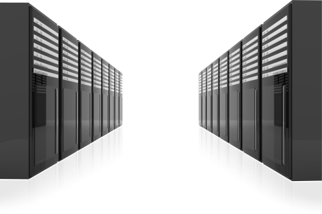
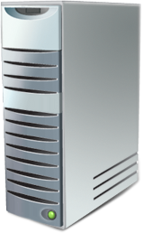
SQL Server Innovations
Managed Self-Service BI
Multi-server management
Virtualization & Live Migration
Highly scalable DW appliances from 10s to 100s TB
Hardware choice
Seamless integration with Microsoft BI
Scalable relational database platform
Consistent, familiar model & tools
Self-managed, highly available cloud services
Notes:
SQL Server 2008 R2 is our next generation database platform

Slide 4
Microsoft Data Warehouse Vision
Make SQL Server the gold standard for data warehousing offering customers
Massive Scalability at Low Cost
Hardware Choice
Improved Business Agility and Alignment
Democratized Business Intelligence

Slide 5
Customer Challenges
Approximate data volume managed by data warehouse
Increased volumes of data
Need to reduce costs
Increased adoption of DW appliances
Move to MPP
Demand for flexibility and mixed workloads across the enterprise
Desire for real-time analytics
Growing importance of data quality
Today
In 3 Years
Less than 500 GB
21%
5%
500 GB – 1 TB
20%
12%
1 – 3 TB
21%
18%
3 – 10 TB
19%
25%
More than 10 TB
17%
34%
Don’t Know
2%
6%
Source: TDWI Report – Next Generation DW
Notes:
Now let’s take a look at the challenges facing data warehouse industry as a whole. The Data Warehouse Institute (TDWI) recently published a report entitled “Next Generation Data Warehouse Platforms”, which identified a number of common challenges.
[Click to reveal each bullet and chart]
Increased Volumes of Data – today’s largest data warehouses are in the 100’s of terabytes scale, but data volumes in many organizations are rising dramatically. Within 3 years, there will be significantly more organizations with 100’s of terabytes of data, and many organizations will be breaking into the petabyte range.
Need to reduce costs – The global economic recession of 2009 has affected companies of all sizes all over the world. Now more than ever, budgets are being squeezed and there is a growing requirement for IT services to do more with less.
Increased adoption of hardware appliances – more and more organizations are purchasing data warehouse appliances rather than building their own bespoke data warehouse server infrastructure and installing software.
Move to Massively Parallel Processing (MPP) – while symmetric multi-processing works well for today’s data warehouses and data marts, as data volume and data warehouse utilization grows, many organizations are looking to MPP processing architectures to increase scalability and performance.
Demand for flexibility and mixed workloads – Data Warehouses are now serving an increasing range and number of user groups, each with their own requirements and workloads. Organizations are trying to find ways to meet the needs of a diverse range of users while maintaining the overall consistency of enterprise data an the ability to adapt to changes in the business.
Desire for real-time analytics – While historical reporting and analysis continue to be important, organizations are increasingly looking for real-time analysis solutions that will enable them to be more responsive and informed when making critical business decisions.
Growing importance of data quality – Organizations are increasingly aware of the need for the data in their data warehouse to be accurate and consistent, so many data warehouse professionals are looking for data quality tools that will help them improve the overall quality of their data.

Slide 6
Customer Challenges
Increased volumes of data
Need to reduce costs
Increased adoption of DW appliances
Move to MPP
Demand for flexibility and mixed workloads across the enterprise
Desire for real-time analytics
Growing importance of data quality
Effect of current recession on DW teams and projects
Budget reduced
57%
Hiring frozen
41%
Approved projects on hold
30%
Priorities shift to short-term gains
31%
No impact so far
27%
New tool and platform acquisitions frozen
25%
Some team members laid off
19%
Focus shifted from new dev to admin of old solutions
18%
Other
3%
Source: TDWI Report – Next Generation DW
Notes:
Now let’s take a look at the challenges facing data warehouse industry as a whole. The Data Warehouse Institute (TDWI) recently published a report entitled “Next Generation Data Warehouse Platforms”, which identified a number of common challenges.
[Click to reveal each bullet and chart]
Increased Volumes of Data – today’s largest data warehouses are in the 100’s of terabytes scale, but data volumes in many organizations are rising dramatically. Within 3 years, there will be significantly more organizations with 100’s of terabytes of data, and many organizations will be breaking into the petabyte range.
Need to reduce costs – The global economic recession of 2009 has affected companies of all sizes all over the world. Now more than ever, budgets are being squeezed and there is a growing requirement for IT services to do more with less.
Increased adoption of hardware appliances – more and more organizations are purchasing data warehouse appliances rather than building their own bespoke data warehouse server infrastructure and installing software.
Move to Massively Parallel Processing (MPP) – while symmetric multi-processing works well for today’s data warehouses and data marts, as data volume and data warehouse utilization grows, many organizations are looking to MPP processing architectures to increase scalability and performance.
Demand for flexibility and mixed workloads – Data Warehouses are now serving an increasing range and number of user groups, each with their own requirements and workloads. Organizations are trying to find ways to meet the needs of a diverse range of users while maintaining the overall consistency of enterprise data an the ability to adapt to changes in the business.
Desire for real-time analytics – While historical reporting and analysis continue to be important, organizations are increasingly looking for real-time analysis solutions that will enable them to be more responsive and informed when making critical business decisions.
Growing importance of data quality – Organizations are increasingly aware of the need for the data in their data warehouse to be accurate and consistent, so many data warehouse professionals are looking for data quality tools that will help them improve the overall quality of their data.

Slide 7
Customer Challenges
Increased volumes of data
Need to reduce costs
Increased adoption of DW appliances
Move to MPP
Demand for flexibility and mixed workloads across the enterprise
Desire for real-time analytics
Growing importance of data quality
DW Processing Architectures
Have Today
Would Prefer
Symmetrical Multiprocessing (SMP)
61%
27%
Massively Parallel Processing (MPP)
33%
68%
Other
6%
5%
Source: TDWI Report – Next Generation DW
Notes:
Now let’s take a look at the challenges facing data warehouse industry as a whole. The Data Warehouse Institute (TDWI) recently published a report entitled “Next Generation Data Warehouse Platforms”, which identified a number of common challenges.
[Click to reveal each bullet and chart]
Increased Volumes of Data – today’s largest data warehouses are in the 100’s of terabytes scale, but data volumes in many organizations are rising dramatically. Within 3 years, there will be significantly more organizations with 100’s of terabytes of data, and many organizations will be breaking into the petabyte range.
Need to reduce costs – The global economic recession of 2009 has affected companies of all sizes all over the world. Now more than ever, budgets are being squeezed and there is a growing requirement for IT services to do more with less.
Increased adoption of hardware appliances – more and more organizations are purchasing data warehouse appliances rather than building their own bespoke data warehouse server infrastructure and installing software.
Move to Massively Parallel Processing (MPP) – while symmetric multi-processing works well for today’s data warehouses and data marts, as data volume and data warehouse utilization grows, many organizations are looking to MPP processing architectures to increase scalability and performance.
Demand for flexibility and mixed workloads – Data Warehouses are now serving an increasing range and number of user groups, each with their own requirements and workloads. Organizations are trying to find ways to meet the needs of a diverse range of users while maintaining the overall consistency of enterprise data an the ability to adapt to changes in the business.
Desire for real-time analytics – While historical reporting and analysis continue to be important, organizations are increasingly looking for real-time analysis solutions that will enable them to be more responsive and informed when making critical business decisions.
Growing importance of data quality – Organizations are increasingly aware of the need for the data in their data warehouse to be accurate and consistent, so many data warehouse professionals are looking for data quality tools that will help them improve the overall quality of their data.

Slide 8
Customer Challenges
Increased volumes of data
Need to reduce costs
Increased adoption of DW appliances
Move to MPP
Demand for flexibility and mixed workloads across the enterprise
Desire for real-time analytics
Growing importance of data quality
Techniques used in primary data warehouse solution
Today
In 3 years
Mixed Workloads
46%
72%
Advanced Analytics
(e.g. data mining/predictive)
38%
85%
Source: TDWI Report – Next Generation DW
Notes:
Now let’s take a look at the challenges facing data warehouse industry as a whole. The Data Warehouse Institute (TDWI) recently published a report entitled “Next Generation Data Warehouse Platforms”, which identified a number of common challenges.
[Click to reveal each bullet and chart]
Increased Volumes of Data – today’s largest data warehouses are in the 100’s of terabytes scale, but data volumes in many organizations are rising dramatically. Within 3 years, there will be significantly more organizations with 100’s of terabytes of data, and many organizations will be breaking into the petabyte range.
Need to reduce costs – The global economic recession of 2009 has affected companies of all sizes all over the world. Now more than ever, budgets are being squeezed and there is a growing requirement for IT services to do more with less.
Increased adoption of hardware appliances – more and more organizations are purchasing data warehouse appliances rather than building their own bespoke data warehouse server infrastructure and installing software.
Move to Massively Parallel Processing (MPP) – while symmetric multi-processing works well for today’s data warehouses and data marts, as data volume and data warehouse utilization grows, many organizations are looking to MPP processing architectures to increase scalability and performance.
Demand for flexibility and mixed workloads – Data Warehouses are now serving an increasing range and number of user groups, each with their own requirements and workloads. Organizations are trying to find ways to meet the needs of a diverse range of users while maintaining the overall consistency of enterprise data an the ability to adapt to changes in the business.
Desire for real-time analytics – While historical reporting and analysis continue to be important, organizations are increasingly looking for real-time analysis solutions that will enable them to be more responsive and informed when making critical business decisions.
Growing importance of data quality – Organizations are increasingly aware of the need for the data in their data warehouse to be accurate and consistent, so many data warehouse professionals are looking for data quality tools that will help them improve the overall quality of their data.

Slide 9
Data Warehouse Industry Trends
100%
Good growth, good commitment
Broad Commitment
Flat growth, good/ moderate commitment
Advanced Analytics
Centralized EDW
Analytics within EDW
Data Quality
✓
75%
✓
HA for DW
✓
✓
64-bit
MDM
Analytics Outside EDW
Blades in Racks
DBMS Built for DW
Web Services
✓
✓
Real-time DW
MPP
Security
Plan to Use
50%
DBMS Built for Transactions
SMP
✓
Streaming Data
SOA
Low-Power Hardware
DW Appliance
✓
✓
Good growth, moderate commitment
Mixed Workloads
Server Virtualization
Data Federation
DW Bundles
Columnar DBMS
In-Memory DBMS
25%
SaaS
Declining usage despite commitment
Open Source OS
Open Source
Reporting
Good growth, small commitment
Narrow Commitment
Software Appliance
Open Source
Data Integration
Public Cloud
Open Source DBMS
0%
-50%
-25%
0%
25%
50%
75%
100%
Decreasing Usage
Anticipated Growth in the next 3 Years
Increasing Usage
✓ Areas of strategic investment for Microsoft
Source: TDWI
Notes:
This chart, taken from the TDWI Next Generation Data Warehouse Platforms report, shows data warehouse features and techniques plotted for delta (growth) and plan to use (commitment).
As you’ll see in the rest of this presentation, Microsoft’s strategy for data warehousing aligns extremely well with the features and techniques that have broad commitment and good growth. The green ticks show specific technology areas Microsoft is strategically investing in.

Slide 10
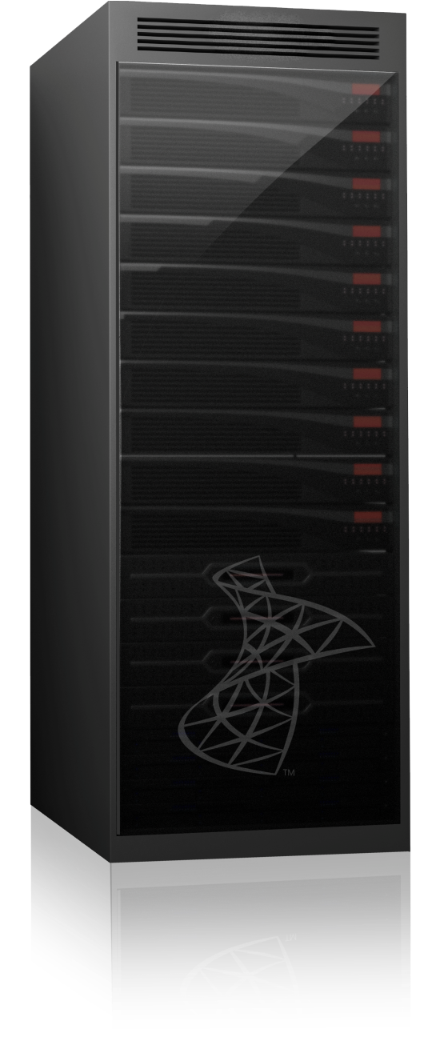
SQL Server Parallel Data Warehouse A data warehouse appliance with massive scalability
High Scalability from 10s to 100s of TB
High scale through Massively Parallel Processing (MPP) system
Choice of hardware vendor
Low cost through industry standard hardware
Deep integration with Microsoft BI
Notes:
SQL Server Parallel Data Warehouse is a data warehouse appliance that offers massive scalability at low cost.
[Click to reveal components of SQL Server Parallel Data Warehouse]
SQL Server Parallel Data Warehouse is built on the MPP technology acquired with Datallegro, and is provided as an appliance running SQL Server on Windows Server, with standard hardware components from a number of hardware vendors – HP, IBM, Dell, Bull, and EMC. This provides a balanced solution consisting of software and hardware working together.
SQL Server Parallel Data Warehouse will support data warehouses that store 100’s of terabytes, and beyond into the petabyte range while offering a low total cost of ownership, previously unseen at this end of the market.
SQL Server Parallel Data Warehouse will empower business by providing enterprise class performance and the flexibility of a hub and spoke architecture that enables organizations to implement a data warehouse and data mart ecosystem that meets their needs.

Slide 11
Parallel Data Warehouse compute node
Database Server Storage Node

Slide 12
Parallel Data Warehouse Appliance - Hardware Architecture
Database Servers
Storage Nodes
Control Nodes
Active / Passive
SQL
SQL
Client Drivers
SQL
SQL
SQL
Management Servers
SQL
Data Center
Monitoring
SQL
Dual Infiniband
Dual Fiber Channel
Landing Zone
SQL
ETL Load Interface
SQL
Backup Node
SQL
Corporate Backup
Solution
SQL
Spare Database Server
Corporate Network
Private Network

Slide 13
Parallel Data Warehouse demo at BI conference 2008
Query
Cache flushed
Inner joins
Report
Retailer: day-part analysis
Sales, Time, Date, Prod type
Sample Results
625K rows returned in 11 seconds from 1 trillion row table
Final product will be even faster

Slide 14
Case Study: First Premier Bankcard
Existing
Environment
Current
Challenges
Madison
Highlights
Hardware
16 CPU HP 8620 Itanium
Hitachi Storage 27TB Raw SATA 21 LUNS
Software
Windows 2003 SP2
SQLServer 2008
SSIS/SSRS
Data Warehouse
18 Terabytes
Star Schema
80 Fact Tables
500 + Dimensions
Data Load Speeds
Analytic Capacity
Analytic Speed
Mixed Workload
Total Cost of Ownership
Improved by 300%
30TB/160 Cores
Query Speeds 70X Improvement
Concurrency Mixed Workload
TCO Lowered by 50%

Slide 15
Parallel Data Warehouse – An Appliance Experience
All hardware from a single vendor
Multiple vendors to chose from
Orderable at the rack level
Vendor will
Assemble appliances
Image appliances with OS, SQL Server and PDW software
Appliance installed in less than a day
Support –
Microsoft provides first call support
Hardware partner provides onsite break / fix support

Slide 16
Parallel Data Warehouse sample offerings
1 Rack
Maximum capacity 91 TB ¹
Total Price $2.0M
Software Price $1.3M ²
Hardware Price $0.7M ³
2 Racks
Maximum capacity 182 TB ¹
Total Price $3.7M
Software Price $2.5M ²
Hardware Price $1.2M ³
Notes:
Assume 2.5X Compression ratio
The prices listed are estimated prices based on $57.5k per processor; reseller pricing may vary Software prices include Windows Server licenses. Software price excludes Support. Only License prices included
HW Price includes estimated HW Support. The actual HW support costs will vary by Vendor and region
Preliminary Information Subject to Change

Slide 17
Parallel Data Warehouse TimeLine
PDW vNext
Focus on continually lowering the costs of high end DW, while increasing performance
Additional Hardware Partners
Closer functional alignment with SQL Server
Better integration with SQL and tools and technologies
Microsoft Announce Intention to Acquire DATAllegro (July)
Acquisition Closes (Sept)
150TB demo of DATAllegro on SQL Server run at BI Conference (Oct)
MTP Program Launched
Circa 10 Customers Provided with early Madison Benchmark
Madison Named as SQL Server 2008 R2 Parallel Data Warehouse
List Price at $57.5K per proc
2008
2009
2010
Beyond
Project “Madison”
Compatibility with DATAllegro v3
MS BI integration
MTP 2 Program to Launch (fully functional, fully performant)
TAP Program (on client site)
RTM in Summer 2010
?
Preliminary Information Subject to Change

Slide 18
Hub & Spoke Architecture

Slide 19
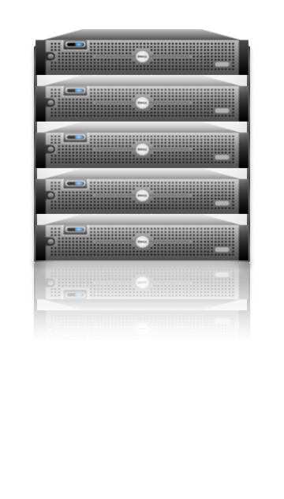
Hub and Spoke – Flexible Business Alignment
EDW provides “single version of truth” but makes it difficult to support mixed workloads and multiple user groups, each requiring SLAs
Notes:
The Enterprise Data Warehouse (EDW) is a common way to centralize business data for all BI needs throughout the organization. In this case, the EDW is a “single version of the truth”. The centralized architecture simplifies data governance, making it straightforward to track and audit data. Yet as the EDW becomes successful and adoption increases, it becomes inflexible, expensive, and unresponsive to business needs since it is harder to make changes to the data warehouse.

Slide 20
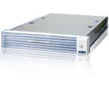
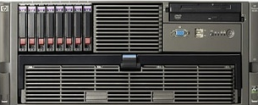
Hub and Spoke – Flexible Business Alignment
Departmental data marts enable mixed workloads, but make it difficult to consolidate information across the enterprise
Notes:
Independent data marts, each serving the needs of a single user group (e.g. The sales team, the HR team, etc.) provide a decentralized alternative to the EDW model, enabling business units to create and tune data marts to suit their own needs. However, data governance can be difficult because it is harder to link data across the company. Though it is more responsive, this approach often causes serious management issues for IT departments that have to deal with compliance and IT governance across the organization.

Slide 21
Hub and Spoke – Flexible Business Alignment
Parallel database copy technology enables rapid data movement and consistency between hub and spokes
Support user groups with very different SLAs:
Performance
Capacity
Loading
Concurrency
Create SQL Server 2008, Fast Track Data Warehouse, and SQL Server Analysis Services spokes
A Hub and Spoke solution gives you the flexibility to add/change diverse workloads/user groups, while maintaining data consistency across the enterprise
Notes:
A hub and spoke solution, such as that supported by SQL Server Parallel Data Warehouse, comprises a centralized EDW and a set of loosely coupled data marts. For many years, this has been the preferred approach for enterprise-wide data warehousing, and numerous studies since 2003 confirm that hub and spoke is the most popular data warehouse architecture among DW professionals. Traditionally, implementing a hub and spoke architecture has been challenging due to practical limitations of the database engine and network resources.
[Click to display types of spoke]
With SQL Server Parallel Data Warehouse, you can create a diverse range of types of spoke, from SQL Server Parallel Data Warehouse MPP appliances for user groups with extreme scalability requirements, fast track data warehouse implementations, SQL Server 2008 Enterprise data warehouses, and even SQL Server 2008 Analysis Services OLAP databases.
[Click to display parallel database copy point]
However, SQL Server Parallel Data Warehouse’s parallel database copy technology enables rapid data integration between spokes and the SQL Server Parallel Data Warehouse hub, making it easier to build hub and spoke solutions that integrate your diverse data marts and the enterprise data warehouse.
[Click to display multiple user SLA point]
SQL Server Parallel Data Warehouse’s Hub and Spoke architecture enables you to support user groups with very different SLAs; supports hot, warm and cold data; different requirements on data Loading, etc.

Slide 22
Technology Previews for Parallel Data Warehouse
MTP & TAP programs

Slide 23
Beta Programs for Parallel Data Warehouse
Two Programs
MTP – Madison Technology Preview
20 – 30 participants
Duration of 4 to 6 weeks
TAP – Beta production implementation
6 – 8 customers
First iteration 9 to 12 weeks
Notes:
MTP
As mentioned earlier, the Madison Technology Preview or MTP is our method of supporting customer or prospective client interested in test driving the MPP Appliance technology.
The MTP program requires a minimal investment by the end user as Microsoft supplies the Appliance hardware platform in our data center and the technical resources from the initial scoping effort to the actual execution of the MTP. The end user identifies the existing DW subject area for the MTP, provides test data, DDL, queries and existing benchmarks. Microsoft Madison specialist will write the MTP scope document presents it to the customer for our joint review and approval
Customers are responsible for providing the data, queries and metrics on the existing load times and queries so we can make comparisons during the MTP process. In very large data capacity situations we would most likely ask for sample seed data and then agree on data expansion rules to eliminate any bottle necks with data transfer. Microsoft goes to great lengths with regard to data security and can assure customers that their data is secure. Once we have the data loaded and queries tested at our Data Center the customer is invited to join us to test drive the Madison appliance.
We do have MTP2 slots available and to start the process a short MTP questionnaire needs to be completed by the end user and submitted to the MSFT DW SSP who will then enter the request into a web based nomination form. Clients would be notified shortly thereafter if their nomination has been accepted.
TAP
The Technology Adoption Program or TAP requires customers acquire the Madison Reference Hardware and Microsoft supplies all software required at no charge along with technical resources to work with the client to stand up the Madison DW in production. Once the Madison product in Released to Manufacturing (RTM) then the customer would purchase the required software and maintenance. Microsoft DW SSP’s have access to more details on this process including the Reference Hardware architectures, their estimated list price and the software costs should this detailed due diligence step be required. We expect TAP to start late this CY 2009.

Slide 24
Beta Programs for Parallel Data Warehouse
Requirements
Focus on EDW and large data marts
Migration projects, not green field
Open to customers & prospects
30+ TB of data
At least 4 customers with 100+ TB
Hub-and-spoke in only a select few cases
MTP2 and TAP slots are available
Notes:
The requirements are very straight forward with the exception of an exclusive feature in the Madison DW Appliance – Hub and Spoke Distributed DW Architecture.
Traditionally an Enterprise DW or EDW is implemented in a single monolithic architecture where a Single Version of the Truth is maintained and spawns multiple Data Marts (typically for Dimensional reporting) and supporting bulk ETL feeds - daily loads or more frequent loads based on the latency of the data (near real time loads). Madison supports EDW architectures and we are in general agnostic to the type of data model (3NF, Kimball Dimensional, Corporate Inmon Information Factory or hybrids of all).
However, as data capacities grow so do the number of concurrent end users, their query workloads and the complexity of the workloads with more and more ad-hoc analysis and eventually predictive analysis and when combined with the ever increasing ETL feeds the existing EDW infrastructure is stressed – not to mention the stress IT gets when the end users get the bill for more expensive EDW Hardware/Software upgrades. Many times additional capacity is not needed just more performance and competing MPP platforms (read Teradata, Exadata, Neoview, Netezza, Greenplum etc…) there are no alternatives but to buy more MPP nodes just to get more performance and the cost to capital and on going support is very expensive. This drives end users to start up their own data marts and then data consistency is an issue and the integrity of the single version of the truth is compromised.
Madison’s Hub and Spoke EDW Architecture uniquely provides a viable solution for this situation as it preserves the Single Version of the Truth in the Madison HUB and yet offers flexibly sized SQL 2008 Fast Track Data Mart spokes that are sized for the business’s performance requirements and BUDGET! The IT group preserves the integrity of the Single Version of the Truth on the Madison HUB and simply spawns the DATA Marts as they would in the traditional EDW architecture but then publish them to the Madison enabled SQL 2008 Fast Track spokes using a combination of DATAllegro IP for high speed HUB to Spoke parallel database copy and a dedicated very high speed Infiniband network fabric to populate the spoke with the needed data to perform its function.
A DW SSP can supply existing examples of this technology in production and more details on the implementation of Hub and Spoke architecture in a follow up session. Whitepapers are also available on http://www.microsoft.com/sqlserver/2008/en/us/madison.aspx for both Introduction and Implementing Hub and Spoke architectures. Once again this is a Microsoft exclusive supporting both traditional EDW and distributed Hub and Spoke architectures!

Slide 25
Getting you there

Slide 26
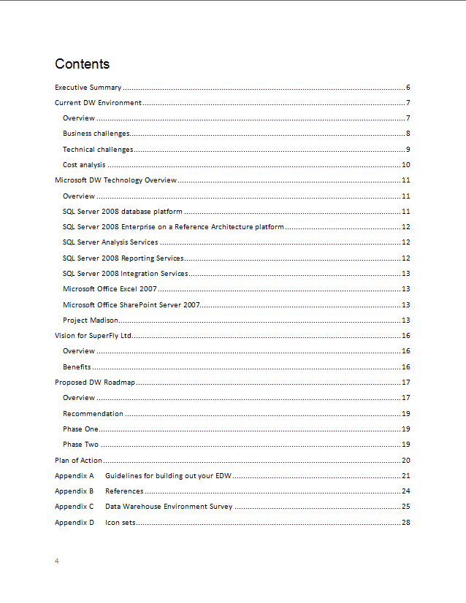
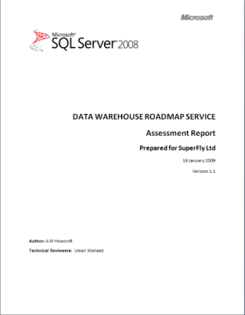
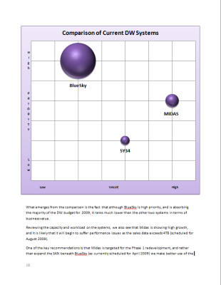
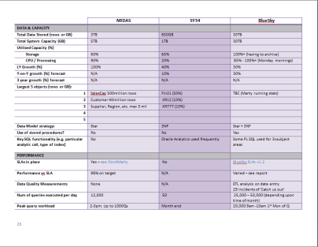
Data Warehouse Roadmap Service
Requirements
Existing DW
Volume of end-user data 1TB+
Considering change to BI or DW infrastructure
On site survey
Interview of key stake holders in Data Warehouse environment
Performed by Microsoft Architect
Service also available from selected Microsoft partners with deep Data Warehouse expertise
2-5 days duration
Deliverables
Presentation of key findings
Report detailing findings
Results delivered approximately 10 days after survey

Slide 27
Next Steps
Learn More:
Visit the Microsoft Data Warehousing portal
Visit the Fast Track and Parallel Data Warehouse web pages
Visit the SQL Server DW Portal on TechNet
Try Now:
Talk to your Microsoft representative to schedule:
Data Warehouse roadmap service
Joining the Technology Preview or TAP program for Parallel Data Warehouse

Slide 28
Summary
Parallel Data Warehouse offers
massive scalability to 100’s of TB
Appliance experience
Hardware choice
Low cost through industry standard hardware
Integration with Microsoft BI tools
Hub-and-spoke architecture integrates SMP reference architectures with Madison
Technology Preview underway

Slide 29
© 2009 Microsoft Corporation. All rights reserved. Microsoft, Windows, Windows Vista and other product names are or may be registered trademarks and/or trademarks in the U.S. and/or other countries.
The information herein is for informational purposes only and represents the current view of Microsoft Corporation as of the date of this presentation. Because Microsoft must respond to changing market conditions, it should not be interpreted to be a commitment on the part of Microsoft, and Microsoft cannot guarantee the accuracy of any information provided after the date of this presentation. MICROSOFT MAKES NO WARRANTIES, EXPRESS, IMPLIED OR STATUTORY, AS TO THE INFORMATION IN THIS PRESENTATION.

Slide 30
Customer Challenges
Approximate data volume managed by data warehouse
DW Processing Architectures
Technologies used in primary data warehouse solution
Techniques used in primary data warehouse solution
Techniques used in primary data warehouse solution
Technologies used in primary data warehouse solution
Increased volumes of data
Need to reduce costs
Increased adoption of DW appliances
Move to MPP
Demand for flexibility and mixed workloads across the enterprise
Desire for real-time analytics
Growing importance of data quality
Effect of current recession on DW teams and projects
Have Today
Today
Today
Today
Today
Today
In 3 Years
Would Prefer
In 3 years
In 3 years
In 3 years
In 3 years
Budget reduced
57%
Symmetrical Multiprocessing (SMP)
53%
46%
17%
42%
61%
Data Warehouse Appliance
Hiring frozen
21%
Mixed Workloads
Real-time data warehousing
Data Quality Tool
Less than 500 GB
41%
78%
72%
92%
82%
27%
5%
Approved projects on hold
30%
Priorities shift to short-term gains
Advanced Analytics
(e.g. data mining/predictive)
Massively Parallel Processing (MPP)
38%
33%
500 GB – 1 TB
20%
31%
85%
68%
No impact so far
12%
27%
New tool and platform acquisitions frozen
1 – 3 TB
6%
21%
Other
25%
5%
18%
Some team members laid off
19%
3 – 10 TB
19%
Focus shifted from new dev to admin of old solutions
18%
25%
Other
3%
More than 10 TB
17%
34%
Don’t Know
2%
6%
Source: TDWI
Notes:
Now let’s take a look at the challenges facing data warehouse industry as a whole. The Data Warehouse Institute (TDWI) recently published a report entitled “Next Generation Data Warehouse Platforms”, which identified a number of common challenges.
[Click to reveal each bullet and chart]
Increased Volumes of Data – today’s largest data warehouses are in the 100’s of terabytes scale, but data volumes in many organizations are rising dramatically. Within 3 years, there will be significantly more organizations with 100’s of terabytes of data, and many organizations will be breaking into the petabyte range.
Need to reduce costs – The global economic recession of 2009 has affected companies of all sizes all over the world. Now more than ever, budgets are being squeezed and there is a growing requirement for IT services to do more with less.
Increased adoption of hardware appliances – more and more organizations are purchasing data warehouse appliances rather than building their own bespoke data warehouse server infrastructure and installing software.
Move to Massively Parallel Processing (MPP) – while symmetric multi-processing works well for today’s data warehouses and data marts, as data volume and data warehouse utilization grows, many organizations are looking to MPP processing architectures to increase scalability and performance.
Demand for flexibility and mixed workloads – Data Warehouses are now serving an increasing range and number of user groups, each with their own requirements and workloads. Organizations are trying to find ways to meet the needs of a diverse range of users while maintaining the overall consistency of enterprise data an the ability to adapt to changes in the business.
Desire for real-time analytics – While historical reporting and analysis continue to be important, organizations are increasingly looking for real-time analysis solutions that will enable them to be more responsive and informed when making critical business decisions.
Growing importance of data quality – Organizations are increasingly aware of the need for the data in their data warehouse to be accurate and consistent, so many data warehouse professionals are looking for data quality tools that will help them improve the overall quality of their data.

Slide 31
Parallel Data Warehouse compute node – Dell / EMC
Database Server Storage Node

Slide 32
PDW Appliance Hardware Architecture – Dell / EMC
Database Servers
Storage Nodes
Control Nodes
Active / Passive
SQL
SQL
Client Drivers
SQL
SQL
SQL
Management Servers
SQL
Data Center
Monitoring
SQL
Dual Infiniband
Dual Fiber Channel
Landing Zone
SQL
ETL Load Interface
SQL
Backup Node
Corporate Backup
Solution
Spare Database Server
Corporate Network
Private Network

Slide 33
© 2009 Microsoft Corporation. All rights reserved. Microsoft, Windows, Windows Vista and other product names are or may be registered trademarks and/or trademarks in the U.S. and/or other countries.
The information herein is for informational purposes only and represents the current view of Microsoft Corporation as of the date of this presentation. Because Microsoft must respond to changing market conditions, it should not be interpreted to be a commitment on the part of Microsoft, and Microsoft cannot guarantee the accuracy of any information provided after the date of this presentation. MICROSOFT MAKES NO WARRANTIES, EXPRESS, IMPLIED OR STATUTORY, AS TO THE INFORMATION IN THIS PRESENTATION.

Slide 34
Demo Title
Name
Title
Group
demo

Slide 35
Video Title
Name
Title
Group
video

