Slide 1
Introducing the 2007 Microsoft Office system
Enda Flynn
IW Product Marketing Manager
March 2008
endaf@microsoft.com

Slide 2
Agenda
Working with Different File Formats
New Fluent User Interface
Office Button
Viewing Options
Ribbon
Quick Access Toolbar
The Mini Toolbar
Introducing Microsoft Office Word 2007
Introducing Microsoft Office Excel 2007
Introducing Microsoft Office PowerPoint 2007
Introducing Microsoft Office Outlook 2007
Groove and SharePoint 2007

Slide 3
What’s New in Office 2007?
Working with Different File Formats
Earlier Office Versions
Can convert to Office 2007
Can set default file format for other versions
Install Compatibility add-in tool to open 2007 files in earlier versions
Saving to PDF or XPS Format
Add-in tool must be installed
Using XML Formats
Can create, modify, and save documents for earlier versions
New file extension with x refers to Open Office XML format

Slide 4
Fluent User Interface
Office Button
Upper left corner
Replaces File menu
Contains all the commands for working with the output of a document e.g. saving, emailing etc.

Slide 5
Fluent User Interface
Locating the View Options
Lower right corner
Controls how you view your document
OR…Click View tab
Zoom Level
View Modes Zoom

Slide 6
Fluent User Interface
Changing the View
View buttons on status bar with Zoom options
Normal view now called Draft
Full Screen Reading view replaces Print Preview option
Print Web
Layout Layout Draft
Full Outline
Screen
Reading

Slide 7
Notes:
*
*
©2005 Microsoft Corporation. All rights reserved.
This presentation is for informational purposes only. Microsoft makes no warranties, express or implied, in this summary.
SITO Summit 2005Financial Analyst Meeting 2005
*
*
©2005 Microsoft Corporation. All rights reserved.
This presentation is for informational purposes only. Microsoft makes no warranties, express or implied, in this summary.
*
© 2002 Microsoft Corporation. All rights reserved.
This presentation is for informational purposes only. Microsoft makes no warranties, express or implied, in this summary.

Slide 8
Notes:
*
*
©2005 Microsoft Corporation. All rights reserved.
This presentation is for informational purposes only. Microsoft makes no warranties, express or implied, in this summary.
SITO Summit 2005Financial Analyst Meeting 2005
*
*
©2005 Microsoft Corporation. All rights reserved.
This presentation is for informational purposes only. Microsoft makes no warranties, express or implied, in this summary.
*
© 2002 Microsoft Corporation. All rights reserved.
This presentation is for informational purposes only. Microsoft makes no warranties, express or implied, in this summary.

Slide 9
Fluent User Interface
Ribbon
Tabs replace traditional menu bar
Commands grouped logically
Can be minimized
Context Sensitive
Most commonly used features on Home tab
Hover to display ScreenTip with command name and brief description

Slide 10
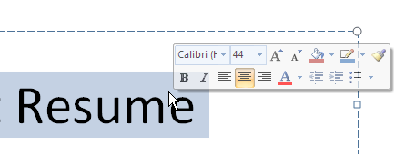
Fluent User Interface
Quick Access Toolbar
Located at right of Office button
Can be customized for most commonly used commands
Can change location to above or below Ribbon
The Mini Toolbar
Select and point at text
Semi-transparent until point in toolbar
Most common options for program
No ScreenTips

Slide 11
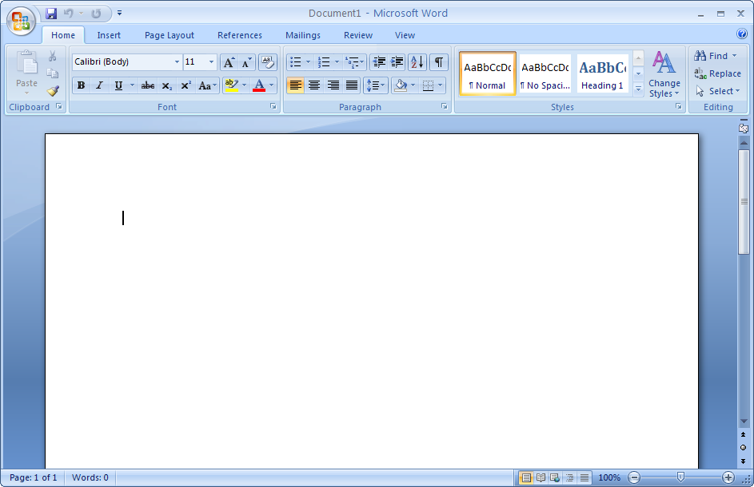
Introducing Microsoft Office Word 2007
Quick Close
Office Access Maximize
Button Toolbar Ribbon Tab Title Bar Minimize
Microsoft Office Word Help
Group
Show dialog box or window
More
Horizontal Split Bar
View Ruler
Page Spelling View Zoom
Number Status Buttons Bar

Slide 12
What’s New in Office 2007?
Formatting with Ease
Galleries and Live Previews
Drop-downs of graphical representation of formatting changes – known as ‘galleries’
See changes in document on the fly with ‘Live Previews’

Slide 13
What’s New in Office 2007?
Working with Pictures
Separate command for pictures and clip art in Illustrations group
Once picture inserted, Picture Tools Format tab appears (context sensitive)
To display Format Picture dialog box:
Right-click picture and click Format Picture
Picture Tools Format tab, Size group, click

Slide 14
What’s New in Office 2007?
Proofing Documents
Using the Document Inspector
Can find and detect:
Comments, revision marks, document versions, or annotations
Properties of document
Information in headers or footers
Hidden text using the Hidden text feature
Custom XML data not visible in document
Click , Prepare, Properties
Easily identify and remove sensitive information – ideal for tenders, legal practice etc.

Slide 15
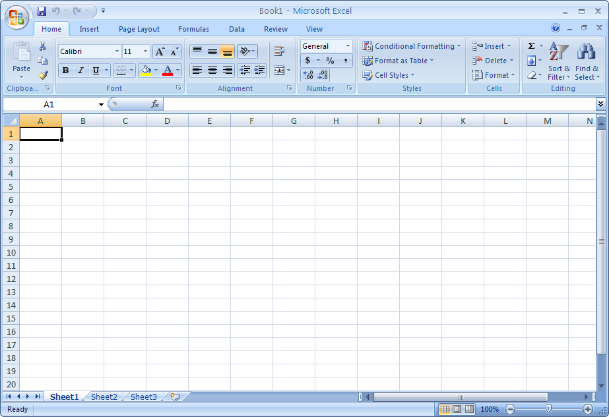
Introducing Microsoft Office Excel 2007
Quick Close
Office Access Title Maximize
Button Toolbar Ribbon Tab Bar Help Minimize
Expand Formula Bar
Group
Insert Worksheet View Buttons Zoom

Slide 16
Introducing Microsoft Office Excel 2007
Expansions to Excel 2007
Worksheet can contain 1,048,576 rows and 16,384 columns
Unlimited number of formatting types
Number of cell references limited only to amount of RAM
Memory management increased
Supports dual processors and multithread chipsets
Supports up to 16 million colors

Slide 17
Excel 2007: Tables
Convert data into impactful tables
Using Table Styles
Replaces AutoFormat command
Can create style for table or PivotTable
Converts data to table format or database table
New ribbon options for tables

Slide 18
Excel 2007: Formatting Options
Conditional Formatting
Additional option called data bars
Sets up “mini chart” in cell range
Home tab, Styles group, Conditional Formatting

Slide 19
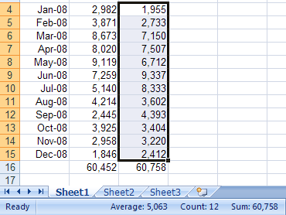
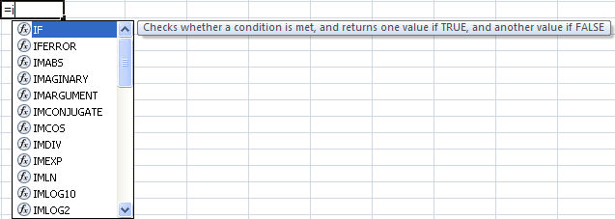
Excel 2007: Working with Formulas
Formula tab contains most commonly used functions
Click or press + + to expand Formula Bar
AutoCalculate expanded
Formula AutoComplete expanded

Slide 20
Excel 2007: Using Charts
Expanded for more enhancement and accessibility
Process to create the same but large variety of options for manipulating chart items
Colour and ease of formatting bringing charts to life

Slide 21
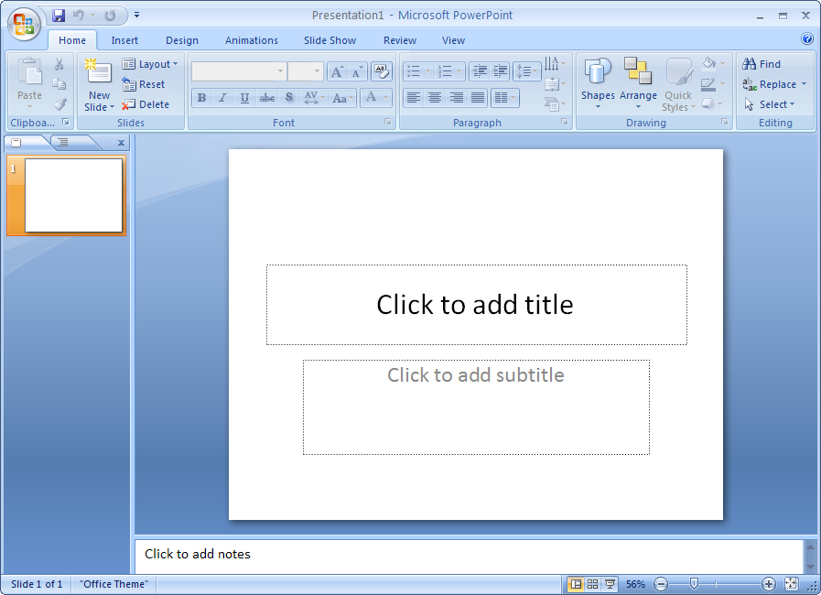
Introducing Microsoft Office PowerPoint 2007
Quick Close
Office Access Title Maximize
Button Toolbar Ribbon Tabs Bar Minimize
Group
View Zoom Fit slide to
Buttons current window

Slide 22
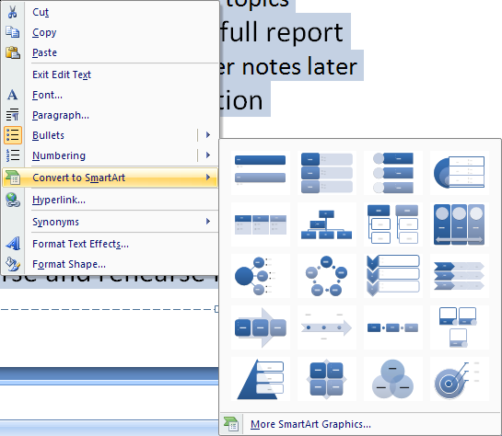
PowerPoint 2007
Converting Bulleted List to SmartArt
Different effect for bullet points
To convert bulleted list, select text and then:
On Home tab and in Paragraph group, click
OR…Right-click selection and then click Convert to SmartArt

Slide 23
PowerPoint 2007
Using SmartArt
Once diagram created, two new tabs appear for enhancing or modifying diagram
Replaces Insert Diagram or Organization Chart command
Variety of options for different types of diagrams
Once diagram created, two new tabs appear for enhancing or modifying diagram

Slide 24
PowerPoint 2007
Converting to SmartArt
Different way to show or emphasize points
Similar options to creating SmartArt

Slide 25
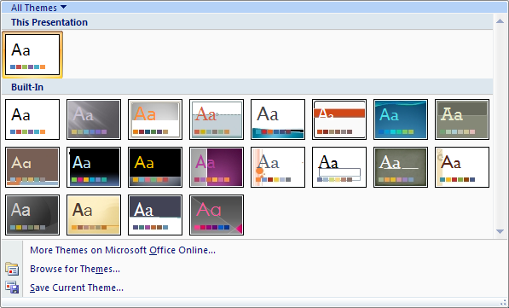
PowerPoint 2007
Applying Themes
Replaces slide design options in earlier versions
Variety of effects included
Can be customized to suit presentation

Slide 26
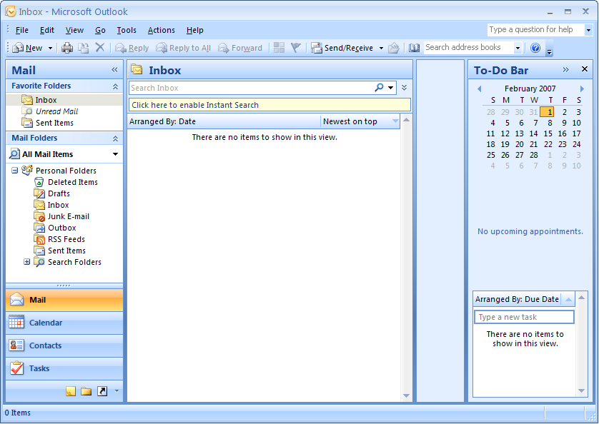
Introducing Microsoft Office Outlook 2007
Type words to search for
Reading Pane
Expand / Minimize
To-Do Bar

Slide 27
Outlook 2007
Sending Messages
New Ribbon appears in new message

Slide 28
Outlook 2007
Working with Attachments
To send attachment with new message:
Message tab, Include group, click Attach File or Attach Item
Insert tab, Include group, click Attach File or Attach Item
To preview attachment
Right-click attachment file and then click Preview, Preview File

Slide 29
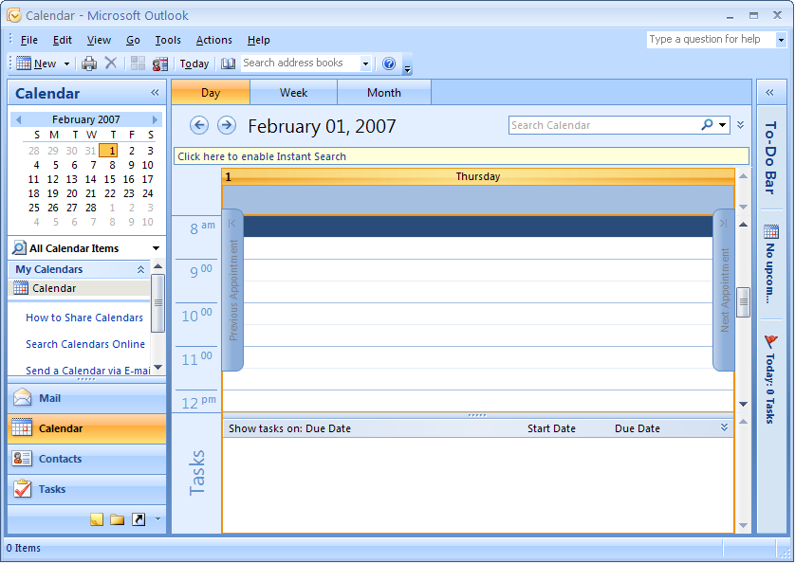
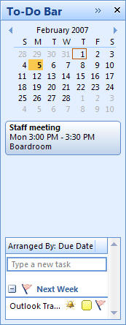
Outlook 2007
To-Do Bar
Integrating emails and tasks with calendar
Calendaring
Side-by-side calendaring, calendar overlay

Slide 30
Outlook 2007
Additional component that has to be installed
Windows Desktop Search part of install
Uses search components in Windows to find Outlook items
Can use (Expand the Query Builder) on right of heading bar
Change search options in Tools, Options

Slide 31
Accessible Help & Tips: "Get Started" Plug-in
Word
Excel
PowerPoint

