Slide 2
It's 11:00 PM—
Do You Know Where
Where Your Data Is?
Steve Riley
Sr. Security Strategist
Microsoft Trustworthy Computing Group
steve.riley@microsoft.com
http://blogs.technet.com/steriley

Slide 3

What Do The Bad Guys
Really Want, Anyway?

Slide 4










Who are the bad guys?
National Interest
Spy
Fastest
growing
segment
Personal Gain
Thief
Tools created by experts now used by less skilled attackers and criminals
Trespasser
Personal Fame
Curiosity
Vandal
Author
Script-kiddy
Hobbyist
Hacker
Expert
Specialist

Slide 5
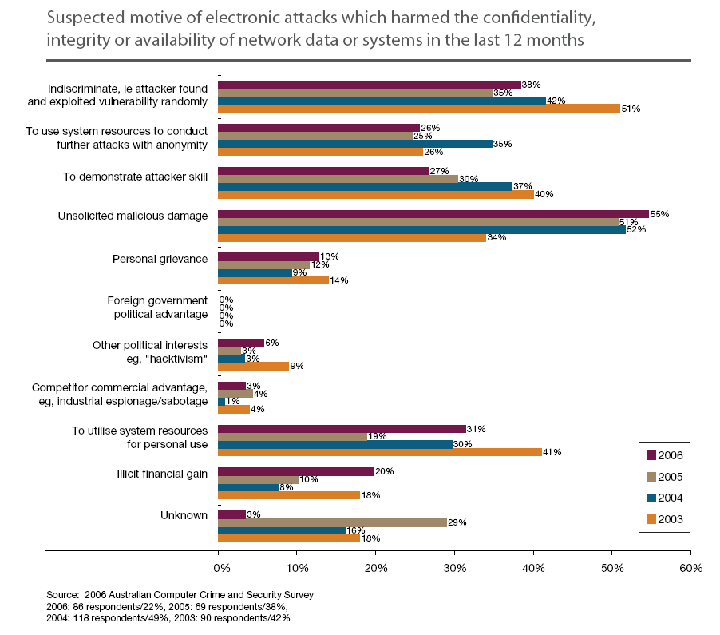

Slide 6
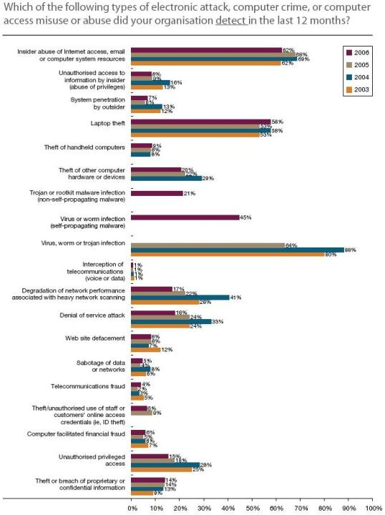

Slide 7
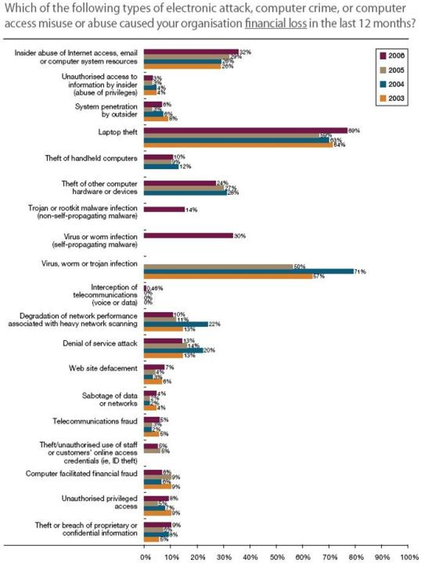

Slide 8
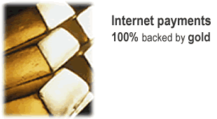

Online payment system founded in 1996
Based on gold (also silver, platinum, and palladium)
3,100,000 accounts
3,700,000 grams of gold in assets
66,000 spends each day, total 460 kg
Generates substantial income from storage and spend fees
Transactions are irreversible
No independent auditor of physical bars

Slide 9
W32/Grams
e-gold has some interesting security features
  Limit account access to an individual IP address
  Use one-time pass phrases
But e-gold got hit by a trojan anyway
  Delivered as VB Script email attachment
  Specifically designed to attack e-gold
Process—
  Wait for user to complete authentication
  Hijack session, return new window to user
  Employ OLE automation to fill in invisible form
  Repeat, thus emptying a user’s account

Slide 10
Our Dilemma

Slide 11
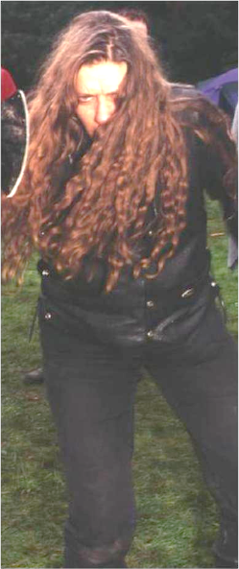

Access denied!
They must have the data! Now!

Slide 12
Frightening
Chronology of data breaches: 2005-2007
http://www.privacyrights.org/ar/ChronDataBreaches.htm
126 pages—155,000,972 records
Cost of a breach
http://www.informationweek.com/
news/showArticle.jhtml?articleID=199000222
US$90-US$305 per record
No one gives a @#$%!
http://searchsecurity.techtarget.com/
originalContent/0,289142,sid14_gci1255391,00.html
85% reported breach; 46% don’t encrypt; 57% lack incident response plan

Slide 13
Classifying Data

Slide 14

Confidentiality classifications
Data class | Criteria | Examples
Public | No harm if publicly exposed | Information on your public web site
Internal | No significant harm if publicly exposed | Information on your internal web sites
Confidential | Public exposure could harm business | Proprietary trade secrets
Private | Public exposure could harm someone’s privacy | Government identification numbers, credit card numbers
Important for responding to breaches
Classifications help guide what your response is
http://www.computerworld.com/action/article.do?articleId=9014071

Slide 15
Retention classifications
Data class | Retention period | Examples
Regulated | 7 years | Financial statements
Historical business | 3 years | Completed client contracts
Temporary | 1 year | E-mails
Important for discovery during trials
Major penalties if new information is discovered after a trial starts
  So get rid of it!
Routinely purge e-mails and file shares
http://www.computerworld.com/action/article.do?articleId=9014071

Slide 16
Recovery classifications
Data class | Recovery time | Examples
Mission-critical | Immediate | E-commerce web site data
Urgent | Within 72 hours | E-mails
Nonurgent | Within 30 days | Client contracts; employee information
Need to recover business data in the event of a disaster
Prohibit (can you?) employees from storing mission-critical data on home computers or portable devices
Routinely purge e-mails and file shares
http://www.computerworld.com/action/article.do?articleId=9014071

Slide 17
First, Back To School

Slide 18
Confidentiality
Integrity
Availability

Slide 19
Confidentiality
Utility
Authenticity
Integrity
Availability
Possession

Slide 20
Identity, authentication, authorization
identity | Who are you? This is public knowledge, a claim the security principal makes about itself
authentication | OK, prove it This is a secret, known by the security principal, that the system can validate
authorization | I believe you This is a list of rights, permissions, and access, granted by the system to the security principal

Slide 21
Which is which?
authorization
authentication
identity
User IDs
✓
Passwords
✓
Tokens and tickets
✓
Digital certificates
✓
Private keys
✓
Public keys
✓
Biometrics
✓

Slide 22
The Two Attributes

Slide 23
Confidentiality
Ensure information is visible only to authorized consumers
Principal mechanism: encryption
By itself, encryption can’t prevent interception
Possession
Ensure information is available only to authorized consumers
Principal mechanism: access control
By itself, access control can’t provide secrecy

Slide 24
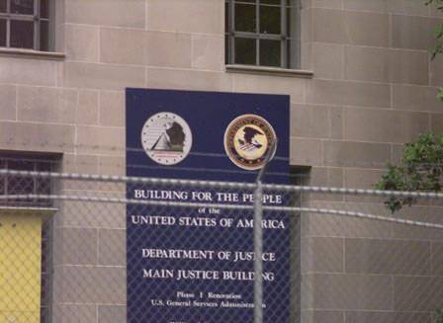

Slide 25
Possession controls
Gates, guards, guns
Access control lists, permissions
Locked-down configurations
  Some legitimate claims that this impedes agility
Inherent weakness
Authorized users will never abuse trust

Slide 26
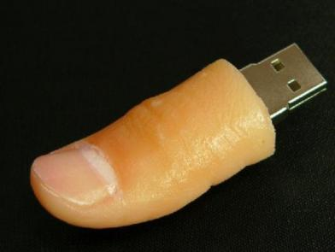


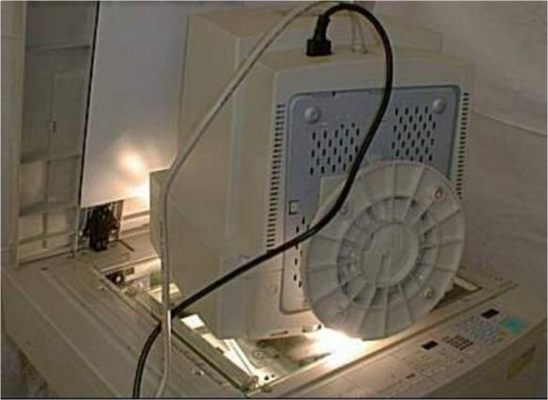

Slide 27


Slide 28
Confidentiality controls
At rest—
  EFS
  BitLocker
  RMS
  S/MIME
  SQL Server encryption
In flight—
  IPsec
  SSL
  S/MIME
  SQL Server encryption
Inherent strength
Protects data regardless of physical location

Slide 29
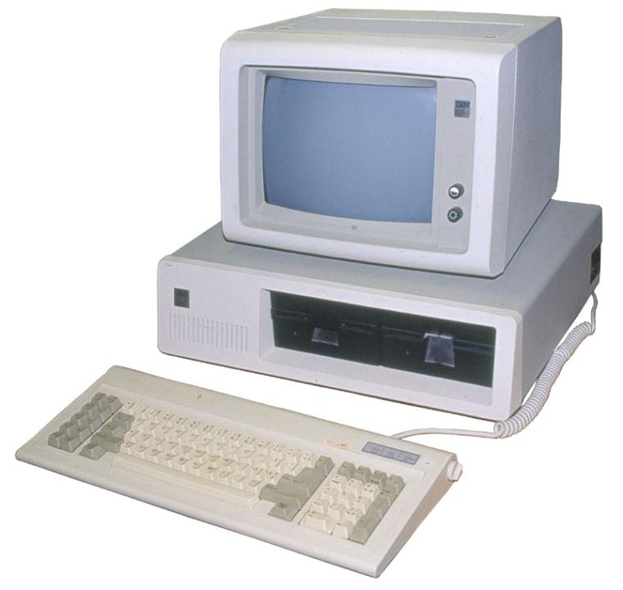

Slide 30
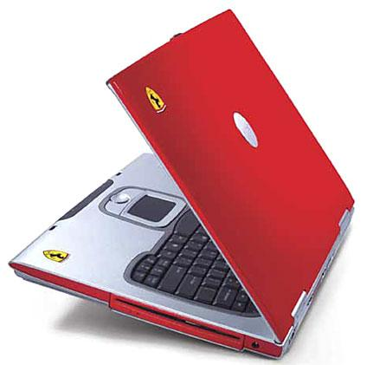
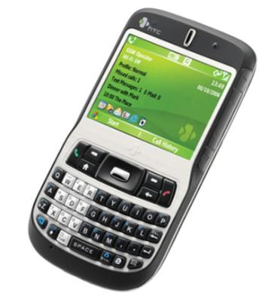

Slide 31
Strategies For
Protecting Mobile Data

Slide 32
Protecting data—possession controls
BIOS passwords
Not universally supported
Pretty much no recovery if you forget!
SysKey mode 3
Useful mostly for protecting local accounts
Use system restore disk if you forget
Good passwords
Mitigate “pass-the-hash” attacks

Slide 33
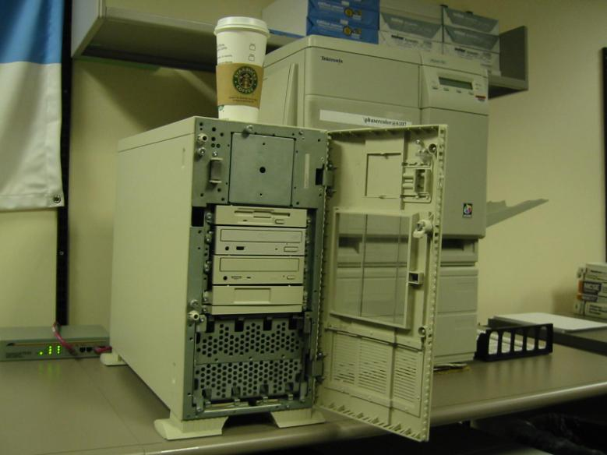
SysKey

Slide 34
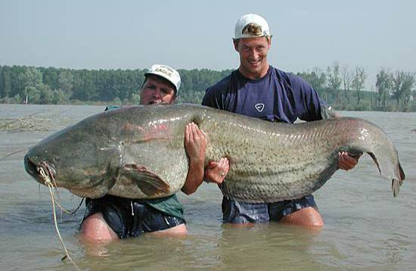
Good passwords

Slide 35
Protecting data—confidentiality controls
S/MIME
Supported by pretty much all mail user agents
Protects both at rest and in flight
Perennial problem: how do I get you my key—securely?
Encrypting file system (EFS)
Transparent to applications and users
Computationally infeasible to break (domain accounts or SysKey 3)
Must implement recovery agents; better with domain and PKI
BitLocker drive encryption (BDE)
Full volume encryption of Windows partition
Protects all data stored there, too
Provides mechanisms for recovery
Rights management services (RMS)
Access control that doesn’t rely on possession controls
Policy enforcement mechanism in supported applications

Slide 36
Keys in Windows
A sampling…
  SysKey startup key
  DPAPI master keys
  EFS and file encryption keys
  S/MIME keys
  IPsec keys
  Computer and user keys
  SSL keys
  Storage root keys
  Volume encryption keys
How are they protected?

Slide 37











Key protection in Windows
1: in registry
2: on floppy
3: at bootup
SSL
keys
IPsec
keys
DPAPI
key
SAM
or AD
LSA
secrets
Safe mode
admin pw
startup
key
at logon
EFS
keys
S/MIME
keys
DPAPI
key
user
profile
startup
key

Slide 38
Possession vs. confidentiality
Possession: effective only when clients are managed
Confidentiality: usually effective everywhere
However—
  EFS: prefers managed clients
  BDE: prefers managed clients
  RMS: effective everywhere

Slide 39

announcing

Slide 40
Data Encryption Toolkit for Mobile PCs
Executive Overview
  Business Risks
  Regulatory Risks
  Mitigating Risks with the
  Data Encryption Toolkit
Security Analysis
  Risk Discussion
  BitLocker Drive Encryption
  Encrypting File System
  BitLocker and EFS Together
  Choosing the Right Solution
Planning and Implementation Guide
  Planning Considerations
  Configuration and Deployment Tasks
  Operations and Recovery Scenarios
EFS Assistant
  Evaluator’s Quick Start
  Understanding the EFS Assistant
  Configuring and Deploying the EFS Assistant
  Managing the EFS Assistant
  User Communication

Slide 41
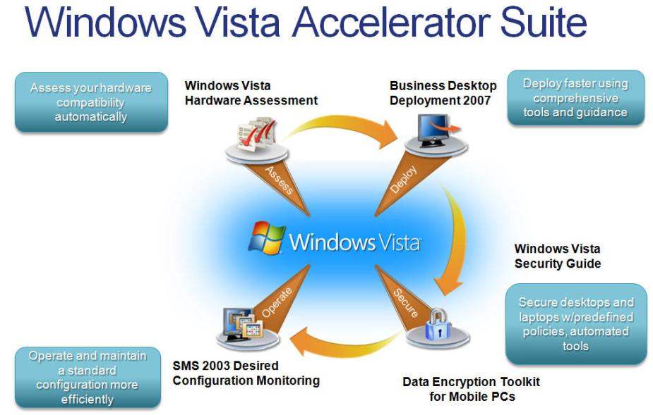

Slide 42
Encrypting File System
Strategies For
Protecting Mobile Data

Slide 43





EFS operation
encrypt FEK with EFS key
EFS certificate request
with public EFS key
encrypt FEK with default recovery agent
generate public and private EFS keys
public key bound to cert; store cert and private key in profile
generate file encryption key
Assumptions: domain accounts, enterprise CA, Windows Server 2003, Windows XP

Slide 44
Avoid EFS “gotchas”
Back up that EFS certificate and the keys!
  You will lose access if you have no PKI or DRA
  CIPHER /X command → store on USB drive
Also export local DRA and remove from computer
Eliminate plain-text “shreds”
  Encrypt folders, not files
  CIPHER /W → wipe slack space: 00-FF-random
Please, just use an enterprise CA
  Set up for auto-enrollment
  Configure DRA in group policy
  Now you won’t have any worries

Slide 45
Vista—smart card support
User keys
Recovery keys
  No need now for dedicated recovery station
  Even works over Remote Desktop
No reprompt for PIN if also used for logon
Wizards for selecting keys and moving files among cards

Slide 46
Vista—more
Page file
  Uses system-generated key at startup
  Key destroyed at shutdown
Offline files cache
  With user’s key—protects from local admins

Slide 47
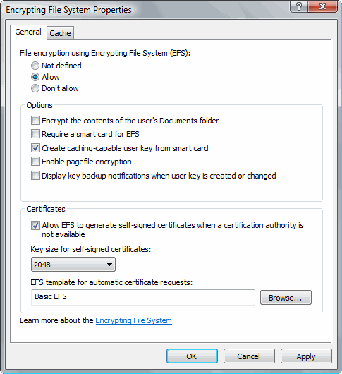

Slide 48
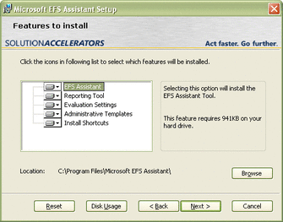
EFS Assistant
Running after install automatically encrypts folders known to contain data files
Can change in Group Policy
Results Viewer shows
output in Excel

Slide 49
Default encrypted folders
Folder | Path
Documents (Vista) | %USERPROFILE%\Documents
My Documents (XP) | %USERPROFILE%\My Documents
Desktop (Vista and XP) | %USERPROFILE%\Desktop
IE Favorites (Vista and XP) | %USERPROFILE%\Favorites
IE History (Vista) | %LOCALAPPDATA%\Microsoft\Windows\History
IE History (XP) | %USERPROFILE%\Local Settings\History
Temporary Internet Files (Vista) | %LOCALAPPDATA%\Microsoft\Windows\Temporary Internet Files
Temporary Internet Files (XP) | %USERPROFILE%\Local Settings\Temporary Internet Files
CD Burn cache (Vista) | %LOCALAPPDATA%\Microsoft\Windows\Burn\Burn
CD Burn cache (XP) | %USERPROFILE%\Local Settings\Application Data\Microsoft\CD Burning
IE7 Feeds cache (Vista) | %LOCALAPPDATA%\Microsoft\Feeds Cache
IE7 Feeds cache (XP) | %USERPROFILE%\Local Settings\Application Data\Microsoft\Feeds Cache
Outlook OST and PST cache (Vista) | %LOCALAPPDATA%\Microsoft\Outlook\
Outlook OST and PST cache (XP) | %USERPROFILE%\Local Settings\Application Data\Microsoft\Outlook
Office Document Workspace cache (Vista) | %LOCALAPPDATA%\Microsoft\OFFICE
Office Document Workspace cache (XP) | %USERPROFILE%\Local Settings\Application Data\Microsoft\OFFICE

Slide 50
BitLocker
Drive Encryption
Strategies For
Protecting Mobile Data

Slide 51
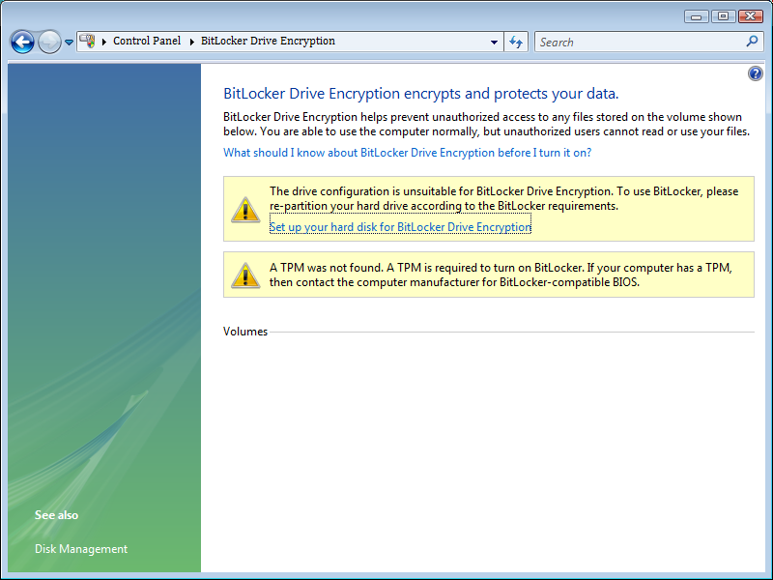
BDE control panel

Slide 52
Can use TPM 1.2 chip
Microcontroller affixed to motherboard
Stores keys and digital certificates
For BDE, TPM stores storage root key
  SRK decrypts volume encryption key only when system boots normally; compares each boot process against previously stored measurements
  No user interaction or visibility (unless you require a PIN or additional start-up key)
  Recovery key can be archived in Active Directory for the inevitable “omg” moment
  Prohibits meaningful use of software debuggers during boot

Slide 53
TPM architecture
PCR[15]
Reset all registers, transfer execution to Core Root of Trust Measurement
Measure next stage of firmware into PCR[0] and data into PCR[1]
  Hardware test and configuration
Code always measured first, then executed
New PCR value is SHA-1 hashed then concatenated with previous hash; permanently written to PCR
Option ROMs and data into PCR[2] and [3]
MBR into PCR[4], partition table in PCR[5]
PCR[14]
PCR[13]
PCR[12]
PCR[11]
PCR[10]
PCR[9]
PCR[8]
Platform Configuration Registers
PCR[7]
PCR[6]
PCR[5]
PCR[4]
PCR[3]
PCR[2]
PCR[1]
PCR[0]

Slide 54
TPM architecture
PCR[15]
MBR takes over; loads first sector of active boot partition into memory; measures first 512 bytes into PCR[8]
Boot sector loads; measures remainder into PCR[9] and transfers execution
Boot code measures BOOTMGR into PCR[10] and transfers execution
Any additional boot applications must load only from BDE volume
  BDE storage root key in PCR[11]
Finally, BOOTMGR transfers control to operating system; OS checks integrity of all executables loaded
PCR[14]
PCR[13]
PCR[12]
PCR[11]
PCR[10]
PCR[9]
PCR[8]
Platform Configuration Registers
PCR[7]
PCR[6]
PCR[5]
PCR[4]
PCR[3]
PCR[2]
PCR[1]
PCR[0]

Slide 55
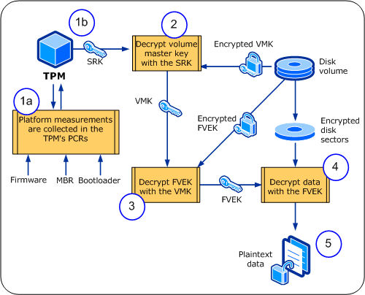
Decryption process: TPM only
BIOS starts, initializes TPM, performs code and data measurements
TPM releases storage
root key and decrypts volume master key
VMK decrypts full-
volume encryption key
FVEK decrypts disk sectors when read
Applications receive plaintext data

Slide 56
Risks: TPM only
Mitigated
Nonmitigated
Key discovery through offline attacks
  128-bit AES-CBC+Elephant diffuser
  Options: 256-bit; with/without Elephant
Offline attacks against Windows
Attacks against the boot process
Plaintext data leaks
  The data you store on the volume
  Hibernation file
  Paging file
User error
Decommissioning PCs without wiping drives
  Simply delete the key
Computer left in hibernation/sleep/standby
  Prompt for password during resume
Unlocked desktop
  There is no patch for, well…
Password discovery
  The TPM is not a credential
Online attacks against Windows
Hardware platform attacks
  Direct memory access across PCI bus?
Failure to protect domain password

Slide 57
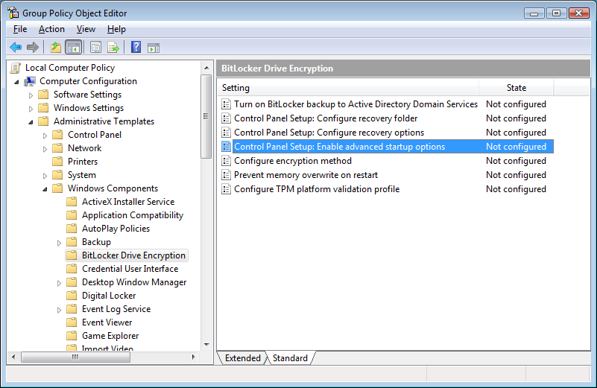
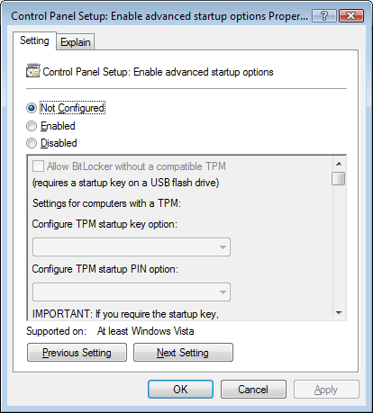
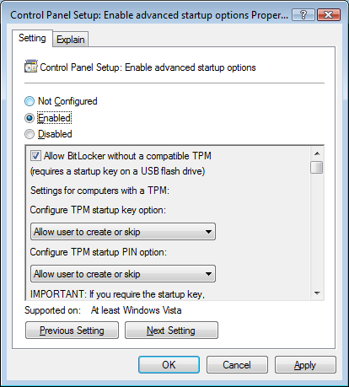
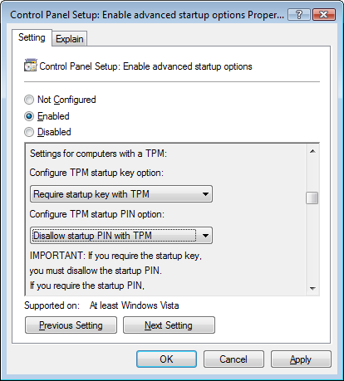
Group policy: USB startup key, no TPM

Slide 58
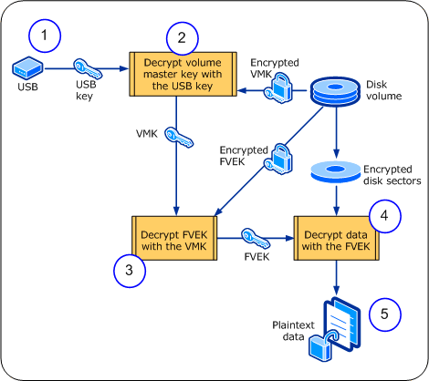
Decryption process: USB, no TPM
OS prompts user to insert USB drive with the key
Key on USB decrypts volume master key
VMK decrypts full-
volume encryption key
FVEK decrypts disk sectors when read
Applications receive plaintext data

Slide 59
Risks: USB, no TPM
Mitigated
Nonmitigated
Computer left in hibernation
  BitLocker requires USB during resume
Password discovery
  BitLocker requires something other than domain credential—the USB startup key
Key discovery through offline attacks
  No USB → can’t decrypt VMK
Offline attacks against Windows
Plaintext data leaks
  The data you store on the volume
  Hibernation file
  Paging file
User error
Decommissioning PCs without wiping drives
Attacks against the boot process
Computer left in sleep/standby
  Prompt for password during resume
Unlocked desktop
  There is no patch for, well…
Online attacks against Windows
Hardware platform attacks
  Direct memory access across PCI bus?
Failure to protect USB drive

Slide 60
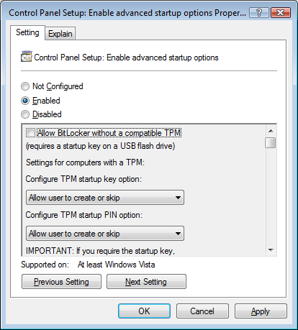

Group policy: USB startup key and TPM

Slide 61
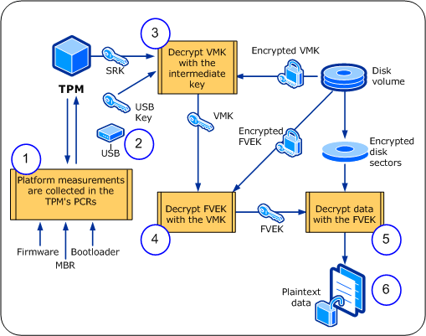
Decryption process: USB and TPM
BIOS starts, initializes TPM, performs code and data measurements
OS prompts user to insert USB drive with the key
TPM releases SRK and combines with USB key to create intermediate key, which decrypts VMK
VMK decrypts full-
volume encryption key
FVEK decrypts disk sectors when read
Applications receive plaintext data

Slide 62
Risks: USB and TPM
Mitigated
Nonmitigated
Computer left in hibernation
  BitLocker requires USB during resume
Password discovery
  BitLocker requires something other than domain credential—the USB startup key
Key discovery through offline attacks
  No USB → can’t decrypt VMK
Offline attacks against Windows
Attacks against the boot process
Plaintext data leaks
  The data you store on the volume
  Hibernation file
  Paging file
User error
Decommissioning PCs without wiping drives
Computer left in sleep/standby
  Prompt for password during resume
Unlocked desktop
  There is no patch for, well…
Online attacks against Windows
Hardware platform attacks
  Direct memory access across PCI bus?
Failure to protect USB drive

Slide 63

Group policy: user PIN and TPM

Slide 64
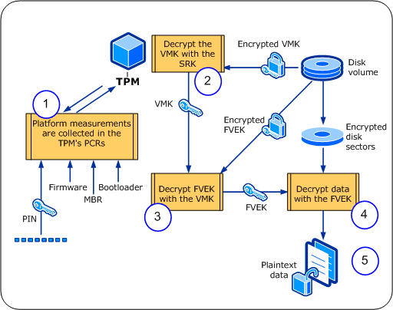
Decryption process: PIN and TPM
BIOS starts, initializes TPM, performs code and data measurements; user is prompted for PIN
TPM releases SRK and combines with PIN to decrypt VMK
VMK decrypts full-
volume encryption key
FVEK decrypts disk sectors when read
Applications receive plaintext data

Slide 65
Risks: PIN and TPM
Mitigated
Nonmitigated
Computer left in hibernation
  BitLocker requires PIN resume
Password discovery
  BitLocker requires something other than domain credential—the PIN
Key discovery through offline attacks
  No PIN → can’t decrypt VMK
Offline attacks against Windows
Attacks against the boot process
Plaintext data leaks
  The data you store on the volume
  Hibernation file
  Paging file
User error
Decommissioning PCs without wiping drives
Computer left in sleep/standby
  Prompt for password during resume
Unlocked desktop
  There is no patch for, well…
Online attacks against Windows
Hardware platform attacks
  Direct memory access across PCI bus?
Failure to protect USB drive

Slide 66
Recommendation
User-supplied PIN plus TPM chip
No external token to lose or attack
PIN uses function keys only
  Processes input before localized keyboard drivers
  Anti-hammering delay mitigates brute-force attacks
  7 characters, 4 unique, 2 repeated
    http://blogs.msdn.com/si_team/archive/2006/04/10/572888.aspx

Slide 67
TPM architecture
PCR[15]
TPM measures all code and reports results
Default BitLocker consumption: 0,2,4,8,9,10,11
Might consider removing 0 and 2?
PCR[14]
PCR[13]
PCR[12]
PCR[11]
PCR[10]
PCR[9]
PCR[8]
Platform Configuration Registers
PCR[7]
PCR[6]
PCR[5]
PCR[4]
PCR[3]
PCR[2]
PCR[1]
PCR[0]

Slide 68
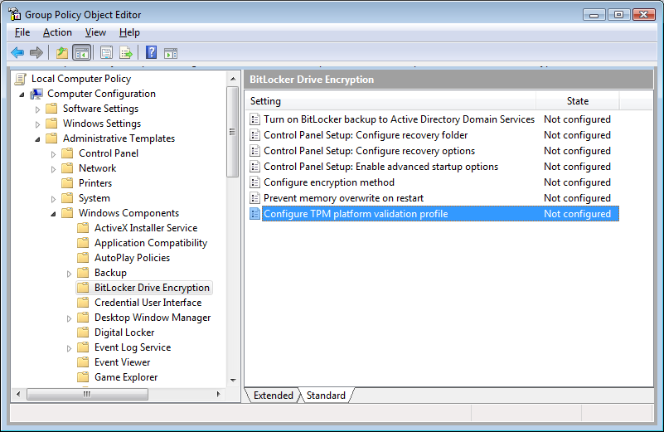
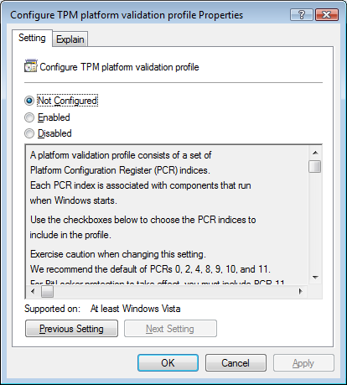
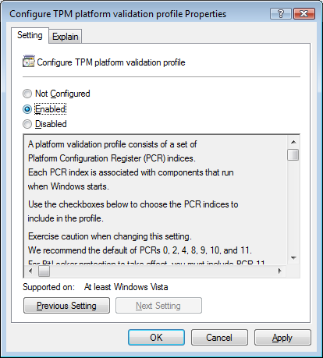
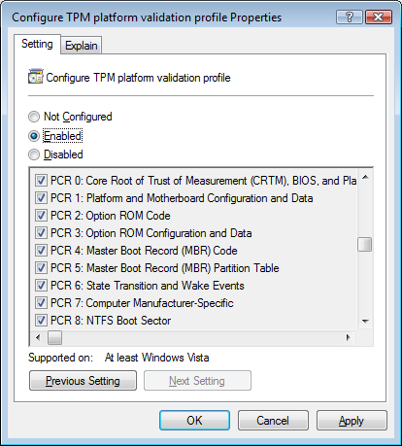
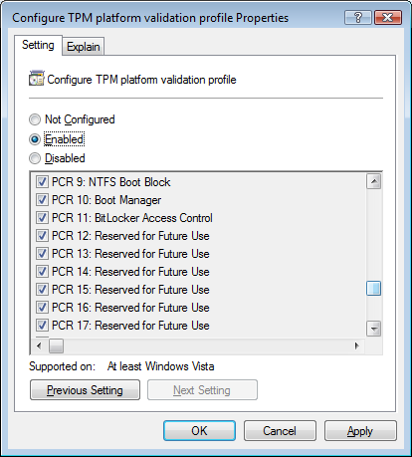
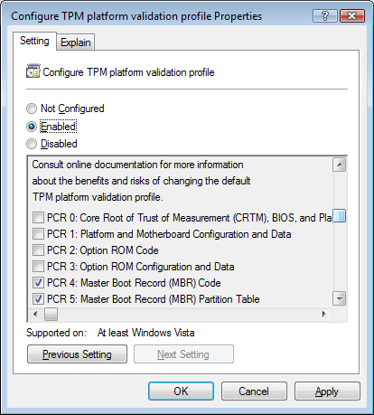
Group policy: validation profile

Slide 69
BDE recovery options
Useful in case of some kind of hardware failure
It’s a password; stored in different ways—
  Removable media
  Printed
  Active Directory
Also, service packs and driver upgrades trigger a loader that recomputes and reseals TPM secrets

Slide 70
Storing passwords in AD
DCs must run Windows Server 2003 SP1 or later
  Schema extensions use attribute confidential flag
  No particular forest functional level requirements
Extend schema
Modify ACL of domain object
  New inheritable ACE
  Allows SELF to write to ms-TPM-OwnerInformation
Enable option in Group Policy
Do this before you enable BDE anywhere!
technet2.microsoft.com/WindowsVista/en/library/
3dbad515-5a32-4330-ad6f-d1fb6dfcdd411033.mspx

Slide 71
Schema extensions
Computer object
ms-FVE-RecoveryInformation
ms-FVE-RecoveryPassword
ms-FVE-RecoveryGuid
ms-FVE-VolumeGuid
ms-FVE-KeyPackage
ms-TPE-OwnerInformation

Slide 72
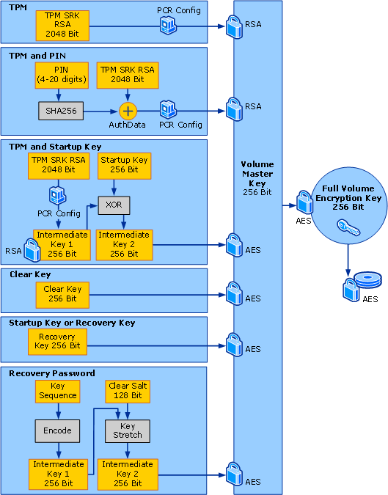
BitLocker key usage

Slide 73
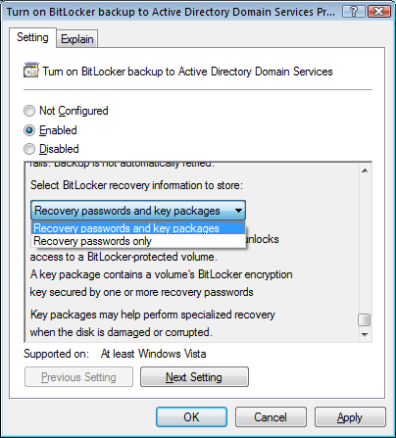
BDE vs. “availability”
Damaged hard drives
  Mount drive in another computer
  Use BDE repair tool:
  KB 928201
  Use recovery password to
  unlock volume encryption key
Forensics and legal
implications
  Bad guys will use BDE, too
  There is no back door!

Slide 74
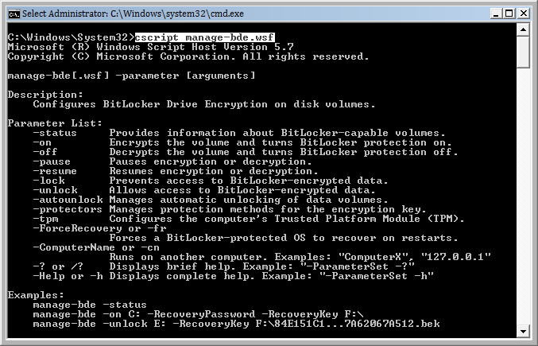
What about other volumes?

Slide 75
BDE deployment
Requires hardware and software upgrades
  Phase in, start with high priority computers
  Verify BIOS support
Ideal for laptops
Also consider for desktop computers and servers in insecure environments
  Factory floors
  Kiosks
  Remote office domain controllers
AD configuration for recovery password

Slide 76
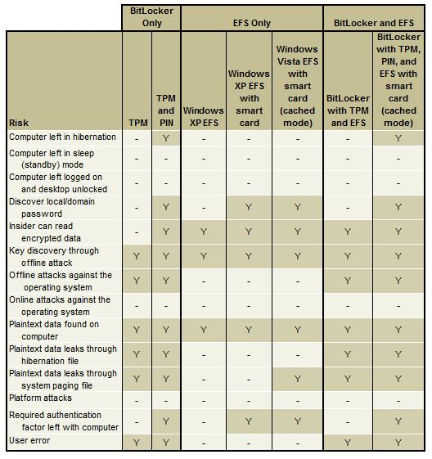
Combining BDE and EFS
Microsoft publishes
guidance describing
how to configure
But in most cases
I just can’t see why

Slide 77
OK, maybe a few reasons
BDE officially unsupported on non-Windows volume
EFS can protect files on removable drives shared by multiple people
  I see RMS as a better alternative, though—especially with templates, it becomes very easy to grant access
Interesting: EFS a file, email to home account, go home, use smart card to access file
  Can also do this with S/MIME certificates on smart cards

Slide 78
Rights Management
Services and IRM
Strategies For
Protecting Mobile Data

Slide 79
Windows Rights Management Services
Another way of expressing an ACL
  That also incorporates secrecy
Project usage policy onto information you own
Policy persists with information
  Examples: view, read-only, copy, print, save, forward, modify, time-based
  Rights live within the file wherever the file goes
  Does not rely on external system to impose access control
Keeps internal information internal
  Only authorized users can access protected information
Establishes an audit trail to track usage of protected files

Slide 80




WRMS workflow
Author receives a client licensor certificate (CLC) the first time they rights-protect information
SQL Server
Active Directory
Author defines a set of usage rights and rules for the file; application creates a publishing license and encrypts the file
RMS Server
Author distributes file
1
4
Recipient clicks file to open, the application calls to the RMS server which validates the user and issues a use license
2
3
5
Application renders file and enforces rights
Information Author
The Recipient

Slide 81
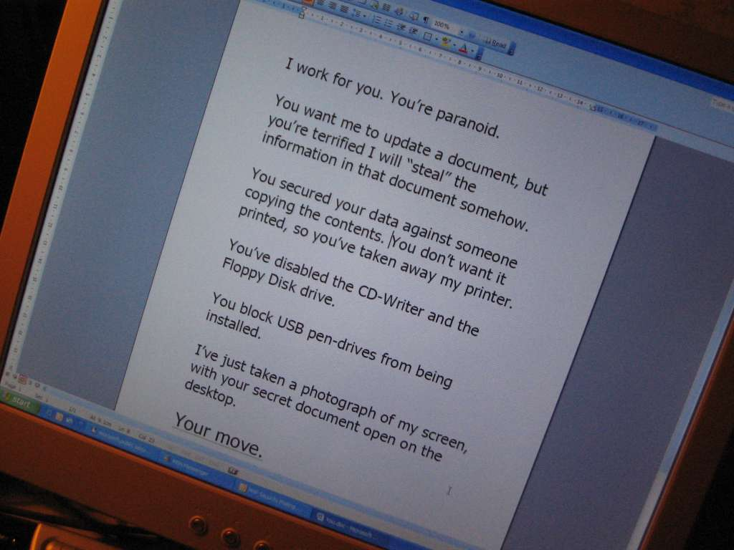

Slide 82
Document protection and storage
Created when file is protected
a
Only added to the file after server licenses a user to open it
Publishing License
End User Licenses
Content Key
Rights for a
particular user
Encrypted with the server’s public key
Encrypted with the user’s public key
Rights Info
w/ email addresses
Content Key
(big random number)
Encrypted with the server’s public key
The Content of the File
(Text, Pictures, metadata, etc)
Encrypted with the user’s public key
Encrypted with content key, a cryptographically secure 128-bit AES symmetric encryption key
E-mail ULs are stored in the local RMS license cache, not in the e-mails directly

Slide 83
SharePoint Server 2007
Per-user access policies on document libraries
Policy and encryption applied to documents when users open them
  Documents remain decrypted in library so that they’re searchable
  No user account can access or display the unencrypted content—search results always scoped to permissions
  Uploaded documents are decrypted when stored
Doesn’t apply to docs that were protected before stored in the library!

Slide 84

Document Control
  Add RMS controls to 65 applications and file formats
  CAD files, Acrobat, Visio…
Email Control
  Server-side policy enforcement at email gateway
Blackberry Gateway
  Send and receive protected messages

Slide 85

Forced classification of documents and email with visible labels
Shell extension to classify existing documents
Associate classification levels with RMS templates

Slide 86
WRMS scenarios
Internal data
Control email forwarding
Limit access to files
Manage document retention policies
Customer data
Keep PII private and audit access
Implement rights-protection in applications that process PII or other sensitive data

Slide 87
Too Much!

Slide 88
Aren’t they just all the same?
S/MIME
Protect data in flight on its way to the receiver
Protect data at rest in receiver’s mailbox
Ensure only receiver can consume it
EFS and BitLocker
Protect data at rest
Is the time part of “physical access + time = compromise”
RMS
Enforce object-based access control
Keep information private when not in use
Removes recipient’s ability to spread the trust

Slide 89
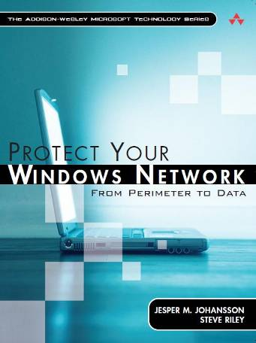
Steve Riley
steve.riley@microsoft.com
http://blogs.technet.com/steriley
www.protectyourwindowsnetwork.com
Thanks
very much!

Slide 90


