Slide 1
Windows 7 Enterprise Briefing
-Partner Session
8.20am Carlos Martinez– Saving Customers Money
8.30am Ben Green – Windows 7 for Enterprises
8.50am Close & Q&A
9.00am Tea & Coffee as Customers arrive
9.30am Customer Briefing Commences

Slide 2
Solutions to Help Customers Save Money
Professional Desktop

Slide 3
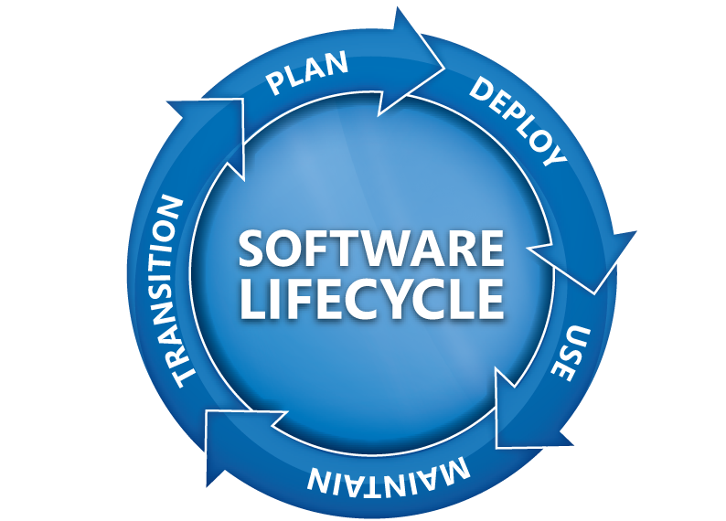
Windows Software Assurance Supports Entire Software Lifecycle
New Version Rights
Spread Payments
Desktop Deployment Planning Services
Windows Fundamentals for Legacy PCs
Extended Hotfix Support
Windows Vista
Enterprise
Enterprise Source Licensing Program
Training Vouchers
E-Learning
  TechNet Subscription
  24x7 Problem Resolution Support

Slide 4
Your Windows Strategy leverages Software Assurance
Product
Receive Windows Vista Enterprise and Windows 7 Enterprise* rights
Microsoft Desktop Optimisation Pack is available for purchase with Software Assurance
Cost
The most cost-effective way to acquire licenses for the next release of Windows (spread payments over 3 years rather than pay once at higher cost)
Pay less if customer also needs Office and Core or ECAL
Decreased monitoring of deployed versions versus OEM licenses

Slide 5
Key Take-Aways
Microsoft® market research shows an untapped revenue opportunity* for partners selling Windows® Volume Licensing to mid-sized customers with 50 to 250 PCs.
The new Windows ‘No Better Time’ campaign offers and collateral can help you drive your Volume Licensing business with a discount and extended grace period for adding Software Assurance to Windows.
Most hardware and software that runs with Windows Vista will run well with Windows 7. Encourage customers to deploy Windows Vista today to lay the groundwork for Windows 7
Windows 7 Beta is generating a lot of excitement and there is no better time to encourage customers to purchase Software Assurance – the upgrade to Windows 7 is included along with the option to add Microsoft Desktop Optimisation Pack.
* $9/PC from new features driving increased customer adoption of Software Assurance and MDOP. The Optimised Desktop Solutions White Paper at https://partner.microsoft.com/windowsspartnersolutions provides background for this estimate.

Slide 6
Solutions to Help Customers Save Money
Professional Desktop

Slide 7



Key Solutions for Today's Uncertain Economy
Windows 7 Enterprise Briefing
Ben Green
NZ Windows Business Group Manager

Slide 8








What We Heard from Customers
“My users are becoming more savvy and have more diverse needs. How do I keep people connected to what they need?”
“How can I enable the software and devices my users require and minimise their risk?”
“How can I reduce costs and take advantage of new technologies like virtualisation?”

Slide 9





The Desktop Optimisation Vision
The Challenge:
Deliver an infrastructure that enables people to be successful in their jobs
Creates Tension:
  End-users want flexibility
  IT needs greater control
The Solution:
Desktop Optimisation
  Empowering both end-users and IT
Desktop Optimisation

Slide 10




Windows Optimised Desktop
Flexible offerings to meet unique needs
Core Infrastructure Optimisation best practices:
PC Lifecycle Planning
Standard Image Deployment
Desktop Virtualisation
Automation of IT Management
Comprehensive Security
For Software Assurance Customers:
Windows Optimised Desktop
Flexible client computing scenarios to meet your unique needs
Available By Subscription to Software Assurance Customers:

Slide 11
Desktop TCO breakdown
Desktop costs go beyond hardware and software
70% of desktop TCO is
labor-related
Desktop TCO
($4600 - $5000/year)
50%
100%
(US$/desktop/year)
20%
30%
HW/SW
IT costs
End-user
Total
Cost of hardware and software
Cost of IT labor and administration
Cost of self support and downtime
Source: Leading analyst firm, December 2005
Note: Excludes server and network costs for centrally managed services

Slide 12






Cost Savings Scenarios
Windows® and MDOP can save you money, now
  Partial list of Cost-saving Scenarios
  Cost-saving through MDOP
  and Windows
  Examples with short-term savings potential⁽³⁾
  Rapidly reduce the major buckets of desktop cost:
    End-user
    IT costs
    HW/SW
    Overhead / Facilities (Electricity)
  Microsoft is offering to demonstrate the short-term savings potential:
    Use existing MDOP Proof of Concept program ⁽¹⁾
    Focus on fast ROI scenarios
    Leverage PoC materials from Microsoft including new guidance and examples
    Deploy Microsoft-funded PoC in your location with a Microsoft® Certified Partner
  Helpdesk
  Group
  Policy Management
  Quicker diagnosis and recovery of desktops resulting
  Centralised Group Policy Management procedures
  Software Asset Management
  Green PC
  Automated, multi-site asset management
  Power policy management and centralised control
  Opportunities in Reducing Desktop TCO ⁽²⁾
Impact from a broad set of TCO reduction best practices as described by the Optimised Desktop
Note: Depicted TCO reduction is not exclusively from the four examples
$4,600-$5,000
End-user (support,
lost time)
50%
(US$ /desktop/year)
$3,200-$3,300
IT costs
(IT labor and admin)
20%
Note : (1) Ask your WPS/WDDS Partner or Microsoft Account Manager for details
(2) Leading Analyst Firm, December 2005
  (3) Refer “Quantifying the Value of Microsoft's Desktop Optimisation Pack” for more information
HW/SW
30%
Typically-Managed
Locked &
Well-managed

Slide 13
Windows 7 Development Process
New approach for Windows development and disclosure
  Spend more time on planning & vision phase analysing trends and needs before building features.
  Focus on end-to-end business scenarios – not just new features and technologies.
Planning
  Give our customer and partners a timeframe for the release and stick to our plan – 3 years for Windows 7.
  Disclose with higher degree of certainty and minimise changes
Predictability
  Engaging with partners earlier and more closely to enable seamless experiences and compatibility across hardware, software and services
Ecosystem
We are here
Vision Development & Test Pre-Beta Beta Release Candidate Release

Slide 14




Windows 7 Builds on Windows Vista
Deployment, Testing, and Pilots Today Will Continue to Pay Off
  Similar Compatibility:
  Most software that runs on Windows Vista will run on Windows 7. Exceptions will be low level code (AV, Firewall, Imaging, etc).
  Hardware that runs Windows Vista well will run Windows 7 well.
Few Changes: Focus on quality and reliability improvements
Deep Changes: New models for security, drivers, deployment, and networking

Slide 15














Windows 7 for the Enterprise
Makes the things you do today faster and easier, and new things possible
Make Users Productive Anywhere
Enhance Security & Control
Streamline PC Management
  At their desk
  In a branch
  On the road
  Protect data & PCs
  Built on Windows Vista foundation
  Easy migration
  Keep PCs running
  Virtualisation

Slide 16



Make Users Productive Anywhere
Remove Barriers
to Information
Faster & Easier for Everyday Tasks
  Search your PC and intranet
  Internet Explorer 8 retrieves data beyond the page
  Responsive, reliable performance
  Intuitive UI and navigation
Access Information
From Anywhere
  DirectAccess™ mobile connectivity
  BranchCache™ network boost

Slide 17




Enhance Security & Control
Protect Data on PCs
& Devices
  BitLocker To Go™ protects data
  on removable drives
  BitLocker™ simplifies encryptions and key management for all drives
Protect Users
& Infrastructure
Build on Windows Vista Security Foundation
  AppLocker™ controls what applications run
  Internet Explorer 8 helps keep users safe online
  User Account Control prompts less
  Security Development Lifecycle for defense in depth

Slide 18





Streamline PC Management
Keep PCs Running Smoothly
Easier Deployment from Windows Vista
  Compatibility with Windows Vista hardware, software, tools
  New tools speed image creation,
  migration, and deployment
  PowerShell & Group
  Policy management
  ease configuration
  Troubleshooting platform reduces help desk issues
  Better Support for Client Virtualisation
  Improve VDI experience with multi-monitor and mic support
  Same tools to manage and service VHD & WIM images

Slide 19








Increased Value in Optimised Desktop
SA Customer Satisfaction
Make Users Productive Anywhere
  DirectAccess
  BranchCache™
  Enterprise Search Scopes
Enhance Security and Protect Data
  BitLocker & BitLocker To Go
  AppLocker
Streamline PC Management
  MUI Language Packs
  VDI Enhancements
  (VDI requires VECD license)
  Boot from VHD
  Subsystem for UNIX
  4 Virtual Operating Systems
  Network Boot License

Slide 20





What to do Today
Microsoft guidance to optimise desktop infrastructure
 |  | Take advantage of MDOP products to optimise your existing PC infrastructure and ease future upgrades. Project scope to deploy is small with rapid payback on investment.
 |  | On track for release 3 years after Windows Vista general availability. When Windows 7 Enterprise ships, active Software Assurance customers will have rights to deploy it. Deploy Windows Vista today in preparation for Windows 7.
 |  | Service Pack 2 available now. Deploy today to experience security, search, mobility, and TCO benefits as soon as possible. Be ready to deploy on new PCs you purchase this year. Investments in Windows Vista will ease migration to Windows 7.
 |  | Post Windows XP end of sale (July 30, 2008) downgrades still available for businesses. Per standard Microsoft lifecycle policy, support and critical updates available until April, 2014. Service Pack 3 released in April 2008
 |  | Migrate Windows 2000 PCs to Windows Vista as soon as possible. Extended support ends Q2 2010.

Slide 21
Solutions to Help Customers Save Money
Professional Desktop

Slide 22
Windows ‘No Better Time’
There’s no better time to buy Windows Vista Business when you buy it with Software Assurance. We have two special offers to make it really easy!
Along with the support, services, training, and tools that SA provides, you’ll also get Windows 7 as an included upgrade when it’s released!
Available via Open Business, Open Value, until end of June 2009
Offer 1: 20% Discount
Upgrade with Software Assurance
Offer 2: 15% Discount
Software Assurance Only + 180 days to buy SA only from original purchase
Customers who purchased a NEW PC with OEM Windows in the last 180 days (usually 90 days!)
Has no Software Assurance or expired SA.
Purchased OEM Windows more than 180 days ago.
www.microsoft.co.nz/hotoffers

Slide 23
Trade in: Save up to 40%
***For customers committing to Professional Desktop prior to 5 June 2009 ***
Trade-in offer . Customers can get ‘credit’ for software licenses they already own, by trading them in for a Professional Desktop suite (L&SA, Open Value only)
Why ?
One agreement. Finally, Software Management made easy.
Makes sense for organisations around 70+ desktops
Takes into account existing purchases
Customised deal for each customer
Contact your distribution account manager
www.microsoft.co.nz/hotoffers

Slide 24
Windows 7 Enterprise Briefing
9:30 am Event Commences
Ben Green - Windows 7 for the Enterprise
David Downs– Making the Business Case for upgrading the Desktop
10:30 am Tea and Coffee Break
10 :45 am Deannah Templeton - Windows 7 Demo Session 1 Productivity and Security
11:15 am Stu Fox - Windows 7 Demo Session 2
Management and Deployment
Noon Event Close

Slide 25
Key Take-Aways
1
Microsoft® market research shows an untapped revenue opportunity* for partners selling Windows® Volume Licensing to mid-sized customers with 50 to 250 PCs.
The new Windows ‘No Better Time’ campaign offers and collateral can help you drive your Volume Licensing business with a discount and extended grace period for adding Software Assurance to Windows.
2
Windows 7 Beta is generating a lot of excitement and there is no better time to encourage customers to purchase Software Assurance – the upgrade to Windows 7 is included along with the option to add Microsoft Desktop Optimisation Pack.
3
4
Most hardware and software that runs with Windows Vista will run well with Windows 7. Encourage customers to deploy Windows Vista today to lay the groundwork for Windows 7!
* $9/PC from new features driving increased customer adoption of Software Assurance and MDOP. The Optimised Desktop Solutions White Paper at https://partner.microsoft.com/windowsspartnersolutions provides background for this estimate.

