Slide 1

Forefront Server Management Console 之建置與應用
Forefront 系列
Notes:
<SLIDETITLE INCLUDE=0>Entry Slide</SLIDETITLE>
<KEYWORDS></KEYWORDS>
<KEYMESSAGE></KEYMESSAGE>
<SLIDEBUILDS>0</SLIDEBUILDS>
<SLIDESCRIPT></SLIDESCRIPT>
<SLIDETRANSITION>
</SLIDETRANSITION>
<COMMENT></COMMENT>
<ADDITIONALINFORMATION>
<ITEM></ITEM>
</ADDITIONALINFORMATION>

Slide 2

Forefront Server Management Console 之建置與應用
Notes:
<SLIDETITLE INCLUDE=7>Title Slide</SLIDETITLE>
<KEYWORDS></KEYWORDS>
<KEYMESSAGE></KEYMESSAGE>
<SLIDEBUILDS>0</SLIDEBUILDS>
<SLIDESCRIPT>
Hello and Welcome to this Microsoft TechNet session on {insert session title}. My name is {insert name}
</SLIDESCRIPT>
<SLIDETRANSITION>
<TRANSITION LENGTH=7>Let us start this session by going into more detail on exactly what we will be covering.</TRANSITION>
</SLIDETRANSITION>
<COMMENT></COMMENT>
<ADDITIONALINFORMATION>
<ITEM></ITEM>
</ADDITIONALINFORMATION>

Slide 3
課程大綱
Forefront Server Management Console 概觀
Forefront Server Management Console 之建置
Forefront Server Management Console 之應用
Notes:
<SLIDETITLE INCLUDE=7>What we will Cover</SLIDETITLE>
<KEYWORDS></KEYWORDS>
<KEYMESSAGE></KEYMESSAGE>
<SLIDEBUILDS>0</SLIDEBUILDS>
<SLIDESCRIPT>
[When writing the script for this slide, expand a bit on the list on the slide, do not simply list the slides items here. Think of this as the advert for the session, explain a bit more what will be covered and how.]
</SLIDESCRIPT>
<SLIDETRANSITION>
<TRANSITION LENGTH=7>As with most TechNet sessions, some prior experience of Microsoft technologies or similar technologies is always helpful, the next slide provides a brief overview of what would be helpful, but not essential, for this session.</TRANSITION>
</SLIDETRANSITION>
<COMMENT></COMMENT>
<ADDITIONALINFORMATION>
<ITEM></ITEM>
</ADDITIONALINFORMATION>

Slide 4
Forefront Server Management Console 概觀

Slide 5














Forefront Security 全產品
Past
Present
Future
Client
Next Generation Client Security
Next Generation Server Security
Server
Integrated Protection & Management
Codenamed ‘Stirling’
(Beta 2)
Edge
Next Generation Edge Security & Access

Slide 6
概觀
協助企業保護他們的 Exchange Server 與 SharePoint Server 環境反對病毒、蠕蟲、垃圾郵件與不適當的內容
Management
Reporting
Alert

Slide 7
支援的環境基礎
Products | Sybari Enterprise Manager (SEM) | Antigen Enterprise Manager (AEM) | Forefront Server Security Management Console (FSSMC)
Sybari Antigen for Exchange/SMTP 8.0
Sybari Antigen for SharePoint 8.0
Sybari Antigen for IM 8.0
Microsoft Antigen for Exchange/SMTP 9.0
Microsoft Forefront Security for Exchange Server
Microsoft Forefront Security for SharePoint Server

Slide 8

















支援的拓樸
Windows SharePoint Services
(on Windows Server)
Office SharePoint
Server
Exchange Edge Server
Collaboration
Exchange
Hub Server
Exchange Mail Server
Internet
Users
Edge
Viruses
Worms
Spam
E-mail
DMZ servers not supported
Management Console

Slide 9
伺服器需求
Windows 2003 SP2 (x86)
Up to 1000 managed servers
Managed Server OS
  Windows 2000
  Windows 2003
  Windows 2008 (Longhorn server)
SQL Server 2000 sp4 or SQL Server 2005

Slide 10
為何使用 FSSMC
Central Management
Unified Reporting
Comprehensive Protection
Enhanced Security

Slide 11
產品特色
管理
Cluster Support
Hot fix Deployment
Operations Job
Product Activation
Product Deployment
Template Deployment
Manual Scan Job
Signature and Engine Redistribution
General Options Job
Global Configuration
Server Auto discovery
Server Filter
Server Groups
報告
Quarantine Manager
Remote Log Retrieval
Schedule Report
警報
Alerts
Alert Logs
At a Glance
Engine and Signature version
Detections
SMTP Traffic
Redundancy

Slide 12
Forefront Server Management Console 之建置

Slide 13
安裝
需要 domain user 並具備本機管理權限
需要安裝在加入網域中的伺服器
  不能是 DC、Exchange 或 SharePoint server
Express Install
  使用本機 SQL Server Express database
Enterprise Install
  使用遠端或本機端的 SQL 2000 或 SQL 2005 資料庫
  同時支援 NT 與 SQL authentication

Slide 14
安裝 – 升級更新
你可以選擇從原來的系統中保留原來的資料升級
  在資料庫與檔案系統上的資料都將留住
建議：使用與之前安裝時所用的一樣的使用者帳戶
Antigen Enterprise Manager 9
Forefront Server Security Management Console
Stirling

Slide 15
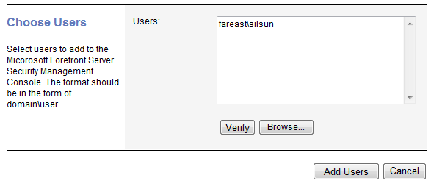
管理 – 使用者
加一個網域使用者帳戶並且為 FSSMC 的管理者
  使用者可以來自於其他受信任的網域
手動輸入或者利用“Browse”選擇要加入的使用者

Slide 16
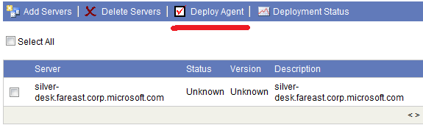
管理 – 伺服器
使用 FSSMC 加入受管理的伺服器
  伺服器可能來自於其他受信任的網域
  亦支援“Browse”選擇要加入的伺服器
所有伺服器使用 FQDN 識別
  FSSMC 可以自動轉換 NetBIOS 名稱或 IP 至 FQDN 名稱
在新增完伺服器後，請在啟用接下來的操作前部屬 Agent 。

Slide 17

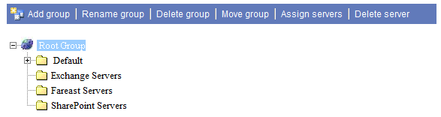
管理 – 伺服器
伺服器自動探索
  每晚會掃描 Active directory 搜尋 Exchange Servers
  所有新的探索出來的伺服器將被列在銀幕上與回報你可以直接點選加入：
群組伺服器以方便管理

Slide 18
管理 – 套件
管理軟體套件被部屬在 managed server，包括：
  Forefront Installation packages
  hot fixes
  template files
  license files (for Microsoft Antigen 9)
Signature 更新套件不會需要在此更新
套件的設定是可以被定義的

Slide 19
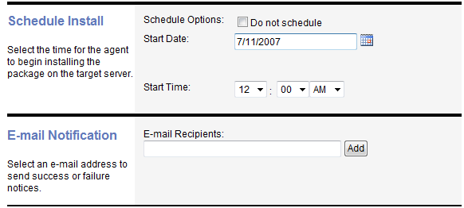
管理 – 部屬工作
在選取的伺服器與所選的時間上排程部屬軟體套裝
透過郵件通知接收工作狀態
主要功能：
  移除 Forefront Server Security
  部屬 Forefront hot-fixes
  部屬 templates
  啟動產品

Slide 20
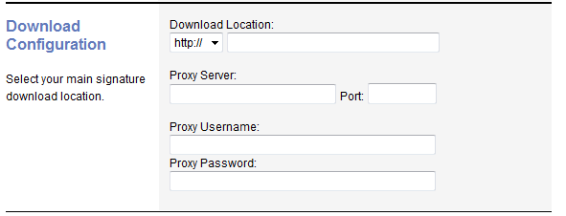
管理 – Signature 分配
FSSMC 的主要工作
FSSMC 伺服器扮演集中下載至所有被管理的伺服器上
  只有在需要更新的時候
  在本機端儲存更新的檔案
  可以在 global configuration 設定 proxy 與下載位置

Slide 21
Internet
Download Manifest
Download
Update
FSSMC Service
^{1.Download Req}
Redistribution Agent
^{4.Complete}
Redistribution Share
FSSMC
^{7. Get update files}
Forefront Server
8. Result
5. Start Update
FSCStarter.exe
^{6.Update}
Deployment Agent

Slide 22
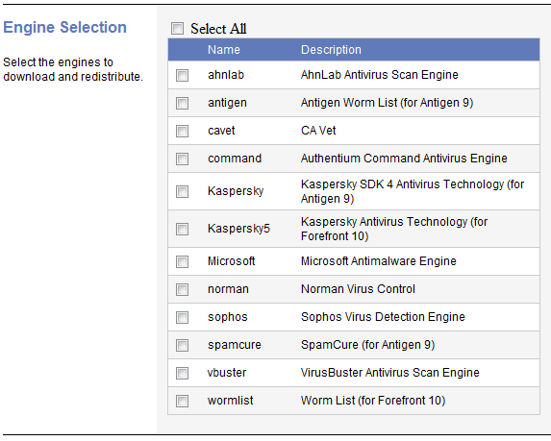
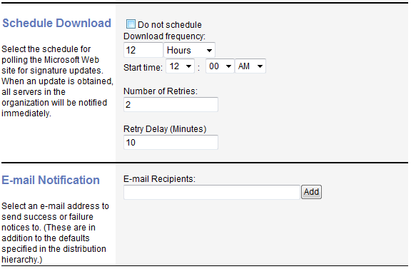
管理 – Signature 分配
Signature Update Schedule
Select Engine to Update

Slide 23
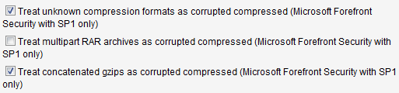
管理 – 一般選項
一般選項是系統等級的設定針對 Antigen 或 Forefront Security 產品
  這些設定都會放在 Registry 內。
同時支援 Antigen 與 Forefront 產品
這個工作將會覆蓋目前所有其他之前套用的設定
這包含部分 Forefront SP1 定義

Slide 24
Forefront Server Management Console 之應用

Slide 25
管理 – Operation Job
在疫情爆發階段，用戶需要立即的行動來緩和攻擊。 Microsoft Forefront Server Security Management Console，提供集中安全管理工具，允許使用者很快的回應重大事件給備管理伺服器
簡化管理每一個伺服器，採用支援 Template 方式提供額外的管理機制。

Slide 26
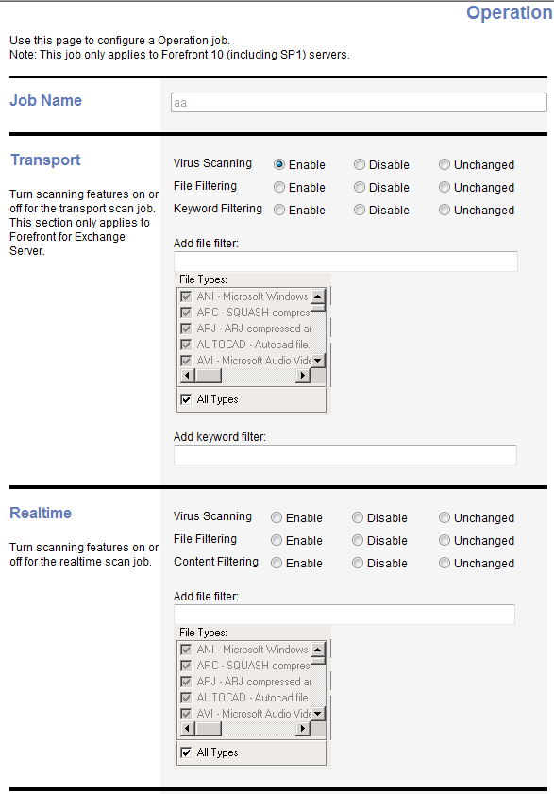
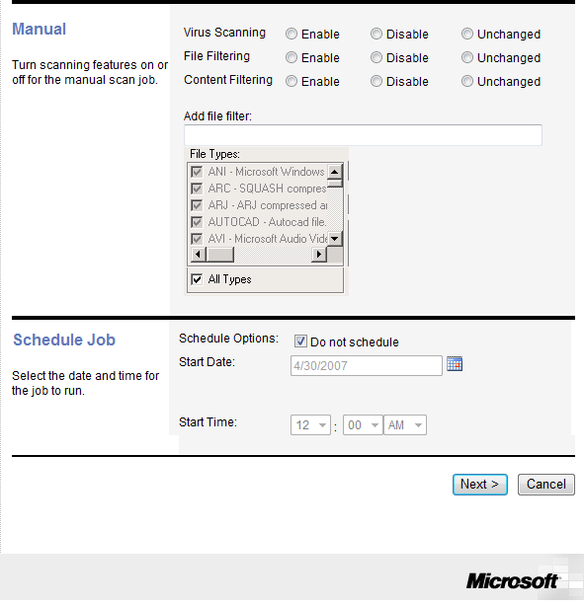
樣本 – Operation Job

Slide 27
管理 – Other Jobs
排程報告
  依據排程使用 eMail 回應所定義的報告內容
遠端紀錄取回
  取回程式的紀錄檔，包括新增或是隔離的資料。依據排程從遠端主機上取回
手動掃描
  依據排程在指定的伺服器上啟用手動掃描的動作

Slide 28
管理 – 容錯
單一的 FSSMC Server 可能負責重大的活動任務，例如 Signature Updates 或 Settings Propagation。假如連線到這台伺服器發生錯誤，網路的問題或是其他不幸事故，此時就有必要透過其他的 FSSMC server 來履行與管理控制問題主機的機制。
SQL replication 是使用背景資料同步作業。

Slide 29
正常狀態
Primary FSSMC Server
Backup FSSMC Server
Configurations
Manage
Server

Slide 30
緊急狀況處置
Primary FSSMC Server
Backup FSSMC Server
Configurations
Manage
Configurations
Manage
Server

Slide 31
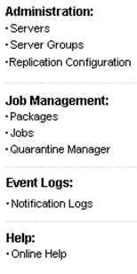
備份中的東西有：
View servers and server groups
View or Copy packages created on the Primary Server.
Add a package
Copy, Rename, Edit or Delete a package created on the Backup Server
View or Copy a deployment, signature redistribution, general options and remote logs retrieval job created on the Primary Server.
Create new signature redistribution, deployment, general options or remote logs retrieval job.
Edit, Copy or Delete a signature redistribution, deployment, general options or remote logs retrieval job created on the Backup Server
Check the status of a job
Run a signature redistribution, deployment, general options or remote logs retrieval job.

Slide 32
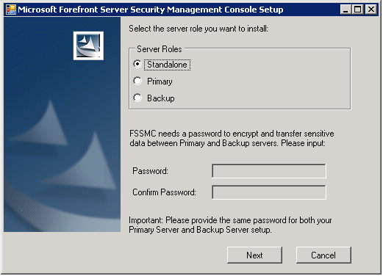
安裝
Primary
Backup

Slide 33
重要密碼
你必須在主要與備份的伺服器上輸入相同的密碼！
  這個密碼會對敏感的資料上作加密，並從主要的伺服器上同步至備份的伺服器上。舉例來說，帳戶憑證。
假如不協調：
Primary FSSMC Server
Backup FSSMC Server
Configurations

Slide 34
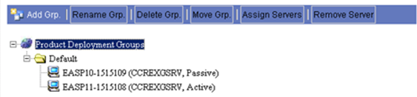
管理 – 支援 Cluster
所有 CCR 與 Exchange 2003 cluster 都支援
Cluster nodes 會顯示在定義的主機上
Cluster name 與 node status 同時秀出

Slide 35
CCR Cluster Support
Forefront servers on the two CCR nodes

Slide 36
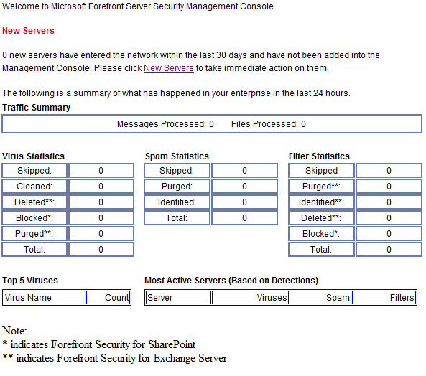
報告 – 粗略報告
A system status screen showing key data points within 24 hrs
  New Servers
  Virus Statistics
  Spam Statistics
  Filter Statistics
  Top 5 Viruses
  Most active servers

Slide 37
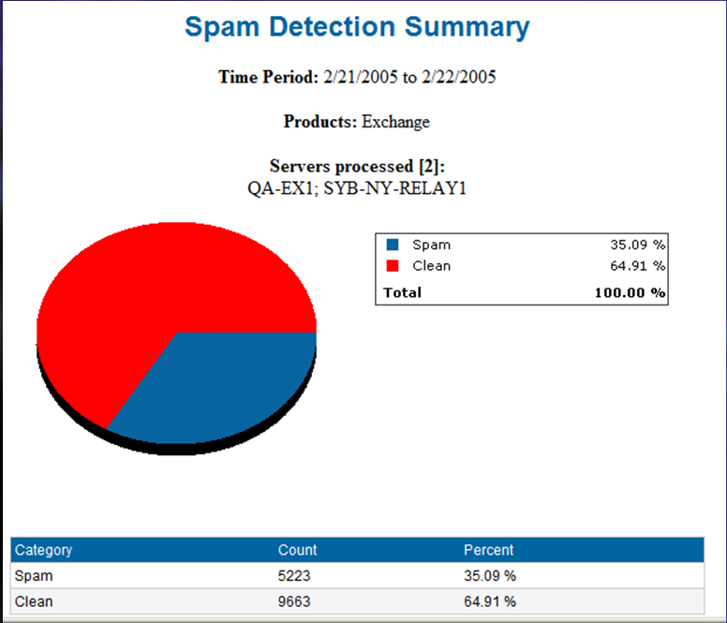
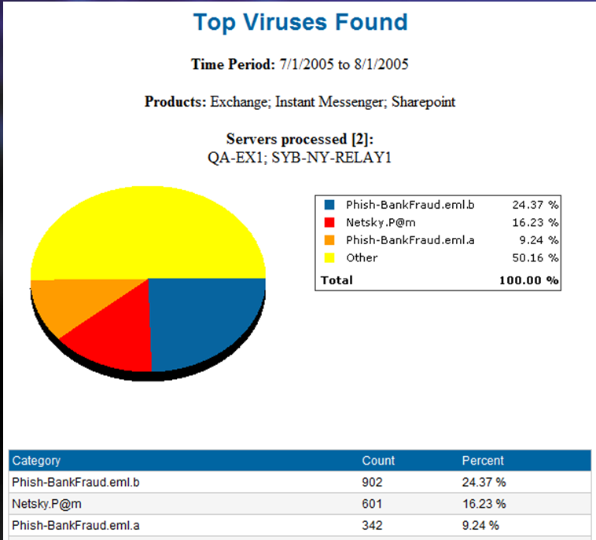
報告 – 範例偵測報告

Slide 38
報告 – 過期掃描引擎與 signature 版本
問題：安全管理人員想要針對系統更新狀態得到回應，如果 signatures 與掃描引擎過期時就要能夠盡快更新。
解決方案：Microsoft Forefront Server Security Management Console 能夠查看每一台被管理的伺服器上 signature 與掃描引擎的版本。假如版本過期就可透過 FSSMC 完成更新。

Slide 39
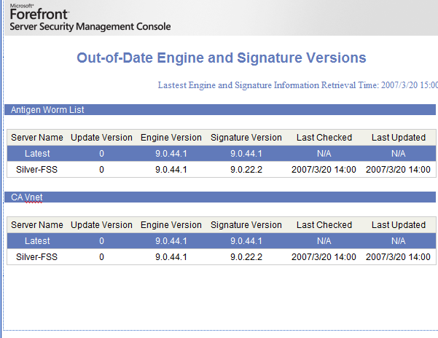
報告 –過期掃描引擎與 signature 版本
Turn RED when cannot connect to internet

Slide 40
報告 –過期掃描引擎與 signature 版本
如何工作
  FSSMC 由 Internet 下載定義檔
  比對 Internet 上的掃描引擎與 signature 版本與儲存在資料庫上被管理伺服器的內容。
  當掃描引擎與 signature 版本有以下狀態時會更新：
    需要部屬 agent
    Running job
    在 managed server上發生變更。然後 agent 將偵測變更與通知 FSSMC
    Poll

Slide 41
報告 – 其他
Quarantine Manager
SMTP Traffic
New Servers

Slide 42
Alert
Provide a mechanism to let you know when outbreak comes or when detection fails
  Virus, spam and filter alerts
  Malfunction alert: no infection within x minutes. This can be caused by:
    Scan job crash
    Misconfiguration
  Outbreak alert: Your server is under serious condition!
Alert for engine update status- Success or Fail

Slide 43
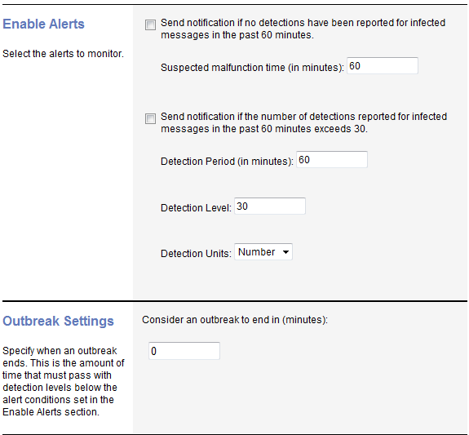
Alert-Virus Alert
Malfunction Alert
Outbreak Alert

Slide 44
Best practices
How to configure signature redistribution job
  Group 2~3 engines in one job to update.
  Schedule a 5 min interval between each job.
  Select all servers to be updated in each job.
How to retrieve log effectively
  Specify small time period to retrieve in order to reduce network jam
Real time signature update report usage
  Schedule this report and be alerted when any server is not updated for 30 min after a update comes out.

Slide 45
Trouble Shooting
Notification/Alert Logs
  從 information icon 查詢相關通知項目
Tools
  Log Generator
  Database Purging Tool
  Password Changing Tool

Slide 46
參考資源
Web site
  http://www.microsoft.com/forefront/serversecurity/mgmt/overview.mspx
Web cast
  Technical Overview of Forefront Server Security Management Console
  Take Control with Forefront Server Security Management Console
Forum
  http://forums.microsoft.com/ForeFront/ShowForum.aspx?ForumID=1298&SiteID=41

Slide 47
安全產品資源
Forefront All-Up (Overview of the entire product line-up)
  Internal: http://forefront
  Customer: www.microsoft.com/forefront
  Partner: https://partner.microsoft.com/global/productssolutions/securityproducts
Partner Readiness
  Enroll as a Security Software Advisor—FREE, online, takes less than 5 minutes
    Earn up to 30% when you recommend and deploy Forefront security SKUs. (Don’t miss out on money you earned!)
    https://partner.microsoft.com/securitysoftwareadvisor
  Get Trained!
    US Partners: www.msreadiness.com/forefront
    WW Partners: https://training.partner.microsoft.com/plc/home.aspx
Need Help?
  Technical
    ISA Server: ISAqa@microsoft.com
    Forefront Client: spybiz@microsoft.com
    Forefront Server: ffserver@microsoft.com
    Whale: IAGqa@microsoft.com
  Business / Pricing and Licensing
    Security Business Desk: secbus@microsoft.com

Slide 48
Q & A

Slide 49


Find all these support options at www.microsoft.com/technet/support
Microsoft offers a progressive series of support options starting with no-charge online support and developing
through subscription, incident, and contract support.
1. No-Charge Online
Support
Knowledge Base
Search a vast database of articles to pinpoint the information you need.
Newsgroups
Access over 20,000 active newsgroups on scores of topics.
Product Support Centers
Get answers to frequently asked questions, plus how-to articles and step-by-step instructions organized
by product.
DLL Help Database
Search here to identify the software used to install a specific DLL version.
Events and Errors Message Center
Resolve event and error messages fast with explanations, recommendations, and links to support and resources.
Support Webcasts
Tune in to live technical presentations by Microsoft experts and take part in real-time Q&A.
Chats
Chat online with Microsoft specialists
or search the transcript archives.
User Group Program
Access information and support for IT and other interest-specific user groups.
TechNet Security Resource Center
Get ahead of security risks with
resources that keep you current,
including security newsletters and
the Microsoft notification service.
2. Subscription-Based
Support
TechNet Subscription
Subscribe to TechNet for a personal
library of articles, service packs, how-tos, resource kits, tools, utilities, and more. Your subscription includes monthly updates delivered on CD or DVD, so you always have the latest information,
straight from the source.
Upgrade to a TechNet Plus subscription and add all this:
1. Full-version evaluation software, including Microsoft Office
System and Windows Server System™ products, without
time restrictions.
2. Free support — two complimentary incidents, plus a discount on other support calls.
3. Unlimited, next-business-day
access to reliable answers from
the IT community and Microsoft
Support Professionals through Managed Newsgroups (English only).
3. Assisted Incident
Support
E-mail Support
Get online incident help via e-mail from a Microsoft Support Professional.
Phone Support
Get incident help over the phone from a Microsoft Support Professional.
Phone Support Contract
Save with a discounted 5-Pack Phone Support contract.
Advisory Services
Add remotely delivered consultation options from Microsoft Advisory Services for proactive support that goes far beyond routine product maintenance.
4. Contract-Based
Support
Premier Support
Get the flexibility to match support
options to your organization and
enjoy direct access to Microsoft
technical experts at any time, day
or night. Premier Support delivers customized options for businesses
with complex needs, including
dedicated technical professionals to oversee your support, 24x7 problem resolution, and training and workshops that keep your IT staff up to date.
Essential Support
Essential Support offers prepackaged options specifically designed to meet
the fundamental support requirements
of any business, large or small. Includes account management, problem
resolution, and information services.
Notes:
<SLIDETITLE INCLUDE=7 >TechNet Troubleshooting and Support</SLIDETITLE>
<KEYWORDS>Community</KEYWORDS>
<KEYMESSAGE>Where to get more help
</KEYMESSAGE>
<SLIDEBUILDS>0</SLIDEBUILDS>
<SLIDESCRIPT>The enhanced TechNet Troubleshooting and Support page outlines all the ways IT professionals get support assistance from Microsoft. From free online support options to subscription-based support, you’ll find all your Microsoft support resources in one location at www.microsoft.com/technet/support.
</SLIDESCRIPT>
<SLIDETRANSITION>
<TRANSITION LENGTH=1>TechNet also provides a number of community resources.</TRANSITION>
<TRANSITION LENGTH=2>TechNet also provides a number of community resources.</TRANSITION>
<TRANSITION LENGTH=4>TechNet also provides a number of community resources.</TRANSITION>
</SLIDETRANSITION>
<COMMENT></COMMENT>
<ADDITIONALINFORMATION>
<ITEM>www.microsoft.com/technet/support</ITEM>
</ADDITIONALINFORMATION>

Slide 50

Notes:
<SLIDETITLE INCLUDE=0>Tag line</SLIDETITLE>
<KEYWORDS></KEYWORDS>
<KEYMESSAGE></KEYMESSAGE>
<SLIDEBUILDS>0</SLIDEBUILDS>
<SLIDESCRIPT></SLIDESCRIPT>
<SLIDETRANSITION>
</SLIDETRANSITION>
<COMMENT></COMMENT>
<ADDITIONALINFORMATION>
<ITEM></ITEM>
</ADDITIONALINFORMATION>

