Slide 1


System Center Operations Manager 2007 – Technical Overview
Howard Chow
Microsoft MVP
Notes:
1

Slide 2
What Will We Cover?
Core infrastructure optimization
Installation overview
New monitoring features
End-to-end monitoring
Security and enterprise features
Client monitoring
Reporting
Notes:
2

Slide 3
Agenda
Understanding Core Infrastructure Optimization
Installing Operations Manager 2007
Discussing New Monitoring Features
Configuring End-to-End Monitoring
Exploring Security and Enterprise Features
Configuring Client Monitoring
Examining Reporting Capabilities
Notes:
3

Slide 4













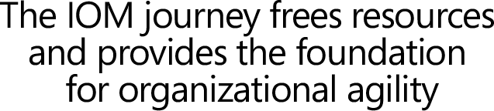





Infrastructure Optimization Model
Managed IT
infrastructure
with limited
automation
Managed and
consolidated IT
infrastructure
with maximum
automation
Fully automated
management,
dynamic resource
usage, business-
linked SLAs
Uncoordinated,
manual
infrastructure
Cost center
More efficient cost center
Business enabler
Strategic asset
Notes:
4

Slide 5
Agenda
Understanding Core Infrastructure Optimization
Installing Operations Manager 2007
Discussing New Monitoring Features
Configuring End-to-End Monitoring
Exploring Security and Enterprise Features
Configuring Client Monitoring
Examining Reporting Capabilities
Notes:
5

Slide 6
Basic Components
Operational Database
Root Management Server
Console
Agent

Slide 7
Other Components
Reporting Database
Reporting Server
Web Console
Gateway Management Server
Audit Collection Services Server

Slide 8


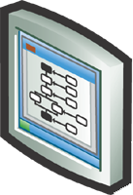

Simple Deployment
All components on one server

Slide 9




Installation Overview
Database
Management Servers
User Interfaces
Agents
Reporting
Management Packs
Management Pack Objects
Reports

Slide 10
Active Directory Integration
How to configure Active Directory integration?
  Run an Active Directory container tool to create a Management Group container
  Note: No Active Directory schema extensions required
  Create rules to specify which agents report to which management servers
  Install agents

Slide 11
Agents
Different ways to install an agent
  Windows PowerShell™
  Manual agent install
  Command-line install
  Software distribution application
  Imaged machine
What’s new?
  Support for Windows XP embedded devices
  Windows Vista™
  Microsoft Windows Server code-named “Longhorn” Beta 3

Slide 12
Gateway Server
Monitoring computers in untrusted domains
How to configure the Gateway server
  Import certificate on the server that will host the Gateway server
  Run Gateway server setup and point it to a management server

Slide 13
Side-by-Side Migration
Management Group 1:
MOM 2005
Management Group 2:
Operations Manager 2007
2005
2007
2005
2007
2005
2007

Slide 14
demonstration
Operations Console
  Exploring the Operations Console

Slide 15
Agenda
Understanding Core Infrastructure Optimization
Installing Operations Manager 2007
Discussing New Monitoring Features
Configuring End-to-End Monitoring
Exploring Security and Enterprise Features
Configuring Client Monitoring
Examining Reporting Capabilities
Notes:
15

Slide 16
Service Models
Operations Manager 2007 management packs (MPs) contain SDM v2 models
Formal definition of:
  Types of objects (classes)
  Properties of classes
  Types of relationships between objects
Supported by:
  Discovery rules
  Health model

Slide 17




Class Example
Entity
System.Library
Logical entity
Local application
Specializes
Microsoft.Windows.
Library
Windows local application
DNS client
Microsoft.Windows.DNS

Slide 18

Relationship Example
Entity
Logical entity
Local application
Windows local application
Hosts
DNS client
Windows computer

Slide 19
Core Model – Defined in MPs
Microsoft.SQLServer.Library
Microsoft.SystemCenter.Library
Microsoft.Windows.Library
System.Health.Library
System.Performance
System.Library

Slide 20
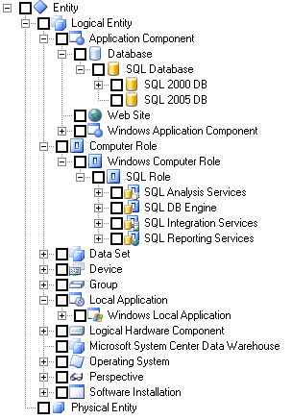
Core Model
System.Library
Microsoft.Windows.Library
Microsoft.SQLServer.Library
Microsoft.SQLServer.2005

Slide 21
Referencing MPs
Why?
  Specialize a class
  Specialize a relationship
  Use a module type, monitor type
  Use a view type
  Use an image
  Target something at a class
  Roll up health
  Extend a health model

Slide 22
Discovering the Model
Discover parts of the service model
Methods:
  Registry
  WMI
  Script
  OLEDB
  LDAP
  Custom code (native/managed)
  And more…

Slide 23
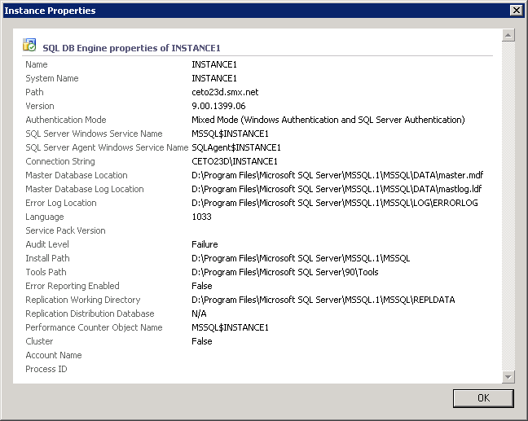
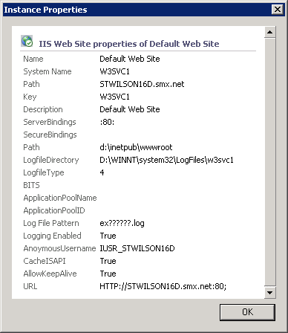
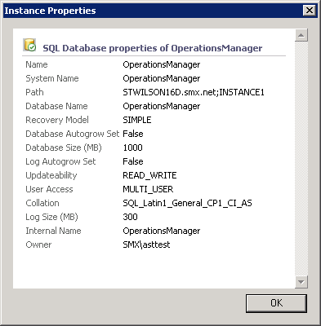
Discovered Objects

Slide 24



Discovered Relationships
stwilson15d.smx.net
stwilson15d\Instance1
master
model
OperationsManager
tempdb
test1
test2

Slide 25
Agenda
Understanding Core Infrastructure Optimization
Installing Operations Manager 2007
Discussing New Monitoring Features
Configuring End-to-End Monitoring
Exploring Security and Enterprise Features
Configuring Client Monitoring
Examining Reporting Capabilities
Notes:
25

Slide 26
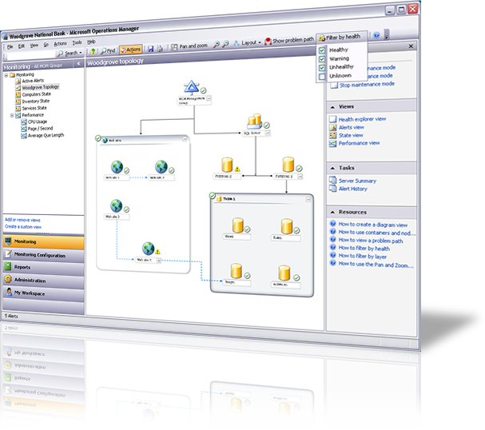
What Is a Distributed Application?

Slide 27
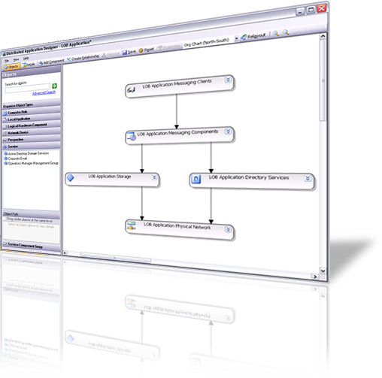
Designing Distributed Applications

Slide 28
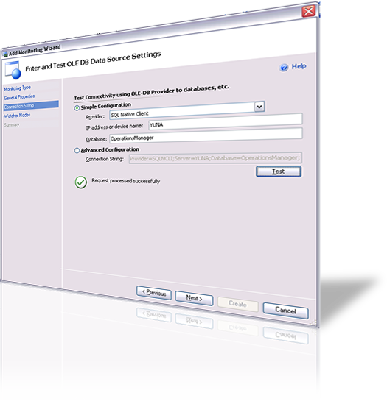
Monitoring Data Sources

Slide 29
Agenda
Understanding Core Infrastructure Optimization
Installing Operations Manager 2007
Discussing New Monitoring Features
Configuring End-to-End Monitoring
Exploring Security and Enterprise Features
Configuring Client Monitoring
Examining Reporting Capabilities
Notes:
29

Slide 30
Network Security
Mutual authentication: Always ON
Channel always encrypted
Client SDK ←→ SDK Service
OLEDB security
New Web console

Slide 31
Firewall Topology

Slide 32
Gateway Server
Domain A
Domain B
No
Trust
Mutual
Auth:
Cert Based
Mutual
Auth:
Kerberos
Mutual
Auth:
Kerberos

Slide 33
Role-Based Security
Scope
Profile
Role = Profile + Scope
Membership of roles
User can only access data relevant to their scope
Authorization enforced at SDK layer

Slide 34
demonstration
Creating User Roles
  Create User Roles and Configure Security Options

Slide 35
Run As Execution
Operations Manager 2007 solution:
Run As Execution
Support for multiple Run As accounts
Overcomes the issue of all MPs sharing the same identity
Useful for synthetic transactions

Slide 36

Run As Execution
Health Service
Default
Action Account
Monitoring Host
Run As Account
Monitoring Host
Operations
Manager
2007
Run As Account
Monitoring Host
MOM Service
Action Account
MOM Host
MOM 2005

Slide 37
Audit Collection
What is audit collection (AC)?
  Collect security events from computers
How to deploy AC?
  Run AC setup on Management Server
    Install AC database remotely
  Audit Collection Services (ACS) agent deployed with Operations Manager agent
    Enable AC on agent and specify management server

Slide 38
Agenda
Understanding Core Infrastructure Optimization
Installing Operations Manager 2007
Discussing New Monitoring Features
Configuring End-to-End Monitoring
Exploring Security and Enterprise Features
Configuring Client Monitoring
Examining Reporting Capabilities
Notes:
38

Slide 39















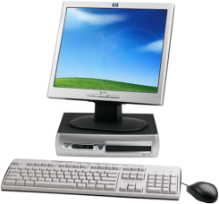

Client Monitoring Vision
Proactive monitoring
Visibility into application and computer health
Business-critical desktop
Enabling desktop as part of service delivery
Synthetic transactions for monitoring of application availability gives user perspective
End-to-end service
Aggregate reporting of desktop health
View computers as an aggregate group
Exception monitoring, computer health
Aggregate reports
Client diagnostics for rapid problem resolution
Collection of diagnostic information
Future integration with Service Desk
Client diagnostics

Slide 40

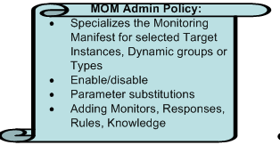



AEM – Collection
Watson.microsoft.com
\\momserver\errordata
HTTP(S)://momserver/Watson
scrim.microsoft.com

Slide 41
AEM - Reports
Reporting on crash/hang data
Summary report for errors
Costs incurred from errors, system crashes
Top N application crash summary
Top N error groups by application
Error trending report by application
System crash report

Slide 42
Windows Management Pack
Overview
Platform coverage
Designed for aggregate and critical client monitoring
Feature areas
Suite of management packs

Slide 43
Management Pack Features
Availability and Reliability
Service Availability
Service Failures
Storage Availability (NEW) *
Storage Capacity Issues (NEW) *
Performance Sub-System Issues
Performance
Monitor Abnormalities for KPIs (NEW) *
Measuring for KPIs (NEW)
OS Startup/Shutdown Performance (NEW) *
Hardware and Configuration
Application Compatibility Issues (NEW) *
Service Configuration Issues
Share Configuration Issues
Disk/Memory Failures and Issues (NEW) *
Views
Standard Views
System Performance Dashboards (NEW)
Reliability Views
Tasks
System Information
Network Diagnostics
System Restart/Shutdown
Process Diagnostics (NEW)
Reports
Global Reports
Desktop Memory Report (NEW) *
Desktop Disk Health Report (NEW) *
Desktop Performance (NEW) *
Purchasing Reports (NEW) *

Slide 44
Information Worker MP: Overview
Platform and version coverage
Designed for aggregate and critical client monitoring
Feature areas
Suite of management packs
* A subset of features will not work on Agentless

Slide 45
Agenda
Understanding Core Infrastructure Optimization
Installing Operations Manager 2007
Discussing New Monitoring Features
Configuring End-to-End Monitoring
Exploring Security and Enterprise Features
Configuring Client Monitoring
Examining Reporting Capabilities
Notes:
45

Slide 46
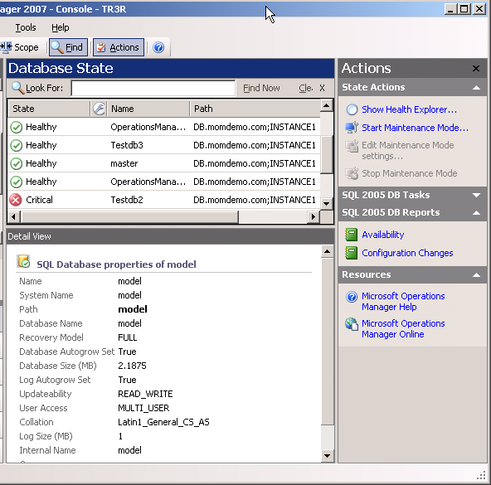
Console Integration
Targeted Reports
If the object selected in the console derives from a target class defined in the management pack, the respective report is displayed in the action pane
The context of the chosen object(s) is passed to the report as parameters

Slide 47
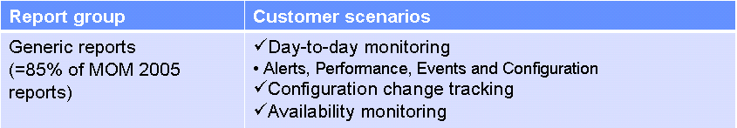
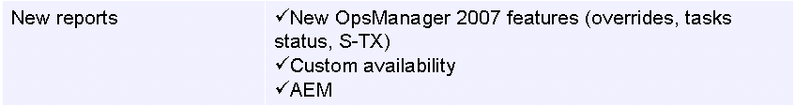
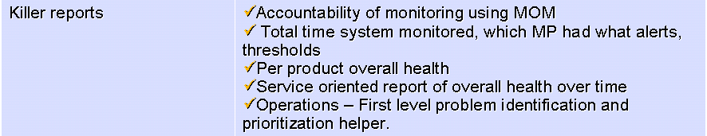
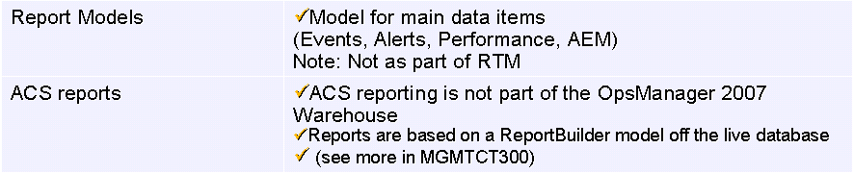
New Reports

Slide 48
Management Pack Report Contents
Dataset
Script
Resources
Report
Linked report
Report parameter
Report parameter control
Contains localization for all languages

Slide 49
Session Summary
Installation is easy
New monitoring features offer improved security and end-to-end monitoring, as well as client monitoring
Reporting now makes viewing collected data easier and provides more presentation options
Notes:
49

