Slide 1
Windows 7 Training

Slide 2
Windows® 7 Compatibility
User Interface Privilege Isolation (UIPI)

Slide 3
Introduction
Windows Vista® introduced the concept of integrity levels
By default, a process cannot send a window message to another process with a higher integrity level
This mechanism is called User Interface Privilege Isolation (UIPI)

Slide 4
The Problem
When running with UAC (User Account Control)
Processes running with standard user privileges run with normal integrity level
Processes running with administrator privileges run with high integrity level
Sending (or posting) messages from a process with a lower integrity level to a higher one will fail
Except some (undocumented) specific messages

Slide 5
Identifying The Problem
Message sending or posting fails
GetLastError returns 5 (Access Denied)
Run Process Explorer (from www.SysInternals.com) with administrator privileges
Add a column for “Integrity Level”
Check the relevant processes

Slide 6
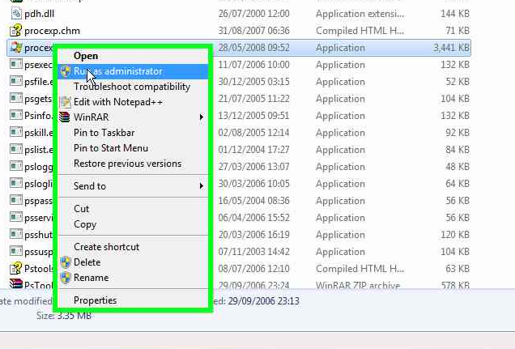
Identifying the Problem Starting process explorer
Start with administrator privilege

Slide 7
Identifying The Problem Adding integrity level (1)

Slide 8
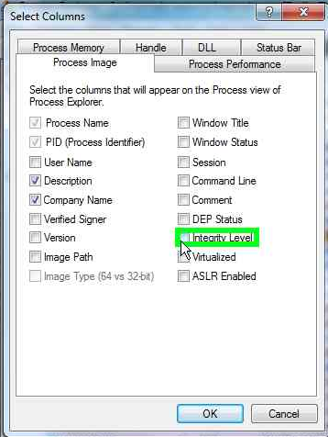
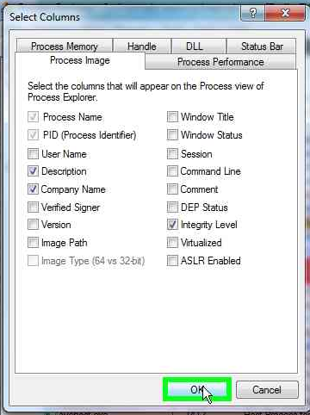
Identifying The Problem Adding integrity level (2)

Slide 9
Identifying The Problem
Look at the communicating processes
Different integrity levels

Slide 10
Solutions
If possible, run relevant processes with standard user privileges
Will make their integrity level the same (normal)
In code, call ChangeWindowMessageFilter(Ex)to allow messages to come in

Slide 11
CreateWindowMessageFilter
ChangeWindowMessageFilter(
theMessage,
MSGFLT_ADD);

Slide 12
ChangeWindowMessageFilterEx
New to Windows 7
Allows filtering messages to specific windows
ChangeWindowMessageFilterworks on a process-wide basis

Slide 13
Summary
What is UIPI?
Protection mechanism
Cannot send or post windows messages to higher level privilege process
Typical with UAC
How to fix
Native: ChangeWindowFilter(Ex)
Managed: P/Invoke around those
How to diagnose
Process Explorer with “Integrity Level” column

Slide 14
Additional Resources
Application Compatibility Cookbook: http://msdn.microsoft.com/enus/library/ bb963893.aspx
The Windows Vista and Windows Server® 2008 Developer Story: http://msdn.microsoft.com/enus/library/ aa905330.aspx
Edgar Barbosa: Windows Vista UIPI:http://www.coseinc.com/Vista_UIPI.ppt.pdf

Slide 15
© 2009 Microsoft Corporation. All rights reserved. Microsoft, Windows, Windows Vista and other product names are or may be registered trademarks and/or trademarks in the U.S. and/or other countries.
The information herein is for informational purposes only and represents the current view of Microsoft Corporation as of the date of this presentation. Because Microsoft must respond to changing market conditions, it should not be interpreted to be a commitment on the part of Microsoft, and Microsoft cannot guarantee the accuracy of any information provided after the date of this presentation. MICROSOFT MAKES NO WARRANTIES, EXPRESS, IMPLIED OR STATUTORY, AS TO THE INFORMATION IN THIS PRESENTATION.

