Slide 1
Windows 7 Training

Slide 2
The Windows®
7 Taskbar
Microsoft® Corporation

Slide 3
Where Did We Come From?
Evolution of launch surfaces
Evolution of UI concepts

Slide 4
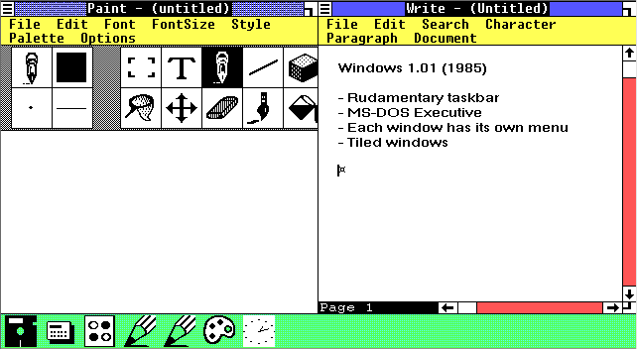

Slide 5
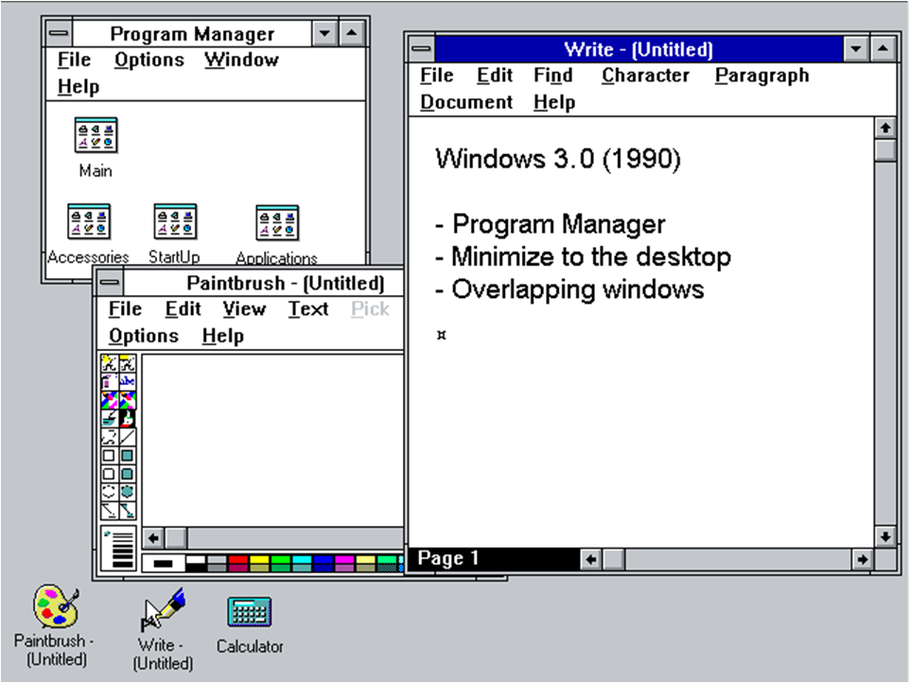

Slide 6
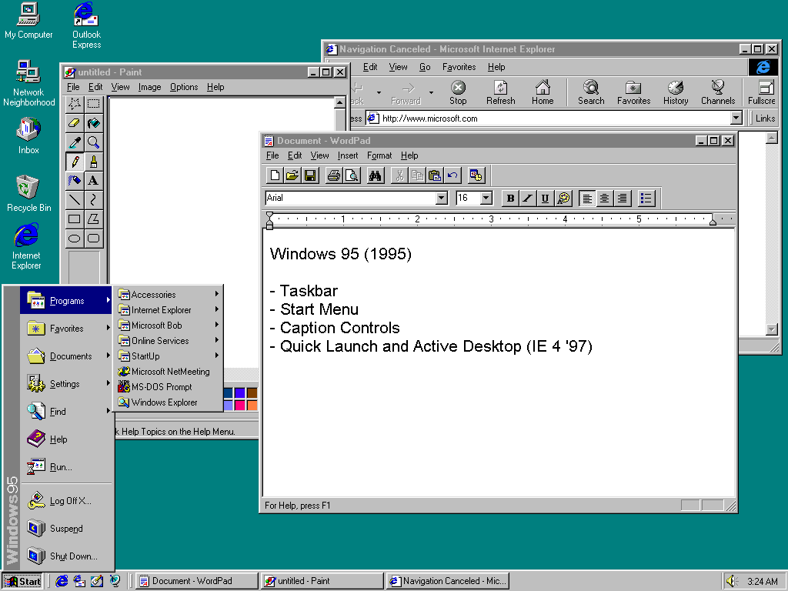

Slide 7
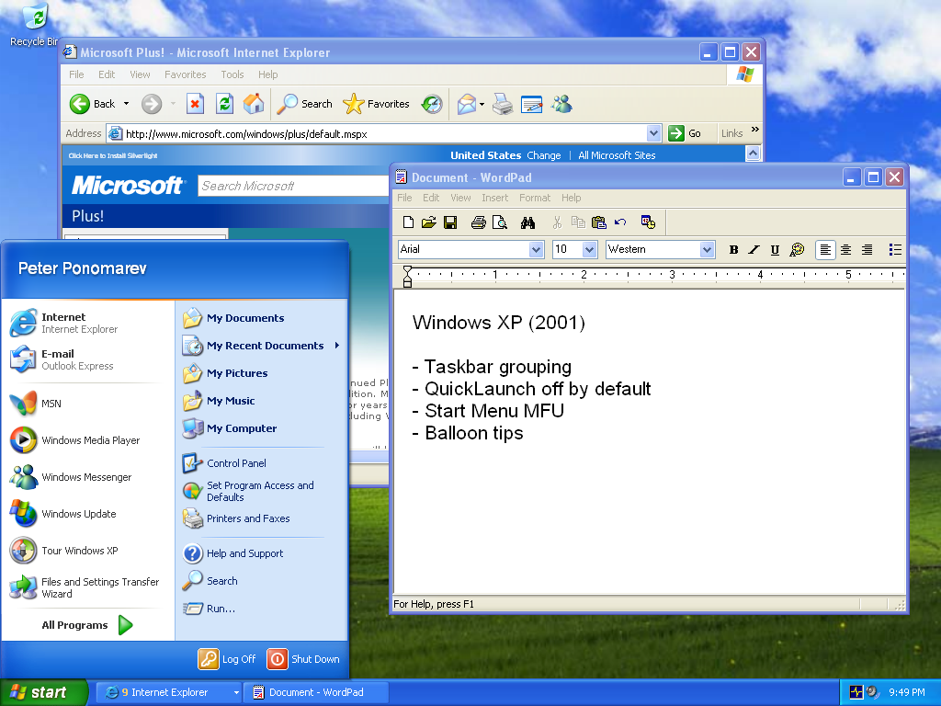

Slide 8
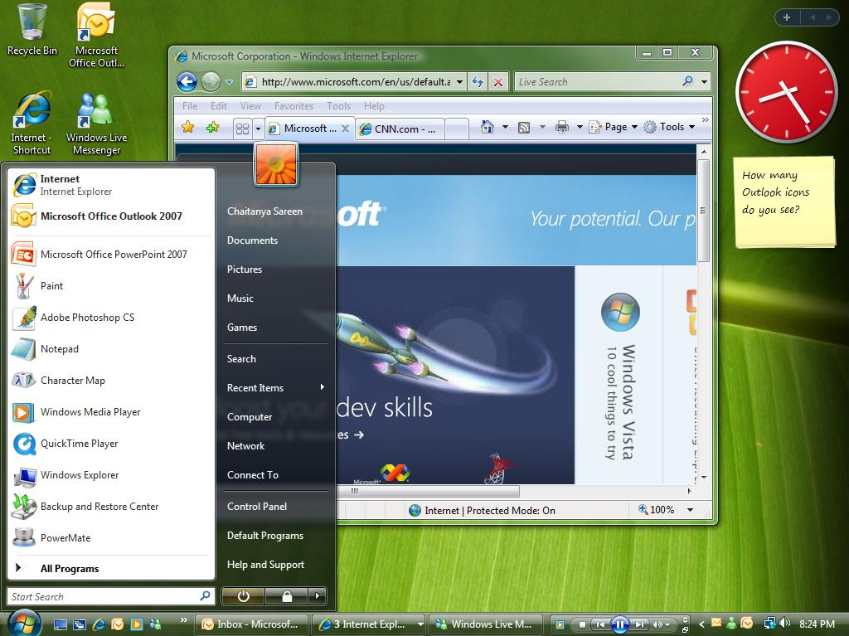

Slide 9
Some Metrics
The evolution was justified, but…
  More than 90% of sessions have fewer than
  15 windows
  More than 70% of sessions have fewer than 10
  Non-default taskbar options are used by 0-10% of users

Slide 10
Design Goals For New Taskbar
Single launch surface for frequent programs and destinations
  Things you use all the time are at
  your fingertips
Easily controllable
  Manage your windows with confidence
Clean, noise-free, and simple
Revolution
  New User Experience design guidelines
  New opportunities for extensibility

Slide 11
The New Taskbar
demo
…and beyond

Slide 12
The Rest of This Session
Managed and native APIs
Best practices and UI guidelines
A word about compatibility
Lab: Make your application taskbar-friendly

Slide 13
Terminology and Topics
Taskbar buttons and application ID
Jump lists, destinations, and tasks
Thumbnail toolbars
Overlay icons and progress icons
Custom thumbnail and peek
Custom switching functionality
(multiple-document interface or tabbed-document interface)

Slide 14

Taskbar Buttons
Consolidation
  Quick launch
  Notification area icon
  Desktop shortcut
  Running application windows
Multiple windows and hover
Running
Not running
Active

Slide 15
Taskbar Buttons
Design considerations
Only users can pin applications to
the taskbar
The icon’s hot-track color is the icon’s dominant color
Test icons with high DPI
Test with various themes and glass colors

Slide 16
How Are Windows Grouped?
Enter: Application ID
It’s a string, not a GUID
  Limited to 128 characters
  Naming convention – Company.Product.SubProduct.Version
All your application components have it:
  Process, shortcut, window, taskbar button, document type

Slide 17
Application ID
Design considerations
Default: Computed by process name
Customize
  Several executables, same application
  Same executable (host), many applications
  Multiple shortcuts
When customizing Jump Lists, set the Application ID

Slide 18
Application ID
Heuristics of determining the Application ID
Application ID can “fall back”
to a larger scope if needed
Process
Shortcut
Windows
Application ID
Default computation
Jump List
Document Type Registration

Slide 19
Setting the Application ID
Process-wide – affects all windows in the current process:
#include <windows.h>
#pragma comment (lib, "shell32.lib")
SetCurrentProcessExplicitAppUserModelId(
L"Microsoft.Samples.AppId1");
Windows7Application.SetCurrentProcessAppId(
"Microsoft.Samples.AppId1");

Slide 20
Window Application ID
PROPVARIANT pv;
InitPropVariantFromString(
L"Microsoft.Samples.AppId2", &pv);
IPropertyStore *pps;
HRESULT hr = SHGetPropertyStoreForWindow(
hWnd, IID_PPV_ARGS(&pps));
pps->SetValue(PKEY_AppUserModel_ID, pv);
myForm.SetAppId("Microsoft.Samples.AppId2");

Slide 21
Application ID
demo
…and its effects on the taskbar

Slide 22
Windows Shell
Overview
The Windows Shell is the user’s and developer’s gate to the system
  Folders and files to access local computer
  Virtual objects to access network printers, network computers, Control Panel, Recycle Bin
Windows® Explorer provides a graphical representation of the Shell namespace

Slide 23
Windows Shell
Extensibility
Search providers
Preview handlers
Explorer extensions
Desktop gadgets
Taskbar desk-bands
Control Panel applets

Slide 24
Windows Shell
Application interaction
Application support
  Common file dialogs
  Known folders and libraries
  Property system
Terminology
  IShellItem – represents folders and files
  IShellLink – represents shell shortcuts
  IShellFolder – represents folders

Slide 25
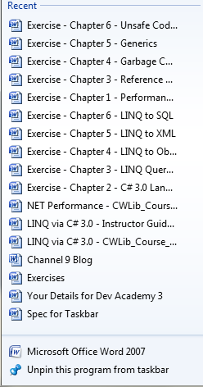
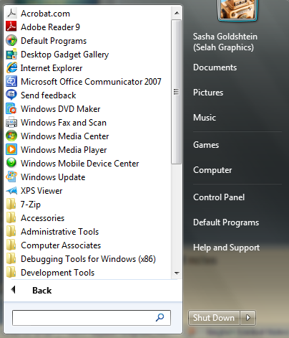
Jump List
It’s a mini Start menu

Slide 26
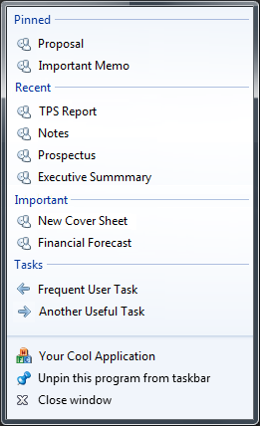
Jump Lists
A detailed look
Pinned category
Destinations
(“nouns”)
Known categories
Custom categories
User tasks
Tasks
(“verbs”)
Taskbar tasks

Slide 27
Jump Lists
Design considerations
Surface key destinations and tasks
  Recent and frequent are free
  Pinned is also free (if users use it)
  Respect items the user removes!
Addictive: You don’t look for documents anywhere else!
  You also expect the common tasks to be there

Slide 28
Customizing the Jump List
Step 1: Get the free stuff to work
Associate your program with the file extension
Use common file dialogs
Use explicit recent document API
SHAddToRecentDocs(SHARDW_PATH, "file.ext");
RH.RegisterFileAssociations(...);
OpenFileDialogofd = ...; ofd.ShowDialog();
JumpListManagerjlm = ...;
jlm.AddToRecent("file.ext");

Slide 29
Recent Documents
demo
…in a Jump List

Slide 30
Customizing the Jump List
Step 2: Adding tasks
What would your user like to do?
  Launch your application with special arguments?
  Launch other applications?
Tasks are IShellLink objects
  Rich shortcut semantics including arguments, working directory, icon, and so on.

Slide 31
Customizing the Jump List
Step 2: Adding tasks
IObjectCollection* poc = ...;
IShellLink* task = ...;
Poc->AddObject(task);
ICustomDestinationList* pcdl = ...;
Pcdl->BeginList(...);
IObjectArray* poa = ... poc;
Pcdl->AddUserTasks(poa);
Pcdl->CommitList();
JumpListManagerjlm = ...;
jlm.AddTask(new ShellLink { Path=..., ... });

Slide 32
Customizing the Jump List
Step 3: Do you have categories?
Does it make sense to categorize documents?
  Is frequent, recent, pinned not enough?
  For example, Inbox, Outbox, Sales, Marketing …
Categories contain IShellItem or
IShellLink objects
  These are documents: You need a file association

Slide 33
Customizing the Jump List
Step 3: Adding categories
IObjectCollection* poc = ...;
IShellItem* item = ...;
Poc->AddObject(item);
ICustomDestinationList* pcdl = ...;
Pcdl->BeginList(...);
IObjectArray* poa = ... poc;
Pcdl->AppendCategory(L"Sales", poa);
Pcdl->CommitList();
JumpListManagerjlm = ...;
jlm.AddCustomDestination(
new ShellItem { Path=..., Category=... });

Slide 34
Tasks and Destinations
demo
…in a Jump List

Slide 35
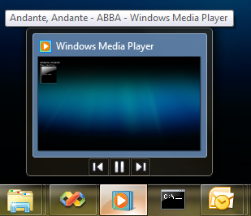
Thumbnail Toolbars
Remote control from the taskbar

Slide 36
Thumbnail Toolbars
Design considerations
You get up to seven buttons
  Can’t add or delete; can hide and disable
Tasks are not thumbnail buttons!
Tasks | Thumbnail Buttons
Entry point | Menu or toolbar
Application-wide | Window-specific
Can act dynamically | Must be static

Slide 37
Creating Thumbnail Toolbars
UINT wm_tbc = RegisterWindowMessage(
"TaskbarButtonCreated");
MSG m; GetMessage(..., &m);
if (m.message == wm_tbc) {
ITaskbarList3* ptl = ...;
THUMBBUTTON btn = {...};
ptl->ThumbBarAddButtons(m.hWnd, 1, &btn);
}
ThumbButtonManagertbm = ...;
tbm.CreateThumbButton(...).Clicked += ...;

Slide 38
Thumbnail Toolbars
demo
…work without leaving the taskbar

Slide 39

Get More From Taskbar Buttons
Overlay and progress icons
Consolidate: Uncluttered notification area
Provide progress and additional information through the taskbar button
  It’s free if you use standard progress dialogs

Slide 40
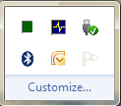




Taskbar Overlay and Progress
Design considerations
Notification area is now user controlled:
  Leave yourself out if possible!
Use taskbar buttons for custom progress or
status information

Slide 41
Taskbar Overlay and Progress
The APIs
ITaskbarList3* ptl = ...;
ptl->SetOverlayIcon(
hwnd, hicon, L"Accessible Description");
ptl->SetProgressState(hwnd, TBPF_NORMAL);
for (inti = 0; i < MAX; ++i) {
ptl->SetProgressValue(hwnd, i, MAX);
}
myForm.SetTaskbarOverlayIcon(icon, "...");
ProgressBarpb = ...;
pb.SetTaskbarProgress();

Slide 42
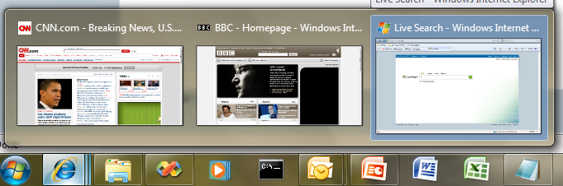
Live Thumbnails
Live thumbnails: A livepreview
  Windows Vista®: One thumbnail per window
  Windows 7: Grouped thumbnails

Slide 43
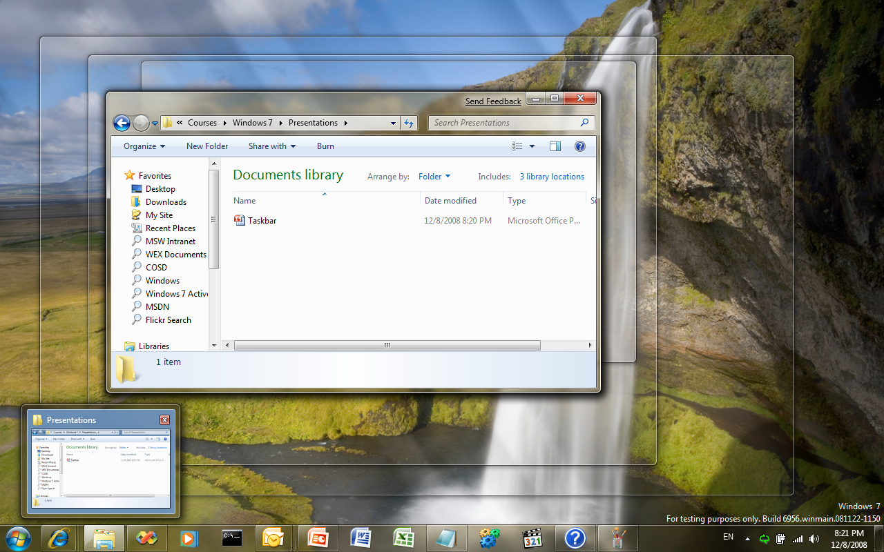
Peek Preview (Aero Peek)
Live peek without a click

Slide 44
Live Thumbnails and Peek
Design considerations
Desktop Window Manager (DWM) only talks to top-level windows
  Child windows need a custom representation
The thumbnail might be “too much” or
“not enough”
  What if you could …
Test your thumbnails to make sure they
are useful
If they aren’t, customize them!

Slide 45
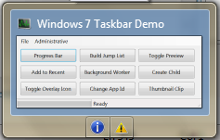
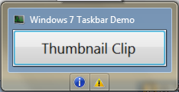
Thumbnail Clip (Zoom)
Zoom into the important parts!

Slide 46
Customizing Live Thumbnails
DwmSetWindowAttribute(
...,DWMWA_HAS_ICONIC_BITMAP,...);
DwmSetWindowAttribute(
...,DWMWA_FORCE_ICONIC_REPRESENTATION,...);
/* in the WndProc */
case WM_DWMSENDICONICTHUMBNAIL:
HBITMAP hbm = ...;
DwmSetIconicThumbnail(hwnd, hbm, ...);
CustomWindowsManagercwm = ...;
cwm.ThumbnailRequested += (o,e)=>e.Bitmap=b;

Slide 47
Customizing Peek Preview
DwmSetWindowAttribute(
...,DWMWA_HAS_ICONIC_BITMAP,...);
DwmSetWindowAttribute(
...,DWMWA_FORCE_ICONIC_REPRESENTATION,...);
/* in the WndProc */
case WM_DWMSENDICONICLIVEPREVIEWBITMAP:
HBITMAP hbm = ...;
DwmSetIconicLivePreviewBitmap(...hbm,...);
CustomWindowsManagercwm = ...;
cwm.PeekRequested += (o,e)=>e.Bitmap=b;

Slide 48
Customized Preview
demo
…or how to read abstracts from the taskbar

Slide 49
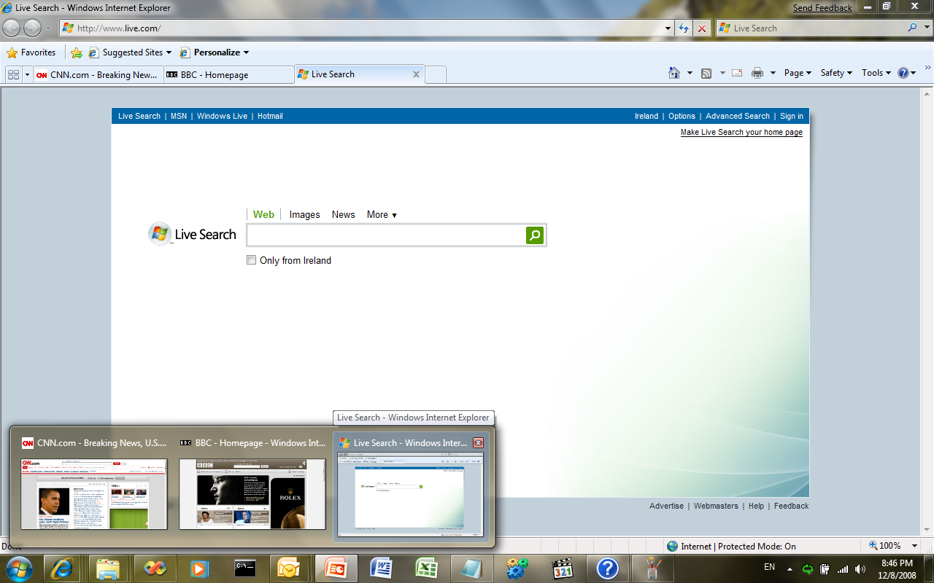
MDI and TDI Window Switchers
What about Internet Explorer tabs?

Slide 50
Custom Window Switchers
Use ITaskbarList3::RegisterTab, SetTabOrder, SetTabActive
Child window must create a proxy top-level window for custom thumbnail and peek
  The proxy window is typically invisible
Proxy window must handle WM_ACTIVATE and WM_SYSCOMMAND

Slide 51
Custom Window Switchers
TabPage tab = new TabPage(...);
tabControl.TabPages.Add(tab);
varcwm = new CustomWindowsManager(
tab.Handle, parent.Handle);
cwm.PeekRequested += (o,e) => {
e.Bitmap = storedBitmap; /*Earlier*/
e.DoNotMirrorBitmap = true; /*DWM bug*/
};
cwm.ThumbnailRequested += (o,e) =>
e.UseWindowScreenshot = true;

Slide 52
Tab Preview
demo
Controlling TDI previews

Slide 53
Compatibility and Migration
Quick launch is deprecated
Notification area should be kept clean
Proper file associations are crucial for most-recently used or most-frequently used and custom categories
Users will expect destinations and tasks
Should child windows have thumbnails?
Bad examples:
  Microsoft Visual Studio® 2008
  Microsoft Office Outlook® 2007

Slide 54
Summary
Evolution of launch surfaces
Taskbar: The place I want to live
Making friends with the APIs
Prepare your application today!

Slide 55

© 2009 Microsoft Corporation. All rights reserved. Microsoft, Windows, Windows Vista and other product names are or may be registered trademarks and/or trademarks in the U.S. and/or other countries.
The information herein is for informational purposes only and represents the current view of Microsoft Corporation as of the date of this presentation. Because Microsoft must respond to changing market conditions, it should not be interpreted to be a commitment on the part of Microsoft, and Microsoft cannot guarantee the accuracy of any information provided after the date of this presentation.
MICROSOFT MAKES NO WARRANTIES, EXPRESS, IMPLIED OR STATUTORY, AS TO THE INFORMATION IN THIS PRESENTATION.

