Slide 1
Windows 7 Training

Slide 2
Windows® 7 Compatibility
Session 0 Isolation
Isolation of Windows 7 Services

Slide 3
Windows Sessions
Session
Window station (WinSta0)
Desktop (default desktop)
User application or service

Slide 4
What Happened?
In Windows® XP, services and user applications ran together in session 0
Starting with Windows Vista®, services are alone in session 0
User applications run in session 1, session 2, and so on (fast user switching and Terminal Services)

Slide 5
The Problems
Window messages can’t cross desktop boundaries (and of course session boundaries)
Kernel objects are private to a session by default
Services can’t display UI on the user’s desktop
Access control adds confusion to the mix

Slide 6
Identifying The Problem
Symptoms
No UI is displayed when there used to be some
“Interactive services dialog detection”
Clients receive access denied errors when talking to a service
Clients do not receive a response from a service when using local objects
Use tools to verify
Process Explorer (for examining handles)

Slide 7
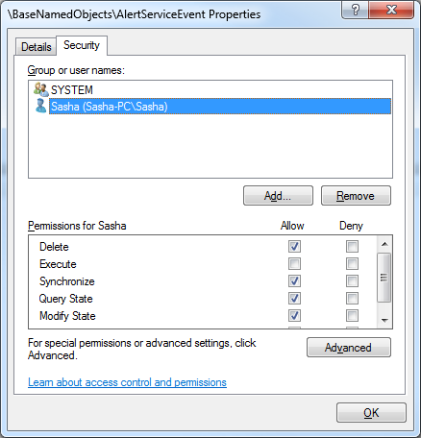
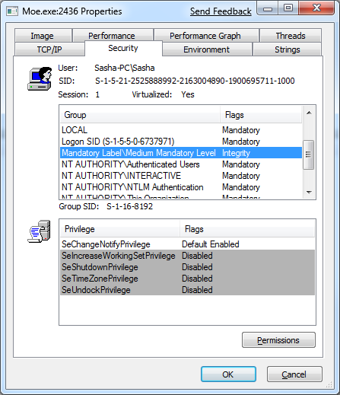
Process Explorer Access control and integrity levels

Slide 8
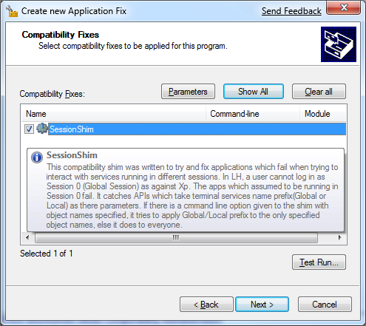
Kernel Object Namespaces Solutions
Shim the problematic objects
Prefix object names with Global\

Slide 9
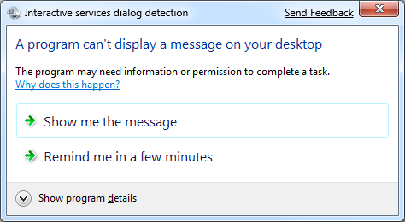
Displaying UI To The User Solutions
Automatic mitigation prompts the user (if the service is interactive)
Highly inconvenient
For simple messages,
use WTSSendMessage
To launch a complex UI client, use CreateProcessAsUser
Find the “active” user

Slide 10
Using WTSSendMessage
DWORD dwSession = WTSGetActiveConsoleSessionId();
DWORD dwResponse = 0;
WTSSendMessage(
WTS_CURRENT_SERVER_HANDLE, dwSession,
lpszTitle,
(wcslen(lpszTitle) + 1) * sizeof(wchar_t),
lpszMessage,
(wcslen(lpszMessage) + 1) * sizeof(wchar_t),
0, 0, &dwResponse, FALSE);

Slide 11
Access Control And Integrity Levels Solutions
Let the client create shared objects (shared memory, pipes, and so on)
Modify the DACL to give clients access
Modify the SACL to add a mandatory integrity level appropriate to the client
Usually medium integrity level

Slide 12
Modifying The Integrity Level
InitializeAcl(acl, ...);
SID sid; //...initialization
sid.SubAuthority[0] =
SECURITY_MANDATORY_MEDIUM_RID;
AddMandatoryAce(acl, ..., &sid);
SetNamedSecurityInfo(
L"MyObject", SE_KERNEL_OBJECT,
LABEL_SECURITY_INFORMATION,
..., acl);

Slide 13
Setting DACL And SACL
ConvertSidToStringSid(account->User.Sid, &lpszSid);
wsprintf(sddl,
L"O:SYG:BAD:(A;;GA;;;SY)(A;;GA;;;%s)S:(ML;;NW;;;ME)",
lpszSid);
PSID sd;
ConvertStringSecurityDescriptorToSecurityDescriptor(
sddl, SDDL_REVISION_1, &sd, NULL);
SECURITY_ATTRIBUTES sa; //...initialize SA
sa.lpSecurityDescriptor = sd;
CreateEvent(&sa, FALSE, FALSE, ...);

Slide 14
Summary
Services are isolated into a separate session, with no UI access and no shared resources
Extra care must be taken to communicate between services and applications
Properly displaying UI in the right user desktop
Properly creating and securing shared objects

Slide 15
Additional Resources
Application Compatibility: UAC: Standard User Changes: http://msdn.microsoft.com/en-us/library/bb963893.aspx
Modifying the Mandatory Integrity Level for a Securable Object in Windows Vista: http://blogs.msdn.com/cjacks/archive/2006/10/24/modifying-the-mandatory-integrity-level-for-a-securable-object-in-windows-vista.aspx
Windows Integrity Mechanism Resources: http://msdn.microsoft.com/en-us/library/bb625959.aspx
Impact of Session 0 Isolation on Services and Drivers in Windows Vista: http://www.microsoft.com/whdc/system/vista/services.mspx

Slide 16
© 2009 Microsoft Corporation. All rights reserved. Microsoft, Windows, Windows Vista and other product names are or may be registered trademarks and/or trademarks in the U.S. and/or other countries.
The information herein is for informational purposes only and represents the current view of Microsoft Corporation as of the date of this presentation. Because Microsoft must respond to changing market conditions, it should not be interpreted to be a commitment on the part of Microsoft, and Microsoft cannot guarantee the accuracy of any information provided after the date of this presentation. MICROSOFT MAKES NO WARRANTIES, EXPRESS, IMPLIED OR STATUTORY, AS TO THE INFORMATION IN THIS PRESENTATION.

