Slide 1
Windows 7 Training

Slide 2
Windows® Ribbon
Microsoft® Corporation

Slide 3
Agenda
Windows Ribbon Landscape
Windows Ribbon API overview, architecture
Markup syntax overview
Integrating into your application
Initialization
Event handling
Getting and setting properties

Slide 4
Microsoft ® Office 2007 Ribbon
Office Button
Tab
Contextual Tab Set
Help
Quick Access Toolbar
Contextual Tab
Group (aka “Chunk”)
Dialog Box Launcher

Slide 5
Windows Scenic Ribbon
Office Button
Quick Access Toolbar
Tab
Contextual Tab Set
Help
Contextual Tab
Group (aka “Chunk”)
Dialog Box Launcher
In-box with Windows® 7, redistribution available to Windows Vista®
Win32 API, COM-based (targets native developers first)
Feature parity (or close) with Microsoft Office 2007 Ribbon

Slide 6
The Ribbon Landscape
WPF
MFC
Scenic
Target:
Managed
Target:
MFC native
Target:
Native
needs .NET Framework 3.5
Windows 2000 or later
Windows Vista or later
Office 2007 and Windows styles
Office 2007 and Windows styles
Windows visual style
Coming soon… Official release in 2009
Available now in Visual Studio® 2008 SP1
Coming soon…
Ships with Windows 7
Microsoft’s Ribbon Strategy
¹ Office 2007 style available now, Windows style available 2009

Slide 7
Windows Ribbon API Overview
Windows 7 introduces a new, native API for creating Ribbon-based UIs
COM-based API (includes UIRibbon.h)
API will be available for Windows Vista in the future
UI markup via XAML-based format
Very similar to the WPF Ribbon syntax
Feature parity (or almost) with Office 2007 Ribbon
Used by Windows 7 in Microsoft Paint, WordPad, Live Movie Maker, and so on

Slide 8
Windows Ribbon API Architecture
Strong Model-View-Controller separation
Code and markup decoupling
Small C++ API surface
Windows Scenic Ribbon
Application-specific business logic
void DoStuff()
{
…
…
}
Markup
Organization of controls
<Ribbon>
<Tab> <Button … />
</Tab>
</Ribbon>
COM API
Initialization and
events handling
MyHandler::Execute(…) { DoStuff(); }

Slide 9
Windows Ribbon API Architecture
Focuses on commands, not controls or representation details
Sometimes called intent-based UI
Also can be viewed as “command framework”
Automatically adjusts the UI based on state retrieved from the host application

Slide 10
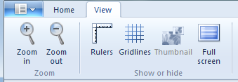
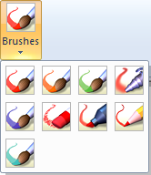
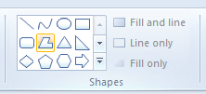
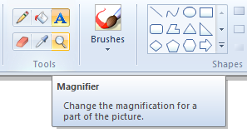
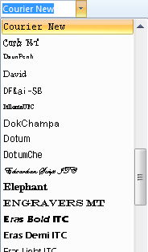
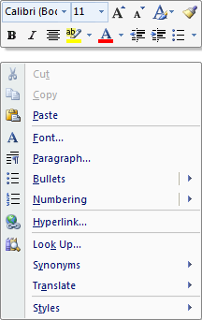
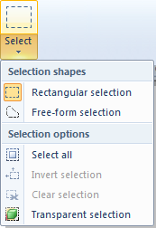
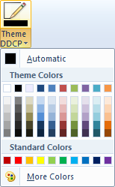
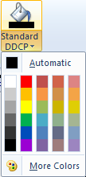
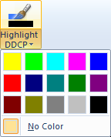
Windows Ribbon Controls
Font control
Buttons & split buttons
Tabs and groups
Check boxes
Help button
“In-Ribbon” galleries
Group dialog launchers
Dropdown galleries
Tooltips
Spinners
Combo boxes
Categorized menus
Mini toolbar and contextual menu
Color pickers

Slide 11
Ribbon Markup Commands Section
XAML-based. Consists of two sections: commands and views
Command elements specify a name (ref. in the views section), a label, an image (.bmp only) and tooltip. An ID (number) may also be specified
<?xmlversion="1.0" encoding="utf-8"?>
<Applicationxmlns='http://schemas.microsoft.com/windows/2009/Scenic/Intent'>
<Application.Commands>
<CommandName='Home' LabelTitle='Home'/>
<CommandName='HomePage' LabelTitle='HomePage'>
<Command.LargeImages>
<ImageSource='res/HomePageHH.bmp'/>
</Command.LargeImages>
</Command>
</Application.Commands>

Slide 12
Ribbon Markup Views Section
Specifies the organization of commands into tabs, groups, quick access toolbar, and application menu
Specifies the controls to use for each command
<Application.Views>
<Ribbon>
<Ribbon.Tabs>
<TabCommandName='Home'>
<GroupCommandName='GoHomePage' SizeDefinition='OneButton'>
<ButtonCommandName='HomePage'/>
</Group>
</Tab>
</Ribbon.Tabs>
</Ribbon>
</Application.Views>
</Application>

Slide 13
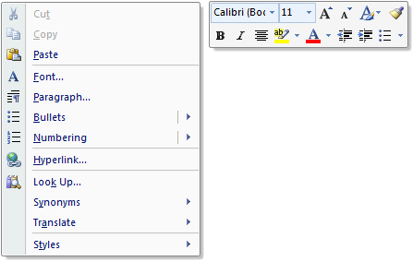
More About Views
Windows Ribbon supports two types of views: the ribbon view and the contextual UI view
The contextual UI provides a richer context system than previously available

Slide 14
Ribbon Markup
UICC.exe converts the XAML into an optimized binary format and creates an .rc file which contains this binary blob along with resources referenced in the markup
You should define a custom build step for the markup file which invokes UICC.exe
An .h file is also generated which contains #defines for the various command IDs

Slide 15
Application Modes
You may wish to hide some controls in different modes of your application
In Microsoft Paint, the Text tab should only be available when editing text
In the markup, define the application modes in which a control is available
Propagates to child controls
In code, call the IUIFrameworkSetModes function
Bit mask. 0 is the default mode
<ButtonCommandName='Paste' ApplicationModes='1,3'/>

Slide 16
Windows 7 Ribbon
Demo
Markup overview

Slide 17
Windows Ribbon API Interfaces
Consists of these main interfaces
IUIFramework – initialize ribbon, load markup resource, get or set command property values or state, set application modes
IUIApplication– user-implemented interface. Retrieves user command handler for each command defined in the markup. Notifies about view state changes
IUICommandHandler – user-implemented interface. Handles commands, updates property value (for example, setting a command to enabled or disabled based on view)

Slide 18
Integrating Windows Ribbon
Ribbon Platform
Application
CoCreateInstance
Initialize (HWND, IUIApplication*)
IUIApplication
IUIFramework
LoadUI( resourceName )
OnCreateCommand
Execute, UpdateProperty
IUICommandHandler
Get/SetUICommandProperty, InvalidateUICommand

Slide 19
Windows Ribbon API Initialization
IUIFramework* g_pFramework = NULL;
::CoCreateInstance(CLSID_UIRibbonFramework, NULL, CLSCTX_INPROC_SERVER, IID_PPV_ARGS(&g_pFramework));
CComObject<CApplication> *pApp = NULL;
CComObject<CApplication>::CreateInstance(&pApp);
CComPtr<IUIApplication> spApp(pApp);
g_pFramework->Initialize(hWindowFrame, spApp);
g_pFramework->LoadUI(GetModuleHandle(NULL), L"APPLICATION_RIBBON");

Slide 20
Windows Ribbon API Event handling
class CApplication :
public CComObjectRootEx<CComMultiThreadModel>,
public IUIApplication,
public IUICommandHandler
{
public:
BEGIN_COM_MAP(CApplication)
COM_INTERFACE_ENTRY(IUIApplication)
COM_INTERFACE_ENTRY(IUICommandHandler)
END_COM_MAP()
...

Slide 21
Windows Ribbon API Event Handling
STDMETHOD(OnViewChanged)(UINT32 nViewID,
__in UI_VIEWTYPE typeID, __in IUnknown* pView,
UI_VIEWVERB verb, INT32 uReasonCode)
{ return E_NOTIMPL; }
STDMETHOD(OnCreateUICommand)(UINT32 nCmdID,
__in UI_COMMANDTYPE typeID,
__deref_outIUICommandHandler** ppCmdHndlr)
{ return QueryInterface(IID_PPV_ARGS(ppCmdHndlr)); }
STDMETHOD(OnDestroyUICommand)(UINT32 commandId,
__in UI_COMMANDTYPE typeID,
__in_optIUICommandHandler* pCommandHandler)
{ return E_NOTIMPL; }

Slide 22
Windows Ribbon API Event Handling
STDMETHODIMP Execute(UINT nCmdID,
UI_EXECUTIONVERB verb,
__in_opt const PROPERTYKEY* key,
__in_opt const PROPVARIANT* ppropvarValue,
__in_optIUISimplePropertySet* pCmdExecProps)
{
if (verb == UI_EXECUTIONVERB_EXECUTE
&& nCmdID == HomePage)
MessageBox(NULL, L"Clicked on HomePagebtn”, L"HomePage Button Execute“, MB_OK);
return S_OK;
}

Slide 23
Windows Ribbon API Event handling
STDMETHODIMP UpdateProperty(UINT nCmdID,
__in REFPROPERTYKEY key,
__in_opt const PROPVARIANT* ppropvarCurrentValue,
__out PROPVARIANT* ppropvarNewValue)
{
if (key == UI_PKEY_Enabled &&
nCmdID == HomePage && m_bPressed)
{
return UIInitPropertyFromBoolean(
UI_PKEY_Enabled, FALSE, ppropvarNewValue);
}
return E_NOTIMPL;
}

Slide 24
Windows Ribbon
Demo
APIs

Slide 25
© 2009 Microsoft Corporation. All rights reserved. Microsoft, Windows, Windows Vista and other product names are or may be registered trademarks and/or trademarks in the U.S. and/or other countries.
The information herein is for informational purposes only and represents the current view of Microsoft Corporation as of the date of this presentation. Because Microsoft must respond to changing market conditions, it should not be interpreted to be a commitment on the part of Microsoft, and Microsoft cannot guarantee the accuracy of any information provided after the date of this presentation. MICROSOFT MAKES NO WARRANTIES, EXPRESS, IMPLIED OR STATUTORY, AS TO THE INFORMATION IN THIS PRESENTATION.

