Slide 1
Windows 7 Training

Slide 2
Windows® 7 Multi-Touch
Microsoft® Corporation

Slide 3
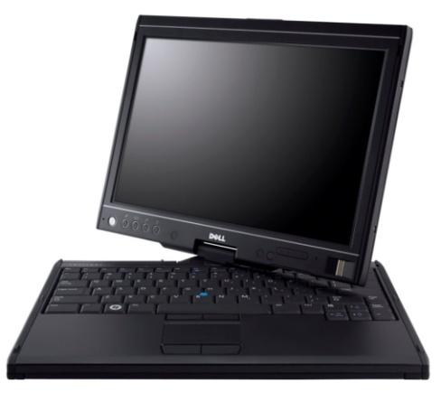
Multi-Touch Is Here!
Hardware
Multi-touch capable PCs on the market today; multi-touch appears in a broad set of form factors
Software
Windows 7, .NET Framework 4.0
Consumers
New scenarios, next wave of user
experience, high “WOW” factor

Slide 4
Windows Photo Viewer Paint
Demo
Windows 7 built-in multi-touch

Slide 5
Agenda
Multi-touch overview
Control Panel settings
Touch scenarios, “Good, Better, Best” model
Platform details
Native Win32 gesture and touch support
Manipulations and inertia
Windows Presentation Foundation (WPF) support
UX guidelines for touch applications
Summary

Slide 6
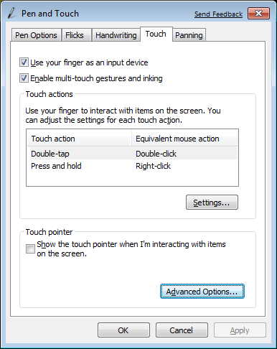
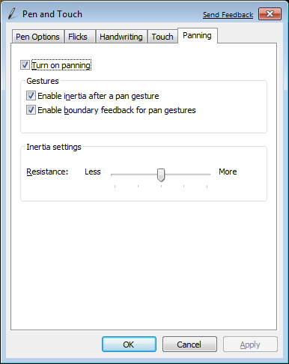
Control Panel Pen and Touch

Slide 7
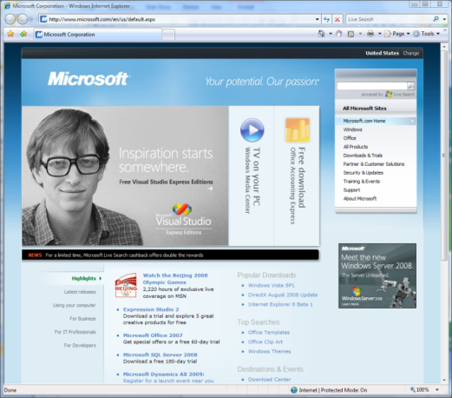
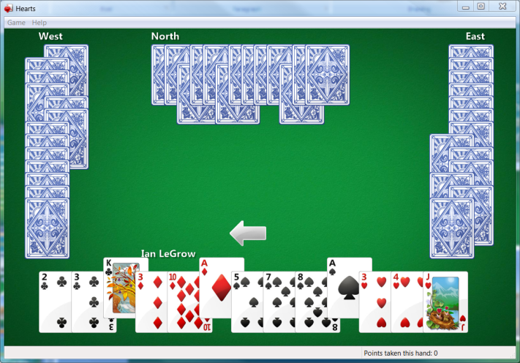
Touch Scenarios and Windows 7
Developer Platform: At the root is the touch developer platform that exposes touch APIs for any application
UI Enhancements: Focusing on the core scenarios, many parts of the core UI have been optimized for touch experiences
Gestures: Multi-touch gestures have been added to enable consistent panning and zooming in most applications.
Applications: A set of multi-touch focused applications that demonstrate the power of touch will ship separately from Windows 7
There are several key scenarios for multi-touch
Navigating and consuming the Web
Reading and sorting email
Viewing photos
Playing casual games
Consuming music and video
Navigating files and arranging windows
Using Microsoft Office applications
All focused on consumption

Slide 8
Multi-Touch Development Tiers Good – Better – Best
Best
Better
Good
Windows application can target one of three levels of touch integration
Good: No specific touch APIs are used but the application UI is appropriately sized and works well with the built-in gestures
Better: The gesture APIs are supported to give smooth natural interactions
Best: Deep touch-focused experiences designed to take advantage of multi-touch features

Slide 9
 | Good
APIs | For Free! Panning/zoom gestures Right-click gesture
Native Win32 | Controls with standard scrollbars
WPF | WPF 3.5 SP1 API CodePack WPF 4.0 full support + Controls
WinForms | Controls with standard scrollbars
Better
Gesture notifications Pan/zoom/rotate and so on
WM_GESTURE message
Gesture events Inertia configuration
WM_GESTURE message via interoperability
Best
Raw touch data Manipulation and inertia processors
WM_TOUCH COM-based manipulation and inertia processors
Touch events Manipulation and inertia processors
Manipulation and inertia processors via COM interoperability

Slide 10
Testing the Digitizer Capabilities
Passing SM_DIGITIZER to GetSystemMetrics() returns a bit field:
0x01 | 0x02 | 0x04 | 0x08 | 0x10 | 0x20 | 0x40 | 0x80 | Bit
Integrated Touch | External Touch | Integrated Pen | External Pen | Reserved | Reserved | Multi input | Stack Ready | Value
// test for touch
int value = GetSystemMetrics(SM_DIGITIZER));
if (value & 0x80){ /* stack ready */}
if (value & 0x40)
{
bMutiTouch = TRUE;/* digitizer is multitouch */
MessageBox(L"Multitouch found", L"IsMulti!", MB_OK);
}
if (value & 0x01){ /* Integrated touch */}

Slide 11
Registering for Touch XOR Gesture Messages
BOOL InitInstance(HINSTANCE hInstance, intnCmdShow)
{
HWND hWnd;
hWnd = CreateWindow(…)
if (!hWnd) return FALSE;
//We will receive WM_GESTURE messages by default
//Calling RegisterTouchWindow stops gesture message
if (bTouchMessages && bMultiTouch)
RegisterTouchWindow(hWnd, 0);
ShowWindow(hWnd, nCmdShow);
UpdateWindow(hWnd);
return TRUE;
}

Slide 12
Win32 Samples
Demo
Windows 7 gesture and touch

Slide 13
Setting Gesture Configuration
By default the application receives all gesture messages
You can configure which gestures will be sent:
BOOL WINAPI SetGestureConfig(HWND hWnd, DWORD dwReserved, UINT cIDs, PGESTURECONFIG pGestureConfig, UINT cbSize)
This API gets an array of GESTURECONFIG structures
cbSizeis the size of the array, cIDs is the length
dwReservedshould be0

Slide 14
The GESTURECONFIGStructure
typedefstruct _GESTURECONFIG { DWORD dwID; //One of GID_* (0, ZOOM, PAN, // ROTATE, TWOFINGERTAP, ROLLOVER DWORD dwWant; //One of GC_* (ALLGESTURES, // ZOOM, PAN, PAN_*, ROTATE, // TWOFINGERTAP, ROLLOVER
DWORD dwBlock; //Same arguments as dwWant // but block the message
} GESTURECONFIG, *PGESTURECONFIG;

Slide 15
Configure hWnd To Get All Gestures
GESTURECONFIG gestureConfig;
gestureConfig.dwID = 0;
gestureConfig.dwBlock = 0;
gestureConfig.dwWant = GC_ALLGESTURES;
SetGestureConfig(hWnd, 0, 1,
&gestureConfig,
sizeof(gestureConfig));

Slide 16
Dynamically Changing Gesture Configurations
The WM_GESTURENOTIFY message is sent to indicate that a gesture message is about to be received
case WM_GESTURENOTIFY:
{
GESTURECONFIG gc = {0,GC_ALLGESTURES,0};
SetGestureConfig(hWnd, 0, 1, &gc,
sizeof(GESTURECONFIG));
}
break;

Slide 17
Predefined Gestures Translate
Place two fingers in the application window and drag in the direction you want
SFP – Single Finger Panning
SetGestureConfig() for GC_PAN
Specify GC_PAN_WITH_SINGLE_FINGER_VERTICALLY and/or GC_PAN_WITH_SINGLE_FINGER_HORIZONTALLY

Slide 18
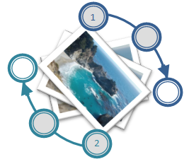
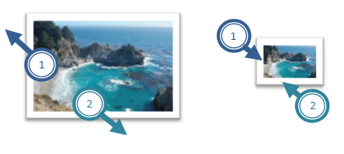
Zoom and Rotate
Rotate
Touch the image with two fingers and turn fingers in a circle
Zoom
Touch the image with two fingers and move them closer or further apart

Slide 19
Two Finger Tap and Finger Roll
Two Finger Tap
Tap once with both fingers
Finger Roll
Place one finger on the screen, place second finger on the screen, lift the second finger, and then lift the first finger

Slide 20
WM_GESTURE Message
GESTUREINFO gi;
gi.cbSize = sizeof(GESTUREINFO);
gi.dwFlags = 0; gi.ptsLocation.x = 0; …
GetGestureInfo((HGESTUREINFO)lParam, &gi);
// now interpret the gesture
switch (gi.dwID){
case GID_ZOOM:
// Code for zooming goes here
break;
case GID_PAN:
// Code for panning goes here
break;
case GID_ROTATE: …
}
CloseGestureInfoHandle((HGESTUREINFO)lParam);

Slide 21
GESTUREINFO Structure
typedefstruct _GESTUREINFO
{
UINT cbSize;
DWORD dwFlags; //GF_* (BEGIN, INERTIA, END)
DWORD dwID; //GID_* (BEGIN, END, ZOOM, PAN,
//ROTATE, TWOFINGERTAP, ROLLOVER)
HWND hwndTarget;
POINTS ptsLocation;
DWORD dwInstanceID;
DWORD dwSequenceID;
ULONGLONG ullArguments; //8 Bytes Gesture Arg
UINT cbExtraArgs;
} GESTUREINFO, *PGESTUREINFO;

Slide 22
Decoding Gesture
(dwFlags & GF_BEGIN) != 0
Indicates that this is a new gesture
If dwFlags is 0 (or GF_INERTIA)
For Pan:
We have to calculate the translation delta since last message
For Rotate:
We have to calculate the angle delta since last message
For Zoom:
We have to calculate the zoom factor delta since last message

Slide 23
Multi-Touch in .NET Framework
For WPF
Interop sample library for .NET Framework 3.5
Multi-touch, gesture, Inertia, Manipulation
.NET Framework 4.0 release
Multi-touch specific new controls
For WinForms (Windows 7 launch)
Interoperability to native Win32 APIs – TouchWrapper

Slide 24
The Windows Integration Library
Windows7.Multitouch.Handler
A base class for Touch and Gesture handlers
Use Factory to create one of the handlers
For WinForm, managed Win32 hWnd, and WPF gesture support the handler subclass the Window (hWnd)
For WPF touch support, use stylus event with the help of the Factory.EnableStylusEvents() method

Slide 25
Using the GestureHandler
public MainForm()
{
InitializeComponent();
…
_gestureHandler = TouchBridge.Handler.
CreateHandler<TouchBridge.GestureHandler>(this);
_gestureHandler.Pan += ProcessPan;
_gestureHandler.PanBegin += ProcessPan;
_gestureHandler.PanEnd += ProcessPan;
_gestureHandler.Rotate += ProcessRotate;
_gestureHandler.RollOver += ProcessRollOver;
_gestureHandler.TwoFingerTap += ProcessTwoFingerTap;
_gestureHandler.Zoom += ProcessZoom;
}

Slide 26
MTGesture
Demo
Windows7.Multitouch.GestureHandler

Slide 27
WM_TOUCH
Semantically similar to mouse messages
Conveys raw touch data to Win32 apps
Scenario examples
Finger painting
custom gestures
feeding higher level controls

Slide 28
Handling WM_TOUCH
UINT cInputs = LOWORD(wParam);
PTOUCHINPUT pInputs = new TOUCHINPUT[cInputs];
if (pInputs != NULL)
{
if (GetTouchInputInfo((HTOUCHINPUT)lParam, cInputs, pInputs,
sizeof(TOUCHINPUT)))
{
// process pInputs
}
else { … } // error handling
}
else { … } // error handling, presumably out of memory
if (!CloseTouchInputHandle((HTOUCHINPUT)lParam))
{
// error handling
}

Slide 29
Using the TouchHandler
public MainForm()
{
InitializeComponent();
_touchHandler =
Factory.CreateHandler<TouchHandler>(this);
_touchHandler.TouchDown += OnTouchDownHandler;
_touchHandler.TouchMove += OnTouchMoveHandler;
_touchHandler.TouchUp += OnTouchUpHandler;
Paint += new PaintEventHandler(this.OnPaintHandler);
}

Slide 30
MTScratchPad
Demo
TouchBridge.TouchHandler

Slide 31
Manipulations
Manipulations are a great foundation for touch-optimized experiences. They are
2D affine transformations (translate, scale, rotate)
Superset of supported gestures
Supports multiple concurrent manipulations
Need a source of raw data: WM_TOUCH
Similar to Surface APIs
Interfaces
IManipulationProcessor
IManipulationEvents

Slide 32
Inertia
Provides basic physics
Works hand in hand with manipulations
Interfaces
IInertiaProcessor
IManipulationEvents – Same event interface as manipulations

Slide 33
Windows7 Integration Library Manipulation
A .NET wrapper
You need to forward touch events
You get back manipulation events
Be ready to process translation, rotation and expansion all together
If there are many objects on the screen
Find a good heuristic to decide which object to move

Slide 34
Using Manipulation
public MainForm()
{
InitializeComponent();
_touchHandler = Factory.CreateHandler<TouchHandler>(this);
_processor = new
ManipulationProcessor(ProcessorManipulations.ALL);
_objectList = new List<DrawingObject> { … };
_touchHandler.TouchDown += (s,e ) =>
{ _processor.ProcessDown((uint)e.Id, e.Location); };
_touchHandler.TouchUp += (s, e) =>
{ _processor.ProcessUp((uint)e.Id, e.Location); };
_touchHandler.TouchMove += (s, e) =>
{ _processor.ProcessMove((uint)e.Id, e.Location); };
_processor.ManipulationDelta += ProcessManipulationDelta;
_processor.PivotRadius = 2;
}

Slide 35
Using Manipulation
private void ProcessManipulationDelta(object sender,
ManipulationDeltaEventArgs e)
{
DrawingObjectobj = FindObject(Point.Round(e.Location));
if (obj == null) return;
obj.Move(e.TranslationDelta.ToSize());
obj.Rotate(e.RotationDelta, Point.Round(e.Location));
obj.Zoom(e.ScaleDelta, Point.Round(e.Location));
Invalidate();
}

Slide 36
Manipulation
Demo
mtManipulation

Slide 37
Windows7 Integration Library Inertia
The integration library offers a Manipulation Processor with Inertia capabilities
It is derived from the ManipulationProcessor
It has the InertiaProcessor property that returns the inner inertia processor
You should find good values as an input to the inertia processor
Initial Translation, Rotation and Expansion Velocities
Deceleration velocity for each of them

Slide 38
Inertia
Demo
mtInertia

Slide 39
Multi-Touch in WPF
UIElement and UIElement3D changes
Gesture events (tracking)
Touch system gesture events (single)
Raw touch events
Multi-touch support in controls
ScrollViewer update to accept pan gestures
Base controls updated to be multi-touch aware
Multi-capture support
New multi-touch specific controls
Compatible with Surface SDK 2.0

Slide 40
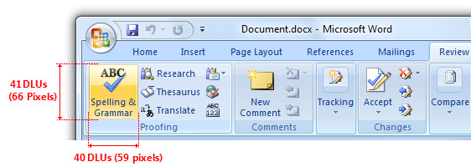
User Experience Considerations
General guidelines
Big targets
Whitespace
Avoid hover
See UX guidelines
Be aware of hardware
Form factor
Avoid on-hover UI
Edges, jitter, etc.
Gesture guidelines
Use common gestures
Gestures need to be intuitive and natural
Moving away from shortcut style gestures to manipulations

Slide 41
Call To Action
Decide which application scenarios make sense for touch
Decide which tier of investment is appropriate
Check your current applications
Add
Gesture
Or manipulation
Or inertia
Build something amazing!

Slide 42
© 2009 Microsoft Corporation. All rights reserved. Microsoft, Windows, Windows Vista and other product names are or may be registered trademarks and/or trademarks in the U.S. and/or other countries.
The information herein is for informational purposes only and represents the current view of Microsoft Corporation as of the date of this presentation. Because Microsoft must respond to changing market conditions, it should not be interpreted to be a commitment on the part of Microsoft, and Microsoft cannot guarantee the accuracy of any information provided after the date of this presentation. MICROSOFT MAKES NO WARRANTIES, EXPRESS, IMPLIED OR STATUTORY, AS TO THE INFORMATION IN THIS PRESENTATION.

