Slide 1
Windows 7 Training

Slide 2
Windows® 7 Compatibility
High DPI Applications
DPI Awareness of Windows 7 Applications

Slide 3

High DPI Displays Are Common
Automatic Configurations of High DPI Settings
Description | Horizontal | Vertical | Width (in) | Panel DPI | OS DPI | Scale level
17" WXGA+ | 1440 | 900 | 17 | 100 | 96 | 100%
15.4" WXGA+ | 1440 | 900 | 15.4 | 110 | 96 | 100%
15.4" WXGA | 1280 | 768 | 15.4 | 97 | 96 | 100%
14.1" WXGA | 1280 | 768 | 14.1 | 106 | 96 | 100%
13.3" WXGA | 1280 | 768 | 13.3 | 112 | 96 | 100%
17" WUXGA | 1920 | 1200 | 17 | 133 | 120 | 125%
17" WSXGA+ | 1680 | 1050 | 17 | 117 | 120 | 125%
15.4" WSXGA+ | 1680 | 1050 | 15.4 | 129 | 120 | 125%
14.1" WXGA+ | 1440 | 900 | 14.1 | 120 | 96* | 125%
13.3" WXGA+ | 1440 | 900 | 13.3 | 127 | 96* | 125%
12.1" WXGA | 1280 | 768 | 12.1 | 123 | 96* | 125%
15.4" WUXGA | 1920 | 1200 | 15.4 | 147 | 144 | 150%
The “Scale level” column represents the default configuration based on the Max. Horizontal Image Size and Max. Vertical Image Size parameters from the EDID. Note that this requires that the EDID contains valid data for (See VESA EDID Spec for more details)
*Note: We never configure DPI producing an effective resolution of < 1024x768

Slide 4
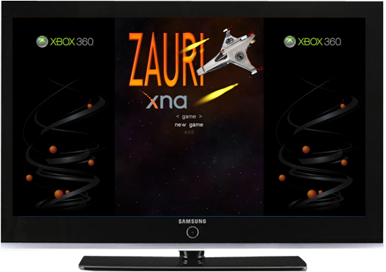

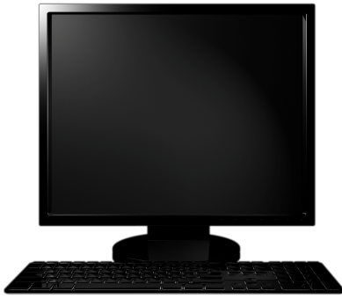
Why Do We Care?
Non-native resolution negates the value of high-fidelity displays
Text looks blurry because ClearType requires native resolution
Can’t display native high-definition content
  720p high-definition video requires 1280x720 resolution
  1080p requires 1920x1080
  1.9 megapixel photos require 1600x1200 native
Many people accidentally select a non-native aspect ratio
Pixilated content does not take advantage of the display
Non-native aspect ratio settings “squish” content

Slide 5
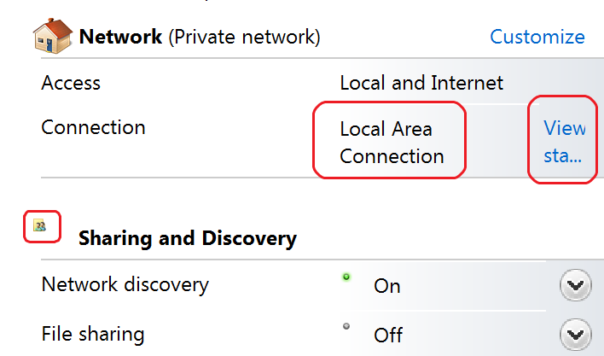
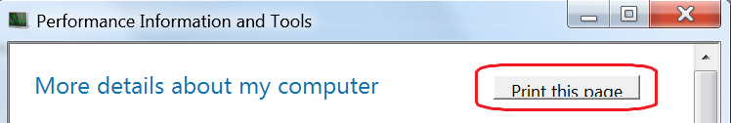
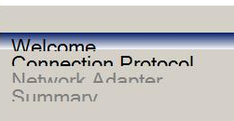
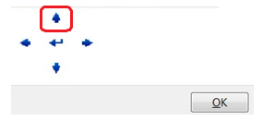
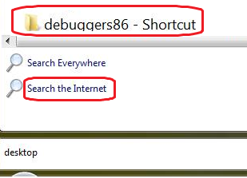
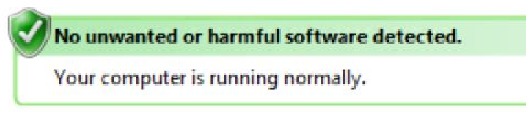
The Problems
Clipped text
Layout issues and image size issues
WinForms issues
Pixilated bitmaps
Blurry UI
Mismatched font sizes

Slide 6
Automatic Scaling Is a Stopgap,
Not a Solution
Automatic scaling introduces blurriness in the
application window
Some cross-application input operations fail due to
mis-matched coordinate spaces
Some APIs are not virtualized and result in visual artifacts
Only applies to applications which are not declared as High DPI Aware
By default, only enabled for DPI settings of >= 144
Automatic scaling is an application compatibility feature to ease the transition while the ISV ecosystem catches up to the hardware display capabilities

Slide 7
Solution
Native Win32 applications
  Be DPI Aware – include DPI Aware manifest
  Scale all UI text, points and sizes using the DPI values returned by the GetDeviceCaps API
.Net WinForm applications
  Mind the “AutoScaleMode” form property – Use “Font” or “DPI” values
Always test your application on high DPI settings

Slide 8
DPI Aware Manifest
<application xmlns="urn:schemas-microsoft-com:asm.v3">
<windowsSettings>
<dpiAware xmlns="http://schemas.microsoft.com/SMI/2005/WindowsSettings">true</dpiAware>
</windowsSettings>
</application>
<!-- See http://msdn2.microsoft.com/en-us/library/ms633543.aspx -->

Slide 9
Use DPI Values From GetDeviceCaps API
// Get the DPI values
HDC hdc = GetDC(NULL);
intdpiX = GetDeviceCaps(hdc, LOGPIXELSX);
intdpiY = GetDeviceCaps(hdc, LOGPIXELSY);
ReleaseDC(NULL, hdc);
…
// Scale using the DPI values
SIZE buttonSize = {60, 26};
buttonSize.cx = buttonSize.cx * dpiX / 96;
buttonSize.cy = buttonSize.cy * dpiY / 96;
CreateWindow(“Button”,…, buttonSize.cx, buttonSize.cy,…);

Slide 10
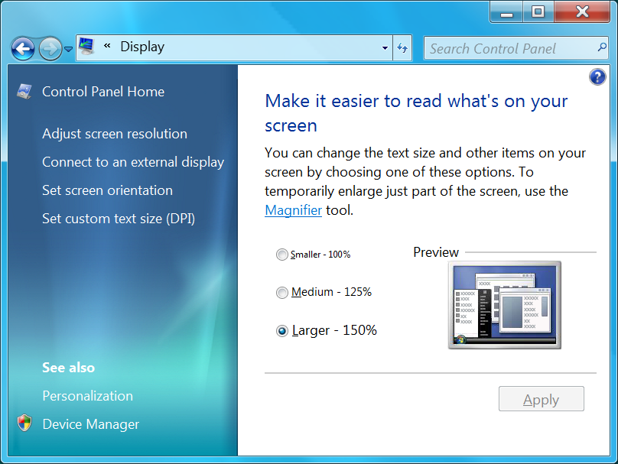

Configure DPI via Display Control Panel
Windows 7 uses scaling percentage instead of a raw DPI value
  This is because most
  users don’t
  understand DPI
  100% = 96
  DPI, 125% = 120 DPI,
  150% = 144 DPI

Slide 11

DPI Settings Change System Metrics
System Metric | 96 DPI | 120 DPI | 144 DPI
GetDeviceCaps(hDC, LOGPIXELSX) | 96 | 120 | 144
DEFAULT_GUI_FONT height | 13 | 16 | 20
SM_CXHTHUMB (scroll bar control) | 17 | 21 | 26
SM_XICON (icon width) | 32 | 40 | 48
Font and Text
When the DPI increases, the UI uses more pixels to draw icons, UI controls (such as scrollbars), and text

Slide 12



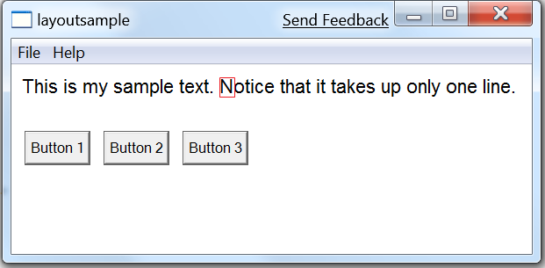
System Text Size Increases With DPI
This is the letter “N” blown at 1300% using a magnifier
Notice the number of pixels used increases with DPI
Also notice the sub-pixel coloration from ClearType, which is why native resolution is important
96 DPI
(11 pixels)
120 DPI
(13 pixels)
144 DPI
(16 pixels)

Slide 13
Summary
High DPI displays are common
  Defaults are set to higher DPI settings
Unawareness to high DPI causes major UI issues
  Can even effect proper application functionality
Be DPI aware
  Declare awareness and scale your UI properly in native Win32 applications
  Mind the form’s “AutoScaleMode” property in .NetWinForm applications
  Test your applications with High DPI settings

Slide 14
Additional Resources
White paper: Writing High-DPI Win32 Applications:
  http://msdn.microsoft.com/en-us/library/dd464646(VS.85).aspx
Ensuring your application displays properly on High-DPI Displays:
  http://msdn.microsoft.com/en-us/library/dd756693(VS.85).aspx
Windows 7 Engineering Blog High DPI Post:
  http://blogs.msdn.com/e7/archive/2008/09/13/follow-up-on-high-dpi-resolution.aspx
  http://blogs.msdn.com/e7/archive/2008/09/16/more-follow-up-to-discussion-about-high-dpi.aspx

Slide 15

© 2009 Microsoft Corporation. All rights reserved. Microsoft, Windows, Windows Vista and other product names are or may be registered trademarks and/or trademarks in the U.S. and/or other countries.
The information herein is for informational purposes only and represents the current view of Microsoft Corporation as of the date of this presentation. Because Microsoft must respond to changing market conditions, it should not be interpreted to be a commitment on the part of Microsoft, and Microsoft cannot guarantee the accuracy of any information provided after the date of this presentation.
MICROSOFT MAKES NO WARRANTIES, EXPRESS, IMPLIED OR STATUTORY, AS TO THE INFORMATION IN THIS PRESENTATION.

