Slide 1
Windows 7 Training

Slide 2
Background Services and Tasks
Microsoft® Corporation

Slide 3
Agenda
Impact of background activities
Services vs. tasks
Service startup types
Service performance and security goals
Task triggers
Lab: Configuring a Trigger Start Service

Slide 4
Impact of Background Activities Many activities in the background
Performance
Responsiveness
Consumes resources
Boot, shutdown, logoff, and so on
Reliability
Memory leaks
System crashes and hangs
Dependent application crashes
Security
Greater attack surface
System privileges
Successful attack may compromise entire system
Power consumption
Extra disk, CPU utilization
Decrease in battery life
Prevents idle efficiencies

Slide 5
Windows Background Services Services vs. tasks
Continuously run
Typically no user session (Windows Vista®: Session 0)
Can specify dependency
Run by the Service Control Manager (Services.exe)
Short duration activity
Take action on user logon
Standalone executable
Run by the Task Scheduler (taskeng.exe)
Windows Service
Scheduled Task

Slide 6
Service Design Goals
Immediate startup (<500 ms)
Immediate shutdown (<200 ms)
Overall – less than 2% CPU activity when idle
No blocking calls in the service’s main thread
Security
Run with least privileges
Run in a low-rights service account

Slide 7
Services When?
OEMs and third parties are responsible for (way) too many services
Most services are not required during log-on
Even more services are not required during boot
Conclusion: Most services can be launched on demand when needed

Slide 8
Service Startup Types Before Windows Vista
Automatic Start
Your service is always there
Launched as part of the boot sequence
Startup time
Footprint
Demand Start (manual)
You must programmatically launch the service
Problems?
Automatic Start adds latency to boot and shutdown, always consumes resources …
Demand Start is hard to program against

Slide 9
Automatic (Delayed Start) Services Introduced in Windows Vista
Sure, they are Automatic Start, but …
The system waits before starting them
Approximately two minutes
Runs their ServiceMain at lowest priority
Results
Improves boot or logon latency
Very appropriate for non-critical services such as Windows Update

Slide 10
Automatic (Delayed Start) API
SERVICE_DELAYED_AUTO_START_INFO
delayedAutoStartInfo = {0};
delayedAutoStartInfo.fDelayedAutostart =
TRUE;
ChangeServiceConfig2(
hService,
SERVICE_CONFIG_DELAYED_AUTO_START_INFO,
&delayedAutoStartInfo
);

Slide 11
Trigger Start Services Introduced in Windows 7
The service should be running only if it has something to do
Network-related service without connectivity
USB-related service without USB devices
File transfer service with firewall port closed
Trigger Start services are started when needed
Responsible for stopping when idle or done

Slide 12
Trigger Start Services Introduced in Windows 7
Available service triggers:
Device interface arrival
Joining or leaving a domain
Opening or closing a firewall port
Group policy change
First IP address arrival
Custom event – Event Tracing for Windows (ETW)

Slide 13
Unified Background Processes Manager (UBPM)
Public API
SCM
(services.exe)
Task Scheduler
(Schedsvc.dll)
Unified Background
Process Manager (UBPM)
(Services.exe)
Services…
Tasks…

Slide 14
Trigger Start API
SERVICE_TRIGGER trigger = {0};
trigger.dwTriggerType =
SERVICE_TRIGGER_TYPE_IP_ADDRESS_AVAILABILITY;
trigger.dwAction =
SERVICE_TRIGGER_ACTION_SERVICE_START;
trigger.pTriggerSubtype =
(GUID*)&NETWORK_MANAGER_FIRST_IP_ADDRESS_ARRIVAL_GUID;
SERVICE_TRIGGER_INFO info = {0};
info.cTriggers = 1;
info.pTriggers = &trigger;
ChangeServiceConfig2 (hService,
SERVICE_CONFIG_TRIGGER_INFO, &info);

Slide 15
Windows Vista Bridge Sample
Managed class library to ease .NET Framework access to Windows Vista® features
UAC, power management, restart and recovery, network awareness, Aero® Glass and more
It is a sample library not a full product
Open source with no support
Use at your own risk

Slide 16
The Windows Bridge Intermediate Solution
Enables access to Windows 7 Service Control Manager API from managed code
Contains the ServiceControl class that wraps the Windows SCM API
Functions to register, configure, run services
Stops, activates, and deactivates services
It is a sample library not a full product
Open source with no support
Use at your own risk

Slide 17
Trigger Start Services
demo
Converting a service to Trigger Start

Slide 18
Service Security Hardening
Performance is not everything
Services are primary attack surfaces
Mitigation
Run as low-right accounts (LocalService, NetworkService)
Declare required privileges
Use service-specific SIDs for object access

Slide 19
Requested Privileges API
SERVICE_REQUIRED_PRIVILEGES_INFO
requiredPrivileges = {0};
requiredPrivileges.pmszRequiredPrivileges =
SE_CHANGE_NOTIFY_NAME L"\0";
ChangeServiceConfig2(
hService,
SERVICE_CONFIG_REQUIRED_PRIVILEGES_INFO,
&requiredPrivileges);

Slide 20
Hardened Service
demo
…how it can really do less harm

Slide 21
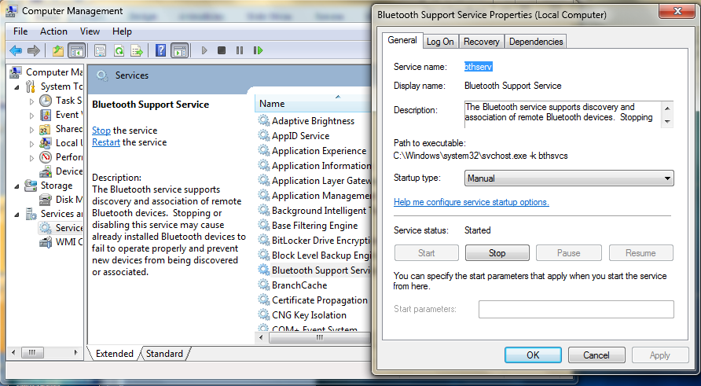
Services Configuration UI

Slide 22
Scheduled Tasks
Tasks have always been launched by triggers
Windows Vista extends the variety of task triggers and conditions
Task
Actions – what it does
Triggers – what triggers it
Conditions – what must hold

Slide 23
Task Triggers And Conditions
Which user to use for launching the task?
What triggers the task?
Schedule (calendar), delay, repeat, or auto-expire
At log on, start up, lock, or unlock
On an event log entry
Start only if
Computer is idle, on AC power, or connected to a specific network connection
Do what?
Run a program, send e-mail, show a message

Slide 24
Creating Tasks API Partial sample
ITaskServicescheduler =
new TaskSchedulerClass();
scheduler.Connect(null, null, null, null);
ITaskFolderrootFolder =
scheduler.GetFolder("\\");
ITaskDefinition task = scheduler.NewTask(0);
IExecAction action = (IExecAction)
task.Actions.Create(
_TASK_ACTION_TYPE.TASK_ACTION_EXEC);

Slide 25
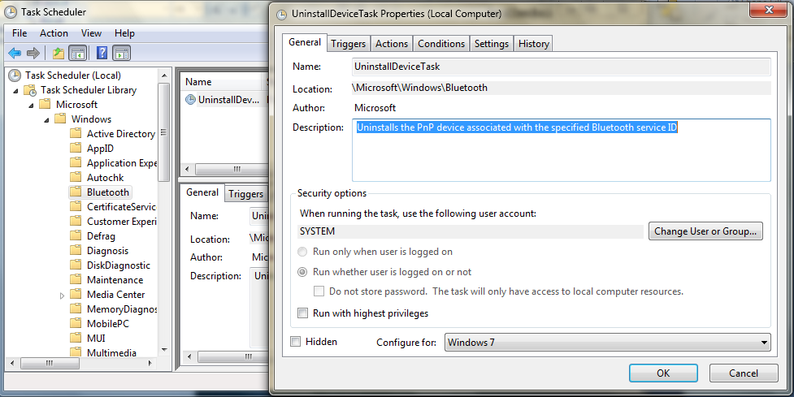
Task Scheduler UI

Slide 26
Scheduled Task
demo
…greet the user when he comes back

Slide 27
UBPM Unified Background Process Manager
Public API
SCM
(services.exe)
Task Scheduler
(Schedsvc.dll)
Unified Background
Process Manager (UBPM)
(Services.exe)
ETW Driven
Services…
Tasks…

Slide 28
Summary
Embrace service design goals: performance, security, power consumption
Does your service have to run all the time?
Retire “old” Windows XP-style services and consider: Automatic (Delayed Start) services, Trigger Start services, scheduled tasks
Give your background activity the minimum security privileges
Strive to minimize background work on idle

Slide 29
© 2009 Microsoft Corporation. All rights reserved. Microsoft, Windows, Windows Vista and other product names are or may be registered trademarks and/or trademarks in the U.S. and/or other countries.
The information herein is for informational purposes only and represents the current view of Microsoft Corporation as of the date of this presentation. Because Microsoft must respond to changing market conditions, it should not be interpreted to be a commitment on the part of Microsoft, and Microsoft cannot guarantee the accuracy of any information provided after the date of this presentation. MICROSOFT MAKES NO WARRANTIES, EXPRESS, IMPLIED OR STATUTORY, AS TO THE INFORMATION IN THIS PRESENTATION.

