Slide 1
Optimizing IT Operations
Lessons From the Field
A practical guide for maturing your IT Infrastructure
Presenter’s name
IT Architecture & Planning
Microsoft Consulting Services

Slide 2




What is Optimized IT?
Basic
Uncoordinated, manual
infrastructure
Standardized
Centrally Managed IT Infrastructure with some automation
Optimized
Managed and consolidated IT Infrastructure
Dynamic
Fully automated IT management dynamic resource usage and business linked SLA's
Objective
React
Manage
Reduce complexity
Agility
Ability to
Change
Slow weeks/ months
Weeks
Days
Minutes
Resource
Utilization
Unknown
Known, poor
Optimized
High, As needed
Processes
& Automation
Ad hoc
Defined
Mature
Policy-based
Business
Alignment
No SLAs
Arbitrary SLAs
Class of Service SLAs
Business SLAs
Role of
IT
Cost Center
Efficient
Cost Center
Business Enabler
Strategic Asset

Slide 3
Agenda
The benefits of Optimized IT revisited
Approaching the Journey
  Where are you currently?
  Where do you want to go?
  How will you get there
Tools, Methods and Frameworks
Q & A

Slide 4
Microsoft Services
Maximize business value
Focused on complex implementations
Early in the Microsoft technology release cycle
Risk mitigation
Local presence with global scale
Partner ecosystem
Architecture & Planning
Enterprise Support
Technology Consulting

Slide 5
The outcome is worth it
Rationalize your infrastructure
Realize value from your IT Investments
Free up resources for innovation
Minimize redundancy
Integrate and Standardize
Align IT with business priorities

Slide 6
How do you plan for IT?
Who shouts loudest?
Boss’s prerogative?
It got passed over last time?
Everyone else has one!
Compliance and regulation?
Failed implementation replacements?
Whoever pays or has budget?

Slide 7

There’s a better way….

Slide 8
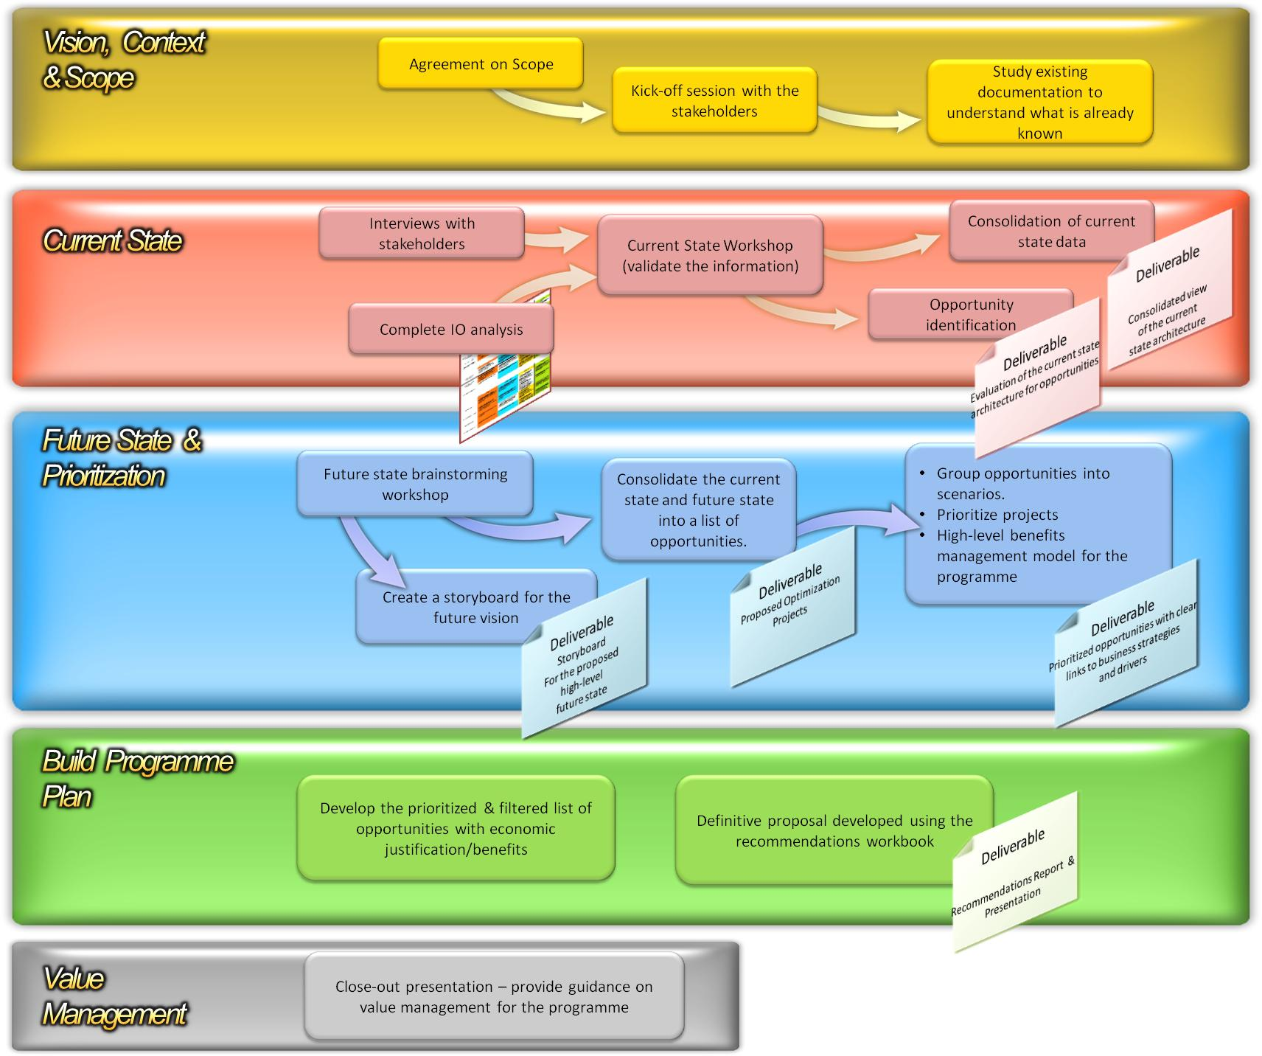
Services Approach

Slide 9
Set your Vision and Scope
Define your vision and scope
Use IO Capabilities as the foundation
Define your priorities
Communicate aggressively
Get buy in
Underpin all IT capabilities with business capabilities/initiatives
Define Vision/Scope

Slide 10

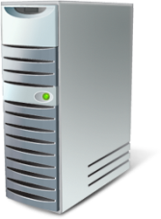
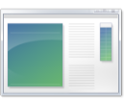









Focus on the Capabilities
Application Platform Optimization Model
User Experience
Business Intelligence
SOA and Business Process
Application Platform
BASIC
STANDARDIZED
ADVANCED
DYNAMIC
Data Management
Development
Business Productivity Infrastructure Optimization Model
Unified Communications
IT and Security Process
Collaboration
Enterprise Content Management
Business Productivity
BASIC
STANDARDIZED
RATIONALIZED
DYNAMIC
Enterprise Search
Business Intelligence
Core Infrastructure Optimization Model
Identity and Access Management
Desktop, Device, and Server Mgmt
BASIC
STANDARDIZED
RATIONALIZED
DYNAMIC
Core Infrastructure
Security and Networking
Data Protection and Recovery

Slide 11
Assess your Current State
Use a maturity model to help assess your technology services and capabilities
+
Include the broader strategic and operational issues in the IT organization and the wider business context
Define Vision/Scope
Current State Assessment

Slide 12
Define your Future State
Leverage the IO Model
Focus beyond technology to deliver services to the business.
Look to industry models for IT Process maturity
Define clear criteria for prioritizing opportunities
Identify high-level cost, benefit, risk, and other criteria for each opportunity
Define Vision/Scope
Current State Assessment
Define a Future State

Slide 13
Business Benefits Primer
Define the investment objectives
Identify benefits, measures and owners
Structure the benefits (New, Better, Stop)
Determine the value of the benefits
Identify costs and risks
Degree of
Explicitness
Do New
Things
Do Things
Better
Stop Doing
Things
Financial
Can you convert it to money?
Quantifiable
Have you got the figures available now?
Measurable
Can you measure it?
Observable
Can you observe it?
© Cranfield Management University

Slide 14
Build the plan
Gradual approach to maturity and categorize the change
Portfolio management approach for effective selection, investment priority and risk
Clear objectives
Define Vision/Scope
Current State Assessment
Define a Future State
Build the plan

Slide 15
Measure progress
Measure value realized from initiatives
Track maturity improvements through regular assessments
Use clear measures to define the impact of maturity improvements. For example:
  Reliability & Rationalization
  Agility
Define Vision/Scope
Current State Assessment
Define a Future State
Measure Progress
Build the plan

Slide 16
Thoughts on execution
Execute, timing will never be perfect
Dare to do the challenging and complex initiatives
Don’t just focus on the tactical
Be specific about what success looks like
Beware of multi-year projects

Slide 17
Tools available on ms.com
www.
microsoft.com
Optimization Self Assessment Tool
Rapid Economic Justification
Microsoft Operations Framework
Solution Accelerators
Microsoft Solutions Framework

Slide 18
Optimization Self Assessment Tool
Where does my organization rank on the Optimization model?
How do we compare to the competition?
What roadmap should we follow?
What is the quantifiable value of improving?
Download and templates at http://technet.microsoft.com/en-us/infrastructure/bb736011.aspx

Slide 19
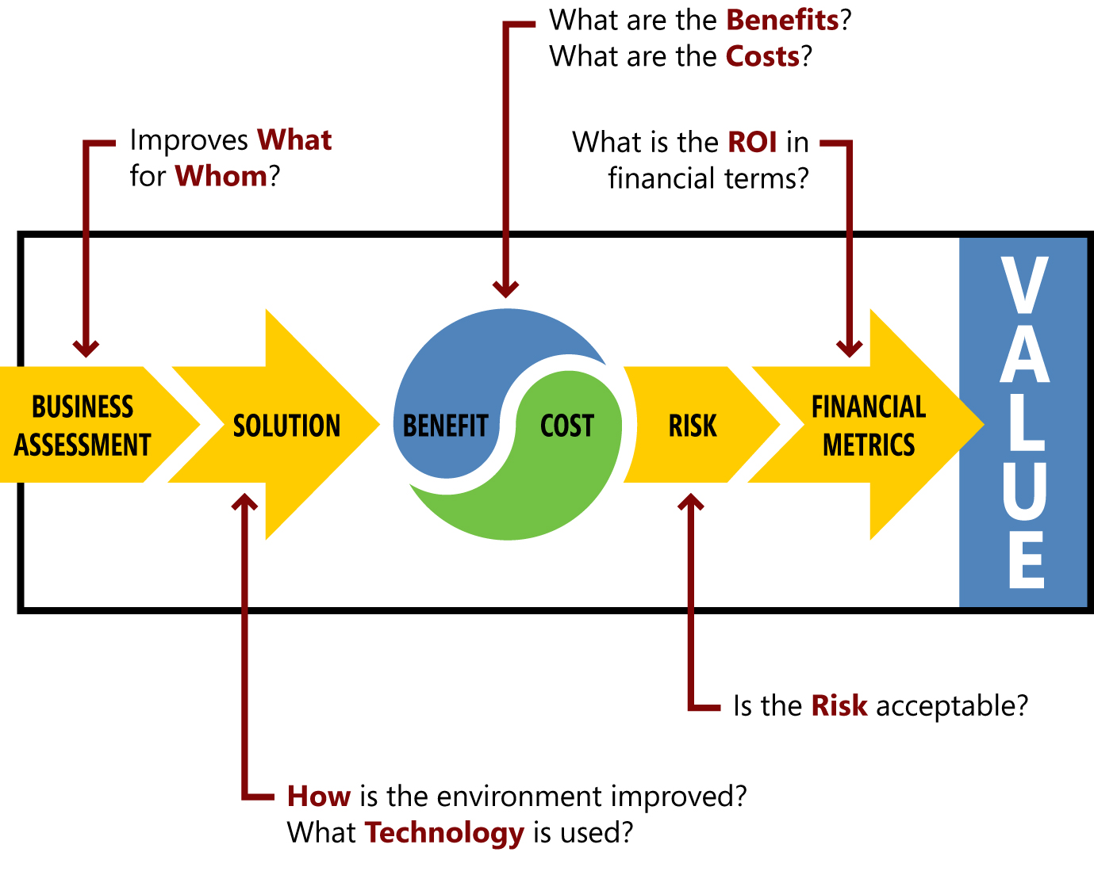
Rapid Economic Justification (REJ)
Download and templates at http://www.microsoft.com/business/enterprise/value.mspx

Slide 20
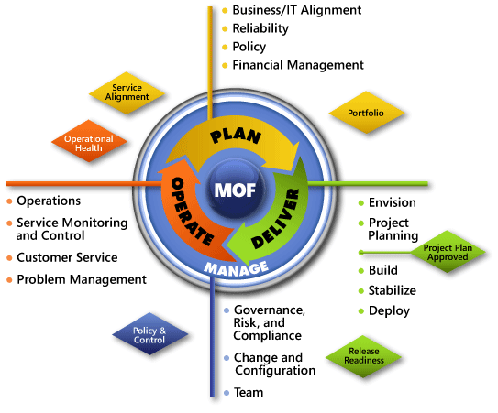
Microsoft Operations Framework (MOF)
Download & templates at http://technet.microsoft.com/en-us/library/cc506049.aspx

Slide 21
Microsoft Solutions Framework (MSF)
Deploy
Envision
Stabilize
Build
Plan
Download & Templates at http://www.microsoft.com/technet/solutionaccelerators/msf/default.mspx

Slide 22
Solution Accelerators
Detailed guides to take the guesswork out of technology deployments.
Tested and proven automation tools and guides
Architectures with baked-in security and manageability
Cover IO capabilities for Core Infrastructure, Business Productivity and Application platform
http://www.microsoft.com/solutionaccelerators

Slide 23
Lessons From The Field
INDUSTRY: Retail
Customer Situation
  IT in reactive mode to deploy capabilities for the business
  IT struggling with prioritization
  Seeking increased value from technology investments
Approach Taken
  Review of key concepts of the IO Model and set scope
  Current state assessment of capabilities
  Roadmap created to improve maturity level in several areas
  Prioritization of initiatives based on expected benefit
Result
  Additional business value from existing technology investments
  IO as a tool to assist with project prioritization
  IT Capabilities become building blocks for business capabilities

Slide 24
Lessons From The Field
INDUSTRY: Telecom
Customer Situation
  Driving to increase service levels while lowering cost
  Scope: Desktop end Management environment
Approach Taken
  Understand current state
  Lower cost by simplification and enterprise desktop architecture
Result
  ROI for consolidation of Management tools
  TCO benchmarking
  Program plan aligned to improve service and lower costs

Slide 25
Lessons From The Field
INDUSTRY: Professional Services
Customer Situation
  High operational cost related to desktop deployment
  High TCO due to undefined methodologies
  Scope: Desktop deployment
Approach Taken
  Understand desktop deployment methodologies
  Leverage current infrastructure – consolidate technologies
  Skills and Roles assessment(mapping) – resource reassignment
  Lower cost by automating desktop deployment process
Result
  Reduce TCO by half (3 times faster to deploy – no onsite visit)
  High ROI due to deployment technologies consolidation
  Increase agility by controlling the Desktop lifecycle
  Increase user productivity

Slide 26
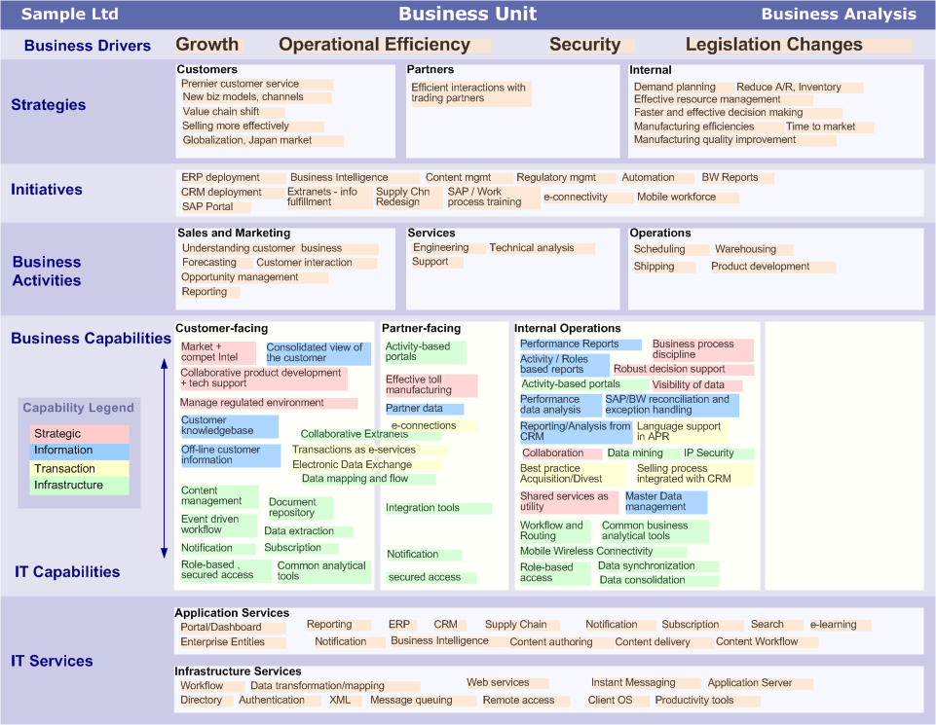
One Alignment Perspective

Slide 27
IT as a portfolio of assets Example
Services Domains
Services Clusters
Notes:
Services Domains

Slide 28
In Summary
To get to your vision of optimized IT
  Define your objectives
  Assess where you are today relative to those objectives
  Clearly articulate where you want to be
  Develop the roadmap for gradual execution based on a set of priority parameters (ideally aligned with your business priorities)
  Execute and Measure often
  Adjust accordingly, change is constant

Slide 29
References
IO Self Assessment
http://technet.microsoft.com/en-us/infrastructure/bb736011.aspx
Rapid Economic Justification
http://www.microsoft.com/business/enterprise/value.mspx
Microsoft Operations Framework
http://technet.microsoft.com/en-us/library/cc506049.aspx
Microsoft Solutions Framework
http://www.microsoft.com/technet/solutionaccelerators/msf/default.mspx
Microsoft Solutions Accelerators
http://www.microsoft.com/solutionaccelerators
Microsoft Services
http://www.microsoft.com/services

Slide 30
Questions?
How can we help?
Look for Microsoft Services datasheets on your USB Key and in the Services Catalogue found in your kit.

