Slide 1
Windows Live Services
ADVERTISING

Slide 2






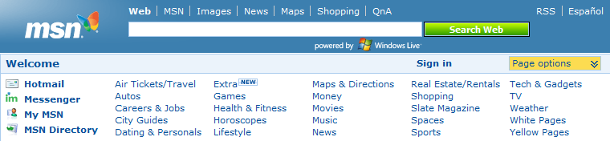
What is Windows Live?
Windows Live is a set of Web and client software services from Microsoft
These services replace some existing software services historically offered under the MSN brand including Hotmail, Messenger, Spaces and Search
MSN continues as a programmed content portal–all software services will be Windows Live
MICROSOFT CONFIDENTIAL
Notes:
2
2
For years Microsoft has had many offerings in the online software services space: MSN, Hotmail, Messenger and the like. Windows Live now encompasses all that and more, including things like Soapbox (video sharing) and all sorts of new and exciting offerings. And of course, Search is a cornerstone of the service, with vastly improved Search capabilities and new offerings like local.live.com.

Slide 3


Windows Live in Slovakia
504 369 active users monthly
Spending here 3% of all time online
One of the most visited Instant Messaging Service
3th most used Mail Service
504 369
active users
351 826
active users
120 817
active users
Notes:
3

Slide 4
Who is our USER?
Gender
WOMEN
MEN
Age

Slide 5
Advertising placements
Microsoft Advertising & StarmediaCo. have joined their strengths
to bring you the opportunity to advertise on Windows Live in Slovakia.

Slide 6

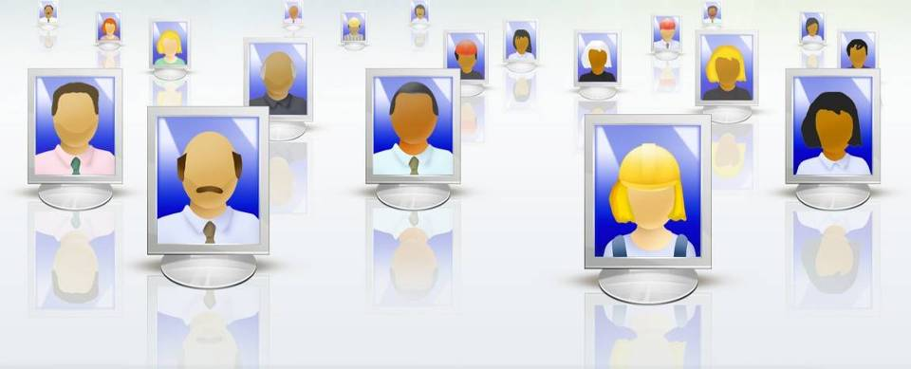







Be targeted
Targeting criteria:
Gender
Age
Used OS (Windows, MAC)
Time of the day
Placements:
WL Messenger Banner
WL Messenger Textlink
WL Hotmail Banners
Notes:
6

Slide 7
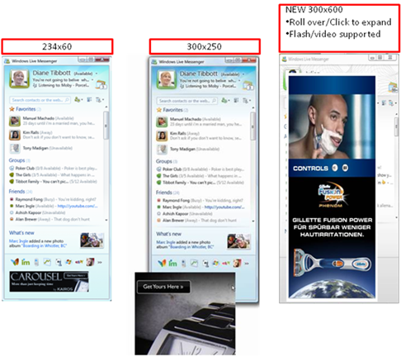
Be at the start of all conversation activity
234x60 Main Window Ad - Expandable
Starting point for all IM activity
  Great brand exposure
Highly prominent position. Located below the “What’s New” and the Tabs
Available packages: 6 weekly per 500K impressions
Notes:
- Starting point for all IM activity – great brand exposure
Highly prominent position, users see and interact with their contacts
Expand to 300X250
7

Slide 8
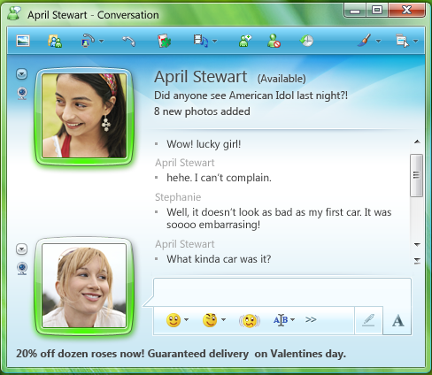


Insert your products "Call to Action" right into the conversation window
Conversation Window Text Link
Place your brand message and URL at the bottom of the conversation window to be seen throughout every conversation
Also visible within the sharing folder section
Available packages: 4 weekly per 1M impressions
Notes:
8
Conversation Window Text Link
Place your brand message and URL at the bottom of the conversation window to be seen throughout every conversation.

Slide 9
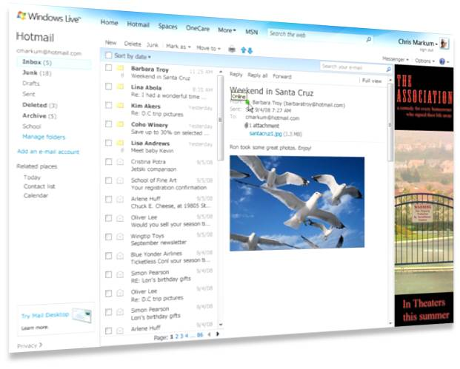
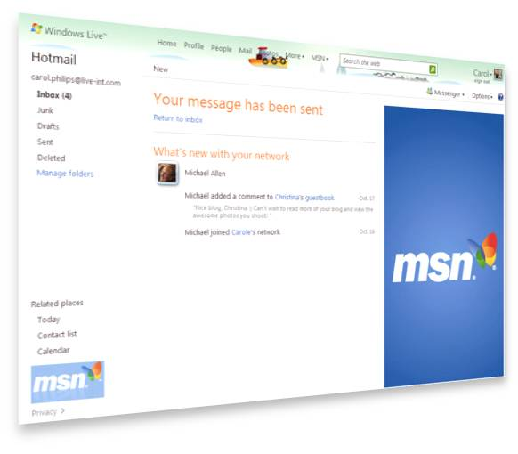

Use internal pages to start communication with exact user you choose
Hotmail 160 x 600 Skyscraper
Place your display ad on place, where users goes back many times per day
You can target your communication however you want
Available on Hotmail Inbox, Read and Folder pages
Available packages: 4 weekly per 1M impressions
Notes:
9

Slide 10

Interested? ☺
+421 2 5737 3521
windowslive@starmedia.sk
Notes:
10
10
For years Microsoft has had many offerings in the online software services space: MSN, Hotmail, Messenger and the like. Windows Live now encompasses all that and more, including things like Soapbox (video sharing) and all sorts of new and exciting offerings. And of course, Search is a cornerstone of the service, with vastly improved Search capabilities and new offerings like local.live.com.

