Slide 2
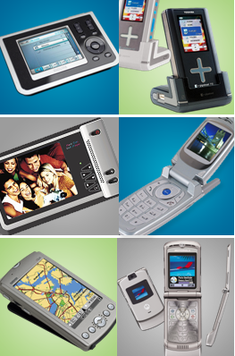
i.MX – Powerful but Low Power Consumption Application Processor i.MX －强劲,低功耗的应用处理器系列
何瑾军
华为技术有限公司
Dec. 2008
zhaojie2@huawei.com

Slide 3

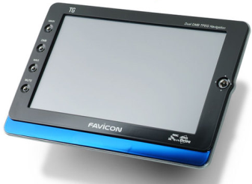
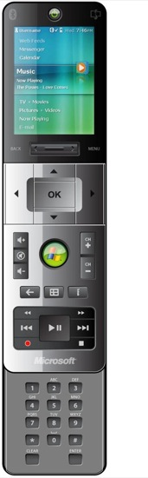
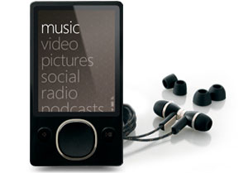
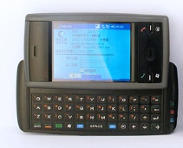
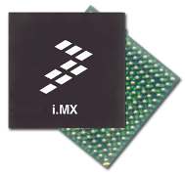

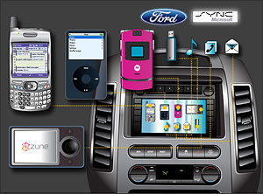

Freescale + Microsoft 嵌入系统方案
Freescale i.MX
Microsoft’s 嵌入系统软件
客户需要的产品

Slide 4

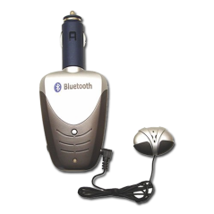

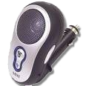







消费级解决方案与汽车级解决方案的共通平台
消费级产品
方便携带, 容易使用
多样化的音视兼容
低价格, 多变化,迎合快速产品更新换代
微功耗,小巧
汽车信息电子
影音及导航
免费或收费服务
与移动产品的互通
成熟的面向大众市场的平台
高可靠的汽车级平台
高性能芯片
  ColdFire, i.MX, Symphony™
零缺陷长寿命设计
  AEC-Q100 qual, 5-10 yr life cycle
多种OS支持
  WinCE, Windows Mobile, Windows Automotive
可升级的软件系统
  Performance headroom for new multimedia standards
  S/W drops on consumer cycles
中间件的支持
  Multimedia Codecs, Filesystems

Slide 5

i.MX 规划
& i.MX35/37 介绍

Slide 6




飞思卡尔 i.MX 规划
.net Microframework
Next Gen.
WinCE 5.0
WinCE 6.0
Cortex A-8 1Ghz
High Performance
Application Processor
720P Video
2D&3D GPU
i.MX37
Windows Mobile 6.0
ARM1176 532Mhz
High Performance
Video
Ultra-low power
i.MX31
Windows Automotive
ARM1136 532MHz
MPEG4 VGA Enc/Dec
H.264 HVGA Dec
2D/3D Graphics
HS USBOTG/host
Image/video post processing
ATM926 400MHz
90nm process
10/100 Ethernet
HS USB OTG
H.264 D1 Enc/Dec
i.MX21
i.MX31L
i.MX27
ARM926 266/350MHz
130nm process
MPEG4 CIF Enc/Dec
Color LCD Controller
16 channel DMA
USB OTG
i.MX35
MX31 包含out
2D/3D Graphics
ARM1136 400/532Mhz
Automotive SoC
MOST/CAN bus
DDR2
USB HS OTG w/t PHY
i.MX1
Starting at 150MHz
180nm process
MPEG4 Enc/Dec
Embedded Bluetooth
i.MXL
i.MXS
Starting at 150MHz
180nm process
支持 GPRS,
WCDMA, WLAN
Starting at 100MHz
USB, CSPI, UART
Low cost ARM9
180nm
2003
2004
2005
2006
2007 2008
2009

Slide 7
i.MX31(L) (C) 应用处理器
规格:
CPU: ARM1136, 532MHz
Process: 90nm
Core Voltage: 1.2-1.6V
i.MX31 特点
ARM1136 包含 128Kb L2 Cache
Integrated 3D graphics processor
  Eliminates 2 chip solution
  Eliminates separate memory subsystem
Integrated HW Image Processing Unit (IPU)
  CMOS/CCD Interface
  Resize, CSC, Deblock, Dering, Blending
Vector Floating Point Co-Processor (VFP)
Smart DMA RISC-based DMA controller
Connectivity
  WLAN, BT, GPS via external chipset
  HS USB, ATA-6, MMC/SDIO, MS-Pro, Compact Flash
  266MHz Mobile DDR, NAND/NOR, Mobile SDRAM, SRAM
Scale - shipped multi-million units
Breadth – design wins in PMP, PND, Cellular,
IP Telephony, POS terminals
量产与封装:
Shipping Now
Package types:
  457-ball, 14x14, MAPBGA, 0.5mm pitch
  473-ball, 19x19, MAPBGA, 0.8mm pitch
i.MX31
Connectivity
System Control
Internal
CPU Complex
JTAG, ETM
3 x CSPI
Bootstrap
2 x SSI/I²S
ARM1136 CPU
Smart Speed
Switch (MAX)
3 x I²C
System Reset
i-cache
d-cache
L2-cache
PLL &
Power Mgmt
Audio Mux
External
ROM
Patch
ETM
5 x UART
Multimedia &
Human Interface
USB OTG HS
VFP
2 x USB Host
Graphics
Accelerator
1-Wire
Special Functions
Std System
I/O
Fast IrDA
MPEG-4
Encoder
Security HW
Keypad
Expansion
Memory
Interface
eDMA
IPU
2 x MMC / SD
3 x Timers
Inversion and
Rotation
PCMCIA / CF
SDRAM/DDR
PWM
VSync
WD Timer
Camera I/F
2 x Memory
Stick - Pro
NANDF Ctl
RTC
Blending
SIM
PSRAM
GPIO
Display/TV Ctl
ATA
SmartMedia
RAM, ROM
Pre & Post
Processing
Not available on i.MX31L
Notes:
Need Package Size

Slide 8
i.MX27(L) 应用处理器
规格:
CPU: ARM926EJ-S, 400MHz
Process: 90nm
Core Voltage: 1.2-1.5V
i.MX27 特点
16 KB L1 I-Cache and D-Cache
16-channel DMA
Multi-standard video codecs at D1 resolution (i.MX27 only)
  Video pre- and post-processing, scaling
Security
  Crypto Accelerator
  Security controller 包含 encrypted RAM storage
  Electronically blown fuse box
  High-assurance boot
Real-time OS/SW integrity checker
Dynamic Process temperature Compensation (DPTC)
Connectivity
  Ethernet 802.3 MAC
  USB 2.0 OTG 480Mbps
  USB 2.0 Host 12Mbps, USB 2.0 Host 480Mbps
  PCMCIA/CF, Audio MUX
  MCC, SD, IrDA, 8x8 keypad, CMOS sensor interface
  ATA-6, Memory Stick (i.MX27 only)
量产与封装:
Package types
  404-ball, 17x17, MAPBGA, 0.65mm pitch
i.MX27(L)
System Control
Connectivity
JTAG/ICEM
IrDA
Bootstrap
ARM926EJ-S
CPU
Platform
MMC/SD x3
CLK
Mgt.
PCMCIA/CF
I
Cache
D
Cache
MMU
UART x6
SSI/I²S x2
Std System
Memory
Control
Bus
Control
Internal
Control
I²C x2
Timer x6
HS USB OTG
Host x2
RTC
Audio Mux
PWM
Multimedia Accelerator
1-Wire
Watch Dog
Hardware Video Codecs
MPEG4/H.263/H.264
ATA-6
GPIO
CSPI x3
DMA
Pre and Post Processing
Camera I/F
10/100 Ethernet
GPIO
Security
Ext Memory I/F
8x8 Keypad
Sahara v2
DDR/SDRAM
NAND Flash
Vsync Flash
EIM
LCD Control
RTIC
Memory Stick Pro
SCC
DDR/SDRAM
NAND Flash
Vsync Flash
EIM
RNGA
IIM
Not available on i.MX27L
Notes:
Need Package Size

Slide 9
i.MX37应用处理器
规格:
  CPU:ARM1176JZF-S, 532-600MHz
  Package:302 BGA 10x10mm .5mm pitch
  Temp Range:-20 to 70C
i.MX37 特点
  Highly integrated, low power, D1 video playback
  Ideal for large capacity flash or hard disk media players and navigation devices
  Excellent connectivity options
    HDD: ATA-6 (HDD) Interface, CE-ATA
    mDDR 16/32bit @ 166/133 MHz
    mSDRAM 16/32 bit @ 133/100MHz
    NAND SLC/MLC Flash, eSD, eMMC 包含 8-bit ECC
  Robust Multimedia:
    480i PAL/NTSC Component / Composite TV-Out
    Video: HW Decoder (D1, 30fps)
    IPUv3D – Image Processing Unit
      24-bit Display Interface and Controller
      Hardware Resizing, inversion, Rotation
      Hardware Color Space Conversion
      Video and graphics combining
量产与封装:
  Samples: Now
  Production:Q1 2009
System
Control
i.MX37
Connectivity
JTAG, ETM
CPU Complex
Mem Stick Pro
Power Mgmt
ARM1176CPU
MMC/SDIO x2
PLL x 3
16KB
i-cache
16KB
d-cache
128KB
L2-cache
UART x3
Clocks &
Reset Control
Audio Mux
MMU
AXI Switch
HS CSPI x3
System
1-Wire
Timer x3
Vector Floating
Point Unit
PWM
SSI/I²S x2
Watch Dog x2
Multimedia
GPIO
Smart DMA
H.264 BP, MP, HP
I²C x3
Memory
VC-1 SP, MP, AP
S/PDIF TX
ROM
MPEG4 SP, ASP, DivX
USB HS PHY
RAM
MPEG2 MP @ ML
CE-ATA/SDIO
Security
ATA-6
sRTC
Image Processing Unit
Keypad
Trust Zone
Resizing
Ext Mem I/F
mSDRAM
mDDR
NAND Flash
RNGC
CSC & Blending
RTIC v3
Inversion/Rotation
SCC v2
Display/TV Control
PAL/NTSC Out
HAB
Notes:
8

Slide 10
i.MX37应用处理器
功耗和性能
Single ARM1176 Core 包含 128KB L2 Cache allows for efficient operation of high level operating systems such as Linux / WinCE and complex use cases needed for mid-end PMP and MID products
Freescale proprietary C65 LPGP process enables core voltages below 1.0V for lower power consumption
多媒体
Full support of a wide range of video codecs up to D1 8Mbps on 16 or 32-bit mDDR
  H.264 BP, MP, HP
  WMV/VC-1 SP, MP, AP
  MPEG4 SP, ASP including DivX 3,4,5,6
  MPEG2 MP@ML (12Mbps)
PAL/NTSC component / composite video output
Display processor capable of supporting multiple graphics planes, overlays, rotation and scaling
Proprietary software de-interlace middleware
Real Video RMVB decoding to VGA resolution in software
Connectivity
支持最新 SD 2.1, MMC 4.3 包括 boot 功能 (rev 1.1)
封装
10x10 MAP BGA Packaging for small form factor portable devices
系统方案
Designed to operate with MC13892 (Atlas AP Lite) PMIC with customer feature support such as low power boot and full driver support included in the i.MX37 BSP
Also supported by Wolfson WM8350 integrated PMIC+Audio IC
软件/OS:
Linux 2.6.24 and WinCE 6.0 BSPs
Available OpenMAX or G-Streamer support for multimedia codecs on Linux, DShow on WinCE
Software compatibility with i.MX51 product for maximum software re-use across projects
Notes:
9

Slide 11
MX37视频回放功耗情况
Power Domain
H.264 MP 720x480 内容 WVGA LCD显示
MX37
ARM
8.5
Peripherals
105
i.MX IC
I/O
11.5
PLL
4.4
total
129.4mW
DDR I/O
49mW
MX37 H264 视频回放情形:
  ARM: 198MHz @ 0.8V
  Peripherals: 132MHz @ 1.2V
  DDR = 132MHz, 32bit
  Single PLL usage @ 396MHz
  ARM activity:
    Audio codec - 13.8MCPS
    Audio OS + Control - 5MCPS
    Video OS + Control - 10MCPS
  Video stream: MP D1
  Audio stream: MP3, 44.1KHz
  LCD display: WVGA

Slide 12
i.MX35应用处理器
规格
CPU:ARM1136JF-S, 400+MHz
Process:CMOS90LP
Core Voltage:1.22-1.47V
Package:400 ball 0.8mm BGA
i.MX35特点
IPU - Image Processing Unit support 24-bit WVGA
OpenVG 1.1 GPU, 2.5D graphics rendering (i.MX35G)
Audio Peripherals
- 2x SSI / I2S, ESAI for 5.1 Channel Sound
- SPDIF I/O
- ASRC
Support common memory types
- SDRAM 16/32 bit, 133 MHz
- DDR2 16/32 bit, 266MHz
- SLC/MLC NAND
USB 2.0 (2 ports)
- HS OTG with HS PHY,
- HS Host w/ ULPI or FS PHY
CAN (x2) and MLB (MOST)
10/100 Ethernet
Most GPIO are 3.3V capable
量产:
Qualification 2Q 2009
System Control
i.MX35
Connectivity
JTAG, ETM
2x CSPI
Bootstrap
CPU Complex
2x SSI/I²S
System Reset
ARM1136 CPU
Smart Speed
Switch (MAX)
ESAI
PLL &
Power Mgmt
16KB
i-cache
16KB
d-cache
128KB
L2-cache
3x I²C
3x UART
32KB Boot ROM
2KB Secure RAM
128KB
SRAM
USB HS Host
FS-PHY or ULPI
Multimedia &
Human Interface
Vector Floating
Point Unit
USB HS OTG
w/ HS-PHY
8x8 Keypad
ASRC
Special Functions
Standard
System I/O
SPDIF I/O
OpenVG 1.1
2.5D Accel.
Security HW
2x FlexCAN
Image
Processing Unit
sDMA
MLB
Inversion and
Rotation
External
Memory
3 x Timers
Ethernet
SDRAM
mSDRAM
mDDR
DDR2
NOR
SLC NAND
MLC NAND
PWM
1-Wire
Pre & Post
Processing
WD Timer
2x SDIO/MMC
Camera I/F
RTC
SDIO/
Memory Stick
Blending
GPIO
PATA
Display Ctrl
CE-ATA
Inherited from i.MX31
New or enhanced from i.MX31
Notes:
For Suppliers of Automotive Infotainment and Navigation systems, i.MX35 is an applications processor created to meet the stringent automotive qualification requirements from a supplier that is a recognized leader to this customer base (#1 in Automotive Semiconductors).
Our understanding of the requirements of Automotive systems, our success 包含 key consumer products (e.g. Zune) and our partnership 包含 industry leaders like Microsoft and the Automotive companies themselves give Freescale a unique position to ensure that the features and software of our next generation product are well aligned and matched to the market requirements. This is especially critical for the relatively long design and product life cycles of automotive systems.
包含 this in mind, Freescale is designing the i.MX35 to meet automotive reliability requirements across the automotive temperature range. The performance of the 400MHz ARM11 CPU 包含 128KB L2 Cache and a Vector Floating point unit will 支持 application options like up to 12x CD ripping, speech recognition, and hands-free telephony. Overall system cost is lowered 包含 i.MX35 by inclusion of on-chip USB-Phy and an additional 128KB SRAM that can eliminate the need for external DRAM in many audio use-cases.

Slide 13
i.MX31 与 i.MX35 的比较
 | i.MX31 | i.MX35 | 改进
Internal SRAM | - | 128KB | 增加 128KB internal SRAM
USB2.0 | ULPI OTG HS x1; Host HS x1; Host FS x1 | OTG HS 包含 HS PHY x1; HS Host 包含 FS PHY x1; | 删除 1 USB Host 增加 1 USB HS PHY + 1 FS PHY
SDIO Interfaces | MMC/SD/SDIO x2 Memory Stick x2 | MMC/SD/SDIO x2; SDIO/MemStick x1, CE-ATA x1 | 增加 1 SDIO plus CE-ATA interface & MMC Plus 支持
SPDIF Interface | - | 1 input, 1 output | 增加 SPDIF
SSI/I²S | x2 | x2 plus 1-ESAI | 增加 Enhanced Serial Audio Interface
ASRC | - | x1 | Async Sample Rate Converter
UART | x5 | x3 (up to 4mbps) | 删除 2 UARTs
CSPI | x3 | x2 | 删除 1 CSPI
Fast Ethernet Controller | - | x1 | 增加 FEC 10/100
CAN Interface | - | x2 | 增加 2 CAN interfaces
Media Local Bus | - | x1 (50mbps) | 增加 MLB Interface
2D/3D Graphics Accelerator | Yes | Yes 2D (OpenVG 1.1) No 3D | 替换 2D Graphics Accelerator (i.MX35G)
MPEG4SP Video encoder | Yes | No | 删除 video encoder
DRAM Interface | 1.8V 16/32-bit SDRAM / mobile DDR | 3.3/1.8V 16/32=bit SDRAM / mobile DDR, DDR2 | 增加 3.3V memory and DDR2 支持
NAND Flash Controller | SLC NAND Flash | MLC/SLC NAND Flash | 增加 MLC NAND Flash 支持
Notes:
The Enhanced Serial Audio Interface (ESAI) provides a full-duplex serial port for serial communication
包含 a variety of serial devices, including industry-standard codecs, SPDIF transceivers, and other DSPs.
The ESAI consists of independent transmitter and receiver sections, each section 包含 its own clock
generator.The ESAI is named synchronous because all serial transfers are synchronized to a clock.
Additional synchronization signals are used to delineate the word frames. The normal mode of operation
is used to transfer data at a periodic rate, one word per period. The network mode is similar in that it is also
intended for periodic transfers; however, it 支持s up to 32 words (time slots) per period. This mode can
be used to build time division multiplexed (TDM) networks. In contrast, the on-demand mode is intended
for non-periodic transfers of data and to transfer data serially at high speed when the data becomes
available.
The ASRC is designed to convert the sampling rate of a signal associated to an input clock into a signal associated to a different output clock. It 支持s concurrent sample rate conversion of of about -120dB THD+N. The sample rate conversion of each channel is associated to a pair of incoming and outgoing sampling rates.

Slide 14
i.MX35 系列
 | i.MX351 | i.MX355 | i.MX356
Target Applications | Automotive Audio Applications without sophisticated display | Automotive Connectivity / Gateway Low-end Navigation | Mid-end Navigation Applications with complex HMI
Key differences | No Camera Interface No LCD controller 16-bit DRAM interface Reduced peripherals | Camera Interface Colour LCD controller (24-bit interface) 16/32-bit DRAM interface Full peripherals | OpenVG1.1 2D Graphics Accelerator
Package | 400 ball 0.8mm pitch BGA (17mm x 17mm) | 400 ball 0.8mm pitch BGA (17mm x 17mm) | Same package and pinout as i.MX351/355
Positioning | Lowest cost ARM11 device; next step up from MCF5251 | Mainstream Automotive device | Optimized for 2D/2.5D Graphics

Slide 15
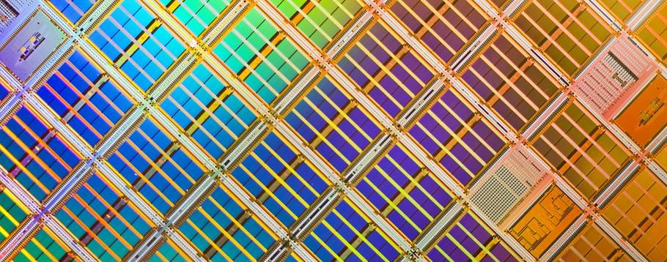
.net Micro Framework

Slide 16
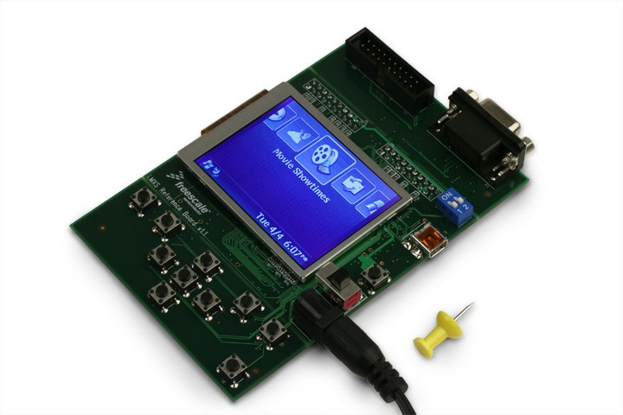
.NET Micro Framework & i.MX Sideshow 方案
基于微软开发的 .net Micro Framework系统, Freescale’s 开发了基于ARM920 的 i.MXL/i.MXS 处理器的应用开发板.
MC9328MXS
Connectivity
CPU Complex
Standard
I²C
ARM 920TDMI
PWM
SPI
I Cache
D Cache
GPIO
USBd
Timer x 2
UART x 2
Interrupt handler
MMU
WD timer
SSI/I²S
Bus Controller
RTC
System Control
11 DMA Channels
Debug
Power management
Bootstrap
EMI & SDRAMC
Human I/F
JTAG/ETM
LCDC
Notes:
Freescale’s i.MXS Development Kit features a small form-factor reference board that has a 2.5 inch color LCD panel 包含 QVGA resolution. The development kit also includes a USB interface and an expansion connector for add-on modules such as Bluetooth™ technology or the ZigBee™ wireless protocol,
MXSDVK:
i.MXS 100 MHz reference design
Based on ARM920T core
Small form-factor
2.5” LCD 包含 QVGA resolution
32 MB SDRAM & 8 MB NOR FLASH
USB 1.1 Device Interface
I²C interface for PC SMBus expansion
UART expansion connector for add-on modules such as Bluetooth or ZigBee
Audio expansion connector
Detachable debug interface and keypad
USB cable and 5V power supply
Additional items available
ARM MultiICE Debug Tools
Microsoft .NET Micro Framework and Windows Vista SideShow SDKs
Wireless Add-on Modules

Slide 17
系统框图
Gadgets (Device/Host)
Windows SideShow
Platform Components
Provided by
Windows SideShow API
Microsoft
Windows User-mode Driver
Framework (UMDF)
ISV
.Net Micro Framework
IHV
Enhanced Driver
OEM
Windows SideShow
Class Extension
DDI Implementation
WinUsb
Vista OS
USB
Enhanced
Device
Enhanced
Device
or
Windows
Vista™ PC
Wireless Interface

Slide 18
总结
高性能可扩展方案
先进技术产品
可靠 & 缩短开发时间
Freescale SoC
Microsoft’s嵌入系统软件
客户需要的产品

Slide 19
Freescale™ and the Freescale logo are trademarks of Freescale Semiconductor, Inc. All other product or service names are the property of their respective owners. © Freescale Semiconductor, Inc. 2005.

Slide 20

本地化参考资源
网络资源
  Windows 硬件开发者网站http://www.microsoft.com/China/WHDC
  Windows 硬件质量在线服务:
  https://winqual.microsoft.com
  Windows 媒体中心中文网站: http://www.microsoft.com/china/windows/products/winfamily/mediacenter/default.mspx
  Windows徽标计划中文技术论坛 http://forums.microsoft.com/china/ShowForum.aspx?ForumID=2150&SiteID=15
  Windows徽标流程问题联系
  HICWHQL@microsoft.com

Slide 21


© 2008 Microsoft Corporation. All rights reserved. Microsoft, Windows, Windows Vista and other product names are or may be registered trademarks and/or trademarks in the U.S. and/or other countries.
The information herein is for informational purposes only and represents the current view of Microsoft Corporation as of the date of this presentation. Because Microsoft must respond to changing market conditions, it should not be interpreted to be a commitment on the part of Microsoft, and Microsoft cannot guarantee the accuracy of any information provided after the date of this presentation.
MICROSOFT MAKES NO WARRANTIES, EXPRESS, IMPLIED OR STATUTORY, AS TO THE INFORMATION IN THIS PRESENTATION.

