Slide 2
Multi-Touch In Windows 7
<speaker name>
<title>
Microsoft Corporation

Slide 3
Agenda
Multi-touch Overview
Demo
Now is the Time!
Multi-touch Tenets
Augmenting Windows
Delivering Consistency
Hardware and Software
Writing Drivers
Logo Considerations

Slide 4
Multi-Touch In Windows 7
demo

Slide 5
Now Is The Time! Customers are ready for touch
Multi-touch offers clear differentiation with a high “Wow” factor for consumers
Multi-touch enhances on-the-go use and opens up new scenarios for business
90% of people in focus groups claimed they would pay a 20-30% premium for a PC with multi-touch
Seeing is believing: Consumer purchase intent doubles after hands-on experience

Slide 6
Now Is The Time! Mainstream digitizers are available
Multi-touch sensors are available today for a range of form-factors from laptops up to large all-in-ones
Windows 7 will work with any multi-touch digitizer meeting the logo requirements
We are working closely with several digitizer partners, including
Elo, N-Trig, NextWindow, and Wacom
Contact us to be added to this list

Slide 7
Now Is The Time! ISVs are investing in multi-touch
ISVs are enthusiastic about multi-touch!
We are working with several ISVs today on multi-touch applications, including
AutoDesk
Corel
Sonic
Cyberlink
Avoco Secure
Identity Mine

Slide 8
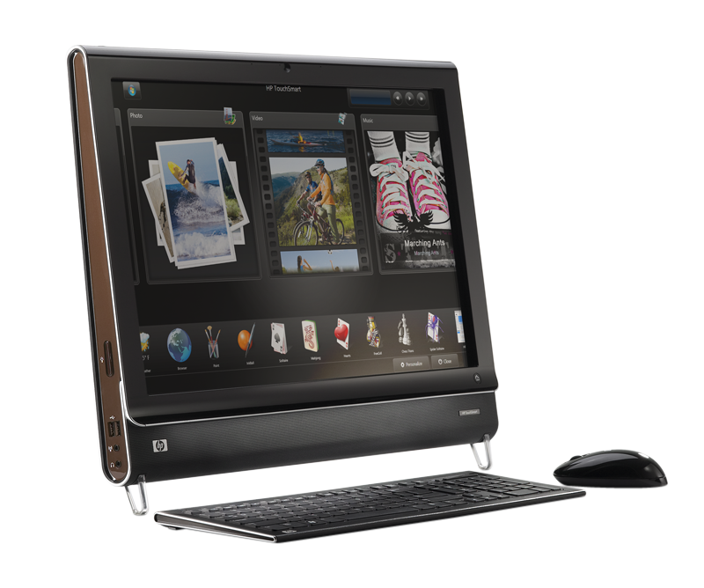
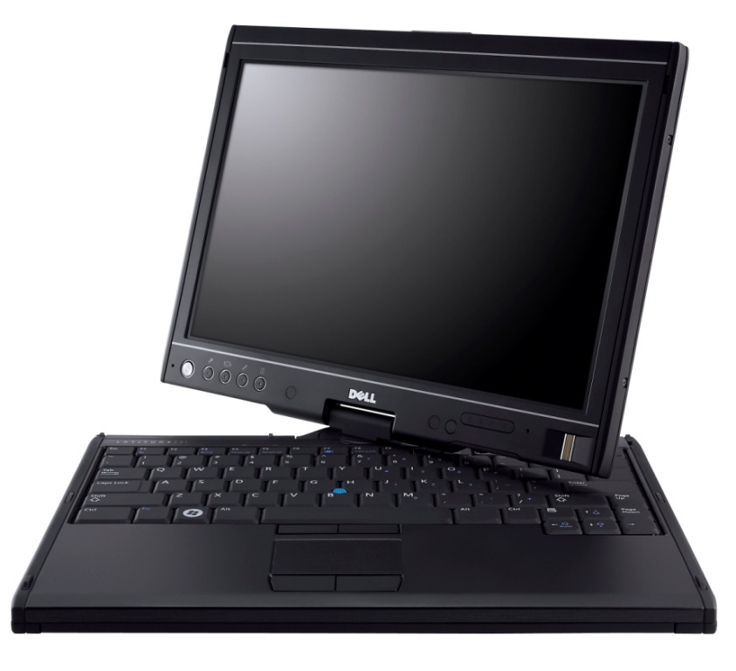
Multi-Touch Capable PCs Are Available Today
HP TouchSmart
All-in-one PC with 2-touch digitizer from NextWindow
Dell Latitude XT
Laptop with multi-touch and pen digitizer from N-Trig

Slide 9
Windows 7 Multi-Touch Goals
Augment the Windows experience
Make routine activities easier with touch
Delight customers with direct manipulation
Deliver consistency
Consistent user experience
Consistent developer, IHV, OEM platform
Succeeding with multi-touch is a team effort, we are working with many hardware and software partners

Slide 10
Augmenting The Experience Simple gestures for everyday use
Single finger panning for touch
Consistent multi-touch gestures
Gestures for double click, right click, panning, zoom, and rotate
Designed for 2+ touch systems
Gestures are available across the operating system and available “for free” to most applications

Slide 11
Augmenting The Experience Optimize for consumption scenarios
Customers are most likely to use touch for consumption activities
Navigating and consuming the web
Consuming photos, music, and video
Reading and sorting e-mail
Playing casual games
Using Office applications
We’ve optimized these areas for touch

Slide 12
A Short List Of Investments…
Core Windows
Applications
Touch-optimized top-level UI
Start menu, taskbar, window arranging, Explorer etc
Ripple feedback, cursor updates
Touch optimized flicks
Panning UX and feedback
Boundary feedback, bounce, inertia
Visually appealing and “fun”
Photo viewer
MT zoom and rotation
Touch-optimized Media Player
Touchable playback controls
Touch-friendly keyboard
New visuals, improved look, launching and feedback
Prediction and improved correction experience
Internet Explorer
Pan and zoom and navigation gestures
“Open link in new tab” gesture
Address bar drag menu
Media Center
Live gallery panning
On-screen keyboard
Larger transport controls and seek
New Now Playing and details pages
Multi-touch pack
Separate delivery of multi-touch games and surface style mapping – not part of Windows
Also
Windows Live Photo Gallery
XPS viewer
MS Paint

Slide 13
Deliver Consistency
Consistent for partners
IHVs and OEMs: Digitizers interface through HID
Developers: Standard APIs regardless of the digitizer technology used
Consistent for customers
Gestures that work the same in every application on any Windows Touch PC
Consistency through Windows Logo
Logo ensures a minimum level of functionality
New touch features are only enabled with Logo certified multi-touch digitizers

Slide 14
Multi-Touch Software Good-Better-Best
Multi-touch offers a tangible way to differentiate, a Windows application can target one of 3 levels of touch integration
Good: No specific touch APIs are used but the application UI is appropriately sized and works well with the built-in gestures
Better: The gesture APIs are supported to give smooth natural interactions
Best: Deep touch focused experiences designed to take advantage of multi-touch

Slide 15
Multi-Touch Hardware Laptop and AIO form-factors are great for Multi-touch
Target form-factors: Laptops and all-in-ones
Laptops: Users are closer to the screen and touch has high benefits in mobile situations
AIOs: Often in high traffic areas of the home where walk-up use is common
Hinges and pen are optional
Not all touch laptops need to be tablet PCs
More on Logo later

Slide 16
Tablet PC Hardware A multi-touch and pen enabled tablet PC is the ultimate mobile PC
Windows 7 continues our investment pen and tablet PC
Predictive text on soft keyboard
Recognition for 13 new languages (25 total)
Dramatically improved Asian recognition
Handwriting personalization in all languages
New math recognition
A tablet PC can have multi-touch but does not need to
Touch is focused on mainstream users
Tablet PC is best for verticals and education
Notes:
Additional languages handwriting recognition support represents larger addressable market for Tablet PCs.
East Asian accuracy improvements should fuel better market adoption and ISV engagement.
Math recognition presents opportunity for differentiated offering for Education Vertical.

Slide 17
Multi-touch Drivers in Windows 7
Great drivers are key to a great end-user experience!
How can we help?
WDK samples and tools
Driver guidance in this talk and WinHEC whitepaper
Logo requirements represent min hardware bar to properly enable the multi-touch feature set

Slide 18
Driver Framework
KMDF
Shim will ship in-box in Win7 (mshidkmdf.sys), also shipped as a sample with Vista SP1 WDK
WDK Samples using the shim: WacomKMDF, EloMT, raw USB
Removes power management and PnP handling code
IRP cancelation logic goes away (see WacomPen samples)
UMDF
Can’t write a HID miniport driver in UMDF
WDM
Not recommended for new drivers

Slide 19
Exposing Your Multi-touch Device To Windows
Multi-touch devices are a superset of HID touch devices
Use existing HID touch usages, but additionally report HID contact id and max number of supported contacts
Configuration collection allows easier device configuration for down-level or other scenarios

Slide 20
Proposed Multi-touch Additions To HID Specification
Notes:
Contact identifier: The ID of the current contact. An ID must remain constant while it is detected by the device, and each separate concurrent contact needs a unique ID. IDs can be reused after a contact is no longer detected. If the device supports “in-air” packets, the ID must persist from the time the contact is detected until the time it goes out of range.
Configuration: The CA for the top level collection housing the feature report.
Input mode: A read/write value feature to get and set the current input configuration of a device.
Device index: Identifies the top level collection for which the configuration is intended. This addresses the scenario where a report descriptor contains more than one multi-input top level collection.
Actual contact count: This usage is specifically for devices that report all current contact information using the parallel or hybrid mode described below. Since the report count for each usage in this device’s top level collection will be less than or equal to the maximum number of contacts the device supports, this usage should convey the actual number of valid contacts in the current packet. A device that cannot provide this information must use NULL for all values in the first position that do not contain valid contact information. The usage should be in the top level collection.
Maximum number of contacts: A read only feature for getting the total number of contacts a multi-touch device supports. This usage must be included in a feature report that is part of the multi-touch top level collection regardless of the reporting mode being used.

Slide 21
Reporting Modes
Serial
Each packet contains a single update, multiple contacts are streamed serially
Can reduce per contact sample rate
Parallel
Each packet is capable of reporting the total number of contacts the device can detect
Large packets, often not fully utilized
Hybrid (Recommended)
Packets are large enough to report some number of contacts
Multiple packets can be reported serially in one logical frame
Avoids issues with serial and parallel

Slide 22
HID Multi-touch
Required usages
Touch collection (page 0x0D, usage 0x04)
X (0x01, 0x30), Y (0x01, 0x31), Tip switch (0x0D, 0x42), In-range (0x0D, 0x32)
Contact id (0x0D, 0x51)
Max count (0x0D, 0x55)
Recommended optional usages
Confidence (0x0D, 0x47)
Width and height (0x0D, 0x48 and 0x49)
Pressure (0x0D, 0x30)

Slide 23
Tips And Tricks
For null values, set the null bit on all main items in the report descriptor
Use the physical dimensions property for X and Y usages
If you cannot report accurate units, report 0 units
Report a top-level collection for each function your device supports (touch, multi-touch, pen)
If the device does not have a mouse, add a mouse collection that does not send data
More in Digitizer Drivers for Touch, Multi-touch, and Pen Devices whitepaper!
Notes:
Null values
Null values should be specified as outlined in the HID specification. The null bit must be set on all main items in the report descriptor. Note that device can use either the actual count usage or null values to notify the host of actual number of valid contacts in a packet.

Slide 24
Capability Discovery And Configuration
If the configuration collection exists, Windows 7 will open it exclusively
Windows 7 will attempt to set it to multiple input
On Vista or XP Tablet Edition, 3rd party applications can set the configuration as necessary
The device index usage specifies the collection to configure
Multi-touch collections are identified via the contact id usage
If set to mouse, route data through the mouse collection
Notes:
Multi-touch devices are identified via the contact id usage
Single touch is recommended for Windows XP Tablet PC Edition and Windows Vista. The mouse is recommended for Windows XP and Windows 2000.

Slide 25
General Guidance
Do as much in firmware as possible
For USB devices, consider selective suspend
Helpful WDK tools
DriverVerifier, StaticDriverVerifier, PreFastForDrivers, CheckINF, and others
Notes:
A digitizer device reports proper physical dimensions by using the physical dimensions property of the x and y usage. Windows 7 uses these values in gesture recognition and other platform features. Inaccurate information about the physical dimensions may affect the performance of those features.
If for some reason a digitizer device cannot report accurate physical dimensions, report 0 units.

Slide 26
Driver Distribution
Millions of users worldwide automatically update their systems at http://windowsupdate.microsoft.com
Highly recommended: Distribute your logoed drivers through Windows Update
Manage settings for distributing your driver via Driver Distribution Center (DDC) on Winqual
View download statistics and WER data
For details, see Distributing Drivers on Windows Update

Slide 27
Logo Considerations

Slide 28
What's So Important?
The user experience
Multi-touch technology will stand or fall on the quality of the user experience
To succeed, touch must be simple, reliable and consistent
The quality of the user experience begins with the digitizer and its drivers
New Windows 7 touch features will only work on PCs that have a Logo certified digitizer
Multi-touch is also an AQ – Additional Qualification
Customers can find devices or systems that enable specific experiences, partners can communicate that their device/system supports the experience
No extra requirements: get the Windows 7 Multi-touch logo - and you get the Windows 7 Multi-touch AQ for free
We’ll do what we can to help you meet the quality bar

Slide 29
Logo Tools and Submission
Windows Logo Kit 1.3 (Windows 7 preview)
Available later this year
Preview changes to the logo program for Windows 7 and expected tests
Automated tests querying HID values
Windows Logo Kit 1.4
Will ship at same time as Windows 7 RC
Comprehensive manual test set
Placing contacts, drawing lines, circles, other patterns
Complete validation of HID Usage and the user experience requirements
Multi-touch requirements apply equally to devices and systems
Hardware integrations can introduce noise
Keep testing at every phase of integration
Devices need to be submitted for manual logo verification test pass at Microsoft lab
Also optional for systems – a free test and support resource!

Slide 30
HID Class
Multi-touch digitizers must appear to the OS as HID digitizers, and not as a mouse or other proprietary device.
Why?
So Windows knows when to enable multi-touch capabilities
Design and test tips
Standard device class in HID descriptor
Automated descriptor query
Observe all required HID and Multi-touch Extension usages

Slide 31
Screen Coverage
Input requirements apply equally to all areas, including edges and corners.
Why?
To avoid blind spots or dead areas. The desktop experience in Windows relies on accurate touch at edges and corners
Design and test tips
Crucial to test this at all integration phases - hardware placement can easily impact it
Tests will include touch points throughout the screen area and at all extremes

Slide 32
Battery Operation
For battery-operated devices, the requirements must be met whether the device is running on AC or battery power.
Why?
Mobile user scenarios are primary; the requirements are equally important for tethered or mobile use
Design and test tips
If digitizer performance is impacted by power supply, design for both cases
Tests must be run on both cases

Slide 33
Sampling and Resolution
Sample rate: at least 50hz per finger.
Resolution: At least 100ppi and at least display resolution.
Why?
Packet rate determines responsiveness and ability to handle fast-moving fingers
Resolution is a fundamental component of accuracy; pixel level accuracy is important for many user scenarios
Design and test tips
50hz is really a minimum (USB supports up to 133hz)
For the manual tests, sample rate will be measured for all contacts

Slide 34
Jitter
For all fingers, if a contact is stationary, the reported position data must not change
Why?
Stationary contacts are an important class of interaction primitives; many applications need to be able to rely on stationary contacts
Design and test tips
Manual test will require multiple stationary contacts, will log position data

Slide 35
Contact Accuracy
Tracing a line, circle, or other pattern should produce data that is within 0.5mm of the expected data pattern and without interruption to the pattern.
Why?
Accuracy of contacts in motion is fundamental to almost all multi-touch scenarios.
Incorrect up/down data destroys integrity of linear movements, including dragging and line drawing
Design and test tips
Prioritize accuracy in design (meeting this generally buys you the other requirements)
Manual tests following lines and patterns on a canvas (MSPaint good testbed)

Slide 36
Contact Offset
The physical contact with the device and the position the device reports must be within 2mm of each other for all fingers applies whether each contact is stationary or in motion, and when multiple fingers make contact simultaneously or separately.
Why?
Reduced offset is crucial to accuracy (and user perceptions of accuracy)
High accuracy in movement operations, and guaranteed correlation of x, y co-ordinates
Design and test tips
No cheating! This is core to every requirement
Manual test will require finger contact at known points on the screen

Slide 37
Ghost Points
No data must be reported for locations where contact is not made.
Why?
Random input packets are guaranteed to destroy trust and turn users instantly against the technology
Design and test tips
Ensure elimination of noise at all phases of construction/integration
If mobile, move it around while testing
Tests will specify periods of inactivity

Slide 38
Device Fundamentals
General core driver requirements for all devices – satisfying another dimension of the user experience
Drivers must be secure, stable, reliable… architected to maximize reliability and stability and do not leak resources…
Install/uninstall behavior
In the wild: All drivers must maintain a high Driver Quality Rating (DQR) or the manufacturer must make a fixed driver available to customers within 90 days
…

Slide 39
Beyond Logo
Lead the field with an even better user experience
Support optional HID usages for richer applications
Contact width/height, Pressure, Valid touch confidence
Double-tapping should work with minimal uplift of the finger
Many users lift the finger only a small distance off the screen to double-tap
Performance
Device-side gesture detection strongly discouraged
Palm rejection should be especially fast
Pen use on touch screen
Input should not be triggered by dust or small insects

Slide 40
Call To Action
Put Multi-touch on your roadmap – now is the time
Engage with us, we want to help
Build drivers following the guidance and samples in the Windows Driver Kit
Run the tests in Windows Logo Kit frequently
Contact us if you have any questions
Notes:
For drivers:
Build KMDF drivers that appear to Windows per the guidance here and in the whitepaper
Take full advantage of the samples and tools in the WDK
Do as much in firmware as possible

Slide 41
Additional Resources
WinHEC white papers:
Digitizer drivers for touch, Multi-touch, and pen devices
How to Design and Test Multi-touch Hardware Solutions for Windows 7
Enabling USB Selective Suspend for Human Interface Devices
Specserver
HID extensions for Multi-touch
Web sites
Pen and touch driver guidance http://www.microsoft.com/whdc/device/input/PEN_touch.mspx
Getting started with the Windows Logo program http://www.microsoft.com/whdc/winlogo/getstart/default.mspx
Contact us:
tab-ext@microsoft.com

Slide 42
Q&A

Slide 43
© 2008 Microsoft Corporation. All rights reserved. Microsoft, Windows, Windows Vista and other product names are or may be registered trademarks and/or trademarks in the U.S. and/or other countries.
The information herein is for informational purposes only and represents the current view of Microsoft Corporation as of the date of this presentation. Because Microsoft must respond to changing market conditions, it should not be interpreted to be a commitment on the part of Microsoft, and Microsoft cannot guarantee the accuracy of any information provided after the date of this presentation. MICROSOFT MAKES NO WARRANTIES, EXPRESS, IMPLIED OR STATUTORY, AS TO THE INFORMATION IN THIS PRESENTATION.

