Slide 1
PHP on Windows Overview

Slide 2
AGENDA
MS Support for PHP community
WS08 +PHP
FASTCGI
Enhancing PHP with IIS
Extending PHP with .NET

Slide 3
Combined effort for PHP excellence
ADOdb
First LGPL Open Source project that Microsoft has contributed to
SQL Server PHP Driver
This first release of SQL Server Driver for PHP is designed to enable PHP applications to be developed and deployed on SQL Server
IIS7+ FastCGI
Improvement the performance of PHP on Windows
Expression Web 2.0
Broadens tool focus to support PHP site editing
Notes:
A few examples:
Microsoft / Zend Technologies collaboration
PHP optimized for Windows
IIS FastCGI: solid platform for PHP on IIS 6/7
Tested/insured compatibility with many popular PHP applications
Ongoing focus on making Windows/IIS an excellent platform for PHP applications
Microsoft has provided a patch that provides ADOdb database abstraction layer support for the PHP SQL driver. What may be more significant to open-source advocates is that Microsoft is licensing the patch under the Free Software Foundation's lesser GPL (LGPL) licensing terms.
SQL SERVER DRIVER
The SQL Server Driver for PHP is designed to enable reliable, scalable integration with SQL Server for PHP applications deployed on the Windows platform. The Driver for PHP is a PHP 5 extension that allows the reading and writing of SQL Server data from within PHP scripts. It provides a procedural interface for accessing data in all Editions of SQL Server 2005 and SQL Server 2008 (including Express Editions), and makes use of PHP features, including PHP streams to read and write large objects.
The release of SQL Server Driver for PHP v1.0 marks another step in Microsoft’s continued commitment to interoperability. Earlier this year, the release of IIS 7.0 and its FastCGI support was the major step towards making Windows the platform of choice for both developing and deploying PHP applications. To show our level of commitment to the PHP community, we've also posted the source code for our driver to Microsoft's CodePlex site.
This release of the SQL Server PHP driver makes it easier for the PHP development community to use SQL Server as their database of choice for PHP applications. We encourage you to download our driver and explore the sample application described in the .chm file. If you'd prefer to access our documentation on-line, it's available on the MSDN site. To keep up with our announcements and customer feedback, please check out our team blog or the MSDN forum site for the driver.
IIS7
IIS 7.0 offers new capabilities that dramatically improve the way Web solutions are developed, deployed, and managed.
Modular architecture in IIS 7 provides additional functionality to PHP applications.
IIS had always supported PHP, but in a way that precluded many real-life PHP applications from being hosted in production environments. This was due to limitations in the two ways IIS offered for running PHP applications: using the Common Gateway Interface (CGI) protocol or using the PHP ISAPI extension.
Because CGI requires a separate process for each request, apps hosted using CGI would perform poorly on Windows. Conversely, PHP apps using the IIS high-performance multithreaded ISAPI interface would often suffer from instability due to the lack of thread safety in some popular PHP extensions.
In an attempt to solve these problems, the IIS team developed the FastCGI component. The open FastCGI protocol allows PHP and many other application frameworks that require a single-threaded environment (including Ruby on Rails, Perl, and Python) to run more reliably on IIS. Unlike the standard CGI implementation, FastCGI enables process reuse by maintaining a pool of worker processes, each processing no more than one request at a time, thus resulting in much-improved performance. FastCGI also benefitted from a community-centric development and testing model.
Expression WEB 2.0
About Expression
Microsoft Expression Studio takes your creative possibilities to a new level. The professional design tools and innovative technologies in Expression Studio give you the flexibility and freedom to bring your vision to reality—whether you are designing standards-based Web sites, rich user experiences for the desktop and Silverlight, or managing digital assets and content.
Edit PHP pages
Broaden your scope by now editing PHP sites with Expression Web 2. Apply the full set of standards based design tools to a wider range of sites.

Slide 4
Open Source Participation
Community
Partnership
Choice
Contribution
Notes:
Opportunities for developers, IT administrators, and end users to learn, be creative, and solve problems collaboratively have always been important in the IT ecosystem. Microsoft has offered or participated in providing resources to support community, through newsgroups, events, blogs and in much more. Today the scope of community, like the IT ecosystem, includes open source. For Microsoft, this means:
Participating in dialogue through Port25, the portal for the Open Source Software Lab at Microsoft. Since the launch of the site in 2006, there have been more than 18 million visits to Port25’s blogs and resources for users and developers of open source technologies.
Participating in industry events like OSCON, the world’s largest open source developer conference, where Microsoft employees actively contribute and present.
Zendcon, the premiere PHP industry event
Helping developers connect, collaborate and exchange ideas, including offering CodePlex.com, the open source and shared source project hosting site offered by Microsoft. Over the past two years, Microsoft teams and the community have started over 5,000 projects – 90% of which were started by the broader community.
Microsoft is committed to working with other software providers to meet the needs of customers in heterogeneous environments--this includes providers of open source technologies and products. We can achieve this through business and technical partnerships with open source-based businesses and communities. These partnerships exist today with notable examples such as JBoss, SUN, Novell, SugarCRM, XenSource, Zend, and the PHP.net community and we continue to explore new collaborative opportunities each and every day.

Slide 5
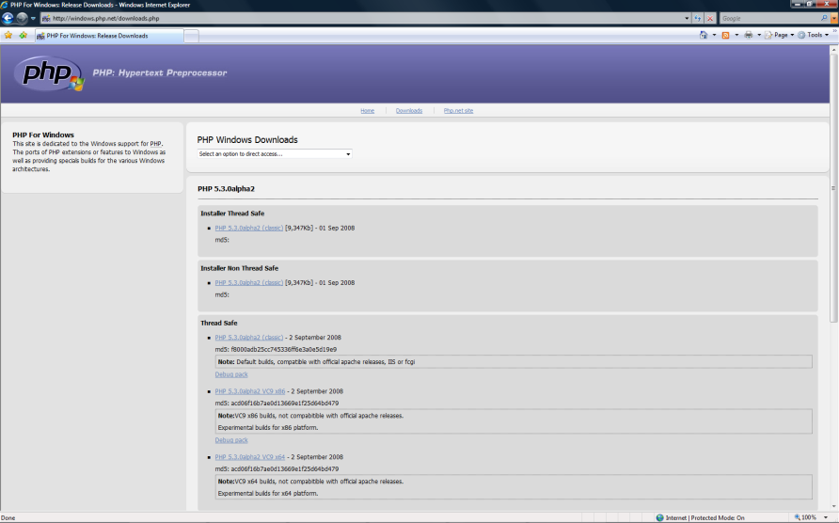
http://windows.php.net/download.php
Notes:
Even php.net has created a site for Windows!

Slide 7
Advantages of PHP on IIS7
Modular architecture for reduced attack surface
XML-based configuration system
Remote management capability
Advanced diagnostics
Ability to extend IIS7 using managed code
Integration with WMS and Media Pack
PHP users who deployed to Apache in the past will be more comfortable with IIS7 than IIS6 due to the new configuration system and modular architecture.
Notes:
Reasons why IIS 7 Rocks!
All details relocated from the IIS.NET Web site:
IIS7 is faster and more efficient than any other version of IIS.
With IIS7 you can manage whole Web farms from one place.
IIS7 allows you to delegate management workload with site owners. Site owners can also remotely manage their sites and applications over HTTPS from Windows Vista, Windows XP, Windows Server 2003, and Windows Server 2008. IIS7's XCopy deployment model even allows you to deploy applications preconfigured!
IIS7 is much more flexible and customizable than before, allowing you to fine tune the server (including server core!) to minimize security footprint and downtime due to patching.
You can save loads of time by automating more tasks with the interface that is right for you.
If you do run into issues, IIS7 makes it easy to resolve site issues faster, minimizing down time.
IIS7 includes built-in support for PHP, making it the best Web server for both Open Source languages and .NET. You can now have a single Windows platform to host all your web workloads!
IIS7 makes it easy to publish content securely over FTP/SSL or WebDAV!
Windows and IIS7 are cheaper than ever with the new Windows Web 2008 product. This version of Windows is super inexpensive and supports all the great features of IIS, SharePoint, SQL, Windows Media server and more for Internet facing sites!
And as if that isn't enough, IIS7 is getting better every day with new IIS7 Extensions like built-in progressive streaming and playlist support for media content, URL Rewrite capabilities, integrated database management, powershell support, and much more.
Leaner Web Servers
The ability to deploy lean IIS 7.0 servers draws from the modular architecture of the server. Practically all of its Web server features are implemented as modular components that can be added or removed individually. Thus you can remove any server features that are not necessary for an application's operation, resulting in noteworthy benefits including a significantly reduced attack surface area, a smaller operating footprint, and improved performance.
Build on a Lean OS
Windows Server® 2008 also provides OS-level componentization that you can use to further reduce the surface area of your Web server. Server Core is a minimal installation option for the Windows Server 2008 operating system and contains a minimal set of core OS subsystems. Server Core is an ideal environment for lean IIS 7.0 Web servers.

Slide 8
PHP optimized for Windows
PHP 5.2.1+ has been optimized for Windows
Performance optimizations for the Windows platform
Moved from generic APR to Win32 API
Many Windows-specific and FastCGI-specific performance improvements
Many Windows-specific bugs finally fixed
Non-thread-safe builds for maximum performance with IIS FastCGI
Notes:
In the past
According to 3rd party research over 70% of PHP developers develop on Windows but
Few use Windows/IIS to host PHP applications
PHP developers use Windows to develop their applications, but not host.
Why?
1) The two available modes of hosting PHP on IIS a few problems:
A) PHP ISAPI: Previous releases of PHP, and many PHP extensions to-date are not thread-safe, resulting in instability for many
B) CGI: Stable, but very slow performance due to cost of starting processes on Windows
2) PHP engine itself wasn’t mature on Windows, causing compatibility and performance problems.
A) Implemented with APR (Apache portable runtime) instead of directly on Win32, subpar performance
B) Many Windows-specific PHP bugs haven’t been fixed
3) IIS lacked certain Apache features historically common in PHP apps, such as mod_rewrite
With IIS7 things have changed
IIS 7.0 is now an excellent platform for PHP applications
PHP applications just work, easy to set up and manage
MS has increased it involvement with the PHP community
Contributions to PHP projects (ADOdb being the first_
You can win from hosting PHP applications on IIS 7.0
NOTE:
Thread-safe: Recent PHP releases provide the logic for multi-threaded environments, such as the ISAPI (many popular community extensions still don’t, which makes multithreaded environments unacceptable for many PHP apps -> hence our push for using FastCGI which insures single-threaded execution)
Since FastCGI doesn’t require thread safety, non-thread-safe PHP builds with the synchronization code removed provide an extra performance boost for the FastCGI environment (up to 30% in some helloworld benchmarks)

Slide 9
IIS FastCGI
Building a solid platform for PHP apps
Open standard
Supported by PHP and many other open source frameworks (RoR, Perl, Python, …)
vs. ISAPI:
Provides required stability for non-thread-safe PHP applications
vs. CGI:
Drastically improves performance
Notes:
IIS 7.0 comes with extended support for application frameworks through FastCGI, an open protocol that is supported by many open-source application frameworks that otherwise may not support stable and high-performance native integration with IIS. Unlike the CGI (Common Gateway Interface) protocol, which has been supported by IIS for a long time, FastCGI provides much improved performance on the Windows platform. This is primarily due to the FastCGI reusable process architecture, which eliminates the heavy per-request process creation overhead, enabling clients to take advantage of persistent keep-alive connections.
If you are supporting application frameworks on IIS using CGI or another mechanism, you achieve improved performance (and in some cases, stability) by moving to the FastCGI protocol.
The first application framework to take advantage of this support is PHP. In fact, the IIS team has worked directly with Zend Technologies to make sure that the IIS Fast­CGI implementation works well with PHP and enables performance improvements in the PHP framework on Windows. If you have a mix of Web server technologies that include ASP or ASP.NET applications running on IIS, and PHP or other FastCGI-compliant application frameworks using other technologies, you may be able to consolidate these apps on the IIS 7.0 platform.
IIS and PHP
IIS had always supported PHP, but in a way that precluded many real-life PHP applications from being hosted in production environments. This was due to limitations in the two ways IIS offered for running PHP applications: using the Common Gateway Interface (CGI) protocol or using the PHP ISAPI extension.
Because CGI requires a separate process for each request, apps hosted using CGI would perform poorly on Windows. Conversely, PHP apps using the IIS high-performance multithreaded ISAPI interface would often suffer from instability due to the lack of thread safety in some popular PHP extensions.
In an attempt to solve these problems, the IIS team developed the FastCGI component. The open FastCGI protocol allows PHP and many other application frameworks that require a single-threaded environment (including Ruby on Rails, Perl, and Python) to run more reliably on IIS. Unlike the standard CGI implementation, FastCGI enables process reuse by maintaining a pool of worker processes, each processing no more than one request at a time, thus resulting in much-improved performance. FastCGI also benefitted from a community-centric development and testing model.
At the same time, Zend Technologies worked to improve the general performance and stability of the PHP scripting engine and core extensions on Windows, making numerous performance improvements and fixing dozens of Windows-specific bugs.
Moving PHP and other application frameworks to IIS 7.0 and FastCGI will allow you to take advantage of various IIS 7.0 features, including the ASP.NET Integrated pipeline.
This provides a very convenient option for enhancing application frameworks with ASP.NET services without converting them to ASP.NET.

Slide 10
IIS FastCGI- Under the hood
FastCGI process pool for PHP5
IIS Worker Process
FastCGI handler
ASP.NET
Static
FastCGI protocol over named pipes or TCP
Authenticate
Authorize
Map Request
Read Configuration
Handle Request
Send Response
Log Request
php-cgi.exe
FastCGI process pool for PHP4
Request queue
php.exe
Notes:
FastCGI request processing:
- Applications configure handler mappings to map FastCGI pools to application content. Any number of FastCGI pools can be created to support different FastcgI-compliant application frameworks, or different versions of them (e.g., PHP 4.0 or PHP 5.0).
- Handler mapping causes the request to be dispatched to the FastCGI handler.
- The FastCGI handler dispatches the request to one of the FastCGI worker processes (php-cgi.exe) for the corresponding FastCGI pool. Only 1 request is processed in each FastCGI worker process at a time – if no processes are available, a new one may be created up to a configurable limit, or the request will be queued for later processing. Over a 100x performance improvement over CGI is realized from reusing processes.
- The request can take advantage of any services provided by IIS or ASP.NET modules configured for the application, enabling rich feature scenarios for PHP applications (more on this later).

Slide 11
FastCGI Reliability
Guaranteed thread safety
Process isolation:
Separate process isolate failure from IIS worker process
Separate process pools per IIS application pool isolate failures from other application pools
Multiple processes reduce failure impact to application
Reliability features:
Timeouts (activityTimeout, requestTimeout)
Periodic process restarts (instanceMaxRequests)
Rapid fail protection (rapidFailsPerMinute)
Notes:
Notes: These features help insure and increase reliability of PHP applications when hosted on WS08/IIS.
Because FastCGI insures single request concurrency for each FastCGI worker process, it insures thread safety for PHP applications while providing concurrency on the process level.
Also, unlike the ISAPI, FastCGI requests are processed in a separate process (the FastCGI worker process). This isolates failure to that process, and makes sure that failures there do not affect the health of the IIS worker process.
Additionally, since separate FastCGI pools are created for each IIS application pool, the standard IIS application pool isolation can be used to isolate failure in one group of PHP applications from another. It also enables effectively isolating PHP applications by setting permissions for different application pools using the same isolation model as is used for ASP, ASP.NET, static content, and other application content. This enables a single permission strategy for all application content regardless of application technology.
Even within a single PHP application, the use of multiple worker processes reduces the impact of failure in each process. Typically in case of process failure, only a single request will be affected, and a new FastCGI worker process will be created if needed to replace the failed process.
FastCGI also provides a number of features to further enhance reliability of FastCGI applications:
-activityTimeout – makes sure that the FastCGI process remains active (receives request data, sends response), helps detect timeouts/deadlocks in application code without limiting the overall request execution time. Also helps detect failed or non-FastCGI-compliant worker processes.
requestTimeout – makes sure that the request finishes in the specified amount of time, helps detect timeouts/deadlocks in application code
instanceMaxRequests – recycle each FastCGI worker process after the specified number of requests. Helps alleviate performance degradation/corruption in less-than-perfect application code by purging the processes periodically.
rapidFailsPerMinute – protect the system from trying to start FastCGI processes due to a persistent failure condition, by temporarily disabling the FastCGI pool

Slide 12
FastCGI Performance
Performance architecture
Reusable processes (reduced process creation overhead)
Keep-alive connections
Non-PHP content served directly by IIS
Benefit from IIS performance features
Output caching
Compression
Notes:
NOTE:
Talking points (will provide details later):
IIS 7.0/FastCGI is a performant platform for hosting PHP applications (explain how)
Can leverage additional IIS 7.0 features to improve PHP application performance (for some examples, see http://technet.microsoft.com/en-us/magazine/cc745952.aspx)
Fast and reliable hosting of PHP applications in IIS
The FastCGI protocol enables PHP applications to be hosted on the IIS web server in a high-performance and reliable way. FastCGI provides a high-performance alternative to the Common Gateway Interface (CGI), a standard way of interfacing external applications with Web servers that has been supported as part of the IIS feature-set since the very first release.
CGI programs are executables launched by the web server for each request in order to process the request and generate dynamic responses that are sent back to the client. Because many of these frameworks do not support multi-threaded execution, CGI enables them to execute reliably on IIS by executing exactly one request per process. Unfortunately, it provides poor performance due to the high cost of starting and shutting down a process for each request.
FastCGI addresses the performance issues inherent to CGI by providing a mechanism to reuse a single process over and over again for many requests. Additionally, FastCGI maintains compatibility with non-thread-safe libraries by providing a pool of reusable processes and ensuring that each process will only handle one request at a time.

Slide 13
Run PHP apps on IIS 7.0
Easy to set up:
Install PHP with FastCGI
Deploy the application
Compatible:
Top 10 PHP applications tested/documented on www.iis.net/php
Ease migration with Url Rewrite support for mod_rewrite configuration
Notes:
Control IIS configuration for PHP applications via web.config
Example: setting default document for PHP application
Run PHP applications in the new IIS7 integrated pipeline with ASP.NET and other web applications
Extend existing PHP applications with rich ASP.NET functionality
Develop new .NET modules that run in the integrated pipeline to handle PHP requests the same way as the module handles requests for ASP.NET content.
Example: URL Rewriter that makes “pretty” URLs for PHP and ASP.NET content.

Slide 14
PHP on IIS 7.0
demo

Slide 15
Flexibility
Flexible configuration
Run multiple PHP versions/different PHP configurations side by side
Host PHP content in any web site, application, or virtual directory
Host PHP content side by side with any other application framework (ASP, ASP.NET, etc)
Powerful deployment
Store and x-copy deploy IIS 7.0 configuration with your PHP application
Configure desired security models and access rights to content
Store PHP applications and associated IIS 7.0 configuration on remote UNC locations
Rich app features
Notes:
This slide reviews the reasons for IIS7’s flexibility in production.

Slide 16
Develop
PHP developers already develop on Windows
Simplified development cycle
Develop/test locally on the same machine
Deploy to the same environment
Single configuration to manage
Simple x-copy deployment
Predictable results
Host PHP applications in the same environment
Notes:
The new PHP support enables a simplified development experience for developers that already develop on Windows – they can now test/host their applications in the same environment, and achieve predictable results when hosting their application (using one of the many hosters that offer this exact platform)
IIS Kernel Mode Caching for PHP applications
Of course, this is just the start for PHP developers. Once they're on Windows and IIS7, there are a ton of cool features to begin taking advantage of like:
distributed configuration
new admin tool for IIS configuration
diagnostic tools like failed request tracing, and .NET integration (think ASP.net forms auth for a PHP app!) and more - all of which are unique to IIS7. One of the cool things that I wanted to show off, while we're talking about performance, is the new output cache.
The IIS7 output cache is a new feature in IIS7 which makes it possible to cache entire responses in memory - even from dynamic content. Unlike the existing caches IIS has, it is a 'smart' cache, enabling you to configure it to cache separate copies of responses for the same page (like index.php) based on query string value.
One of the other really cool things about it is the fact that it is integrated with the http.sys (kernel mode driver) cache, allowing for blazing fast performance.
Output caching is going to be a very powerful feature for all kinds of applications, from PHP to ColdFusion, Classic ASP to CGI.
It will work with any content type, and can significantly speed up performance for applications where the underlying data doesn't change or where the changes occur at a predictable rate (so you can timeout the cache at the expected interval).
Even in cases where the data is changing, say, once a second, it may make great sense to use the output cache with an expiration of 1 second. This allows for the dynamic processing to occur only once a second, instead of on every request, significantly speeding up response times and lowering CPU.

Slide 17
Host
Consolidate servers
Host PHP applications on the same server as ASP, ASP.NET, and other Windows applications
Manage a single environment/fewer servers
Use a single set of tools to manage your servers and applications
Leverage the IIS 7.0 management stack
IIS Manager, Powershell, config APIs
Delegated management and x-copy deployment of server settings
Remote management (including server core)
Notes:
Deploy and manage ASP and PHP apps on the same server.
Consolidate your infrastructure
In the typical shared hosting scenario, it is common to see what is called an 80/20 distribution, where 80 percent of requests go to 20 percent of sites. This results in a small percentage of sites being active at any given time. To allow a higher number of active sites, IIS 7.0 provides active lifetime management. This can help you to reclaim memory from inactive applications in order to allow more active applications to be hosted.
IIS 7.0 introduces a new algorithm called dynamic idle, which proactively adjusts the idle timeouts of worker processes based on memory available on the server. As memory becomes low, idle applications are removed more rapidly, thereby allowing more active applications to be hosted. However, if the memory is available, the timeouts can remain large to provide better performance and maintain application state. In addition to allowing more applications to be active, dynamic idle also helps avoid low memory conditions that cause severe performance degradation due to thrashing.

Slide 18
Enahnce
IIS 7.0 is a rich web server platform that offers many benefits to PHP applications
Leverage IIS features
Strengthen security, provide access control
Improve performance
Add media features
Extend PHP applications using the ASP.NET integrated pipeline
Add ASP.NET application services
Extend PHP applications using the .NET framework
Notes:
NOTES:
IIS 7.0 offers rich features to application frameworks – PHP is no exception.
PHP apps can leverage IIS 7.0 features to:
- strengthen security
- improve performance
- provide rich server-side media serving, more …
Like ASP.NET features, but wish they were available for PHP? With IIS 7.0, they are – can use ASP.NET runtime services with PHP applications.
ASP.NET Integrated pipeline, the .NET extensibility layer for IIS 7.0, offers
ASP.NET services and .NET extensibility for any application framework
- Can use existing ASP.NET services for PHP applications (e.g. output cache, role manager)
- Can extend PHP apps / add custom server features using .NET
Rapidly extend the Web server to add custom functionality using .NET (compare with C++ for Apache extensions), without having to rewrite your PHP application to ASP.NET:
Reuse existing application assets
Faster development
Less maintenance/support problems
Why extend? Extensibility is key for the Web server to get it to work the way you want. It’s a key theme for IIS 7.0. The next demo will illustrate a few cool scenarios for extending PHP applications.

Slide 19
Secure
IIS 7.0 security
Reduces attack surface area with Server Core, and modular IIS feature set
Harden PHP application security:
IIS Application pool isolation model
Request filtering
Implement access control:
Many authentication schemes
Flexible authorization schemes
IP/domain restrictions
Notes:
Security:
Builds on the excellent security track record of IIS 6.0
offers additional features to improve application security
In previous versions of IIS, this wouldn't mean much for a PHP application, since it is not an ASP.NET application. But in IIS 7.0, the ASP.NET Integrated mode engine is designed specifically for this scenario, allowing ASP.NET features to be used with any content, including other application frameworks. Using the functionality of ASP.NET Integrated mode, a PHP application can take advantage of the ASP.NET membership, forms authentication, and Login controls just like a native ASP.NET application. In fact, if you already have an existing ASP.NET application that uses forms authentication, you can simply drop in a PHP application and, with just a few steps, enable it to have the same user security as the rest of your application. This results in consistent user security across your entire site.

Slide 20
Improve performance
Leverage IIS performance features:
Output Caching: the best way to improve application performance on the IIS platform
IIS output cache for highest performance
ASP.NET output cache for maximum flexibility
Response compression: reduce bandwidth costs, reduce network trip time
Bitrate throttling: reduce wasted bandwidth when hosting media
Notes:
NOTES:
Will provide talking points for these. See http://technet.microsoft.com/en-us/magazine/cc745952.aspx for rough idea
Output Caching
Generally speaking, caching is the number-one way to improve the performance of applications that execute repeated work. Unlike application-specific performance improvements, which often require a lot of effort and chew away at the processing overhead of an app, caching eliminates the overhead of repeat requests for the same content.
Prior to IIS 7.0, both IIS and ASP.NET have offered caching capabilities in the form of the IIS kernel cache and the ASP.NET Output Cache. The IIS kernel cache provided maximum performance, but was restricted primarily to static content. The ASP.NET Output Cache was a far more complete solution for caching dynamic content, albeit with slower performance and less efficient memory management. The new Output Cache in IIS 7.0 bridges the gap between the IIS kernel cache and the ASP.NET Output Cache.
The IIS 7.0 Output Cache enables caching of dynamic content from any application, including ASP, ASP.NET, PHP, and any other IIS 7.0-compatible application framework. By providing basic support for content variability and expiration, this new feature makes it possible to implement caching for content that cannot be cached by the IIS kernel cache. Still, it enables the use of the kernel cache for content that does meet the restrictions.
Bandwidth Reduction from Compression
IS 7.0 provides the two compression features introduced by its predecessor: static compression and dynamic compression. Static compression pre-compresses static content and saves it on disk, thereby allowing future requests to serve compressed content directly without compression overhead.
Dynamic compression compresses the response in real time, and therefore enables compression for responses generated by applications. Any application framework on IIS 7.0 can take advantage of dynamic compression—including ASP, ASP.NET, or PHP.

Slide 21
Add rich app features
Leverage IIS features
Authentication/authorization
Url Rewriting
Media features
Bitrate throttling
Web playlists
OOB and third party features
Build your own (next slide)
Notes:
NOTES:
IIS has many features (40+) that PHP apps can leverage
- add access control schemes with authentication/authorization features
- url rewriting
- media playlist
- more
URL rewrite module
provides a rule-based rewriting mechanism for changing requested URL’s before they get processed by web server. The module can be used to express URL rewriting logic that can use regular expressions or wildcards and can make rewriting decisions based on HTTP headers and server variables. While the primary purpose of the module is to rewrite requested URL’s, it also has functionality to perform redirects, send custom responses or abort requests based on the logic expressed in the rewrite rules.
The Microsoft URL Rewrite Module for IIS 7.0 provides flexible rules-based rewrite engine that can be used to perform broad spectrum of URL manipulation tasks, including, but not limited to:
Enabling user friendly and search engine friendly URL with dynamic web applications;
Rewriting URL’s based on HTTP headers and server variables;
Web site content management;
Controlling access to web site content.
Media Bit Rate Throttling
With increasing numbers of sites offering media content, the bandwidth costs for many businesses are skyrocketing. What's worse, a large percentage of media bandwidth is wasted because the media content sent to the client is never really used. Why does this happen?
Think about the last time you watched an online video or saw a video ad when browsing. Did you watch the video to the very end? It is common for users browsing video sites to watch only part of a video before moving on to the next video or leaving the page. However, a Web server using progressive download to deliver the video will typically send significantly more data than is required for those few seconds of playtime. Most of that data never gets used.
If your videos on average only get 5 seconds of viewing time but deliver (buffer) 30 seconds worth of video data in those 5 seconds, you are potentially wasting more than 80 percent of your bandwidth!
Open/extensible architecture means more features built by the IIS team, community, ISVs, and yourself!
The next demo shows this off

Slide 22
Enhance PHP applications with IIS 7.0 features
demo

Slide 23
Extend
IIS 7.0 offers unparalleled extensibility
Allows ASP.NET services to be used with any application content
Allows any application framework to be extended with .NET services
Developers can extend PHP applications with the .NET framework without rewriting PHP applications
Rapidly extend the web server with .NET, not C++/COM.
Build a single set of .NET services for all applications on your server (PHP, ASP, ASP.NET, other)
Notes:
NOTE:
Like any ASP.NET features, but wish they were available for PHP? With IIS 7.0, they are – can use ASP.NET runtime services with PHP apps
Rapidly extend the web server to add custom functionality using .NET (compare with C++ for Apache extensions), without having to rewriting your PHP app to ASP.NET
- reuse existing app assets
- faster development
- less maintenance/support problems
ASP.NET Output Caching
The output cache is a feature of ASP.NET that allows reuse of responses produced by Web applications for subsequent requests to the same resources. In fact, ASP.NET provides an extensive set of features for caching both application data inside ASP.NET applications with its Cache API and an application's entire responses with the output cache. Both features can often enhance an application's performance and significantly reduce the load on the back-end resources. New in IIS 7.0 is the ability to use the ASP.NET output cache for non-ASP.NET content types.
In other words, your PHP app!
Why extend? Extensibility is key for the web server to get it to work the way you want. It’s a key theme for IIS 7.0. Demo will illustrate a few cool scenarios for extending PHP apps.

Slide 24
Extend PHP applications with .NET
demo

Slide 25
Summary
IIS 7.0 is an excellent platform for PHP applications
Reliable
High-performance
Compatible
Running PHP on IIS 7.0 makes sense
Develop/test/deploy in a single environment
Consolidate servers and simplify management
IIS 7.0 brings rich features to PHP applications
Notes:
We’ve come a long way
WS08 - A solid platform for PHP apps
Win by hosting PHP applications on Windows
Simplify deployment and testing
Reduce TCO
Leverage the power of IIS 7.0 to make PHP apps better
Take advantage of IIS 7.0 features
Bring power of .NET extensibility to PHP

Slide 26
Going forward
Microsoft has an ongoing focus on making PHP great on Windows
Community:
www.iis.net/php
PHP forums on iis.net: http://forums.iis.net/1102.aspx
Contributions to community projects
ADOdb

Slide 27
© 2008 Microsoft Corporation. All rights reserved. Microsoft, Windows, Windows Vista and other product names are or may be registered trademarks and/or trademarks in the U.S. and/or other countries.
The information herein is for informational purposes only and represents the current view of Microsoft Corporation as of the date of this presentation. Because Microsoft must respond to changing market conditions, it should not be interpreted to be a commitment on the part of Microsoft, and Microsoft cannot guarantee the accuracy of any information provided after the date of this presentation. MICROSOFT MAKES NO WARRANTIES, EXPRESS, IMPLIED OR STATUTORY, AS TO THE INFORMATION IN THIS PRESENTATION.

Slide 28
PHP apps on SQL Server
Build reliable applications on industry leading scalability and availability
Improve productivity through rich data types and powerful management tools
Unleash the power of your applications by building BI capability
Notes:
Notes:
SQL Server provides industry-leading performance and enterprise-ready scalability. SQL Server delivers an infrastructure that can grow with your business and it has a proven record in handling large workloads.
Increased Availability
Minimize downtime and speed recovery, and achieve the appropriate level of availability defined by service level agreements.
Decreased Downtime
Recover quickly from unplanned downtime, and minimize downtime from system maintenance and operational procedures that are necessary for smooth operation of mission-critical applications.
Support very large database systems by leveraging SQL Server 2008 scale-out technologies to distribute its load and data efficiently.
Leverage the SQL Server 2008 enhanced data type support to manage relational and non-relational data, including precise date and time management, XML data, external documents and files, and new spatial information, using either planar or geodetic representations.
A set of world-class tools and an integrated debugging environment help reduce development costs.
SQL Server Management Studio, which is designed to help create a self-managing system, helps reduce database management time.
Troubleshoot, tune, and monitor SQL Server 2008 instances across the enterprise with Performance Data Collector.
SQL Server 2008 Business Intelligence platform provides a scalable business intelligence (BI) platform optimized for data integration, reporting, and analysis, enabling organizations to deliver intelligence where users want it.
Use powerful wizards and innovative design tools for building integration, reporting, and analysis solutions within a single environment, and enjoy the increased developer productivity and faster capitalization on new analysis and reporting capabilities.

Slide 29
PHP Development Support
PHP 5.2.5, Fast CGI
Intellisense, code-coloring and snippets
Preview PHP includes on design surface
Preview PHP pages in any installed browser with built-in development server
More details at: http://msdn.microsoft.com/en-us/library/cc295181.aspx
Notes:
In response to feedback from Expression Web 1 users, we’ve added a rich set of features for PHP development in Expression Web version 2. There are the expected productivity features such as code-coloring, snippets and IntelliSense™, but it doesn’t stop there. The product now ships with a PHP development server that lets you test your PHP pages without any other external web server dependencies (e.g. IIS or Apache). Essentially, PHP is now a first-class citizen in Expression Web 2, and will continue to be in upcoming versions of the product.
Expression Web 2 supports PHP 5.2.5 and Fast CGI with IIS 6 and 7.
Code editor support
IntelliSense is especially helpful for built in PHP functions since it will show the list of required parameters along with their appropriate data types. Color coding of PHP code makes it easier to edit and PHP snippets represent common PHP code items which can be inserted into your PHP document simply by selecting them from a menu list. For example, EW2 can write for you the entire PHP include if you choose it from the Insert menu and then navigate to the file which you want to include.
PHP includes
Now you can preview includes on the design surface of Expression Web so you can see how your page will render.
Preview PHP Pages
All you need to do is specify the location on your hard disk of the PHP runtime to use for processing PHP content in your web pages. But the real strength of EW2's built-in web server is its integration with different browsers. When you select Preview in Browser from the EW2 menu, you are presented with the choice of various browsers—including browsers preconfigured to different window sizes—in which to view your page.

Slide 30
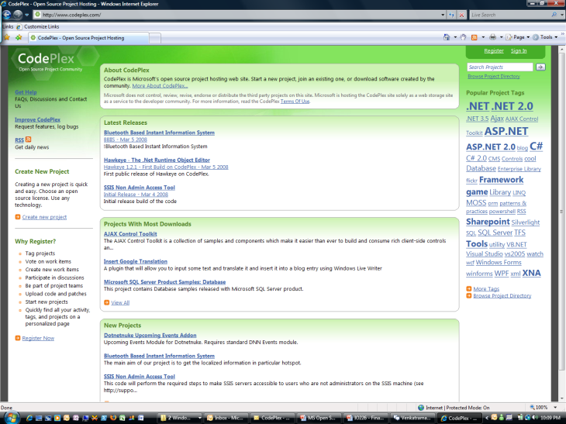
http://www.codeplex.com

Slide 31
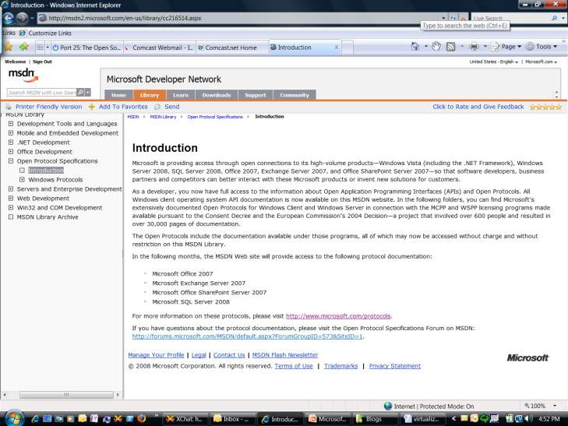
http://msdn2.microsoft.com/ en-us/library/cc216514.aspx

Slide 32
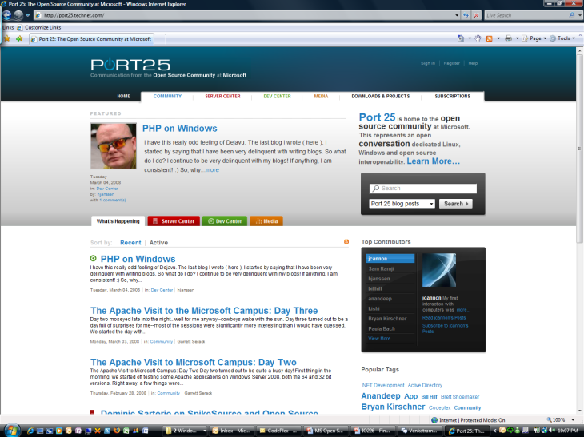
http://port25.technet.com

Slide 33
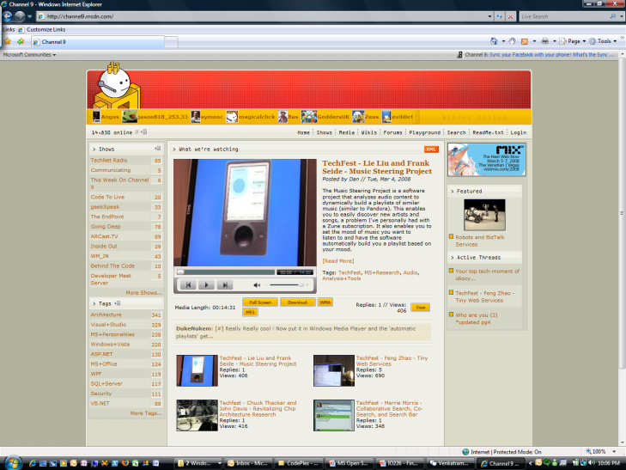
http://channel9.msdn.com

Slide 34
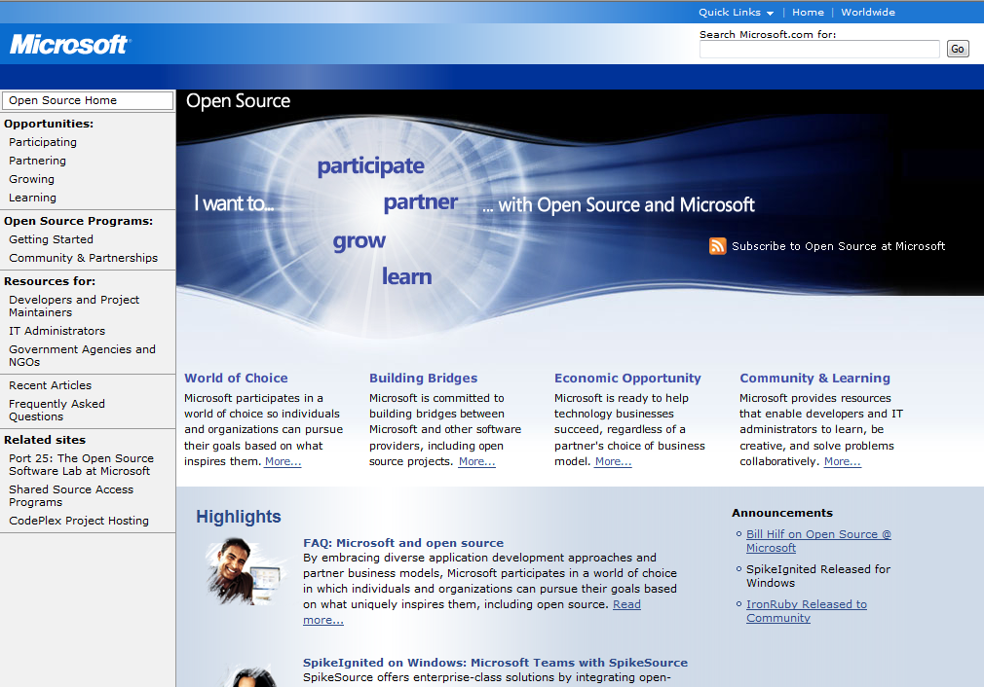
http://www.microsoft.com/opensource

