Slide 2
Next Generation Virtualization Computing
Christopher Samson
Senior Hosting Technology Specialist
Microsoft

Slide 3
What is Virtualization?
Virtualization is the isolation of one computing resource from the others
Virtual Applications
Any application on any computer on-demand
Applications installed to
Specific hardware and OS
Virtual Presentation
Presentation layer separate from process
Interface bound to process
Operating System assigned
to specific hardware
Virtual Machine
OS can be assigned to any desktop or server
Storage assigned to specific
locations
Virtual Storage
Storage and backup over the network
Network assigned to specific
locations
Virtual Network
Localizing dispersed resources
Traditional software stack
Component isolation with Virtualization
Notes:
Virtualization in an IT environment is essentially the isolation of one computing resource from the others. By separating the different layers in the logic stack, you enable greater flexibility and simplified change management—you no longer need to configure each element for them to all work together.
In a traditional hardware/software stack, all of the elements are bound together, required specific configuration to allow the components to properly interact with each other. Creating new capability entails procuring and configuring the hardware, software and interfaces.
In a virtualized stack. Each element is logically isolated and independent. Adding new capability can be as simple as replicating an OS and application instance on existing hardware that has excess capacity.
Perhaps the best way to understand Virtualization in a practical application is to look at the most common use, machine virtualization. Machine Virtualization is where an Operating System and Application are packaged together to form a virtual machine, which is then hosted on a physical server running a host operating system or Hypervisor (a thin layer of software that provides the basic interface with the hardware).
The most important concept to understand is that this virtual machine (OS+App) is operating independent from the OS on the physical server. In fact, multiple virtual machines can run on a single physical server, while providing the isolation and security as if they were each on their own discrete hardware.

Slide 4
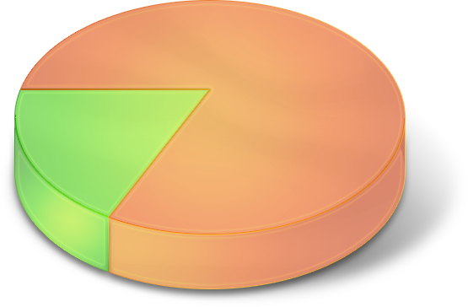
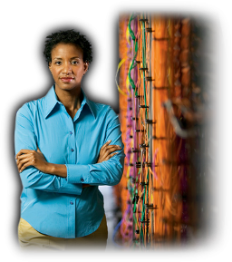
More Pressure Than Ever on IT
Technology Change
Security
Cost Reduction
Keep Business Up and Running
Increase
Utilization
Increase
Responsiveness
Business Results and New Value
Notes:
Key Message:
Amidst all these trends, there’s more pressure than ever on IT. The bulk of IT budgets today is spent just “treading water” rather than adding new business value. Microsoft is focused on trying to help your IT department flip that equation.
As companies grow, their IT infrastructures grow along with them. But more often that not, the pace of that growth is uneven, driven as much by the conditions under which they operate as the model they aspire to. You add an application here. You add functionality there. You add people across the board. Yet the more variables you add to your infrastructure, the harder it can be to manage and, more importantly, to keep secure.
So even as the costs for hardware and software are tracking downward, the costs of managing and supporting your infrastructure are increasing.
$140B is spent on management and support – yet s/w is only 6% of it. Software is an enabler…

Slide 5
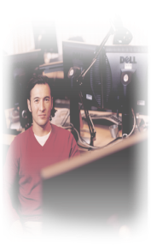
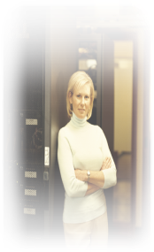
Virtualization Benefits
Enable
Agility
Increase
Availability
Reduce Total Cost of Ownership
Dynamic provisioning
Migration
Self-managing dynamic systems
Backup
Recovery
Business continuity
Power
Asset utilization
Application testing
Basic
Standardized
Rationalized
Dynamic
http://www.microsoft.com/io
http://www.microsoft.com/io
Notes:
Customer maturity; arrow from left to right

Slide 6
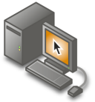
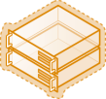
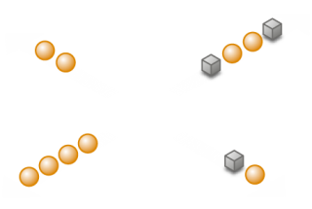
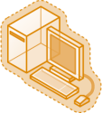
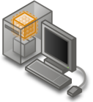
Microsoft Virtualization Products
A comprehensive set of virtualization products, from the data center to the desktop
Assets – both virtual and physical – are managed from a single platform
Server Virtualization
Presentation Virtualization
Management
Desktop Virtualization
Application Virtualization
6

Slide 7
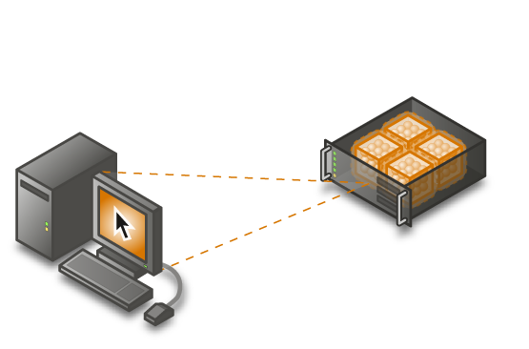
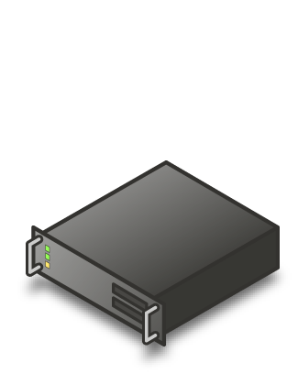
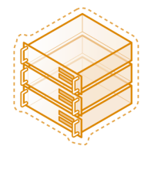
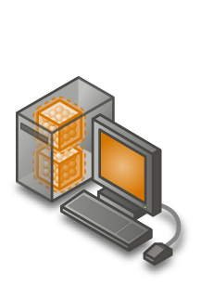
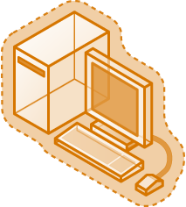
Reduce Total Cost of Ownership
Challenge:
Multiple management tools and learning curves
Application Virtualization
Server Virtualization
Presentation Virtualization
Solution: A single management platform that leverages existing investments
Desktop Virtualization
Application Virtualization
7

Slide 8
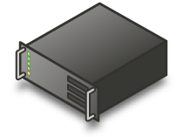
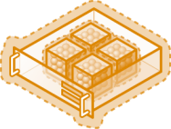
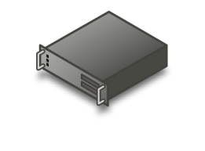
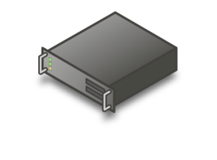
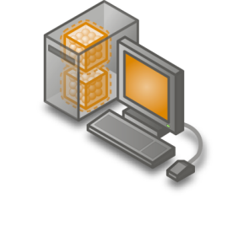
Increase Availability
Backup
Challenge:
Providing disaster recovery for business continuity for operating systems and applications
Microsoft System Center
Virtual Application
Server A
Solution: Virtualize operating systems and applications – enabling easy backup, replication and moving to available servers
Microsoft System
Center Virtual Application
Server B
8

Slide 9
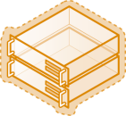
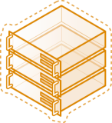
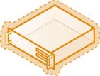
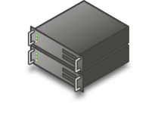
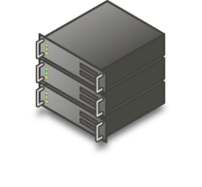
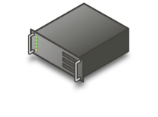
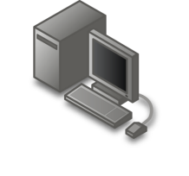
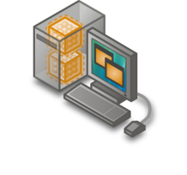
Improve Agility
Challenge:
Inability to respond quickly to changing needs at desktops and the datacenter
Solution: Quick migration and dynamic provisioning of servers and desktops are based on real-time needs using a single management platform
9

Slide 10
Focus – Server Virtualization
Hyper-V - A Hypervisor based virtualization platform

Slide 11
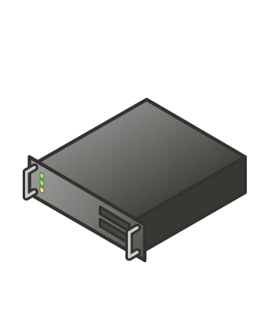
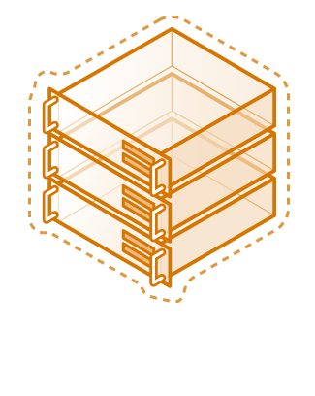
Server virtualization with Hyper-V
A hypervisor-based virtualization platform enabling consolidation of multiple physical systems and providing an integrated physical and virtual machine management
Challenges:
Underutilized hardware
Excessive power consumption
Minimizing planned and unplanned downtime
Server Virtualization
Hyper-V along with System Center Virtual Machine Manager enables you to lower costs, increase availability and progress towards a Dynamic IT environment
11

Slide 12
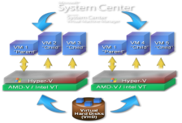
Hyper-V and Virtual Machine Manager
Improved Resource Optimization
Virtualization is a feature of Windows Server 2008
Greater scalability with x64 guest support and SMP support
Centralized virtual machine deployment and management
Increased Reliability and Security
Microkernelized hypervisor has an inherently secure architecture
Common management, security, driver model
Integrated with Active Directory® support and enables delegated VM management
Better Flexibility and Manageability
Support for Quick Migration and Live Backups
Broad management tool support including SC VMM
Enables rapid provisioning and patch management leveraging common tools and processes
VM
VM
VM
VM
VM
VM
VM
VM
VM
VM
VM
VM
VM
VM
VM
VM
VM
VM
VM
VM
VM
VM
VM
VM
12

Slide 13
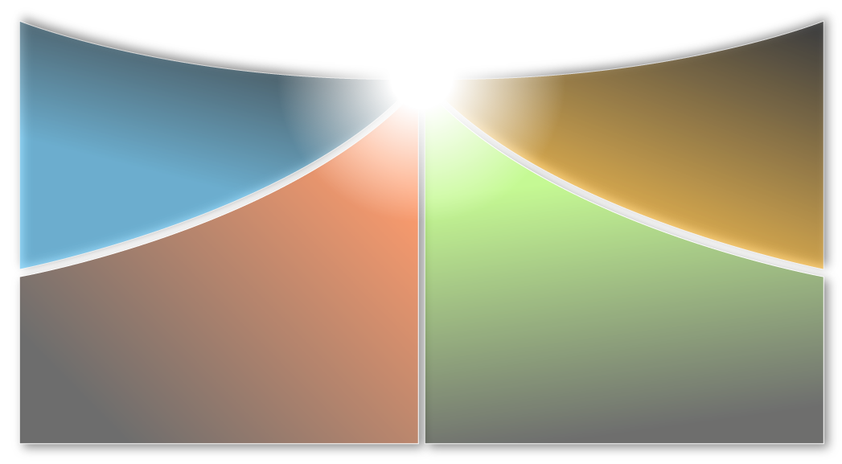
Virtualization to Increase Productivity
DFS replication
Remote Differential Compression
BitLocker and Read-only DC
Powershell
Centralized backup
Rapid, reliable recovery
Operational simplicity
Workload consolidation
Workload portability
Legacy application hosting
Specialized environments
Disaster recovery
Monitor operational status
Automate ticket generation
Robust reporting
13

Slide 14
Hyper-V Administration Console
DEMO!

Slide 15
Windows Server 2008 Hyper-V
Greater scalability and improved performance
x64 bit host and guest support
SMP Support
Increased reliability and security
Minimal trusted code base
Windows running a foundation role
Better flexibility and manageability
Quick Migration
New UI
Broad management tool support including SCVMM
VM 2 “Child”
VM 2 “Child”
VM 1 “Parent”
VHD
Windows Hypervisor
AMD-V / Intel VT
15

Slide 16
Machine Virtualization Fundamentals: VM Architecture
Type-2 VMM
Hybrid VMM
Type-1 VMM (Hypervisor)
Guest 1
Guest 2
VMM
Guest 1
Guest 2
Guest 1
Guest 2
Host OS
Host OS
VMM
VMM
Hardware
Hardware
Hardware
Examples: JVM CLR
Examples: Virtual PC & Virtual Server
Examples: Windows Server 2008 Hyper-V
16

Slide 17
Monolithic vs. Microkernelized
Monolithic hypervisor
Simpler than a modern kernel, but still complex
Contains its own drivers model
Microkernelized hypervisor
Simple partitioning functionality
Increase reliability and minimize TCB
No third-party code
Drivers run within guests
VM 1
(“Admin”)
VM 2
VM 3
VM 1 (“Parent”)
VM 2
(“Child”)
VM 3
(“Child”)
Virt
Stack
Hypervisor
Drivers
Drivers
Drivers
Drivers
Drivers
Drivers
Drivers
Drivers
Drivers
Drivers
Drivers
Drivers
Hypervisor
Hardware
Hardware
VMware ESX Approach
Hyper-V Approach
Microkernelized Hypervisor has an inherently secure architecture with minimal attack surface
17

Slide 18
Hyper-V: Architecture
Parent Partition
Child Partitions
Provided by:
Virtualization Stack
Microsoft
WMI Provider
Applications
Virtual Server
VM Worker Processes
VM Service
ISV
User Mode
OEM
Virtualization Service Clients (VSCs)
Windows Kernel
Server Core
Virtualization Service Providers (VSPs)
Windows Kernel
IHV Drivers
VMBus
Enlightenments
Kernel Mode
Windows hypervisor
“Designed for Windows” Server Hardware
18

Slide 19
Virtualization Management in System Center
Server consolidation via virtual migration
VM provisioning and configuration
Server health monitoring & management
Performance reporting and analysis
Patch management & software upgrades
VM backup and recovery
Disaster recovery
19

Slide 20
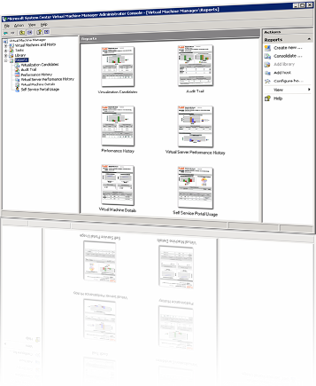
A centralized management application solution for Microsoft virtual server software.
Increased Physical Server Utilization
Deploys multiple virtual servers on 1 physical server
Increases flexibility
Sets up servers for testing
Decreases hardware costs
Centralized Management of Virtual Infrastructure
Uses MOM pack for reporting and health monitoring
Reports on consolidation candidates, utilization trending, optimization opportunities
Rapid Provisioning of New Virtual Machines
Enables end users to use Self Service Provisioning UI to request and place VMs
Enables administrators to configure rules and boundaries for provisioning
VM
VM
VM
VM
VM
VM
VM
VM
VM
VM
VM
VM
VM
VM
VM
VM
VM
VM
VM
VM
VM
VM
VM
VM
20
Notes:
System Center Virtual Machine Manager
Microsoft System Center Virtual Machine Manager is the latest addition to the System Center family of management products and provides centralized management of Windows Virtual Machine infrastructure. Virtual Machine Manager enables increased physical server utilization, centralized management of virtual infrastructure and rapid provisioning of new virtual machines by the administrator and end users.
Microsoft System Center Virtual Machine Manager is an enterprise management application for a virtualized data center. It enables increased physical server utilization, centralized management of virtual machine infrastructure and rapid provisioning of new virtual machines by the administrator and users. Virtual Machine Manager is fully integrated with the System Center product family.
Resource Optimization
Virtual Machine Manager delivers simple and complete support for consolidating physical hardware on virtual infrastructure and optimizing utilization.
Rapid Provisioning and Agility
Virtual Machine Manager provides rapid provisioning of virtual machines from physical machines, templates in the image library, or by users.

Slide 21
System Center Virtual Machine Manager
Customer Pain Points
Virtual Machine Manager Solution
Maximize Resources
Centralized virtual machine deployment and management
Intelligent placement of Virtual Machines
Fast and reliable physical-to-virtual-machine conversion (P2V) and virtual-to-virtual (V2V) conversion
Comprehensive service-level enterprise monitoring with Operations Manager integration
Operational Cost (management, power, space, risk of new systems)
Achieve Agility
Rapid provisioning of new and virtual machines with templates and profiles
Centralized library of infrastructure components
Leverage and extend existing storage infrastructure
Allow for delegated management of VMs
Speed of Provisioning (time to deploy, machine sprawl [physical and virtual])
Leverage Skills
Familiar interface, common foundation
Monitor physical and virtual machines from one console
Fully scriptable using PowerShell
Leverage knowledge in Active Directory® domain services to management of virtual machines
Management Capability (Separate solutions for virtual infrastructure, not integrated, specialized staff)
21
Notes:
Purpose of slide
One slide summary of customer pain points around virtualization and explain how SC VMM solves them

Slide 22
Virtual Machine Manager: Architecture
Client
Administrator’s Console
Self Service Web Portal
Integrated Application
Windows® PowerShell
Windows Communication Foundation
SCVMM Engine
Windows Remote Management (WS-MAN)
SCVMM Agent
SCVMM Agent
SCVMM Agent
BITS
BITS
Library
Host
P2V Source
22

Slide 23
What's in VMM
Every VMM component is remotely installable
Support for hosts in a Perimeter Network
Completely new Administrator Console
Completely new UI based on the System Center Framework - same as System Center Operations Manager, Service Desk, etc.
64-bit VMM Server support
Physical to Virtual Conversions (Windows Server 2003, Windows XP and Windows 2000)
Virtual to Virtual Conversions of VMware VMs and disks to Virtual Server VHD formats
Operations Manager 2007 Management Pack and Reports
23

Slide 24
System Center Virtual Machine Manager
DEMO!

Slide 25
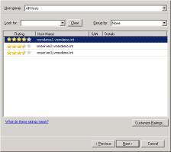
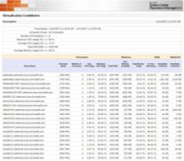
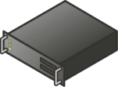
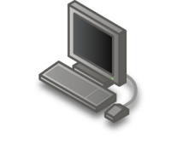
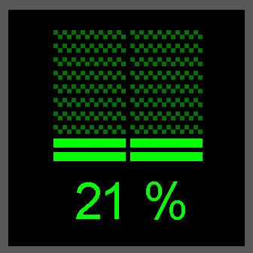
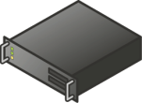
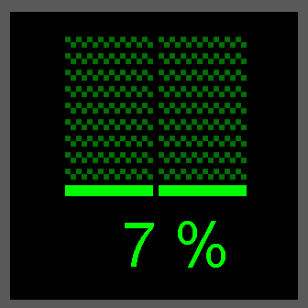
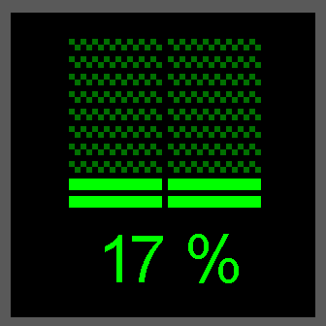
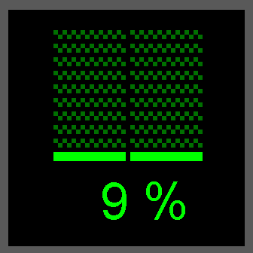
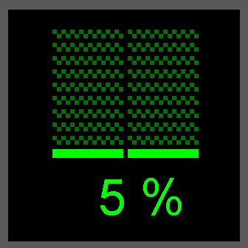
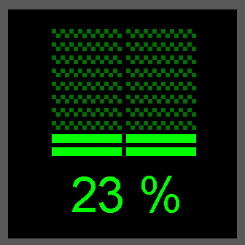
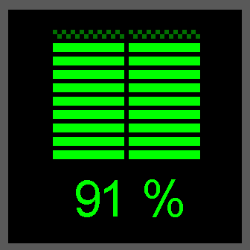
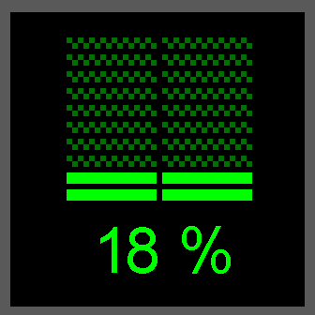
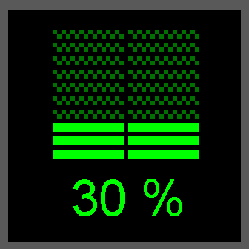
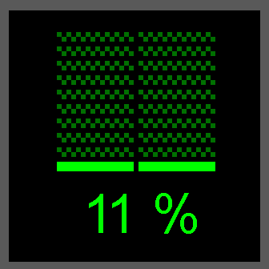
Scenario: Consolidation
Physical servers converted to virtual machines
Performance data collected to identify consolidation candidates
Physical machines retired or repurposed
Prioritized report of consolidation candidates
Virtual Machine Manager agents deployed to virtual machine hosts
Performance data collected from VM hosts for intelligent placement
Intelligent placement of each VM on optimal host
Physical Infrastructure
Virtual Machine Hosts
25

Slide 26
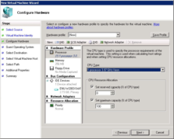
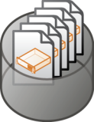
Scenario: Administrative Provisioning
New VM created from configured template
Pre-configured template selected for new VM
VM configuration customized from template
Intelligent placement of new VM on optimal host
Centralized Library of VM Templates
Performance data collected from VM hosts for intelligent placement
Virtual Machine Hosts
26

Slide 27
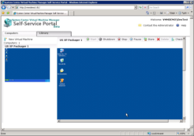
Scenario: Delegated Provisioning
Web-Based UI
VM created from administrator-assigned template
Delegated user begins creating new virtual machine
Updated web UI for delegated provisioning
Centralized Library of VM Templates
VM automatically placed on optimally designated host
Virtual Machine Hosts
27

Slide 28
Economics of WS Virtualization
The most cost-effective edition depends on the number of VMs per processor
Standard is most cost-effective for 1-3 VMs on a server
Enterprise is most cost effective for 4 VMs on a server and up to 4 VMs per processor
Datacenter is most cost effective for more than 4 VMs per processor
At 4 VMs per processor, Datacenter is slightly more but provides room to grow
28

Slide 29
Licensing
Infrastructure
Management
Interoperability
Applications
Deliver cost-effective, flexible and simplified licensing
Create agility
Better utilize server resources
Partner with AMD and Intel
Ease consolidation onto virtual infrastructure
Better utilize management resources
Free up IT spend
Support heterogeneity across the datacenter
OSP (Open Specification Promise) VHD
Server Virtualization Validation program
Accelerate deployment
Reduce the cost of supporting applications
Turn apps into dynamic, real-time services
29

Slide 30
© 2008 Microsoft Corporation. All rights reserved.
This presentation is for informational purposes only. Microsoft makes no warranties, express or implied, in this summary.
All other trademarks are property of their respective owners. The names of actual companies and products mentioned herein may be the trademarks of their respective owners.

Slide 31
Thank you

