Slide 2
WHAT
WHO
WHY
HOW

Slide 3
WHY - This Opportunity
Great “Reverse” attach Platform
Strong margin
Part of the leading SaaS Solution Set
#1 Brand Recognition
ARPU
Retention

Slide 4
WHY - On-Premises & On-Demand
On-Premises
On-Premises
On-Demand
On-Demand
Now SOON
On-demand is fastest-growing area in CRM (24%+ thru FY10)
EMEA CRM SPLA sales are up 100% in Q1 vs. FY 08.

Slide 5
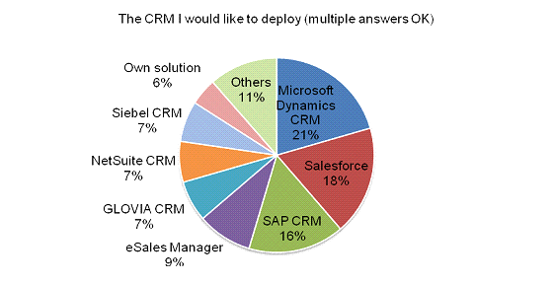
Customers WANT to Deploy Microsoft CRM
http://techtarget.itmedia.co.jp/tt/news/0803/03/news03.html

Slide 6
WHY- CRM Completes SaaS?
CRM
SharePoint
Exchange/
Outlook/OCS
Complete SaaS
Solution

Slide 7
WHY- Reverse Attach CRM Service Pricing
CRM is not a attach for MAPI is a new platform with Attach opportunity
SP Template or
Vertical Template
CRM - $60
Exchange Online
Standard -$10 USL
SharePoint Online
Standard -$7.25 USL
CRM
SharePoint
Exchange/
Outlook/OCS
Initial hosters’ experience substantial MS attach
Office Communications Online
(IM & Presence)- $2.50 USL
Complete SaaS
Solution
Office Live Meeting
Standard - $4.50 USL
Notes: 1) Indicative pricing in USD $
2) 30-50% up sell Value

Slide 8
WHAT – (makes it difficult)
Microsoft Dynamics CRM is a Gartner Top Right-Hand Quadrant CRM solution.
Is a business solution not a tool – Required VALUE selling and differentiation. You need to understand end-clients business needs in advance.
This is a volume business that requires tight integrations with a high touch partner

Slide 9
WHAT - Traditional Dynamics On-Premise
Partners:
Build directly onto the platform
Incorporate the Microsoft servers
Work with Partner software
Add to MS Business Apps
Supply Professional Services
Resell Microsoft and partner s/w
Partner Solutions
MS Servers and tools
O/S Extensions
Windows
(Building blocks, core services, API’s)
H/W
A highly profitable & successful partner driven ecosystem

Slide 10
WHAT- an expanded and NEW opportunity
Enterprise class solutions carry New “opportunities”:
Requires solution sales expertise
Requires clear understanding of end-clients business needs
Requires integration
Not tools
High touch service
A familiar but expanded opportunity
Partner Solutions
MS Servers
O/S Extensions
Windows
(Building clocks, API’s
Core Services)
H/W
Partner Hosting
Windows Cloud Services
(Building clocks, core services, API’s, Storage, Hosting)
Extension Services

Slide 11
What – A solution, not a provisioned session
Delivery and Integrations
SP Template or
Vertical Template
CRM - $60
Exchange Online
Standard -$10 USL
Templates and vertical expertise.
SharePoint Online
Standard -$7.25 USL
Office Communications Online
(IM & Presence)- $2.50 USL
Office Live Meeting
Standard - $4.50 USL

Slide 12
Who do you work with, who do you sell to
May have to re-invent as a business solution provider or find relationship with a business solution provider.
Look at your customer base
Cross sell / up sell
What verticals
Predict clients needs and define purchase personas
Find partners that match the vertical you are targeting
ALWAYS ALWAYS clearly understand who is selling to who.

Slide 13
Who - Sales
Solution Providers
GSI/SI/VAR
Who sells
Target Client
Hoster
Application
SI/VAR
Application
Hoster
UMM
1
Hoster
Managed
GSI
GSI
UMM/E
2
3
Telcos
Telco
MM/SMB
4
Small Hosters
SI/VAR
MS VAR
MM/SMB

Slide 14
Who – Can Help Help You Deliver

Slide 15
How – think like a buyer
Understand price point and operating margins. Make sure you understand your partners business.
Reach out to technical and business partners who can assist.
Find partners that match the vertical you are targeting
ALWAYS ALWAYS clearly understand who is selling to who and develop buying personas.

Slide 16
How Much
Hosted CRM with moderate Customization 10–25 Seats
Hosted CRM with vertical Customization and Backend Integration 5–50 Seats
Hosted CRM with Customization and Integration to Backend Systems 100–500 Seats
50–70 € per Seat/Month
50–100 € per Seat/Month
100–125 € per Seat/Month

Slide 17
Tools & Resources
Potential Hoster or reseller partners
Thinking about On-demand CRM
Transitioning
Taking off w/CRM
S+S Self Assessment tool
Technical Guidance
Hosted Exchange Connectors
TCO toolkit
Technical and Business Sessions
EMEA hosters now available
Sales Activation Workshops
Click-Try-Buy
ISV Hoster
White Paper
Campaign
in a Box
Ace/Nurture
S+S Self Assessment tool
ISV & Metro Recruitment
S+S Incubation Center
Hosting Days ISV track
Available
Hosters
Resellers
ISV

Slide 18
Who Sales
Click to Offer
Click to Sign-up
Day to 1st Contact
Hour to ‘Live’
Month to Close

Slide 19
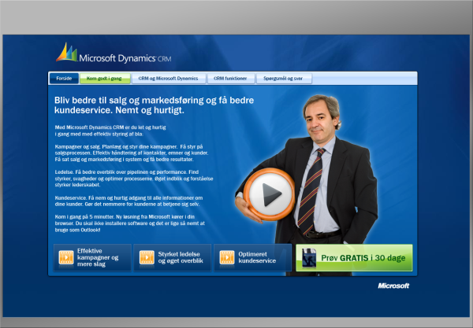
Click – Try - BUY

Slide 20
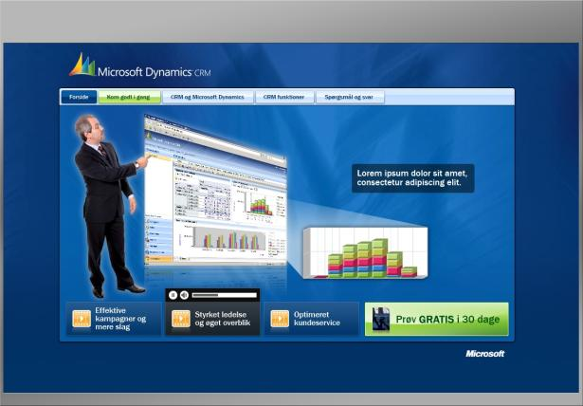
Click – Try - BUY

Slide 21
Solved
Why – Market demand, ARPU, retention
What – A business solution, vertical, competitive advantage
Who – Who is the end-client and How are you selling
How – Personas, 5-click, templates

Slide 22
Thank you

