Slide 2
Hosting Solutions Competency
Leverage Software + Services through tailored hosting solutions

Slide 3
The Hosting Game is Changing – Bringing Pressure AND Opportunities
Shift to Software+Services
Pursue new market opportunities
Pressure on pricing
Distinguish your company
Market attrition
Improve efficiency and effectiveness
Increased competition
Build better relationships
3

Slide 4
And Because Your Success Is Our Success
1
Microsoft is committed to the partner model
2
Microsoft seeks a win/win/win
3
Microsoft delivers to partners through MSPP
Microsoft
Total Revenue
96%
of
Microsoft revenue
is
partner driven
Partner Program
90%
80%
70%
Advance Innovation
60%
Build Trusted
Relationships
50%
40%
30%
Connect &
Engage
20%
Accelerate
Growth
10%
4

Slide 5
MSPP Supports Every Element Of Your Business
Advance Innovation
Build Trusted Relationships
Demo Showcase
Partner-exclusive training
MSDN subscriptions
TechNet subscriptions
Beta Program
Industry research
Project guides
Business Value Toolkits
Customer Satisfaction Index tracking
Partner-only information
Response management
Online concierge
Connect & Engage
Accelerate Growth
Internal-use software licenses
Customizable marketing campaigns
Incident support
Customer facing credentials
Technical Demonstration Toolkit
Leads and referrals
Partner Channel Builder
ROI calculators
Pre-sales technical support
Solutions accelerators
Best practice guides
5

Slide 6
Aligning Hosting to Customer Needs while moving up the stack
Enterprise
BPOS Dedicated
BPOS Standard
Partner Hosted Exchange | SharePoint | CRM
Low Customization
High Customization
Geographic requirements
Regulatory compliance
Transitory needs
Customized SLA
Custom code
Contract flexibility
Tailored features – Blackberry | Storage
Streamlined Communications and Collaboration
Security and Reliability
Simplified Management
SMB

Slide 7
Bringing Software+Services
to market with a VAR | SI
Don’t be a “commodity”
Bundle everything
Sell by the seat
Tailor to each customer
Key advantages
No “picking apart” pricing
Sticky relationships
Customer
VAR / SI
Hoster
Watch Video: https://partner.microsoft.com/global/productssolutions/40074158

Slide 8
Better Margins Result from Specialization within a Partner- Hosted Model
Dynamic CRM Partner Hosted
Dynamic CRM On Premise
Dynamics CRM Online

Slide 9
Start-Up Hosting
PROFIT
LOSS
Should I host or should I resell?
TIME

Slide 10
Three Levels of Engagement for Hosting Partners
Hosting Solutions Competency
Recruit
Engage
Grow
CS Hosting Community
Non-registered
Partner experience

Slide 11
CS Hosting Community Benefits Or "Why should I join?"
Sign up for industry specific newsletters that will keep you informed of all partner activities including
Training
New product releases
Upcoming events
PR
Readiness tools, basic sales & marketing tools (sell-with)
Deployment guidance
http://partner.microsoft.com/hostingcommunity
Notes:
6/18/2009 5:43 PM
11

Slide 12
Providing Targeted Benefits with the Hosting Solutions Competency
The Microsoft Hosting Solutions Competency gets you:
Solutions Listing in Customer Directory
Hosting Services Sales Toolkit
Clear and direct connection with Microsoft
Branding that demonstrates your experience and skills to customers
Hosting Product and Sales Training
Unique Vertical Offerings
Enhanced connections to partners and customers
Hosting research from IDC and Forrester to improve your market impact
12

Slide 13
Including Hosting-Oriented Licensing Benefits
Examples of Competency Licenses
Microsoft Office Enterprise 2007 | Up to 100 | Up to 500
Microsoft Exchange Server 2007 Enterprise Edition | Up to 5 | Up to 7
Microsoft Windows Server 2008 Enterprise Edition (x86, x64) 12 | Up to 3 | Up to 10
Microsoft Office Communications Server 2007 Enterprise Edition | Up to 4 | Up to 6
Microsoft Windows Vista Business and Enterprise Editions | Up to 100 | Up to 500
Microsoft SQL Server 2005 Enterprise Edition (x32, x64) | Up to 3 | Up to 10
Microsoft Office SharePoint Server 2007 | Up to 2 | Up to 4
Microsoft Dynamics CRM 4.0 Professional Server | Up to 3 (Professional) | Up to 3 (Enterprise)
For a complete list of the over 100 licenses available, go to the Hosting Solutions Competency Website
13

Slide 14
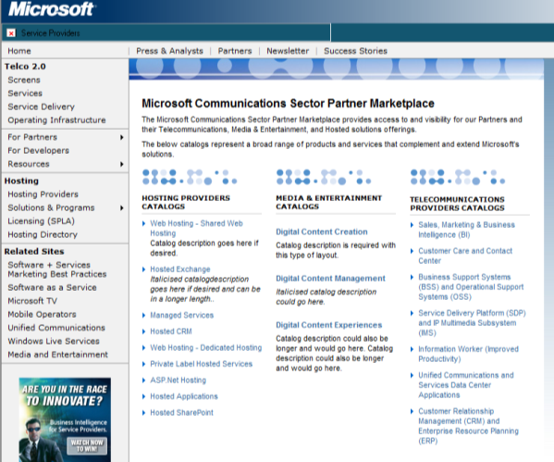
Partner Solution Marketplace
Notes:
6/18/2009 5:43 PM
14

Slide 15
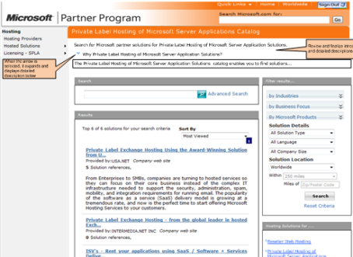
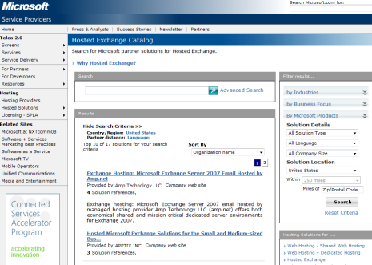
End Customer Hosting Catalogs link to SMS&P campaigns
Partner facing
End customer facing

Slide 16
Hosting Catalog Structure
Reseller Catalogs | End customer Catalogs
Reseller Web Hosting | Web Presence and Web Applications
Private Label Hosting of MS Server Applications | Hosted Business Email & Collaboration
 | Hosted Collaboration & Document Management
 | Hosted Customer Relationship Management
ISV Application Hosting and Consulting (S + S Incubation Centers) | Hosted Application (3rd party ISV apps)
 | Managed Services & dedicated hosting
 | Hosted Managed Desktop Solutions

Slide 17
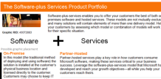
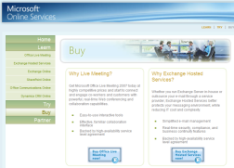
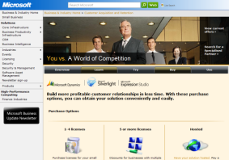
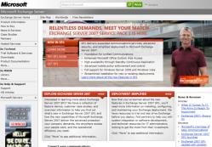
Driving Traffic to the Hosting Catalogs
S+S end customer site
www.microsot.com/Spluss
S+S MSPP
http://partner.microsoft.com/splus
BPOS
www.microsoft.com/online
Exchange
www.microsoft.com/exchange
Loc SMSP
Loc SMSP
Loc SMSP
Local SMS&P

Slide 18
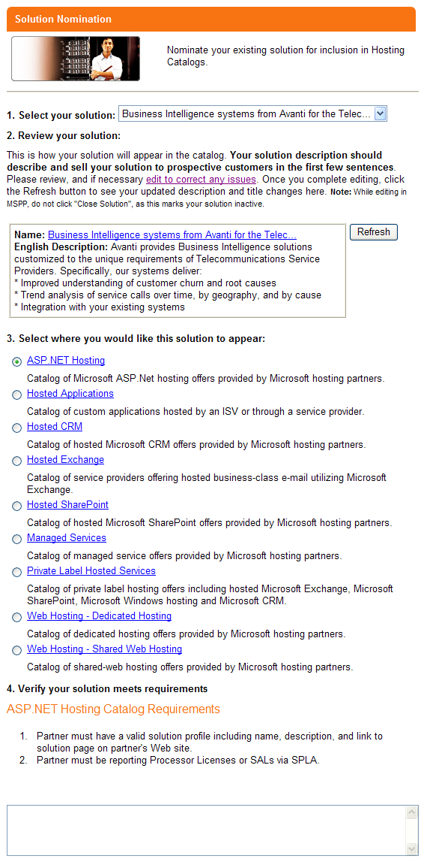
Solution Nomination Hosting
Select the Solution
Review the Solution
Choose the right Catalog
Verify the Requirements
Notes:
6/18/2009 5:43 PM
18

Slide 19
Meet Three Simple Requirements to Join the Competency
1
2
3
SPLA Requirements
75 Processor Licenses or 3000 SAL’s in the last 12 months.
Employ Two Microsoft Certified Professionals
Employ or contract at least two exclusive Microsoft Certified Professionals (MCPs).
Three Costumer References
You must submit at least three customer references that feature
the design and implementation of a hosting solution. The reference will remain valid for two years from the date the reference is approved.
Ad interim
* Annual fee for MSPP Certified Level is approximately $1500 USD – please check for regional variation
19

Slide 20
Resources to review
External - Hosting Competency:
https://partner.microsoft.com/global/program/competencies/mspphostingsolutions
Communication Sector Hosting Partner Community:
https://partner.microsoft.com/hostingcommunity
Notes:
6/18/2009 5:43 PM
20

Slide 21
Call To Action
Join the Hosting Solutions Competency
Publish your solution to the Hosting Catalogs and generate leads
Work with your PAM to leverage SMB hosting campaign material

Slide 22
© 2008 Microsoft Corporation. All rights reserved. Microsoft, Windows, Windows Vista and other product names are or may be registered trademarks and/or trademarks in the U.S. and/or other countries.
The information herein is for informational purposes only and represents the current view of Microsoft Corporation as of the date of this presentation. Because Microsoft must respond to changing market conditions, it should not be interpreted to be a commitment on the part of Microsoft, and Microsoft cannot guarantee the accuracy of any information provided after the date of this presentation. MICROSOFT MAKES NO WARRANTIES, EXPRESS, IMPLIED OR STATUTORY, AS TO THE INFORMATION IN THIS PRESENTATION.
Hosting Solutions Competency
22

