Slide 2
The Business Opportunity for Hosted Communication and Collaboration in the SMB market

Slide 3
Solution overview

Slide 4
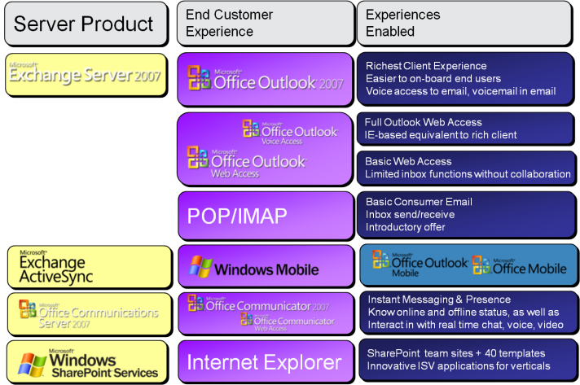
End Customer Experiences HMC 4.0 and 4.5

Slide 5
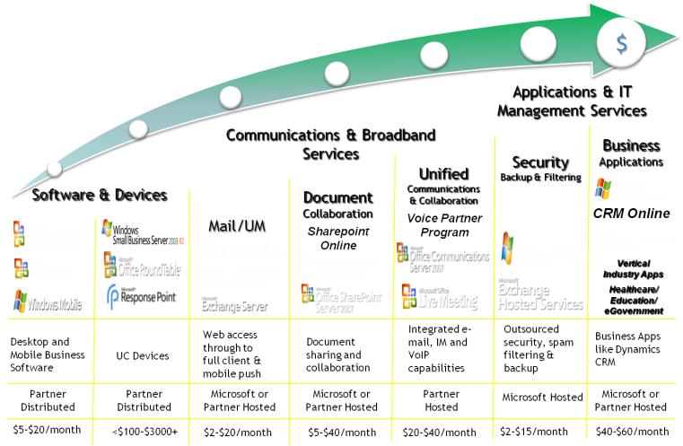
Sell With Business: Delivering the Business Services Revenue Roadmap
Over half of all Hosted Exchange customers plan to add at least one additional service
30% will add two or more
Notes:
5

Slide 6
Business Opportunities

Slide 7
Hosting helps you save your customers money
All companies – small and large – need to get more out of IT
With smaller IT investments budgets
The flexibility to scale IT up and down
With less risk but high security and privacy
Hosting is a great way to buy, deploy and consume IT solutions because it offers
Pay-as-you-go cost structure (per user per month)
No large upfront IT investment
Managed by professionals with resources needed
Flexibility to add/remove users/applications to exactly fit the business needs

Slide 8
Hosted Exchange Business Email Opportunity (EMEA)
Country | Overall Opportunity |  |  | Best candidates
 | % of SMB | # SMBs | # Users | % of SMB | # SMBs | # Users | Best Candidate Industries
NL | 41% | 153K | 804K | 13% | 47K | 239K | Professional Services, Finance, Retail, and Wholesale
BE | 58% | 267K | 1.2M | 25% | 113K | 404K | Professional Services, Transportation, Insurance, and Consumer Services
DE | 43% | 539K | 6.6M | 16% | 197K | 1.4M | Wholesale/Retail, and Services industries
NO | 52 | 63k | 367k | 19% | 24K | 99K | Professional Services, Wholesale, Consumer Services, and Manufacturing
DK | 40% | 50K | 319K | 13% | 16K | 68K | Professional Services, Utilities, Hotel / Restaurant, and Wholesale / Retail
FR | 57% | 803K | 4.8M | 14% | 200k | 888k | Wholesale/Retail, and Services
UK | 52% | 633K | 2.5M | 18% | 217K | 677K | Professional & IT Services, Transportation, and Wholesale
IT | 58% | 1.2M | 6.9M | 16% | 389k | 2.1M | Finance, professional Services, Transportation, and Healthcare
SE | 45% | 95K | 579K | 13% | 28k | 112K | Professional Services, Insurance, and Finance
CZ | 47% | 148k | 846K | 15% | 48k | 296k | Professional Services, It Service, Manufacturing, Retail, Wholesale
We have only just begun to take the penetrate the Best Candidates opportunity!
Source: Edge Strategies, 2005- 2008.

Slide 9
Example: German SMB Population
Adopters: 40% of SMB Companies expressed an interest in adopting Hosted Messaging and Collaboration at some price. (495k companies, 6.1m mailboxes)
Best Candidate* Opportunity: 16% (197k companies, 1.4m mailboxes) Willing to pay 15 € and would consider adopting within 12 months.
Short Term Opportunity: 2% (19k companies, 828k mailboxes) Willing to pay 7.50 € or more and consider adopting within 12 months.
Mid Term Opportunity: 6% (80k companies, 1.4m mailboxes) Willing to pay 7.50 € or more and consider adopting in a 12-24 months time frame.
Long Term Opportunity: 3% (40k companies, 281k mailboxes) Willing to pay 7.50 € or more and consider adopting in a time frame beyond 24 months.
Additional Potential Opportunity: 16% (203k companies, 2.7m mailboxes) Would consider adopting at a low price (2.50 - 5 €), or would not consider adopting but scored high on at least two dimensions of the Edge Messaging & Collaboration Needs segmentation matrix (see slides below).
Source: Edge Strategies Primary research done in 12 countries in EMEA.
Non-Candidates: 57% Did not indicate a willingness to adopt.

Slide 10
Korea
About ~17 % of SMB Companies ( 3-150 employees) are moving toward on- line versus on-premise as their primary computing environment. Majority expect a split ( hybrid) environment with both Hosted and On-Premise for the long term.
20% believe they would definitely benefit from HMC after the detailed description of HMC was presented to them. Another 45% believed they would probably benefit but will need to be
8% of small companies and 12 % of medium companies indicated a willingness to pay US $15 Per User Per Month (15,550 KRW) for full HMC email which included PUSH email, and the other features of HMC 3.5 WITHIN a YEAR. 29% overall would consider adopting in 2-3 years. We are not, however, recommending the 15,550 price point. This is only used as way to determine highest level of interest.
Many business were also interested in specific capabilities of HMC 4.5 /UC. VOIP and Hosted CRM were most desired as individual services. Business class IM is also of interest to mid-sized companies.
10% of small and 9 % of medium companies would consider the full package of UC services for US $50 (52,000 KRW) or more per user per month (Best Candidates).

Slide 11
Korea: 10% of SMB Companies in Korea are interested In considering HMC within the next year at $US 15.
Overall, 10% of SMB companies in Korea qualify as best candidates for Hosted Exchange over the next several years – these are the first firms to adopt.
8% of Small
12% of Medium
The best candidates for Hosted Exchange are defined as likely to consider Hosted Exchange for $15 or more per user per month, and likely to consider switching in 1 year or less.
Would consider
Hosted Exchange at…
Base: Not already using Hosted Exchange
Timeframe for switching to
Hosted Exchange
Base: Willing to consider Hosted Exchange
Best Candidates for
Hosted Exchange
 | Total (N=370) | Small (N=241) | Medium (N=129)
Best Candidate | 10% | 8% | 12%
Possible Candidate | 10% | 8% | 12%
Others | 81% | 83% | 75%
Possible Candidates have many reasons for exclusion from the “Best Candidate” category. Price, time frame, existing infrastructure, anticipated future growth, and lack of clarity on the value proposition are key factors.
DRAFT

Slide 12
China
36% of small and 28% of mid-sized business represent a significant opportunity for hosted messaging and collaboration and communication services and applications.
With respect to Hosted Exchange in particular, over half would consider or evaluate Hosted Exchange in the next few years.
13% of companies qualify as “Best Candidates” for Hosted Exchange (potentially interested in adopting at equivalent of us $10 within 2 years).
11% of Small companies with 1-50 employees
14% of Medium companies with 51 or more employees
Characteristics of “Best Candidates” include
Likely to be using POP email account
Growth Oriented
Part of work force is Mobile - Outside Sales and Customer Service
Best Industries are: Hospitality & Travel, IT, and Media and Manufacturing
Interested in Unified Communications is still at early stage,
Strong interest (29% of small, 25% of medium) expressed in CRM
Strong interest – for small companies – in Mobile office (24%).
First choice for hosted applications provider is either the mobile phone company (34% of small, 29% of medium) or a specialized hostedd app provider (29% of small, 30% of medium).

Slide 13
China: The best candidates for Hosted Exchange are defined as likely to consider Hosted Exchange for $10 or more per user per month, and likely to switch within 2 years.
Overall, 13% of companies qualify as best candidates for Hosted Exchange over the next several years. 38% are possible candidates if price were lower and / or a longer time frame is considered.
11% of Small
14% of Medium
Would consider
Hosted Exchange at…
Base: Not already using Hosted Exchange
Timeframe for switching to
Hosted Exchange
Base: Willing to consider Hosted Exchange
Best Candidates for
Hosted Exchange
 | Total (N=301) | Small (N=132) | Medium (N=169)
Best Candidates | 13% | 11% | 14%
Possible Candidates | 38% | 35% | 40%
Non-Candidates | 49% | 54% | 46%
Possible Candidates have many reasons for exclusion from the “Best Candidate” category. Price, time frame, existing infrastructure, anticipated future growth, and lack of clarity on the value proposition are key factors.

Slide 14
India
Over half of all companies agree that they could benefit from the capabilities of Hosted Exchange
13% of companies qualify as “Best Candidates” for Hosted Exchange
Interested in adopting at equivalent of us $10 within 2 years.
15% of Small companies with 1-24PCs
9% of Medium companies with 25 – 250 PCs
Characteristics of “Best Candidates” include
Likely to be using POP email account if smaller, or older exchange server if larger
Growth Oriented
Part of work force is Mobile - Outside Sales and Customer Service
Best Industries are:
Import/Export, Manufacturing, IT and to some extent, Retail
Strong interest (48%) is expressed in both VOIP
Including integrated voice applications which included Click-to-call from address book)
5% of smaller, and 20% of mid-sized, business would consider paying over $50 US per user for a complete package of Hosted Services including VOIP, but we believe that they would not require this complete package for all of their employees.
Strong interest in Hosted CRM (61%) at some point in the future.
A larger percentage of companies are interested in individual UC components such as web conferencing, Business IM and Document Sharing /Collaboration./

Slide 15
India: The best candidates for Hosted Exchange are defined as likely to consider Hosted Exchange for $10 or more per user per month, and likely to switch in 2 years or less.
We then asked whether, given the price, whether they would might consider switching within two years or less in order to determine who and how many many were most interested.
Overall, 13% of companies qualify as best candidates for Hosted Exchange
15% of Small
9% of Medium
Would consider
Hosted Exchange at…
Base: Not already using Hosted Exchange
Timeframe for switching to
Hosted Exchange
Base: Not already using Hosted Exchange
Best Candidates for
Hosted Exchange
 | Total (N=403) | Small (N=223) | Medium (N=180)
Best Candidate | 13% | 15% | 9%
Possible Candidate | 59% | 59% | 60%
Non Candidate | 28% | 26% | 31%

Slide 16
LATAM
16% of companies qualify as best candidates for Hosted Exchange (potentially interested in adopting at equivalent of us $15 within approximately one year.
18% of Small
12% of Medium
21% of companies in the three major metro areas agree that they could definitely benefit from having the capabilities of Hosted Exchange, and an additional 47%, feel that they would probably benefit.
Interest levels are highest in Sao Paulo( 46^%) followed by Bogota (53%) and Mexico City (34%)
Characteristics of “Best Candidates” include
Likely to be using POP email account if smaller, or older exchange server if larger
Growth Oriented
Part of work force is Mobile - Outside Sales and Customer Service
Best industries adoptions are: Business Services , Manufacturing, Retail
Over 17% I of smaller, and over 22% of mid-sized business would consider paying over $50 US per user for a complete package of Hosted Services including VOIP.
The wireline service provider was first choice of over 40% of all companies.
A substantial number of companies (~20%) would prefer Specialized Service Providers who has expertise in the particular applications of interest

Slide 17
LATAM: The “Best Candidates” for Hosted Exchange are defined as those who are likely to consider Hosted Exchange for $15 or more per user per month, and likely to consider switching in 1 year or less.
Overall, 16% of companies qualify as best candidates for Hosted Exchange
18% of Small
12% of Medium
Would consider
Hosted Exchange at…
Base: All respondents
Timeframe for considering to
Hosted Exchange
Base: Likely to consider
Best Candidates for
Hosted Exchange
 | Total (N=851) | Small (N=570) | Medium (N=281)
Best Candidate | 16% | 18% | 12%
Possible Candidate | 16% | 16% | 15%
Non Candidate | 69% | 66% | 73%

Slide 18
MEA Gulf
37% of small and 25% of mid-sized companies leaning toward increased use of Hosted Apps.
After describing the full HMC offer, but before considering cost, approximately 39% of SMB companies with (3-200 employees) indicated that their organizations would definitely benefit from having the capabilities available through HMC ( Hosted Exchange).
Improved communication with customers, better customer service and then better collaboration and increased productivity are the benefits that customers would expect
40% of small and 29% of mid-sized companies would at least consider HMC at some time in the future at the $10 per user per month price point
“Best Candidates” for HMC
Pay at least US $10 per month
14% would potentially adopt within a year.
20% of small and 18% of mid-sized companies based on a 2-year adoption

Slide 19
MEA/Gulf: The “Best Candidates” for Hosted Exchange are defined as likely to consider Hosted Exchange for $10 or more per user per month, and likely to switch in 2 years or less.
Overall, 20% of companies qualify as best candidates for Hosted Exchange - Companies willing to pay at least US $10 and purchase in less than 2 years.
22% of Small
18% of Medium
Would consider
Hosted Exchange at…
Base: All respondents
Timeframe for switching to
Hosted Exchange
Base: All respondents
Best Candidates for
Hosted Exchange
 | Total (N=648) | Small (N=274) | Medium (N=374)
Best Candidate | 20% | 22% | 18%
Possible Candidate | 51% | 51% | 51%
Non Candidate | 29% | 28% | 31%
Possible Candidates have many reasons for exclusion from the “Best Candidate” category. Price, Time Frame existing infrastructure, anticipated future growth and lack of clarity on the value proposition are key factors.

Slide 20
Hosted Exchange Business Email - Key Sales Drivers
49%
47%
41%
Anywhere Access
Mobility and Remote Access needs
Mobility
Work from home
Employees in home or branch Office
Device related synchronization
E-mail while traveling
Mobile push email
Get More Done
Collaboration needs
Better ways to share and track documents
Work together effectively
Check, Share Calendars
Share Ad-hock company information
Share Customer Information
Peace of Mind
Operational Efficiency and Effectiveness
Off-Site Back-Up
Lower TCO
Predictable costs, no large up front investment
Threat Protection
Quality and Availability of Tech Support
High Availability
Best candidates have multiple needs. 68% prefer a single source for their HMC and mobility Solutions. This is particularly true for Best Candidates

Slide 21
Up Selling POP Users to Premium Business Email
Best practices from the field: Business Email Up Sell campaign
Target: Your existing SMB users that use free POP email today
Benchmark Results
30% of all approached free POP mail users accept the trial
80% of active trial users buy premium Business Email
24% POP → Business Email conversion rate is the benchmark!
Use campaign tools and best practice recommendations to reduce risk
Should become part of the standard business/sales activities and processes
70% of Hosted Exchange Business Email seats were POP accounts
Offer free trial of premium Business Email offer
Ensure trial user become active users of the premium service
10% conversion ratio is a realistic objective initially

Slide 22
Not all Consumer are just “Consumers”
10%⁽¹⁾ or 22.8M⁽²⁾ of North American online adults run a business out of their home
In the US, home-based businesses account for nearly half of all businesses⁽¹⁾
Although these consumers conduct business from their homes, they mainly opt for consumer-class services over more robust business tiers of landline voice, Internet, or wireless voice and data services. […] Consumer product strategists at these service providers are currently missing a lucrative opportunity with these high-earning, tech-loving consumers by not adequately addressing both their personal and business needs.⁽¹⁾
Home Workers Buy telecom Services Like Consumer, Forrester Research, June 11, 2008
Service Providers’ Product Strategists Have Left The Home Worker Market Segment Untapped, Forrester Research, August 6, 2008

Slide 23
HMC Attached Services

Slide 24
Business Opportunity - Mobile
42% of all decision makers indicated that they would consider paying for HMC mobility features.
Push mail + data backup + device wipe
Those who are currently using PUSH email are more likely (52%) than others (38%).
WM users currently receiving free Push Email would pay between $5 and $8 per month for these services.
Companies with Windows Mobile users are significantly MORE likely to consider HMC than those who do not.
14% of SMBs are “Best Candidates” for HMC, 24% of SMB companies where a decision influencer uses WM Devices are “Best Candidates”.
Edge Strategies, Jan 2006. Sample: SMB (25% US, 25% Europe, 50% UK) with 50% 1-5, 25% 5-25 and 25% 26-100 employees.

Slide 25
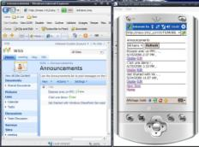
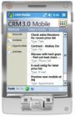
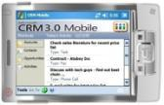
Microsoft Hosting is Mobile-Ready

Slide 26
New features of Hosted Exchange 2007 + Windows Mobile 6
Calendar
Setting up a meeting can view attendee status/forward meeting requests
Information search
Search Corporate directory as your Contacts database
Gain access to URL linked document from e-mail on SharePoint
Search Exchange server for stored messages (Inbox/Sub Folder)
Make being away from the desk easier
Increased protection of confidential messages and documents
Flag Messages
Setting Out Of Office
“Fetch” for long messages
One-touch keyboard shortcuts

Slide 27
SharePoint Market Opportunity
SMBs interested in Windows SharePoint Services–based solutions (US data)
24% Actively interested
Of all SMBS 5.4% Best candidates
Willing to pay US$10 per user per month and adopt within 12 month
Industry or Vertical | % of Best Candidates
Professional Services | 20%
Finance, Real Estate, and Insurance (FIRE) | 16%
Construction | 16%
Business Services | 11%
Consumer Services | 8%
Healthcare | 7%
Business Function | Description | % SMBs High Need
Project management | Coordinate schedules, tasks, and documents internally and externally | 39%
Problem Resolution | Assign responsibility, track progress, and resolve problems | 35%
“Lightweight” (CRM) | Share and update information on customer accounts, contacts, and sales | 28%
Centralized Document Management | Coordinate updating and distribution of company documents, lists, policies, and procedures | 26%
Departmental Portals | Access to department-specific information, regardless of location | 22%
Source: Edge Research

Slide 28
Going to Market with SharePoint – Business Solutions, not products
Intranet for your business
Project sites
Extranet: Stay in touch with customers and suppliers
Publish and broadcast (blogs and wikis)
Running business operations cost-effectively (Application Templates)
Develop applications quickly (SharePoint Designer, ASP.NET, Visual Studio)

Slide 29
Helping Partners Succeed

Slide 30
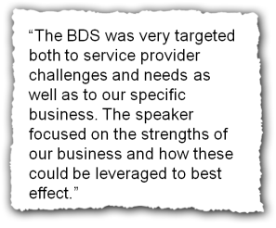
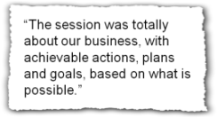
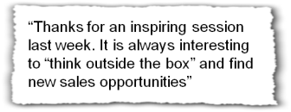
Helping Partners Succeed
Market research
Partner ecosystem
TAP Programs
ADS - Architecture & Design Session
BDS – Business Design Session
2-day workshop to (re)define offering and go-to-market, best practices, etc → action plan
HMC, ISV, WSS, CRM
Sales Training
Best Practices
Outbound Sales Workshops
Silverlight demos
Go-To-Market Support
With Microsoft SMS&P in countries

Slide 31
Outbound Sales Workshops and Resources
Outbound Sales Playbook
Sales Workshop
Results of MAPI up sell pilot
20% conversion POP users to MAPI using telesales agency
“How to” documented in Playbook
Available to partners and through MSPP Hosting Competency
Contacts for b2balive are
Rutger Pekelharing +31 653 494 521| r.pekelharing@b2balive.eu
Raoul Kloppenborg +31 654 320 340 r.kloppenborg@b2balive.eu
Half day executive workshop:
Objective is build the high level business case and to achieve full buy-in from the executive team in a (larger) service provider for increased investment in outbound sales resources.
US$ 4,500.
2 day outbound sales master class:
Deliverables are 1) a detailed business and 2) a project plan for the service provider to execute.
Cost is US$ 7,500.

Slide 32
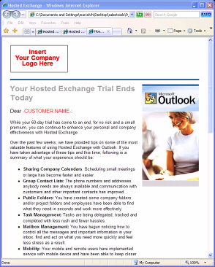
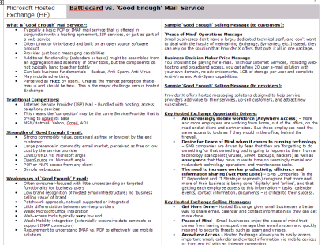
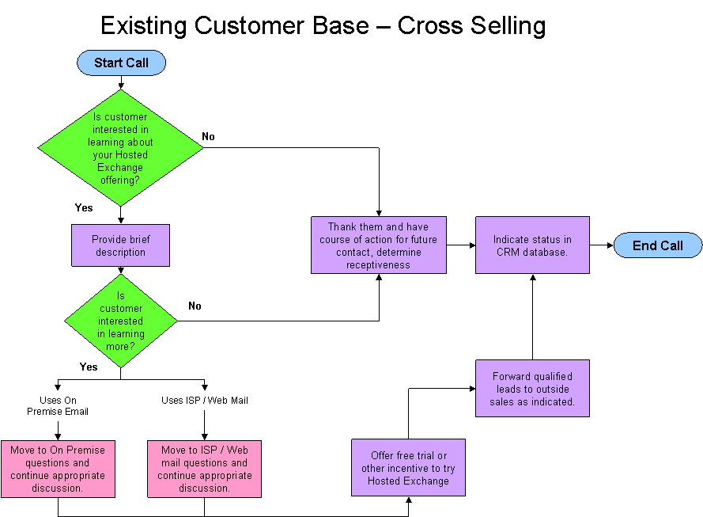
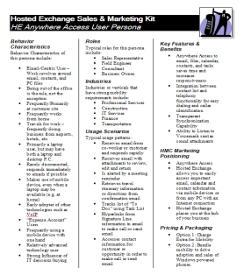
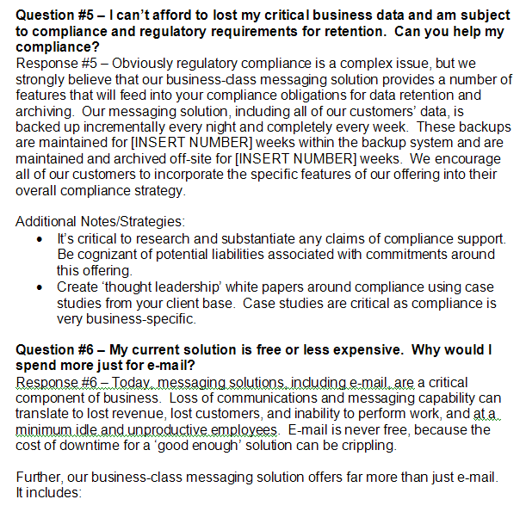
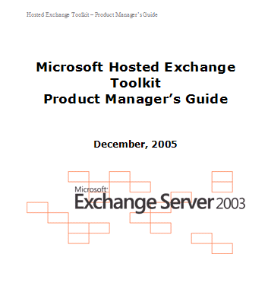
Hosted Exchange + SharePoint Sales Toolkit

Slide 33
HMC Sales Toolkit v2
Table of contents
8 Key Success Factors
Core Sales Materials
Telesales
Email Marketing
Exchange Hosted Services
Online Best Practices
Upsell Best Practices
Sales Training
Needs Analysis
TCD-TCO Tools
Supported Languages
V1: 11 languages
V2: English only today. Localization planned (FY08).
What’s New and Improved?
MAPI Up Sell Best Practices
Guidance on running an effective MAPI campaign.
Business Email Sales Training
Trainer’s guide and training decks
Online best practices
Guidance on how to promote and sell HMC online.
Key Success Factors in selling HMC
Greatly improved instruction for deployment and online examples of
Total Cost of Ownership calculator,
Cost of Downtime calculator
Needs Assessment Tool
http://tools.muralconsulting.com/
Exchange Hosted Service Toolkit
To help partners resell EHS.

Slide 34
© 2009 Microsoft Corporation. All rights reserved.
Microsoft, Active Directory, Excel, FrontPage, SharePoint, Visual Basic, Windows, the Windows logo, Windows Media, Windows NT, and Windows Server are either registered trademarks or trademarks of Microsoft Corporation in the United States and/or other countries. The names of actual companies and products mentioned herein may be the trademarks of their respective owners.
The information contained in this document represents the current view of Microsoft Corporation on the issues discussed as of the date of publication. Because Microsoft must respond to changing market conditions, it should not be interpreted to be a commitment on the part of Microsoft, and Microsoft cannot guarantee the accuracy of any information presented after the date of publication. Schedules and features contained in this document are subject to change.
This document is for informational purposes only. MICROSOFT MAKES NO WARRANTIES, EXPRESS, IMPLIED OR STATUTORY, AS TO THE INFORMATION IN THIS DOCUMENT.
The example companies, organizations, products, domain names, e-mail addresses, logos, people, places, and events depicted herein are fictitious. No association with any real company, organization, product, domain name, e-mail address, logo, person, places, or events is intended or should be inferred.
This presentation is for informational purposes only. Microsoft makes no warranties, express or implied, in this summary.

Slide 35
Thank you

