Slide 2
Software plus Services Architecture BEST PRACTICES FOR THE ISV

Slide 3
Context
Facts
Software as a Service (SaaS) is getting a lot of attention
Lots of buzz but little architectural guidance on the topic
Architecture Strategy Team is investing in SaaS Guidance
Currently, more an ISV topic than a SI or Enterprise
Today’s Objectives
Talk about the technical challenges of SaaS
Show you some basic architecture best practices
Show you where to go for more information

Slide 4
Agenda
Software as a Service (SaaS) Overview
Architectural Shift Overview
Some Design Patterns
Microsoft Resources that can help you
Q&A

Slide 5
Overview of software as a service

Slide 6
What Is a SaaS ISV?
Not all SaaS ISVs are created equal
Single / Multi-Tenancy
Degree of customization per “user”
Scalability of the service
Enterprise vs. consumer market
Monetization model
Sales model (direct/indirect)
…
Simply put:
Software deployed as a hosted service and accessed over the Internet.
As opposed to: “On premise”
2 categories of SaaS applications are getting the most attention:
(a) Enterprise LOB SaaS
(b) “Web 2.0” Consumer SaaS

Slide 7
SaaS “Actors” And Interests
SIs and VARs
“SaaS” Buyers (consumer/enterprise)
More control; Try before buy; Pay what I use; De-risk operations; Quicker time-to-value
Create marketplaces; Offer composite applications; Become a platform
Aggregators
ISVc
ISVd
ISVa
ISVb
Enable new business models (“long tail”, ad-funded); (Re)Architect for SaaS delivery
“SaaS” Hosters
Provide shared services (billing, SLA monitoring and enforcement) to SaaS ISVs
Move “up the stack” provide value-added services: Become SaaS hoster
“Classic” Hosters
With no deployment and little “in-house” customization, where can I add value?

Slide 8
SaaS is the Delivery Aspect of a Larger Value Proposition Called S+S
Software + Services
Web 2.0
+
SaaS
+
SOA
Experience
Monetization
Delivery
Composition
Federation
PC
Browser
Mobile
TV
Software
License
Subscription
Service
Transaction
Advertising
On Premises
Partner Hosted
Microsoft Hosted
Aggregation of Services
Directory federation
Storage
Computer resources

Slide 9
How does saas impact your system architecture

Slide 10
SaaS Affects the Entire Consumption Cycle In particular in the L.O.B. application space
Purchase
Deployment
Management
From:
Long eval process
CapEx
To:
Try before you buy
OpEx
From:
Customization
To:
Configuration
From:
Reliance on internal IT
To:
SLAs
Buyer
Enable:
Try before you buy
Enable:
Configuration (no custom code)
Enable:
SLA monitoring/ enforcement
Seller

Slide 11
Big Deal 1 Importance of economy of scale

Slide 12
Big Deal 2 The long tail
Dozens of markets of millions or millions of markets of dozens?
Your large customers
$ per Customer
What if you lower your cost of sale (i.e., lower barrier to entry) and you also lower cost of operations
Your typical customers
(Currently) “non addressable” customers
New addressable market  current market
# of Customers

Slide 13
Big Deal 3 Monetization options
Subscription (monthly fee per seat)
Transaction-based pricing (profit sharing)
Ad-based revenue (e.g., pay per click)

Slide 14
Big Deal 4 Humans are costly
Reduce human intervention
Interactive online marketing instead of pure
direct sales
Self provisioning
Self customization
Delegated administration
Automatic billing

Slide 15
Some Design patterns

Slide 16
Requires Architectural Shift Single instance – multi-tenancy
Multi-tenant efficient
Sharing resources (one instance to run them all)
Customizable
Customization through configuration
Scalable
Many applications will require Internet scale

Slide 17
“Basic” SaaS Maturity Model
1
Ad-hoc/custom
Application hosting model (ASP)
2
Configurable (but single tenant)
Physical or virtual isolation
Tenant 1
Tenant 2
Tenant 3
Tenant 1
Tenant 2
Tenant 3
Instance 1
Instance 2
Instance 3
Instance
Instance
Instance
3
Configurable, multi-tenant
4
Scalable, configurable, multi-tenant
Tenant 1
Tenant 2
Tenant 3
Tenant 1
Tenant 2
Tenant 3
Tenant Load Balancer
Instance
Instance
Instance
Instance

Slide 18
Share Versus Isolate
Share
SLA per tenant
Economy of Scale
Isolate
Data Separation
Simpler Management
The right balance is determined by…
Business model | “Can I monetize isolation?”
Architectural model | “Can I run on a single logical instance?”
Operation model | “Can I guarantee my SLA without isolating?”
Customer demand | “I want my data to be separate.”

Slide 19
High Level Application Architecture
Smart Client
Browser
Security Services
Meta Data Services
Presentation
Process Services
Directory
Service
Business Services
Meta Data
File System
Databases

Slide 20
Meta Data Service
Customizable
UI/Branding
Workflow
Data Model
Business rules
Domain-specific
Scope
Nested hierarchy of customization
Inheritable
E.g., Enterprise, department, user levels
UI/branding
Scope
Workflow/business rules
Data model extensions
Access control
Domain-specific ext.
0 or more scopes

Slide 21
Security Services
Authentication
Username/password, X509 certificates
SSO
Authorization
RBAC, rule-based
Audit
Security events
Policy driven on/off
Authentication
Authorization
Auditing

Slide 22
Access Control
Scope
Business Rules
Users
Role
Permission
Groups
…
Permission
Authorization policies can be defined at different scopes (enterprise, dept., etc.)
Permissions, roles, groups, and business rules can be customizable per tenant

Slide 23
Data Model Extension
Tenant A
Tenant B
Catalog Item
Product ID
Description
Category ID
Catalog Item
Product ID
Description
Classification Code
Challenges
Defining custom fields and storing custom data for each tenant
Business logic that can handle custom fields
Presentation logic that can handle custom fields

Slide 24
Custom Fields Data And Definition
Metadata/data dictionary required
3 general approaches
Separate database for each tenant
Shared database, a canned set of extended fields
Shared database, any number of extended fields
Tradeoff between each approach

Slide 25
Dedicated Tenant Database
Approach
Separate database for each tenant
Database maintains data dictionary
Advantages
Easy to implement
Meta data identifies database instance for each tenant
Tradeoff
Number of tenants per database server is low
Infrastructure cost of providing service rise quickly
When to use
When tenant has data isolation requirements
Able to monetize the data extension/isolation feature
Tenant 1
Tenant 2
Tenant 3

Slide 26
Shared Database, Fixed Set of Extensions
Approach
All tenants data in one database
Pre-defined set of custom fields
Advantages
Easy to implement
Maximize number of tenants per database server
Tradeoff
Tendency to results in sparse table
When to use
When data co-mingling is OK
Easy to anticipate pre-defined custom fields
Tenant ID | F1 | F2 | C1 | C2 | C3
345 | Ted | 53 | Null | Paid | Null
777 | Kay | 34 | 23 | Null | Null
784 | Mary | 45 | Null | Null | Null
345 | Ned | 21 | Null | Owe | Null
438 | Pat | 26 | Null | Null | Yes

Slide 27
Same Database, Variable Custom Extensions
Tenant ID | F1 | F2 | Record ID
764 | Ted | $56 | 893
673 | John | $32 | Null
783 | Sal | $99 | 564
Approach
All tenants in one database
Variable number of custom fields
Name-value pair in separate tables
Advantage
“Unlimited” number/option for custom fields
Tradeoff
Increase index/search/ query/update complexity
When to use
OK to co-mingle tenant data
Custom fields are high value features
Difficult to predict custom fields
Record ID | Name | Value
893 | Status | Gold
893 | Expire | 7-29-2008
564 | Affiliation | Acme

Slide 28
Scaling the Application
Stateless
Improve service memory footprint
Improve ability to load balance
Asynchronous I/O
Do useful work while waiting for I/O to complete
Resource pooling
Threads, network and database connections
Maximize concurrency
Minimize exclusive locking

Slide 29
Shared Services
Smart Client
Browser
Security Services
SaaS Provider
Meta Data Services
Presentation
Process Services
Directory
Service
SaaS Hoster
Shared Services: E.g., Billing, Metering, SLA Monitoring… a.k.a. SO Infra, Service Delivery Platform, OSS/BSS
Business Services
“Classic” Hosting CPU-Storage-Bandwidth
“Classic” Hoster
Meta Data
File System
Databases
As provider: Do you build or buy the hosting?

Slide 30
Fundamental Question “Do it yourself” vs. get it “as a service”
Do it yourself
(high control but low EoS)
Not possible
(high Control – high EoS)
High
Control
Tradeoff
Not interesting
(low control – low EoS)
“As a service”
(high EoS but low control)
Low
Economy of Scale (EoS)
Low
High
Trading control for economy of scale (or vice versa)
Do it yourself = High control but low economy of scale
Get it “as a service” = High economy of scale but low control

Slide 31
Microsoft resources that will help you

Slide 32
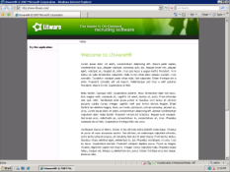
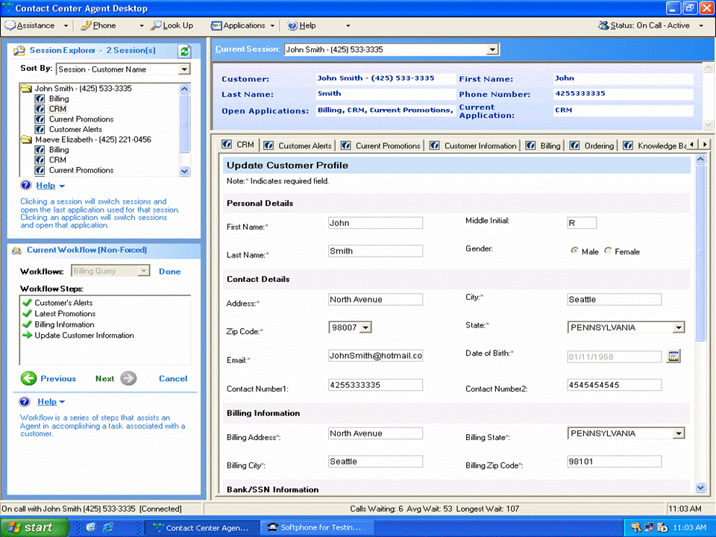
LitwareHR Reference Application Multiple clients, servers + services
http://www.codeplex.com/LitwareHR
Private
Website
Functional
Services
Web Client
SQL Server
Multi-Tenant Data Access
Public
Website
Metadata
Services
Network
SQL Server
Data Services
Smart Client
WCF/WF
REST/ SOAP APIs

Slide 33
Application Design Tools The Software+Services Blueprints Library
Blueprints Manager
Add-in for Visual Studio
Manages Blueprint components
Facilitates their use on Visual Studio projects
Build-your-own-Blueprint tools
Blueprint Kits for S+S
process guidance,
human-readable resources (docs, decks, videos, etc.)
machine-readable resources (code snippets, templates, frameworks, DSL tools, etc.)
Blueprints available today
Outlook + Services
Video.Show (Jan 08)
Silverlight in Sharepoint
Multi-Tenant Data Access
Desktop Services Host
Sync Framework
Workflow Activity Factory
Third party Blueprints
InfoSys Blueprints library
Many more coming this year
Visit http://www.codeplex.com/blueprints

Slide 34
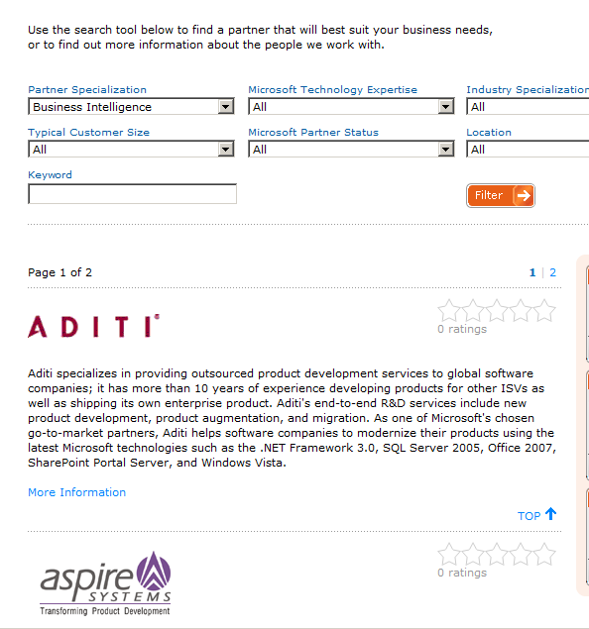
Find a Development Partner: www.isvnxt.com
Directory of S+S Development Partners
Specialists in Platform Migrations
Specialists in Product Development

Slide 35
Select the Right Hosting Partner
Software+Services Incubation Centers are hosters who specialize in bringing ISVs to market
Business Design Sessions
The program provides the SaaS ISV with
Business Design Session
Architecture Design Session
Access to Microsoft development partners
Microsoft Gold Certified hosting
Access to new channels to market
Additional technical and business guidance
Architecture Design Sessions
Proof of Concept/Launch
Catalogue
Find a partner today:
http://www.microsoft.com/hosting/programs/incubationcenter.mspx

Slide 36
For More Information
Microsoft SaaS Incubation Center Program
http://www.microsoft.com/hosting/programs/incubationcenter.mspx
Microsoft ISV Connector
http://www.microsoft.com/isv
Microsoft Software plus Services
http://msdn.microsoft.com/en-us/architecture/aa699384.aspx
Microsoft Software plus Services hosting providers
http://www.microsoft.com/serviceproviders/scenarios/softwareasaservice.mspx
Microsoft Partner Program
https://partner.microsoft.com/global/program/competencies/isvsolutions
How Microsoft products are licensed by hosters and S+S ISVs
http://www.microsoft.com/serviceproviders/licensing/default.mspx
Special information for Startups
http://www.microsoftstartupzone.com/

Slide 37
Questions?

Slide 38
© 2008 Microsoft Corporation. All rights reserved. Microsoft, Windows, Windows Vista and other product names are or may be registered trademarks and/or trademarks in the U.S. and/or other countries.
The information herein is for informational purposes only and represents the current view of Microsoft Corporation as of the date of this presentation. Because Microsoft must respond to changing market conditions, it should not be interpreted to be a commitment on the part of Microsoft, and Microsoft cannot guarantee the accuracy of any information provided after the date of this presentation. MICROSOFT MAKES NO WARRANTIES, EXPRESS, IMPLIED OR STATUTORY, AS TO THE INFORMATION IN THIS PRESENTATION.

Slide 39
Case studies

Slide 40
Success Stories
Click logo to see details
Real Estate Performance Management, through Microsoft Office integration
Innovative data visualization and analysis in Excel
Solution provider delivers greater flexibility to customers
LogicaCMG wins Microsoft partner award for innovative USB mobile security solution
Web-based accounting solution increases business growth, customer flexibility
Solution provider helps client save 39% with Software + Services solution
Solution developer helps customers minimize recruitment costs with Web-based model
Portable Payment System integrates with Windows Mobile and other ISV applications
S+S based Sales Tax calculation service integrates with MS Dynamics and other Accounting systems

Slide 41
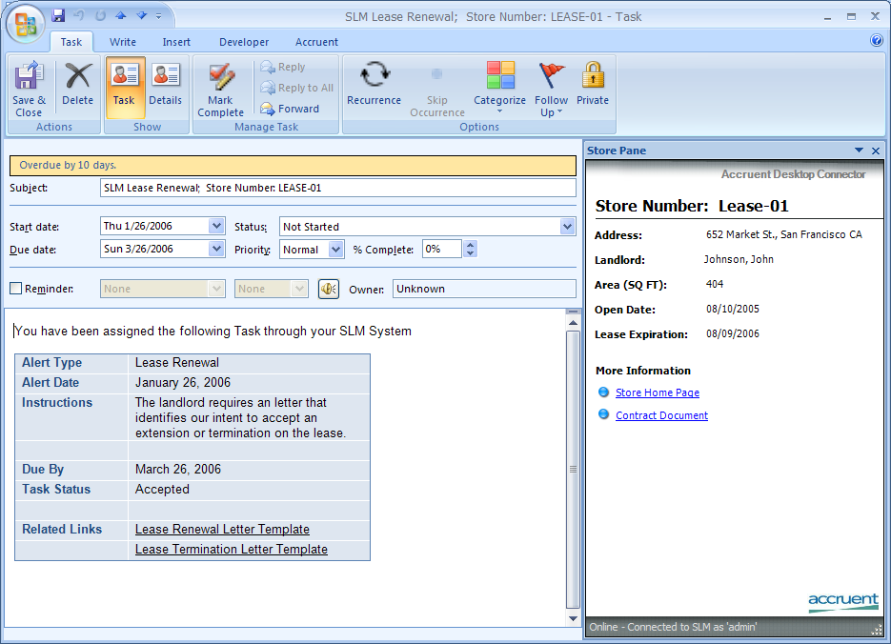
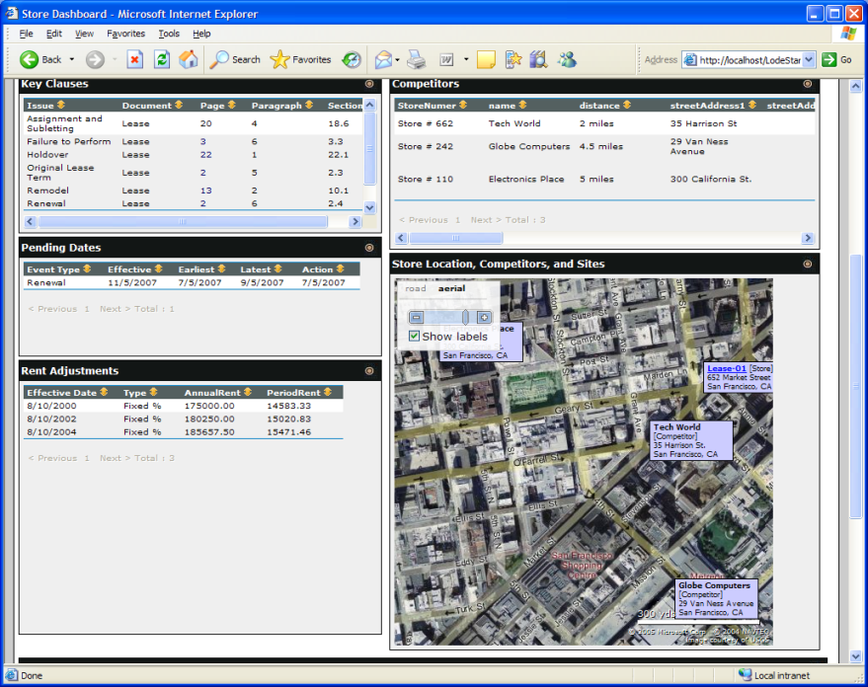
USA
ISV
www.accruent.com
Real Estate Performance Management: Creating visibility across the real estate lifecycle to deliver revenue growth, cost reduction, and compliance
Capability
BI and Portals
Key Office 2007 Technologies Used
Excel
Exchange
Outlook
SharePoint Server
Word
XML file format
Virtual Earth
About Accruent
Accruent, is the leader in real estate performance management (RPM) application solutions. Accruent has over a decade of innovation in the market and helps more than 340 of the world’s most demanding companies manage real estate cost and revenue drivers to optimize their impact on company performance. This experience and customer best practices are institutionalized and embedded into our solutions.
The information contained in this document relates to prerelease software product which may be substantially modified before its first commercial release. Accordingly, the information may not accurately describe or reflect the software product when first commercially released. This document is provided for informational purposes only and Microsoft makes no warranties, express or implied, with respect to this document or the information contained in it.
➔ Case Studies Overview
Notes:
41

Slide 42
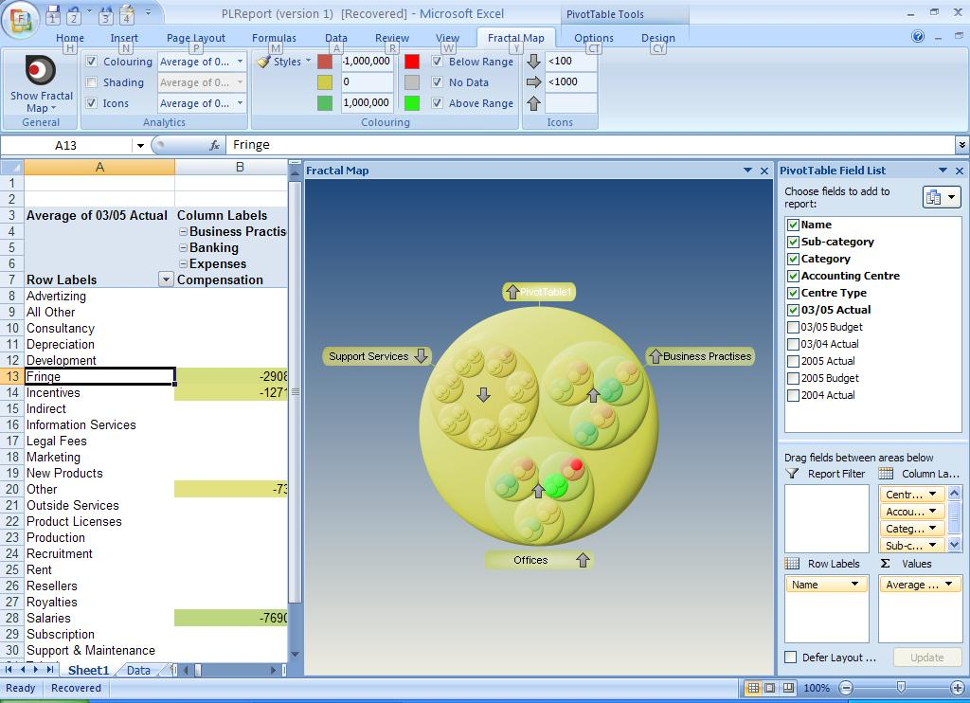
USA
ISV
www.fractaledge.com
Fractal Maps for Office 2007: Award-winning data visualization system made readily available to all information workers for the first time
Capability
BI and Portals
Key Office 2007 Technologies Used
Excel
Pivot tables
XML file format
Custom ribbon/task pane
Analysis/ Reporting Services
About Accruent
We provide breakthrough data visualization software that allows our customers to understand and act on their business intelligence more quickly and accurately.
8 of the global top 10 investment banks use our patented technology for compliance and risk management. Now, with Fractal Maps for Office 2007, you too can find out how to get more out of your critical business information.
The information contained in this document relates to prerelease software product which may be substantially modified before its first commercial release. Accordingly, the information may not accurately describe or reflect the software product when first commercially released. This document is provided for informational purposes only and Microsoft makes no warranties, express or implied, with respect to this document or the information contained in it.
➔ Case Studies Overview
Notes:
42

Slide 43
“We’ve experienced 50% year-over-year growth, but, really, our opportunities are limitless because the Software + Services model removes... [price as an obstacle] for our customers.”
– Srikant Rao, Chief Executive Officer, Affordable Business Solutions
Solution provider delivers greater flexibility to customers
Profile
Partner
Affordable Business Solutions (ABS)
Bangalore, India
Type: ISV/VAR
Customers
Raman FibreScience
Products involved
Microsoft Dynamics AX 4.0
Microsoft Dynamics CRM 3.0
Microsoft Dynamics NAV 5.0
Microsoft Office Project Server 2007
Microsoft SQL Server 2005
Customer Business Challenge
Targets India’s small and midsize businesses
Wanted to remove high up-front costs as barrier for customer adoption of solutions
Customer Results/Benefits
Revenue
Annual revenue growth of 50%
Reach
Increased business scalability
Partnership support for enhanced credibility
Flexibility
Improved flexibility for customers
Solution
Joined the Microsoft® Partner Program as a Microsoft Dynamics™ implementation partner
Decided to offer business solutions through hosted Software + Services model
➔ Case Studies Overview

Slide 44
“Our Microsoft partnership was crucial in ensuring that this unique solution was deployed and supported correctly from a legal standpoint.”
– Martin Kiaer, Principal Consultant, LogicaCMG
LogicaCMG wins Microsoft partner award for innovative USB mobile security solution
Profile
Partner
LogicaCMG, a global IT services and wireless telecom company based in Europe, employs 20,000 staff in 34 countries, and has nearly 40 years of experience
Type: Hoster/ISV
Products involved
Microsoft SQL Server 2000
Microsoft Windows 2000 Server
SAP on Microsoft Technologies
Customer Business Challenge
Develop mobile computing solution for clients with security concerns
Show that Windows®-based mobile solution is more secure, reliable, and flexible than a Linux-based solution
Grow market for new solution
Customer Results/Benefits
Reach
Danish National Police chose Windows-based solution over Linux
Revenue
Boost security solution revenue 20%
Velocity
Microsoft alliance helps to grow market share, to drive innovation, and to endorse the solution through awards
Solution
Created an adaptable mobile solution that allows users to boot Windows XP from a USB device
Worked with Microsoft Partner Program to solve licensing issues
➔ Case Studies Overview

Slide 45
“The small-business market presents us with a massive opportunity, and it’s a market that is easy to reach with Software + Services because we can offer a low cost for entry.”
– Rod Drury, Chief Executive Officer, Xero
Web-based accounting solution increases business growth, customer flexibility
Profile
Partner
Xero is a 32-person strong company offering an online accounting system for small and medium sized businesses
Wellington, New Zealand
Type: ISV
Products involved
2007 Microsoft Office suites
Microsoft ASP.NET
Microsoft SQL Server 2005
Microsoft Visual Studio 2005
Microsoft Visual Studio 2005
Team Foundation Server
Customer Business Challenge
Built Web-based accounting solution for small businesses
Chose to build as a subscription service
Decided to use Microsoft products and development tools
Customer Results/Benefits
Reach
Faster introduction to new markets
Velocity
Increased opportunity for growth
Rapid Product Development
Flexibility
Access to resources
Increased exposure for more sales opportunities
Solution
Joined the Microsoft Partner Program and achieved Gold Certified Partner status in May 2007
Was the first independent software vendor to be certified as a hosted solution provider in New Zealand
➔ Case Studies Overview

Slide 46
“We view the Software + Services model as a way to offer small and start-up businesses the same financial management and CRM solutions that are typically reserved for upper midsize and enterprise organizations.”
– Jeff Pyden, Managing Director, OmniVue Business Solutions
Solution provider helps client save 39% with Software+Services solution
Profile
Partner
Alpharetta, Georgia–based OmniVue Business Solutions is a Microsoft® Gold Certified Partner that provides hosted and on-premise Microsoft Dynamics business solutions
Type: Hoster
Customers
Flo Healthcare
Products involved
Microsoft Dynamics CRM 3.0
Microsoft Dynamics GP 10.0
Microsoft Dynamics SL 6.5
Microsoft Exchange Server 2007
Microsoft Forecaster
Microsoft FRx
Microsoft SQL Server 2000
Microsoft Virtual Server 2005
Microsoft Windows Server 2003
Customer Business Challenge
Provides small and midsize companies with enterprise-level financial and business solutions
Wanted to give clients a range of software, financing, and support options
Customer Results/Benefits
Reach
Ability to offer added value to clients
Revenue
Increased growth opportunity with 100% to 200% growth in hosting revenue in the last few years
Flexibility
Improved quality of life for consultants
Solution
Decided to offer organizations choice of on-site or hosted solutions
Provides Software+Services offering, which is especially helpful for start-up organizations
➔ Case Studies Overview

Slide 47
“Software + Services also makes it possible for companies to streamline their accounting practices – some of our customers have used our solutions to reduce invoicing costs by up to 75 percent.”
– Nick Ray, Chief Executive Officer, expressHR
Solution developer helps customers minimize recruitment costs with Web-based model
Profile
Partner
Feltham, England–based expressHR is a leading provider of recruitment vendor management technology for permanent, temporary, and contract labor
Type: ISV
Customers
Carillion
Products involved
Microsoft SQL Server 2005
Microsoft Windows Server 2003
Enterprise Edition
Customer Business Challenge
Provides automated recruitment solution for enterprise organizations
Wanted to provide better access to information for employers, recruiters, and potential employees
Customer Results/Benefits
Revenue
Expanding revenue base; 35% yearly growth
Reach
Greater customer acceptance, value
Partnership support and credibility
Velocity
Faster deployment and greater flexibility for software changes
Solution
Developed a Software+Services business model in which expressHR hosts the solution and customers pay based on their transaction throughput
Joined Microsoft Partner Program
➔ Case Studies Overview

Slide 48
“Our software-plus-services approach, our use of Microsoft technologies, and our innovative design all contribute to a solution that’s making a positive difference for our customers.”
– Ross Gillies-Tuck, Senior Product Manager, Mint Wireless
Portable Payment System integrates with mobile devices, accounting packages, and the web
Profile
Partner
Mint Wireless set out to provide a solution that could help on-site workers of all kinds—from mechanics to builders—immediately collect credit card payments from a customer
Type: ISV
Customers
Waste Wizards
Whitford City Glass
Concrete Cutting
Just Desserts
Products involved
.NET Framework
Windows Server 2003
SQL Server 2005
Windows Mobile 5 & 6
Customer Business Challenge
Mint wanted to create a mobile payment solution so that trades people and other mobile on-site workers could better manage their cash flow
Customer Results/Benefits
Improved cash flow and reduced administration
Cost-effective subscription-based solution
Ease of use
Ease of maintenance
Enhanced security
Solution
Using Microsoft technologies and a software + services approach, Mint Wireless developed a solution that supports mobile credit card payments, invoicing, and transaction integration with accounting systems
➔ Case Studies Overview

Slide 49
“The software-plus-services approach allows us to provide small and mid-sized organizations with the ‘big business’ protection of sales tax automation without breaking their budgets.”
– Marshal Kushniruk, VP of Customer Experience and Strategic Accounts, Avalara
Solution Provider solves Sales Tax complexities using Software + Services
Profile
Partner
Avalara is a solution provider focusing on transactional tax services. The company, located on Bainbridge Island, Washington, has about 100 employees
Type: ISV
Customers
Tapco
Moveable Cubicle
Products involved
ASP.NET 2.0
Visual Studio 2005
SQL Server 2005
Customer Business Challenge
Avalara recognized a need for affordable sales tax calculation and compliance services by small and mid-sized businesses
Customer Results/Benefits
Smaller businesses benefit from an affordable sales-tax services
Customers save valuable time and resources while reducing exposure to possible audits
Solution provider sees rapid business growth
Solution
Avalara created AvaTax, a sales tax calculation service that is built on a software-plus-service model
The cloud-based AvaTax service integrates with MS Dynamics and other Accounting systems using adapters
➔ Case Studies Overview

