Slide 2
Microsoft Programs for S+S ISVs

Slide 3
Agenda
Introductions
The investigation stage
The buildout stage
The market/sell stage
How you can get started

Slide 4
Introductions
Software+Services offers tremendous opportunity for ISVs
Combine online and offline features
Reach new customers and new markets
Up-sell new features to existing customers
Software+Services presents many challenges for traditional ISVs
New product architectures
New operational responsibilities
Moving from prepaid to subscription selling
Microsoft has programs to take you there step by step

Slide 5
Resources for every stage of your development
Investigate
Buildout
Market & Sell
Software plus Services ISV Roadmap Portal
Online Readiness Self-Assessment
BizSpark
Microsoft Technology Centers
NXT Program
S+S Incubation Centers
Business Growth Webinars
Lead generation support: Partner EDGE program
Microsoft Partner Program

Slide 6
Agenda
Introductions
The investigation stage
The Software+Services ISV roadmap portal
The Software+Services online readiness self-assessment for ISVs
The buildout stage
The market/sell stage
How you can get started

Slide 7
S+S ISV Roadmap Portal
Your starting point to learn about Software+Services for ISVs
Links to Software+Services content across all major Microsoft properties (MSCOM, MSDN, Partner Portal)
Organized by development stage, type of ISV and type of content
http://www.microsoft.com/hosting/isv.mspx

Slide 8
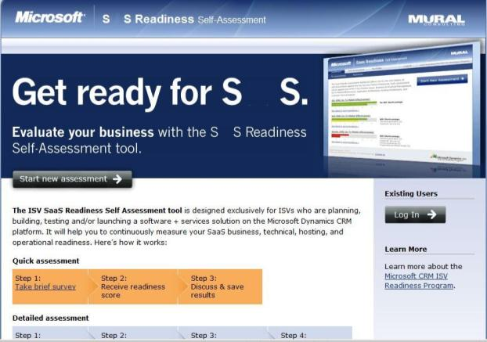
Evaluate your business readiness for S+S: free online self-assessment
+
+
+
S+S Success
Visit http://www.splussready.com
and start an evaluation today

Slide 9
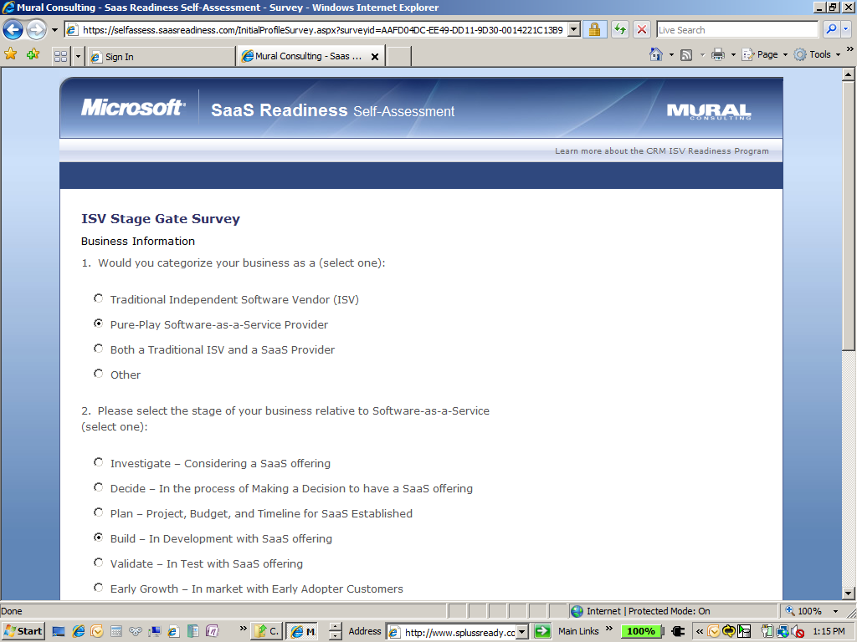
Profile your business along key criteria to obtain targeted questions and recommendations

Slide 10
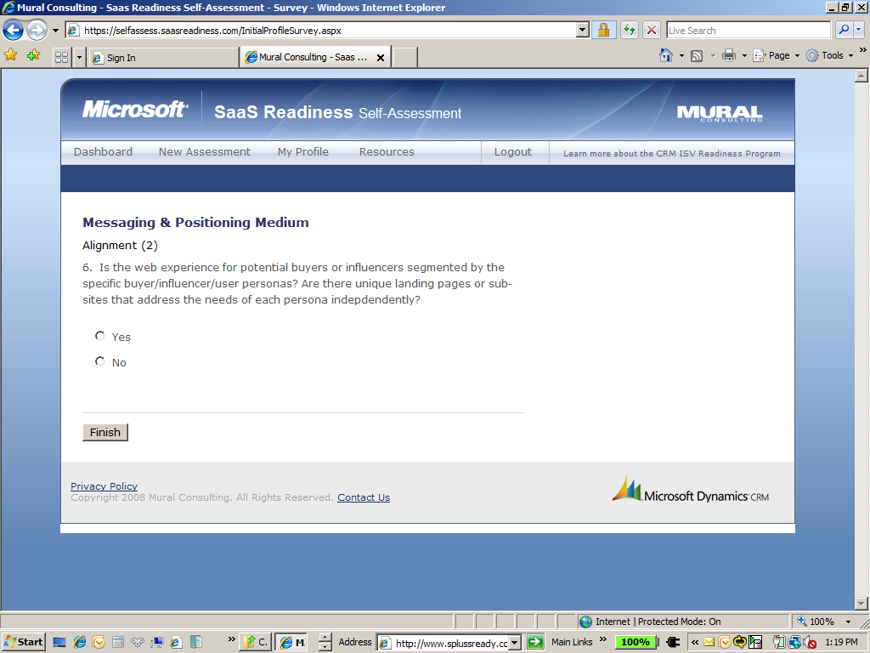
Evaluate your business on critical Software+Services Success Factors

Slide 11
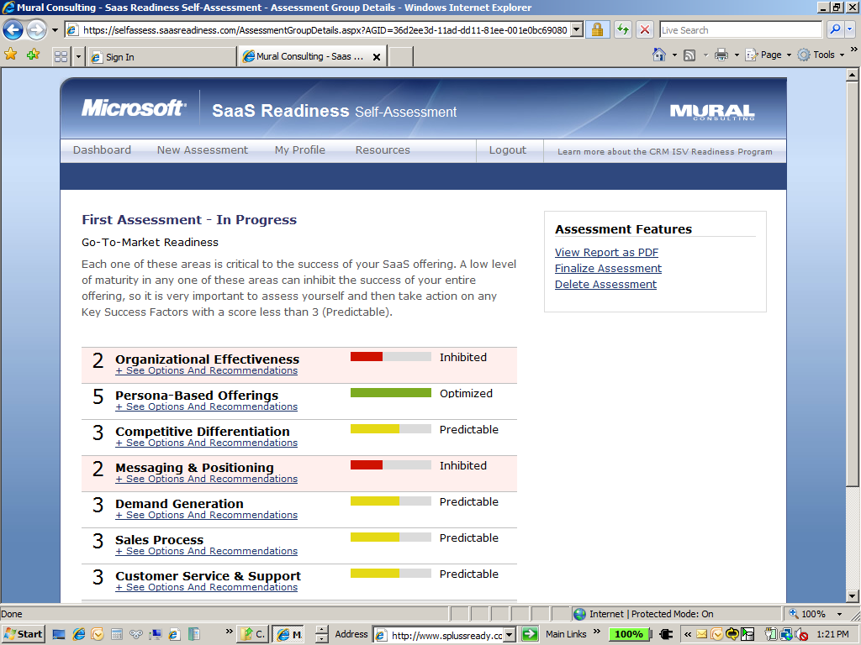
Readiness rating and recommendations
Save as PDF

Slide 12
Agenda
Introductions
The investigation stage
The buildout stage
For startups: BizSpark
For managed partners: The MTCs
For unmanaged partners: The NXT program
Preparing for hosting: The Software+Services Incubation Center program and SPLA licensing
The market/sell stage
How you can get started

Slide 13
A Special Opportunity for Startups BizSpark
Microsoft BizSpark is a new program that unites Startups with resources. It is an extension to existing Microsoft Local Software Economy and academic programs, such as DreamSpark, and is delivered in partnership with the entrepreneur and hosting communities.
What do you get?
Full-featured, world-class development tools and platform technologies, all for a small fee (USD$100)
Rights to put Microsoft server products into production, with no CPU limits, at no additional cost for three years, on your own or with a BizSpark hosting partner
Visibility on Microsoft’s Startup Zone
A united, global community of support resources
A committed partner in achieving success
http://www.microsoft.com/bizspark

Slide 14
Offer And Requirements
Design, Dev, Test Tools
Expression Studio
VS TS w/MSDN Premium
Team Foundation Server (TFS)
Requirements
When entering the program, all of the following must be true about the startup
Building a software-based product or service
In business for less than three years
Less than $1M in revenue
A private company
For production licenses, startups must be…
Building a new software as a service offer (to be delivered on any platform) over the Internet
Program length is three years
Startups re-enroll annually (confirming their ownership hasn’t changed, and they haven’t gone public)
USD $100 fee due when Startups exit the program, not when they join so no up-front payment is required
“Production” Licenses for hosted online applications
Windows Server 2008
SQL Server 2008
SharePoint Portal Server 2008
Systems Center
BizTalk Server 2006 R2
Live Services
Cloud Services as they arrive
2-4 local variants
“Run Your Business” for Internal Use
Live Workspace

Slide 15
The Process
Step 1: Microsoft engages partner community
Step 2: Network Partners enlist Startups in their organizations
Entrepreneur Organizations
(incubators, business angels,…)
Government Agencies
Investors
University Incubators
Step 3: Startups enroll in BizSpark to receive benefits

Slide 16
The Global Community

Slide 17
Partnering With A BizSpark Hoster
Worldwide Network
Over 30 hosters worldwide
Special ISV expertise
Launching a hosted application requires special expertise. You need an experienced hosting partner.
BizSpark hosting partners have a special focus on startup ISVs
They are skilled in bringing On-Demand software applications to market and hosting them at scale
Some partners can provide value added services like provisioning, monitoring, billing and external system integrations
Other partners will specialize in early stage needs like low-cost development and testing environments
Read the hosting guidance provided in the BizSpark User Guide, choose your partner carefully, and launch your product with confidence!
Discounted Hosting offers
BizSpark Hosters will not charge you any Microsoft licensing fees
They may have additional offers specifically for startups
Signing Up
Check the list of BizSpark Hosters on your BizSpark member portal
Click on their URLs to view their BizSpark offers
Select a hoster to partner with

Slide 18
For Mature ISVs: Software+Services Workshops
Microsoft Technology Centers (MTC) provide our customers everything they need – technology experts, industry leaders, and an outstanding environment – to help them envision, architect, and prove secure, customized solutions, based on Microsoft and partner technologies.
http://www.microsoft.com/mtc

Slide 19
Three Critical Components Make up the MTC
Three Critical Components Make up the MTC
People
Technology Experts.
Process
Unique Offerings.
Place
Outstanding Facilities.
Each MTC has a dedicated staff of Technology Architects with established credibility in IT, breadth ability to position the entire platform, and effectively facilitate customer decisions.
Refined through 6 years of delivery, evaluation and improvement, the MTC’s engagement offerings and supporting systems drive decision enablement and actionable next steps for the customer.
Offerings include Strategy Briefing, Architecture Design Session, and Proof-of-Concept workshops.
MTCs provide facility-based engagement delivery which enables the customer to focus completely on their decision process, and allows Microsoft to tap into all necessary resources to enable a solution that exactly meets the customer’s needs in a timely manner.

Slide 20
Offerings
The MTCs marshal their premier resources into three unique offerings –
Strategy Briefings, Architecture Design Sessions, and Proof-of-Concept workshops.
Envision
Strategy Briefing.
Architect
Architecture Design Session.
Prove
Proof-of-Concept Workshop.
The Strategy Briefing begins with a diagnostic consultation led by an MTC technology specialist. Information about the customer’s business situation is then used to tailor the presentation of a live, scenario-based demonstration of Microsoft and Partner technologies, enabling customers to envision what is possible for their business.
Target Outcome: Shared vision and next steps established with key decision makers.
Time Investment: 1 day
By mapping the customer’s major requirements to the technical solution, this engagement will provide the customer with architectural guidance , preferred practices input, and risk analysis to help achieve the desired solution.
Target Outcome – May Include:
Vision/Scope Document
Architecture Assessment Document
Proof-of-Concept Project Plan
Time Investment: 1 – 3 days
This hands-on engagement is held in a private, secure development suite preconfigured to simulate the customer’s real working environment. Customers are assisted throughout the development and validation of their architecture to de-risk the solution implementation following the POC.
Target Outcome – May Include:
Direct knowledge transfer and guidance on implementation techniques for solution
Solution Prototype
Data/object models
Transaction cost analysis
Performance/optimization guidance
Time Investment: 2 – 3 weeks

Slide 21
Worldwide Locations
MTCs are based strategically around the globe.
Atlanta, Georgia
Austin, Texas
Bangalore, India
Beijing, China
Boston, Massachusetts
Chicago, Illinois
Dallas, Texas*
Dubai, UAE
Irvine, California
Munich, Germany
New York, New York
Paris, France
Reston, Virginia
Silicon Valley, California
Taipei, Taiwan
Thames Valley, U.K.

Slide 22
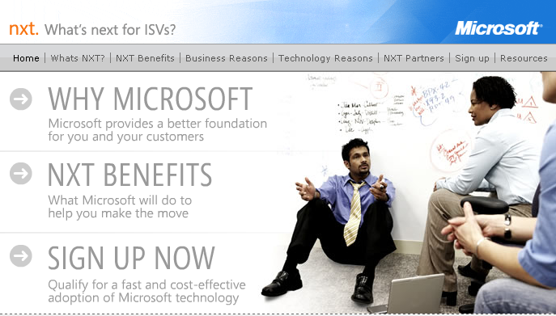
Are you Re-Platforming? Check out NXT
http://www.isvnxt.com

Slide 23
Special NXT offer for ISVs moving to the Microsoft Software+Services Platform
Stage 1
Stage 2
Stage 3
Stage 4
1 months
2 months
3 months
6months
ISV meets with NXT Delivery Partner
ISV signs an Letter of Intent with Microsoft
ISV agrees to work with Microsoft Platform
ISV becomes certified Partner
Activities
Complimentary platform strategy session
Architecture Design
Discounted POC (BIF funding may be available)
Free access to all available U.S. readiness training
Discounted Migration
Free Platform Test with Veritest
ISVR
Program nominations, e.g., TAP
MSPP Fee waived*
PR in a box
Customer Reference tool
Account Management (only for >$5M, OS or DB win, signed royalty agreement*
Benefits to DP ISV
Training, co-marketing, BIF for ADS/POCs, and others from closer relationship with Microsoft
*These offerings are up to subsidiary discretion and budget availability

Slide 24
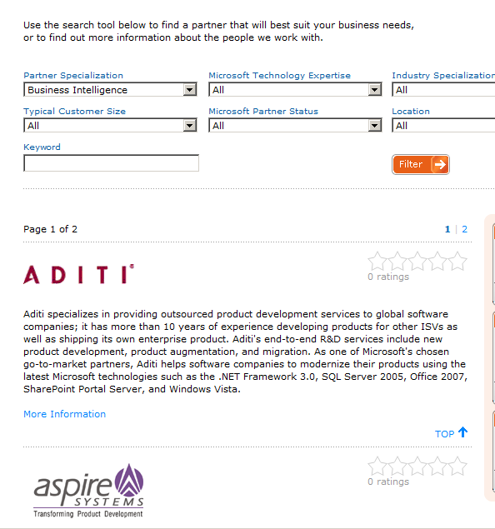
Find a Development Partner on NXT
Directory of S+S Development Partners
Specialists in Platform Migrations
Specialists in Product Development

Slide 25
Preparing for Launch: what is a SaaS Delivery Platform?
A fully managed hosting infrastructure, plus…
SaaS business services
Online self-service account management
Usage metering
Easy invoicing, bill presentment and usage explanation
SaaS operations
Performance Monitoring
Easy Capacity increase / decrease
Backup / DR of customer data
Datacenter task automation
End to end data / process security
SaaS support
End to end customer support
Customized service level agreements
SaaS infrastructure
Firewall, intrusion detection, encryption, access control
Business process integration services
Directory and identity management services
Usage tracking, data warehousing and business intelligence

Slide 26
Don’t Build – Partner!
Software+Services Incubation Centers are hosters who specialize in bringing ISVs to market
Business Design Sessions
The program provides the SaaS ISV with
Business Design Session
Architecture Design Session
Access to Microsoft development partners
Microsoft Gold Certified hosting
Access to new channels to market
Additional technical and business guidance
Architecture Design Sessions
Proof of Concept/Launch
Catalogue
Find a partner today:
http://www.microsoft.com/hosting/programs/incubationcenter.mspx

Slide 27
Where Is Microsoft Going With Cloud Services? Introducing Azure
An Internet-scale cloud services platform hosted in Microsoft data centers, which provides an operating system and a set of developer services that can be used individually or together.
Azure™ Services Platform
Microsoft SharePoint Services
Microsoft Dynamics CRM Services
Will be released in late 2009–early 2010 timeframe. Beta programs coming.
http://www.azure.com

Slide 28
Licensing Your Hosted Services The Microsoft Services Provider Licensing Agreement
SPLA is a monthly “per user or per CPU” licensing program for hosted services
You buy it yourself or through your hoster
One agreement licenses you for all our server products
What does this mean for you?
Avoid upfront investments
Treat licensing as an operating expense
Map your licensing costs to your business model
Pay only for what you use
Get the latest software versions
Have a worldwide reach
Demos, tests, and evaluations and no cost

Slide 29
Advantage Of SPLA Pay only for the capacity you use
Perpetual
License
Avoid paying for unused capacity
SPLA
System
Load
Time
Pay only for the CPUs you use, when you use them
No need to pre-pay for peak capacity
Costs scale up/down to match demand
Roll platform licensing into COGS

Slide 30
SPLA is Designed to Help You Grow a Hosted-Services Business
Perpetual
License
SPLA
Load
Time
No up-front cash investment
License costs follow your business growth
Easily add any Microsoft server product to your solution
Always run on the latest server versions

Slide 31
Agenda
Introductions
The investigation stage
The buildout stage
The market/sell stage
The “Grow Your Software+Services Business” Webinars
EDGE: The Enterprise Demand Generation Engine
How you can get started

Slide 32
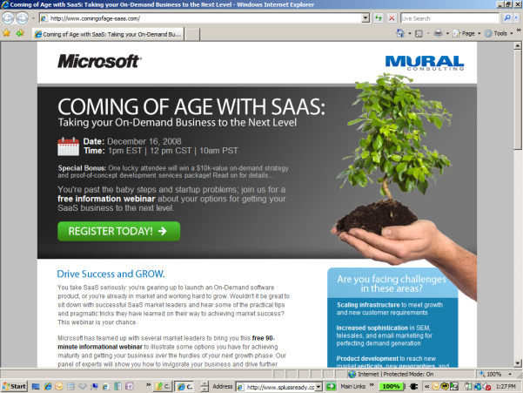
Training Webinars on how to Grow your Software+Services Business
Aimed at ISVs entering or in market with a S+S solution
Targeted best practices and success stories
Connections to key business partners
http://www.comingofage-saas.com

Slide 33
Telesales Lead Generation The Partner EDGE
Partner EDGE utilizes professional telesales callers
Partners provide the initial customer contact list
Partner EDGE campaigns are designed to create MSSP 20% leads that identify and address: Need, budget, timeframe, and decision maker
Partners receive lead summaries in real time
Partner EDGE leads are entered into Microsoft’s CRM system for joint sales
EDGEinfo@microsoft.com

Slide 34
Partner EDGE Execution
Partner s work with Partner EDGE call centers to create campaigns
Partner EDGE callers begin call downs and engage in peer-to-peer conversations with business decision makers
Qualified leads are generated and emailed to the Partner and are uploaded into Microsoft’s CRM system for tracking
Partner and call center have weekly status calls to review campaign progress, Q&A, and tailor approach where necessary

Slide 35
What is your Next Step?
Investigate
Buildout
Market & Sell
Software plus Services ISV Roadmap Portal
Online Readiness Self-Assessment
BizSpark
Microsoft Technology Centers
NXT Program
S+S Incubation Centers
Business Growth Webinars
Lead generation support: Partner EDGE program
Microsoft Partner Program
Determine your stage of Software+Services adoption
Visit the ISV Roadmap portal and learn about the resources available for your stage
If you are a startup: enroll in BizSpark today
If you are building a solution: engage with the MTC in your region
If you are selling a S+S product today: attend the Webinars

Slide 36
Thank You
Tell us what you need to succeed: email the Software+Services ISV Sales Office (ssisvoff@microsoft.com)

Slide 37
© 2008 Microsoft Corporation. All rights reserved. Microsoft, Windows, Windows Vista and other product names are or may be registered trademarks and/or trademarks in the U.S. and/or other countries.
The information herein is for informational purposes only and represents the current view of Microsoft Corporation as of the date of this presentation. Because Microsoft must respond to changing market conditions, it should not be interpreted to be a commitment on the part of Microsoft, and Microsoft cannot guarantee the accuracy of any information provided after the date of this presentation. MICROSOFT MAKES NO WARRANTIES, EXPRESS, IMPLIED OR STATUTORY, AS TO THE INFORMATION IN THIS PRESENTATION.

