Slide 1

Rutger Pekelharing
Sales Execution of Hosted Services Through Superior Customer Experience Management

Slide 2
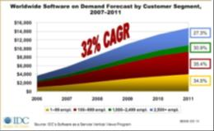


The SaaS Market—it’s big, it’s global and many companies offer the same solution
Forecast: BIG Market for SaaS
Borderless Markets
Where hosting companies can offer HMC services anywhere in the world, and
Customers can purchase HMC services anywhere in the world.
There is great market opportunity for hosting businesses…
Europe: >1.350 HMC Providers
…and many providers offering comparable solutions.

Slide 3
Enough Compelling Reasons to Buy HMC Services
Security
Most SaaS installations are co-located in secure data centers with levels of security and management that even enterprise IT departments find hard to achieve.
Managing business costs
The SaaS model allows costs to be spread over a period of time rather than paid for upfront.
Anywhere Access
It eases remote access to business applications and interaction between different organizations, both which are increasingly required for many business processes.

Slide 4
Customer Experience Management is a Sales Weapon
Exceptional customer service has a high impact on customer loyalty.
Customer loyalty has a positive impact on financial outcomes:
Customer referrals
Customer spend
= Sales

Slide 5
Customer Experience Map – it is about choices
Phases
WOW
Enjoyable
Functional
Uneventful
Missed it
Never Again
Feelings
“I Love it”
“I like it”
“Works for me”
“OK”
“I Don’t Like it”
“I hate it”
Memory
High
Mid
Low
None
Mid
High
Impact on Loyalty
Share with Many
Share with few
Neutral
Decrease
66% decrease
100% Loss
Source: Lior Arussy

Slide 6
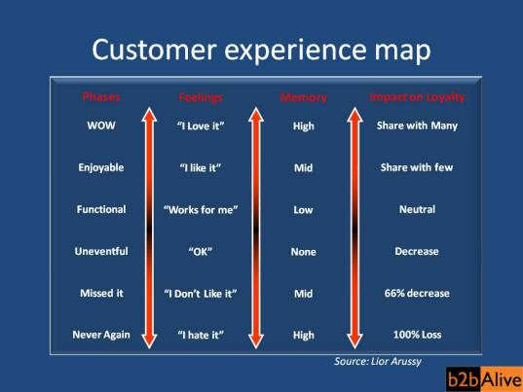
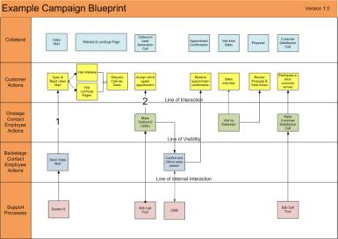
Surprise customers consistently with
“WOW” Experiences
Why?
Only WOW experiences help you create loyal customers, and…
Achieve 10%-20% sales conversion

Slide 7
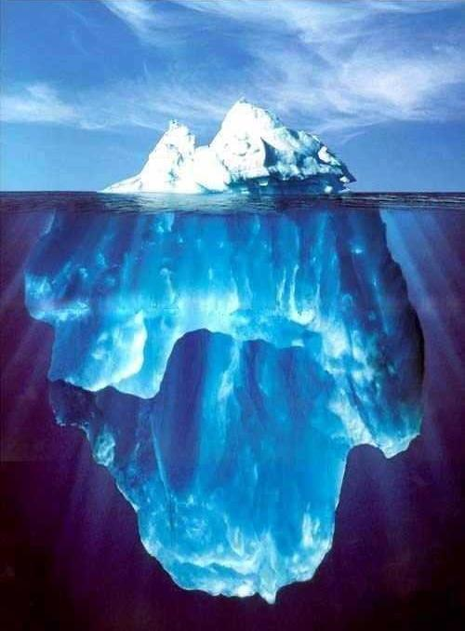
If you create “Never Again” Experiences…
For every 1 unhappy customer you create…
…there are 26 other unhappy customers who say nothing.
And of those 26, 24 will leave.
Source: U.S. Office of Consumer Affairs

Slide 8
Main Campaign Success Criteria

Slide 9

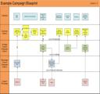
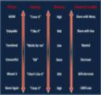
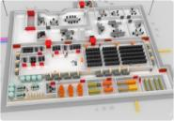
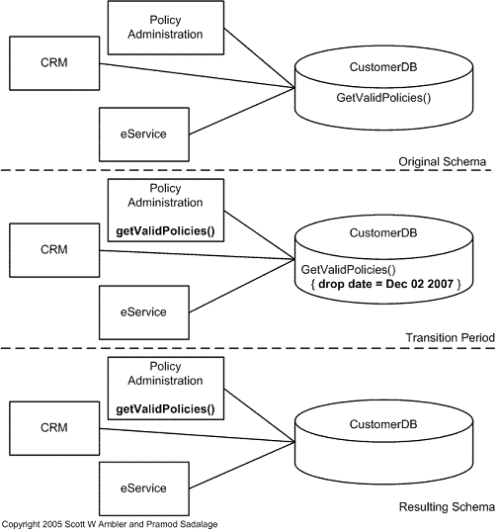
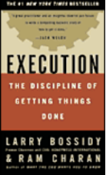
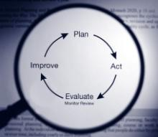
Prepare & Execute Campaigns
(1)
(2)
(3)
Form the Best Project Team
Complete in RASCI chart
Design WOW Offers & Processes
Be Ambitious
Align all IT Systems & Processes
One shared goal
(4)
(5)
(6)
Prepare your Database
Execute with Discipline
Learn from every campaign

Slide 10
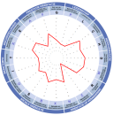
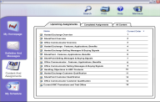
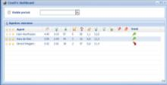
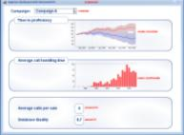
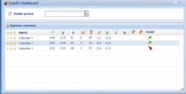
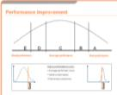
Sales Execution - Agent Management
(1)
(2)
(3)
Recruit Agents Who Win
Select smart with
psycho-metric assessments
Train Agents to Win
Train for the right behavior
Enable Agents to Win
Transparent real-time reporting
(4)
(5)
(6)
Coach Agents to Win
Coach with facts
Compare Agent Performance
Compare performance:
Sales Agents
Sales Teams
Call Centers
Optimize Performance
Continuously monitor the performance gap

Slide 11
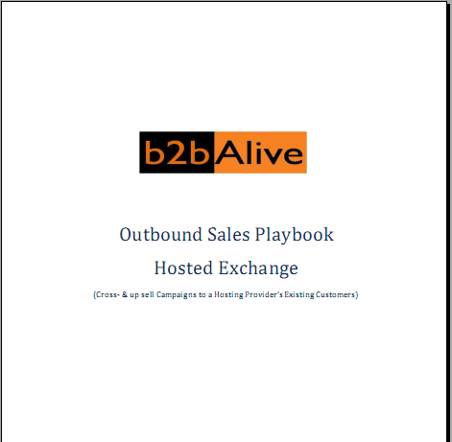

For the “How To” Read:
“Outbound Sales Playbook – Hosted Exchange”
You can download the Playbook from the Hosting Competency section on the Microsoft Partner Program Portal: https://partner.microsoft.com/global/program/competencies/mspphostingsolutions and look in the Sales and Marketing Resources section.
Rutger Pekelharing
Mail: r.pekelharing@b2balive.eu
Mobile: +31(653)494521
Raoul Kloppenborg
Mail: r.kloppenborg@b2balive.eu
Mobile: +31(654)320340

Slide 12

Your Project Management Partner for cross & up sell campaigns with:
Expert in:
  Sales Campaign Design
  Sales Campaign Preparation & Execution
  Sales agent selection, training & coaching
  Managing outsourced call centers
  10%-20% Sales Conversion

Slide 13
b2bAlive Sales Services
  Workshops
    Outbound Sales
    Campaign Blueprinting
    Campaign Project Planning
  Services
    Campaign Project Management
    Agent selection & training
    B.I. & database services
  SaaS Solutions
    Telesales call support tools
    Real-time sales performance cockpits
    Psychometric assessment tool for ( )sales teams

Slide 14
Thank you

