Slide 1
Why Hosters/Partners Should Care About Software-plus-Services

Slide 2
Outline
Business landscape, customers, and market opportunity
The opportunities Software-plus-Services brings to you
Microsoft’s hosting platform and its strengths
How can you grow by partnering with Microsoft?
Summary and next steps

Slide 3
Hosting Industry

Slide 4
Landscape Is Changing
New competition arrives
New business models emerging
Ad-supported, Web 2.0
Bundled solutions
Utility /cloud
But can the new players address
Higher degree of customization?
Integration?
Responsiveness and regional presence?
Verticals and specialization?
Breadth of offerings?
“Should I stay in the low-end server business?”
“What does cloud computing mean to my
business?”
“How can I become a SaaS hoster?”
“Will I make more money as a hoster, a reseller or both?”

Slide 5
Your Customers Today
SMBs
WOULD LIKE TO USE WEB TO
COMMUNICATE, COLLABORATE
AND TRADE USING WEB
CONSUMERS
LOOKING AT THE WEB
AS AN EXTENSION TO THEIR
PCS AND DEVICES
ISVs
LOOKING FOR RELIABLE
PARTNERS TO HOST AND
MANAGE APPLICATIONS
INFRASTRUCTURE

Slide 6
Market Opportunity Worldwide
Source: Tier1 Research Reports, 2008
Source: IDC, 2008
Increased value in Hosted Infrastructure, Software On Demand (SaaS) as a soft economy puts pressure on customers’ capital expenditures

Slide 7
How Can You Capture the Growth Ahead?
Address all customer needs
Build a strong business with sticky offerings
SURROUND YOUR CUSTOMER
Deliver the best
customer experience
The key to
growth
Invest in service infrastructure
that aligns with
strengths
INVEST SMART
NO COMPROMISE
Avoid when
hard to scale and margins diminish

Slide 8
The Opportunities Brought to You By Software-plus-Services

Slide 9
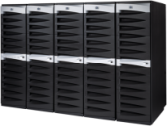
Software-plus-Services The power of choice
Partner
Hosted
Microsoft Hosted
On-Premises
Control & ownership
Strategic capabilities
Advanced integration
Outsourced IT
Industry / Vertical configuration
Packaged solutions
Rapid implementation
Anywhere-access
Rich customization

Slide 10
Mix, Match, Deliver and Grow
Resell Microsoft Online Services
Enterprise class software hosted by Microsoft. Sold through partners as a subscribed service.
YOU
COMMUNICATE . COLLABORATE . TRADE . IT INFRASTRUCTURE . WEB 2.0 EXPERIENCE
TOTAL CUSTOMER EXPERIENCE
Host & Deliver
License Microsoft products on a monthly basis. Host and deliver subscription based software services.
Source from White Label Providers
Roll out your own brand of service
by sourcing from a partner ecosystem.

Slide 11
Resell Microsoft Online Services

Slide 12
Microsoft Online Services
Resell Microsoft Online Services
Enterprise-class software delivered as subscription service hosted by Microsoft and sold with partners
Expand reach, increase velocity, and grow revenue
Business Productivity Online Suite

Slide 13
Source From White-Label Providers

Slide 14
Repackage & Accelerate
Source From White-Label Providers
Sign up as a reseller
Deliver services under your own brand
Own customer relationship
Reduced operations and support costs
No capital expenditures

Slide 15
Host and Deliver

Slide 16
Host and Deliver
Host & Deliver
License Microsoft products on a monthly basis through the Services Provider License Agreement (SPLA).
Use these products to host and deliver software services to your customers.
Windows Hosting Platform

Slide 17
Host & Deliver
Secure
Scalable
Built for Web
Supports Hot Add Memory and Add/Replace for up to 64 Processors
Presentation Virtualization – Application Remoting
Hyper-V Server Virtualization
Network Access Protection
Read-Only Domain Controller
Active Directory Rights Management Services
Internet Information Services 7.0 compatible with Hosting business model including resellers
Hosting of apps and services
(.NET, PHP, SharePoint )
Management and lower Infrastructure costs
Solid Foundation
Management
Reliability
Server Manager
Windows PowerShell™
Power Management
Server Core Installation Option – No GUI
Enhancements to Failover Clustering

Slide 18
Hyper-V
Host & Deliver
Lower TCO
Dynamic IT
Hoster Value
Enables highly scalable and responsive data center environment
Improve server stability and reduced down time
Rapid deployment and monitoring
Reduces IT costs and increase server utilization
Optimizes business, network infrastructure
Simplifies support
Easier to deliver application hosting and monitoring
Offer a virtual data center at low cost
ISVs and SMBs get better SLAs from provisioning to disaster recovery
Hyper-V. An Integral Part of Windows Server 2008
Quick Virtual Machine Migration
High Availability Through Virtual Machine Clustering and Host-Host Connectivity
Live Snapshots for Backups
Hyper-V. A Server Core Role
Supports Remote Management
Reduced Attack Area
Linux Integration Components for SUSE
Enterprise Server 10 SP1 x86 & x64

Slide 19
Internet Information Services (IIS) 7.0
Host & Deliver
SECURE
Reduced Server Footprint
Automatic Application Isolation
Rich Delegation Infrastructure
RELIABLE
FLEXIBLE
Load Balancing & Routing
Dynamic Caching & Compression
Powerful Diagnostics
Modular & Extensible Web Server
Optimize Bandwidth for Media Delivery
Develop and Deploy PHP as well as ASP.NET
MORE CONTROL
Manage Entire Infrastructure from One Point
Delegate Management & Publishing to Remote Users
Easy to Archive, Package, Migrate, and Deploy

Slide 20
Complete Service Management Lifecycle with One Solution
Host & Deliver
Configuration Manager
Hardware Provisioning
Virtual Workload Provisioning
Performance
and Health Monitoring
Backup
OS / Software Deploy, Patching and State Mgmt
Disaster Recovery
Data Protection Manager
Virtual Machine Manager
Operations Manager

Slide 21
Host & Deliver
Agile Web applications
Low monthly licensing fee
Mission-critical capability
No memory or DB size limits
Scale without limits
Developer productivity
Publishing tools, policy-based mgnt.
Business-level
SLAs
.NET and PHP application support
Business
intelligence
Resell As Online Service
Host and Deliver

Slide 22
Hosted Products
Host & Deliver
HMC 4.5
Unified Communications
Windows Server Hosting Guidance
Shared and Dedicated Hosting
New services
Private label
Technologies for hosting
Best practices
Empowers hosters
Exchange 2007 SP1
SQL 08
SharePoint
Hyper V
OCS 2007
WS 08
CRM 4.0 Planning & Deployment Guidance
High Margin Opportunities
SaaS ISV Hosting
Custom Applications
HMC integration
Best practices
S+S Incubation Centers
GSP
S+S self assessment
CRM 4.0
CRM 4.0
SQL 08
SQL 08
WS 08
WS08

Slide 23
Convenient Licensing
Host & Deliver
Via Service Provider Licensing Agreement (SPLA)
Monthly pricing
Always up to date software

Slide 24
To Join SPLA Program
Host & Deliver
Enroll in Microsoft Partner Program
Contact a designated SPLA reseller to sign a SPLA agreement
Registered Members
Partner Program

Slide 25
The Hosting Solutions Competency
Host & Deliver
The Microsoft Hosting Solutions Competency gets you:
Solutions Listing in Customer Directory
Hosting Services Sales Toolkit
Clear and direct connection with Microsoft
Branding that demonstrates your experience and skills to customers
Hosting Product and Sales Training
Unique Vertical Offerings
Get listed in Microsoft hosting catalogs so customers can find you
Hosting research from IDC, Forrester to improve your market impact

Slide 26
The Hosting Solutions Competency
Host & Deliver
1
Service Provider Licensing Agreement Requirements
2
Employ Two Microsoft Certified Professionals
3
Three customer references that feature your hosting solution
75 processor licenses or 3,000 SALs in the last 12 months.
Employ or contract at least two exclusive Microsoft Certified Professionals (MCPs).
Each reference is verified with your customer and will be valid for two years from the date the reference is approved.
* Annual fee for MSPP Certified Level is approximately $1500 USD – please check for regional variation

Slide 27
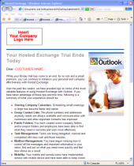
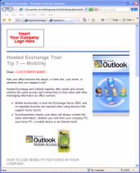
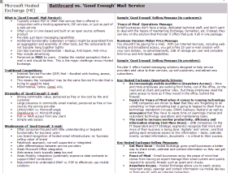
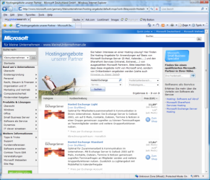
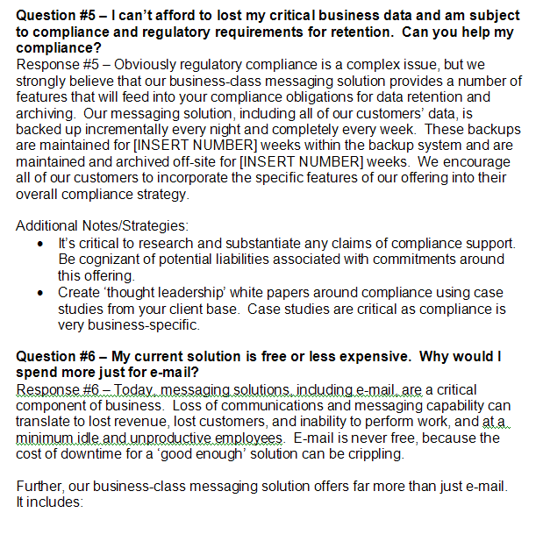
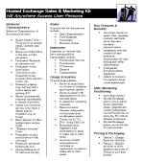
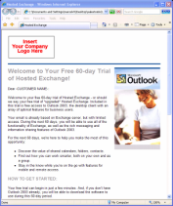
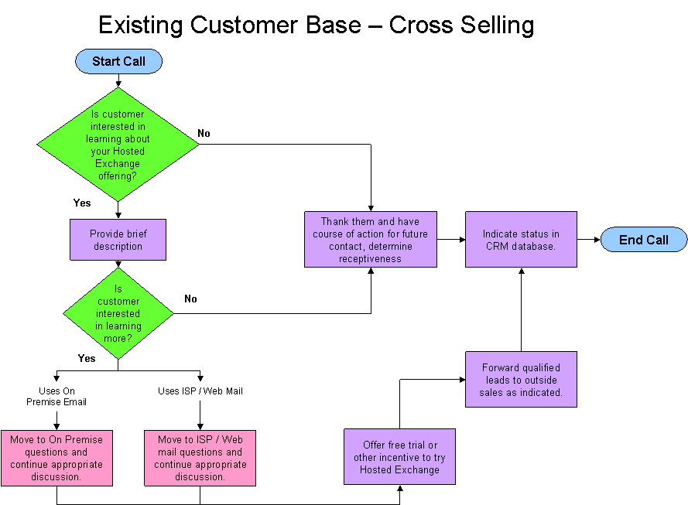
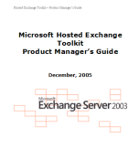
Helping You Grow Your Business
Host & Deliver
Architecture & Design Sessions
Business Development Sessions
Sales Training and Tool Kits
Marketing email templates, brochure template, product manager guide, persona descriptions, battle card, objection handling, telesales script, sales presentation, web site template, TCO tool
And more …

Slide 28
Your Success Is Our Success
Host & Deliver
1
Microsoft is committed to the partner model
2
Microsoft seeks a win/win/win
3
Microsoft delivers to Partners through MSPP
96%
of
Microsoft’s
revenue is
partner driven
Partner Program
Advance Innovation
Build Trusted
Relationships
Connect &
Engage
Accelerate
Growth

Slide 29
Summary

Slide 30
Microsoft’s Strategy for Next Gen Hosting
Platform
Next generation hosting and service delivery platform
Windows Server 2008 with Hyper-V
Services
Applications you can deliver as a service
Experience
Delivering the digital lifestyle experience to your customers
Mix and match components from Microsoft’s platform and services
to accelerate your growth while delivering superior customer experience

Slide 31
Can the Competition Deliver?
Experience enabling & supporting over 300,000 partners worldwide
DEPENDABILITY.
EXPERIENCE.
Familiar brand and user experience
Product accountability, standards and roadmap
WORLDWIDE
ECOSYSTEM.
Large pool of certified talent
Extensive 3rd party support and solutions
Products localized, tested and adapted for hosting
CHOICE.
EMPOWERMENT.
Choose to resell services deployed on world class infrastructure
Extensive technical and marketing guidance
Avenues for demand generation and sales leads

Slide 32
Next Steps
Learn the Windows Hosting Platform
http://www.microsoft.com/hosting/solutions/windowsserverhostingguidance.mspx
http://www.asp.net
http://www.iis.net
Learn about SPLA
http://www.microsoft.com/hosting
Learn about Software-plus-Services Platform
https://partner.microsoft.com/US/program/pmcommsector
Get started on Windows Platform today

Slide 33
© 2009 Microsoft Corporation. All rights reserved. Microsoft, Windows and other product/technology names are the trademarks or registered trademarks of the Microsoft Corporation group of companies in the United States and/or in other countries. The information herein is for informational purposes only and represents the current view of Microsoft Corporation as of the date of this presentation. Because Microsoft must respond to changing market conditions, it should not be interpreted to be a commitment on the part of Microsoft, and Microsoft cannot guarantee the accuracy of any information provided after the date of this presentation. MICROSOFT MAKES NO WARRANTIES, EXPRESS, IMPLIED OR STATUTORY, AS TO THE INFORMATION IN THIS PRESENTATION.

