Slide 1
SQL Server Integration Services

Slide 2
Agenda
SSIS Overview
End-to-End Integration
Competitive Features
Next Release

Slide 3
Agenda
SSIS Overview
End-to-End Integration
Competitive Features
Next Release

Slide 4
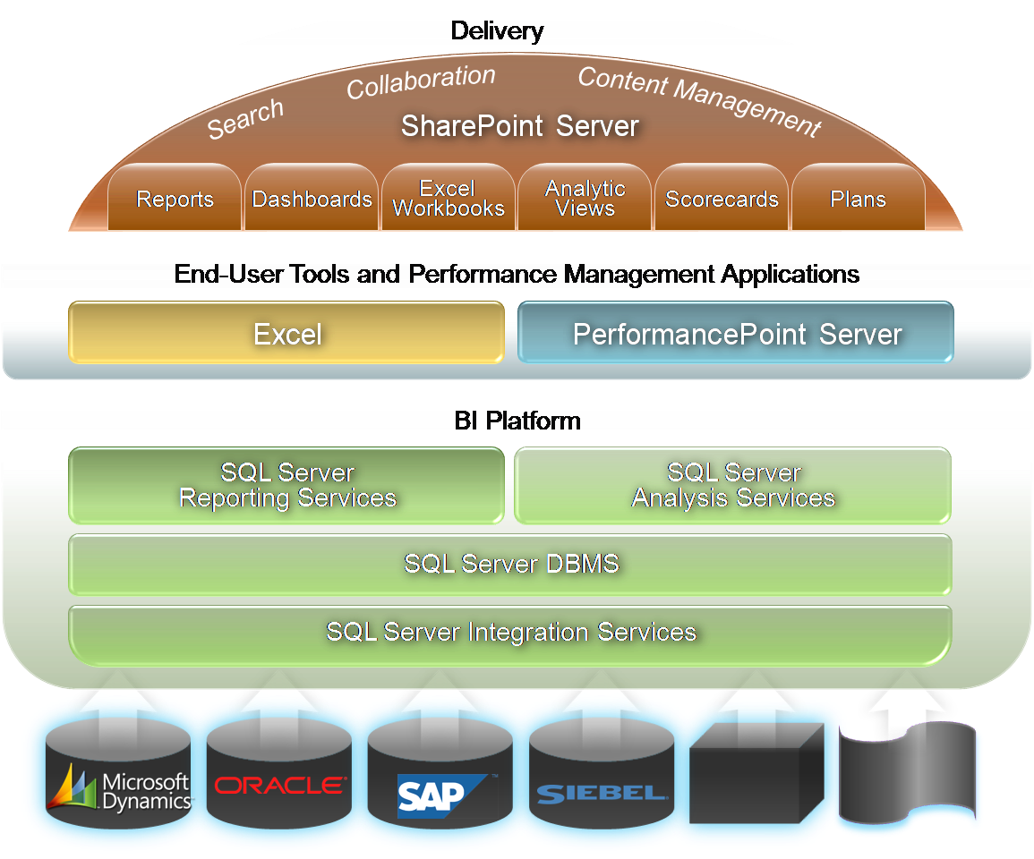
Integrated BI Platform

Slide 5
Integrated BI Platform

Slide 6
Key Message …
SSIS = ETL

Slide 7
Traditional ETL
Shrink-wrapped ETL Tool Expensive!
Custom Solution Expensive!
Risky!
Hybrid Expensive!
Risky!
Complex!

Slide 8
Traditional ETL Limitations
Data volumes
Data sources
Agility

Slide 9


















Traditional ETL Pain
ELT
Data mining
GeoSpatial Data:
Semi structured
GeoSpatial
Application
Staging
Staging
Warehouse
ETL
Legacy data: binary files
Hand
coding
Cleansing
&
ELT
Reports
ETL
Staging
Application database
Mobile
data
Integration and warehousing require separate, staged operations.
Preparation of data requires different, often incompatible, tools.

Slide 10
SQL Server Integration Services
All ETL in one place, one tool
All data sources
Configurable deployment
Comprehensive monitoring

Slide 11



SQL Server Integration Services
GeoSpatial
Components
Data mining
components
Mobile
data
GeoSpatial Data:
Semi structured
Custom
source
Merges
Legacy data:
binary files
Warehouse
Standard
sources
Data-cleansing
components
Application database
SSIS
Reports
Integration is a seamless, manageable operation.
Source, prepare, & load data in single, auditable process.
Scale to handle heavy and complex data requirements.
Cube

Slide 12

SSIS Reviews
“Microsoft Addresses Enterprise ETL. Microsoft’s new tool for extract, transform, and load (ETL) addresses enterprise ETL requirements like collaborative development, dedicated administration, and server scalability. It also goes beyond ETL to include functions related to data integration, such as data quality, data profiling, and text mining. FORRESTER
Solid Foundation for creating packages. With the release of SQL Server Integration Services, Microsoft now has a powerful ETL tool that is not only enterprise class but can also go a long way in increasing the productivity of developers. Its feature set makes it extremely easy and seamless to build sophisticated, high-performance ETL applications. Developer.com
SQL Server Bulks Up. SSIS will change the way your company thinks about its data. Systems that couldn’t communicate before are now perfectly integrated and have the full power of .Net behind them. Complex data load operations into warehouses and disparate systems will take a fraction of the time to build, execute, and support.
InfoWorld

Slide 13
Agenda
SSIS Overview
End-to-End Integration
Competitive Features
Next Release

Slide 14
SSIS End-to-End
Source Data
Source Provider
Control and Flow
Destination Provider
Destination Data

Slide 15
SSIS Data Source & Destination
Source Data
Source Provider
Control and Flow
Destination Provider
Destination Data

Slide 16
Data Source / Destination
Source Data
Source Provider
Control and Flow
Destination Provider
Destination Data
SQL Server
DB2
DB2/400
Oracle
SAP
Access
Excel
Office 2007
Sybase
Informix
Teradata
FoxPro
File DBs
Adabas
CISAM
DISAM
Ingres II
Oracle Rdb
RMS
Enscribe
SQL/MP
IMS/DB
VSAM
LDAP

Slide 17
Data Partners
Source Data
Source Provider
Control and Flow
Destination Provider
Destination Data
ETI
  www.eti.com
  High performance connector for Teradata
Persistent Systems
  www.persistentsys.com
  High performance destination for Oracle
Attunity
  www.attunity.com
  Data Federation, Replication and CDC
Data Direct
  www.datadirect.com
  64-bit providers for Oracle, DB2, Sybase
Informatica
  www.informatica.com
  PowerExchange for legacy migration and integration

Slide 18
SSIS Providers
Source Data
Source Provider
Control and Flow
Destination Provider
Destination Data

Slide 19
Providers
Source Data
Source Provider
Control and Flow
Destination Provider
Destination Data
Component | SQL Server | OLE DB | ADO.NET | ODBC | ADO
Import/Export Wizard Source | - | Y | Y | Y | N
Import/Export Wizard Destination | - | Y | N | N | N
Execute SQL Task | - | Y | Y | Y | Y
Bulk Insert Task | Y | N | N | N | N
Data Flow Source | - | Y | Y | Y | N
Data Flow Destination | Y | Y | N | N | N
SQL Server Destination | Y | N | N | N | N
OLE DB Command | - | Y | N | N | N
Lookup Reference Tables | - | Y | N | N | N
Fuzzy Lookup Reference Tables | Y | N | N | N | N
Fuzzy Grouping Work Tables | Y | N | N | N | N
Slowly Changing Dimension Outputs | - | Y | N | N | N
Term Extraction Work Tables | Y | N | N | N | N
Term Lookup Work Tables | Y | N | N | N | N
Term Lookup Reference Tables | - | Y | N | N | N

Slide 20
Providers
Source Data
Source Provider
Control and Flow
Destination Provider
Destination Data
Component | SQL Server | OLE DB | SQL / OLE
Import/Export Wizard Source | - | Y | Y
Import/Export Wizard Destination | - | Y | Y
Execute SQL Task | - | Y | Y
Bulk Insert Task | Y | N | Y
Data Flow Source | - | Y | Y
Data Flow Destination | Y | Y | Y
SQL Server Destination | Y | N | Y
OLE DB Command | - | Y | Y
Lookup Reference Tables | - | Y | Y
Fuzzy Lookup Reference Tables | Y | N | Y
Fuzzy Grouping Work Tables | Y | N | Y
Slowly Changing Dimension Outputs | - | Y | Y
Term Extraction Work Tables | Y | N | Y
Term Lookup Work Tables | Y | N | Y
Term Lookup Reference Tables | - | Y | Y

Slide 21
SSIS Control & Flow
Source Data
Source Provider
Control and Flow
Destination Provider
Destination Data

Slide 22
Control - Maintenance
Source Data
Source Provider
Control and Flow
Destination Provider
Destination Data
Back up database
Check database integrity
Execute agent task
Execute T-SQL
History cleanup
Maintenance cleanup
Notify operator
Rebuild index
Reorganise index
Shrink database
Update statistics

Slide 23
Control - Flow
Source Data
Source Provider
Control and Flow
Destination Provider
Destination Data
For, Foreach loop
ActiveX script
Analysis Services DDL
Analysis Services process
Bulk Insert
Data flow
Data mining query
DTS Package
SSIS Package
Process / Program
SQL
File System
FTP
Message Queue
Script
Mail
WMI
XML (Validate, transform, query, merge, diff)

Slide 24
Flow - Transformations
Source Data
Source Provider
Control and Flow
Destination Provider
Destination Data
Aggregate
Audit
Character Map
Conditional Split
Copy Column
Data Type Conversion
Data Mining Query
Derived Column
Export Column
Fuzzy Grouping
Fuzzy Lookup
Import Column
Lookup
Merge
Merge Join
Multicast
OLEDB Command
Percentage Sampling
Pivot
Row Count
Row Sampling
Script
Slowly Changing Dimension
Term Extraction
Term Lookup
Union All
Unpivot

Slide 25
Flow - Highlights
Source Data
Source Provider
Control and Flow
Destination Provider
Destination Data
Aggregate
Audit
Character Map
Conditional Split
Copy Column
Data Type Conversion
Data Mining Query
Derived Column
Export Column
Fuzzy Grouping
Fuzzy Lookup
Import Column
Lookup
Merge
Merge Join
Multicast
OLEDB Command
Percentage Sampling
Pivot
Row Count
Row Sampling
Script
Slowly Changing Dimension
Sort
Term Extraction
Term Lookup
Union All
Unpivot

Slide 26
Flow – Data Mining Query
Source Data
Source Provider
Control and Flow
Destination Provider
Destination Data
Use data mining to predict future values
“Based on this customer’s demographic profile, how long are we likely to retain their business?”

Slide 27
Flow – Fuzzy Grouping
Source Data
Source Provider
Control and Flow
Destination Provider
Destination Data
Ron Dunn
Ronald Dunn
Ronald J. Dunn
Ronald James Dunn

Slide 28
Flow – Sampling
Source Data
Source Provider
Control and Flow
Destination Provider
Destination Data
Randomly select rows from input data set
“Give me a 10% of the customer records for test data”

Slide 29
Flow – Slowly Changing Dim.
Source Data
Source Provider
Control and Flow
Destination Provider
Destination Data
Maintain current and obsolete versions of data
“Show me the account profile at this time last year … accounting for the changes in territory and account manager.”

Slide 30
Flow – Term Extraction
Source Data
Source Provider
Control and Flow
Destination Provider
Destination Data
Find common words and phrases in text
“What are the topics most commonly discussed this week in our customer support forum?”

Slide 31
SSIS Development
Source Data
Source Provider
Control and Flow
Destination Provider
Destination Data

Slide 32
Development - Scripting
Source Data
Source Provider
Control and Flow
Destination Provider
Destination Data
Variables
Expressions
Identifiers
Operators
Event Handlers
Transactions
Logging
Checkpoints

Slide 33
Development - Tools
Source Data
Source Provider
Control and Flow
Destination Provider
Destination Data
Business Intelligence Desktop Studio (BIDS)
Import / Export Wizard
DTS Migration Wizard
Package Deployment Wizard

Slide 34
Agenda
SSIS Overview
End-to-End Integration
Competitive Features
Next Release

Slide 35
Competitive Summary
Feature | “A” | “B” | SSIS
Basic ETL | *** | *** | ***
Data Warehouse ETL | * | *** | ****
Data Integration | **** | **** | ***
Ease of use | *** | ** | ****
Cost | * | ** | ****
Support Ecosystem | ** | * | ****

Slide 36
Agenda
SSIS Overview
End-to-End Integration
Competitive Features
Next Release

Slide 37
SQL Server 2008 Target
Data Warehouse Scalability
  Robust and productive platform
  Large data warehouses
  High speed data loads

Slide 38
Scalability Enhancements
Identifying Source Data for Extraction
Performance of complex ETL packages
Dealing with Reference Data
Bulk Data Insertion

Slide 39
Source Data Extraction
Extracting data from the source is expensive
  Triggers (synchronous IO penalty)
  Timestamp columns (Schema changes)
  Complex queries (delayed IO penalty)
  Custom (ISV, mirror, snapshot, …)
Need to know what changed at source since a point in time

Slide 40




Change Data Capture - CDC
What changed?
  Table, operation, column
Enabled per table
  Hidden change tables store captured changes
  One change table per source table that is tracked
  Retention-based cleanup jobs
CDC APIs provide access to change data
  Table valued functions and scalar functions provide access to change data and CDC metadata
  TVF allows the changes to be gathered for specific intervals enabling incremental population of DW
  Transactional consistency is maintained across multiple tables for the same request interval
OLTP
Change Tables
Data Warehouse

Slide 41
Dealing with Reference Data
Loading reference data in the ETL process is expensive
  Dimension lookups are core to ETL
  Table joins need to be performed outside the database
  Often involves staging the data
  Bottleneck – resource intensive
Efficient lookups are key to optimal ETL performance
  Multiple modes of operation
  Wide array of data sources
  Cache sharing and reuse
Problems in current SSIS Lookup component
  Cache is reloaded on every execution and/or loop
  Cache sharing semantics ‘magic’
  Caches can only be loaded through OleDb

Slide 42
SSIS Lookup Task
Flexible cache implementation
  Cache-load is a separate operation to Lookup
  Hydrated and dehydrated to the file system
  Amortize cache-load across multiple cache-reads
  Caches can be explicitly shared
Adaptable
  Caches can be loaded from any source (SQL, Text, Mainframe,…)
  Track cache hits and misses
  Cascaded Lookup patterns
Multiple modes
  Full Cache (pre-load all rows, most memory, fastest)
  Partial Cache (on miss, query database and store result)
  No Cache (pass-through to DB, least memory, slowest)

Slide 43
Bulk Loading Data
Database I/O is typically the major cost in ETL
  Large number of rows
  Complex semantics
  Indexes, constraints, triggers, …
Inserts, Updates & Deletes included in same source stream
  Usually with no way to distinguish them
  Solved using inelegant patterns (ELT)
  Contention and b/locking
How do we lower the cost?
  Simplify semantics
  Simplify development
  Improve overall performance

Slide 44
SQL Server 2008: MERGE
Single statement can deal with Inserts, Updates & Deletes all at once
  Canonical statement similar to existing standards
  Includes both SCD-1 and SCD-2 semantics
  Includes DELETE semantics
Performance Goals
  20% faster
  Minimal logging on inserts (2x)
  Optimized loading directly from text file – OPENQUERY(BULK…)

Slide 45
MERGE
MERGE dbo.branch as target
USING (select id,name from etl.branch_log) as source
ON source.id = target.id
WHEN MATCHED THEN
update set target.name = source.name
WHEN NOT MATCHED THEN
insert (id,name) values (source.id,source,name)

Slide 46
Agenda
SSIS Overview
End-to-End Integration
Competitive Features
Next Release

Slide 47
Remember …
SSIS = ETL

