Slide 1
SQL Server Analysis Services

Slide 2
Agenda
What is SQL Server Analysis Services?
Developing SSAS models – best practice
The end-user experience of SSAS
The future – SSAS 2008

Slide 3
Agenda
What is SQL Server Analysis Services?
Developing SSAS models
The end-user experience of SSAS
The future – SSAS 2008

Slide 4
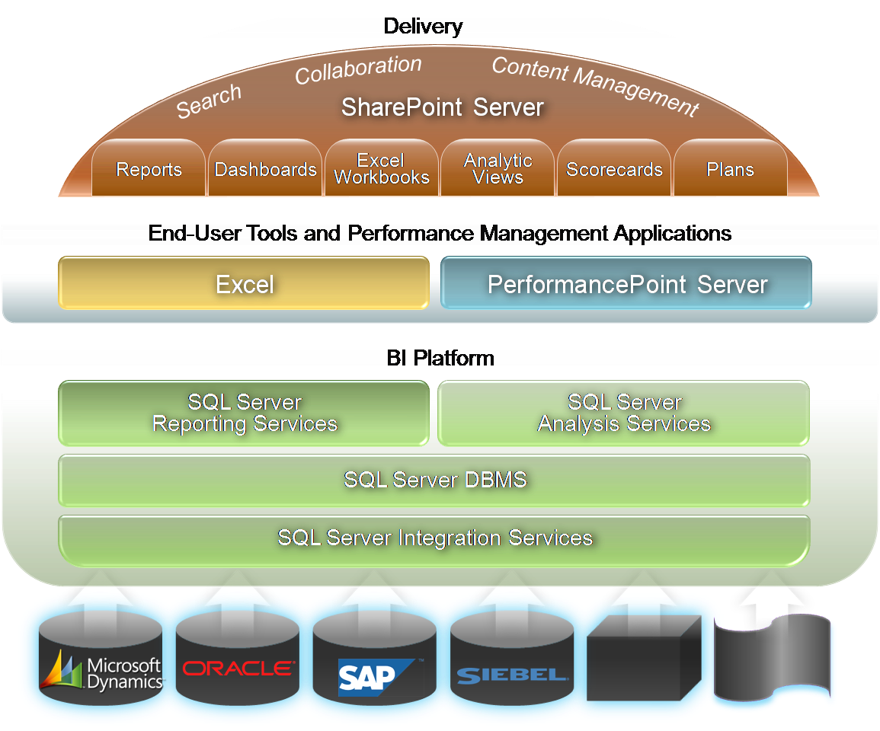
Integrated BI Platform

Slide 5
Integrated BI Platform

Slide 6
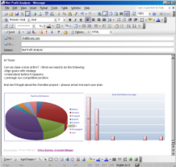
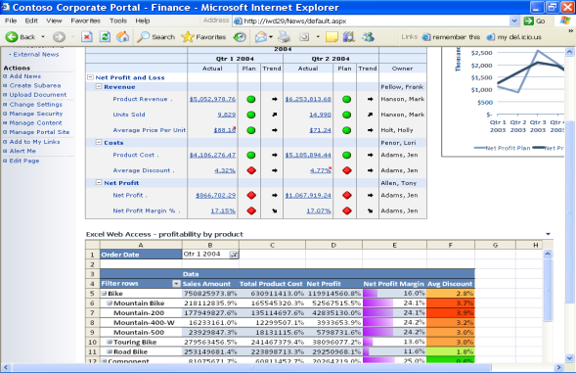


What is Analysis Services?
PerformancePoint Server 2007
Microsoft SharePoint technologies
ProClarity 6.1
Excel 2007

Slide 7
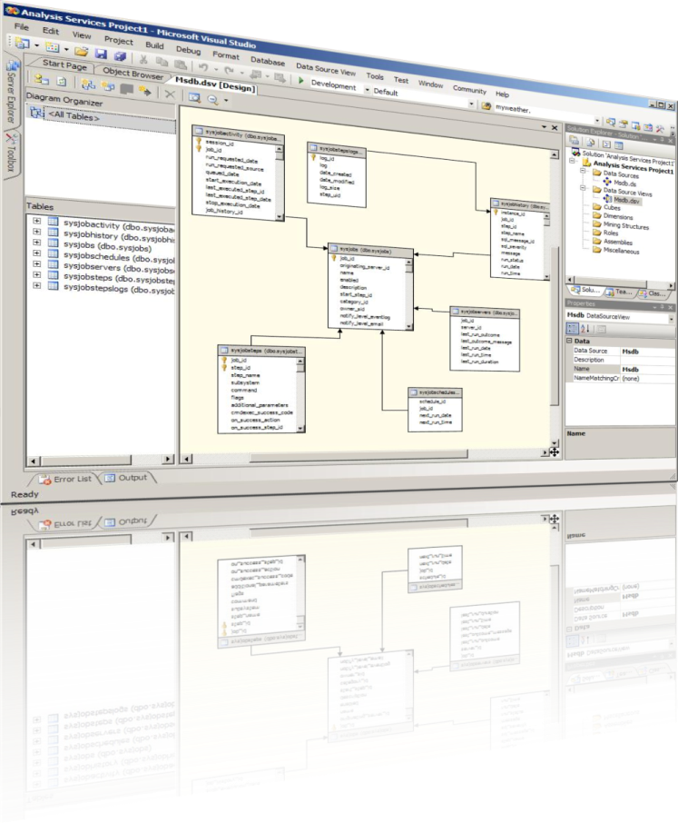



Enterprise Scalability
  High Developer Productivity
  Visual development environment
  Project lifecycle support
  Intuitive BI wizards
  Single tool, multiple technologies
Scalable Infrastructure
  Heterogeneous data Integration
  Parallel partition processing
  Global enterprise scalability
  User-differentiated perspectives
  Superior Performance
  Real-time data access
  Centralized server calculations
  Automatic synchronization

Slide 8
BI Development Studio
Life-cycle support
    Spans develop, test, deploy, modify, test…
One tool, multiple technologies:
    Integration, Analysis, Data Mining & Reporting…
Visual Studio®–based development environment
    Supports team development, source control, versioning, developer in, resource independent coding
BI Wizard – logic jump-start

Slide 9
Scalable Infrastructure
Data Source View (DSV)
  Multiple data sources in a single model
  Single business view across the enterprise
Translations for global scalability
  Multiple languages for all user-accessible objects
  Provides native experience in any language
Perspectives
  Multiple user perspectives across one data model
  More simple end-user navigation

Slide 10
Superior Performance
Fully centralized server calculations
  Limits need for calculations on client
  No excess data transported to the client
Attribute-based hierarchies
  No duplicate data among hierarchies sharing common attributes
Parallel Partitioning
Proactive Caching

Slide 11
Comprehensive Analytics
Unified Dimensional Model
  One consolidated business view
  Integrated relational & OLAP analysis
  Business information modeling
  Time- and financial intelligence
Central manageability of key metrics
  Calculation driven visual indicators
  Server based KPI framework
  Centrally managed repository
  Pervasive end-user accessibility
Predictive Analytics
  Complete data Mining framework
  Extensible .NET programming model
  Embeddable viewers
  SQL language based API

Slide 12
Unified Dimensional Model
A bridge between transactional data and business users
Combines the best of traditional OLAP …
  Performance
  Rich calculations
…. with the best of relational reporting
  Real time & Detail level data
  Complex schema
  Simplified management

Slide 13
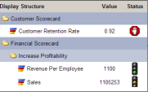
UDM – from Sources to Users
Security
End-user model
Translations, Actions, KPIs
Calculations
Scope(Customer.Country.USA, *);
Sales = 2;
End Scope;
Storage / Caching Policies
Basic Dimensional Model
Cubes and Dimensions
Data Source View

Slide 14
The KPI Framework
  Designed for creation, management and storage of server based KPIs
  Centralized access to corporate wide KPIs
  Exposed through the standard XML/A APIs supporting easy accessibility for end-users via multiple UIs
    Performance Point Server 2007
    ProClarity
    Excel 2007
    SharePoint Server 2007

Slide 15
Data Mining Framework
  Predictive Analytics for competitive edge
  Complete Data Mining Framework
    Prediction query builder and model assessment tools
    Extensible .NET programming model and embeddable viewers
  SQL language based APIs
  Integration with DTS (ETL)
    DTS is the interactive data mining environment
    Use DM prediction as an integral part of the ETL data pipeline transformations

Slide 16
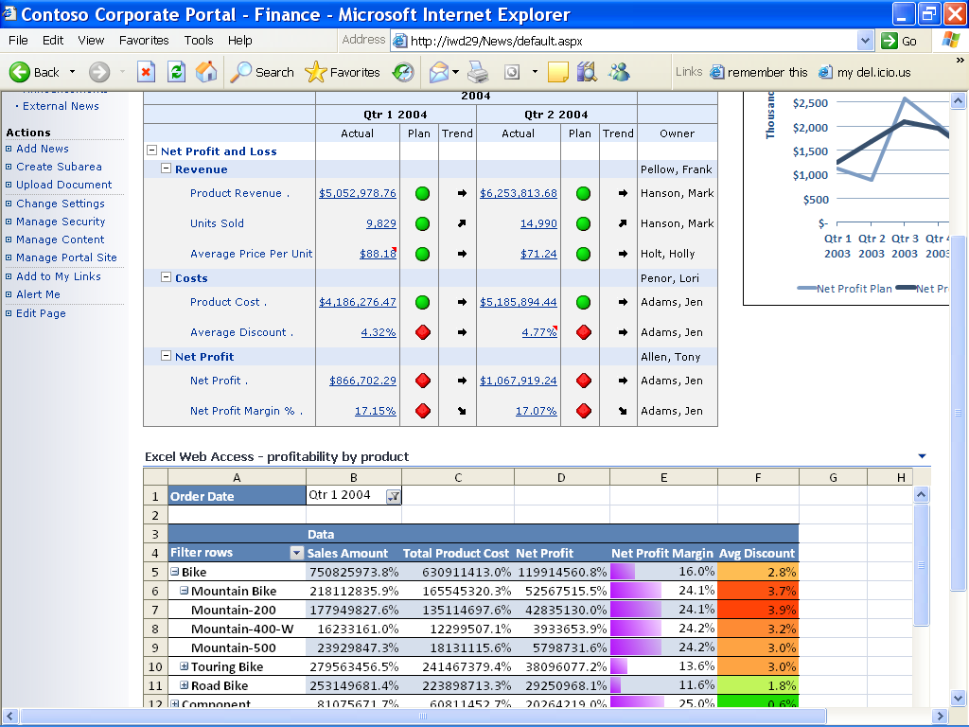



Pervasive Business Insight
Optimized Office Interoperability
  Powerful analysis in Excel 2007
  Advanced visualization in ProClarity
  Collaboration through SharePoint
  Performance management
  through PerformancePoint Server
Rich Partner Ecosystem Extensibility
  Vertically specialized solutions
  Packaged applications
  API support from all major BI vendors
Open, embeddable architecture
  Open API
  XML/A based protocols
  Native web service functionality
  Close loop analysis

Slide 17


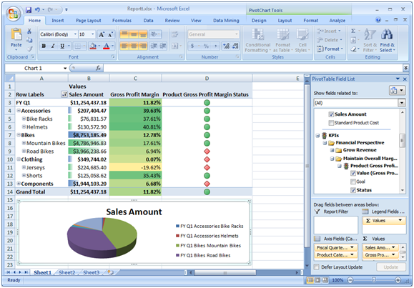
Office 2007 Integration
Rich Excel 2007 Integration
Great cross product investments optimizing Excel 2007 as analytical client for Analysis Services
Enhancements around local cubes
Improvements of custom grouping
Significant performance and functionality investments
New Microsoft SQL Server 2005 Data Mining Add-Ins for Office 2007

Slide 18
Office Integration
  Tight interoperability with every end user tool and application from Microsoft Office offering a complete, end-to-end Microsoft BI Solution
    Powerful analysis in Excel 2007
    Advanced visualization in ProClarity
    Collaboration through SharePoint Server 2007
    Performance management through Performance-
    Point Server 2007

Slide 19

Data Mining Add-Ins for Office 2007
Enable easy to use predictive analysis
  At every desktop
  For every information worker
  Through three powerful add-Ins
  Table Analysis Tools for Excel
  Data Mining Client for Excel
  Data Mining Templates for Visio
  Available
  As free download
  Part of SQL Server 2005 Analysis Services SP2 (Feature Pack)
“What Microsoft has done is to make data mining available on the desktop to everyone” (David Norris, Associate Analyst, Bloor Research).

Slide 20
Open Embeddable Architecture
  Open API for greater programmability
  XML/A based protocols
  Native web services functionality
    Every UDM as a Web Service
  Server Actions for close loop analysis
    Server-based commands available for end user execution through client applications
    Available as URL, Reporting and Drill-through Actions

Slide 21







Partner Ecosystem
  Rich partner ecosystem extending the platform
    Developing of vertically specialized solutions
    Offering packaged BI applications
    Embedding analytical capabilities into business applications
  Analysis Services API support from all major BI vendors

Slide 22
Agenda
What is SQL Server Analysis Services?
Developing SSAS models – best practice
The end-user experience of SSAS
The future – SSAS 2008

Slide 23
Creating an Analysis Services Cube
Session code: BINIL302-R1

Slide 24
Creating Cubes
Avoid using the .NET data providers
Define dimension and fact table relationships in the data warehouse
Avoid unrelated measure groups in the same cube

Slide 25
Data Providers
  SQL Native Client (SNAC)
    This is the fastest provider and the preferred provider when building a cube off of SQL Server data.
  Native OLE DB\Microsoft OLE DB provider for SQL Server
    This is slower in performance than the native client. Good for AS2000 implementations.
  .NET Providers\SQL Client Data Provider
    This is the slowest provider and is optimized for loading small data sets from SQL Server into a .NET application. This is also the default after a migration of Analysis Services cubes.

Slide 26
Best Practices: Data Provider
Using multiple data sources
  The SQL created uses the non pass through query OPENQUERY function to access the other data source. This is slow.
  It is better to use linked servers behind the scenes for optimal performance.

Slide 27
Tables -> Dimensions
Primary and Foreign Keys
  If your underlying data source has primary key and foreign key definitions, your DSV will pick them up and leverage them as a starting point.
  If your underlying data has no keys you will need to define the relationships manually.

Slide 28
Measure Groups
One cube with many “unrelated” measure groups
  The problem is user context
  Create Perspectives to simplify the user experience
  Perspectives show up to the end user as separate cubes

Slide 29
Attributes and Hierarchies
Avoid the tempting desire to include too many attributes
Create attribute relationships (Strong Hierarchies) whenever they exist in the data, and don’t if they don’t
Use numeric key columns that uniquely define attributes

Slide 30
Attribute Relationships
One-to-many relationships between attributes
  City → State → Country
Rigid v/s flexible relationships (default is flexible)
  Day -> Month
  Account -> Territory
All attributes directly/indirectly related to key attribute

Slide 31
Hierarchies
Strong Hierarchies
  Roll up to 1-and-only-1 parent
  Materialized on disk during processing
  Weak hierarchies are built on the fly during queries (and cached in memory)
Create strong hierarchies whenever possible
  Using attribute relationships, with unique keys for each member
  Not always appropriate (e.g. Age-Gender)

Slide 32
Calculated Members & KPIs
Push calculations as far back in the Analytic Data Lifecycle as possible
Avoid KPI trends based solely on the prior period
Less is more when presenting KPIs

Slide 33
Calculations
SSAS calculated members resolve on the fly during query time
  Create and store calculations as far back in the data lifecycle as possible
    Add a column to Fact Tables during ETL process
    Add a Named Calculation on a Fact Table in DSV
    Use Measure Expression property on Measure
  Some calculations (i.e. Ratios) must resolve at query execution time to get a proper roll up

Slide 34
Best Practices: KPIs
Trends based solely on Prior Period can be misleading
  May need to base the Trend on a prior date range
  Instead of trending this Month versus Last Month, consider using this Month versus Year to Date Average

Slide 35
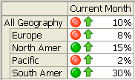
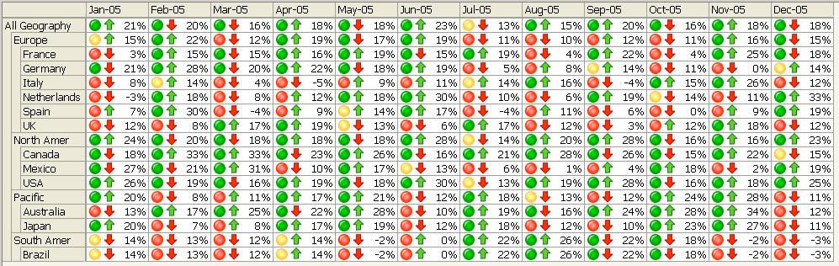
Best Practices: KPIs
Use caution when displaying KPI views
    VS

Slide 36
Agenda
What is SQL Server Analysis Services?
Developing SSAS models – best practice
The end-user experience of SSAS
The future – SSAS 2008

Slide 37
Agenda
What is SQL Server Analysis Services?
Developing SSAS models – best practice
The end-user experience of SSAS
The future – SSAS 2008

Slide 38
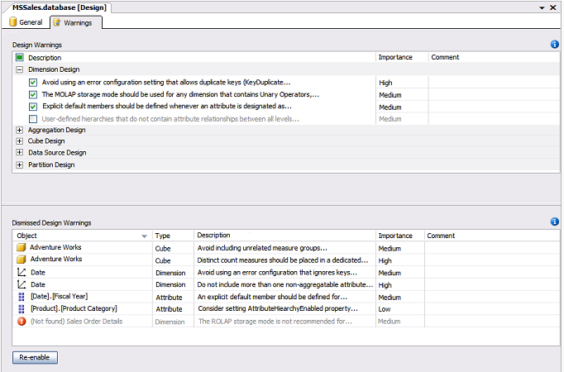
Development Experience
Design
Monitor
Run
“Designed to Perform”
AMO Warnings
  40+ real-time best practices
  Hints, not pop-ups
  Dismissible:
    By instance or globally
    Can specify comment in each case

Slide 39
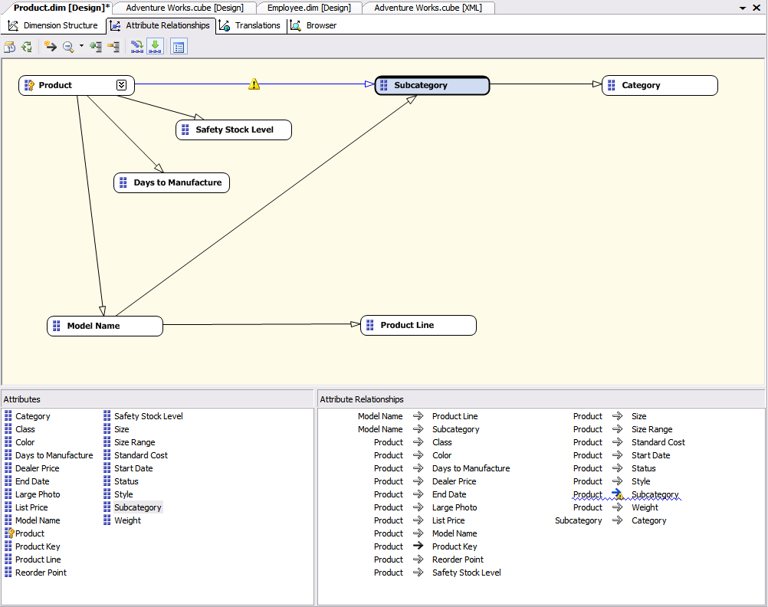
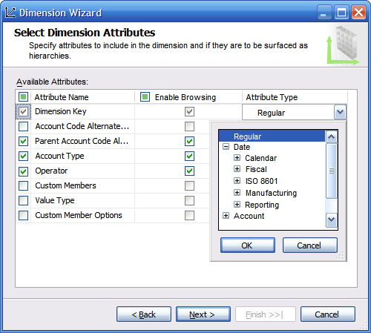
Dimension Design
“Designed to Perform”
Design
Monitor
Run
Attribute Relationship Designer
Dimension Wizard
  Automatically create p-c attributes
  Enable classifying member properties
  Safer error configuration settings
Dimension Editor
  Streamlined interface
  New dialog for specifying key columns
  Property grid support for editing key columns

Slide 40
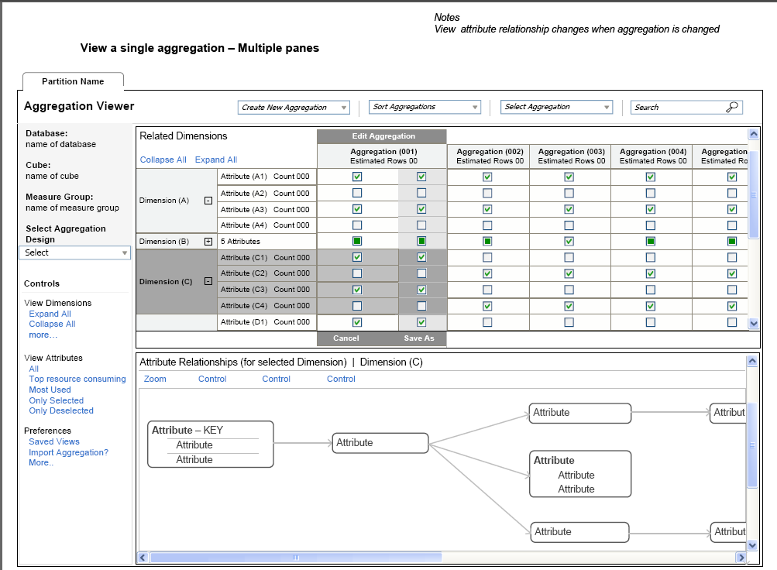
Aggregation Design
“Designed to Perform”
Design
Monitor
Run
One Wizard
  Initial aggregations
  Usage based aggregations
  Design by Query (New)
  Better inputs into algorithm
Improved Algorithm
  Improved initial aggregations
  Optimized for usage-driven aggregations
  Support for intelligently merging old and new aggregations
Dedicated Designer
  View aggregation designs and aggregations
  Manually edit/create/delete aggregations
  Many built-in validations to assist in creating optimal designs

Slide 41
Resource Monitoring
“Designed to Perform”
Design
Monitor
Run
Exposing server resource information as cube for you to perform resource analysis
Analysis Services
Reports generated in Reporting Services
Default Resource cube
Rich analytical client applications
Resource tables (DMV)
Ad hoc analysis
Select * from Session_Resources

Slide 42
MDX Block Computation
“Designed to Perform”
Design
Monitor
Run
Cube space populated at fact table generally extremely “sparse”
Goal is to compute expressions only where they need to be computed, otherwise default
Order of magnitude performance over SSAS2005

Slide 43
Scalable Backup
“Designed to Perform”
Design
Monitor
Run
Ask/Need | Estimated 20% of cubes are greater then 50GB. BI is mission critical to many business. Needs fast and reliable backup. “ I need a fast mean of moving /shipping cubes from one server to another”
Today's Problem | Analysis Services 2005 backup scales well up to 20GB cubes. Beyond 20GB seeing significant performance degradation on backup operation. Note: 20GB of AS cubes represents ~ 80GB relational data. Today's workaround: File copy of data folder
AS 2008 Solution | Out of the box performance that is comparable to the speed of file copy.

Slide 44
Backup Performance - AS 2008
“Designed to Perform”
Design
Monitor
Run

Slide 45
MOLAP Writeback
“Designed to Perform”
Design
Monitor
Run
 | Drink | Food | Non-Consumable
Canada | (null) | (null) | (null)
Mexico | (null) | (null) | (null)
USA | (null) | 100 | (null)
Analysis Services 2005
Analysis Services 2008
Update
Update
Analysis Services
Analysis Services
Query to writeback (ROLAP) partition
Update to (ROLAP) partition
Query to
MOLAP
partition
Update to (ROLAP) partition
Incremental Process
Query to
MOLAP
partition

Slide 46
Writeback Benefits
“Designed to Perform”
Design
Monitor
Run
Improved Overall Query Performance
  No ROLAP queries
Improved writeback
  Cost of concurrent incremental update small compared to ROLAP queries
Benefits (approx)
  In house testing demonstrates a 5x performance boost for a 2 million cell update

Slide 47
Scalable Shared databases (Read-only)
“Designed to Perform”
Design
Monitor
Run
Ask/Need | Easy way of scaling out AS data cross multiple machines.
Today's Problem | While MOLAP cubes are Read-Only databases, no two servers are share same data directory. Cube Sync – works but have latency issues which are not acceptable in LB solutions.
AS 2008 Solution | Single read-only copy database is shared between several Analysis Servers.
Virtual IP
. . .
Analysis Server
Analysis Server
Analysis Server
SAN storage
Note: This improvement is on the bubble

Slide 48
Data Mining in AS 2008
Engine and algorithm improvements
  Better prediction and insight
  Respond to requests from existing data mining users, typically specialists
Data Mining Add-ins for Office 2007
  Delivering a compelling end-user experience
  Bring data mining to a new, and much larger audience

Slide 49
Better Time Series Support
SQL Server 2005
  Introduced the ARTXP Time Series
  Built from MS Research
  Most accurately predict the next step in a series
  Less suitable for predicting further out
SQL Server 2008
  ARTXP is still available
    Best for short term predictions
  Also includes ARIMA
    The most common Time Series algorithm
    Well understood by most data miners
    Reasonable predictions when projecting beyond next 10 steps

