Slide 1
Microsoft Business Intelligence
Bruno Aziza
Senior Product Manager,
Microsoft Business Division

Slide 2
Information Overload
IM/chat
Spreadsheets
Scorecards
Meetings
Newspapers
Spreadsheets
Scorecards
IM/chat
Newspapers
Financial reports
Documents
Meetings
Documents
Email
Email
Portals
Slide decks
Portals
Slide decks
Business books
Webcasts
Business books
Webcasts
Presentations
RSS feeds
Presentations
Project plans
Project plans
Intranet
Intranet
RSS feeds
Blogs
Dashboards
Dashboards
Magazines
Analytic applications
Magazines
Internet
Television reports
Television reports
Blogs
Internet
Charts and graphs
Charts and graphs

Slide 3
The Execution Gap…
95% of a typical workforce does not understand how the organizational goals and objectives relate to their jobs
90% of organizations fail to execute their strategies successfully
86% of teams spend less than one hour per month discussing strategy
60% of organizations do not link their strategies to their plans and budgets
Source: Palladium Group/BSCOL

Slide 4
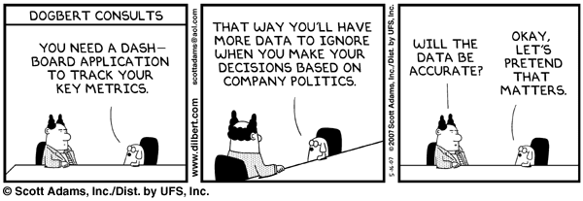

Slide 5
Conventional Thinking… Conventional Results.
Gartner Survey of 1,400 CIOs 1,400 CIOs in more than 30 countries representing $90B+ in IT Spending
Gartner: “Business Intelligence will surpass security as their [CIOs] top technology priority this year.”
InformationWeek article on BI Spending
Less than a quarter of workers use BI software today
Only 8% report more than half of employees use BI software
But, 38% say more than half of their employee’s will use BI software in two years
http://www.gartner.com/press_releases/asset_143678_11.html
http://www.informationweek.com/showArticle.jhtml;jsessionid=IFNUVEI1VUFNYQSNDBOCKH0CJUMEKJVN?articleID=181500685

Slide 6
Our Vision: BI for Everyone
TODAY…
YESTERDAY…
BI for Everyone
Specialized
BI Tools

Slide 7
BI For Everyone How do you get there?
Integration
Economics
Functionality

Slide 8
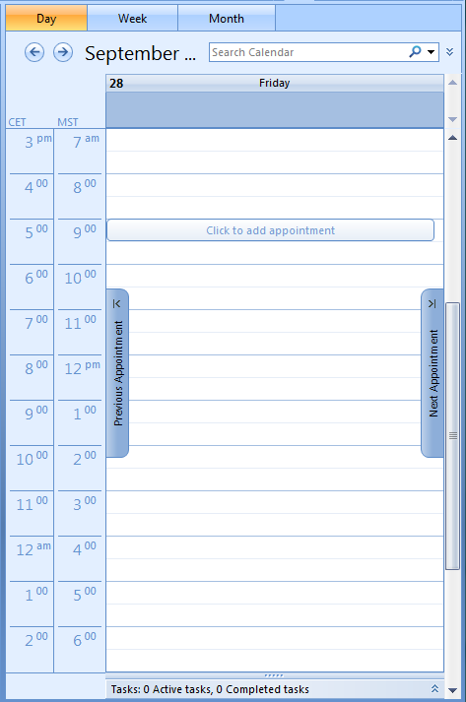
Focus on Functionality: A Typical Information Worker’s Day….
E-mail, meetings, conference calls, analysis
Work on proposals, approve some things, etc.
All reliant on some component of a BI system
Review of feedback from colleagues on proposals and ideas
Presentation preparation
Ad hoc analysis and “what-if’s”
Understand market trends and direction
Plan or adjust based on analysis
Make decisions based on the data and analysis at hand
Email
Prep M&A Presentation
Meeting on Goals
Product Quality Deep Dive
Lunch
Customer Meeting
Product Introduction Analysis
M&A Presentation
Email

Slide 9
There Are Key Capabilities Needed To Support This Spectrum
Personal BI
Team BI
Organizational BI
Spreadsheet Analysis
Data entry and report viewing
Publish and Share Information
Aggregate Plans and Forecasts
Synchronize and Align Goals and Tasks
Consolidate Results
Communicate our Status
Understand Variances and Take Corrective Action

Slide 10
What We Are Doing About It
Increasing our BI Investments
Extending our BI product line:
SQL Server and Office
Partnering more broadly and deeply
Delivering a market leading
Performance Management Application

Slide 11
Comprehensive Approach to BI
TOOLS &
APPLICATIONS
PLATFORM
Trusted platform
Data warehousing
Developer-ready
Enterprise scalability
Collaborative BI
Pervasive reach
Performance mgmt
Search, Content mgmt

Slide 12
Our End-to-End BI Offering
DELIVERY
COLLABORATION
CONTENT MANAGEMENT
SEARCH
SharePoint Server
Reports
Dashboards
Excel
Workbooks
Analytic
Views
Scorecards
Plans
END USER TOOLS & PERFORMANCE MANAGEMENT APPS
Excel
PerformancePoint Server
BI PLATFORM
SQL Server

Slide 13
Microsoft Business Intelligence
Covering the spectrum for all types of business requirements
Strategic
Value
Scorecards
Planning
Dashboards
Authoring
Ad hoc Query
Consolidation
Data
Integration
Analysis
Storage
Reports
Analytics
Data
Management
Sound
Data
Personal
and Team
Insight
Organizational
Decisions
Platform
Applications

Slide 14
Microsoft BI And PM
PerformancePoint Server
(includes Business Scorecard Manager)
ProClarity® Analytics
Performance
Management
Office SharePoint® Server 2007
Office Excel 2007
Integration Services
Analysis Services
Reporting Services
Business Intelligence
SQL Server 2005
Notes:
12/5/2007 4:40 PM
14
© 2005 Microsoft Corporation. All rights reserved.
This presentation is for informational purposes only. Microsoft makes no warranties, express or implied, in this summary.

Slide 15
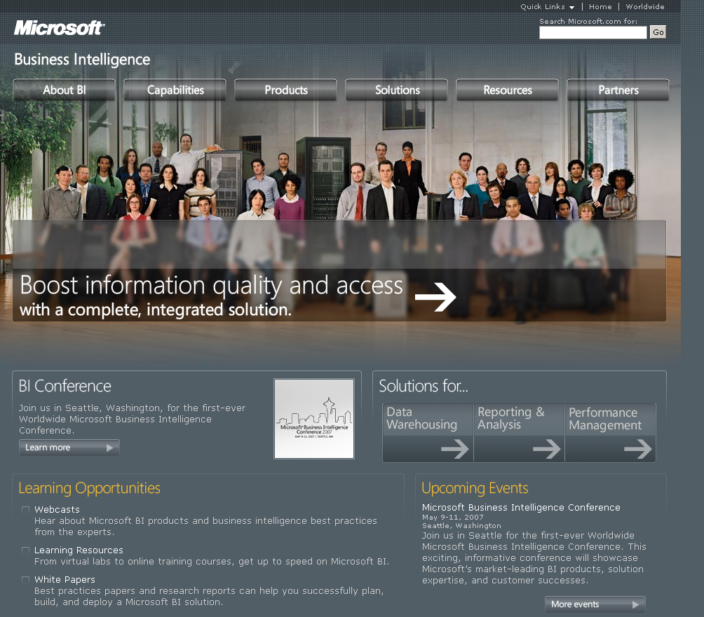

Slide 16
Performance Management
Performance Management software has the potential to transform how people drive business performance
Performance Management can give you the ability to
Understand what is happening in the business
Set a course for where you want to take the business
Give you more confidence in your decisions

Slide 17
Performance Management
Performance Management Applications
Financial
Budgeting, Planning and Forecasting, Consolidation, Management Reporting, Scorecards & Analytics
“I need to improve our analytics capabilities so we can understand our current business performance and do a better job of planning for the future."
Operational/Supply Chain/MFG
Operational Dashboards, Supply Chain Analytics, Constraint Based Planning
“I need better visibility into my cost of operations so I can target specific cost reduction opportunities that won’t have a negative impact.”
Sales/Customer/Marketing
Analytic CRM, Sales Forecasting, Campaign Management & Analytics, Sales Scorecards
“I need better visibility into our pipeline performance so I can focus on deals that help me grow business with my most profitable customers.”
Human Resources
HR Analytics, Headcount Planning, Talent Scorecards, OPEX Planning & Analytics
“I need better visibility into our talent management so I can plan for growth and understand issues before they become troublesome.”

Slide 18
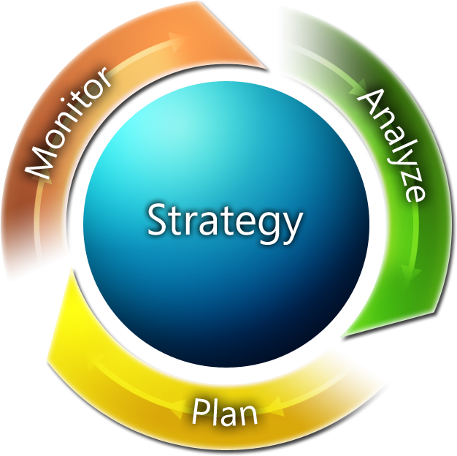
Performance Management Better execute on strategy
What happened?
What is happening?
Why did it happen?
What will happen? What do I want to happen?
Notes:
18

Slide 19
The Role of Excel
Why Business Users Love Excel:
What PerformancePoint Server 2007 Brings:
Familiar
Powerful
Flexible
Where people work
Excel with “live” and interactive data
Processes and rules
A central model
Security
Trust

Slide 20
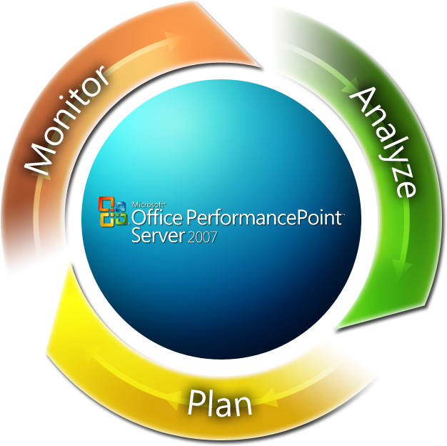
Performance Management Capabilities Delivered
What is happening?
Scorecards and Dashboards
What happened?
Reporting
Why did it happen?
Analytics
What will happen? Forecasting
What do I want to happen?
Planning, Budgeting, Consolidation
Notes:
20

Slide 21
Office PerformancePointServer 2007 Market Momentum
10,000+ Customers in CTP
Almost 1,000 Partners Trained
Enterprise Customers around the globe
In use at Microsoft for 2+ years!

Slide 22
Performance Management at Microsoft: An Internal Case Study

Slide 23
Microsoft’s Performance Management Process
Strategic
Planning
(December)
Mid-Year
Review
(January)
Target
Setting
(March)
Business
Planning
(June)
Ongoing Monitoring and Analysis
Strategic plan with 3-5 year outlook, key investments
Performance status at Mid-Year Review
Target setting turns long range plans into annual goals
Business planning turns annual goals into operational plans

Slide 24
Performance Management Challenges In The Business Divisions (MBD)
Multi-dimensional matrix
Top down target, bottom up budget
Disconnected processes and tools
Inconsistent data definitions
Overlapping accountability
Small, MM Solns. & Partners
Orig. Equip. Mfg. (OEM)
Enterprise & Partner Group
Dev. & Plat. Evangelism
Public Sector
BMO (Business & Mktng. Org.)
Americas
SMSG (Sales, Mktng & Servcs. Grp.)
EMEA
APAC
Worldwide Licensing & Pricing
Operations

Slide 25
Disconnected Data A Tangled Web
Multiple Sources
Multiple Uses
Microsoft Sales
Scorecards
Microsoft People
Dashboards
Microsoft Spend
Reporting
Microsoft Marketing
Forecasting
Microsoft Product Development
Analysis

Slide 26
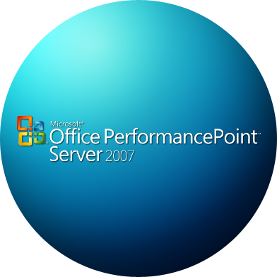
Microsoft Business Division's Performance Management Solution
Enabling a common planning, monitoring and analysis framework across a matrixed organization
Multiple Sources
Multiple Uses
Microsoft Sales
Scorecards
Microsoft People
Dashboards
Microsoft Spend
Reporting
Microsoft Marketing
Forecasting
Microsoft Product Development
Analysis

Slide 27
Microsoft Business Division’s Solution
Challenge
Solution
Results/Benefits
Disconnected scorecard, reporting, and analysis
Inconsistent processes and taxonomy
Manual and inefficient data gathering
PerformancePoint -scorecards and drill down
PerformancePoint - workflow
SharePoint – web presentation
Excel Services -“thin” spreadsheets
SQL Server 2005 -sound data
Consolidated and Simplified
5 processes →1
Dozens of data sources → 1
15 reports →1
Consistent and Accurate
One set of data rules
One data transformation
Customized
Business user administration
Saves weeks/months

Slide 28
Performance Management Challenges At Microsoft Worldwide
Enterprise & Partner Group
Small, MM
Solns. & Partners
Dev. & Plat. Evangelism
Orig. Equip.
Mfg. (OEM)
Public Sector
Multi-dimensional matrix
Top down target, bottom up budget
Disconnected processes and tools
Inconsistent data definitions
Overlapping accountability
Orig. Equip. Mfg. (OEM)
Commercial Software Initiatives (CSI)
Small, MM Solns. & Partners
Enterprise & Partner Group
Dev. & Plat. Evangelism
Public Sector
Customer & Partner Experience (CPE)
Global Initiatives
BMO (Business & Mktng. Org.)
Citizenship
Americas
Americas
EMEA
SMSG (Sales, Mktng & Servcs. Grp.)
EMEA
APAC
BMO (Business & Mktng. Org.)
APAC
Worldwide Licensing & Pricing
SMSG (Sales, Mktng & Servcs. Grp.)
Supporting Cross Functional Groups
Operations
Worldwide Licensing & Pricing
Operations

Slide 29
Microsoft’s Planning and Forecasting Solution
Challenge
Solution
Results/Benefits
PerformancePoint - planning and forecasting
Excel – end user interface
SharePoint – web presentation
SQL Server 2005 – Sound, integrated data
Consolidated and Simplified
Integrated planning/forecasting/reporting
Flexible refresh saves days
Consistent and Accurate
One data model
One user experience – saves training
Customized
Custom driver based modeling in Excel
Multiple legacy tools
Offline modeling
Manual reporting and data transformation
Inefficient consolidation

Slide 30
It's a New Day for Business Intelligence
End-to-End BI Solution
Enterprise Ready
Bringing BI to Everyone

Slide 31
Thank You!

