Slide 1
Bruno Aziza
Senior Product Manager, Business Intelligence

Slide 2
What is Performance Management
Performance Management is defined by the processes, methodologies and technologies organizations use to monitor, analyze and plan
business performance.

Slide 3
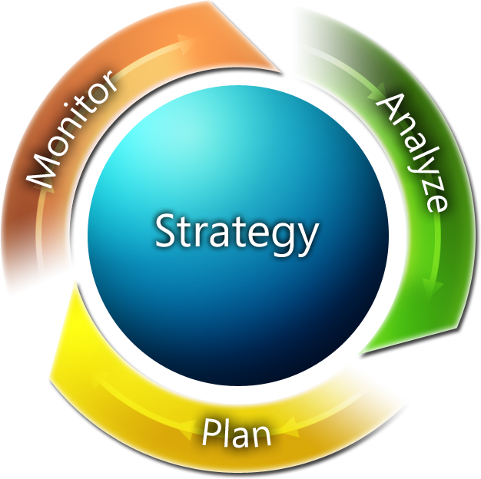
Performance Management Better execute on strategy
What happened?
What is happening?
Why?
What will happen? What do I want to happen?
Notes:
3

Slide 4
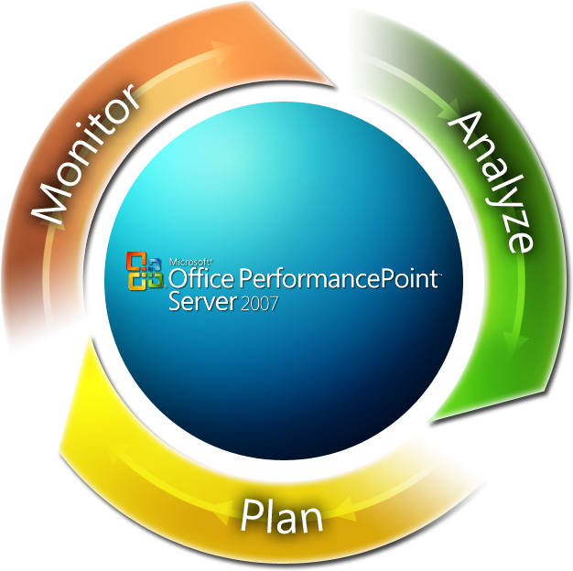
Performance Management Capabilities Delivered
What is happening?
Scorecards and Dashboards
What happened?
Reporting
Why did it happen?
Analytics
What will happen? Forecasting
What do I want to happen?
Planning, Budgeting, Consolidation
Notes:
4

Slide 5
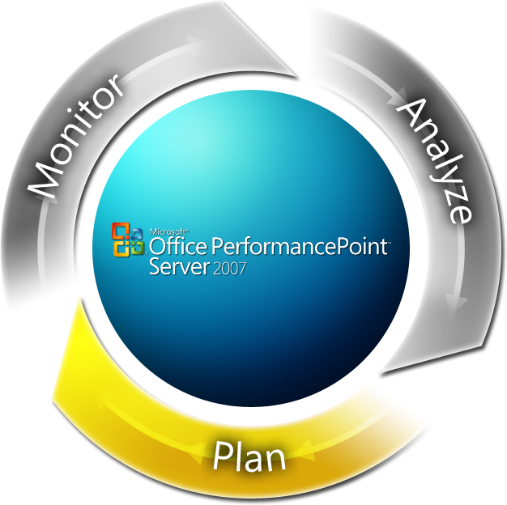
Performance Management
Notes:
5

Slide 6
Sessions
Day | Time (PST) | Session Name | Register
9/28/07 | 1:00 - 2:30p.m. | Introduction | Attend
10/11/07 | 2:00 - 3:30p.m. | Technical Overview | Attend
10/26/07 | 8:00 - 9:30p.m. | Budgeting | Attend
11/2/07 | 11:30 - 1:00p.m. | Revenue Forecasting | Attend
11/16/07 | 1:00 - 2:30p.m. | Monthly Reporting | Attend
11/30/07 | 1:00 - 2:30p.m. | Strategic Planning and Scorecarding | Register

Slide 7
Architecture Planning
Planning Server and Database
Model
Consume
Import and stage data.
Build and manage models, cycles, dimensions and hierarchies.
Manage user access and roles.
Deploy templates to Microsoft Office Excel, and reports SQL Server Reporting Services (RS).
Stores metadata and business logic.
Manages Planning Add-in.
Contribute to plans, forecasts and budgets in a rich, secure and auditable environment.
Work and customize forms and reports.
Submit, approve and audit assignments and consolidation jobs.

Slide 8
Key Functionality Areas
Monitoring Server and Database
Design
Consume
Dimensions/Hierarchies
Models
Cycles
Roles/Security

Slide 9
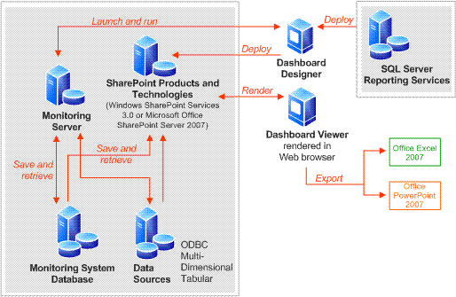
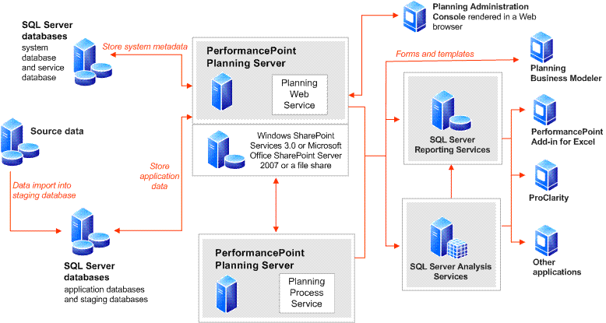
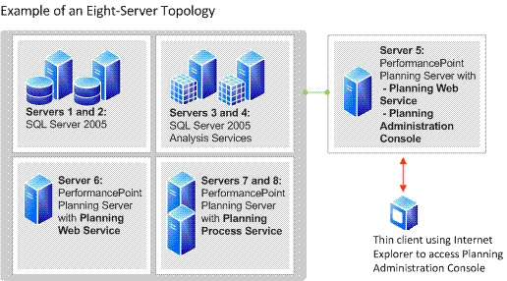
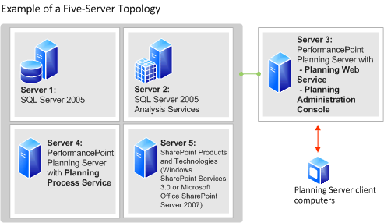
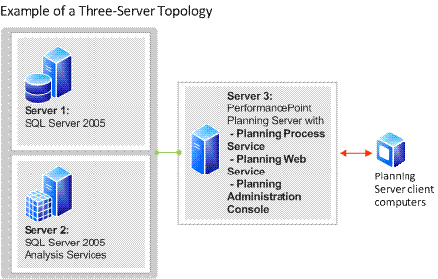
More on Architecture
Technical Portals
Office Developer Portal here
TechCenter here

Slide 10
Dimensions and Hierarchies
Definition
Dimensions: line items, groupings and roll-ups by which a company defines and measures the components of its business.
Hierarchies: the relationship between various dimensions. They go from simple parent-child relationship to customized hierarchies based on calculations.
Examples: accounts, products, geographies, customers…etc.
Typical challenges
“Single version of the truth” and synchronization across multiple business operations.
Dimensions and hierarchies change management prevents agility.
These pain points become more important when customers need to absorb business changes (M&A, end of life of products…etc).
Why are dimensions and hierarchies are important
PerformancePoint Server provides centralized hierarchy and dimension management .
Hierarchies and dimensions can be defined at a corporate level and still allow flexibility across the multiple business operations they affect.
Accounts
Time
Products
Customers
Geographies
Dimensions

Slide 11
Models
Definition
Set of data, calculations and definitions that bring together the historical, planned, budgeted and forecasted views of the business.
Examples: modeling operational expenses and revenue.
Typical challenges
Most customers design models using links and macros in disconnected spreadsheets.
The process of modeling is often cumbersome, lengthy, error prone, expensive and rarely re-usable.
They are often describe as inaccurate and inflexible, and have little correlation with the way business is ran.
Why are models important
PerformancePoint Server models allow business users define and maintain models in a scalable, connected and reusable fashion.

Slide 12
Cycles
Definition
The business process which coordinates the various performance management protagonists.
Examples: rolling sales forecast, budgeting process.
Typical challenges
Companies lacking integration typically can’t implement cycles efficiently. They end up emailing spreadsheets, often pushing the wrong data to the wrong person at the wrong time.
Lack of managed cycles makes it difficult to iterate plans and forecast changes.
Lack of security causes compliance, security holes and prevents auditability.
Why are cycles are important
PerformancePoint Server supports cycles going across multiple user types and roles (approvers, contributors…etc).
PerformancePoint Server supports rolling cycles and process management.

Slide 13
Roles and Security
Definition
Security: the way a company defines what user/group has access to what information.
Roles: what impact each user has on a given process.
Examples: forecast contributor, an approver…etc
Typical challenges
Security is often tied to a document being exchanged, rarely to the data or the user role.
Security is a top IT priority but it is expensive to implement and to maintain. Security management is often defined as inflexible.
Why are roles and security important
They are centralized in PerformancePoint Server, which guarantees consistency and changes can be deployed with more flexibility.
PerformancePoint Server allows business users to manage them.

Slide 14
Performance Management Better execute on strategy
What happened?
What is happening?
Why?
What will happen? What do I want to happen?
Notes:
14

Slide 15
Performance Management Capabilities Delivered
What is happening?
Scorecards and Dashboards
What happened?
Reporting
Why did it happen?
Analytics
What will happen? Forecasting
What do I want to happen?
Planning, Budgeting, Consolidation
Notes:
15

Slide 16
What does budgeting look like?
Manage the Process
1
Load, stage and analyze data.
Build logic, approval hierarchy, data flow, cycles and timetable.
Create input templates.
Analyze and report on progress ongoing and results.
Conclude Budget.
Top Down
3
2
Bottom Up
Set budgetary guidance (including targets and timetable).
Communicate plan and guidance.
Set timetable for local iterations.
Coordinate and aggregate contributions.
Review and freeze budget version.

Slide 17
Who is involved?
Manage the Process
1
Corporate Executives (CEO, COO, CFO).
Budget Process Owners (Business Managers and Analysts).
Infrastructure Owners (IT analysts and administrators).
Top Down
3
2
Bottom Up
Budget Process Owners.
Local Budget Process Owners.
Local Budget Process Owners.
Budget Owners.
Budget Contributors.

Slide 18
What are common limitations?
Manage the Process
1
Integration (between financial and operational data).
Information quality and consistency.
Ability to analyze and report on drivers and performance.
Top Down
3
2
Bottom Up
Process for translating a global budget into local targets.
Process for establishing realistic and clear local guidance.
Process for orchestrating contribution.
Process for consolidating information back-up to corporate budget.

Slide 19
Why PerformancePoint Server for budgeting?
Manage the Process
1
Integration: Business Modeler ETL.
Quality/Consistency: Business Modeler Rules and Logic.
Analyze/Report : Integrated reports, dashboards and analytics.
Top Down
2
3
Bottom Up
Translation: Model-to-Model
Local guidance: Rules and Logic
Orchestration: templates, cycles, data flows.
Consolidation: FI, consolidation, allocations and associations.

Slide 20
Demo

Slide 21
What's covered
Create member sets
Create models
Business rules
Create associations
Dimensions and Member associations
Create forms
Create users and cycles

Slide 22
Guides and downloads
Technical Portals
Office Developer Portal here
PerformancePoint Server TechCenter here
Technical guides
Planning Server Business Rules Development Guide here
Monitoring SDK guides here
Software downloads, sample data and tools
PerformancePoint Server 2007 Evaluation Version (x86) here
PerformancePoint Server 2007 Evaluation Version (x64) here
PerformancePoint Server 2007 Sample: Monitoring Data here
PerformancePoint Server 2007 Sample: Planning Data here
Data Import Wizard for Microsoft Dynamics AX Tool here
PerformancePoint Server 2007 Tool: Scorecard Migration Tool here

Slide 23
How do I
How do I set up a model for shares calculation and consolidation?
How do I create an association to move data between models?
How do I use an assumption model?
How do I write a business rule?
How do I customize a Currency rule template?
How do I customize an Intercompany Reconciliation template?
How do I export data with an outbound rule?
How to: Applications and Models
How to: Dimensions and Members
How to: Business Rules
How to: Associations Between Models
Use multiple data sources in a single Time Intelligence filter
Link KPIs to reports
Move my content from one environment to another

Slide 24
Sessions
Day | Time (PST) | Session Name | Register
9/28/07 | 1:00 - 2:30p.m. | Introduction | Attend
10/11/07 | 2:00 - 3:30p.m. | Technical Overview | Attend
10/26/07 | 8:00 - 9:30p.m. | Budgeting | Attend
11/2/07 | 11:30 - 1:00p.m. | Revenue Forecasting | Attend
11/16/07 | 1:00 - 2:30p.m. | Monthly Reporting | Attend
11/30/07 | 1:00 - 2:30p.m. | Strategic Planning and Scorecarding | Register

Slide 25
Calls to Action
1) Visit the PerformancePoint Server 2007 site!
http://www.microsoft.com/performancepoint
2) Visit the TechCenter site!
http://technet.microsoft.com/office/performancepoint/default.aspx
3) Attend the upcoming TechNet webcasts!
www.microsoft.com/technet

Slide 26
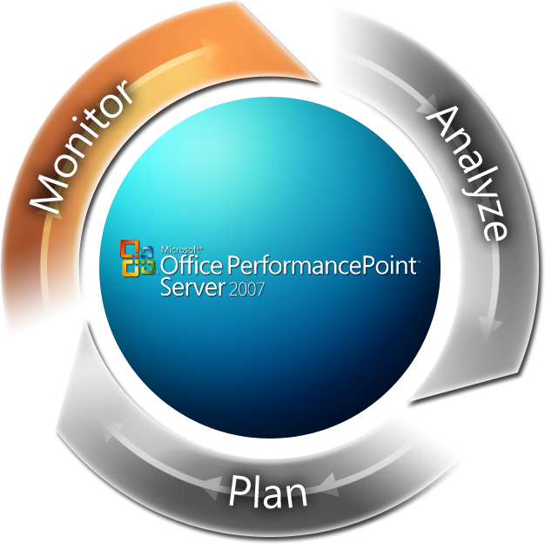
Performance Management
Notes:
26

Slide 27
Architecture Monitoring and Analysis
Monitoring Server and Database
Design
Consume
Access data sources.
Build and manage kpis, scorecards, analytics and dashboards.
Manage user access and roles.
Deploy dashboards to ASP,net, WSS,MOSS and RS.
Stores metadata and business logic.
Manages Designer application.
Consume complete dashboards over the web.
Interact with rich kpis, scorecards and analytics.
Export work to Excel and PowerPoint.

Slide 28
Key Functionality Areas
Monitoring Server and Database
Design
Consume
Scorecard Elements
Dashboard Elements
Report Views
Open APIs

Slide 29
More on Architecture
Technical Portals
Office Developer Portal here
TechCenter here

Slide 30
Scorecard Elements
Profit
Revenue
Cost
Definition
The way a company defines and measures performance
Examples: KPI sourcing, banding, weighting and roll-up.
Typical challenges
Sourcing information from multiple data sources is often challenging making it difficult for employees to see a complete picture of performance.
Building flexible rules and logic in KPIs, scorecards is often difficult and it is a capability that is only reserved to a few highly trained analysts or IT staff.
Why are scorecard elements important
They are centralized in PerformancePoint Server, which guarantees consistency and changes can be deployed with more flexibility.
PerformancePoint Server allows business users to manage KPIs and scorecards.

Slide 31
Dashboard Elements
Definition
The way a company can provide a relevant and consistent view of performance to all employees.
Examples: filters, assembly of various scorecards and views in a single location.
Typical challenges
Building dashboards that allows employees to do more than just look at numbers. Dashboards are often “too flat”.
Providing all employees with consistent and actionable information in web-based dashboards that include KPIs, scorecards and analytics.
Why are dashboard elements important
PerformancePoint Server makes it easy for business users to quickly assemble and deploy a complete view of their individual, group or organization performance.
PerformancePoint Server makes is easy for more employees to consume in complete dashboards in a browser environment.
PerformancePoint Server dashboards are highly interactive and allows employees to gain better insight faster.

Slide 32
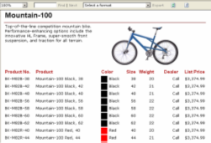
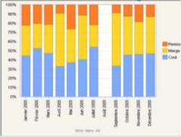
Report Views
Definition
The way additional and contextual information can be provided to employees to help with better insight and easier investigation.
Examples: Strategy Maps, Excel Services Report Views, PAS Views, Reporting Services Views, document libraries.
Typical challenges
Integrating and displaying additional structured and unstructured information in a single environment is often challenging.
Providing complementary information to scorecards, KPIs is often done outside of the dashboard, making it challenging for employees to quickly get a better understanding of business performance and act on it.
Why are report views important
They are centralized in PerformancePoint Server, which guarantees consistency and changes can be deployed with more flexibility.
PerformancePoint Server allows business users to get additional visual context about their metrics, and become great entry points for better, more focused analysis.

Slide 33
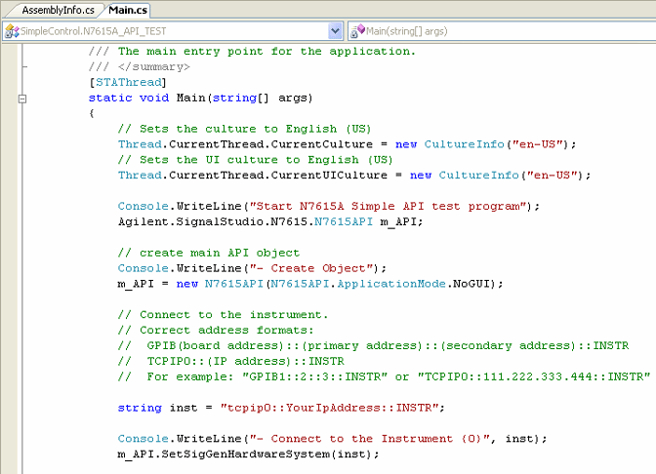
Open APIs
Definition
APIs (application program interface): allow developers to extend the original functionality of the product.
Examples: override urls, integration with other applications, creation of new wizards…etc
Typical challenges
Most dashboarding and scorecarding solutions are rigid and inflexible. Some are restricted to certain methodologies, some simply require significant customization and configuration to adapt to the company needs and business processes.
Lack of openness restricts companies to deploy solution that is appropriate to their needs, might they be related to particular extended functionality or additional content.
Why are PerformancePoint APIs are important
APIs allow individual developers, customers and partners to build customized integration with their specific data and business needs.
APIs allow individual developers, customers and partners to extend the current product capabilities in order to innovate on the already widely adopted Microsoft platform.

Slide 34
Product information
What is Microsoft Office PerformancePoint Server 2007 here
Interactive product demo here
Features here
Top ten benefits here
Case studies here
News and Reviews here
System requirements here
Licensing here
More @ http://www.microsoft.com/performancepoint
Datasheets
Overview of PerformancePoint Server 2007 here
Monitoring Performance here
Data Analysis and Visualization here
Planning, Budgeting, Forecasting and Modeling here
Management Reporting and Consolidation here

