Slide 1
Developing ASP.NET Web Applications for Mobile Devices
Punit Shah
Technical Lead | Microsoft
punits@microsoft.com

Slide 2
Introduction
Why build a Mobile Web Application?
Greater productivity, faster & efficient communication and data-on-demand.
According to Gartner Research, worldwide Smartphone sales are expected to reach 1.28 billion units this year ( 11% increase over 2007's)

Slide 3
FAQs for Mobile Web Development
How can we support modern phone features like colors, flash, tickers and tables using ASP.NET mobile controls?
What will happen when a new device comes to market with a different screen size and a new markup language version?
Why will Microsoft not provide device specific updates?
Notes:
The original plan for the ASP.NET 1.x mobile controls involved releasing periodic 'Device Updates' to add support for specific devices as they came to market. Based on the evolution of the mobile device market, Microsoft has decided to change our device support plan to focus on delivering support for broad categories of devices and markup languages, and to deliver a set of tools to enable customers to develop custom support for the specific devices which they wish to target. In ASP.NET 1.x and in future releases, this change means that Microsoft will not specifically certify individual new devices for use with ASP.NET controls (through either product releases or device updates). Instead, Microsoft has provided adapters for the ASP.NET 1.x mobile controls that render markup compliant with common markup languages (HTML, cHTML, XHTML Mobile Profile, and CHTML) and work on standard browsers. These adapters will continue to function on the ASP.NET 2.0 runtime.
Profile and membership are supported, but the ASP.NET 1.x mobile controls will not support master pages, web parts, and themes.
Depending on the specific scenario it may be possible to support for these features via custom controls or pages or adapters. Both the ASP.NET 1.x mobile controls and ASP.NET 2.0 runtime support adaptive rendering for custom controls. By developing device adapters for feature rich devices, developers can tell ASP.NET to render enhanced functionality for devices that support it, while still delivering basic support for downlevel devices
Microsoft provides the tools necessary for developers to build support for the specific devices that they need to target, even if these new devices have different screen sizes. In cases where there is a major change (such as a new markup language), Microsoft will decide whether or not to publish new device adapters on a case by case basis.
Our original plan was to provide regular updates, however, based on the evolution of the market we needed to change our approach in order to better address the rapid proliferation of different kinds of devices around the world. In speaking with customers, we've found that most developers are interested in targeting a specific set of devices (often these devices are those supported by a given corporate IT department or mobile phone company), rather than all devices from around the world. For those customers who want to target specific devices we will provide a set of tools to help them build support for those devices immediately, rather than having to wait for Microsoft to provide an update. If customers would like assistance with building support we can put them in touch with 3rd party companies who specialize in mobile development with ASP.NET, or with Microsoft PSS

Slide 4
Challenges until now…
Different form factors needed different ways of dealing with controls
Learning new markup languages
Lack of a platform that would render appropriate markup across multiple devices
Extending existing mobile websites to support new devices
Testing mechanisms

Slide 5
What ASP.NET Mobile Controls offer?
Write-once mobile web pages
  From a single code base target multiple devices
Support for a variety of devices
  Web enabled Cell Phones, PDAs and Pagers
Support multiple mark-up languages
  WML1.1 (WAP); cHTML 1.0, and HTML 3.2

Slide 6
What ASP.NET Mobile Controls offer?
Customizable and extensible framework
  Add new controls and support for new devices
Integrates with Visual Studio.NET
  World-class development tool

Slide 7
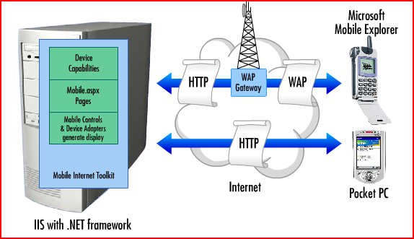
Mobile Web Application Architecture

Slide 8
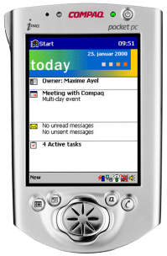
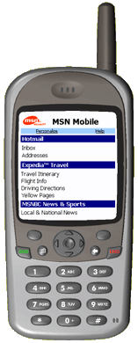
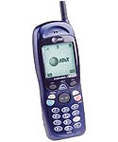
How does ASP.NET Mobile Application work?
IIS
ASP.NET
Create
mobile Web Form
HTTP
Request
Device
Capabilities
Mobile
Presentation
Layer (controls)
Mobile.aspx
Pages
Integrate
Business Logic
Mobile Controls
&
Device Adapters
generate display
Test
Target Devices
HTTP
Response
Post to
Web Servers
Development Environment
Production Environment

Slide 9
What do you need to get started?
Visual Studio.NET & .NET Framework
Mobile Internet Toolkit (Only with VS 2002/2003)
Device Emulators
Microsoft Active Sync (Only with XP, 2000 and 2003)
Mobile Templates (With VS2005/2008): http://blogs.msdn.com/webdevtools/archive/2007/01/09/tip-trick-using-mobile-web-forms-with-web-applicaiton-projects.aspx

Slide 10
Walkthrough:
Developing a mobile web application
DEMO

Slide 11
Customization
Reasons to customize?
    Optimize the rendering
        Per device or class of device
        Used on a per application basis
    Control the exact display
    Override the default behavior
Scenarios
    Different images
    Inject browser-specific markup

Slide 12
Walkthrough:
Customizing a mobile web application
DEMO

Slide 13
ASP.NET vs. Mobile Controls
Web Forms vs. Mobile Web Forms
Viewstate Mechanism
Use of Cookies
OnViewStateExpire Event
SessionStateHistorySize
Notes:
Many people confuse the terms Mobile Web Forms page and Mobile Form Control.
A Mobile Web Form page is the .aspx file that contains one or more Mobile Form Controls.
A Mobile Form Control is itself a mobile control which contains other controls.
Mobile Form control is the outermost control and cannot be nested.
Limited Layout Possibilities: Since mark up is determined at runtime.
In mobile web application the implementation of ViewState is very different from normal web application because of bandwidth limitation.
In mobile web applications, the ViewState is saved in the Session object and not sent to the client. Instead only the identifier is sent across to the client.
When using Session to store ViewState, important considerations need to be taken care of:
Sessions can expire, which means you can loose ViewState.
No. of minutes allowed to elapse before a response is received from the client.
If user posts back data after given interval, OnViewStateExpire is called.
Session information can fall out of sync. This can normally happen when user clicks Back button on his device. This can be taken careof by:
<mobileControls sessionStateHistorySize="45" cookielessDataDictionaryType="System.Web.Mobile.CookielessData" allowCustomAttributes="true">

Slide 14
Supporting New Devices
  Defining Mobile Device in Configuration Files.
  Identifying the device. (User-Agent)
  Identifying device capabilities.
  Establishing Capabilities through Testing

Slide 15
Best Practices
Make user input as simple as possible
Design mobile-friendly page layouts
Only show essential information
Avoid heavy graphics
Avoid navigation links and send minimal text on pages.
Usability Tests.

Slide 16
Feedback/Q&A
Your Feedback is important to us.
  Please take a few moments to fill out our online feedback form
Use the Question Manager on LiveMeeting to ask your questions now!

