Slide 1
Reduce your cost and improve your agility with SQL Server Consolidation

Slide 2
Agenda
The Trend Towards Consolidation
Choosing a Data Platform
Consolidating with SQL Server 2008 R2
Resources
Notes:
This is what we’ll cover in this presentation.
The first section (“The Trend Towards Consolidation”) describes how consolidation has become an increasingly important consideration for most organizations and IT professionals.
The second section (“Choosing a Database Platform”) describes some of the key considerations for choosing a database platform for consolidation, and highlights some of the key benefits of SQL Server 2008.
The third section (“Consolidating with SQL Server 2008”) drills into more detail about the consolidation options available with SQL server 2008, and the key features/technologies that help you consolidate.
The fourth section (“Advantages of Consolidation on Enterprise Edition”) provides a rationale for making SQL Server 2008 Enterprise Edition the preferred platform for database consolidation.
The fifth section (“Consolidation Resources”) provides some additional information to help customers consolidate on SQL Server 2008.

Slide 3
The Trend Towards
Consolidation

Slide 4
What Is Consolidation?
The Trend Towards Consolidation
Reduce the number of servers in the enterprise and optimize utilization of hardware resources
Combine applications from multiple underutilized servers to fewer servers
Notes:
Consolidation is simply the act of rationalizing applications from multiple servers to a fewer servers. It can occur either by installing all of those applications onto a reduced number of physical machines or by creating “virtual” computers on one physical set of hardware.
A typical example of consolidation would be an organization that identified 50 servers that are running at 10% capacity (in terms of hardware resource utilization). The applications could be consolidated onto (for example) 5 servers, each then making more effective use of the hardware resources available and reducing the number of application servers in the enterprise.

Slide 5
Forces Driving Consolidation
The Trend Towards Consolidation
Cost
Control
Consistency
Reduced hardware
Reduce power and cooling
Lower cooling requirements
Reduced data center space
Lower license
Greater efficiency of resource utilization
Lower administrative
Greater agility and responsive to business
Better SLAs
Improved compliance management through reduced surface area
Standardize platform
Easier integration
Fewer management points
Notes:
The primary force driving organizations to consolidate is cost. Reducing the number of physical servers can bring significant cost savings through:
Reduced hardware costs
Lower administrative costs
Less power consumption
Lower cooling requirements
Reduced data center space
Lower license costs
Additional benefits of consolidation include greater control of IT services and infrastructure, enabling you to achieve greater agility, be more responsive to business needs, and create better SLAs for your applications; and greater consistency through a standardized platform, which enables easier integration between applications and services, and centralized management.

Slide 6
Key Enablers
The Trend Towards Consolidation
Hardware Advances
Software Advances
Increased processing power
Decreased cost
Storage consolidation (Use of SAN and NAS)
Improved performance, availability, manageability, and reliability
Improved server software isolation for application co-existence
Improved Bandwidth
Virtualization
More reliable, faster network reduces need for local servers
Advance, Hypervisor based virtualization such as Hyper-V
Notes:
Several advances in IT infrastructure make it possible to consolidate servers.
Improved hardware. Intel-compatible hardware has increased in power while decreasing in cost, as evidenced by the growing availability of relatively inexpensive multiprocessor and 64-bit systems from both Intel and AMD. The widespread use of network-attached storage (NAS) and storage area network (SAN) hardware is also encouraging consolidation of data storage. In the past, often a server had sufficient hardware resources to run a single application, so many organizations have followed this pattern and provisioned a dedicated server for each application in the enterprise. With today’s more powerful hardware, these dedicated servers use only a fraction of their hardware resources –with the result that a singe server can now support multiple applications while still providing the required levels of performance and scalability.
Improved software. Software has improved in performance, availability, and reliability. Server software can better isolate and manage applications and processes running simultaneously, reducing the risk of running disparate applications on the same hardware.
Improved bandwidth availability. Improvements to networks, including increased bandwidth between corporate data centers and remote locations such as field offices, reduces the need to locate servers at those remote locations to ensure adequate system response time.
Virtualization. The advent of virtualization software such as Hyper-V makes it possible to reduce the number of physical servers while running multiple virtual servers with dedicated resources and configuration settings.

Slide 7
The Trend Towards Consolidation
Large Enterprises and Consolidation
Close to 60% completed or in progress while 36% are considering
Base: 246 IT executives and managers at US enterprises
(percentages may not total 100 because of rounding)
- June 2008 “The Forrester Wave™: IT Consolidation Consultancies, Q2 2008”
Notes:
Note the large percentage of organizations who have already consolidated or are in the process of doing so.
Note also that over a third of the organizations surveyed are actively considering a consolidation initiative.
Investigating is about understanding what consolidation is , what is required etc. whether it is a good idea or bad idea. Sort of feeling the water and evaluating the feasibility
Considering is the next step .Companies know what consolidation is and they are evaluating . Doing a cost benefits analysis. Deciding whether it is good for them or not.

Slide 8
Choosing a Data Platform

Slide 9
Server Consolidation Considerations
Choosing a Data Platform
Cost of ownership
Business value
Product roadmap
Virtualization support
Ease of standardization
Notes:
When you are consolidating you should think about few issues when choosing a Database platform
Which platforms provides me the lowest TCO now
Which platform meets most of my needs and provides the business value I need now
Which platform will help me in the long term
Since virtualization is such a key piece of technology in the IT of future what platform will provide me the advantage
Which platform will be the easiest to standardize on (Migration cost)

Slide 10
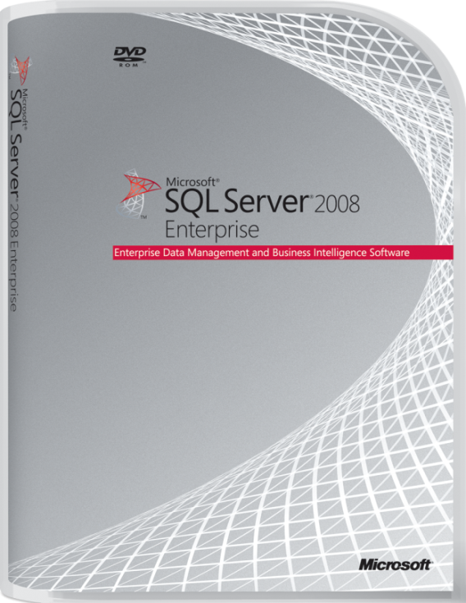
SQL Server 2008 R2 TCO
Choosing a Data Platform
Low cost of ownership
Licensing cost
Complexity and ease of set-up
Support cost
Maintenance cost
Use of low cost commodity hardware
Upgrade cost (SA, EA, APA)
Availability of skilled IT staff
Security breach cost (Highly secured)
Training cost
Integration cost
Total cost of ownership (TCO) for storage at the low end of the industry average scale: $15 to $30 per gigabyte
3-year, risk-adjusted Return on Investment (ROI) of 162% with a payback period of six months after upgrading to SQL Server 2008
Total Economic Impact Of SQL Server 2008 Upgrade
Notes:
SQL Server 2008 offers greater out-of-the-box functionality and lower ongoing maintenance costs than other major databases, including Oracle and IBM DB2.
Enterprise-class high availability technologies, performance and scalability, and security are included in the price, and the range of management tools, automation maintenance capabilities, and proactive administration capabilities such as policy-based management significantly reduce the administrative overheads involved in running database servers across the enterprise. And if that weren’t enough, you also get a full Business Intelligence platform and the ability to store and manage non-relational data such as XML, spatial data, or user-defined types created with managed code.

Slide 11
SQL Server 2008 R2 Business Value
Choosing a Data Platform
Out of the box capabilities
Enterprise Class
Performance & Scalability
Security
Manageability
HA
Virtualization
Full BI platform
ETL, Data Warehousing, OLAP, Data Mining, Reporting
Beyond Relational
XML
User defined data types
Spatial
Notes:
SQL Server 2008 offers greater out-of-the-box functionality and lower ongoing maintenance costs than other major databases, including Oracle and IBM DB2.
Enterprise-class high availability technologies, performance and scalability, and security are included in the price, and the range of management tools, automation maintenance capabilities, and proactive administration capabilities such as policy-based management significantly reduce the administrative overheads involved in running database servers across the enterprise. And if that weren’t enough, you also get a full Business Intelligence platform and the ability to store and manage non-relational data such as XML, spatial data, or user-defined types created with managed code.

Slide 12
Choosing a Data Platform
Product roadmap -Proven past and Promising future
SQL 6.0 1995
SQL 6.5 1996
SQL 7.0 1998
SQL 2000 2000
SQL CE 2000
64-bit 2001
SQL 2005 2005
SQL 2008 2008
SQL 2008 R2 SQL Madison*
Small Server
64-bit
Megaserver +
Scale-up with
>64 Support
From:
Deskside servers
To:
Cell phone to Scale-Out Utility to Cloud
Desktop to SMP (New Architecture)
Auditing
Enterprise Data Platform
Database
Mirroring
Backup/Restore
Log Shipping
Failover Clustering
Enterprise
Class ETL
Multi Server
Management
Replication
Policy-Based
Management
Management
Studio
On-premise
Off-premise
Scripting
GUI
Relational
SQL-CE Device and Desktop
From: Tables and BLOBs
To:
Objects, Places, Documents, XML, Cubes, …
Platform for all Data
XML
Files
XML (SQL-XML)
Spatial
BLOB
Objects
ODBC
ADO.NET Data
Services
From: CRUD, Backup/Restore
To: Analyze, Synchronize, Integrate, Mine, Extend, …
Dynamic Development
OLE DB
ADO.NET
XQuery
CLR Functions,
Procedures in
DBMS Engine
Entity Framework
OLAP and ETL
From: BI as a specialization
To: BI for everyone
DW Scale
Massively
Scale-out DW
Pervasive Insight
Data Mining
Partitioning
Data Profiling
Managed Reporting
Ad-hoc Reporting
Data Visualizations
Self-Service
BI
Data Warehousing
Multiple sources
VS Integration
Office Integration
KPIs
Notes:
Key Points:
SQL Server is fast evolving as a database platform. Over various releases it has steadily evolved into an enterprise-class data platform that meets the needs of the largest of organizations.
This evolution will continue into the future with large data warehousing capabilities through SQL Server “Madison”, simpler management and deployment capabilities in SQL Server “Kilimanjaro”, and cloud-based data storage through SQL Data Services
In the long run you want to adopt a system which is easy to set-up, maintain and low overall cost – SQL Server meets these needs
If you are using other Microsoft technologies, interoperability is important. SQL Server integrates extremely well with other Microsoft products such as Microsoft Office
With so many SQL Server installations in companies all over the world, there are a large base of SQL Server skills that you can build on.

Slide 13
SQL Server 2008 R2 and Virtualization
Choosing a Data Platform
Virtualization Advantages
Licensing advantages
Unlimited Virtualization licensing
Application license mobility
Proven performance/throughput
Virtual machine agility
SC-VMM enable movement of a database server VM from one physical server to another
Sysprep
Simplified data recovery (Hyper-V VHD back-up)
High Availability with Live Migration, & Guest Clustering
Notes:
SQL Server works well in virtual environments such as Microsoft Windows Hyper-V. There are licensing advantages that you can use to install multiple virtual database servers cost-effectively, and you can easily move virtual database servers from one physical server to another in order to perform maintenance tasks or to balance workload utilization. Additionally, since each database server is implemented as a virtual file, you can simplify your backup procedures and back up the entire database server by simply copying the VHD file.
Note that the underlying hardware must support virtualization (e.g. Intel VT and AMD –V)

Slide 14
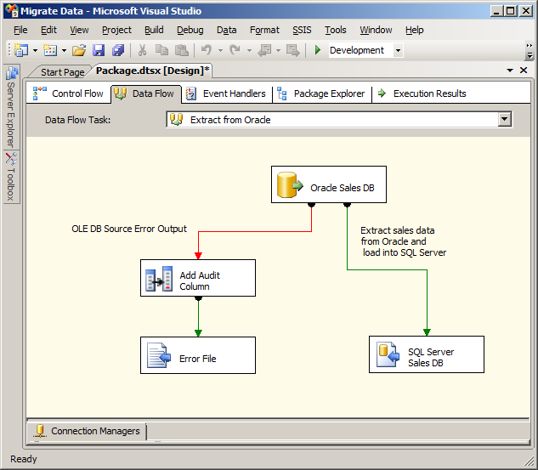
Standardization
Choosing a Data Platform
Standardization Advantages
Scales across all areas of business
OLTP→BI/OLAP/DSS→Web
Small → Extremely large Servers
X86-IA64
32 and 64 bit
Migrate data across the enterprise
Connect to a wide range of data sources
SQL Server
Oracle
DB2
Teradata
Notes:
Standardization on a single database system is often the first step in a consolidation process. This raises the problem of how to migrate data from a potentially wide range of existing systems to your chosen database. SQL Server 2008 includes SQL Server Integration Services, a comprehensive ETL platform that you can use to migrate data from a large number of data sources and apply transformations to the data as it is transferred.

Slide 15
Consolidation with SQL Server 2008 R2

Slide 16
Choosing the Right Consolidation Approach
EVALUATE KEY PARAMETERS FOR YOUR ENVIRONMENT
DENSITY OF APPS
TIME TO MARKET
ISOLATION BETWEEN APPS
Reduce Cap-Ex
Reduce Op-Ex
Agile IT
Performance: Resource utilization efficiency
Security isolation
How long does it take to consolidate?
Predictable Performance: Resource isolation
Manageability Impact
Can my solution Scale?
HA: mitigating single point of failure
HA: Failure isolation
Notes:
So how do we choose. Here are some key parameters to evaluate for your environment.
What is the Isolation between apps
Security isolation
Predictable Performance : Resource isolation
HA : Failure isolation
The answers to these questions directly have an impact on your cap-ex in terms of the hardware you want o upgrade and standardize on
What is the density target you are shooting for
Performance : what is the increase in % of hardware util
Manageability Impact
HA : mitigating single point of failure
The answers to these questions directly have an impact on your op-ex
And finally as we mentioned before, how long does it take before you see ROI and is this an approach that would set you up for success in terms of future growth .

Slide 17
Comparing Consolidation Approaches
 | VIRTUALIZATION | INSTANCE | DATABASE
Security
Resource Management
Density
Migration
High Availability
KEY
Best
Better
Good
Notes:
Security:
Highlight isolation levels
Virtualization: dedicated OS. Leverage OS level features such as BitLocker, EFS, ACL’s in addition to SQL Server features such as granular permissions, TDE, and auditing.
Instance: Can still leverage OS features, need to be careful about which ones. Make sure isolated by service account. Still leverage all SQL Server features.
Database: Potentially still leverage OS features, all apps share same service account. Can leverage some SQL Server features.
Hard dependencies on system objects such as logins or server roles can be problematic.
Resource Management:
Layers of isolation
Virtualization: dedicated resources to VM, can also leverage Resource Governor within the instance.
Instance: leverage WSRM, CPU affinity, and max server memory settings, can also leverage Resource Governor within the instance.
Database: Resource governor
Scale with hardware – hot add CPU/memory for Instance/Database
Hot add storage for all approaches
Keep in mind global resources such as TempDB which may cause contention
Density:
Virtualization has overhead for both host and guest OS
Instance: overhead for each individual instance, 50 instance limit
Database: least amount of overhead
Migration:
Very low cost for virtualization through P2V utility and Live Migration capabilities
Also possible for Instance/Database if database is self-contained
Easy to clone environments and deploy
High availability:
Leverage Hyper-V R2 Live Migration capabilities for zero downtime.
Be careful using SQL Server Failover Clustering with database migration as failover unit is instance.
All three options can leverage DBM, replication, etc.

Slide 18
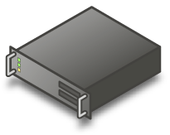
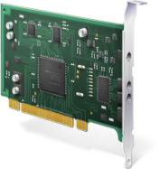
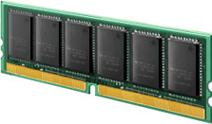
Consolidating with SQL Server 2008
Server Consolidation Options
Multiple Databases
Notes:
Database Stacking involves evaluating capacity on all systems, and moving applications to a single Instance of SQL Server. This is often done in conjunction with a new server purchase.
Consolidating SQL Server Instances with Multiple Databases
One simple approach to consolidating data services with SQL Server 2008 is to use a single instance of SQL Server with multiple databases as shown in Figure 1. This approach is suitable when all of your databases have similar security, manageability, and compatibility requirements, and your hardware can provide the required level of performance and scalability for the workloads that are generated in all of the databases.

Slide 19
Consolidating with SQL Server 2008
Server Consolidation Options
Multiple Instances
Notes:
Consolidating Physical Servers with Multiple Instances
When you have databases with different security, manageability, or compatibility requirements, you can consolidate your data services by running multiple instances of SQL Server 2008 concurrently on a single physical computer to reduce the hardware costs, licensing costs, energy costs, and administrative overhead. This approach is illustrated in Figure 2. The instances are completely isolated from each other and changes to one instance do not affect other instances on the same computer. As well as reduced hardware costs through consolidation, you also benefit from reduced licensing costs because you only need one SQL Server license per physical processor regardless of how many instances are installed.

Slide 20
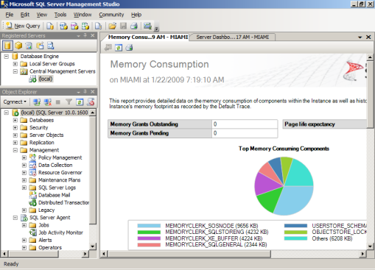
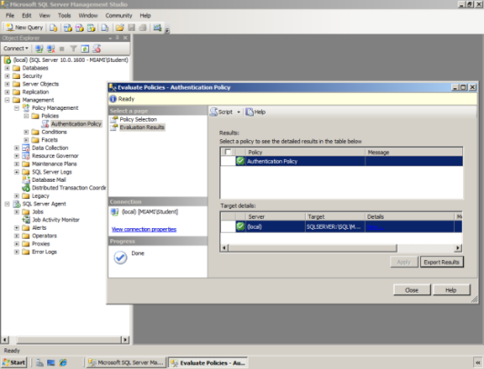
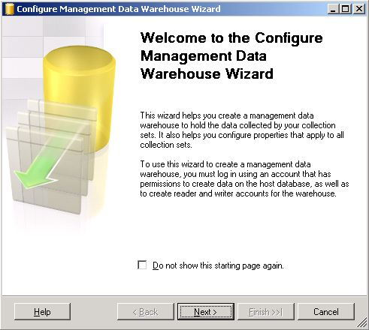
Consolidating with SQL Server 2008 R2
Management
Enterprise Manageability
Policy Based Management
Performance Data Collection
Utility Control Point
SQL Server Management Studio
SQL Server Agent
Central Management Servers
PowerShell
Data Tier Application Component
Define configuration policies on one instance, and apply to many instances
Evaluate policies to monitor or prevent non-compliance
Create a central management data warehouse
Upload data from target servers at scheduled intervals
View consolidated reports from management data warehouse
Notes:
Enterprise Manageability
SQL Server Management Studio: Single administrative user interface for enterprise-wide server management
SQL Server Agent: Multi-server automated maintenance through jobs, alerts, and operators
Central Management Servers: Apply Transact-SQL scripts to multiple servers to ensure consistency across the enterprise
PowerShell: Use a single scripting environment to automate administration across Windows servers, SQL Server instances, and other enterprise applications
Policy-Based Management
Organizations increasingly need to enforce a set of policies to follow regulatory or best practice requirements. Previously this has involved configuring many tables, databases and instances and then periodically checking that the policies are adhered to. In SQL Server 2008 you can consolidate configuration management by defining policies with Policy Based Management and applying them to multiple servers, databases, tables, and other targets in the enterprise. Policy Based Management enables you to:
Ensure compliance with policies for system configuration.
Monitor or prevent changes to the system by authoring policies for the desired configuration.
Scale management across multiple servers.
Reduce total cost of ownership by simplifying administration tasks.
You can enforce policies proactively using triggers, after changes are made by using Service Broker, or on a schedule by using SQL Server Agent. Additionally, you can use ad-hoc execution to check or configure target objects against policies in real time.
Example
Create a condition to check that the authentication mode (in the Server Security facet) is set to Windows
Create a policy to enforce that condition
Apply the policy to multiple servers to ensure enterprise-wide compliance
Performance Data Collection
Centralizing performance data collection reduces administrative overhead for enterprise-wide server monitoring.
Create a central management data warehouse for performance data
Configure data collection sets on target servers to upload data at scheduled intervals
View consolidated reports from management data warehouse

Slide 21
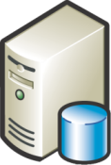
Consolidating with SQL Server 2008 R2
High Availability
Server Clustering
Database Mirroring
Peer-to-Peer Replication
Failover at the instance-level
Cluster up to 16 nodes with Enterprise Edition
2 nodes with Standard Edition
Failover at the database level
Enhancements in SQL Server 2008
Log stream compression
Automatic recovery of corrupted pages
Replicate data between distributed instances
Available only in Enterprise Edition
Enhancements in SQL Server 2008
Simplified configuration and management
Add new nodes without interruption
Notes:
SQL Server 2008 includes a number of high-availability technologies.
Server Clustering protects SQL Server at the instance level, enabling automatic or manual failover of the entire instance, including all of its databases, logins, SQL Server agent tasks, etc. SQL Server 2008 includes some enhancements to clustering support, including a new, simpler installation process.
Database Mirroring protects at the database level, enabling manual or automatic (with a witness server) failover of an individual database from a principal server to a mirror server. SQL server 2008 includes a number of enhancements to mirroring, including log comprssion to increase performance and the ability to automatically recover a corrupted data page from the mirror server.
When using a virtualization solution, a common approach is to use a combination of server clustering (of the parent server) and mirroring (between virtual database servers).
Peer-to-peer replication can also be used to provide high availability by replicating data between multiple SQL Server instances. Enhancements in SQL Server 2008 include a new graphical management interface and the ability to add a node to a peer-to-peer replication topology without interrupting the replication process.

Slide 22
Security
Consolidating with SQL Server 2008 R2
Integrity of consolidated database
3-levels of application isolation
Database (User)
SQL Server Instance (Login)
Server (physical or virtual) (Windows Account)
Transparent Data Encryption
Data is stored in an encrypted form
No application changes required
Enterprise Key Management
Integrate SQL Server encryption into your enterprise key management infrastructure
Notes:
Security is a concern when you consolidate databases, as moving multiple databases to the same server introduces a number of security considerations such as the required level of isolation between applications and the impact of providing administrative access to the server.
SQL Server provides flexibility when consolidating, so you can choose the right level of isolation for your security needs. Additionally, you can use transparent data encryption to protect sensitive data without impacting existing client applications. Finally, you can integrate SQL Server cryptographic key management into your enterprise key management infrastructure.

Slide 23
Reduce Storage Requirements
Consolidating with SQL Server 2008 R2
Data and Backup Compression
Reduce data storage requirements
Benefit from increased performance through reduced I/O
Reduce backup storage and window for backup
Unicode compression
“Our initial testing shows we’ll see 50 percent to 60 percent data compression using SQL Server 2008...we will also benefit from faster query performance”
Mazal Tuchler, BI Manager, Clalit Health Services
Notes:
SQL Server 2008 Enterprise Edition supports data and backup compression. This significantly reduces the hard disk space required for data and backup files on a consolidated server, and also provides a performance benefit since compression results in less I/O.

Slide 24
Manage Workloads Predictably
Consolidating with SQL Server 2008 R2
Resource Governor
Manage resource contention proactively for predictable performance
Prioritize important workloads by defining application pools
By application, user, database, etc.
Consolidate without impacting mission-critical applications
DB1
DB2
DB3
High-Importance Application Pool
Low-Importance Application Pool
Min memory: 20%
Max memory: 90%
Max CPU: 90%
Min memory: 10%
Max memory: 30%
Max CPU: 10%
“We deal with a lot of large data feeds-both coming from manufacturers as data updates, and going out to our subscribers. Resource Governor allows us to control the percent of total resources any operation can consume so that they don’t adversely impact our real-time data access.”
Michael Steineke, Vice President, Information Technology, Edgenet
Notes:
SQL Server 2008 Enterprise Edition includes Resource Governor, which allows organizations to define resource limits and set priorities for different workloads. This enables you to differentiate workloads on a consolidated server and control the utilization of memory and processor resources in order to prevent runaway queries or large workloads from adversely affecting the performance or blocking mission-critical workloads. This ability to proactively control resource utilization provides more predictable performance of consolidated data services, giving you control over server resource prioritization when hosting multiple databases in the same instance.

Slide 25
SQL Server 2008 R2 Support for Virtualization

Slide 26
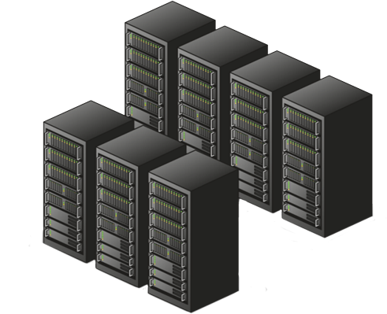
Consolidating with SQL Server 2008
Server Consolidation Options
Virtualization
n
Notes:
Advantages:
Increased utilization
Ability to rapidly provision and start a system
Hardware portability
Disactvantages:
Performance hit
http://en.wikipedia.org/wiki/Comparison_of_platform_virtual_machines

Slide 27
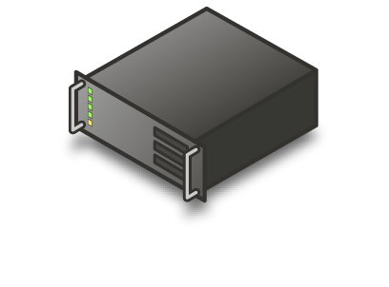
High Availability with Guest Clustering Using iSCSI
VM
FAULT TOLERANCE BOTH AT APPLICATION AND HOST
Guest Cluster
MANAGEMENT EFFICIENCY BASED ON SQL SERVER® AND SYSTEM CENTER MANAGEMENT TOOLS
Guest Cluster
USES WINDOWS FAILOVER CLUSTER
1
2
VHDs FOR DISASTER RECOVERY
Shared Storage
iSCSI
Redundant
Paths to storage
Notes:
Consolidation increases the importance of HA, since there is a high cost to single system failure
Hyper-V offers HA solutions for a SQL Server consolidated environment. First of which is guest clustering
With guest clustering, a guest is a cluster node, and therefore the guest run applications that are monitored in some way by the cluster service, either because they are designed to work with clustering (cluster-aware) or because they are configured in the cluster as a Generic Service, Generic Application, or Generic Script resource can failover. With guest clustering, if either the guest operating system or the clustered application fails, the guest can failover to another guest, either on the same host or on a different host. Guest clustering protects against failure of a cluster-aware application on a guest as well as failure of an individual instance of a guest.
iSCSI Guest Clustering enables high-availability of services and applications in the virtual layer and is fully supported in Windows Server® 2008 and Server 2008 R2.
SQL Server 2008 R2 supports Guest clustering. This is done through the use of the Microsoft iSCSI software initiator running within the virtual machine (VM). This allows all services including Failover Clustering to see the storage natively and perform all actions as if they were physical nodes. All of these VMs can use the same shared iSCSI storage which will store the state of the running applications within the VM. You can even run ‘Validate a Cluster Configuration’ on the VMs to ensure that the Failover Clustering component works!
By combining your guest and host clustering you can create high-availability in both your physical and virtual layers.
The benefits virtualization can bring in this type of scenario to include fault tolerance both at the application and host level and increased management efficiency based on SQL Server® and Microsoft® System Center Management tools.
Source:
http://blogs.technet.com/virtplanet/archive/2009/06/04/guest-clustering-with-sql-server-supported.aspx
http://technet.microsoft.com/en-us/library/cc720387(WS.10).aspx

Slide 28
High Availability with Live Migration
VM
NO LOSS OF SERVICE
AVAILABILITY WITH LOWER COMPLEXITY
Live
Migration
MANAGE LOADS ON VMS ACROSS PHYSICAL MACHINE
1
2
Host cluster
EASIER MANAGEMENT THROUGH SYSTEM CENTER VMM
Shared Storage
iSCSI, SAS, Fibre
Notes:
Speaking Points:
With host clustering, the physical host is the cluster node. If the host stops running, all of its guests are restarted on another physical host. Host clustering protects against failure of a physical host (hardware failure of a computer). On top of this capability is the live migration capability offered in WS08 R2 & supported by SQL Server 2008 R2.
Live migration allows a VM running SQL Server to be live migrated without any loos of network connectivity to the SQL instance even on high throughput workloads. This is very compelling feature that is useful in implementing load balancing across a physical server cluster. Virtual machines can both by manually triggered to live migrate or automatically so using system center management tools that can monitor for certain conditions like high CPU util on a physical server. Live migration also provides out of a box HA capability to applications.
You can also failover individual virtual machines to other hosts within a cluster using Cluster Shared Volume (in Windows Server 2008 R2). Nodes within the cluster can be active-active. You should always remember to ensure there is enough capacity on the CPU in order to be able to failover the nodes in the cluster.
Benefits of this feature also includes less downtime and less loss of service during failover when using live migration as this form of migration is completely transparent to the user.
Source: http://technet.microsoft.com/en-us/library/cc720387(WS.10).aspx

Slide 29
SQL Server Performance: SLAT Impact
CONFIGURATION
RESULTS:
OS: Microsoft® Windows Server® 2008 R2 Hyper-V™
Hardware:
HP DL585 (16 core) with SLAT
HP EVA 8000 storage
Virtual Machines: 4 virtual processors and 7 GB RAM per virtual machine; Fixed size VHD
Increased throughput with consolidation
Near linear scale in throughput with no CPU over-commit
Improved performance with Windows Server 2008 R2 and SLAT processor architecture
Throughput
(Batch requests/sec)
% CPU
Almost Linear Scale
No CPU over-commit
CPU over-commit
Heavy
Load
Moderate
Load
Low
Load
Relative Throughput for Windows Server 2008
Notes:
Relative Throughput = Batches/sec/%Processor

Slide 30
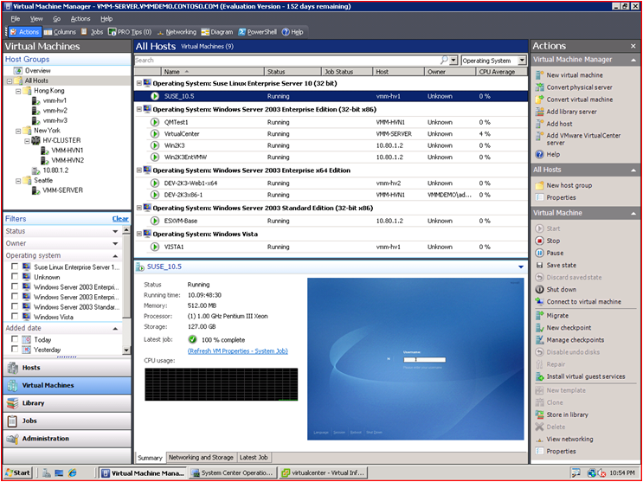
Creating and managing Virtual Machines
MAXIMIZE RESOURCES
INCREASE AGILITY
LEVERAGE SKILLS
Centralized virtual machine deployment and management for Hyper-V, Virtual Server, and VMware ESX servers
Intelligent placement of Virtual Machines
Fast and reliable P2V and V2V conversion
Comprehensive application and service-level monitoring with Operations Manager
Integrated Performance and Resource Optmization (PRO) of VMs
Rapid provisioning of new virtual machines with templates
Centralized library of infrastructure components
Leverage and extend existing storage infrastructure and clusters
Allow for delegated management and access of VMs
Familiar interface, common foundation
Monitor physical and virtual machines from one console
Fully scriptable using Windows PowerShell
Notes:
System Center Virtual machine manager offers a slew of functionality for multi server management by centralizing virtual machine deplyment across dfferent vendors including VMWare, placement, monitoring and performance optimization. Quicker ROI by rapidly provisiong new VMs based on atemplate library. The use of feel of the experience is familiar and works extermely well with the both physical and virtual machines. It is also entirely scriptable.
Hyper-V Role in Windows Server 2008 Server Manager also allows for management within Windows Server 2008

Slide 31
Best Practices and Recommendations
RUNNING SQL SERVER WORKLOADS WITHIN HYPER-V GUEST VM’S IS A GOOD OPTION FOR PRODUCTION ENVIRONMENT
When compared against native the same throughput can be achieved within a guest VM at a cost of slightly increased CPU utilization
Hyper-V benefits from newer generation of processor architecture (SLAT, Snoop filter)
Assuming limitations of Guest VM meet requirements of the workload.
Proper hardware sizing is critical to SQL Server performance
Test/Monitor your workloads
CPU RESOURCES OVER COMMIT ON CASE BY CASE BASIS FOR HIGHER DENSITY
May introduce noticeable performance overhead when all workloads are busy

Slide 32
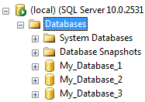
Consolidation Using Windows & SQL Server 2008 R2®
Hyper-V
Live Migration
failover cluster
in guest VMs
Windows Server Resource Manager (WSRM)
System Center VM Manager
VIRTUAL
MACHINES
INSTANCES
DATABASES
HIGHER ISOLATION
Microsoft Assessment and Planning (MAP)
Resource Governor
HIGHER DENSITY
New in
SQL 2008 R2®
>64 logical processors (Windows Server & SQL) 2008 R2
sysprep SQL setup
Data Tier App
LOWER DENSITY
Utility Control Point and Managed Instances
LOWER ISOLATION
Notes:
Benefits / Value Prop
Hyper-V Live migration – Feature of Hypervisor, allows you to migrate VM from one physical box to another while the application itself is unaware of the migration.
See http://www.microsoft.com/downloads/details.aspx?FamilyID=fdd083c6-3fc7-470b-8569-7e6a19fb0fdf&displaylang=en
VM guest failover support – High-availability via failover clustering on guest VMs.
http://blogs.msdn.com/clustering/archive/2008/06/21/8628515.aspx
http://support.microsoft.com/?id=956893
http://blogs.technet.com/dataplatforminsider/archive/2009/06/22/sql-server-support-for-guest-failover-clustering-on-hyper-v.aspx
System Center Virtual Machine Manager
Rapid provisioning of VM images. VM image libraries. Manage VMs from a central console. Multi-machine management. Physical to Virtual migration (P2V).
See http://www.microsoft.com/systemcenter/virtualmachinemanager/en/us/default.aspx
Windows Server Resource Manager – Set CPU and memory resource allocation policies by application. Set according to schedule and/or changes in external environment (e.g., cluster events).
See http://technet.microsoft.com/en-us/library/cc755056.aspx
Microsoft Assessment and Planning Toolkit – Discover SQL instances in your enterprise.
See http://technet.microsoft.com/en-us/solutionaccelerators/dd537566.aspx
Resource Governor – Manage and control resource usage of SQL workloads inside an instance.
See http://msdn.microsoft.com/en-us/library/bb933866.aspx
>64 Logical Processors
SQL 2008 R2 itself supports >64 LPs. This means more databases / instance with less risk of hitting CPU bottlenecks.
Windows 2008 R2 itself supports >64 LPs. This means more SQL instances / box.
Hyper-V for Windows 2008 R2 supports up to 64 LPs. This means more VMs hosting SQL instances / box.
SysPrep – Faster deployments of O/S images containing SQL Server. Decreased provisioning time.
See http://msdn.microsoft.com/en-us/library/ee210754(SQL.105).aspx
Data Tier Application Component – Develop, deploy, and manage SQL data-tier applications as a single unit.
See http://technet.microsoft.com/en-us/library/ee364757.aspx
Utility Control Point and Policy Based Management. Monitor and manager SQL instances from a central console. Apply policies to all managed instances from a central console.
See http://technet.microsoft.com/en-us/library/ee364757.aspx
Processor / Package / CPU Socket: One physical processor – may consist of one or more cores
Core: One processing unit – may consist of one or more logical processor
Logical Processor / Thread: One logical computing engine in the OS, application and driver view
NUMA: Non-Uniform Memory Architecture
NUMA Node: Group of logical processors and cache that are in proximity to each other
Group <new>: Windows Server 2008 R2 Logical grouping of up to 64 logical processors
SQLServer 2008 R2 supports up to 256 logical processors.

Slide 33
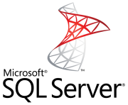
Utility Control Point (UCP)
UCP
Managed Instances
SQL01
SQL02
Simple to setup and use
Central view over managed instances
Central point for policy evaluation
Central collection point for resource utilization metrics
SQL03
DBA
SQL05
UCP
SQL04
Management Studio

Slide 34
Key Concept - Data Tier Application
DATA TIER APPLICATION (DAC)
DATA TIER APPLICATION
Schema
Unit of deployment for T-SQL apps
Contains developer intent as policies
A definition of all the app’s parts
Can Install, Uninstall, and Upgrade
Unit of Deployment
Policies
Extra Files
Deploy
DEPLOYED DATA TIER APPLICATION
DATA TIER APPLICATION
Schema
Unit of management for a DAC
Namespace and resource isolation
Unit of Management
Properties & Metadata

Slide 35
Case Study - Microsoft IT Consolidation Operational Results
ANNUAL OPERATING COST AT 6:1 CONSOLIDATION
ANNUAL RECYCLE COST AT 6:1 CONSOLIDATION
POWER AND COOLING AT 6:1 CONSOLIDATION
Legacy
Consolidated
Legacy
Consolidated
Legacy
Consolidated

Slide 36
© 2009 Microsoft Corporation. All rights reserved.
This presentation is for informational purposes only. Microsoft makes no warranties, express or implied, in this summary.

Slide 37
Appendix

Slide 38
Consolidation Hardware – NUMA & 64bit
Memory
Front side bus contention increases w/ higher #CPUs
SMP
CPU 0
CPU 1
CPU 2
CPU 3
CPU 4
CPU 5
CPU 6
CPU 7
NUMA NODE 0
NUMA NODE 1
CPU 0
CPU 2
CPU 4
CPU 6
NUMA
CPU 1
CPU 3
Foreign
Memory
Access
4x local
CPU 5
CPU 7
Memory
Memory
Local Memory Access
Local Memory Access
NUMA Node isolation presents inherent & significant advantages to software that is designed to take advantage of locality
Microsoft HyperV localizes VM resource utilization to a NUMA boundary
64bit allows significantly more addressable space than 32bit
Notes:
Most server hardware is based on the so called Von Neumann architecture called Symmetric Multi processing, where there is a single storage for both program instructions and data – which leads to contentions in access to memory. SO obviously with an increasein number of CPUs, there is contention in the front side bus access to memory and you are not scalable anymore.
For the past few years, NUMA which stands for Non Uniform memory access has gained wide adoption to an extent that every single server hardware in the market is NUMA based. Consolidation hardware nowadays are always 64bit & NUMA (Non Uniform Memory Access) based
The core idea of NUMA is to create a physical grouping of CPUs called a NUMA node, each having their own memory controller with access to a local bank of memory. These NUMA nodes are then internconnected to each other to form a fully cache coherent system. With this setup local memory access are much cheaper than foreign memory access.
NUMA Node isolation presents inherent & significant advantages to software like Microsoft HyperV & SQL Server that is designed to take advantage of locality
64-bit addressing spans 2⁶⁴ bytes, which is (2³²) ². Our 64-bit address spans more than four billion times as much memory as a 32-bit address
If you want to invest in hardware for future make sure its 64 bit and NUMA.

Slide 39
Consolidation Hardware – hardware assists
With Virtualization an additional level of mapping is required in address translation
Second Level Address Translation (SLAT) - 2nd generation virtualization technology in Intel VT-x with EPT and AMD –V with NPT chips accelerate VM performance to be almost on par with bare metal for common workloads
Continuing innovations in hardware assists – Device and IO virtualization
THE VIRTUAL MACHINE VIEW
GUEST PHYSICAL VIEW
GUEST PHYSICAL VIEW
GUEST PHYSICAL VIEW
Guest Physical Memory Pages
Guest Physical Memory Pages
Guest Physical Memory Pages
VIRTUAL MACHINE 1
VIRTUAL MACHINE 2
VIRTUAL MACHINE 3
SQL Server
Process 4
SQL Server
Process 4
SQL Server
Process 4
HOST PHYSICAL / REAL VIEW
SQL Agent
Process 7
SQL Agent
Process 7
SQL Agent
Process 7
Process 1
Physical Memory Pages
Process 2
Process 1
Process 2
Process 1
Process 2
Operating System
Operating System
Operating System
Hyper Visor
Operating System
Notes:
As many of you know each process in windows has a virtual address space view that gets mapped to the physical memorry. This translation from process view tophysical memory view is done in hardware. However virtualization introduces another level of address indirection. Where you have processes within a VM, each with its own view of address, which needs to be translated to the guest OS’s view (aka guest physical address) of memory. Now this view has to be translated again to the host view (host physical address). Hardware vendors have implemented support for this additional level of address translation, which used to be done in software (expensive). This accelerates VM performance to near bare metal for most common workloads.
Hardware vendors are continuing to make invest in such hardware assists like Device and IO virt support that will make the already minimal perf overhead shrink away in the future.

Slide 40
Consolidation Hardware – Snoop Filtering
NUMA NODE 0
NUMA NODE 1
CPU 0
CPU 2
CPU 4
CPU 6
CPU 1
CPU 3
CPU 5
CPU 7
Memory
Memory
C0 C1 C2 C3 MCH0 C4 C5 C6 C7 MCH1
FETCH ADDR (FIRST TIME)
Issue Fetch to Memory Controller Hub (MCH)
Snoop local caches
Caches respond
Snoop foreign caches
Caches respond
Get data from memory controller
MEMORY
Notes:
Next hardware trend that is relvant is snoop filtering. Let me explain what it means.
As we saw before in a NUMA based architecture, we have physical grouping of CPUs called NUMA node and memory banks closer to each node. What is different about this slide is that I am also showing you the caches within each CPU and typically when a CPU reads a memory address location, it caches that entry for faster access the next time around.
Lets look at an example of how this works. Here we are requesting to read an address for the first time. And you go through the following steps
In all you have 16 messages to perform this read.

Slide 41
Consolidation Hardware – Snoop Filtering
SNOOP FILTER REDUCES INTERNODE TRAFFIC
NUMA NODE 0
NUMA NODE 1
CPU 0
CPU 2
CPU 4
CPU 6
CPU 1
CPU 3
CPU 5
CPU 7
Memory
Memory
C0 C1 C2 C3 MCH0 C4 C5 C6 C7 MCH1
FETCH ADDR (FIRST TIME)
Issue Fetch to Memory Controller Hub (MCH)
Check local snoop filter
Check foreign snoop filter
Get data from memory controller
MEMORY
Notes:
w/ snoop filtering , the same read as you can see takes just 4 messages. 75% less in this particular case

