Slide 1
次世代行動資訊安全解決方案
崔思康
資深企業應用業務經理
台灣微軟
Notes:
Slide 4: Presentation Title Slide

Slide 2
議程
行動通訊產業趨勢
微軟企業行動資訊安全解決方案
Demo
Notes:
Slide 6: Summit Goals (2 minutes)
In these first few minutes, I want to do just a few things:
Identify the goals we have for the meeting and give an overview of the 2 days
Show you a quick profile of who is here today
Share a few thoughts about Microsoft today
and finally share a few thoughts about our software vision
Let me start by sharing our goals for these 2 days. This is important, because we really want to test whether we have achieved these goals at the end of the conference:
First, we want to stimulate how to think about business success today – both from the challenges of management and stimulating innovation and from the challenges and opportunities of globalization
We also want to communicate our strategy and mission. You have invested in us and our platform – and we need to make sure you understand where we are going – and we want to engage in a conversation.
We also want to improve our ability to be a great partner. We take that trust and responsibility very seriously:
When we suggest to you that something new is coming, that can't be a casual commitment.
When we tell you something is important, we have to put our energy, our investment, our passion and our sales and marketing behind it to really drive it.
4) This event has also been designed to facilitate networking between you all and to widen your personal contacts and partnerships so I hope you will benefit from these interactions.
5) And finally, we really want to learn from you and thus we’ve structured a lot of time with open discussions.

Slide 3









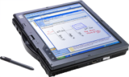
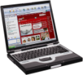




Mobility Market Growth Opportunity
365 Million Smartphones by 2012 – Berg Insight May 2007
According to analyst firm Berg Insight, global shipments of smartphones running advanced OSs will reach 113 million units in 2007. Increasing at 25.6 CAGR percent, shipments are forecasted to reach 365 million units by 2012. Smartphones will then account for over 22 percent of all handsets worldwide, compared to 10 percent today. http://www.cellular-news.com/story/23963.php
35
30
25
20
15
10
5
0
34.1%
Converged
Mobile Phones
365 Million Converged Mobile Devices by 2012
Y/Y % shipping growth
18.6%
Mobile PCs
5.8%
Mobile Phones
2006-2012
SOURCE: According to analyst firm Berg Insight May 2007
Sample Fill
Sample Fill
Sample Fill
Sample Fill
Sample Fill
Sample Fill
Notes:
11/3/2008 6:47 PM
3
11/3/2008 6:47 PM
3
KEY MESSAGES:
Mobility as a key business interest is taking off - Wireless e-mail population to double in 2006 (~25Million). By 2010 expect to be >100 million wireless e-mail users. (Gartner, May 2006)
As Desktop PC and traditional mobile phones sales slacken there is a growing surge in mobile device sales: laptops, tablets and smart converged mobile phones – (Converged phones = devices w/ high-functioning OS + telephony capabilities, able to multi-task, and perform robust functions like wireless e-mail and support LOB applications, incl.3rd party apps – NOT just mobile e-mail (RIM).
Desktop PC sales have matured – 3.9% avg growth until 2010 min replacement activity, emerging market growth – 165M 2008.
CLICK: Mobile phones – 1Billion devices expected to ship this year, mobile phone shipments continue solid growth - 5.8% YoY
Businesses are investing at an ever increasing rate in the potential for mobile solutions to transform their business. - they believe they will get a lot of bang for their buck.
CLICK: Making up for sluggish desktop PC sales is strong continued growth of mobile PCs - avg 18.6% YoY – 112M in 2008. Businesses no longer buying employees desktop PCs but are buying employees mobile PC’s with 3G data cards.
More people everyday thinking about what they can do w/ their mobile device in addition to making phone calls
CLICK: Converged Mobile devices / smartphones - fastest growing segment among mobile devices - 34.1% YoY until 2010. ~1/4 Billion converged devices expected in 2010. By 2007 converged could be10% of total ww handset sales
Converged phone makers: Symbian, Linux (MOT) and RIM and Windows.
W Mobile sales forecast to grow faster than total mobile market:
W Mobile users 2-10 times more likely than Symbian (Nokia) users to use advanced data services. W Mobile is preferred business platform for applications that will consume data services (Telephia Q4 2005 Enterprise Insights Report)
RIM/Blackberry (primarily e-mail only) sales are forecast to grow more slowly than the market, actually decreasing RIM’s total share of market = decline in share of shipments from 7.5% in CY05 to 4.7% in CY10.

Slide 4
Market Shifting Beyond Messaging
Fastest growth in rich mobile scenarios beyond e-mail
  Corporate data access and mobile LOB grows 5.4x from 2006–2011
  Messaging-only grows 2.3x in the same time period
19.8 MM
6.3 MM
0.9 MM
Corporate data access and mobile LOB
4.5 MM
Mobile Messaging
Mobile Messaging
3.6 MM
Corporate data access and mobile LOB
14.7 MM
Note: Sizing based on support for Microsoft solutions. Source: MED Finance analysis and industry reports

Slide 5
議程
行動通訊產業趨勢
微軟企業行動資訊安全解決方案
Demo
Notes:
Slide 6: Summit Goals (2 minutes)
In these first few minutes, I want to do just a few things:
Identify the goals we have for the meeting and give an overview of the 2 days
Show you a quick profile of who is here today
Share a few thoughts about Microsoft today
and finally share a few thoughts about our software vision
Let me start by sharing our goals for these 2 days. This is important, because we really want to test whether we have achieved these goals at the end of the conference:
First, we want to stimulate how to think about business success today – both from the challenges of management and stimulating innovation and from the challenges and opportunities of globalization
We also want to communicate our strategy and mission. You have invested in us and our platform – and we need to make sure you understand where we are going – and we want to engage in a conversation.
We also want to improve our ability to be a great partner. We take that trust and responsibility very seriously:
When we suggest to you that something new is coming, that can't be a casual commitment.
When we tell you something is important, we have to put our energy, our investment, our passion and our sales and marketing behind it to really drive it.
4) This event has also been designed to facilitate networking between you all and to widen your personal contacts and partnerships so I hope you will benefit from these interactions.
5) And finally, we really want to learn from you and thus we’ve structured a lot of time with open discussions.

Slide 6
我們如何設定、配置和控制使用者，限制Windows Mobile設備能做哪些事情、不能做哪些事情?

Slide 7
System Center
Mobile Device Manager 2008
(SCMDM 2008)
微軟企業行動資訊安全解決方案

Slide 8





SCMDM 2008 核心特性
移動設備管理伺服器使帶有Windows Mobile最新版本的手機就像筆記型電腦或桌面電腦那樣在IT基礎架構中得到佈署和管理，並提供與企業資料訪問的功能。
安全性管理
設備管理
移動 VPN
加入Active Directory域。
利用Active Directory/群組原則推送策略 （超過130項策略和設置）。
可禁止通信和相機功能*。
文件加密 。
啟用和禁止應用程式。
遠端資料刪除 。
符合OMA-DM標準。
在企業中對移動設備統一管理。
完全支援無線模式分發
WSUS 3.0發佈
資產收集功能。
SQL Server 2005的報告能力。
角色的管理 。
MMC外掛程式和Powershell命令列擴展。
WMU開啟/關閉控制 。
符合OMA-DM要求。
硬體認證和“雙重封包安全” 。
保持對話連接。
快速重建連接。
網間漫遊。
符合標準(IKEv2、MobIKE、 IPSEC隧道模式)。
管理任務
佈署： 防火牆之內
網路訪問任務
佈署：DMZ內部
Notes:
11/3/2008 6:47 PM
©2005 Microsoft Corporation. All rights reserved.
This presentation is for informational purposes only. Microsoft makes no warranties, express or implied, in this summary.
8
SM - AD GP相互整合– Brian將利用數分鐘的時間展示
DM –豐富的清單報告功能
移動VPN -利用移動VPN呈現全新層次的LOB應用程式
業務目標：
為實現DM和LOB應用程式而提供強健的解決方案，並讓Windows Mobile成為IT基礎架構中的“頭等公民”。
範圍觸及更廣泛的企業客戶細分市場。
與RIM和Nokia爭奪“同類最佳”的企業移動設備體驗。

Slide 9
符合各層面需求的優先順序
BDM
優先順序
IT的優先順序
使用者的優先順序
  提高員工生產力
  可擴展和可靠性
  降低支持成本和TCO
  保護資料和網路。
  可管理、可擴展的IT基礎架構。
  標準化vs.特定方案。
  可與現有系統相互整合或協同工作。
  減少培訓和支援需要。
  任何時間都可以登入企業資訊。
  可靠和好用的電話功能
  提升生產力
Notes:
Erika
11/3/2008 6:47 PM
©2007 Microsoft Corporation. All rights reserved.
This presentation is for informational purposes only. Microsoft makes no warranties, express or implied, in this summary.
9

Slide 10



System Center Mobile Device Manager
系統管理之行動設備管理伺服器
在統一環境中管理Windows Mobile設備的安全性
幫助IT人員管理Windows Mobile設備就像是NB或和桌上型電腦一樣
以單點連線後便可進行更多資訊的瀏覽,同時還可以訪問防火牆之後的企業資料和應用程式。
Notes:
建議的論點：為了概括介紹System Center Mobile Device Manager，我們將關注三項滿足IT專業人員和大中型企業的需要的核心領域。
利用此簡報來概括討論要點－總結起來主要有3點，我們希望受眾能夠領會這些傳達資訊。
10

Slide 11

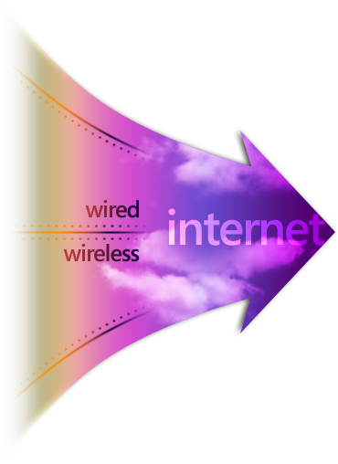








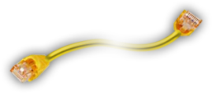

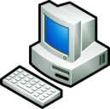






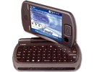



Microsoft Mobile Vision
從任何設備
或地點
…到人員、工具和資源
E-Mail
LOB應用程式
存取控制
受控PC
協同工作
方式
Intranet Web應用程式
非受控PC
(家用PC、信息亭等)
身份&登錄
文件
&文件
即時通訊
行動&傳統設備
防火牆
Web &視訊會議
日曆
由IT人員安全地管理
Notes:
11
關鍵傳達資訊:
Microsoft的願景是讓人們在任何時間、任何地點、利用任何設備都可以訪問表現出色的軟體，從而為人們授予強大能力。
投影片解說詞:
Microsoft Mobile願景的基本前提在於MSFT理解了業務驅動因素和挑戰，並為了滿足這些因素的要求或應對挑戰而開發出了相互整合的解決方案。
目標是為了確保行動設備盡可能安全地遠端連接到人員、工具和資源，與重要資訊保存接觸（而且高效地開展工作）。
WM只不過眾多可供考慮的行動解決方案其中一項（ 稍後章節主要關注）
從多樣化的MSFT產品到防火牆的右側（MapPoint位置伺服器、MSN即時通訊工具、Outlook email –利用一些時間談及它們）
解決方案的優勢在於元件完美地匹配了由客戶回饋/需求而驅動的總體行動性戰略。
演講者注意:
可以開玩笑說投影片太漂亮了…一定會贏得讚賞☺。
強調由Microsoft行動願景而實現的授能的重要性。
解釋合作夥伴生態系統如何改進此願景？
討論在前面章節所看到的熟悉的UI如何對授能的實現起到貢獻和推進作用。
投影片過渡:
讓我們看一下某些Microsoft伺服器元件，它們可以提供您在投影片中所看到的行動相互整合解決方案。

Slide 12

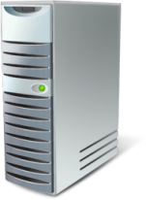

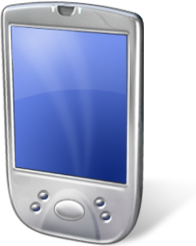
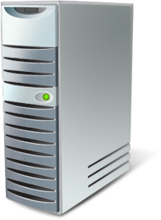




設備管理策略
“兩全其美”的方法 –利用移動設備中的現有用戶端技術 (OMA-DM)以及常用的Windows Server後台技術 (AD、 GP、 WSUS等)
設備管理伺服器代理設備作為用戶端。
  企業OMA-DM代理伺服器
設備連接到設備管理伺服器，並藉由移動設備管理伺服器獲得在多個後台系統的配置和更新資料。
OMA DM SyncML
System Center MDM
管理伺服器
未來的後台應用

Slide 13
設備管理
安全管理
  註冊
  AD域加入
  刪除數據
策略推行
服務啟用/禁用
應用程式禁用/啟用
軟體發佈
資產收集和報告
Notes:
13

Slide 14
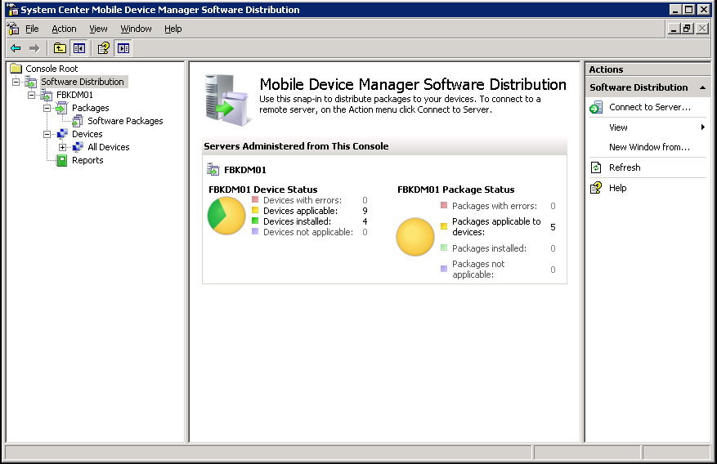
設備管理收益
企業級無線軟體發佈
  與Windows軟體更新服務（WSUS） 3.0協同發揮作用。
    各類規模的企業最廣泛採用的Windows軟體更新解決方案
    (超過60%的企業採用比率)
    具有IT部門所需要的分類和打包能力。
豐富的資產收集和報告功能
  可靠的硬體和軟體資產收集功能
  Microsoft® SQL Server™ 2005的報告服務
    高度彈性與靈活
    自訂化
Notes:
11/3/2008 6:47 PM
©2007 Microsoft Corporation. All rights reserved.
This presentation is for informational purposes only. Microsoft makes no warranties, express or implied, in this summary.
14

Slide 15
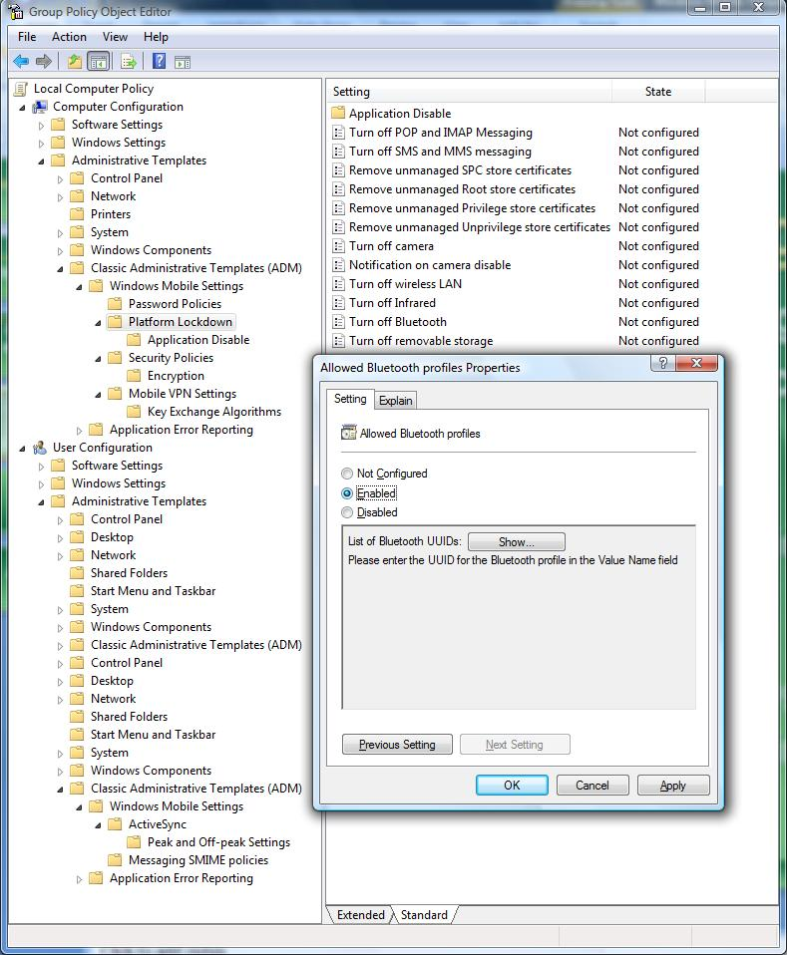
安全性管理
行動設備管理伺服器將 AD群組原則能力延伸到Windows Mobile平台中
Active Directory (AD)是全球範圍內採用最廣泛的企業目錄服務。
Windows Mobile提供超過130項配置策略和設置，可藉由群組原則管理這些配置或設置，包括藍牙控制、Wi-Fi、 SMS/MMS、IR、相機功能和POP/IMAP。
Notes:
11/3/2008 6:47 PM
©2007 Microsoft Corporation. All rights reserved.
This presentation is for informational purposes only. Microsoft makes no warranties, express or implied, in this summary.
15

Slide 16

















安全的企業資料存取
對防火牆後的企業網路和應用程式進行安全登入與操作
  可登入與操作企業網內的任何 數據! (SAP、 Siebel、intranet網站、SQL等)
相容桌面/可擕式PC現有的遠端存取模式 ，並可擴展到更廣泛的應用場景。
  支援精簡型用戶端和胖用戶端應用程式
安全性
    實現端到端的安全性
    DMZ中佈署移動閘道
    符合隱私政策
網域控制站
企業內部網站
移動設備通過移動VPN在受控環境下訪問企業內部資源
效率
    利用最佳化的通道
    自我調整網路，最大程度減少常連接資料流量
企業內部防火牆
可擴展
    透明化移動應用程式
    透明化業務系統服務
移動VPN閘道
DMZ
企業外部防火牆
可靠性
    始終保持連接
    允許Push 技術
Internet
移動 VPN
移動VPN
移動操作者
蜂窩資料連接
WiFi連接
簡便
    減少使用者配置工作
    透明化使用者和應用程式
Notes:
Prithvi
11/3/2008 6:47 PM
©2007 Microsoft Corporation. All rights reserved.
This presentation is for informational purposes only. Microsoft makes no warranties, express or implied, in this summary.
16

Slide 17




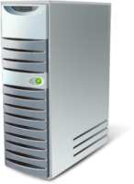

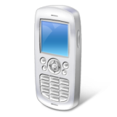

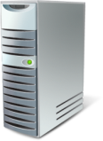

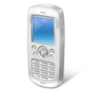
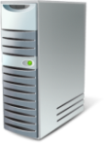


SCMDM 08 Deployment Topology
System Center Mobile Device Manager 2008
IPSEC Mobile IKE
Mobile VPN
Exchange, SharePoint, Intranet
and LOB Servers
128Bit SSL Tunnel
SQL
Server
Initial OTA Device
Enrollment via SSL
SSL User
Authentication
SCMDM 08
Management
Server
MMC
Console
Internet
SCMDM 08
Gateway
Firewall
Firewall
128bit SSL
Tunnel
IPSEC
VPN
Machine Certificate
Authentication
for Mobile VPN
WSUS
Software
Management
One Time PIN
for Enrollment
Device
Certificate
Enrollment
Service
Optional ISA or
Reverse Proxy
Microsoft
Certificate
Authority
Active
Directory
DMZ
Corporate Intranet

Slide 18
伺服器架構
三項新的伺服器角色:
  註冊伺服器
    代理伺服器請求註冊設備
  移動閘道伺服器
    企業網路的接入點
    在企業網路和設備之間傳輸網路和設備管理資料
  設備管理伺服器
    基於OMA-DM規範
三項管理介面:
  支持遠端存取的 MMC外掛程式
    伺服器配置
    設備管理
  自助門戶
    註冊
    數據刪除
  MOM和 SQL報告系統
    資產清單
    監控

Slide 19
MDM設備管理伺服器
位置:
  Intranet內網 (加入網域的伺服器/服務)
用途:
  主要用於管理所有受控設備
  用於設備群組原則應用、設備軟體分發包和設備資料擦除的功能中心
  與現有的基礎架構伺服器通信，如網域控制站、CA。
  代理核心Windows伺服器(AD/CA)和設備之間的資訊傳遞和命令。

Slide 20
MDM註冊伺服器
位置:
  Intranet內網 (加入網域的伺服器/服務)
用途:
  管理設備註冊的業務流程
  建立域對象
  建立證書
  提供分發指令

Slide 21
MDM移動閘道伺服器
位置:
  企業DMZ（無需加入網域）
用途:
  對授權設備接入的連接進行認證
  為設備分配穩定的內部IP地址
  針對設備和應用程式的快速恢復/重新連接特性
  協商金鑰，加密Internet上傳輸的資料

Slide 22
架設SCMDM2008 IT基礎架構細節
需要:
  Windows Server® 2003 SP2 64 bit
  SQL Server™ 2005
  Active Directory® (W2K3 SP1)
  Microsoft Enterprise CA
  WSUS 3.0 SP1
  群組原則管理主控台
  Microsoft PowerShell 1.0
  .Net Framework 2.0
  新版本的Microsoft Windows Mobile
不需要:
  Exchange Server (任何版本)
  系統管理伺服器
  系統中心
  ISA Server

Slide 23
MDM SP1 Feature Updates
Feature updates with MDM SP1 include:
Multiple Instance
  Enables your customers to deploy more than one instance* of MDM within the same Active Directory Forest
  Gives organizations flexibility, enabling multiple divisions within same the organization with different administrative policies to share the same MDM infrastructure
  Helps support deployments of more than 30,000 devices within a single forest
PIN Reset (available at remote console)
  Enables IT Helpdesk to reset PINs for user devices from a centralized console
  Helps keep devices accessible and minimizes loss of data
Enrollment Auto Discovery (available at remote console)
  Eases user enrollment experience—no complex Fully Qualified Domain Name (FQDN) or URL needed
  Helps eliminate guesswork and user confusion by allowing the enrollment server to match the user with the correct MDM instance
Runs with Windows Server 2008
  SP1 will run against a domain/forest running WinServer 2008 AD Domain Services
Performance/Scalability
  Planning a doubling of system/server capacity from MDM 2008 levels

Slide 24
Demo

Slide 25
資源
概要內容
  http://www.microsoft.com/windowsmobile/default.mspx
  http://www.microsoft.com/windowsmobile/mobileoperators/default.mspx
  http://www.microsoft.com/systemcenter/mobile/default.mspx
案例研究
  http://www.microsoft.com/windowsmobile/business/success/default.mspx
  http://www.microsoft.com/resources/casestudies/
白皮書
  http://www.microsoft.com/windowsmobile/business/strategy/default.mspx
技術支援
  http://technet.microsoft.com/default.aspx
  http://msdn.microsoft.com/mobile/security (移動安全性)
  http://supportcenter.windowsmobiletraining.com
Notes:
11/3/2008 6:47 PM
©2005 Microsoft Corporation. All rights reserved.
This presentation is for informational purposes only. Microsoft makes no warranties, express or implied, in this summary.
25

Slide 26
Questions?

Slide 27
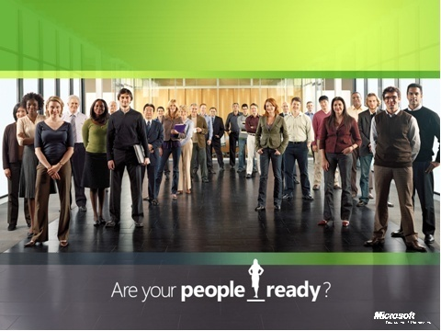
The People-Ready Business
您準備好了嗎?
Notes:
Slide 12: People-Ready Framework (2 Minutes)
Let me close by introducing our new vision of great business software: It’s called People-Ready and you’re going to hear us refer to it throughout the conference.
I am a great believer in the value of software as an enabling tool.
I like to say that software developers are like artists – they create things, they innovate
But we can’t do it just in the lab: we need to listen to customers and partners and understand what they want.
And in the business space, I think innovation is not what innovators do as much as what tools people use to drive business success.
This is where innovation creates value.
This is one of the things that I think that we’ve really now come to understand in the Enterprise space: our single biggest opportunity we have as a company is to help people create business value.
Understanding this, we are in the midst of another change within Microsoft where we're shifting from a product-centric company to a solution and a scenario-centric company. That's what our new People-Ready campaign represents: People-Ready is about great software that enables people to create business value.
The heart and soul of a People-Ready business means that it is an organization that is employing IT as a tool to really help empower their number one asset: their people.
We think this is a pretty unique vision. We don't think it is necessarily shared broadly by our competitors. But for us, this People-Ready drive is really a natural extension of our founding vision of empowering people through software.
So in a sense, People-Ready frames the idea that innovation is less about us and more about how customers and partners utilise IT innovation to make real changes in their businesses.
This idea represents the theme across our two days – and, for you, one way to think about People-Ready is as a filter that you can use to think about how you and your IT investments enable your people to drive business success.
Transition: Introduce Jonas Ridderstrale on next slide

Slide 28
您準備好了嗎?

