Slide 2
VoIP Quality Of Experience
Name
Title
Microsoft Corporation

Slide 3
Session Objectives
Microsoft’s user-focused approach to Quality of Experience
The VoIP Architecture of Office Communications Server 2007
Considerations for deploying OCS 2007 in a corporate network
How OCS 2007 operates in the unmanaged network

Slide 4
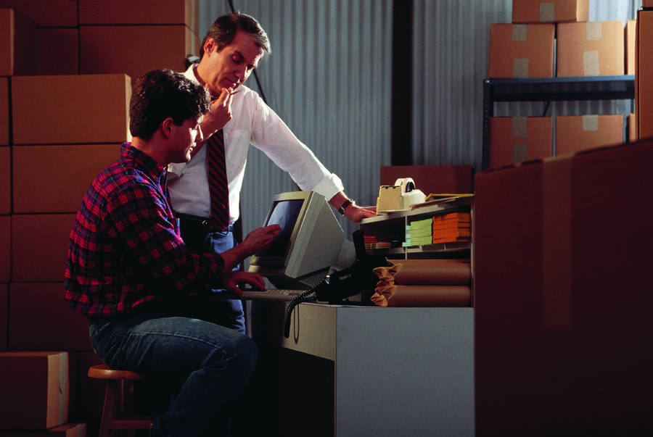
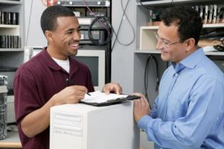


Today’s Business Environment
What customers are telling us
Employees
The media quality and usability is critical
Need the same experience from anywhere
IT Decision Makers
Deliver more than just cost savings
Need to make decisions that ensure flexibility
IT Professionals
Operate within the existing network infrastructure
Consolidate different admin tools
Notes:
Media Quality: employees won’t use it if it’s not going to consistently be great
Experience: We travel, move around – system needs to support many different employee work styles, including those that work remotely
Cost savings: The first round of VoIP was all about moving from two wires to one. Now, we need more
Flexibility: through acquisition or otherwise, my networks and infrastructure are all very different
Operate within: I already have an investment in current networking gear – how can I leverage?
Admin tools: Bring the tools for administering the solution into what I am using today.

Slide 5
Many Dimensions Of Quality
Network
  Getting the packet across the wire
Payload
  Audio and Video content inside the packet
Users
  Caller usability and human factors
Management
  Understanding the user experience
Notes:
Taking this input from our customers, we knew that our view of quality needed to encompass all of these needs.
Users needs
IT Pros needs
Certainly, this wasn’t at the expense of the traditional aspects of Quality with VoIP
Network Service quality alone isn’t sufficient though.

Slide 6
The Challenge Of Packet Networks
Traditional IP telephony not designed for IP networks
  Transfer of circuit switched concepts
  Fragile codecs, sensitive to minute network impairments
    “Even a 1% loss can significantly degrade the user experience
    with G.711, which is considered the standard for toll quality” ¹
    “The default G.729 codec requires packet loss far less
    than 1% to avoid audible errors” ²
Network engineering required for traditional IP telephony
QoS and CAC work to recreate conditions of switched networks
1 - Intel: Overcoming Barriers to High-Quality Voice over IP Deployments
2 - Cisco: Quality of service for Voice over IP
Notes:
Traditional IP Telephony took the concepts from the traditional circuit switched network and applied them to a packet transport….
6

Slide 7
Audio Codecs And Network Service Quality
demo

Slide 8

“The ripe taste of cheese improves with age.
Act on these orders with great speed. “
Codec | Perfect Network | With Network Loss
G.711
G.729
RT Audio Narrowband

Slide 9
Traditional IP Telephony Limitations
Cost $
Traditional approach of QoS/CAC is complex and difficult to manage
Complexity
Admins may not control whole network
Users are increasingly mobile
Ubiquity
Most common source of user dissatisfaction is Voice Quality
Many factors affect voice quality
Notes:
9

Slide 10
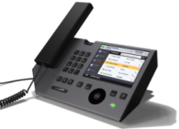

Microsoft's Quality Of Experience
Complete and comprehensive solution that doesn’t require QoS
Comprehensive, user-focused approach to quality
Smart, adaptive end-points
Real time metrics of actual experience
Media stack optimized for unmanaged IP networks
Notes:
Comprehensive, user-focused approach to perceived quality
Centered on users, incorporating all significant parameters of user experience
Includes the network, endpoints, usability, user experience and administration
Smart, adaptive end-points
End-points with real time capability to monitor, pilot, optimize and deliver UC QoE
Real time metrics of actual experience
Measuring, quantifying and monitoring the user’s subjective experience
Media stack optimized for unmanaged IP networks
Rich application that takes real time adaptive and corrective actions to continuously optimize the user’s subjective experience on any network
Users: comprehensive approach to perceived quality
Network: Media stack optimized for unmanaged IP networks
Payload: Smart, adaptive endpoints
Management: Real-time metrics of actual experience
10

Slide 11
Session Objectives
Microsoft’s user-focused approach to Quality of Experience
The VoIP Architecture of Office Communications Server 2007
Considerations for deploying OCS 2007 in a corporate network
How OCS 2007 operates in the unmanaged network

Slide 12
Microsoft’s Real-Time Codecs
RTAudio and RTVideo
Supports Wideband and Narrowband modes
  Wideband greatly improves intelligibility and naturalness of speech
Constant and Variable bit rate modes
  Dynamically responds to changes in audio complexity
Highly efficient use of Bandwidth
  More quality at equivalent bandwidth
  Same quality at lower bandwidth
Multi-rate codec
  Enables real-time adaptation
RTAudio (8kHz) | 28 Kbps
RTAudio (16kHz) | 45 Kbps
G.726 | 48 Kbps
G.711 | 80 Kbps
Notes:
Wideband = 16kHz, Narrowband = 8kHz
More Quality, same BW: RTA Wide vs. G.726
Same Quality, lower BW: RTA Narrow: Very low BR
Multi-rate: in addition to changing bit rate based on speech complexity, we can also vary bit rate based on NSQ

Slide 13
The Microsoft Media Stack
Quality Controller
  Dynamic Adaptation to real-time network conditions
  Progressively reduces bit rate
  No sessions are dropped during this process
Voice Activity Detection/Silence Suppression
  Ensures no ‘empty’ packets are sent
Optimizes the audio that gets into the packet
  Noise suppression
  Automatic gain control
  Automatic echo cancellation
Notes:
QC: Reduces its bit rate progressively to one-third (audio) or one-fourth (video) of the initial bit rate
- Happens across the board, but controlled at the client level – value of having intelligence at the endpoint.

Slide 14
Endpoints
Addressing payload effects end-to-end
  Often most detrimental but least managed
  Even if networks are perfect, endpoints can deteriorate the experience
Microsoft Media Stack embedded into multiple devices
  RTAudio Codec
  Media Stack Features (QC, VAD/SS, AGC)
  Firewall Traversal
Devices with simpler setup and great acoustics
  Supporting 16kHz Audio
  Plug and Play configuration capability

Slide 15
Quality Of Experience At Work
Noise free
Wide-
Band
MOS
Rating
Perfect Network | Corporate Network | Internet | High Congestion
Source: Psytechnics 12/06

Slide 16
Quality Of Experience At Work
Office environment
Wide-
Band
MOS
Rating
Perfect Network | Corporate Network | Internet | High Congestion
Source: Psytechnics 12/06

Slide 17
Media Quality
demo

Slide 18
Session Objectives
Microsoft’s user-focused approach to Quality of Experience
The VoIP Architecture of Office Communications Server 2007
Considerations for deploying OCS 2007 in a corporate network
How OCS 2007 operates in the unmanaged network

Slide 19
Right Sizing Your Network
You are adding a service to your network
Even with 2:1 adaptability clients need bandwidth
Holds true for VoIP telephony or conferencing
Simple policies give you control

Slide 20

What Does Media Take?
Codec | Min Bandwidth | Max Bandwidth
Real-time Audio (RTA) | 24 Kbps | 45 Kbps
Siren | 48 Kbps | 48 Kbps
Real-time Video (VC-1) | 50 Kbps | 250 Kbps
Roundtable Panorama | 50 Kbps | 350 Kbps
These are one-way “on the wire” numbers
Numbers are worst-case
  Silence suppression saves more bandwidth
  Packetization dynamically changes based on usage
Notes:
Packetization dynamically changes based on usage saving more bandwidth

Slide 21
Per User Calculation
Media Type | Bandwidth Needed
Audio | 45 Kbps
Video | 250 Kbps
Data | ~45 Kbps
Signaling | 10 Kbps
Total | 350 Kbps per direction
Type of usage is important when planning
Media Stack adjusts to available bandwidth every 5 seconds
Consider the whole path end-to-end

Slide 22
Other Network Considerations
Delay
  Engineer to less than a mean of 150 milliseconds
Loss
  Up to 10% can be handled without significant problems
Connectivity
  The clients can connect through most common networks
Call Admission Control
  Hard limits aren't required to provide quality
Notes:
Hard limits on simultaneous calls across a link aren't required to guarantee quality with endpoints that dynamically adjust based upon network conditions

Slide 23





Federation With Audio And Video
Communication with users outside your organization
Signaling and data encrypted with certificates
Leverages same infrastructure as for external users
Offers significant toll reduction
OCS 2007
Installation
Edge Servers
In DMZ
Edge Servers
In DMZ
OCS 2007
Installation
Notes:
Communication with contacts outside your organization, without exiting to the PSTN
Offers significant toll reduction by offloading calls with other organizations utilizing OCS

Slide 24
Managing The Usage
Server policy
  Limit the type of conference that can be setup
  Limit who can setup a conference
  Limit how many users per conference
Client policy
  Limit the bandwidth used per application
  Specify the ports, limiting the range used
Notes:
Limit the range of ports used by Audio and Video through policy

Slide 25
QoS Support
OCS 2007 does not require DiffServ, RSVP or CAC
We do work within a DiffServ environment
DSCP marking by the end-points
  By default, end-points mark all media
  Audio: Expedited Forwarding
  Video: Class 3 of Assured Forwarding
DSCP marking can also be tuned through policy
Windows Vista has centralized policy enforcement
Notes:
Watch out for the RSVP trap; Read the QoE Whitepaper for all the details behind RSVP and why it is not supported in OCS – fundamentally, reserving bandwidth across the WAN with RSVP is completely against our whole goals behind the Media Stack and codecs being adaptable to real network conditions.
25

Slide 26
Session Objectives
Microsoft’s user-focused approach to Quality of Experience
The VoIP Architecture of Office Communications Server 2007
Considerations for deploying OCS 2007 in a corporate network
How OCS 2007 operates in the unmanaged network

Slide 27
The Rise of the Mobile Workforce
High-speed connectivity continues to grow more ubiquitous
Little tolerance for potentially complex operations
  Setting up a virtual private network (VPN)
  Finding a connection at a customer site
  Connecting from their home broadband connection
User experience must be equivalent to the corporate network
  Highest possible quality
  Completely Secure
  No extra steps to setup or manage
“We should anticipate the day when more than half of the information
worker workforce can function productively outside of traditional facilities.”
– Heidi Skatrud, Vice President, Runzheimer International,
quoted in http://www.runzheimer.com/web/all/news.2006.06.01.aspx
Notes:
Heidi Skatrud, Vice President, Runzheimer International, quoted in http://www.runzheimer.com/web/all/news.2006.06.01.aspx
27

Slide 28
Challenges For Administrators
No network control where nomadic users operate
  Out of reach of end-to-end network layer management
Traditionally, Quality and Security depend upon
  End-to-end management of the network
  Better NSQ than users can get on the Internet
This approach under-serves the mobile user
  Questionable Quality
  Inconsistent Experience
  Security burden

Slide 29
OCS: Consistent Quality Of Experience
Media Stack designed for use on unmanaged networks
Internal and external usage the same
  Media Relay supporting external connectivity
  NAT-firewall traversal using ICE
VPN-less communications
  Encryption by Default
  TLS for SIP signaling, SRTP for media
Optimal quality on any network, anytime, anywhere
Notes:
Unmanaged Networks:
Modern consumer voice solutions clearly show value of advanced solutions designed first for packet networks
The Windows Live Messenger media stack (the basis for OCS/OC media stack) has already proven out at scale in the real world
> 1 billion minutes of voice / month throughout the world.
OCS provides optimal quality of experience for users working with an Internet connection anywhere and anytime—
in the office connected to a private branch exchange (PBX) or in a busy coffee shop or a noisy airport with a lousy wireless connection.

Slide 30
Key Takeaways
Microsoft’s user-focused approach to Quality of Experience
  Comprehensive approach
  Adaptive end-points
  Advanced media stack
Traffic and quality managed at the application layer
Good network design and engineering still matter
  Be thoughtful about bandwidth – new services need it!!
OCS 2007 provides a high quality end-user experience
Notes:
There is no free lunch – new services take bandwidth
Microsoft’s Quality of Experience is a comprehensive approach that combines adaptive end-points measuring the experience for all calls at all times, and an advanced media stack that can correct network and non-network impairments
Traffic and quality are managed at the application layer rather than network layer and does not require QoS or CAC; it can function on QoS enabled networks and supports DiffServ
Good network design and engineering still matter – priority is sufficient bandwidth and low latency
Office Communications Server 2007 works to deliver
optimal quality on any network, anytime, anywhere
30

Slide 31
Q&A

Slide 32
Resources
Microsoft’s Quality of Experience White Paper
http://www.microsoft.com/downloads/details.aspx?familyid=05625af1-3444-4e67-9557-3fd5af9ae8d1&displaylang=en
  Psytechnics Study
  http://www.psytechnics.com/page.php?id=060307&section=newsandevents/pressreleases/2007
  Visit the OCS 2007 and Exchange Server 2007 Tech Centers
  http://technet.microsoft.com
Notes:
9/6/2007 8:26 AM
© 2005 Microsoft Corporation. All rights reserved.
This presentation is for informational purposes only. Microsoft makes no warranties, express or implied, in this summary.
32

Slide 34

© 2007 Microsoft Corporation. All rights reserved. Microsoft, Windows, Windows Vista and other product names are or may be registered trademarks and/or trademarks in the U.S. and/or other countries.
The information herein is for informational purposes only and represents the current view of Microsoft Corporation as of the date of this presentation. Because Microsoft must respond to changing market conditions, it should not be interpreted to be a commitment on the part of Microsoft, and Microsoft cannot guarantee the accuracy of any information provided after the date of this presentation.
This document may contain information related to pre-release software, which may be substantially modified before its first commercial release.
Accordingly, the information may not accurately describe or reflect the software product when first commercially released
MICROSOFT MAKES NO WARRANTIES, EXPRESS, IMPLIED OR STATUTORY, AS TO THE INFORMATION IN THIS PRESENTATION.

