Slide 1
Windows Server 2008 for Developers
Sasha Goldshtein
Senior Consultant, Sela Group
http://blogs.microsoft.co.il/blogs/sasha
sashag@sela.co.il

Slide 2
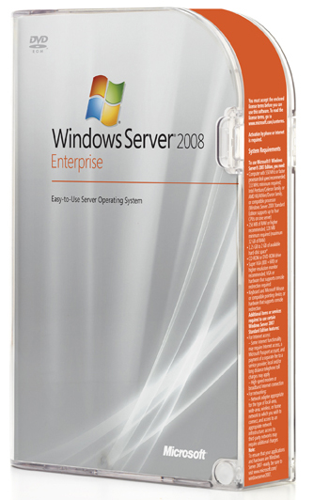
What can you do with Windows Server 2008?

Slide 3
Most existing applications will greatly benefit with no modification.

Slide 4
Time Planning
Description | Time
Introduction | 09:00 – 09:15
Key Changes | 09:15 – 09:45
Restart Manager Kernel Transaction Manager | 09:45 – 11:15
Coffee Break | 11:15 – 11:30
Threading and Synchronization I/O and Networking Management | 11:30 – 13:00
Coffee Break | 13:00 – 13:10
IIS 7.0 | 13:10 – 14:00

Slide 5
Agenda
Intro
RM
KTM
Threading
Synch
I/O
Network
Task Sched
MMC
IIS
Summary
Introduction and Key Changes
Reliability
  RM, KTM
Optimizations
  I/O, Thread & Sync, Networking
Manageability
  Task Scheduler, MMC, IIS 7.0

Slide 6
Editions
Similar to Windows Server 2003:
  Standard Edition
  Enterprise Edition
  Datacenter Edition
  Web Server
  Storage Server
  Small Business Server
  Itanium-based Systems (IA64)
Last 32-bit Windows Server OS

Slide 7
Release Progress
Long evaluation history:
  Beta 1 – July 2005
  Beta 2 – May 2006
  Beta 3 – April 2007
  RC 0 – September 2007
RTM – February 2008
  Official launch – February 27, 2008
  { Heroes Happen Here }
R2 planned for 2009

Slide 8
Key Changes
Intro
RM
KTM
Threading
Synch
I/O
Network
Task Sched
MMC
IIS
Summary

Slide 9
DSI, DFO, TCO, ROI
<This was a set of marketing buzzword slides, but we developers don’t need this kind of thing>
Just consider this:
  You want to design and implement a maintainable and manageable system, because it makes IT happier. Whenever IT are happy, they don’t call you in the middle of the night.

Slide 10
So, You Want to Make IT Happy?
It's Fairly Simple Really
Reliability
Reduce problem surfacing, robust handling
Manageability
Make administration easier so developers aren’t a prerequisite for troubleshooting
Optimization
Easy to scale, harder to flood

Slide 11

Windows Vista & 2008 Server
The Biggest Release of Windows Ever
User Account Control
Aero
WS-Management
Restart Manager
Network Access Protection
Sync Center
Windows SideBar
Monad
Windows Feedback Services
Ad-hoc Meeting Networks
Windows Presentation Foundation
Ink Analysis
Secure Startup
Reading Pane
Protected Mode IE
Presentation Settings
Windows Imaging Format
Parental controls
High Resolution/High DPI
Cancelable I/O
Windows Communication Foundation
Network Location Awareness
Registry/File System Virtualization
Single binary
Stacks
People Near Me
Quick Search
MMC 3.0
Shell Property System
Power Management
Crypto Next Generation
Windows Service Hardening
Live Icons
Glass
SuperFetch
Peer Name Resolution Protocol
Preview Pane
Windows Vista Display Driver Model
IPv6
Winlogon Rearchitecture
Transactional Registry
Taskbar Thumbnails
Windows Resource Protection
Search Folders
User Mode Driver Framework
Memory Diagnostics
Desktop Window Manager
Split Tokens
Function Discovery API
XAML
Windows Workflow Foundation
Windows Filtering Platform
Startup Repair Toolkit
Windows Installer 4.0
Flip3D
Credential Providers
Open Package Specification
Windows Defender
New Open/Save Dialogs
InfoCard
Segoe UI Font
RSS Platform
Mandatory Integrity Control
New Explorers
Transactional File System
Eventing and Instrumentation
Windows Sideshow
Resource Exhaustion Diagnostics
XML Paper Specification
Wizard Framework
Windows Disk Diagnostics
Confident | Clear | Connected
UI Privilege Isolation
Notes:
11

Slide 12
Key Changes
Redesign
System Redesign:
  Restructured audio, print, display and networking architecture
  Memory performance tuning technologies using flash memory and machine learning (ReadyBoost, ReadyDrive, SuperFetch)
  Core changes and new features in the Windows Kernel – memory management, threading, synchronization, scheduling, I/O, transaction support (TxFS, TxR)
  Enhanced Task Scheduler including API 2.0
  Internet Information Server 7.0

Slide 13
Key Changes
Architecture
Restructured server architecture:
  “Server Core” deployment option (for various editions)
    Minimal footprint, approx. 1.5 GB
    Minimal attack surface
    Command-line and remote MMC administration
  Roles can be added to the core
    Domain controller
    DNS, DHCP, TS server
    File, print, web server
Server Roles
DNS
DHCP
File
AD
Server Core
Security, TCP/IP, File Systems, RPC,
plus other Core Server Sub-Systems
Shell,
CLR, IE,
Media, OE,
etc.

Slide 14
Key Changes
Security
Security-Related Changes:
  Security was a primary design goal, as part of the “Trustworthy Computing” Microsoft initiative
  Improvements to the Windows Firewall
  BitLocker drive encryption
  Process integrity levels
  Network Access Protection
  Windows Filtering Platform
  (Vista-only) UAC, Secure Desktop, Windows Defender

Slide 15
Key Changes
Development
Developer Technologies:
  Ships out of the box with the .NET Framework 3.0, including Windows Presentation Foundation, Windows Communication Foundation, Windows Workflow Foundation and Windows CardSpace
  “ClickOnce” and Windows Installer 4.0
  Windows Driver Foundation (KMDF and UMDF)
  Transactional NTFS and registry
  First to ship with Windows PowerShell
  Managed add-ins with MMC 3.0
  More WMI functionality
  Mobile computing APIs – power management, tablet PC ink support
  (Vista only) 3D graphics enhancements (DirectX 9, 10)

Slide 16
Lecture Structure
Reliability
Application Restart and Recovery
Restart Manager
Kernel Transactions Support
Optimizations
Synchronization Mechanisms
Threading and Scheduling
I/O and Networking
Next Generation TCP/IP Stack
I/O Optimizations
Management
Task Scheduler 2.0
ReadyBoost, ReadyBoot, SuperFetch, ReadyDrive
MMC 3.0
IIS 7.0

Slide 17
Accessibility from Managed Code
Trivial
Managed
  Examples: WCF, IIS 7.0
Directly-callable using. NET interop mechanisms
  Example: Task Scheduler API
C++/CLI or PInvoke signatures
  Example: Application Recovery and Restart
Raw Win32
  Example: Kernel Transaction Support
COM
  Example: Distributed Transaction Support
.NET-hostile
  Example: Network Awareness API
Rocket
Science
Adapted from: Kate Gregory, TLA 313, TechEd Europe 2007

Slide 18

Application Restart and Recovery
Intro
RM
KTM
Threading
Synch
I/O
Network
Task Sched
MMC
IIS
Summary
Reliability

Slide 19

Motivation
Provide a built-in watchdog for applications
  Handle crash and restart scenarios gracefully
  Affect user experience as little as possible
Reduce the number of system restarts during software installation
  Enumerating resources required
  Shutting down and restarting applications and services holding onto these resources

Slide 20
Application Recovery
There are nine functions but two are the main ones:
  RegisterApplicationRestart
  RegisterApplicationRecoveryCallback
These two serve different, but complementary goals:
  When your application crashes, it automatically restarts
  When your application crashes, it gets a chance to save some recovery information

Slide 21
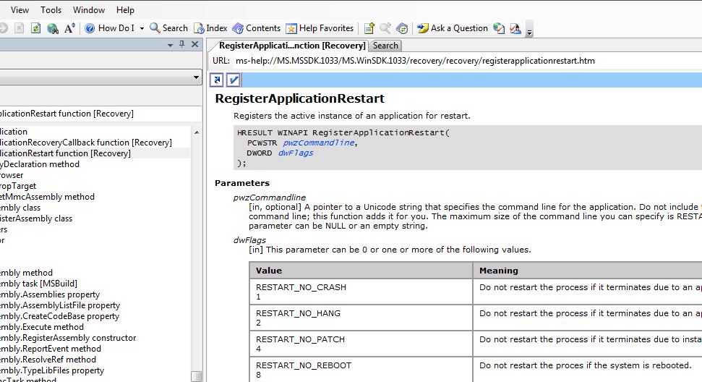
DEMO
Application Restart and Recovery

Slide 22
RM Aware Installation Scenario
When a RM-aware piece of software installs, it will ask all RM-aware applications to shutdown
  Assuming said applications are holding resources (e.g. files) that it needs to update
The RM-aware app will listen to the request and shutdown, saving its state!
When the installation has completed, the installer will restart all the RM-aware applications
The RM-aware application will then restore its state
  If a reboot is unavoidable, after reboot the RM-aware applications will also restart!

Slide 23
Make Your App RM Friendly
We need to make our installations follow the RM philosophy
  Use Windows Installer 4.0
  Manually work with the rstrtmgr.dll API
We need to make our applications also play well
  Register with the system for restart, and be capable of restoring your state when (re)starting up
  Listen for the message from an installation program that you are about to shutdown

Slide 24
Guidelines for Installers
Force shutdown only if you have to
  Use the RmForceShutdown option of the RmShutdown function (might result in data loss for non-RM-aware applications)
If you require restart, enable application restart to minimize impact on the user:
  Use ExitWindowsEx with the EWX_RESTARTAPPS flag
  Use InitiateShutdown with the SHUTDOWN_RESTARTAPPS flag
Note that applications running with elevated privileges will not be restarted

Slide 25
Guidelines for Applications
Windows applications:
  Handle the WM_QUERYENDSESSION message to have a say whether you’re ready to shutdown
  Handle the WM_ENDSESSION message to prepare for graceful shutdown during the specified period
  Handle the WM_CLOSE message to close the UI
Console applications:
  Handle the CTRL_C_EVENT notification to save state and prepare for shutdown

Slide 26
Guidelines for Applications
Services:
  Services should be capable of shutting down and restarting using the Service Control Manager
  Service dependencies are honored by the Restart Manager
Critical system services:
  Critical system services cannot be stopped and restarted without a system restart
  Those include: smss, csrss, winit, logonui, lsass, services, winlogon, System, svchost/RPCSS, svchost/DCOM&PnP

Slide 27
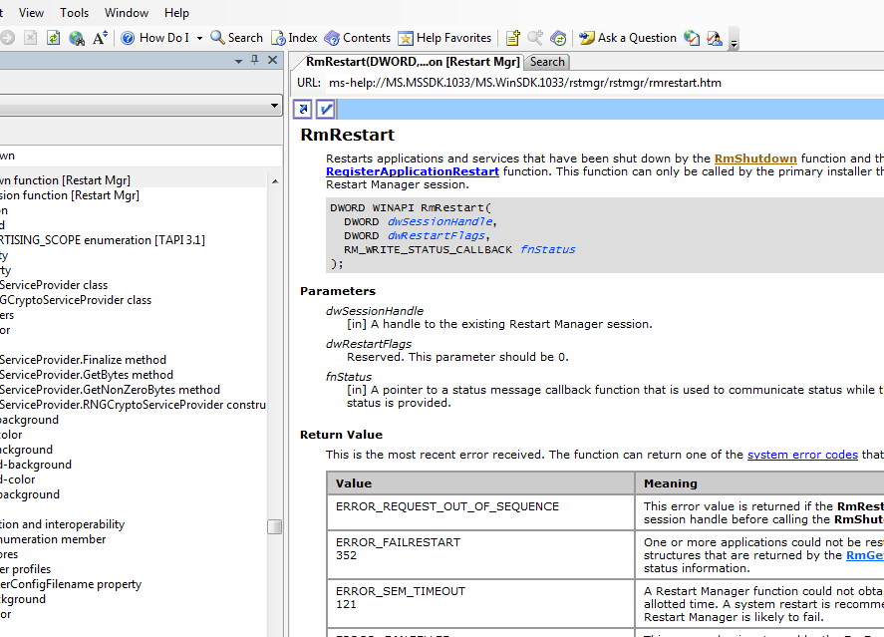
Demo
Enumeration, Shutdown and Restart

Slide 28
Kernel Transaction Manager
Intro
RM
KTM
Threading
Synch
I/O
Network
Task Sched
MMC
IIS
Summary
Reliability

Slide 29
Motivation
Adding full-blown Windows kernel support for transactions
  Including distributed transactions (using MS-DTC)
Providing transactional services to the File System and the Registry

Slide 30

Why Transactions?

Slide 31
What is a Transaction?
A transaction is a group of operations that has the following ACID properties
Description | Term
Either all of the operations in the transaction succeed or none of the operations persist. | Atomic
If the data are consistent before the transaction begins, then they will be consistent after the transaction finishes. | Consistent
The effects of a transaction that is in progress are hidden from all other transactions. | Isolated
When a transaction finishes, its results are persistent and will survive a system crash. | Durable

Slide 32
The Kernel Transaction Object
A transaction is an object that defines a logical unit of work
The transaction is alive as long as there is a handle
The transaction is active if the transaction has not yet been committed or rolled back
If all handles to it have been closed before a commit or rollback occurs, the transaction will be rolled back

Slide 33
Using the KTM
The client calls CreateTransaction
  The transaction can be opened or inherited by any number of processes
  The failure of any of these processes will cause the transaction to abort
The client must pass a transaction to the resource manager explicitly
  The client performs all its transactional operations with one or more RMs, such as transacted file systems
The client calls the CommitTransaction and RollbackTransaction functions
  The RM receives notifications from KTM to prepare and commit its data

Slide 34
Participating in MSDTC Transaction
To participate in a transaction with other RMs such as MSMQ & SQL Server you need to get a handle from the DTC
Use the IKernelTransaction interface to get the handle
  To get the IKernelTransaction, query the interface from the DTC ITransaction
  GetHandle() returns the handle
  Don’t forget to close this handle

Slide 35
TxF – Improving NTFS
NTFS and the Registry are now full members in the rich Windows transactional infrastructure
  Create, Delete, and Update files and keys with the same atomicity, consistency, isolation, and durability that you get with SQL
  Easy Programming Model
    Win32
    COM+
    .NET
Distributed Transacted File Operations
  In Server 2008 and Vista SP1
Notes:
Software Design Review
2/24/2008 5:16 PM
© 2006 Microsoft Corporation. All rights reserved.
This presentation is for informational purposes only. Microsoft makes no warranties, express or implied, in this summary.
35

Slide 36
TxF Scenarios
Why TxF?
  Updating a file – ensure a series of updates to a file succeed completely or fail completely, to maintain consistency in face of application or system failures
  Multi-file updates – e.g. updating a web page and all links to it
  Concurrent update isolation – the reader gets a consistent view of the file even if a writer is updating the file as part of a transaction
  Coordination with registry updates or other RMs (SQL DB, MSMQ, …) using the DTC

Slide 37
Transactional Locking
(Read-Committed Isolation)
There are four players:
  Transaction Readers & Transaction Readers/Writers – see the current changed state of the file in a consistent manner
  Non Transaction Readers – See the last committed state
  Non Transaction Readers/Writers – The file is locked and the operation fails
If an entity is locked by a transaction and another thread tries to modify it, the following error is returned: ERROR_SHARING_VIOLATION

Slide 38
Transacted File Handles
Transactional NTFS binds a file handle to a transaction
For file operations that take a name, there are explicit transacted functions for these operations
  For example, instead of calling CreateFile, call CreateFileTransacted
All operations using these handles are transacted operations

Slide 39
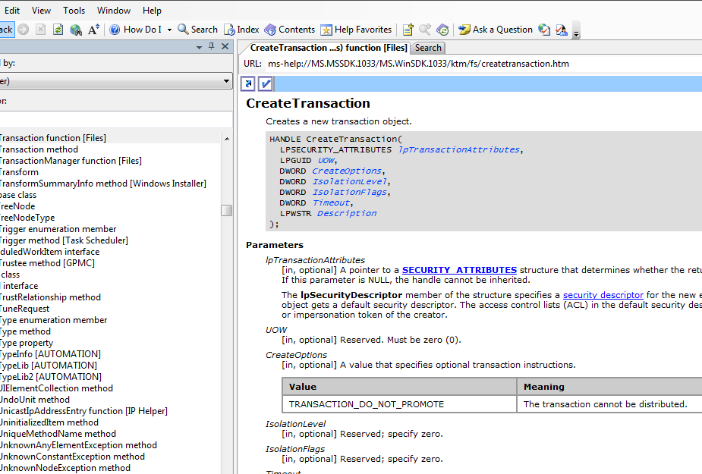
DEMO
Transactional NTFS

Slide 40
Notes on Transactional NTFS
Close the file handle before a transaction commits or rolls back
  The system invalidates the handles when a transaction ends
A file is viewed as a unit of storage
Memory mapped I/O is transparent and consistent with the regular file I/O
An application must flush and close an opened section before committing a transaction
  This means that to some extent, in-memory operations are transactional as well!

Slide 41
Gotchas
A file or directory created within a transaction is not visible outside the transaction
  Attempting to create another file or directory with the same name results in ERROR_TRANSACTIONAL_CONFLICT
Transaction state:
  Non-transacted readers get a snapshot of the file
  Transacted readers within the transaction get an updated view of the file for this transaction
  Transacted readers fail for a file that has a non-transacted writer
  Only a single transacted writer is supported
Modifying a file does not lock its directory
Named streams are transactional at the file level, not at the stream level
Compression changes are not transacted
Reparse point changes are transacted

Slide 42
TxR (Registry)
Needed for “all or none” semantics when changing a group of settings
Adds ACID semantics to group of registry operations
Integrates with TxF and any other Resource Manager which participates in KTM transactions
  A transaction can span across FS and Registry operations
Provides easier way for apps to clean up on error path
42
Notes:
2/24/2008 5:16 PM
©2005 Microsoft Corporation. All rights reserved.
This presentation is for informational purposes only. Microsoft makes no warranties, express or implied, in this summary.
42

Slide 43
Write Your Own Transaction Manager & Resource Manager
If you are writing a transactional service or component or if you need to monitor the state of a kernel transaction, you need to create a resource manager (RM)
To write a resource manager, you must create multiple kernel objects:
  Transaction Manager (TM) objects
  Resource Manager objects
  Enlistment objects
See MSDN for more advanced details

Slide 44
Adding Things Up
Dealing with errors & exceptions is hard
  Programmers usually don’t do that well
  With transactions, just code the happy path!
What is the state of the application now?
  The answer is: use transactions – the state is always consistent!
Transaction = Retry BoundarY

Slide 45

Threading and synchronization
Intro
RM
KTM
Threading
Synch
I/O
Network
Task Sched
MMC
IIS
Summary
Optimizations

Slide 46
Motivation
Supporting advanced scheduling scenarios
  Soft real-time applications requiring fine-grained context-switching control
  Multimedia applications requiring quality playback or capture
Introducing advanced synchronization mechanisms

Slide 47
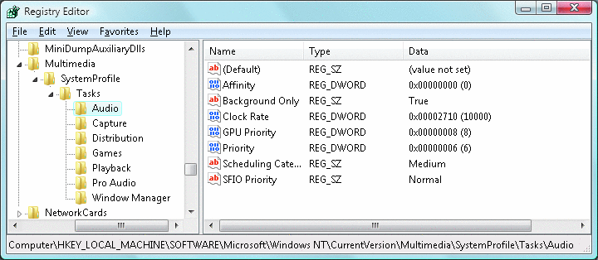
Multimedia Class Scheduler Service
Audio and video demand a seamless playback experience
  Tasks (“audio”, “video”) are registered in the registry

Slide 48
Registry Settings
A Multimedia\SystemProfile key contains the information needed to control the CPU priority
  The CPU % that should be given to low priority threads
  A list of known tasks such as Audio, Capture, Playback Game etc.
  For each task: CPU Affinity, GPU & CPU Priority, etc.

Slide 49
Multimedia Class Scheduler Service
Applications register with one of the tasks
  MMCSS (mmcss.dll) runs as priority 27 and boosts the multimedia threads into the range registered with the task
    Their priorities may be real-time even though they are not running under administrative privileges
  Limitations can be placed on the amount of CPU dedicated to multimedia tasks (to keep the system responsive)

Slide 50
Multimedia Class Scheduler Service
The MMCSS ensures that multimedia applications get their time-sensitive processing & receive prioritized access to CPU resources
Each thread that is performing work related to a particular task calls one of these APIs:
  AvSetMmMaxThreadCharacteristics
  AvSetMmThreadCharacteristics

Slide 51
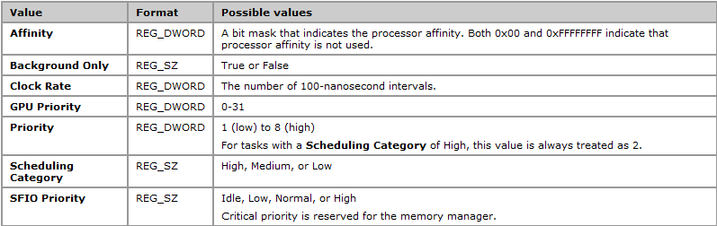
Registry Settings
Registry settings for a task include:

Slide 52
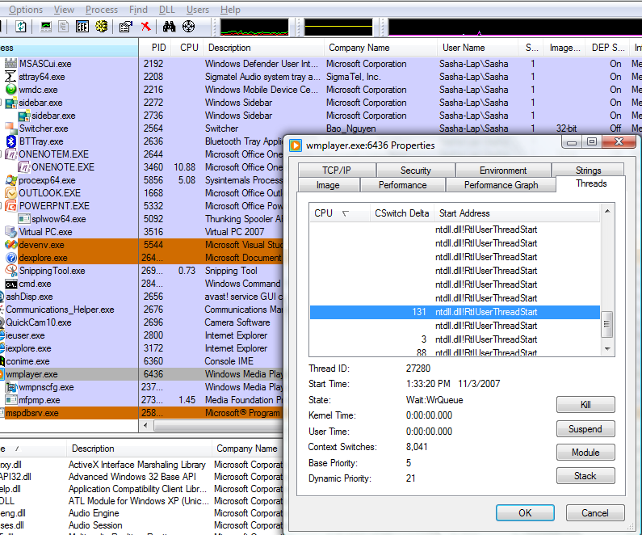
Demo
Media Player priority

Slide 53
Real-Time Thread Scheduling
For many years, application developers have sought a way to schedule real-time tasks on Windows
The two main problems for real-time tasks were:
  Task ordering (task A always runs before task B)
  Limiting the time tasks can run, to ensure real-time responsiveness even in the face of ill-behaved tasks
Enter: Thread Ordering Service

Slide 54
Thread Ordering Service
Ensures that a thread runs once during the specified period and in relative order
  The parent thread creates a group by calling the AvRtCreateThreadOrderingGroup
  You specify the total period and the time-out interval
  Client threads call the AvRtJoinThreadOrderingGroup function to join a thread ordering group
  Each client thread is expected to complete a certain amount of processing each period
  Can’t exceed the time allotted to it, or it will be removed
  Each thread calls the AvRtWaitOnThreadOrderingGroup function in a loop

Slide 55
Thread Ordering Service
Client removes itself using AvRtLeaveThreadOrderingGroup
The parent should not remove itself from the group
If a thread does not complete its execution before the period plus the time-out interval elapses, then it is deleted from the group
The parent thread calls AvRtDeleteThreadOrderingGroup to delete the thread ordering group
The group is also destroyed if the parent does not complete its execution before the period plus the time-out interval elapses

Slide 56
Thread Ordering Group
Creating:
All threads’ main loop:
  HANDLE hContext = NULL;
  LARGE_INTEGER period, timeout;
  GUID guid = { 0 };
  period.QuadPart = Int32x32To64(_100NS_IN_1MS, 1000);
  timeout.QuadPart = Int32x32To64(_100NS_IN_1MS, 10000);
  AvRtCreateThreadOrderingGroup(&hContext, &period, &guid, &timeout);
  while(AvRtWaitOnThreadOrderingGroup(Context))
  { ... }
  if (GetLastError() == ERROR_ACCESS_DENIED)
  // Something went wrong:
  // Ordering group was deleted, or the thread has exceeded
  // the time allotted to it and was removed from the group

Slide 57
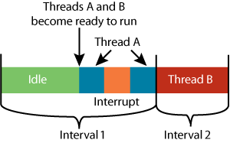
CPU Cycle Counting
Threads may get unfairly charged for interrupt processing
  Quantum charging happens only when the clock interrupt occurs (10-15 ms frequency)

Slide 58
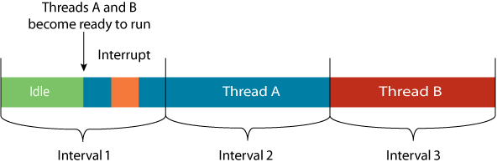
CPU Cycle Counting
Vista & 2008 Server use the cycle counter register of modern processors
  Doesn’t charge for interrupt processing time

Slide 59
Windows Synchronization Objects
Every Windows synchronization object contains a kernel dispatcher header
  A structure keeping track of threads waiting for the object and its synchronization state (signaled or non-signaled)
  Examples of such objects: process, thread, event, mutex, semaphore, file, …
Vista & 2008 Server offer us more flavors of synchronization objects and a powerful synchronization diagnostics API

Slide 60
One-Time Initialization
Consider a resource that is initialized on first use
  Such as the static single-instance reference in a simple singleton implementation
  Such as a static constructor in a .NET class
The one-time initialization functions ensure that initialization occurs only once even when multiple threads attempt the initialization
  Many applications use the interlocked functions to ensure that only one thread performs the initialization

Slide 61
Why Use One-Time Initialization
It is optimized for speed
It creates the appropriate memory barriers on processor architectures that require them
It supports both locked and parallel initialization
It avoids internal locking so the code can operate asynchronously or synchronously

Slide 62
Conditional Variables
Conditional variables simplify the creation of complex synchronization objects
  They allow a thread to enter a sleep state and atomically release a critical section
  They allow a thread to wakeup and atomically acquire a critical section
Consider a consumer/producer scenario working on the same cyclic buffer

Slide 63
Slim Reader-Writer Lock (SRWL)
Reads and writes to/from a resource appear the same to traditional synchronization mechanisms
A Reader-Writer Lock allows multiple readers but only a single writer to enter a critical section
The SRWL is a "slim" RW lock, ultra-fast and lightweight
  Optimized for the case where there are many readers and not-so-many writers for a specific resource
      SRWLOCK rwLock;
      InitializeSRWLock(&rwLock);
      AcquireSRWLockShared(&rwLock);
      // ... shared operations ...
      ReleaseSRWLockShared(&rwLock);

Slide 64
Deadlock and Synchronization Diagnostics
Prior to Vista/2008 Server, the only means to determine which thread is waiting on which synchronization object was through the use of a kernel debugger or a specialized driver
  The information is present but is stored in system-space, accessible only from kernel mode
  Each thread has a linked list of WAIT_BLOCK structures describing the thread’s outstanding wait operations
  Each synchronization object has a DISPATCHER_HEADER structure, which has a linked list of WAIT_BLOCK structures describing the threads waiting for the object

Slide 65

Two Threads Waiting for Two Objects

Slide 66
Wait Chain Traversal
In Vista & 2008 Server, WCT enables diagnosing of hangs and deadlocks, from user-mode code
A wait chain is an alternating sequence of threads and synchronization objects
  A thread waits for an object from the time it requests it until it has acquired it
  A lock is owned by a thread from the time the thread acquires it, until it releases it
  If thread 1 waits for a lock that is owned by thread 2, this is the same as saying that thread 1 waits for thread 2
WCT currently supports the following synchronization primitives:
  ALPC, COM, Critical sections, Mutexes, SendMessage, Wait operations on processes and threads

Slide 67

Wait Chain Traversal
Deadlock detection is already built-in!
  BOOL WINAPI GetThreadWaitChain(
  HWCT WctHandle,
  DWORD_PTR Context,
  DWORD Flags,
  DWORD ThreadId,
  LPDWORD NodeCount
  PWAITCHAIN_NODE_INFO NodeInfoArray,
  LPBOOL IsCycle
  );
Receives the nodes in the wait chain
Indicates a deadlock

Slide 68
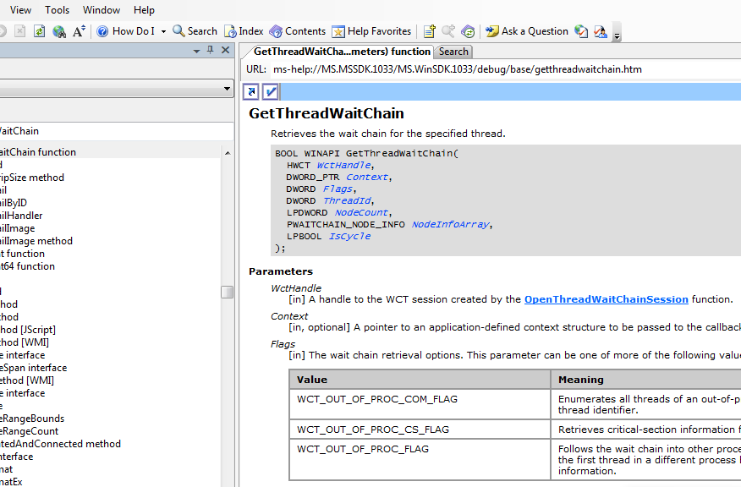
DEMO
Wait Chain Traversal

Slide 69
System Optimizations
Intro
RM
KTM
Threading
Synch
I/O
Network
Task Sched
MMC
IIS
Summary
Optimizations

Slide 70

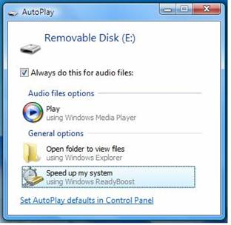
ReadyBoost
Memory is fast
Disks are slow
In between, we have flash memory
  Using flash devices inserted to the system as an extension of RAM (page file)
  Sequential reads go to the disk PF (faster)
  Random access reads go to the flash device
  Data is encrypted with a per-boot key

Slide 71
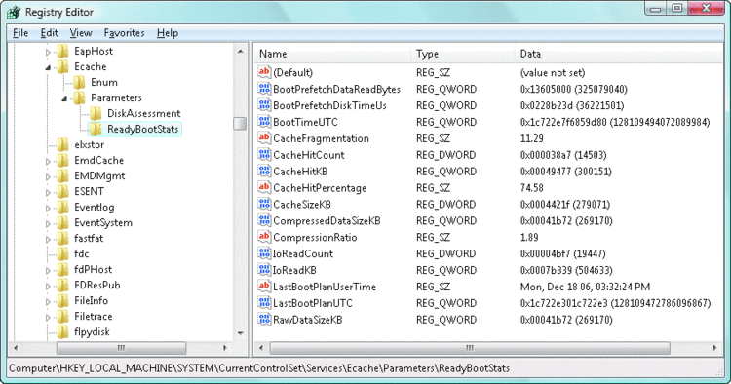
ReadyBoot
Improves on XP boot prefetching
Uses boot idle time to calculate a caching plan for the next boot
Cache populated by the ReadyBoost service and deleted 90 seconds after the boot

Slide 72
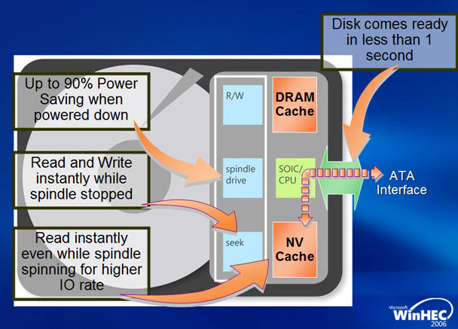
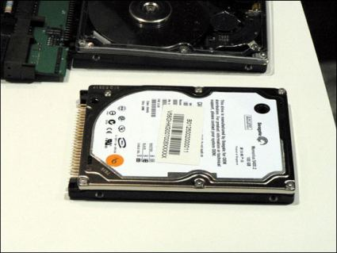
ReadyDrive
Takes advantage of hybrid hard disks (H-HDDs)
  A disk with flash memory (NVRAM)
Disk-write cache to prevent spinning up the disk on battery power

Slide 73

SuperFetch
Relies on MM support for page histories
Writes per-application scenarios
Preloads and prefetches recently evicted or scenario data
  Done at Very Low I/O priority
Has specific support for hibernation, standby, fast user switching (FUS)

Slide 74
Services Shutdown
During system shutdown prior to Vista & 2008 Server, services had a maximum of 20 seconds to perform cleanup
  This simply isn’t enough for some services that are network-related or need to persist large amounts of data
  E.g., the Group Policy and Windows Update services
In Vista & 2008 Server, services may request pre-shutdown notification
  Such services have an indefinite amount of time to complete, but if they don’t respond to queries, they are killed after three minutes
Services may also request shutdown ordering
  Similarly to startup ordering available in earlier versions

Slide 75

Power Management
Since Windows 2000, Windows asks device drivers and applications for their consent to change power state
  A single unresponsive driver/application could prevent shutdown or restart
In Vista & 2008 Server, the Power Manager still notifies drivers and applications, but doesn’t ask for their permission
  The Power Manager waits at most for 20 seconds for the driver/application to respond

Slide 76

I/O Optimizations
Intro
RM
KTM
Threading
Synch
I/O
Network
Task Sched
MMC
IIS
Summary
I/O and Networking

Slide 77

Thread I/O Priorities
Windows has always supported thread CPU priorities, in the 0-31 range
  Separated to normal priorities and real-time priorities
Windows Vista & 2008 Server introduce I/O priorities and I/O bandwidth reservations
Five I/O priority levels are available:
I/O Priority | Used By
Critical | Memory Manager
High | Unused
Normal | Default threads
Low | Default for scheduled tasks
Very low | Background threads

Slide 78
Improve System Responsiveness
Prior to Windows Vista & 2008 Server
  Background threads such as Anti-Virus scanners and Search Indexers interfered with higher priority threads, due to heavy I/O operations
In Vista & 2008 Server SetThreadPriority has two new constants:
  THREAD_MODE_BACKGROUND_BEGIN
  THREAD_MODE_BACKGROUND_END
Between the two calls the system lowers the resource scheduling priorities of the thread (Very Low I/O priority level)
  This value can be specified only if hThread is a handle to the current thread

Slide 79
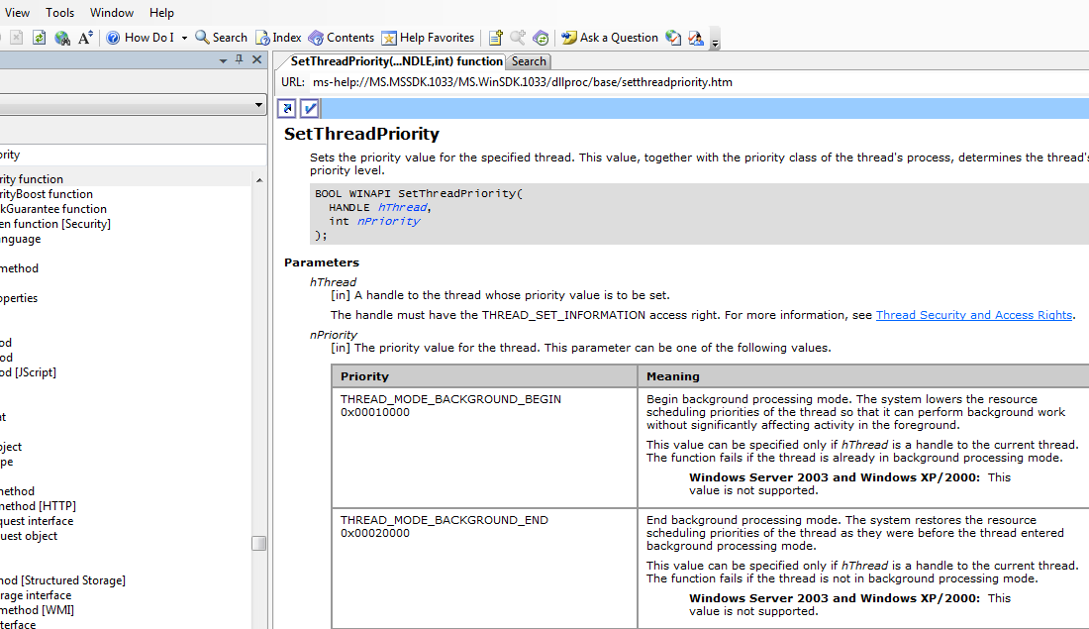
Demo
Copy File FG & BG

Slide 80
I/O Bandwidth Reservation
Request I/O bandwidth reservation for a specified file handle
  SetFileBandwidthReservation
  Applications that requested reservation will be serviced by the I/O system before other applications
Input:
  Period size in milliseconds
  Bandwidth reservation per period
Output:
  Minimum size of I/O request that should be issued by the application
  The number of simultaneous outstanding I/O requests the application should allow for maximum throughput

Slide 81
Cancelable I/O
Prior to Vista & 2008 Server, there was one CancelIo API
  BOOL CancelIo(HANDLE hFile)
  It enables canceling all pending I/O on a specified file handle, that was issued from the calling thread
  This means that we can cancel only overlapped (asynchronous) I/O
  This means that we can’t cancel a particular asynchronous I/O request – we have to cancel all asynchronous I/O for the specified handle

Slide 82
Cancelable I/O
The new CancelSynchronousIo marks pending synchronous I/O operations that are issued by the specified thread as canceled
BOOL CancelSynchronousIo(HANDLE hThread)
  It is called by another thread
  The THREAD_TERMINATE permission is required to call this function

Slide 83
Cancelable I/O
The new CancelIoEx function cancels any I/O operations for the specified file handle
BOOL CancelIoEx(HANDLE hFile,
LPOVERLAPPED lpOverlapped)
  The function cancels I/O operations in the current process, regardless of the calling thread
  Specify which overlapped I/O request to cancel, or cancel all requests for that file handle
  Not all types of operations can be cancelled (depends on the driver)

Slide 84
UI Support for Cancelable I/O
Cancelable I/O requires user interface support to be helpful to end users
  The Windows Explorer uses cancelable I/O, allowing the end user to cancel any I/O operation (including browsing folders)
  The Net command family uses cancelable I/O, e.g. try running net view \\dsfgh112 and then pressing Ctrl+C (on 2003 vs. 2008)
  The file open and file save common dialogs enable their Cancel button while trying to display the contents of a folder

Slide 85
VistA & Server 2008 Network Stack
Intro
RM
KTM
Threading
Synch
I/O
Network
Task Sched
MMC
IIS
Summary
I/O and Networking

Slide 86
What’s New in Networking?
  Next Generation TCP/IP stack
  Quality of Service
  SMB 2.0
  Web Access APIs enhancements
  Winsock enhancements
  NDIS 6.0
  Network Awareness
  P2P
  Firewall enhancements
  IPSec improvements
  Native Wi-Fi architecture (not Ethernet emulated)
  802.11 wireless diagnostics
  Network Access Protection
  http://www.microsoft.com/technet/network/evaluate/new_network.mspx

Slide 87
Next Generation TCP/IP Stack
Complete redesign of TCP/IP functionality for IPv4 and IPv6
  http://www.microsoft.com/technet/network/tcpip/default.mspx
  Optimizing throughput:
    Receive Window Auto-Tuning
    Compound TCP (send window auto-tuning based on bandwidth-delay product)
    ECN Support (RFC 3168) for congestion control at the TCP peers (and not the router)
    Enhancements for High-Loss Environments
      NewReno, Extended SACK, Conservative SACK, F-RTO
  Neighbor Unreachability Detection for IPv4
    ARP cache or TCP based

Slide 88
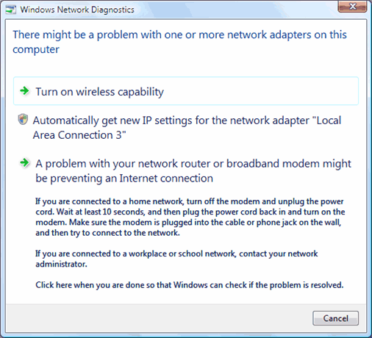
Next Generation TCP/IP Stack
  Fail-back Support for Default Gateway Changes
    Not just fail-over
  Network Diagnostics Support
    Assists users to recover from connectivity problems
    Incorrect IP, gateway not available, invalid DNS settings, media disconnected, local port in use or blocked, low memory

Slide 89
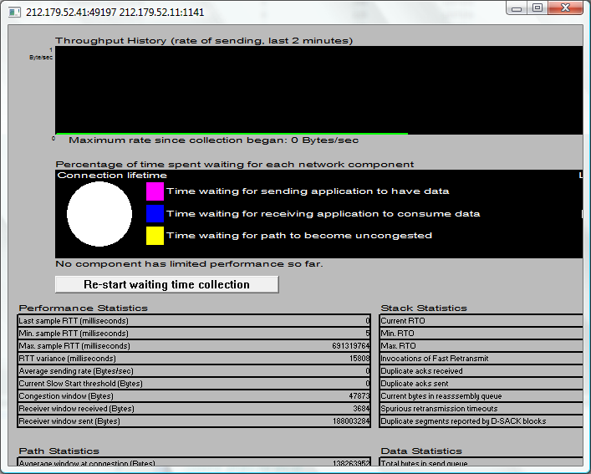
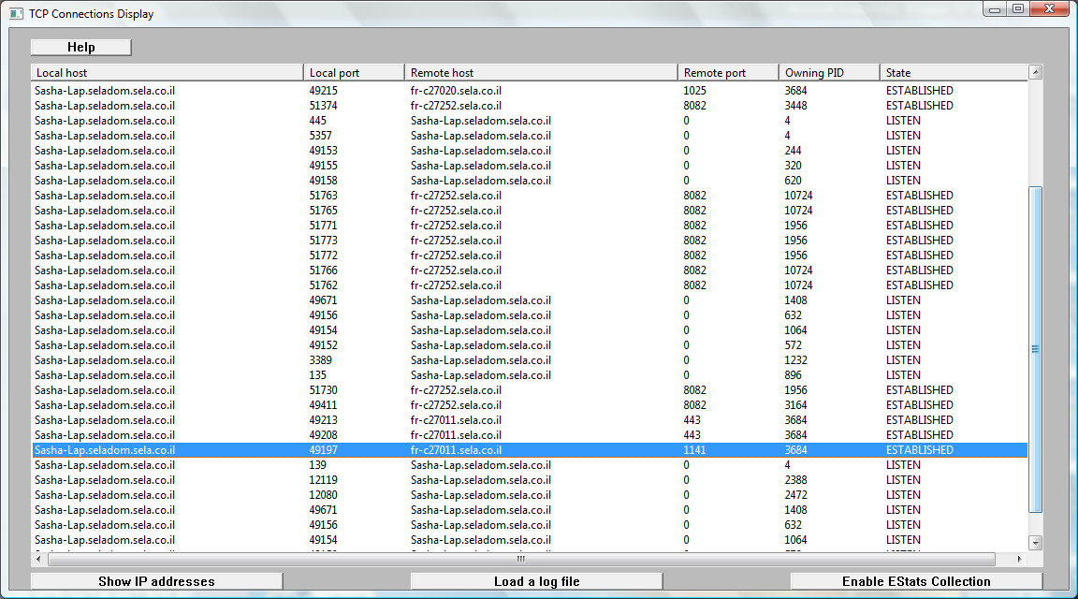
Next Generation TCP/IP Stack
  ESTATS support (performance statistics for TCP)
    Tcpanalyzer.exe

Slide 90
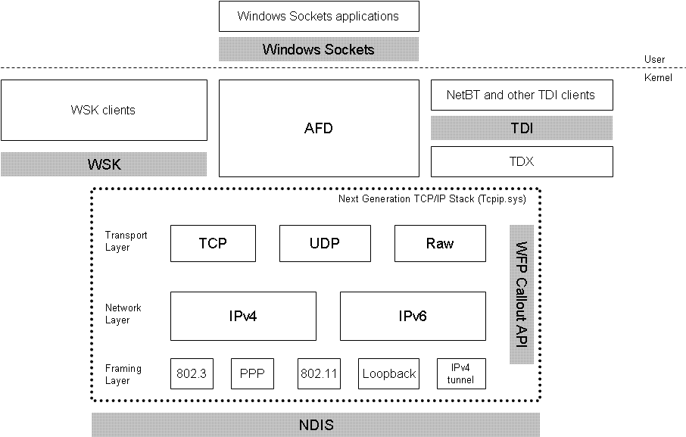
Next Generation TCP/IP Stack
  Windows Filtering Platform (WFP)
    API for third-party filtering decisions
  IPv6 enhancements
    GUI configuration, IPSec support, …
  TCP Chimney Offload
    Offloading processing to dedicated hardware (network adapter)

Slide 91
SMB2: Improved Data Streaming
Parallel Read/Write Requests
Windows Vista and Windows Server 2008 split large data requests and send them in parallel
Posting more data to the underlying transport enables TCP to tune based on network characteristics
Dynamic crediting in SMB2 allows the client to have more outstanding requests
Cache manager and memory manager will issue larger IO’s for paging operations, thus taking advantage of these improvements
Write Request
Write Response
Pre-2008
2008

Slide 92
SMB2: Decreased Chattiness
Less Roundtrips for the Same Data
Open Dir
Open Dir
Response
Query Dir
Query Dir
Response
Query Volume
Response
Query Volume
Close Dir
Response
Close Dir
Query Dir
Response
Satisfied from cache
Query Volume

Slide 93
Web Access APIs Enhancements
HTTP API 2.0
  Multiple applications on the same port
  New APIs for authentication, throttling, logging, connection limits, certificate binding, response caching (all used by IIS 7)
WinHTTP
  Upload up to 2⁶⁴ bytes
  …Other features

Slide 94
Winsock Enhancements
New APIs:
  WsaConnectByName – for all destination X local addresses
  WsaConnectByList
  …some others
ETW tracing for Winsock events
New kernel-mode socket API (Winsock Kernel)
  Replaces TDI
  Much better performance, exposes all new NG TCP/IP stack features
  http://blogs.msdn.com/wndp/archive/2006/02/24/538746.aspx

Slide 95
NDIS 6.0
New offload support
  Offload IPv6 traffic
  Checksum offload for IPv6
  Large send TCP offload (data blocks >64KB)
Lightweight filter drivers
  Replace NDIS intermediate drivers
Receive-side scaling
  Network adapters no longer serviced by one CPU!
  (Requires a compatible network adapter)

Slide 96
Network Awareness API
New API for applications:
  Network detection
  Connectivity changes (notification)
  Querying available connections
  Querying location types (public, private …)

Slide 97
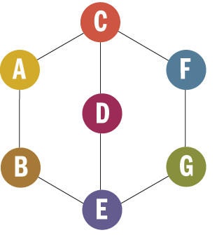
Peer-to-Peer
P2P used to be hard
  Proprietary protocols
  Location and connection establishment
  WAN infrastructure
P2P in Vista, 2008 Server and WCF:
  Peer Name Resolution Protocol (PNRP)
  People Near Me (PNM)
  WCF PeerChannel

Slide 98
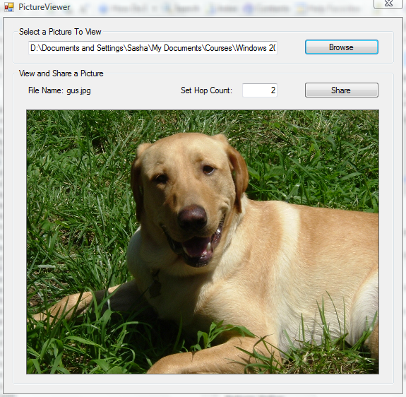
DEMO
Establishing a P2P Network

Slide 99
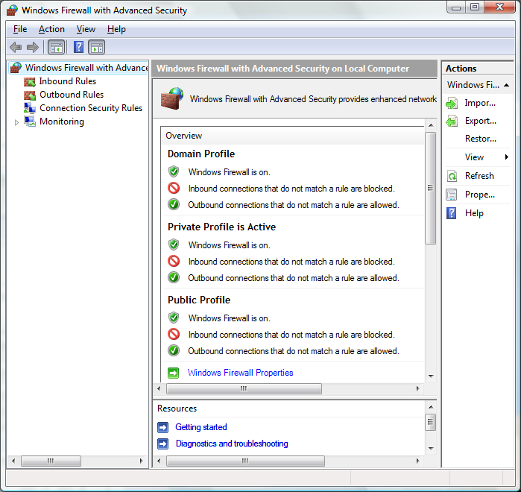
Firewall Enhancements
Outgoing traffic filtering
New MMC snap-in

Slide 100



Network Access Protection
How It Works
Policy Servers
e.g. Patch, AV
3
1
2
Not policy compliant
4
Fix Up
Servers
e.g. Patch
MSFT NPS
Restricted
Network
Windows
Client
DHCP, VPN
Switch/Router
Policy compliant
1
Client requests access to network and presents current health state
5
Corporate Network
2
DHCP, VPN or Switch/Router relays health status to Microsoft Network Policy Server (RADIUS)
3
Network Policy Server (NPS) validates against IT-defined health policy
4
If not policy compliant, client is put in a restricted VLAN and given access to fix up resources to download patches, configurations, signatures (Repeat 1 - 4)
5
If policy compliant, client is granted full access to corporate network
Notes:
100

Slide 101

Task Scheduler 2.0
Intro
RM
KTM
Threading
Synch
I/O
Network
Task Sched
MMC
IIS
Summary
Management

Slide 102
Motivation
Providing a platform for designing and managing complex background operations
Potentially eliminating the need for Windows Service development
  Reducing system load and resource usage
  Reducing system complexity
  Reducing attack surface

Slide 103
The New Task Scheduler
Used widely by parts of Windows Vista and 2008 Server
Relies on the Task Scheduler Service
  Can no longer be disabled by administrators
  You can rely on it always being around
Tasks are stored in the file system
  Create tasks by creating an XML document
  Create tasks by using the Task Scheduler COM API, also accessible from .NET (TaskScheduler 1.1 Type Library)
Supports remote access to tasks & history

Slide 104
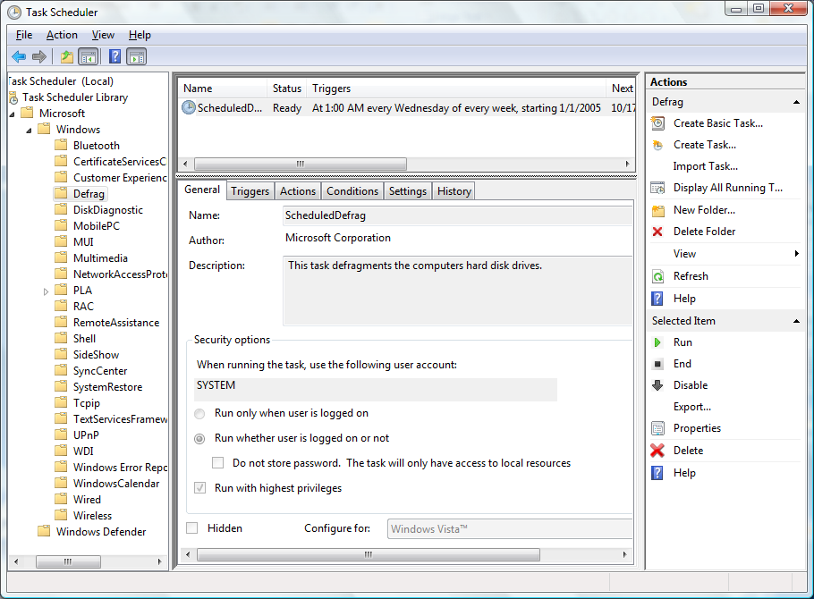
Task Scheduler MMC Snap-In

Slide 105
Configuration Settings
Triggers – what triggers the task
  Schedule (weekly, daily, …)
  At log on / log off / lock / unlock / startup / shutdown
  When the system is idle
  When an event log entry is logged
Actions – what the task does
  Start a program
  Send an e-mail
  Display a message
  Custom handler (your extension point)
Conditions – what determines whether the task will run
  If the computer is idle
  If the computer is on AC power
  If a network connection is available
Additional settings:
  Stop the task if it runs too long
  Retry the task if it fails

Slide 106
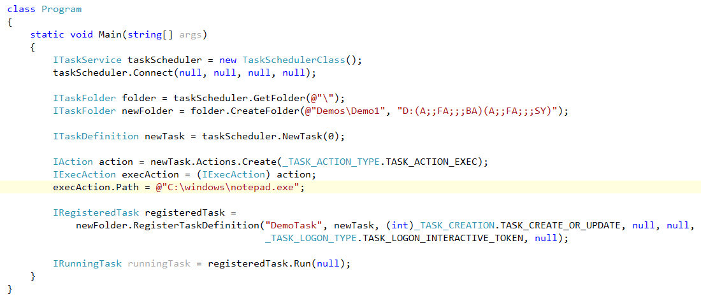
Demo
Managed Task Registration

Slide 107
Custom Task Handler
Implement and register a COM object exposing the ITaskHandler interface
  The only way to provide graceful stop/pause/resume for your task
  Note: it will be hosted out-of-process, so it must have a DllSurrogate entry in its registration script to allow activation inside DllHost.exe
Communicate with the Task Scheduler using the ITaskHandlerStatus interface
  Report progress, report completion

Slide 108
Microsoft Management Console 3.0
Intro
RM
KTM
Threading
Synch
I/O
Network
Task Sched
MMC
IIS
Summary
Management

Slide 109
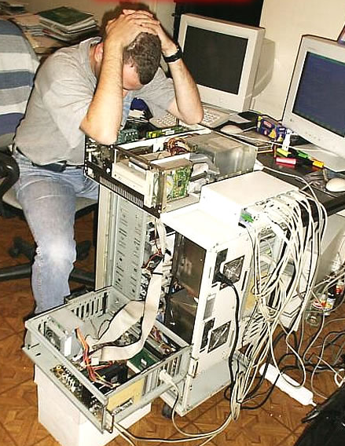
Motivation
Provide a framework for administrative tools in Windows
  GUI platform
  Common layout and content for management-related tasks
Target administrators only

Slide 110
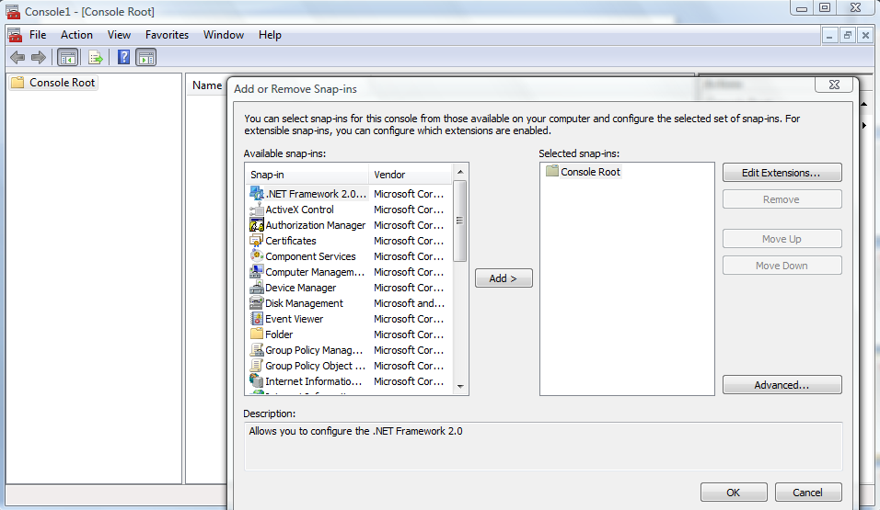
MMC and Snap-Ins

Slide 111
Managed Snap-Ins with MMC 3.0
Authoring snap-ins in managed code:
  Microsoft.ManagementConsole
  Derive from SnapInInstaller
  Derive from SnapIn and use [SnapInSettings]
  Run InstallUtil.exe and you’re set
MMC can now integrate WinForms views
Managed snap-ins have the added bonus of being bitness-agnostic

Slide 112
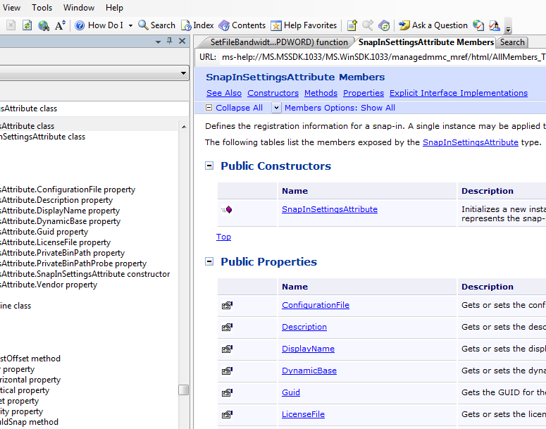
DEMO
Installing a Managed Snap-In
Notes:
…\Windows SDK\v6.0\Samples\SysMgmt\MMC3.0
Take the HtmlView sample and navigate to some other address
InstallUtil to install, and then open in MMC

Slide 113
IIS 7.0
Intro
RM
KTM
Threading
Synch
I/O
Network
Task Sched
MMC
IIS
Summary
Management

Slide 114

Motivation
Providing an extensible and manageable Web server platform for a multitude of applications
  A completely modular web server
  Delegated management of web sites
  Diagnostic features and management APIs

Slide 115
IIS Architecture
Server functionality is split into ~ 40 modules...
Authentication
Authentication
NTLM
Basic
Anon
Authorization
…
Modules plug into a generic request pipeline…
ResolveCache
Determine
Handler
CGI
…
Static File
ExecuteHandler
Modules extend server functionality through a public module API
ISAPI
…
…
UpdateCache
Send Response
SendResponse
Log
Compress
Notes:
In IIS7, rather than have a fixed set of functions in the pipeline, the feautres were modularized. Each feature is contained in a module that exists as an execcutable that is “wired up” to service requests in the pipeline when certain events occur. As a result, we can not actually remove the code for features we don’t require and add entirely new modules written with .NET (managed), or native code (C++). Developers are far more productive in these languages. As a result. IIS 7 can be made to do precisely what your business requires. IF you want to add specialized redirection, reverse proxy, authentication, or auditing systems, for example – this is much easier to do.
What does this mean for an IT Pro? It means that IIS 7 will be doing things that you haven’t seen a web server do before. It will be useful in more places, and in more ways than you initially imagine.
In addition, IIS 7 modularity has many other benefits and is built into more than just the pipeline.

Slide 116
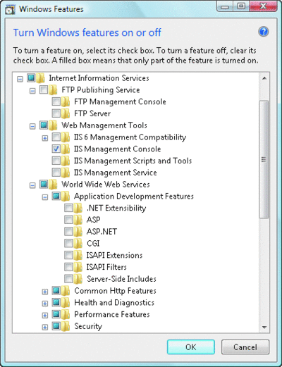
IIS 7.0
Delivered with Windows Vista and 2008 Server
Breaks down the Web server into a core and more than 40 pluggable “feature modules”
  Deploy minimal foot-print servers for specialized roles
  Minimize attack surface
  Improve performance
  Extend with your own
  www.iis.net

Slide 117
Configuration
Configuration is based on distributed XML files
  Global applicationHost.config
  Distributed web.config files for each application in its own directory structure (similar to ASP.NET)
  Configuration can easily be copied
  Configuration can be read from a network share

Slide 118
Administration
New graphical IIS Manager admin tool
  Including advanced monitoring and diagnostics
  Supporting remote administration (HTTP/SSL)
  Providing delegated management of individual applications without administrative access to the server
  Augmented by the appcmd.exe command-line tool

Slide 119
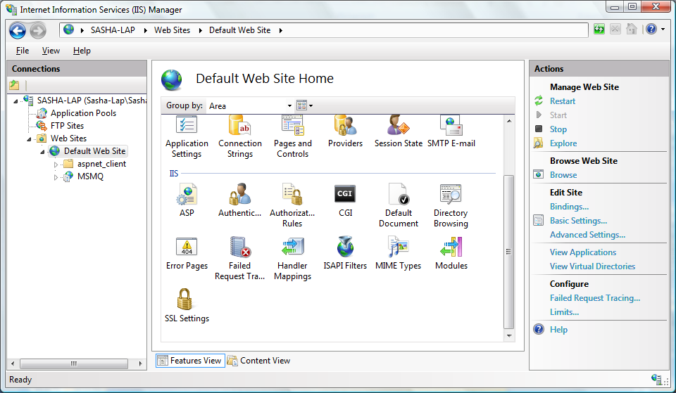
IIS Manager
Notes:
Delegation – server level, Feature Delegation (can be done to site level)
Define users (Windows or IIS Manager users)

Slide 120
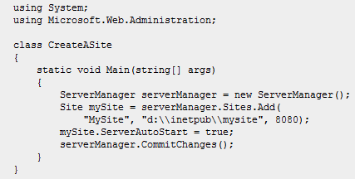
Programmability
Programmatic administration:
  Microsoft.Web.Administration (.NET)
  IIS Configuration COM API, WMI and more
ServerManager iisManager = new ServerManager();
foreach(WorkerProcess w3wp in iisManager.WorkerProcesses) {
Console.WriteLine("W3WP ({0})", w3wp.ProcessId);
foreach(Request request in w3wp.GetRequests(0)) {
Console.WriteLine("{0} - {1},{2},{3}",
request.Url,
request.ClientIPAddr,
request.TimeElapsed,
request.TimeInState);
}
}

Slide 121
Extensibility
Abandoning the ISAPI architecture
Every feature can be extended and customized
ASP.NET full-scale tight integration
  All features exposed to ASP.NET applications
Maintaining backwards compatibility
  Should run most applications without modification
  Uses an emulation layer for almost all features
  Check out the ASP.NET compatibility whitepaper: http://iis.net/default.aspx?tabid=2&subtabid=25&i=1223

Slide 122
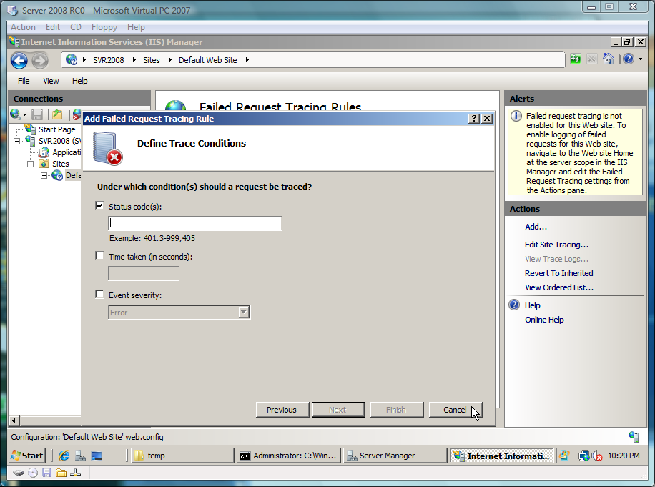
Tracing
IIS Manager offers prescriptive guidance
Runtime diagnostic information
Set up rules for log tracing and events
Notes:
Configure diagnostics and look at the logs (%systemdrive%\inetpub\logs)

Slide 123
Usage Examples
Examples:
  Preventing web leeches from hot-linking to your site’s images (ASP.NET integrated module)
    http://mvolo.com/2006/11/10/stopping-hotlinking-with-iis-and-aspnet.aspx
  Adding a module to IIS manager
    http://www.iis.net/articles/view.aspx/IIS7/Extending-IIS7/Extending-IIS-Manager/How-to-Create-a-Simple-IIS-Manager-Module
  Adding copyright text to images served, with caching
    Demo!
  Throttling media transfer to the playback rate (minimizes bandwidth costs)
    http://www.iis.net/articles/view.aspx/IIS7/Managing-IIS7/Media-in-IIS7/Bit-Rate-Throttling-Configuration-Walkthrough
Notes:
Create web site based on C:\inetpub\CopyrightImages
Enable directory browsing
Add handler for JPG files
Test in IE
Add output caching for JPG files
Test in IE

Slide 124
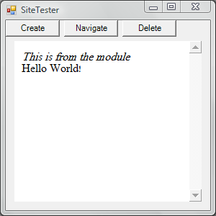
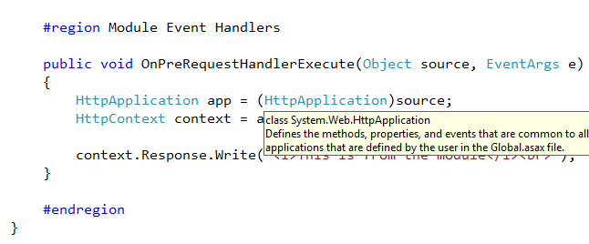
Demo
Writing a Managed IIS7 Module

Slide 125
Summary
Intro
RM
KTM
Threading
Synch
I/O
Network
Task Sched
IIS
MMC
Summary

Slide 126
Summary
Reliability
Application Restart and Recovery
Restart Manager
Kernel Transactions Support
Optimizations
Synchronization Mechanisms
Threading and Scheduling
I/O and Networking
Next Generation TCP/IP Stack
I/O Optimizations
Management
Task Scheduler 2.0
ReadyBoost, ReadyBoot, SuperFetch, ReadyDrive
MMC 3.0
IIS 7.0

Slide 127




















Windows Vista and Server 2008
Better Together
More Efficient Management
Single worldwide servicing model
Event forwarding between client and server
Faster and more reliable remote OS deployments
Network Access Protection ensures health of connecting systems
☑
Greater Availability
Scalable print servers with client-side rendering
Seamless offline experience with client side caching
Policy-based Quality of Service to prioritize application bandwidth
Faster Communications
Fast enterprise class search on clients and servers
Faster networking with new TCP/IP stack and native IPv6
Improved file-sharing performance over high-latency links
Seamless remote access to internal applications and resources
Notes:
Because Windows Vista and Windows Server “Longhorn” are built as part of a single development project, they share a number of new technologies across networking, storage, security and management. Although many of these enhancements apply to either Windows Vista or Windows Server “Longhorn”, when organizations deploy both operating systems, they will see how the combined client-server infrastructure provides even greater advantages.
IT professionals who are administering a Windows Vista / Windows Server “Longhorn” infrastructure will notice many improvements in how they control and manage their environment.
Maintenance is greatly simplified by the use of a single model for updates and service packs across client and server.
Client computers can monitor for specific events and forward to Windows Server “Longhorn” for centralized monitoring and reporting.
Windows Deployment Services provides much faster and more reliable operating system deployment.
Network Access Protection features on Windows Server “Longhorn” ensure that Windows Vista clients connecting to the network are compliant with security policies and restricted from accessing network resources if not.
The reliability, scalability and overall responsiveness of the infrastructure are greatly increased by improvements made to both Windows Vista and Windows Server “Longhorn”
Clients can render print jobs locally before sending to print servers to reduce the load on the server and increase its availability.
Server resources are cached locally so that they are available even if the server is not, with copies automatically updating when the client and server are reconnected.
Applications or scripts that need to run on both client and server can take advantage of the Transactional File System to reduce the risk of error during file and registry operations and roll back to a known good state in the event of failure or cancellation.
Policies can be created to ensure greater Quality of Service for certain applications or services that require prioritization of network bandwidth between client and server.
Windows Vista clients connecting to networks where Windows Server “Longhorn” has been deployed can experience greatly improved communication speeds and reliability.
Searching Windows Server “Longhorn” servers from a Windows Vista client avails of enhanced indexing and caching technologies on both to provide huge performance gains across the enterprise.
Native IPv6 support across all client and server services creates a more scalable and reliable network, while the rewritten TCP/IP stack makes network communication much faster and efficient.
The new Server Message Block 2.0 protocol provides a number of communication enhancements, including greater performance when connecting to file shares over high-latency links and better security through the use of mutual authentication and message signing.
Terminal Services on Windows Server “Longhorn” have many improvements, including providing Windows Vista clients with remote access to internal resources through an HTTP gateway and seamless remote applications that run as if on the local desktop.
-------------------------------WDS-------------------------------------------
After your systems engineers design the client platform, you need to find a way to deploy the application to all your computers. With previous versions of Windows, most enterprises used a technique called imaging, in which an operating system and applications are deployed to computers as a single file. With Longhorn, everyone will use imaging, even if you decide to install Longhorn one-at-a-time by walking to every computer with a CD-ROM in your hand. You won’t have to do that, though, because Longhorn makes automated deployments and migrations easy.
First, the Windows Imaging Format (WIM) makes imaging a breeze compared with non-Microsoft tools you might have used in the past. A single image will work on almost any hardware, without any regional restrictions. So, you won’t need to maintain as many images, which should save you huge amounts of time. You can even add drivers, components, and updates to images without starting the imaged operating system, which should save you hours each time there’s an update. For a more thorough discussion about Longhorn deployment improvements, read Jerry Honeycutt’s article “Disk Imaging with XImag”
----------------------------------RECOVERY AND TROUBLESHOOTING------------------------------------------
Every support center operator has been forced to work late at some point because an executive was having problems with his or her computer and absolutely had to get the problem fixed that night. Longhorn won’t make executives less demanding, but it will help you solve their problems faster and might even fix the problem before the executive has his or her assistant call you.
Help files in Longhorn are much more usable, and almost any user should be able to understand them—even the executives. You can add your own content to Help and Support Center so that users can get assistance with both internal network resources and custom applications. Troubleshooting tools can be customized, and you can escalate unresolved problems directly to your internal support center. Error messages in Longhorn are more meaningful than in earlier versions of Windows and will help users troubleshoot simple problems for themselves, instead of requiring them to call you.
Longhorn is designed to fix some of the most serious problems automatically. For example, if system files become corrupted, Windows XP might simply refuse to start. Longhorn, however, can automatically fail over to a recovery partition. Longhorn then presents the user with Startup Repair (StR), a step-by-step, diagnostics-based troubleshooter. StR analyzes startup logs to determine the cause of the failure and can automatically resolve many problems. If StR is unable to resolve a problem, an administrator can choose to roll back the system to the last known working state. If StR can’t recover the system, StR provides the user with diagnostic information and support options to make troubleshooting easier

Slide 128
Take the Next Step
Give Windows 2008 Server a try!
  Windows 2008 Server homepage
  http://www.microsoft.com/windowsserver2008/default.mspx
Scheduled launch: February 27, 2008
  Together with Visual Studio 2008 and SQL Server 2008 (CTP)

Slide 129
Most existing applications will greatly benefit with no modification.

Slide 130
Thank You!
Sasha Goldshtein
Senior Consultant, Sela Group
http://blogs.microsoft.co.il/blogs/sasha
sashag@sela.co.il

