Slide 1
Auckland
Daylight Savings 2007
Bradley Borrows
Technical Account Manager

Slide 2
Agenda
Overview
What is affected
What is the impact
What is Microsoft doing
What do you need to do
Commonly asked questions
Open Forum
Notes:
My goal of this session to make you, the IT professional aware of the upcoming daylight savings changes for New Zealand
And for you to ask the following questions internally and externally:
“What we doing about Daylight savings:
“what are your suppliers /vendors doing about getting there products ready for the Daylight Savings changes”

Slide 3
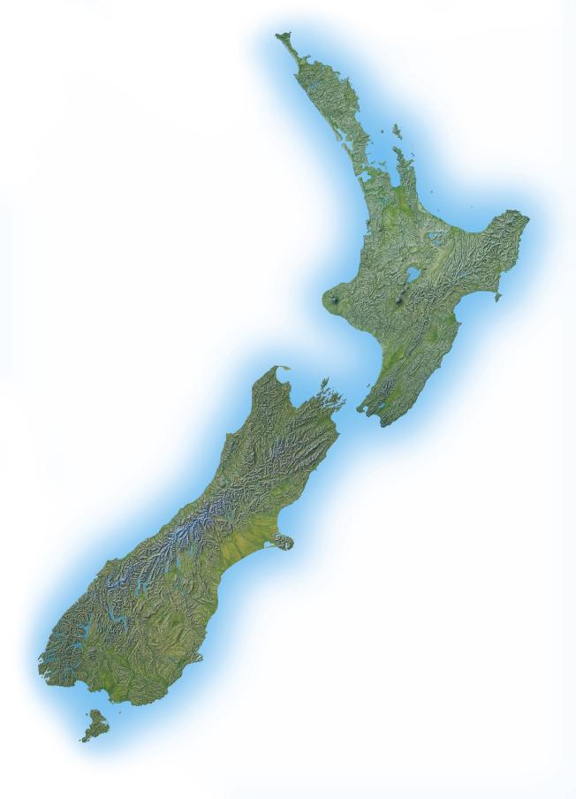
Overview DST 2007
Previous DST Start
First Sunday of October | October 7th 2007
New DST Start
Last Sunday of September | September 30th 2007
Previous DST End
Third Sunday in March | March 22nd 2008
New DST End
First Sunday in April | April 6th 2008
Notes:
History:
In April 2007 the New Zealand Government announced an update to the Time Act of 1974. This update changes the dates of both the start and end of daylight saving time (DST). When this law goes into effect in 2007, DST will start one week earlier (2:00 A.M. on the 30th September 2007) and will end two weeks later (3:00 A.M. on 6th April 2008) than past years.
Background
I’d like to speak to you about an issue which started out as a piece of well-intended legislation (like it always is) here in New Zealand and the potential implications for organizations around the planet who have operations or conduct business with New Zealand branches or customers.
Before we dive into this topic, I just want to ask a quick question for the audience:
How many of your organizations are planning or have plans in place to remediate some of the impacts to your systems due to the change?

Slide 4
What are the key areas affected
Operating System Clocks
Scheduling and Calendaring
Time dependant applications (Date / Time calculations)
Notes:
As you think about your portfolio of applications consider how many of them are time-sensitive?
Operating Systems:
Un patched Operating Systems will write the wrong time stand onto files , it will present the wrong Date, time stamp to applications that read off the system Clock
Scheduling and Calendaring:
Whilst the immediate impact will be on users appointments and resources the potential exposure can be much deeper think about companies that use Travel booking and scheduling applications.
Backups, Batch jobs set to run at midnight will now execute an hour early and truncate the first day of DST2007 by an hour – a 23-hour computer day will not pass muster in a 24-hour legal world.
Time Dependant applications (Date / Time calculations):
Accurate tracking the correct local date and time can affect the intended behavior of applications. If you think about systems that relay on transaction log (e.g., ATMs) these the legal record of the transactions; having them off by an hour can create legal exposure.

Slide 5
What is impacted by this change?
Consumer
Computer &
Network
Infrastructure
Scheduling &
Calendar
Date Calculations
Activity Tracking
Increasing Complexity to Remediate DST Changes
Notes:
This is a technology time line, the impacts of Daylight Savings 2007 change can be grouped into 5 categories of systems that may be affected.
Note that in some cases, systems and applications may need to be updated directly, while in others, the application may simply inherit or “read” the date and time information from the underlying system that it resides on so the changes need only be made to that underlying system.
In many cases, the DST 2007 change will be a relatively minor nuisance. Users may need to manually adjust the time on their devices when the change occurs.
In other cases, there could be confusion and a loss of productivity as scheduling and calendar environments are impacted.
Lastly, there may be significant business implications for the impact of the DST 2007 change in select industries or applications where synchronization of time is important.
Given the broad range of technology in use today, business and IT managers should determine what if any actions should be taken to mitigate the impact of DST 2007 on their organizations.

Slide 6
Category: Consumer Devices
Notes:
Any device that provides date and time functionality that end users or consumers may use.
During the transition window, if these devices are not updated with the correct DST information, notifications will not occur when they should
If you program your personal video recorder to record your favorite show, it will be an hour off.

Slide 7
Category: Computer and Network Infrastructure
Notes:
All computer equipment which maintain it’s own automatic calendars (and hence, their own DST tables) will require updates.
Windows:
Non-patched machines, file date/time stamps will be off
Applications reading the system time will get wrong time
Note: AD and Kerberos use UTC for timestamps – unaffected by DST change

Slide 8
Category: Scheduling / Calendar Applications & Services
Notes:
Messaging applications that include calendar or schedule functionality or standalone calendar tools that organizations use.
These include systems such as transportation or cargo scheduling applications where multiple legs need to be coordinated across different environments.
These may include system task/ job schedulers or other maintenance tools which are scheduled to run at specific times or intervals. Some examples would be system backup tools, virus scanning, scheduled archiving tools, storage compaction / management.
Scheduling and calendars will be off by 1 hour. For corporate users this will have an announce but for organisations that relay on scheduling to make sure that people, machines or good are there on time then this will have more of an impact.
Other key areas to think to about are scheduled jobs and backups/
Exchange:
Certain types (recurring specifically) of new calendar items created via CDO (used by OWA, various connectors, various 3rd party applications like RIM) will be incorrectly offset
Message auditing and retention rules will be off by 1 hour
It is possible that spurious conflicts will be created since meetings will be shifted at different times by different organizers
Outlook:
Appointments and meetings will appear one hour earlier than they should
All-day events will shift and span two days. Existing all-day events are associated with 24 specific hours instead of a given date.
3rd-party utilities that use CDO on the client will be off by 1 hour (Palm, Blackberry, etc…)

Slide 9
Category: Date Calculations
Notes:
During the transition windows for the DST 2007 changes for instance, the total number of hours from 30/8/07 to 3/15/07 would be different depending upon whether the application is performing calculations based on DST 2005 or DST 2007 (there is 1 less hour). While this may not seem like much, imagine compound interest calculations done using hours.
Another example might be the tariff systems popular with many mobile operators where there are time periods during the day where calls from mobile phones are charged different rates or where there are bulk usage plans. The shift or offset during the transition windows for DST 2007 may have a significant impact on how billing and accounting is done for these types of usage plans.
Note that for many computer systems, DST information is “stateless” so that the date / time calculations assume that the calendar has always been that way. What this means is that applications that need to use date and time information spanning multiple years may interpret information incorrectly. For example, if you schedule a recurring meeting from March 10th 2005 through March 10th 2007 at 2:00 pm in PST, how would it be displayed before and after the DST 2007 updates to the system?

Slide 10
Category: Activity Tracking / Logging
Notes:
An area where the correct handling of date and time information is vital is where activity logging is done for audit or regulatory compliance.
For instance, certain types of applications used in manufacturing, financial services or Emergency Services such as automated bank machine transactions or Call Center applications log events with date and time information.
I finally want to highlight one of the more extreme examples, but it could happen. Imagine what could happen if a ATM environment has not been made aware of the new daylight saving time?

Slide 11
Microsoft Affected Products
Mainstream Support
  DST 2007 updates will be provided for free
  Requires current supported service pack
Windows Client | Windows Server | Windows Mobile | Sharepoint Services | Exchange Server | Office Outlook
Dynamics CRM | Biztalk Server | Commerce Server | SQL Notification Services | Visual Studio | Entourage
Extended Support
DST 2007 updates can be purchased under this program for products under Extended Support.
Windows Client 2000 | Windows Server 2000 | Exchange 2000 | Outlook (CDO)
Custom Support
DST 2007 updates can be purchased under this program , this does not include Service Pack Custom Support..
Windows NT 4.0 | Exchange 5.5
Notes:
Microsoft has grouped its affected products into three areas of Support.
Some Key points for the mainstream support:
In the Windows Client space, Windows XP SP2 is the supported OS
Windows Server 2003 SP1 and beyond is supported
Windows Mobile 5 and 6 is supported
Exchange Server 2003 SP2 is supported.
Note: Microsoft provide manual steps for all operating systems
The key point is that products that are in Extended Hotfix support will only receive non security hotfixes as long as a fee is paid for them.
Mainstream Support:
Problem Resolution Support (no-charge incident support, paid incident support, support charged on an hourly basis)
Security update support
The ability to request non-security hotfixes
Extended Support:
All paid incident support options
Security update support at no additional cost
Non-security related hotfix support requires Extended Hot Fix Support. Per-fix fees also apply .
Microsoft will not accept requests for design changes, or new features during the Extended support phase

Slide 12
What is Microsoft’s Response?
Microsoft have produced updates for a number of the products affected by the New Zealand daylight savings changes.
  Remaining updates will be released in the next fortnight.
Guidance
  Knowledge Base Articles
  Deployment guides
  New Zealand focused based DST Website
www.microsoft.co.nz/timezone
Notes:
Currently we have 80% of the updates released.
Once the updates are live we will be looking to get these out to the IT / consumer market by all our available channels.
Update Release Channels
Windows Update/Microsoft Update
Microsoft Download Centre
Briefings to
Tech Ed
Customers
Partners,
Selected EPG accounts
Press & Newsletters
Updates will be released through a combination of channels including Microsoft Customer Support Services (CSS), hotfixes incorporated in Knowledge Base articles, Windows Update, Microsoft Update, Windows Server Update Services (WSUS), and the Microsoft Download Center.

Slide 13
Sample Scenario
Notes:
Whilst the environment highlighted in this slide is simplistic, it highlights the level of patching that will be required to
Some potential considerations that the IT manager responsible for this type of environment would need to look at:
If the DST 2007 changes are deployed into the client devices and servers located in the NZ, would that be sufficient to mitigate this change?

Slide 14
What you need to do and the questions you need to ask?
Review
Check
Risk Analysis ,Plan, Test, Deploy
Communicate
Notes:
Deployment can happen post September 30th 2007
Review your applications and servers
Check with your suppliers, partners, vendors for updates
Risk Analysis ,Action Plan, Test, Deploy
How many employees create or attend meetings scheduled via Outlook?
Do we have vendor applications that are used for scheduling?
Which employees rely on mobile devices to attend meetings as scheduled?
Conduct a Risk Analysis on the impact to your business

Slide 15
Summary
Daylight Savings Starts 30th September
You will need to review more than just your Microsoft products.
Notes:
Review your applications and servers
Check with your suppliers, partners, vendors for updates
Risk Analysis ,Action Plan, Test, Deploy

Slide 16
Commonly asked questions
Does this affect just Microsoft products?
Is this like the Y2K issue?
Is this just a New Zealand Issue?
Notes:
I just wish to get through a few commonly asked questions.
Does this affect just Microsoft products?
I just want to highlight that this is not a Microsoft issue but a IT issue. It as a challenge for IT departments to get the required updates tested and installed before the 30th September
Is this like the Y2K issue?
The answer in short is NO.
Y2K was bug that could of potentially taken down critical systems.
The Daylight Savings changes that we will be discussing today are changes imposed by the government that Microsoft is responding too with updates.
Is this just a New Zealand Issue?
The short answer is “No”. Organizations and companies with locations, customers, users in New Zealand will need to take corrective action. This not only includes large multinational organizations but has the potentially to extend across to international banks, transportation companies branch offices where there IT is localized here in NZ.
With globalization it is also the case that many applications and services that companies rely on are not necessarily managed in the local area where the end users are; in fact they may be located in a data center almost anywhere across the globe.

Slide 17
Open Forum www.microsoft.co.nz/timezone

Slide 18

© 2007 Microsoft Corporation. All rights reserved. Microsoft, Windows, Windows Vista and other product names are or may be registered trademarks and/or trademarks in the U.S. and/or other countries.
The information herein is for informational purposes only and represents the current view of Microsoft Corporation as of the date of this presentation. Because Microsoft must respond to changing market conditions, it should not be interpreted to be a commitment on the part of Microsoft, and Microsoft cannot guarantee the accuracy of any information provided after the date of this presentation.
MICROSOFT MAKES NO WARRANTIES, EXPRESS, IMPLIED OR STATUTORY, AS TO THE INFORMATION IN THIS PRESENTATION.

