Slide 1
Administration and management of Windows-based clusters
Windows HPC Server 2008
Matej Ciesko
HPC Consultant, PM
v-macies@microsoft.com

Slide 2
Agenda
Introduction and Architecture
Management (Demo)
Top500 Supercomputer
Platform integration (Demo)

Slide 3
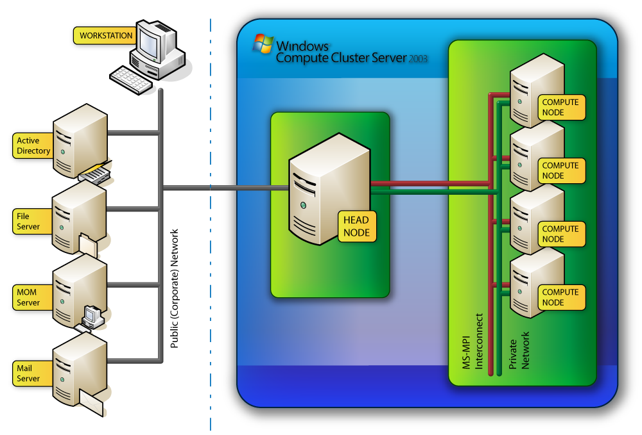
High-Performance Cluster Architecture

Slide 4
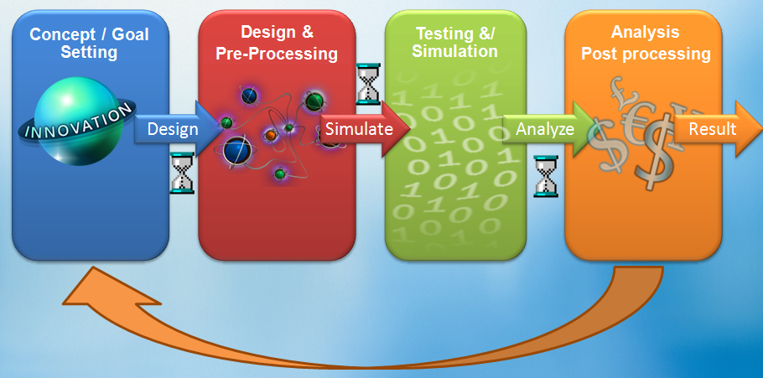
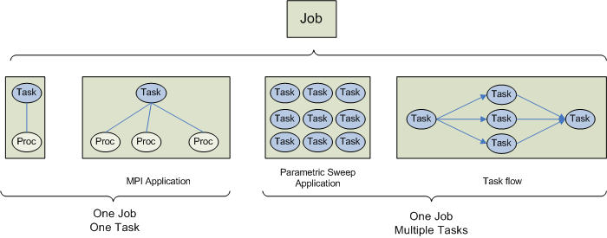
HPC Job

Slide 5
Scheduler Architecture
Job Validation
Resource Allocation
Resource Controller
Admins
Scheduler Store
Compute Nodes
Users

Slide 6
What’s new in the V2 Job Scheduler?
New Scheduling Policies
Heterogeneous Scheduling
Grow and Shrink
Service-Oriented Application Support
A new class of more interactive applications
Simplifies development of in-house cluster applications
Interoperability
Support for the OGF HPC Basic Profile
Pre-Emption
Node/Socket/Core Scheduling
Job Templates
Integration with 3rd party Job Schedulers
Integration between Windows and *Nix clusters

Slide 7
Submitting the job on 9472 cores
Start time < 2 seconds
Id : 584
JobTemplate : Default
Priority : Normal
JobType : Batch
NodeGroups :
OrderBy :
State : Finished
Name :
UserName : CCE\jeffb
Project :
RequestedNodes :
ResourceRequest : 9472-9472 cores
MinMemory :
MaxMemory :
AllocatedNodes : ABE0001,ABE0002,ABE0003,ABE0004,ABE0005,ABE0006,ABE0007,ABE0008,ABE0009,ABE0010,ABE0011,ABE0012,ABE0013,ABE0014,ABE0015,ABE0016,ABE0017,ABE0018,ABE0019,ABE0020,ABE0021,ABE0022,ABE0023,ABE0024,ABE0025,ABE0026,ABE0027,ABE0028,ABE0029,ABE0030,ABE0031,ABE0032,ABE0033,ABE0034,ABE0035,ABE0036,ABE0037,ABE0038,ABE0039,ABE0040,ABE0041,ABE0042,ABE0043,ABE0044,ABE0045,ABE0046,ABE0047,ABE0048,ABE0049,ABE0050,ABE0051,ABE0052,ABE0053,ABE0054,ABE0055,ABE0056,ABE0057,ABE0058,ABE0059,ABE0060,ABE0061,ABE0062,ABE0063,ABE0064,ABE0065,ABE0066,ABE0067,ABE0068,ABE0069,ABE0070,ABE0071,ABE0072,ABE0073,ABE0074,ABE0075,ABE0076,ABE0077,ABE0078,ABE0079,ABE0080,ABE0081,ABE0082,ABE0083,ABE0084,ABE0085,ABE0086,ABE0087,ABE0088,ABE0089,ABE0090,ABE0091,ABE0092,ABE0093,ABE0094,ABE0095,ABE0096,ABE0097,ABE0098,ABE0099,ABE0100,ABE0101,ABE0102,ABE0103,ABE0104,ABE0105,ABE0106,ABE0107,ABE0108,ABE0109,ABE0110,ABE0111,ABE0112,ABE0113,ABE0114,ABE0115,ABE0116,ABE0117,ABE0118,ABE0119,ABE0120,ABE0121,ABE0122,ABE0123,ABE0124,ABE0125,ABE0126,ABE0127,ABE0128,ABE0129,ABE0130,ABE0131,ABE0132,ABE0133,ABE0134,ABE0135,ABE0136,ABE0137,ABE0138,ABE0139,ABE0140,ABE0141,ABE0142,ABE0143,ABE0144,ABE0145,ABE0146,ABE0147,ABE0148,ABE0149,ABE0150,ABE0151,ABE0152,ABE0153,ABE0154,ABE0155,ABE0156,ABE0157,ABE0158,ABE0159,ABE0160,ABE0161,ABE0162,ABE0163,ABE0164,ABE0165,ABE0166,ABE0167,ABE0168,ABE0169,ABE0170,ABE0171,ABE0172,ABE0173,ABE0174,ABE0175,ABE0176,ABE0177,ABE0178,ABE0179,ABE0180,ABE0181,ABE0182,ABE0183,ABE0184,ABE0185,ABE0186,ABE0187,ABE0188,ABE0189,ABE0190,ABE0191,ABE0192,ABE0193,ABE0194,ABE0195,ABE0196,ABE0197,ABE0198,ABE0199,ABE0200,ABE0201,ABE0202,ABE0203,ABE0204,ABE0205,ABE0206,ABE0207,ABE0208,ABE0209,ABE0210,ABE0211,ABE0212,ABE0213,ABE0214,ABE0215,ABE0216,ABE0217,ABE0218,ABE0219,ABE0220,ABE0221,ABE0222,ABE0223,ABE0224,ABE0225,ABE0226,ABE0227,ABE0228,ABE0229,ABE0230,ABE0231,ABE0232,ABE0233,ABE0234,ABE0235,ABE0236,ABE0237,ABE0238,ABE0239,ABE0240,ABE0241,ABE0242,ABE0243,ABE0244,ABE0245,ABE0246,ABE0247,ABE0248,ABE0249,ABE0250,ABE0251,ABE0252,ABE0253,ABE0254,ABE0255,ABE0256,ABE0257,ABE0258,ABE0259,ABE0260,ABE0261,ABE0262,ABE0263,ABE0264,ABE0265,ABE0266,ABE0267,ABE0268,ABE0269,ABE0270,ABE0271,ABE0272,ABE0273,ABE0274,ABE0275,ABE0276,ABE0277,ABE0278,ABE0279,ABE0280,ABE0281,ABE0282,ABE0283,ABE0284,ABE0285,ABE0286,ABE0287,ABE0288,ABE0289,ABE0290,ABE0291,ABE0292,ABE0293,ABE0294,ABE0295,ABE0296,ABE0297,ABE0298,ABE0299,ABE0300,ABE0301,ABE0302,ABE0303,ABE0304,ABE0305,ABE0306,ABE0307,ABE0308,ABE0309,ABE0310,ABE0311,ABE0312,ABE0313,ABE0314,ABE0315,ABE0316,ABE0317,ABE0318,ABE0319,ABE0320,ABE0321,ABE0322,ABE0323,ABE0324,ABE0325,ABE0326,ABE0327,ABE0328,ABE0329,ABE0330,ABE0331,ABE0332,ABE0333,ABE0334,ABE0335,ABE0336,ABE0337,ABE0338,ABE0339,ABE0340,ABE0341,ABE0342,ABE0343,ABE0344,ABE0345,ABE0346,ABE0347,ABE0348,ABE0349,ABE0350,ABE0351,ABE0352,ABE0353,ABE0354,ABE0355,ABE0356,ABE0357,ABE0358,ABE0359,ABE0360,ABE0361,ABE0362,ABE0363,ABE0364,ABE0365,ABE0366,ABE0367,ABE0368,ABE0369,ABE0370,ABE0371,ABE0372,ABE0373,ABE0374,ABE0375,ABE0376,ABE0377,ABE0378,ABE0379,ABE0380,ABE0381,ABE0382,ABE0383,ABE0384,ABE0385,ABE0386,ABE0387,ABE0389,ABE0390,ABE0391,ABE0392,ABE0393,ABE0394,ABE0395,ABE0396,ABE0397,ABE0398,ABE0399,ABE0400,ABE0401,ABE0402,ABE0403,ABE0404,ABE0405,ABE0406,ABE0407,ABE0408,ABE0409,ABE0410,ABE0411,ABE0412,ABE0413,ABE0414,ABE0415,ABE0416,ABE0417,ABE0418,ABE0419,ABE0420,ABE0421,ABE0422,ABE0423,ABE0424,ABE0425,ABE0426,ABE0427,ABE0428,ABE0429,ABE0430,ABE0431,ABE0432,ABE0433,ABE0434,ABE0435,ABE0436,ABE0437,ABE0438,ABE0439,ABE0440,ABE0441,ABE0442,ABE0443,ABE0444,ABE0445,ABE0446,ABE0447,ABE0448,ABE0449,ABE0450,ABE0451,ABE0452,ABE0453,ABE0454,ABE0455,ABE0456,ABE0457,ABE0458,ABE0459,ABE0460,ABE0461,ABE0462,ABE0463,ABE0464,ABE0465,ABE0466,ABE0467,ABE0468,ABE0469,ABE0470,ABE0471,ABE0472,ABE0473,ABE0474,ABE0475,ABE0476,ABE0477,ABE0478,ABE0479,ABE0480,ABE0481,ABE0482,ABE0483,ABE0484,ABE0485,ABE0486,ABE0487,ABE0488,ABE0489,ABE0490,ABE0491,ABE0492,ABE0493,ABE0494,ABE0495,ABE0497,ABE0498,ABE0499,ABE0500,ABE0501,ABE0502,ABE0503,ABE0504,ABE0507,ABE0508,ABE0509,ABE0510,ABE0511,ABE0512,ABE0513,ABE0514,ABE0515,ABE0516,ABE0517,ABE0518,ABE0519,ABE0520,ABE0521,ABE0522,ABE0523,ABE0524,ABE0525,ABE0526,ABE0527,ABE0528,ABE0529,ABE0530,ABE0531,ABE0532,ABE0533,ABE0534,ABE0535,ABE0536,ABE0537,ABE0538,ABE0539,ABE0540,ABE0541,ABE0542,ABE0543,ABE0544,ABE0545,ABE0546,ABE0547,ABE0548,ABE0549,ABE0550,ABE0551,ABE0552,ABE0553,ABE0554,ABE0555,ABE0556,ABE0557,ABE0558,ABE0559,ABE0560,ABE0561,ABE0562,ABE0563,ABE0564,ABE0565,ABE0566,ABE0567,ABE0568,ABE0569,ABE0570,ABE0571,ABE0572,ABE0573,ABE0574,ABE0575,ABE0576,ABE0577,ABE0578,ABE0579,ABE0580,ABE0581,ABE0582,ABE0583,ABE0584,ABE0585,ABE0586,ABE0587,ABE0588,ABE0589,ABE0590,ABE0591,ABE0592,ABE0593,ABE0594,ABE0595,ABE0596,ABE0597,ABE0598,ABE0599,ABE0600,ABE0601,ABE0602,ABE0603,ABE0604,ABE0605,ABE0606,ABE0607,ABE0608,ABE0609,ABE0610,ABE0611,ABE0612,ABE0613,ABE0614,ABE0615,ABE0616,ABE0617,ABE0618,ABE0619,ABE0620,ABE0621,ABE0622,ABE0623,ABE0624,ABE0625,ABE0626,ABE0627,ABE0628,ABE0629,ABE0630,ABE0631,ABE0632,ABE0633,ABE0634,ABE0635,ABE0636,ABE0637,ABE0638,ABE0639,ABE0640,ABE0641,ABE0642,ABE0643,ABE0646,ABE0647,ABE0648,ABE0649,ABE0650,ABE0651,ABE0652,ABE0653,ABE0654,ABE0655,ABE0656,ABE0657,ABE0658,ABE0659,ABE0660,ABE0661,ABE0662,ABE0663,ABE0664,ABE0665,ABE0666,ABE0667,ABE0668,ABE0669,ABE0670,ABE0671,ABE0672,ABE0673,ABE0674,ABE0675,ABE0676,ABE0677,ABE0678,ABE0679,ABE0680,ABE0681,ABE0682,ABE0683,ABE0684,ABE0685,ABE0686,ABE0687,ABE0688,ABE0689,ABE0690,ABE0691,ABE0692,ABE0693,ABE0694,ABE0695,ABE0696,ABE0697,ABE0698,ABE0699,ABE0700,ABE0701,ABE0703,ABE0704,ABE0705,ABE0706,ABE0707,ABE0708,ABE0709,ABE0710,ABE0711,ABE0712,ABE0713,ABE0714,ABE0715,ABE0716,ABE0717,ABE0718,ABE0719,ABE0720,ABE0721,ABE0722,ABE0723,ABE0724,ABE0725,ABE0726,ABE0727,ABE0728,ABE0730,ABE0731,ABE0732,ABE0733,ABE0734,ABE0735,ABE0736,ABE0737,ABE0738,ABE0739,ABE0740,ABE0741,ABE0742,ABE0743,ABE0744,ABE0745,ABE0746,ABE0747,ABE0748,ABE0749,ABE0750,ABE0751,ABE0752,ABE0753,ABE0754,ABE0755,ABE0756,ABE0757,ABE0758,ABE0759,ABE0760,ABE0761,ABE0762,ABE0763,ABE0764,ABE0765,ABE0766,ABE0767,ABE0768,ABE0769,ABE0770,ABE0771,ABE0772,ABE0773,ABE0774,ABE0775,ABE0776,ABE0777,ABE0778,ABE0779,ABE0780,ABE0781,ABE0782,ABE0783,ABE0784,ABE0785,ABE0786,ABE0787,ABE0788,ABE0789,ABE0790,ABE0791,ABE0792,ABE0793,ABE0794,ABE0795,ABE0796,ABE0797,ABE0798,ABE0799,ABE0800,ABE0801,ABE0802,ABE0803,ABE0804,ABE0805,ABE0806,ABE0807,ABE0808,ABE0809,ABE0810,ABE0812,ABE0813,ABE0814,ABE0815,ABE0816,ABE0817,ABE0818,ABE0819,ABE0820,ABE0821,ABE0822,ABE0823,ABE0824,ABE0825,ABE0826,ABE0827,ABE0828,ABE0829,ABE0830,ABE0831,ABE0832,ABE0833,ABE0834,ABE0835,ABE0836,ABE0837,ABE0838,ABE0839,ABE0840,ABE0841,ABE0842,ABE0843,ABE0844,ABE0845,ABE0846,ABE0847,ABE0848,ABE0849,ABE0850,ABE0851,ABE0852,ABE0853,ABE0854,ABE0855,ABE0856,ABE0857,ABE0858,ABE0859,ABE0860,ABE0861,ABE0862,ABE0863,ABE0864,ABE0865,ABE0866,ABE0867,ABE0868,ABE0869,ABE0870,ABE0871,ABE0872,ABE0873,ABE0874,ABE0875,ABE0876,ABE0877,ABE0878,ABE0879,ABE0880,ABE0881,ABE0882,ABE0883,ABE0884,ABE0885,ABE0886,ABE0887,ABE0888,ABE0889,ABE0890,ABE0891,ABE0892,ABE0893,ABE0894,ABE0895,ABE0896,ABE0897,ABE0898,ABE0899,ABE0900,ABE0901,ABE0902,ABE0903,ABE0904,ABE0905,ABE0906,ABE0907,ABE0908,ABE0909,ABE0910,ABE0911,ABE0912,ABE0913,ABE0914,ABE0915,ABE0916,ABE0917,ABE0918,ABE0919,ABE0920,ABE0921,ABE0922,ABE0923,ABE0924,ABE0925,ABE0926,ABE0927,ABE0928,ABE0929,ABE0930,ABE0931,ABE0932,ABE0933,ABE0934,ABE0935,ABE0936,ABE0937,ABE0938,ABE0939,ABE0940,ABE0941,ABE0942,ABE0943,ABE0944,ABE0945,ABE0946,ABE0947,ABE0948,ABE0949,ABE0950,ABE0951,ABE0952,ABE0953,ABE0954,ABE0955,ABE0956,ABE0957,ABE0958,ABE0959,ABE0960,ABE0961,ABE0962,ABE0963,ABE0964,ABE0965,ABE0966,ABE0967,ABE0968,ABE0969,ABE0970,ABE0971,ABE0972,ABE0973,ABE0974,ABE0975,ABE0976,ABE0977,ABE0978,ABE0979,ABE0980,ABE0981,ABE0982,ABE0983,ABE0984,ABE0985,ABE0986,ABE0987,ABE0988,ABE0989,ABE0990,ABE0991,ABE0992,ABE0993,ABE0994,ABE0995,ABE0996,ABE0998,ABE0999,ABE1000,ABE1001,ABE1002,ABE1003,ABE1004,ABE1005,ABE1006,ABE1007,ABE1008,ABE1009,ABE1010,ABE1011,ABE1012,ABE1013,ABE1014,ABE1015,ABE1016,ABE1017,ABE1018,ABE1019,ABE1020,ABE1021,ABE1022,ABE1023,ABE1024,ABE1025,ABE1026,ABE1027,ABE1028,ABE1029,ABE1030,ABE1031,ABE1032,ABE1033,ABE1034,ABE1035,ABE1036,ABE1037,ABE1038,ABE1039,ABE1040,ABE1041,ABE1042,ABE1043,ABE1044,ABE1045,ABE1046,ABE1047,ABE1048,ABE1049,ABE1050,ABE1051,ABE1052,ABE1053,ABE1054,ABE1055,ABE1056,ABE1057,ABE1058,ABE1059,ABE1060,ABE1061,ABE1062,ABE1063,ABE1064,ABE1065,ABE1066,ABE1067,ABE1068,ABE1069,ABE1070,ABE1071,ABE1072,ABE1073,ABE1074,ABE1075,ABE1076,ABE1077,ABE1078,ABE1079,ABE1080,ABE1081,ABE1082,ABE1083,ABE1084,ABE1085,ABE1086,ABE1087,ABE1088,ABE1089,ABE1090,ABE1091,ABE1092,ABE1093,ABE1094,ABE1095,ABE1096,ABE1097,ABE1098,ABE1099,ABE1100,ABE1101,ABE1102,ABE1103,ABE1104,ABE1105,ABE1106,ABE1107,ABE1108,ABE1109,ABE1110,ABE1111,ABE1112,ABE1113,ABE1114,ABE1115,ABE1116,ABE1117,ABE1118,ABE1119,ABE1120,ABE1121,ABE1122,ABE1123,ABE1124,ABE1125,ABE1126,ABE1127,ABE1128,ABE1129,ABE1131,ABE1132,ABE1133,ABE1134,ABE1135,ABE1136,ABE1137,ABE1138,ABE1139,ABE1140,ABE1141,ABE1142,ABE1143,ABE1144,ABE1145,ABE1146,ABE1147,ABE1148,ABE1149,ABE1150,ABE1151,ABE1152,ABE1153,ABE1154,ABE1155,ABE1156,ABE1157,ABE1158,ABE1159,ABE1160,ABE1161,ABE1162,ABE1163,ABE1164,ABE1165,ABE1166,ABE1167,ABE1168,ABE1169,ABE1170,ABE1171,ABE1172,ABE1173,ABE1174,ABE1175,ABE1176,ABE1177,ABE1178,ABE1179,ABE1180,ABE1181,ABE1182,ABE1183,ABE1184,ABE1185,ABE1186,ABE1187,ABE1188,ABE1189,ABE1190,ABE1191,ABE1192,ABE1193,ABE1194,ABE1195
SubmitTime : 4/1/2008 10:51:53 PM
StartTime : 4/1/2008 10:51:54 PM
EndTime : 4/1/2008 10:58:58 PM
PendingReason :
ChangeTime : 4/1/2008 10:58:58 PM
Wait time : 00:00:00:00
Elapsed time : 00:00:07:04
ErrorMessage :
RequeueCount : 0
TaskCount : 1
ConfiguringTaskCount : 0
QueuedTaskCount : 0
RunningTaskCount : 0
FinishedTaskCount : 1
FailedTaskCount : 0
CanceledTaskCount : 0

Slide 8
Microsoft’s Productivity Vision for HPC
Windows HPC allows you to accomplish more, in less time, with reduced effort by leveraging users existing skills and integrating with the tools they are already using.
Administrator
Application Developer
End - User
Integrated Turnkey HPC Cluster Solution
Simplified Setup and Deployment
Built-In Diagnostics
Efficient Cluster Utilization
Integrates with IT Infrastructure and Policies
Integrated Tools for Parallel Programming
Highly Productive Parallel Programming Frameworks
Service-Oriented HPC Applications
Support for Key HPC Development Standards
Unix Application Migration
Seamless Integration with Workstation Applications
Integration with Existing Collaboration and Workflow Solutions
Secure Job Execution and Data Access

Slide 9
Windows Compute Cluster Server Roadmap
Scalable HPC Fabric
Aristotle V3
TBD
HPC clusters as an IT service
Virtualization: Deployment and operation efficiency
Automation: Failure analysis and capacity planning
Storage: Scalable data-parallel computation
Development: high productive parallel programming
Socrates V2 2008
Mainstream High Performance Computing on Windows platform
New Applications: Service Oriented, Workflows, .NET
Turnkey: Pre-configured OEM solutions, template-based deployment, diagnostics
Scale: Large scale imaging/UI/MPI, node grouping, head node failover, reporting
Interoperability: Job Scheduler through Web Services, Parallel File Systems
Enable Departmental High Performance Computing
Out of the box HPC solution on Windows
Simple to set up and manage in a familiar environment
Leverage existing Windows infrastructure, applications and skills
Supports key ISV and Open Source applications, as well as Excel
CCS V1 2006
Notes:
9

Slide 10
Turnkey Cluster Solution
Overall Cluster Setup
Head node
Compute node
Head node
Install x64
OS
Install
Cluster solution (CCP)
Configure
Network
Configure Node Deployment
Boot
WinPE
Deploy Nodes Image
Run
Diagnostics
Network Configuration Wizard
Configure for install and update of networking drivers on nodes via Deployment Management
Network tests via Diagnostics Wunderbar
Network Setup
ToDoList

Slide 11
Top500 Supercomputers

Slide 12
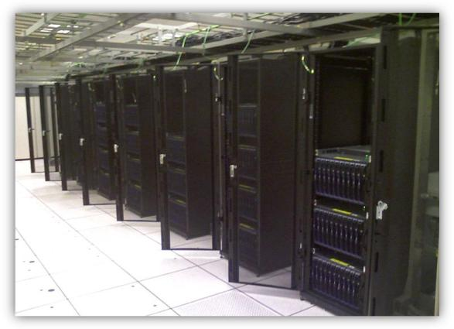
Fall 2008 Top500 Submission
Location | Tukwila, WA
Hardware – Machines | 256 Dual-CPU, quad-core Intel 5320 Clovertown 1.86GHz processors and 8GB RAM
Hardware – Networking | Private & Public: Broadcom GigE MPI: Cisco Infiniband SDR, 34 IB switches in leaf/node configuration
Number of Compute Nodes | 256
Total Number of Cores | 2048
Total Memory | 2 TB of RAM
Particulars of for current Linpack Runs
Best Linpack Result | 11.75 TFLOPS
Best Cluster Efficiency | 77.1%
For Comparison…
Linpack rating from June2007 Top500 run (#106) on the same hardware | 8.99 TFLOPS
Cluster efficiency from June2007 Top500 run (#106) on the same hardware | 59%
Typical Top500 efficiency for Clovertown motherboards w/ IB regardless of Operating System | 65-77% (2 instances of 79%)
30% improvement in efficiency on the same hardware.
About 1 Hour to deploy

Slide 13
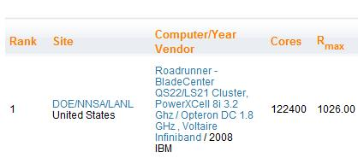
NCSA’s Abe cluster #23 on June 2008 Top500
(http://www.top500.org/list/2008/06/100)

Slide 14
1 second: resources reserved
20 seconds: nodes authenticated and binaries deployed
35 seconds: Linpack run starts
831,816 distinct processor pairs
921 million messages exchanged
53TB of data exchanged

Slide 15
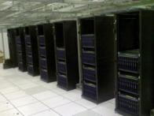
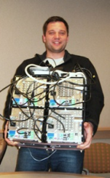
???
NCSA: Spring 2008
V2: 68.5 Tflops, #23,
77+% efficiency
Rainier: Fall 2007
V2: 11.8 Tflops, #116
Rainier: Spring 2007
V1: 9 Tflops, #106
NCSA: Spring 2006
V1: 4.1 Tflops, #130
Shuttle: Winter 2005
V0: 9.46 GFlops

Slide 16
Univ. of Aachen HPL Benchmarks Germany
http://terboven.spaces.live.com/
18 TF and over 75% efficiency
256 nodes, 2048 MPI processes
~ 2 seconds to launch all processes
HPC Server 2008 pre-Beta2

Slide 17
Univ. of Umea HPL Benchmarks Stockholm, Sweden
http://www.top500.org/list/2008/06/100
46 TF and over 85% efficiency
5376 cores
HPC Server 2008 pre-Beta2

Slide 18
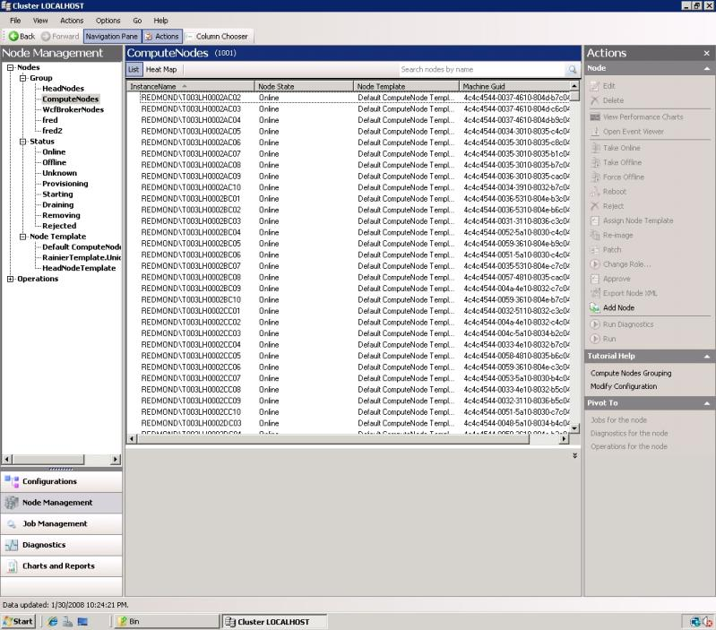
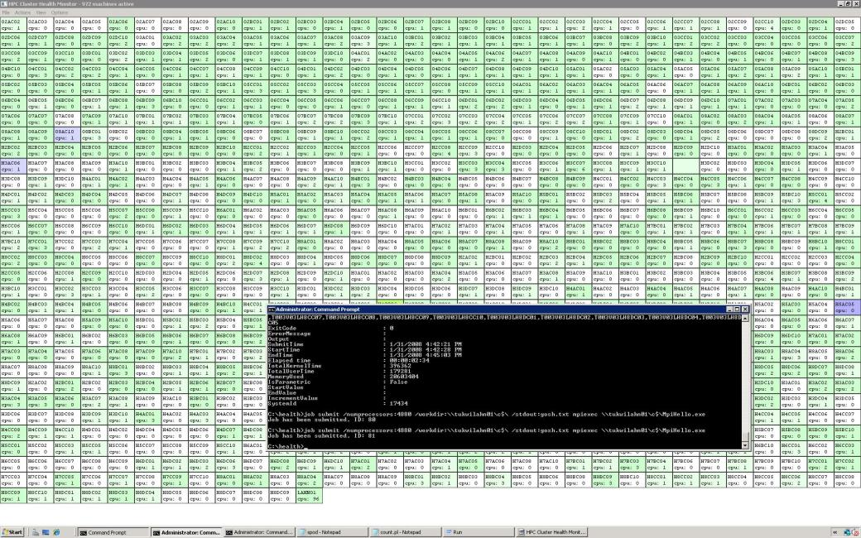
Large Scale Deployments

Slide 19
Resources
Microsoft HPC Web site
http://www.microsoft.com/hpc
Windows HPC Community site
http://www.windowshpc.net
Windows Server x64 information
http://www.microsoft.com/x64/
Windows Server System information
http://www.microsoft.com/windowsserver2003/
Get the Facts Web site
http://www.microsoft.com/getthefacts

Slide 20
© 2004 Microsoft Corporation. All rights reserved.
This presentation is for informational purposes only. Microsoft makes no warranties, express or implied, in this summary.

