Slide 1

Data Patterns in Cloud Computing
Régis Mauger
Infrastructure Architect
regisma@microsoft.com
Pierre Couzy
Technical Architect
piercou@microsoft.com

Slide 2
Data patterns in cloud computing
Best and Worst are sometimes close friends
Where do you store the Data ?
  Azure Storage
    Blobs, Tables and Queues
  A primer on SDS
How do you access the data ?
  REST Interfaces and Ado.Net Data Services
The role of synchronization
  Sync Framework
Towards a standardization of data on the cloud ?

Slide 3





Introduction
Data
People
Data is no longer under your direct control
  70% of IT data lives outside the data center.
What is the current trend ?
Devices
Applications

Slide 4
Data is already “cloudy”
It has been for a long time : think about Outlook and its connection with the enterprise location (OWA / Disconnected use)
It is for a large variety or data. Do you know how we prepared this event ?
Outlook has its rules, policies, administrations tasks, and everything. Not so with Live Mesh ! This talk wants to give you an insight of the techniques and tools you’re about to face in your everyday life so that you are prepared :)

Slide 5
Cloud storage, what options ?
You can host inside Azure
  Bound to an Azure Web app / Worker process
  Table/Queue/Blob
  Think « Azure Application Storage »
You can host on SDS
  Independant from an application
  Open Connectivity through REST interfaces
  Richer capabilities (re
You can host yourself on your DMZ
  Do you have to reinvent the wheel in that case ?

Slide 6




Storage in the Azure world
…
Service
Bus
Workflow
Database
Analytics
Identity
Contacts
Access
Control
…
Reporting
…
Devices
…
Compute
Storage
Manage
…

Slide 7
Windows Azure Storage URLs
Container
Blobs
http://<account>.blob.core.windows.net/<container>
Account
Table
Entities
http://<account>.table.core.windows.net/<table>
Queue
Messages
http://<account>.queue.core.windows.net/<queue>

Slide 8
Windows Azure Storage Account
User creates a globally
unique storage account name
  Receive a 256 bit secret
  key when creating account
Provides security for accessing the store
  Use secret key to create a
  HMAC SHA256 signature for each request
  Use signature to authenticate request at server
Account
Blob
Table
Queue

Slide 9
Windows Azure Storage : blobs
Store large objects (up to 50 GB each)
Standard REST PUT/GET Interface
http://<Account>.blob.core.windows.net/<Container>/<BlobName>
  PutBlob
    Inserts a new blob or overwrites the existing blob
    Support for Continuation on Upload
  GetBlob
    Get whole blob or by starting offset, length
  DeleteBlob
Associate Metadata with Blob
  Metadata is <name, value> pairs
  Up to 8KB per blob

Slide 10
Demo
Blob manipulation on Windows Azure Storage

Slide 11
Blob Namespace
Blob URL
http://<Account>.blob.core.windows.net/<Container>/<BlobName>
Example:
Account – sally
Container – music
BlobName – rock/rush/xanadu.mp3
URL: http://sally.blob.core.windows.net/music/rock/rush/xanadu.mp3
Account
Container
Blob
IMG001.JPG
pictures
IMG002.JPG
sally
movies
MOV1.AVI

Slide 12
Blob Enumeration – Delimiter
Enumerates the list of blobs in a container
  Hierarchical listing: prefix + delimiter
  Continuation: NextMarker + Marker
List top level “directories”
REST Request:
GET http://dvd.blob.windows.net/movies
?comp=list
&delimiter=/
Container “movies” has:
Action/Rocky.avi
Action/Rocky2.avi
Drama/Crime/GodFather.avi
Drama/Crime/GodFather2.avi
Drama/LordOfRings.avi
Thriller/TheBlob.wmv
Container “movies” has:
Action/Rocky1.wmv
Action/Rocky2.wmv
Action/Rocky3.wmv
Action/Rocky4.wmv
Action/Rocky5.wmv
Drama/Crime/GodFather1.wmv
Drama/Crime/GodFather2.wmv
Drama/Memento.wmv
Horror/TheBlob.wmv
Results:
<BlobPrefix>Action</BlobPrefix>
<BlobPrefix>Drama</BlobPrefix>
<BlobPrefix>Horror</BlobPrefix>

Slide 13
Blob Enumeration – Prefix
Enumerates the list of blobs in a container
  Hierarchical listing: prefix + delimiter
  Continuation: NextMarker + Marker
List directory “Drama”:
REST Request:
GET http://dvd.blob.windows.net/movies
?comp=list &prefix=Drama/ &delimiter=/
Container “movies” has:
Action/Rocky1.avi
Action/Rocky2.avi
………
Action/Rocky5.avi
Drama/Crime/GodFather1.avi
Drama/Crime/GodFather2.avi
Drama/Gladiator.avi
Horror/TheBlob.wmv
Container “movies” has:
Action/Rocky1.wmv
Action/Rocky2.wmv
Action/Rocky3.wmv
Action/Rocky4.wmv
Action/Rocky5.wmv
Drama/Crime/GodFather1.wmv
Drama/Crime/GodFather2.wmv
Drama/Memento.wmv
Horror/TheBlob.wmv
Results:
<BlobPrefix>Drama/Crime</BlobPrefix>
<Blob>Drama/Memento.wmv</Blob>

Slide 14
Blob Enumeration – MaxResults
Enumerates the list of blobs in a container
  Hierarchical listing: prefix + delimiter
  Continuation: NextMarker + Marker
Max Results and Next Marker
REST Request:
GET http://dvd.blob.windows.net/movies
?comp=list &prefix=Action &maxresults=3
Container “movies” has:
Action/Rocky1.wmv
Action/Rocky2.wmv
Action/Rocky3.wmv
Action/Rocky4.wmv
Action/Rocky5.wmv
Drama/Crime/GodFather1.wmv
Drama/Crime/GodFather2.wmv
Drama/Memento.wmv
Horror/TheBlob.wmv
Results:
<Blob>Action/Rocky1.wmv</Blob>
<Blob>Action/Rocky2.wmv</Blob>
<Blob>Action/Rocky3.wmv</Blob>
<NextMarker>OpaqueMarker1</NextMarker>

Slide 15
Blob Enumeration – Continuation
Enumerates the list of blobs in a container
  Hierarchical listing: prefix + delimiter
  Continuation: NextMarker + Marker
Using Continuation Marker
REST Request:
GET http://dvd.blob.windows.net/movies
?comp=list &prefix=Action &maxresults=3
&marker=OpaqueMarker1
Container “movies” has:
Action/Rocky1.wmv
Action/Rocky2.wmv
Action/Rocky3.wmv
Action/Rocky4.wmv
Action/Rocky5.wmv
Drama/Crime/GodFather1.wmv
Drama/Crime/GodFather2.wmv
Drama/Memento.wmv
Horror/TheBlob.wmv
Results:
<Blob>Action/Rocky4.wmv</Blob>
<Blob>Action/Rocky5.wmv</Blob>
<NextMarker></NextMarker>

Slide 16
Windows Azure Storage : tables
Tables in Windows Azure Storage are very simple :
  A partition ID (think storage base unit and container scope)
  A Row ID (must be unique at a partition level)
  A list of properties (think columns)
Access can be done with .Net framework 3.5 classes
  System.Data.Services.Client
Partition Key Document Name | Row Key Version | Property 3 Modification Time | ….. | Property N Description
Examples Doc | V1.0 | 8/2/2007 | ….. | Committed version
Examples Doc | V2.0.1 | 9/28/2007 |  | Alice’s working version
FAQ Doc | V1.0 | 5/2/2007 |  | Committed version
FAQ Doc | V1.0.1 | 7/6/2007 |  | Alice’s working version
FAQ Doc | V1.0.2 | 8/1/2007 |  | Sally’s working version

Slide 17
Demo
Table manipulation on Windows Azure Storage

Slide 18
Tables
Tables in Windows Azure Storage are very simple :
  A partition ID (think storage base unit and container scope)
  A Row ID (must be unique at a partition level)
  A list of properties (think columns)

Slide 19
Partition Example
Partition Key Document Name | Row Key Version | Property 3 Modification Time | ….. | Property N Description
Examples Doc | V1.0 | 8/2/2007 | ….. | Committed version
Examples Doc | V2.0.1 | 9/28/2007 |  | Alice’s working version
FAQ Doc | V1.0 | 5/2/2007 |  | Committed version
FAQ Doc | V1.0.1 | 7/6/2007 |  | Alice’s working version
FAQ Doc | V1.0.2 | 8/1/2007 |  | Sally’s working version
Partition
1
Partition
2
Table Partition - all entities in
table with same partition key value
Application controls granularity of partition

Slide 20
Property Types Supported
Partition Key and Row Key
  String (up to 64KB)
Property Types
  String (up to 64KB)
  Binary (up to 64KB)
  Bool
  DateTime
  GUID
  Int
  Int64
  Double

Slide 21
Example Table Definition
Example using ADO.NET Data Services
Table Entities are represented as Class Objects
[DataServiceKey("PartitionKey", "RowKey")]
public class Customer
{
// Partition key – Customer Last name
public string PartitionKey { get; set; }
// Row Key – Customer First name
public string RowKey { get; set; }
// User defined properties here
public DateTime CustomerSince { get; set; }
public double Rating { get; set; }
public string Occupation { get; set; }
}

Slide 22
Create Customers Table
Every Account has a master table called “Tables”
  It is used to keep track of the tables in your account
  To use a table it has to be inserted into “Tables”
[DataServiceKey("TableName")]
public class TableStorageTable
{
public string TableName { get; set; }
}
// serviceUri is “http://<Account>.table.core.windows.net/”
DataServiceContext context = new DataServiceContext(serviceUri);
TableStorageTable table = new TableStorageTable("Customers");
context.AddObject("Tables", table);
DataServiceResponse response = context.SaveChanges();

Slide 23
Create And Insert Entity
Create a new Customer and Insert into Table
Customer cust = new Customer(
“Lee”, // Partition Key = Last Name
“Geddy”, // Row Key = First Name
DateTime.UtcNow, // Customer Since
2.0, // Rating
“Engineer” // Occupation);
// Service Uri is “http://<Account>.table.core.windows.net/”
DataServiceContext context = new DataServiceContext(serviceUri);
context.AddObject(“Customers”, cust);
DataServiceResponse response = context.SaveChanges();

Slide 24
Query A Table
LINQ
DataServiceContext context = new DataServiceContext(“http://myaccount.table.core.windows.net”);
var customers = from o in
context.CreateQuery<Customer>(“Customers”)
where o.PartitionKey == “Lee”
select o;
foreach (Customer customer in customers) { }
REST
GET http://myaccount.table.core.windows.net/Customers?
$filter= PartitionKey eq ‘Lee’

Slide 25
Update And Delete Entity
Customer cust = (
from c in context.CreateQuery<Customer> (“Customers”)
where c.PartitionKey == “Lee” // Partition Key = Last Name
&& c.RowKey == “Geddy” // Row Key = First Name
select c)
.FirstOrDefault();
cust.Occupation = “Musician”;
context.UpdateObject(cust);
DataServiceResponse response = context.SaveChanges();
context.DeleteObject(cust);
DataServiceResponse response = context.SaveChanges();

Slide 26
Azure storage principes
Démos 1 2 et 3 par Régis
Démo 1 : Blob
  Accès par ie
  Interface REST
Démo 2 : table (create table from model)
  RdChat
  Table messages, Name/Body/Timestamp/PartitionKey/RowKey
Démo 3 : queue
  Web+worker

Slide 27
Windows Azure Storage : Queues
Think MSMQ on the Cloud
Queues provide reliable message delivery
  Simple, asynchronous work dispatch
  Programming semantics ensure that a
  message can be processed at least once
Queues are Highly Available,
Durable and Performance Efficient
Access is provided via REST

Slide 28
Demo
Queue manipulation on Windows Azure Storage
Web Role
Worker Role
LB
Cloud Storage (blob, table, queue)

Slide 29
Account, Queues And Messages
An Account can create many Queues
  Queue Name is scoped by the Account
A Queue contains Messages
  No limit on number of messages stored in a Queue
    But a Message is stored for at most a week
http://<Account>.queue.core.windows.net/<QueueName>
Messages
  Message Size <= 8 KB
  To store larger data, store data in blob/entity storage, and the blob/entity name in the message

Slide 30
Queue Programming API
Queues
  Create/Clear/Delete Queues
  Inspect Queue Length
Messages
  Enqueue (QueueName, Message)
  Dequeue (QueueName, Invisibility Time T)
    Returns the Message with a MessageID
    Makes the Message Invisible for Time T
  Delete(QueueName, MessageID)

Slide 31
Dequeue And Delete Messages
Producers
Consumers
P₂
C₁
1. Dequeue(Q, 30 sec) → msg 1
4
3
2
1
3
2
2
1
1
C₂
P₁
2. Dequeue(Q, 30 sec) → msg 2

Slide 32
Dequeue And Delete Messages
Producers
Consumers
1
P₂
C₁
1. Dequeue(Q, 30 sec) → msg 1
5. C₁ crashed
4
3
2
1
3
1
6. msg1 visible 30 seconds after Dequeue
2
C₂
P₁
2. Dequeue(Q, 30 sec) → msg 2
3. C2 consumed msg 2
4. Delete(Q, msg 2)
7. Dequeue(Q, 30 sec) → msg 1
Benefit:
Insures that every message can be processed at
least once

Slide 33
Summary Of Windows Azure Queues
Provide reliable message delivery
  Allows Messages to be retrieved
  and processed at least once
No limit on number of
messages stored in a Queue
Message size is <=8KB

Slide 34


Sql Data Services
SDS is built on three key pillars
Storage for all data types from
birth to archival
Rich data processing services
Operational excellence
Scale-free
High availability
Geo replication
On-demand service
Easy to use
Easy to manage
Data privacy
Competitive pricing

Slide 35
Concepts
Storage Unit
Supports CRUD operations
e.g., DB row, SDS entity
Consistency Unit
Set of storage units
Specified by application
Can be hash or
range partitioned
e.g., Row group, Database, SDS Container
Failover Unit
(a.k.a. Partition)
Unit of management
Group of consistency units
Determined by the system
Can be split or merged at consistency unit boundaries

Slide 36
SDS borrows a lot to Grid computing
Front-end Node
Front-end Node
Front-end Node
REST/SOAP
REST/SOAP
REST/SOAP
SDS front-end
ACE Logic
ACE Logic
ACE Logic
Data Access Library
Data Access Library
Data Access Library
Master Cluster
Service Management
Provisioning
Deployment
Health Monitoring
Master Node
Master Node
Partition Manager
Partition Manager
Data Node Components
Data Node Components
Data Cluster
Data Node
Data Node
Data Node
Data Node
Data Node
SQL Server
Mgmt. Services
SQL Server
Mgmt. Services
SQL Server
Mgmt. Services
SQL Server
Mgmt. Services
SQL Server
Mgmt. Services
Fabric
Fabric
Fabric
Fabric
Fabric
Fabric
Replication
Fetch Partition Map
SQL Client

Slide 37
Failover principles
Master Node (Primary Master)
Data Node 100
SQL Server
Partition Manager
SQL Server
Global Partition Map
Partition Management
Load Balancer
P
Replication Agent
S
Partition Placement Advisor
S
Leader Elector
Fabric
S
Local Partition Map
Data Node 101
Data Node 102
Data Node 103
Data Node 104
Data Node 105
Reconfiguration Agent
PM Location Resolution
P
P
P
P
P
S
S
S
S
S
Failure Detector
S
S
S
S
S
Ring Topology
P
P
S
P
S
S
S
P
S
S
Fabric
Fabric
Secondary
Primary
Secondary

Slide 38
Data Model And ACE Concepts
Authority
Container
Entity
Unit of
geo-location and billing
Tied to
DNS name
Collection
of Containers
Unit of Consistency
Scope for Query and Update
Collection
of Entities
Unit of Storage
Property Bag
of Name/
Value pairs
No Schema Required

Slide 39
Demo
Creating an entity
Querying

Slide 40
SDS
Query language
Textual query language through web-service head, passed in as literal text string
Language patterned after C# LINQ syntax
from e in container
where e.Kind == “FunCar” &&
e[“Zip”] == 98053 &&
e[“Model”] == “Mini Cooper”
select e
Operator semantics handles lack of schema contract
  e[“Zip”] could be number in one entity and string in another
  e[“Tag”] == “CUSTOMER” means look for instances where Tag is a string and has value “CUSTOMER”; i.e., type inference using literal syntax
Query supported over metadata and data properties

Slide 41
Demo
Using SOAP to communicate with SDS

Slide 42




SQL Services Futures
Extending the SQL Data Platform to the cloud
Database
Data Sync
Reporting
Data Mining
Reference Data
ETL
Data services tier of the Azure Services Platform
Built on SQL Server foundation
Broad data platform capabilities as a service
  Friction-free provisioning, scaling
  Significant investments in scale, HA, lights-out operation and TCO

Slide 43
Azure Storage or SDS ?
Windows Azure Storage
SQL Data Services
“Essential storage service in
the cloud”
Provides a core set of non-relational storage and retrieval abstractions at massive scale
“Premium database service in the cloud”
Extends the rich capabilities of the SQL data platform to the cloud at scale
  Relational data processing over structured and unstructured data
  Integrate with key data platform capabilities – e.g. Data Analytics, Reporting, ETL

Slide 44
Hosting data locally
Hosting for the cloud implies being reachable from the internet
Will you enable write access to the data ?
How do you plan to separate data
  Along its uses (capacity planning)
  Along its volatility (caching schemes)
  Along its consumers (JSON, REST, SOAP)
Can we borrow ideas and standards ?
  The enterprise often mimics behaviours
  The web has already solved some of those issues
  .. HTTP, Etag, RSS, CDNs, what can we leverage ?

Slide 45
Protocols for data on the edge
Our requirements :
  Rely on HTTP
  Useable from existing technological stacks
    A browser, a silverlight/flash application, etc…
  Self-descriptive
    So that we minimize the dependencies with client implementations
  Cacheable
    So that scaling can rely on the network infrastructure
  Secure
    And if possible rely on existing authentication schemes
  Queryable
    So that the filtering/paging executes server-side

Slide 46
ADO Data Services Semantics
Underlying data model
- Entity Data Model
- Entities → Resources
- Associations → Links
Operation semantics
- Mapping of HTTP methods
- GET → retrieve resource
- POST → create resource
- PUT → update resource
- DELETE → delete resource

Slide 47
Demo
Create a Data Service
Consume from another app
Look at the EdM that gets generated

Slide 48
URL Conventions
Addressing entities and sets
Entity-set | /Students
Single entity | /Students(1)
Member access | /Students(1)/Name
Link traversal | /Students(1)/ClassRegistrations
Deep access | /Students(1)/ClassRegistrations(2)/Grade
Raw value access | /Students(1)/Photo/$value
Presentation options
Sorting | /Students?$orderby=Name desc
Filtering | /Classes?$filter=substringof(Name, ‘Math’)
Paging | /Students?$top=10&$skip=30
Inline expansion | /Students?$expand=ClassRegistrations

Slide 49



ADO.Net Data Services
Bridging Cloud and Enterprise
Clients
(Tools, Libraries, etc)
HTTP (AtomPub)
ADO.NET Data Services Framework
SQL Data Services
SQL Server
(Cloud data service)
(On premises data service)

Slide 50
Ado.Net DS on the cloud ?
Azure Table Storage is queryable via ADO DS
DevTableGen.exe is a utility that creates an Azure Table compliant with a .Net assembly describing an ADO.Net Data Service
DataSvcUtil.exe is a utility that ships with Ado.Ney Data Service and creates a class compliant with a Data Service

Slide 51
The need for sync
The enterprise landscape was complex
  Data Centers
  Document repositories
  Structured Data on users’ machines
  ..
We have a new layer of data to deal with
  Mobile devices
  Cloud storage
How do we ensure that those data are kept in sync ?
  This is a complex problem
  .. Where 80% of the effort is the same across scenarios
  A synchronization framework should be an efficient answer.

Slide 52
What’s in the Synchronization FW ?
Makes it easy for you to sync participating endpoints
Makes it easy for your endpoint to participate
Comes with built-in endpoints:
  V1: File System, Relational Databases
  V2: SQL Data Services, Live Mesh, ADO.NET Data Services and more
Provides integrated tools and user experiences
  Sync Services for ADO.NET
  SyncToy → Project Codename “Anchorage”
Sync
Local Store
Remote Store
Your Store

Slide 53
Demo : using Sync Framework

Slide 54
Using Microsoft Sync Framework
How synchronization happens
Sync Application
Sync Orchestrator
changes
changes
Sync Provider
Sync Provider
Data
Store
Data Store
changes
changes

Slide 55
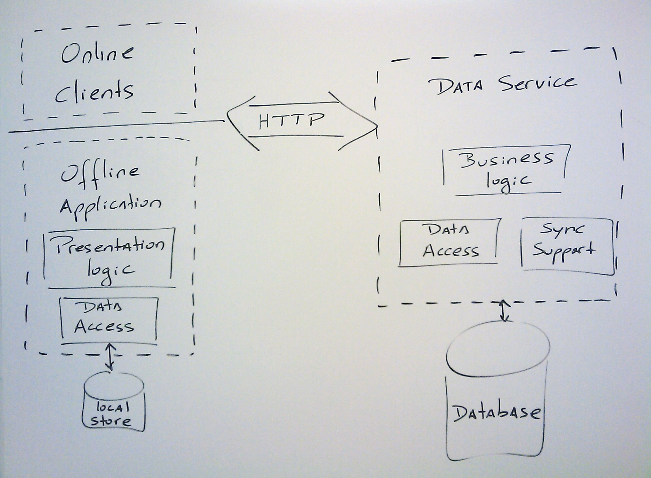
Application Model
Online clients can consume service
Sync-enabled service
Sync in the background
1-tier client application
Local schema follows service

Slide 56







Towards A Business Data Hub ?
Consolidation of business
data from multiple
sources including
  Enterprise databases
  Mobile Workers
  Business Partners
  Remote Offices
Includes sharing between these sources (through bi-directional synchronization)

Slide 57







Desktop Database Sharing
SQL Services
Consolidate business data in the cloud and enabled sharing to other desktops and mobile users
Synchronize when network
is available
Enables database scaling with out upgrading the database or hardware resources
Each user does not have to be connected to the one database
Out-of-the-box publication of Microsoft databases
Database template sharing
Solves the rendezvous problem
Data Services
Sync
Service
"Huron"
Client

Slide 58

Data Consolidation
SQL Services
Online Applications
Data Services
Sync Service
Reporting
Online Access
Online access to data hub and propagation of changes to data endpoints
Low Cost of Administration & Deployment of Mid-Tier
Low Cost, High Availability
Data Security
Reporting, Analytical, Mgmt, etc…
GSM,
CDMA,
etc
"Huron"
Client

Slide 59




Edge To Cloud Services
SQL Services
Organization
"Huron"
Gateway
BI, ERP &
Relational
DMZ
Offload business resources to the cloud
Take advantage of cloud services
Enables scenarios like Business Intelligence, Reporting
and Data Backup
Provides availability and scalability

Slide 60


Slide 62
Links
http://blogs.msdn.com/astoriateam/
  Astoria Team Blog
http://channel9.msdn.com/shows/Going+Deep/FeedSync-Synchronizing-the-Mesh/
  FeedSync
http://msdn.microsoft.com/en-us/library/dd163896.aspx
  Entry point for azure on MSDN
http://channel9.msdn.com/pdc2008/BB15/
  SQL Data Platform, from device to cloud
http://channel9.msdn.com/pdc2008/BB40/
  Sync Framework: Enterprise Data in the Cloud and on Devices
http://channel9.msdn.com/pdc2008/TL08/
  Offline-Enabled Data Services and Desktop apps
http://www.microsoft.com/downloads/details.aspx?FamilyId=109DB36E-CDD0-4514-9FB5-B77D9CEA37F6&displaylang=en
  Sync FW 2 CTP 1
http://code.msdn.microsoft.com/Release/ProjectReleases.aspx?ProjectName=sync&ReleaseId=1713
  Sync FW Samples
http://code.msdn.microsoft.com/sync
  :More Sync Sampoles

Slide 63
Links / 2
http://blogs.msdn.com/sync/
  Sync FW team
http://www.microsoft.com/azure/huron.mspx
  Data Hub on the cloud
http://blogs.msdn.com/access/
  MS Access team blog
http://blogs.msdn.com/cloud/
  Cloud blog
http://www.codeplex.com/feedsyncsamples/
  FeedSync Samples
http://dev.live.com/feedsync/dev/
  FeedSytnc for devs
http://ochoco.blogspot.com/2008/08/microsoft-sync-framework-2-new-sync.html
  Sync Sq;ples

Slide 64
Links cloud
http://www.roughtype.com/archives/2008/10/openness_is_not.php
  Cloud, Google , and standards
https://ipsts.federatedidentity.net/MgmtConsole/Policy.aspx
  Labs identity

Slide 65
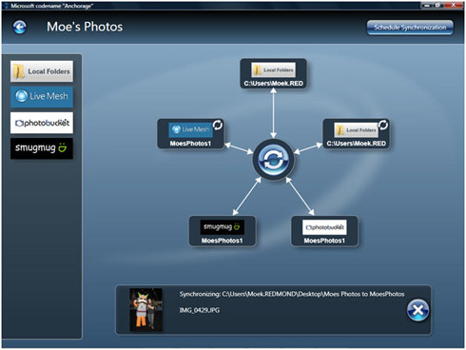
Anchorage

