Slide 1

Payments Implementation on Biztalk Infrastructure
Nov 19, 2008

Slide 2
Table of Contents
Infosys Technologies – Introduction
Case Study: Payments Implementation on Biztalk infrastructure
  Functional Overview
  Technical Overview
Infosys Global Payments Solution

Slide 3








Infosys is a global leader in Consulting and IT Services
Recognition
Achievements:
USD 4bill. + global revenues (2008)
Europe represents over 25% of this figure
~ 32 billion USD market cap (NASDAQ:INFY)
Over 30% annual growth for the last 6 years
Global workforce of 100.000+
More than 450 clients, mostly Fortune 2000 companies
7 of the largest world companies are Infosys customers
Over 87% of projects on-time on-budget
More than 90% recurring customers
Global leader in quality practices CMM5, 6-Sigma, Malcolm Baldridge
Líder en Tecnología Bancaria
Empresa mejor gestionada
Mejor empleador,
Mejor universidad corporativa
Mejor gobierno corporativo

Slide 4
Infosys is a global leader in Consulting and IT Services
REVENUES FROM FINANCIAL SERVICES ($ M)
KEY FIGURES
More than 154 active clients (en su mayoría Global Fortune 2000)
More than 13.000 employees in 31 development centres around the world
6 of the 7 largest US banks
4 of the 5 largest European banks
3 of the 4 largest Australian banks
CAGR aprox. 40%
Other Segments
37.8%
37%
Banking and
Capital Markets

Slide 5

Infosys has rich experience and expertise in the Payments business
Infosys IP in Payments
Global Payments Solution - Comprehensive Payments solution with add-ons for SEPA
Procure-to-Pay & Healthcare Payments Solution- End-to-End Solutions for the SME segment
SEPA Assessment Toolkit
Infosys Product Solution
Leading Core-banking solution with a strong Payments capability
e-Payment & e-Billing capability
Strong Mobile Payment offering
Support Collections, Debit Transfers and Multi-level workflow processing capability
Infosys Value Proposition
Payments Consulting
Large pool of Payments Domain experts
Deep expertise in corporate & retail payments
Thought leadership and participations at International conferences
Engagement Credentials
Infosys has executed many large mission critical engagements in payments & cash management areas in leading international banks
Benefits delivered include cost optimisation, streamlined delivery of planned enhancements, superior Application support for mission critical applications

Slide 6
Illustrative list of Infosys engagements Payments
Client | Engagement Highlights | Key Impact/Benefits
Leading Global Investment Bank | Implemented a Global Payments messaging hub , and helped the bank consolidate cash management and payments infrastructure globally | Six cents cost saving per transaction for a volume of 600,000,000 transactions per year.
Top 10 European bank | Design, development, and implementation of Middle-Office for Payments Factory. Infosys is working on parsing, storing, mapping, routing and reporting functionality for over 70 different payment types. interfacing with different front end and back-end applications and clearing houses | Business benefits include Compliance – SEPA, EPC’s BIC & IBAN validation; Implementation of product solutions including direct debit mandates, salary accounts etc; Infrastructure optimization; Payment transaction repository and E2E status monitoring
Large UK Bank | Involvement in revamping corporate electronic payments and integrating cope payments system for acquired subsidiary Development partner with the client and has been involved design and development of an web-based integrated channel for payments and cash management for corporate customers. Integration Programme including for the Domestic Payment Systems for retail customer. | A monthly revenue of 2m GBP is generated from the new and improved services provided Significant cost reduction in maintaining common payment platform.
Leading Canadian Bank | Designed and developed a comprehensive web-based cash management suite of applications – spanning ACH, Wire Transfers (Incoming & Outgoing), Check Imaging, Reporting, Account Transfers. | Developed a scalable, multi-lingual, robust cash management web application - Successfully stress tested to support 175 concurrent users. It currently has 10,000 users.
Leading US based International Financial Service Provider | Developed an Enterprise Money Movement platform, a solution that enables consistent,standardized MM processing capability across the client organization, spanning multiple Lines of Business (Travel Services, Cards etc). | Estimated total CBA is projected to be over $169mm 5 yr NPV Additional revenue from enhanced float optimization by moving money faster Reduction in Credit and Fraud losses Reduction in operational & development costs

Slide 7
Table of Contents
Infosys Technologies – Introduction
Case Study: Payments Implementation on Biztalk infrastructure
  Functional Overview
  Technical Overview
Infosys Global Payments Solution

Slide 8
Design Development and Implementation of a Strategic Global Payment Messaging Hub for a leading European Investment Bank
Current State – Problem Points
Direct, Diverse Communication between Internal Applications and Gateways
No Central Messaging Hub – No sharing of common functionality, inability to address cross-gateway requirements
Difficulty in addressing Regulatory Requirements like Compliance Screening of messages
Difficulty in addressing Business Requirements like Central Global Payments Network and Reconciliation
No possibility of value addition from a messaging perspective like Message Flow Dashboard and Traffic Analysis
New initiatives require changes to many internal applications
“Payment Messaging Solution Provides A Comprehensive Set Of Value Added Services”
Compliance Screening
Multi-Entity Enabling, Message Validation, Duplicate Checking
Message Transformations / Message Enrichment / Message Sequencing
Content Based Routing / Reconciliation
Manual Message Creation / Repair / Archiving / Printing / Dashboard
Traffic Analysis Reports
Business Analytics Reports
Gateway Comparison Charts
Dynamic Gateway Selection

Slide 9
Problem Definition - Current Financial Messaging Landscape
Fixed Income
Equities
Derivatives
FpML
Trade Entry
Trade Entry
Trade Entry
FO
Order Routing
Order Routing
Order Routing
FIX
Data Store
Data Store
Data Store
Configuration
Configuration
Configuration
OMGEO
Valid. & Enrich
Valid. & Enrich
Valid. & Enrich
MO
Shared Services
Shared Services
Shared Services
Exception handler
Valuation Services
Valuation Services
Valuation Services
Client allocations
Client allocations
Settlement
Settlement
Settlement
SWIFT
Operations
Payments
Payments
Payments
BO
Conf. Router
Conf. Router
Conf. Router
FED
Controllers
Controllers
Controllers
Controllers
CHIPS
EMB
ACH
“Direct, Diverse Communication Between Internal Applications And External Gateways”

Slide 10
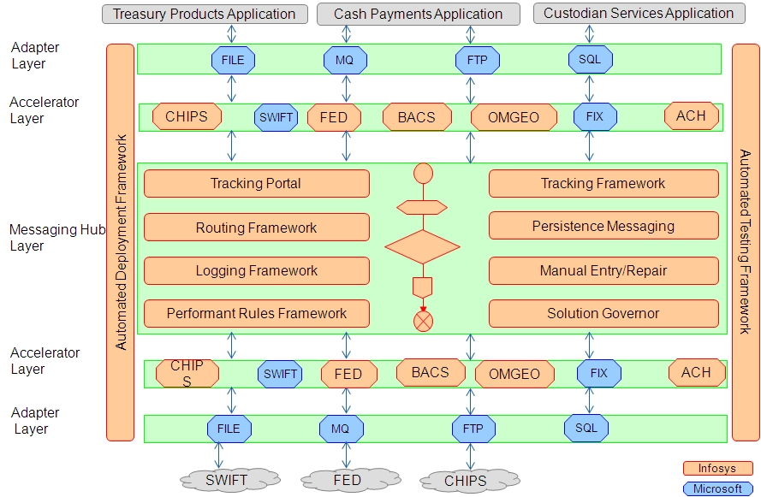
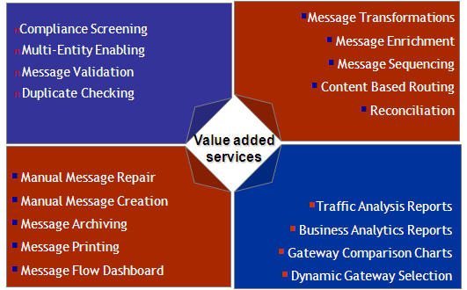
Our Solution - Synopsis

Slide 11
Key benefits Delivered
Engagement Highlights
A strong team of more than 80 BizTalk professionals working from 4 locations across the globe
Central Build Factory & Test Factory at offshore for multiple releases of IMB rolled–out for different geographies
Multiple parallel testing streams for UAT and Go-Live co-ordination
Pilot project for developing the BizTalk Centre of Excellence (CoE)
Impact
A solution architecture that is global and scalable
A fully resilient physical infrastructure
  Four-Layered Architecture
  Clusters for high-availability
  BCP environment for disaster
  Proven methodology for disaster recovery and back-up
Learnings
Exposure to Design, Implementation & Maintenance of Messaging-based Architecture
Understanding of SWIFT Financial Messaging Format
Building and successful Integration of Custom Adapter for SWIFT Messages
Exposure to the BCP guidelines provided by the Federal Bank of the USA

Slide 12
Table of Contents
Infosys Technologies – Introduction
Case Study: Payments Implementation on Biztalk infrastructure
  Functional Overview
  Technical Overview
Infosys Global Payments Solution

Slide 13
Solution Scope
International
Messaging Hub
Handle SWIFT messages
US
Expand to FED and CHIPS
APAC
BOJ-NET, MEPS, CHATS
Build a Financial
Messaging Hub with
the required Technical
Capabilities
Regional
Messaging Hubs
Swiss
SIC, EUROSIC, SECOM,
RTGSPlus, TARGET,Telex
Scalable
and
Performant
Financial
Messaging
Solution
Others
FIX, CREST, EUROCLEAR,
OMGEO, ACH, JASDEC
Manual Message Entry / Repair
Value
Added Services
Decision Support Systems
Messaging Specific Design Processes
Tools to enable efficient
implementation
Automated Testing Frameworks
Automated Deployment Frameworks
“Implement A Hub Connecting Internal Applications With External Gateways Using The Pre-Built And Configurable Financial Messaging Solution”

Slide 14








Our Solution
Applications
Payment sent / received via
SWIFT network
Mainframe
SWIFT Alliance Access
Before…
MQ
Series
MQ
Series
Cash Management
Applications
Applications
MQ
Series
Payment sent via
SWIFT network
Mainframe
SWIFT Alliance Access
…After
MQ
Series
MQ
Series
Message Broker

Slide 15
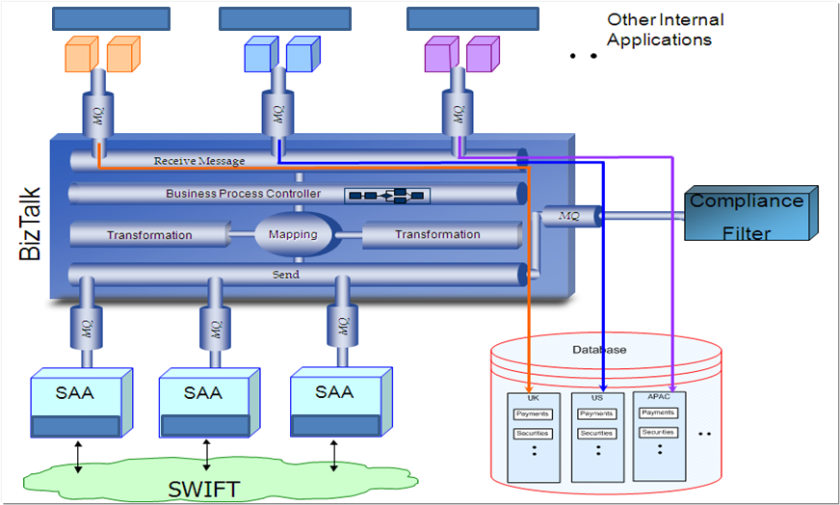
Our Solution ..Contd.

Slide 16
Deployment Architecture

Slide 17
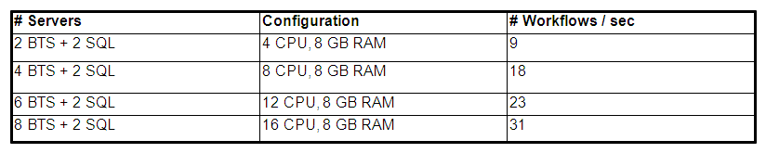
Performance numbers
Scalability tested during testing phase
First round of Performance Testing was done on Proof of Concept Phase in the Intel Labs, UK
Post Build Performance Tuning and Validation exercise done along with MS in Redmond labs, US
Peak Load Testing
  25 workflows / second (One workflow involves 5 messages (avg.) each of around 2 KB size)
  Total throughput = 125 messages / second
  System soak tested for 48 hours on peak load
Steady state Volumes of transaction handled by deployed solution
  350,000 workflows / day – Currently in production
  2,000,000 workflows / day – deployed potential capacity in production
  15 workflows / second – Optimal flow in steady state
Mission Critical Nature of the messaging hub
  200,000,000,000 USD value of messages processed / day

Slide 18
Table of Contents
Infosys Technologies – Introduction
Case Study: Payments Implementation on Biztalk infrastructure
  Functional Overview
  Technical Overview
Infosys Global Payments Solution

Slide 19
Infosys has developed a Global Payment Solution that facilitates accelerated deployment of a Payment Solution
Offers evolutionary approach for banks to efficiently and effectively integrate, automate & manage the payment landscape via consolidation, standardization, Optimization and ability to extend.
Centralize Payment
Data store
Operations
Reporting
Centralize Unique
Functions/Process
Business
Portal
Enterprise Integrations
Centralize
Message bus
Operations
Portal
Centralize Common
Functions/Process
Administration
& Deployment Portal
Self Service
Portal
Hosted Service
(Revenue LOB)
CONSOLIDATE
STANDARDIZE
OPTIMIZE
EXTEND
Consolidate interactions
Single payment transaction data store.
Portal for operations, reporting & Exception Management.
Centralize common Biz processes & function interactions
Centralize the Unique Processes & function interactions
Business Rules administration
Ease of deployments
Aggregated business view
Business Performance reporting
Self service Portal
Extend the to other banks and consortium as a service
Extend for internal Enterprise Application integrations.
Extend to integrate with third party vendors and partners.
MANAGEABILITY
LEVERAGABILITY
PREDICTABILITY
COLLABORATION

Slide 20
Infosys Global Payment Solution (GPS)
Infosys Global Payment Solution offers,
a standard centralized financial messaging & payment interaction management system that provides an evolutionary approach for banks to:
  Efficiently and effectively integrate, automate and manage the payment interaction landscape
  Increase flexibility and speed of payments & financial Messaging
  Reduce the total cost of ownership associated with managing payments interactions and messaging
  Improve customer satisfaction
  Have a potential revenue generating LOB
Wholesale Payment Infrastructure

Slide 21
Infosys Global Payment Solution - Specialized Services
Retail Payments
Wholesale Payments
  Validators
    SEPA: ISO 20022 schema & SEPA Rules validators
    BIC/IBAN: Verify the correct BIC/IBANs
  PE-ACH Adapters
    Bulking outbound Payments for PE-ACH
    De-Bulking inbound Payments from PE-ACH
    STEP2 file validations
  BIC/IBAN Lookup & Converters:
    Replace values of non-compliant fields in the messages using BIC + IBAN lookups
  Pricing: SEPA Pricing Plug in
  Prioritisation: Priority processing for High Value Payments
  Currency Cut-offs: Special processing for messages near currency cut-offs
  Queuing Support: Ability to hold payments till Value date within GPS
  Enhanced Exception Management: Raise alerts on portal/ MOM alerts for Compliance/Liquidity management exceptions

Slide 22
Thank you

