Slide 1
Office 2010 Overview for IT Professionals
<Event Date>
<Name>

Slide 2
Office 2010 Delivers More The Best Productivity Experience Across the PC, Phone & Browser
Work Better Together
Bring Ideas to Life
Use Office Anywhere
E
The Practical Productivity Platform
Collaboration Without Compromise
Insights from Information
PC, Phone & Browser
Manageability, Security, & Cost Management
Notes:
Present this slide if audience is familiar with TDM messages to provide transition to IT Pro session. Notes form TDM – inidicate focus will be on platform pillar
Note – this slide introduces core design principles for Office 2010 and outlines the key value pillars for Office 2010
The objective of this slide is to set the stage of customer pains that we will solve with Office 2010 and to introduce the Office 2010 pillars.
This will frame the discussion and setup a drilldown on the IT Pro/Services pillar for “The Practical Productivity Platform”
The majority of observations we’ve made through user behavior and market trends can be grouped into a few areas.
The core mission of the Microsoft Office team is to deliver fast, reliable, easy-to-use software that helps you engage in your daily activities.
We believe that great productivity software should do the following:
Be easy to use, fast and reliable
Deliver the results you expect across your pc, phone and browser
Be engineered for the diversity of people everywhere
Help you get more from it every day
We have a single-minded focus on executing well on the everyday essentials, and dedication to breaking new ground with innovative ideas to provide you with the best tools for how you will work today and in the future
Work Together - Challenge in sharing expertise and staying connected.
2010 designed to help people work better together while helping IT maintain control through collaboration without compromise
Stronger emphasis on teamwork. It’s recognized that greater results come from sharing expertise but technology has often been a barrier in helping people to work together efficiently. Barrier is coming down with social computing in the mainstream.
This is especially driven by the “Millennials” or “Gen Y” who are now entering the workforce. They like to work collaboratively. They grew up with technology and an internet connection; find answers with a mouse click versus a trip to the local library
Teams are more global – need to overcome geographic and time zone obstacles
Nature of teamwork has changed – desire to work on deliverables at the same time
Customers are demanding faster response times – need to stay connected to respond quickly to stay competitive. Especially in this economic environment.
Bring Ideas to Life - Challenge in managing volumes of digital information
2010 designed to help people bring ideas to life by drawing insights from information
We’ve entered a truly digital age where the challenge has shifted from digging to find information to managing large volumes of information to find the right insights and present it in a meaningful way.
People are often overwhelmed by the information available – how can you weed through all of it to find the insights to make the right decisions?
Shift towards digital content – YouTube takes up the majority of bandwidth today
Use Office Anywhere - Challenge in working across locations and devices
2010 designed to let people use Office from virtually anywhere, through a PC, phone or browser
People expect to have access to the information they need no matter where they are.
Most mobile workers travel with a laptop, but they also want the ease and flexibility to stay informed and productive by using their phone while waiting in line at the airport or in a store, or by logging on to a computer in a hotel lobby.
And IT has arguably the toughest balancing act – the need to deliver these capabilities to the business while facing their own pressures in managing cost & complexity
Challenge in helping a diverse workforce be productive while connecting business processes to desktops
2010 is designed to be the practical platform for IT
It’s IT’s job to empower people with the right tools to be productive – from the creative types looking for cutting edge multimedia, to the number-crunching Excel power users.
In meeting a variety of work-styles, they often must balance how to introduce new capabilities to meet the needs of some, while maintaining continuity and familiarity for others.
Since users don’t rely solely on one computer to get things done, and given trends toward “consumerization of IT” where people have preferences in the types of hardware and software they want to use both at home and at work, IT is challenged to support more devices.
User adoption can affect the ROI of server investments – people often prefer to stay in the applications they’re already using
IT must balance control with providing self-service capabilities to end users to enable them to better work together.
IT is responsible for protecting IP – but it’s hard to control user behavior
IT is on point to provide users with more freedom by enabling them to work from more locations and devices. But they must do so in a safe & secure way.
Both the business and IT need to Do more with less
In the current economic climate, people are not only looking for ways to be more efficient, but are often forced to do so.
Reduction in work force – Existing work force has taken on more responsibilities and needs the right tools to get more done, faster
Cut costs – looking for ways to save on operating expenses wherever possible – from avoiding the need for specialized applications to reducing the amount of paper used
Producing more in-house – reducing outsourced functions – from marketing agencies to project managers
Reduce migration and management costs in delivering technology
Now let’s take a look at the Practical Productivity Platform in detail
2

Slide 3
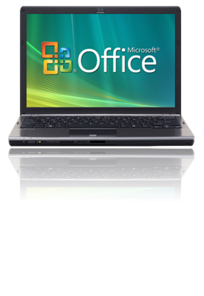
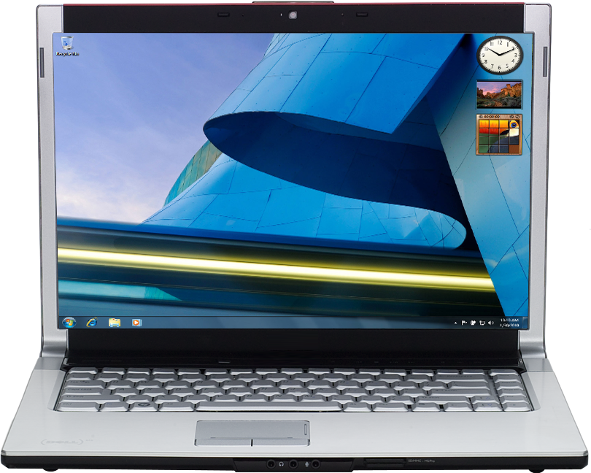
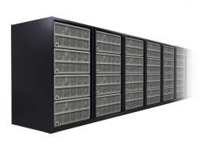
The Practical Productivity Platform A unified platform enabling IT to solve challenges of PC, Phone, and Browser
Easy, Powerful Productivity Experience
SharePoint 2010
Web Apps
Co-Authoring
PowerPoint Broadcast
IT Choice and Control
Virtualized
Online
Service
Exchange 2010
Mail-Tips
Retention
OCS
Embedded Presence
Desktop Sharing
Metal
On-Premises
Servers
Mobile
Notes:
Build 1:
IT Pros need to provide the productivity tools that the business is expecting in today’s connected world. Providing solutions across the PC, phone, and browser allowing them to work in more places. Office 2010 is a tool designed to fit the user demands providing an easy, powerful productivity experience.
The IT Pro view of the world has evolved – now they are being asked to do more than ever to support the business needs. IT needs choice and control of what they will run vs. consume as a service while keeping their enterprise safe and secure. Office 2010 provides the flexibility to control where components will be deployed.
Build 2:
At the core of the needs is Office 2010 - we now have the opportunity to look at the best method to utilize to distribute the applications – both with managed on the metal installs and via virtualized deployments of the application. Office 2010 makes the distinction of the on the metal and virtualized deployments indistinguishable to the user, providing more control and flexibility for the IT Pro.
Build 3:
It is very important to consider the wider solution eco-system that can be leveraged with Office 2010. Office 2010 becomes richer when teamed with key server products such as SharePoint 2010, Exchange 2010, or OCS.
Not only does Office get better, Office 2010 streamlines the integration with these servers, thus better utilizing existing investments. E.g. Office 2010 makes it very simple and intuitive to save and recall documents from a SharePoint library, no more searching for that site Url etc.
The Office features expand when you line the client up with the server solutions. SharePoint enables features such as the web applications, co-authoring, and PowerPoint broadcast from the client.
It is important to consider the complete solution footprint that can be leveraged to meet the business needs – and remember Office 2010 provides deployment flexibility to selectively host some services on-premise or in the cloud.
With this framework in place let’s take a look at how enables IT Pros to serve the business user needs while keeping thing secure and in budget.

Slide 4
The Practical Productivity Platform A unified platform enabling IT to solve challenges of PC, Phone, and Browser
Extending the Office 2010 client application features and reach. Office 2010 makes it easier for users to connect and collaborate.
Make People Productive Anywhere
Easy, Powerful Productivity Experience
SharePoint 2010
Web Apps
Co-Authoring
PowerPoint Broadcast
IT Choice and Control
Virtualized
Manage Risks through Enhancing Security and Control
Online
Service
Exchange 2010
Mail-Tips
Retention
OCS
Embedded Presence
Desktop Sharing
Metal
On-Premises
Reduce Application Management Costs
Servers
Mobile

Slide 5
Meet Deadlines & Reduce Time Spent Coordinating Changes By Enabling Multiple Team Members to Work Together in Real-time
IT Pro Fast Facts
Reduce network demand
Reduce mail churn
Keep content managed
Collab without check-in/out

Slide 6
Share a Presentation with Others Instantly Using Broadcast Slide Show in PowerPoint 2010
IT Pro Fast Facts
Deployment Flexibility
Simple sharing utility
No Add-ins/installation on client
Respects existing privacy tech. like IRM

Slide 7
Work with SharePoint Documents and Lists Offline With SharePoint Workspace 2010
IT Pro Fast Facts
Improve utilization of SharePoint investments
Delivers offline capabilities out of the box
Integrated authentication
Efficient sync reduces network load
Helps manage version deltas
Maintains P2P sharing capabilities for cross firewall scenarios

Slide 8
Making Services More Discoverable Backstage view
IT Pro Fast Facts
Improve feature discoverability
Makes connecting to services simple
Extensible

Slide 9
Provide Self-Service BI Functionality to Users By Using PowerPivot for Excel and New Tools to Visualize Data
IT Pro Fast Facts
Provide self-service BI
Better user adoption of features
Provides user driven dashboards
Improve manageability of data

Slide 10
Enable Users to Edit Videos & Photos In Office 2010, without Using Additional Editing Programs
IT Pro Fast Facts
Minimize need for dedicated apps
Enable users to work in single Office context – less training need
Minimizes rich media file size – compression, trimming

Slide 11
Take Control of Your E-mail and Calendar Better mail management keeps mail safe and relevant
IT Pro Fast Facts
Minimize mail spam
Minimize mail leakage
Minimize required mailbox size
Keep Outlook performing optimally

Slide 12
Work from Virtually any Place or Device With Office Web Apps
IT Pro Fast Facts
Deployment Flexibility
Consistent round tripping
Cross browser support
Consistent user interface with the client
*An appropriate device, Internet connection and Internet Explorer, Firefox or Safari browser are required.
Notes:
No loss of formatting or content from PC to browser

Slide 13
Office Web Applications Greater deployment flexibility
Office Web Apps Include:
Office Web Apps are licensed with Office Standard 2010 and Professional Plus 2010
Word
PowerPoint
Excel
OneNote
Familiar Office Experience
Easy to learn and designed for productivity on the web.
High Fidelity
No surprises when numbers, formulas, equations, charts, and layout appears just as you intended
Trustworthy Roundtripping
PC to Phone to Web without compromise to appearance or data.
Core Design Tenets
On Premises
Online
IT can host Office Web Apps on SharePoint for additional management and control options
Office Web Apps hosted for organizations by Microsoft
Notes:
Office Web Application Companions (WACs), were announced this year
Key component in our “Access Anywhere” message
In this release, adding the ability to access content on a SP site and edit it through the browser!
UE that is very similar to the Rich-Client experience
Major selling-point for low functionality scenarios or a remote/mobile workforce
Web Apps available for:
Microsoft® Office PowerPoint®
Microsoft® Office OneNote®
Microsoft® Office Word
Microsoft® Office Excel®
Web apps are licensed with Office Standard or Pro Plus for on premise deployments
Web apps enable both quick in browser high fidelity viewing and light weight edit from the browser
Note that Outlook Web Access is NOT a office web app
We are the “only” web-based productivity apps that you can host in your on-premises. To be clear not that we will offer the web apps publicly on Windows Live (they can try it out with SkyDrive) but it will also be available as a hosted service.
The on premise deployment of office web apps is based on SharePoint – thus to deploy Office Webs you must install the web apps on a SharePoint server or SharePoint Foundation sever. The on premise deployment option provides local administrators the ability to control the use of the web apps to best support the business needs.
The web apps are focused on:
Providing a familiar Office Experience – the web apps retain the UI Ribbon them used in the Office applications to provide a consistent user experience.
High Fidelity – users should expect documents to appear as they intended regardless of the medium – web apps providing a clear representation of the document in the browser
Round tripping – in short if you edit docs in the web apps data won’t be lost – if objects are not supported for edit, i.e. embedded videos, a place holder is shown – the app doesn’t strip your content – thus if you return the client application your information is retained

Slide 14
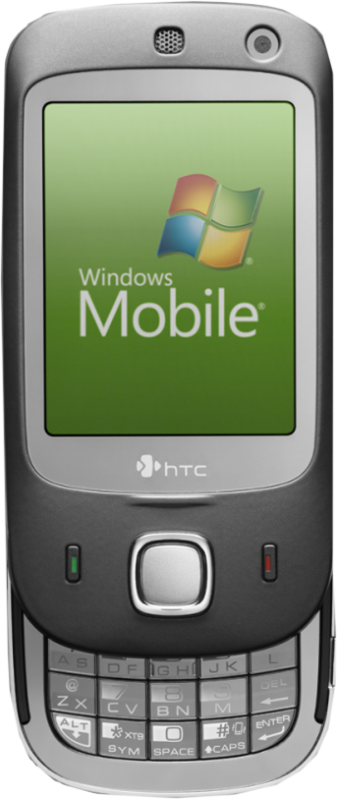
Taking Office to Mobile Devices Providing a robust Office experience
Microbrowsers on Phones and PDAs
WAC viewer enables viewing for:
Word
Excel
PowerPoint
View PowerPoint broadcasts
Supports:
IE on Windows Mobile 5/6/6.1/6.5
Safari4 on iPhone 3G/S
BlackBerry 4.x +
Nokia S60
NetFront 3.4, 3.5 +
Opera Mobile 8.65 +
Openwave 6.2, 7.0 +
Web Apps
Office Mobile 2010
View & Edit Office files
Word, Excel, PowerPoint, & OneNote
Supports:
Windows Mobile 6.5
Nokia E-Series
Office Mobile
SharePoint Workspace Mobile 2010
Enables content sync with SharePoint libraries
Communicator Mobile
View presence & send /receive IMs
Notes:
Q: What are the requirements for Office Mobile 2010? Do I need SharePoint or Exchange?
A:
Office Mobile 2010 Requires a phone running WinMo 6.5
OM 2010 supports Word, Excel, PowerPoint files 97-2010
SharePoint Workspace Mobile 2010 requires SP 2010 server & Universal Access Gateway server be deployed for Mobile VPN connectivity
Exchange is not required

Slide 15
The Practical Productivity Platform A unified platform enabling IT to solve challenges of PC, Phone, and Browser
Make People Productive Anywhere
Easy, Powerful Productivity Experience
SharePoint 2010
Web Apps
Co-Authoring
PowerPoint Broadcast
IT Choice and Control
Virtualized
Manage Risks through Enhancing Security and Control
Online
Service
Security attacks are evolving to target applications while business concerns have advanced the need to ensure compliance with standards and regulations.
Exchange 2010
Mail-Tips
Retention
OCS
Embedded Presence
Desktop Sharing
Metal
On-Premises
Reduce Application Management Costs
Servers
Mobile

Slide 16
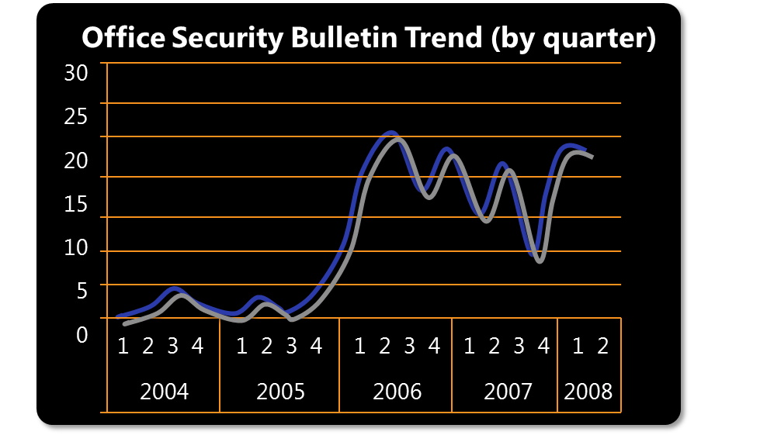
Historical Data of Office Security While attacks increased vulnerabilities are decreasing
Focus of attacks has evolved
Security bulletins have increased
Newer is Better
% of vulns affecting Office 2007 since Jan 2007
Office 2007 raised the bar
OpenXML format is safer
Office 2010 continues improving
28% Vulnerable
72% Not Vulnerable
Applications
OS Libraries
>10x!
OS Transport
Number of Vulnerabilities
2x!
Network
* Diagram from SANS – The Top Cyber Security Risks
Notes:
This figure is an interpretation from the SANS Top Cyber Security Risks article shows the number of vulnerabilities in Network, OS and Applications. You can see that the number of vulnerabilities discovered in Applications is far greater than the number of vulnerabilities discovered in operating systems.
On the rise are quiet attacks on desktop programs, which means that application desktops are under threat. An example; there are a number of email attacks are targeted at commonly used programs such as Adobe PDF Reader, QuickTime, Adobe Flash and Microsoft Office.
Microsoft have taken these attacks seriously and have made a great investment on minimising these attacks in the Office 2010.
Let’s set the stage by looking at the Office Security Bulletin, which looks back to when Office 2003 was shipped. You can see the trend line was looking good up until around 2 years later where there was a significant rise. This is when the fundamental landscape of security changed and attacks in the industry and world as a whole changed. Microsoft had improved operational security and defending servers, but by making the server infrastructure better the attackers decided to look elsewhere. They moved onto the client space.
So in Office 2007 Microsoft made some changes. They had done a lot of work on the engineering fundamentals – raising bugs, fixing bugs, raising the security level bar as a whole. This included educating the testers and having people work on finding bugs and then raising it with Microsoft to fix. They also changed the file format. This made huge improvements and as you can see in this pie graph that 72% of the vulnerabilities did not effect Office 2007. Although this is great, there is still the 28% that needs to be worked on.
One of the security engineering areas that have been worked on is the fuzzing iterations which we will talk in more detail about later in this presentation. You can see in this graph that it was introduced in Office 2007 and has increased significantly in Office 2010.

Slide 17
Layered Defenses Tiered approach to secure the office applications
Harden the Attack Surface
Core Design tenet
Execution prevention
Reducing the Attack Surface
File validation
File block
IT Pro managed
Mitigate the Exploits
Protected viewer
Isolated process
Informed user decisions
Improve User Experience
Minimize clicks
Sticky decisions
Immediate view
Notes:
In Office 2007 there were changes in the security engineering push which has helped move 2010 in the right direction for security. In Office 2010 Microsoft have developed a tier approach to security that we call the layered defence.
The aim for 2010 is to reduce the number of points to defend which helps to harden the attack surface.
Office 2010 works with existing file block functionality and also a new file validation tool to reduce the attack surface.
The impact on systems are minimised as 2010 introduces the ‘Protected viewer’ which allows files to be opened without causing harm to the system.
The security changes should not impact the user’s experience in a negative way. Users will not have to think about whether to open the file as it may not be safe because it will open from within protected viewer automatically.
Layered security
This model means attacks have multiple layers to crack to impact the system
Harden the Attack SurfaceData execution prevention – stops the app from running
Allow user to access content but limit exposure
Gatekeeper – file validation (file fuzzing)
Protected view – virtual sandbox
Reduces the number of prompts
Security questions that we haven’t had to ask before. Answers are pretty strong, but involves a lot of thinking about what you want to do in your environment.
Reducing the Attack Surface:
File validation looks for unknown issues against known valid file structures & File Block enables IT can limit old file format issues while maintaining user productivity
Mitigate the Exploits:
Data is isolated in a secure sandbox preventing harmful action & it enables users to make informed decisions on document trust
Improve User Experience:
User has immediate view of file prior to taking trust actions and reduces number of clicks

Slide 18
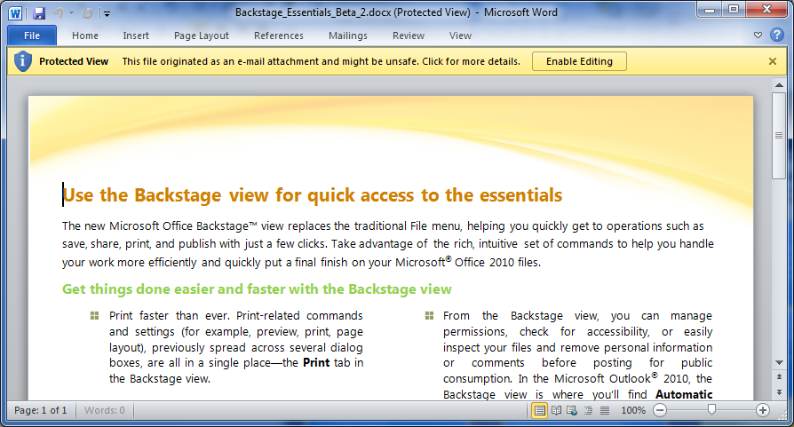
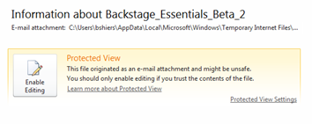
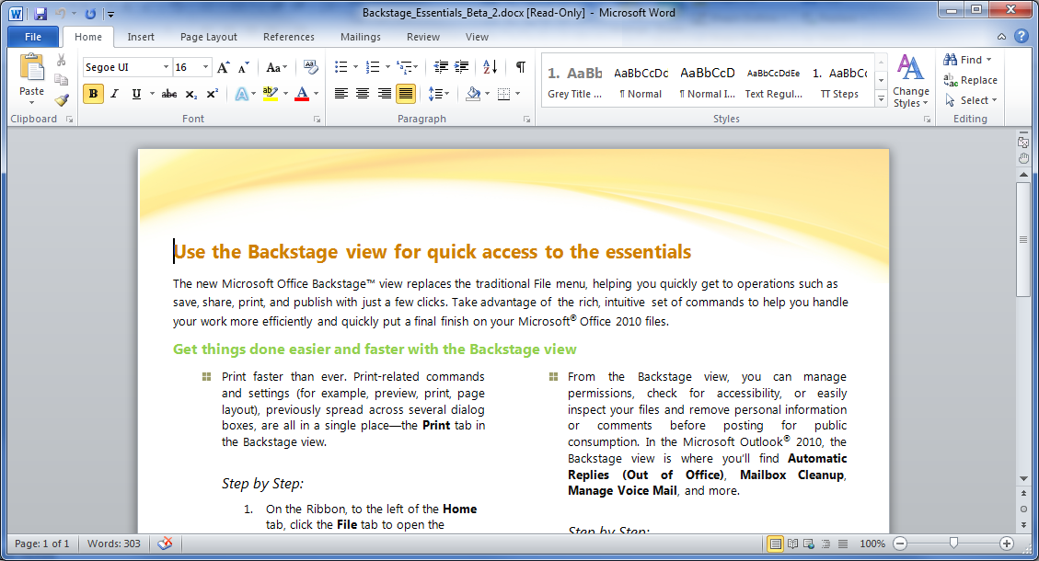
Protected Viewer in Action
1
3
2
Notes:
Document is opened from an untrusted location – in this example an external email attachment. The doc is immediately opened for view but it is sandboxed so any harmful code would be contained. Note users can view the document, even copy content from the document w/out taking any additional actions.
The user can get more details if they wish – displayed in the backstage – this step is optional.
Once the user clicks Enable editing button the doc is made available for edit with all of the application features. If the user opens the same doc again the selection is recalled and it will automatically open w/out the protected viewer.
Or show this live in client:
Demo of protected viewer
Open document from internet location
As doc opens doc is initially placed in protected view sandbox –however user has the ability to review document and only needs to take action if they intended to edit or take action on the document.
Once the user has made the decision the same doc can be opened from that location again – the trust decision is recalled and the user can immediately have full access.
Secondary Demo – Outlook Preview – frame with discussion about preview in Office 2007 where user had to first make a decision to see the document in the preview.
Supporting Information: http://blogs.technet.com/office2010/archive/2009/08/13/protected-view-in-office-2010.aspx

Slide 19
Reducing Risk: Document Inspector Keep documents safe and compliant
IT Pro Fast Facts
Enforceable via group policy
Clean-up options provided to users
Keep users informed of “hidden” information

Slide 20
Reducing Risk: Accessibility Checker Keep documents safe and compliant
IT Pro Fast Facts
Customizable via group policy
Backstage can enforce workflow to run cheeks
Content can improve web compliance – publishing to SharePoint
Notes:
Discussion points while presenting – driving home why accessibility matters:
Three categories for accessibility concerns:
Issues where content is unreadable. For example, a picture missing alternative text (alt text provides a text based representation of an image) is unreadable to a person who is blind.
Issues where content is difficult to read. In general, these issues are less severe than unreadable content – for example, if an author has created a data table and used complex formatting to alter its presentation (i.e. using blank rows or columns, or merged and split cells), then a person with a disability might have difficulty understanding content in the table.
Issues that may or may not make content difficult to read. In our explorations, there were a set of issues that potentially cause users with disabilities difficulty for which we don’t have a high confidence, automatic way to determine whether the issue is really a problem. For example, knowing whether or not the reading order of objects on a slide or cells in a layout table is optimal for a particular reader falls into this bucket.
Reference Information: http://blogs.technet.com/office2010/archive/2010/01/07/office-2010-accessibility-investments-document-accessibility.aspx

Slide 21
Comply with Standards: Accessibility Checker Accessibility importance is increasing a connected world
Automated accessibility checker in Word, Excel, PowerPoint
Uses numerous standards including 508 & WCAG 2.0
Educates the user
How to and why to fix advice
Group policy enforceable
Make it part of the core authoring experience & reduce risk
Notes:
Office 2010 offers several features that help reduce the risks for the your enterprise – this covers compatibility, data integrity, access, and data retention
Office 2010 offers “checkers” in the backstage view
Checker’s use can be configured and controlled by GPO
Accessibility Checker – helps aid doc compliance with accessibility standards – combines standards into a universal checker – applies word, PowerPoint, excel
Can be forced to run
Risk level is assessed in the check – errors and tips

Slide 22
Information Control to Improve Productivity Secure, Sanitary, Safe.
Document inspector removes personal and confidential information
Review comments
Hidden data in Excel
Compatibility checker looks for issues on older versions
Recover drafts and unsaved copies
GPO Configurable
Manage document rights
Notes:
Info Control – is now more extensible in 2010
New feature is the document inspector, leverages fact that doc is open xml
Unique rules can be implemented to fit specific business checking needs

Slide 23
Retention Policy Rich Customization and administrator control
Flexible to user’s workflow
Item-level retention policy
Policies can be applied to user-created files
Exceptions can be made
Search integration
Works when online and in cached mode
Notes:
The Retention policy is a flexible archiving tool that can be configured centrally (?) to ensure that email is retained as per a company’s compliance policies. Retention can be organised down to the item level.
Needs more information

Slide 24
Retention Policy Seamless User Experience built into Office
Visibility into what’s happening with mail
Users can see policy on each item and when it expires
When retention is place on hold users are notified
User education
Policy descriptions are available
Notes:
User can see the retention policy in action with the ability to see the policy information on individual items.
User education regarding retention policy is a major part of ensuring compliance. Users are now able to see exactly what the policy is on each item.
Note that the UI elements are native to Outlook, however notes and options require Exchange 2010

Slide 25
The Practical Productivity Platform A unified platform enabling IT to solve challenges of PC, Phone, and Browser
Make People Productive Anywhere
Easy, Powerful Productivity Experience
SharePoint 2010
Web Apps
Co-Authoring
PowerPoint Broadcast
IT Choice and Control
Virtualized
Manage Risks through Enhancing Security and Control
Online
Service
Exchange 2010
Mail-Tips
Retention
OCS
Embedded Presence
Desktop Sharing
Metal
On-Premises
Reduce Application Management Costs
Reduce the cost and complexity to deploy and maintain Office 2010.
Servers
Mobile

Slide 26
Office 2010 Performance Overview Leverage existing hardware and tap the potential of new hardware
Office 2010 design decisions were made to optimize existing hardware
Disk requirement increases 1.5 GB, other hardware requirements are unchanged
Office 2010 runs well on Netbooks
Boot experience is smoother
Several specific areas where performance is much improved
Excel charting
Outlook speed improved in several areas
PowerPoint animation performance
And also to take advantage of new hardware investments
Better multi-core processor utilization
64-bit & 32-bit versions of the client
X64 enables huge grids for Power Excel users
PowerPoint advances on graphics cards
Services Efficiencies
Change Level Synching – SharePoint Workspace
Co-authoring – minimize users email files
Notes:
Emphasis no need to upgrade hardware, and that the Office team have taken the idea from the O/S team with making 2010 faster than 2007 on the same hardware.
However footprint for diskspace has changed, now requires 3GB, see the system requirements for the Beta version for specifics.
Netbooks – Office 2010 runs well on netbooks, however due to the limited display you might note we don’t meet the suggested display setting of 1024x768. Well Office 2010 addresses the small screen real estate issue by making the ribbon customizable so a user has the option to optimize the specific view for the given hardware.
Boot Experience – boot application faster than it has been
The new Office is optimised for multi-core processors. Additionally there are 2 versions 32 bit and 64 bit
introducing a 64-bit client of Office – BUT
Note the support OS system
What does 64-bit Office provide?
Key question for customers – do they really need it?
Only real gain is within the Excel Client. Unless heavy users with massive calculations there is no current advantage.
More likely to be more pain than gain
32 bit Active –X controls don’t work.
VBA issues with long data types
Major access printing issues
Print to OneNote issues
Long list
32 bit runs fine on 64 bit O/S
Hardware acceleration advances are greater than the advantages in moving to 64-bit
Video acceleration for PowerPoint, show this with embedded videos in PPT
Service efficiencies – all about moving to change level synching

Slide 27
Group Policy Office admin templates allow IT to control features available for end users
Notes:
Group Policy Admin templates
By setting policies, you can define and maintain a particular Office 2010 configuration on users' computers. Unlike other customizations, such as default settings that are distributed in a transform (also known as an .mst file), policies are reapplied every time that a user logs on to the network. Alternatively, policies can be reapplied at some other interval that is set by the administrator. Users cannot edit the registry to change the policies. You can set policies that apply to the local computer (and to every user of that computer), or you can set policies that apply only to individual users. You set per-computer policies under Computer Configuration in the Group Policy snap-in. Per-computer policies are applied the first time that any user logs on to the network from that computer. You set per-user policies under User Configuration in the Group Policy snap-in. Per-user policies are applied when the specified user logs on to the network from any computer. To use an Office 2010 policy template, you must load the template in the Group Policy Microsoft Management Console snap-in.

