Slide 1
My 5th grader has a better web site than you!
Presenter’s Name
Partner Name
Date
Insert Partner Logo
Insert Partner Logo
Insert Partner Logo
Insert Partner Logo
Notes:
So…do any of you actually look at the websites your kids are developing? Have you looked at their Facebook accounts? Well…it may be time to compare your website!!

Slide 2
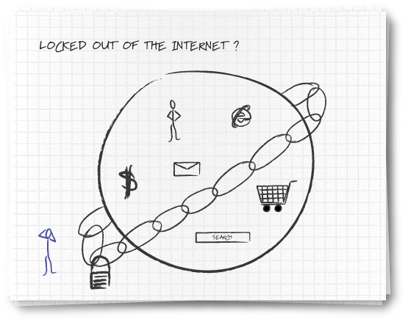
Notes:
This business owner feels completely locked out of the business-building and marketing reach benefits of the web….like many of you, the potential of the web is available to you, but you can’t find the “keys”.

Slide 3
Welcome to your local team
Meet other small business people in your area
Share stories and insights
Find solutions to some of your biggest challenges
Tap into a local network full of resources
  [List Presenters & Introduce them here]
Notes:
Today’s session enables an environment to share ideas…network…create dialogues that can help you plan and run your businesses…The folks around you, collectively have extraordinary wisdom and insight that you can capture by opening up a dialogue.

Slide 4
What challenges are you facing today?
Creating professional-looking web sites and banners appears to be difficult and time-consuming
Knowing how to enter the world of web marketing
Reaching new customers with search marketing
  Think it can help, but don’t know how to get started
Notes:
What is keeping you awake at night regarding the web? Here are some of the issues that we hear around the country. Creating a powerful web destination is important…just like it’s important to have an inviting merchandising experience….but you also have to know how to get buyers to your “web lobby”.
That’s right…a home page should function as a lobby…just like your office. Of course…many people just like you fall into a website by searching for relevant information on one of the popular search engines.
But let’s hear from you…what’s keeping you awake at night?

Slide 5
In 2005, 24% of small business owners considered their Internet presence to be very important for driving their businesses.
In 2008, that rose to 48%.
Warrilow Weekly
Notes:
It’s doubled in 3 years…in 3 more years, it’ll be 100%. Can you imagine your business without a website today? Well your customers can’t imagine doing business with you face-to-face all the time either! Recognize that customer convenience is driving consumer motivation…and the web is the enabler.

Slide 6
Creating professional-looking web sites appears to be difficult and time-consuming
Templates make it easy to create a customized site
Leverage web site and e-commerce templates to get started easily
Ensure a professional look and consistent branding
Use your brand to look “bigger” than you are
Notes:
Search the web for available website templates…also rely on experts who can help you. How many of you have a website? How many of you used outside help to construct it? That’s right…a majority of you.
Let’s share some firms who can help business owners obtain a professional look. Who wants to start?

Slide 7
It costs four to ten times as much to capture a new customer as it does to provide good services to an existing one.
ThinkNewsletter, Thompson Group
Notes:
The web is a great way to keep your business open 24/7, so you’re always available when your customers need something.
Also…the web is becoming a great vehicle for consumers to recommend products and services…do you know how you shape up on Digg or some other consumer recommendation site?

Slide 8
Lack of specialized training required to enter the world of web marketing
Incorporate the web in everything you do
Leverage your authentic voice to create a genuine-feeling, small business web presence
Use quotes from current customers to reach
new customers online
Use search words to expand your reach
Consider using the web rather than the phone as the primary means of customer contact
Notes:
You don’t have to be a technologist… but you do need to be authentic. Capture your voice or the brand you seek to convey. Use quotes and testimonials from your customers…make it feel like a community not a brochure on the web.
By the way…the web is replacing the telephone for interactions with business…incase you haven’t noticed!

Slide 9
“Companies who used search engine marketing site saw an average gain of 73% in site traffic within 6 months.”
MarketingSherpa
Notes:
Search marketing has become the most extraordinary marketing technique developed since the advent of television and zip codes! Show of hands…how many of you used a search engine in the last 24 hours? Amazing isn’t it?
Just 3 years ago…a third of the hands would have been raised. How many of you actually bought something from a company you didn’t know existed until your web search?

Slide 10
Think search marketing can help, but not sure how it works
It’s easy to get started
Review your website to make sure it includes the information customers will want once they’re there
  Leverage your reputation with your existing customers by featuring quotes from them on your site
Increase the odds of being listed higher in search listings by maximizing the usage of critical words that will help customers find your business
Buy search words to augment your marketing program and test the results
Notes:
It is not just about buying paid search terms from the search engines. Drive your listing higher by incorporating as many references as you can in your website of terms consumers will use to search for your type of business…and…yes, you may also need to buy search terms…

Slide 11
Notes:
So…you may feel locked out from the extraordinary benefits the web can deliver for your business…but

Slide 12
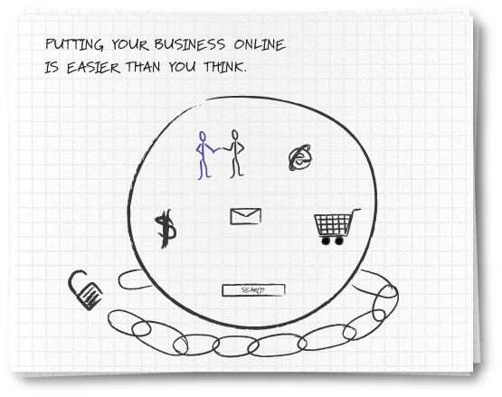
Notes:
….grab the key from those around you today….

Slide 13
My 5th grader has a better web site than you!
Microsoft Solutions

Slide 14



Microsoft Solutions

Slide 15
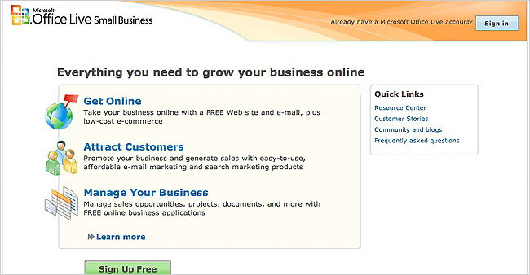
Microsoft Office Live
Get your company online. Set up a FREE web site & e-mail, plus low cost e-commerce - all by yourself.
Attract customers. Market your business with intuitive and affordable email marketing & search marketing products.
Manage your business. Manage sales opportunities, projects, documents, & more with FREE online business applications.
Notes:
Microsoft Office Live
Get your company online. Take your business online with a FREE Web site (with analysis tools) and e-mail, in company communications, plus low-cost e-commerce
Attract customers. Promote your business and generate sales with easy-to-use, affordable e-mail marketing and search marketing products (MSN, Ask.com).
Manage your business. Manage sales opportunities, projects, documents, and much more with FREE online business applications.

Slide 16
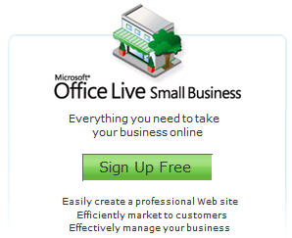
Microsoft Office Live
Next steps
Visit http://mslocalbiz.com to
Learn more at our Resource Center
See what people are saying about Office Live

Slide 17









Windows Small Business Server 2003 R2
Get remote access to the information you need from any PC. See your email, internal websites, network files and business applications.
Provide one central location to store and access business information. All employees can easily find and share documents.
Automatically back up your business data. Easily retrieve damaged or deleted files.
Cost-effectively share resources. Get the most value out of your printers, fax machines and phone lines.
Notes:
Windows Small Business Server 2003 R2
Get remote access to the information you need from any PC. Just log on and you can access email, internal websites, network files and business applications.
Provide one central location to store and access business information. Help your employees easily find, use and share the information they need. Integrates with Windows Mobile-based devices, too.
Automatically back up your business information. Prevent data loss and enable your employees to easily retrieve accidentally deleted files and restore previous versions.
Cost-effectively share resources. Get the most value out of your printers, fax machines and phone lines.

Slide 18
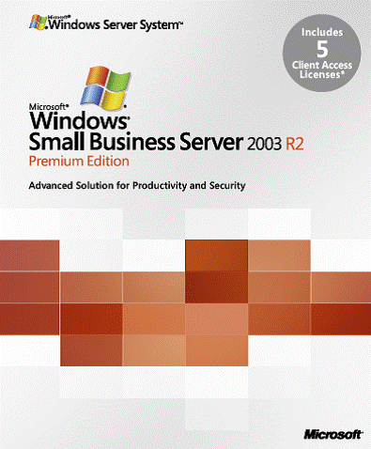
Windows Small Business Server 2003 R2
Demo
Next steps
Visit http://mslocalbiz.com to
Test drive Small Business Server
Get a FREE Technology Assessment

Slide 19
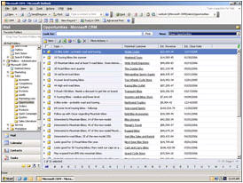
Microsoft Dynamics CRM Online
Get started fast. Dynamics CRM Online is a full-featured subscription CRM solution that you can get up and running quickly.
Maximize the value of your CRM solution. Optimize your campaigns and manage all your customer information online.
Enjoy simple and affordable pricing. Just $39 per user per month.
Smooth migration path. Easily migrate to the on-premise version as your business grows.
Notes:
Microsoft Dynamics CRM Online
Get started fast. Dynamics CRM Online is a full-featured subscription CRM solution. It’s the perfect choice for customers who want to get up and running quickly.
Leverage what you already know. Take advantage of rich CRM capabilities within a familiar Microsoft Office environment.
Maximize the value of your CRM solution. Optimize your marketing campaigns and promotions, gain new insights into your customers, and centrally manage all your customer information online. Flexible design and process automation make it easy.
Enjoy simple and affordable pricing. Just $39 per user per month.
Smooth migration path. You can start out with the Microsoft-hosted version and easily migrate to the on-premise version a your business grows.

Slide 20
Microsoft Dynamics CRM Online
Demo
Next steps
Visit http://mslocalbiz.com to
Try CRM Online FREE for a 30 day trial

Slide 21
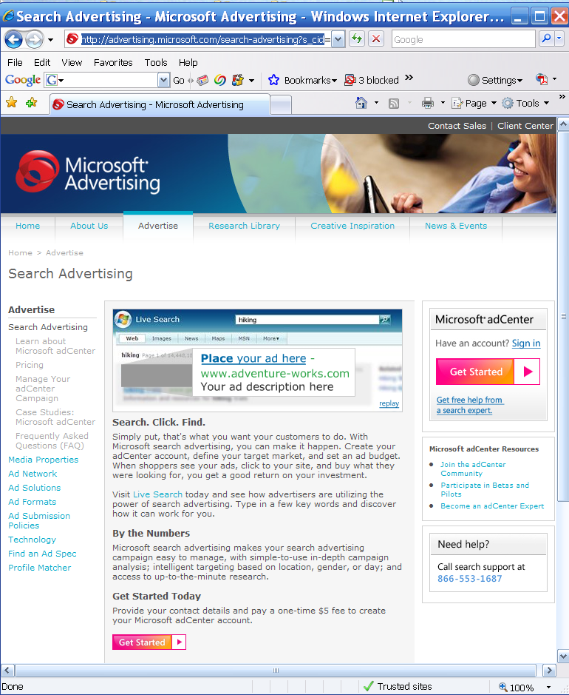
Microsoft adCenter
Live Demo
http://microsoft.com/adcenter

Slide 22
Additional Offers
[Partners – add your own offers here, related to the products you are demonstrating during the event]

Slide 23
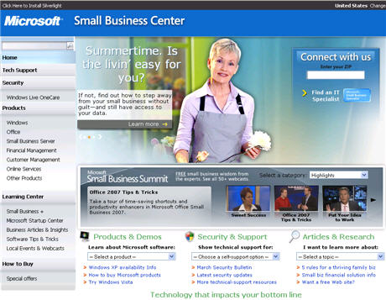
Take the Next Step
Go to http://mslocalbiz.com for complete information about Microsoft solutions for small businesses
Demo software
Download free trials
Get a FREE Technology
Assessment for Small
Business Server

Slide 25
Insert Partner Logo
Insert Partner Logo
Insert Partner Logo
Insert Partner Logo

Slide 26
EXTRA SLIDES

Slide 27
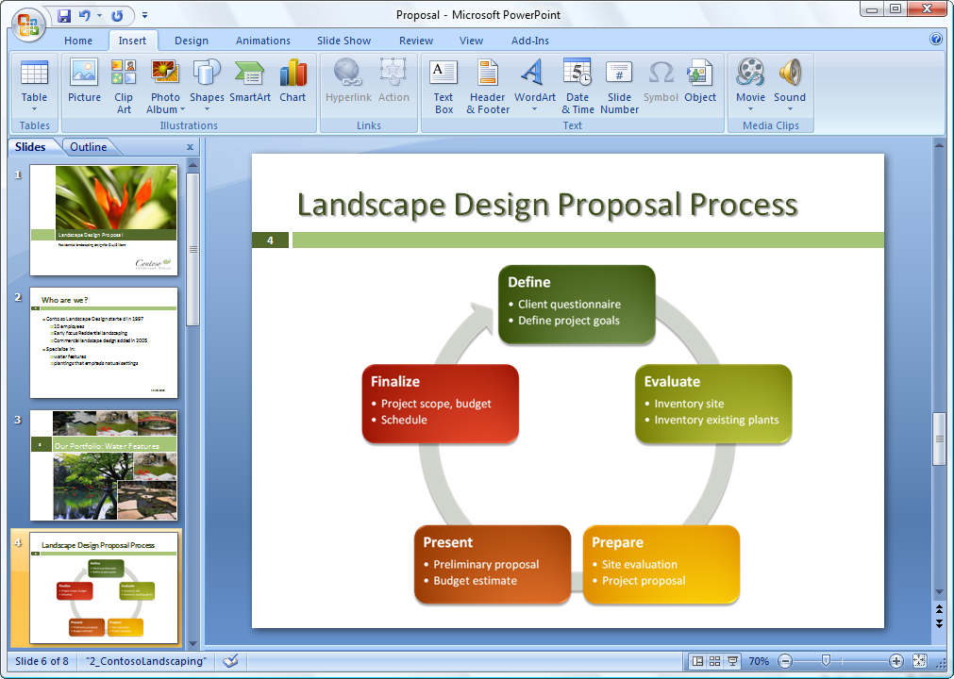
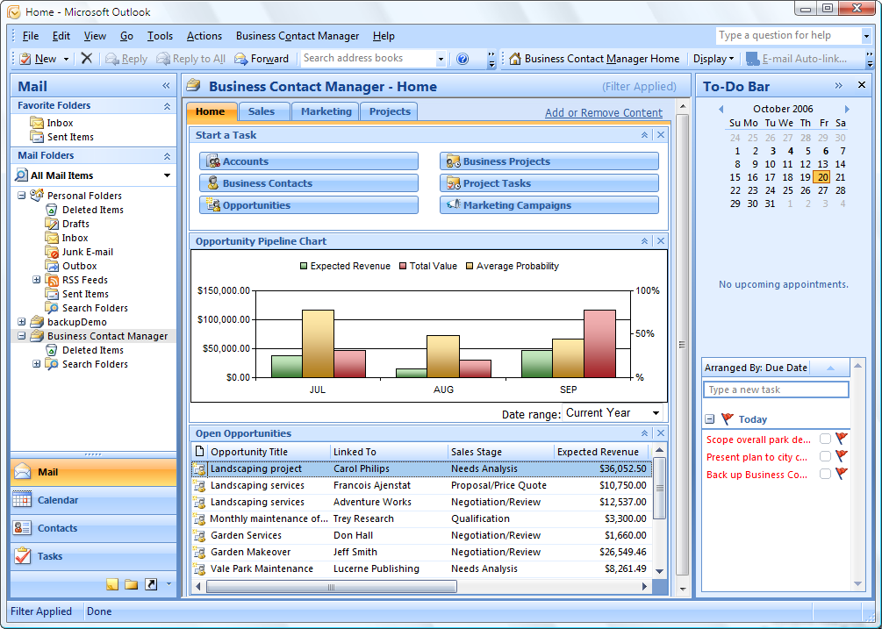


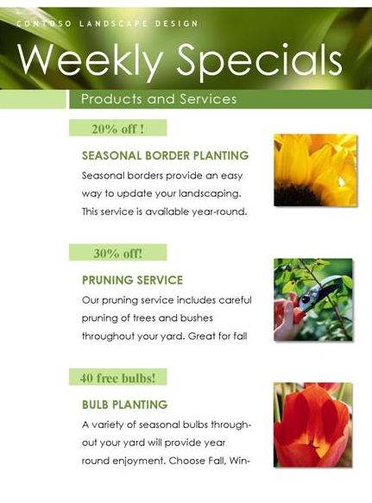
Microsoft Office Small Business 2007
Work more efficiently and effectively. New tools help you work faster and create more professional documents and presentations.
Get started with CRM capabilities. Microsoft Office Outlook with Business Contact Manager includes a complete contact management solution.
Produce professional marketing materials and campaigns in-house. Create impressive marketing materials and campaigns for print, e-mail, and the web.

Slide 28
Microsoft Office Small Business 2007
Demo
Next steps
Visit http://mslocalbiz.com to
Download free trial software
Try Outlook with BCM

Slide 29
Windows Vista Ultimate
Get started faster. Find the programs, business records, and emails you need quickly.
Work how you want, where you want. Keep ahead of changing business needs with powerful mobility and collaboration features.
Ensure your system’s versatility. Enjoy wide compatibility with software applications, peripherals, and services.
Be more secure. Protect your business from malicious software, data loss, and theft.
Notes:
Windows Vista Ultimate
Get started faster. Find the programs, business records, and emails you need to get things done in seconds, not minutes.
Work how you want, where you want. Keep ahead of changing business needs with powerful mobility and collaboration features that let you work from virtually anywhere.
Ensure your system’s versatility. Enjoy wide compatibility with software applications, peripherals, and services.
Be more secure. Protect your business from losing time and money due to malicious software, data loss, PC crashes, and theft.

Slide 30
Windows Vista Ultimate
Demo
Next steps
Visit http://mslocalbiz.com to
Take a test drive

Slide 31
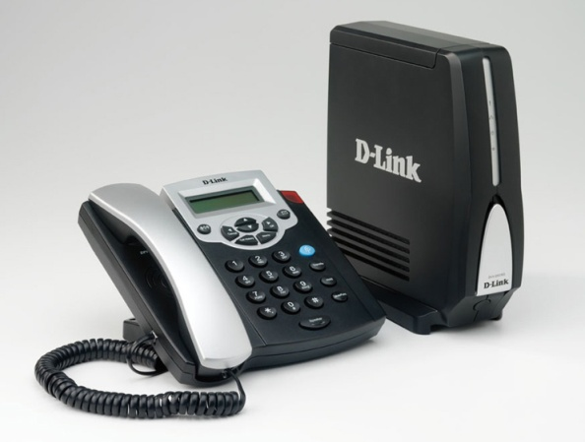
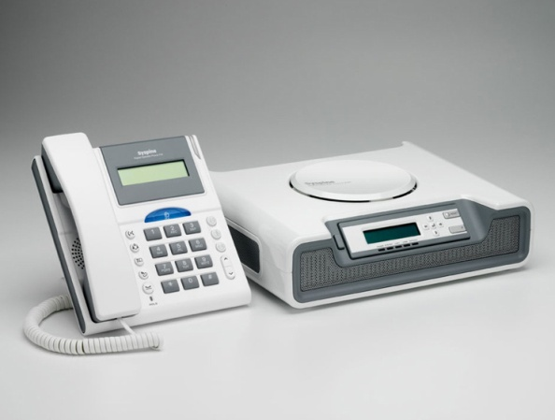
Microsoft Response Point
Fully integrate your phone system with your computer network. Have your voice mail delivered via email, and see Caller-ID on your screen.
Use your phone as a tool for customer satisfaction. Assign special phone numbers to your most important customers.
Create a local presence. Set up unique phone numbers in different locations, so you look local.
Enjoy complete flexibility. Includes a customizable voice attendant and automatic forwarding to your cell or
home phone.
Notes:
Microsoft Response Point
Fully integrate your phone system with your computer network. Have your voice mail delivered via email, and see notifications of incoming calls on your screen with Caller-ID.
Use your phone as a tool for customer satisfaction. You can assign a specific phone number to your most important customer. And it’s possible to see call history at a glance, including the number of times in and out. Importing contacts from Outlook and other solutions is easy, too.
Create a local presence. By having different phone numbers in different locations, you can look local.
Enjoy complete flexibility. Response Point comes with voice activation for FAQ, a customizable voice attendant and on-hold music, and automatic forwarding to your cell or home phone.

