Slide 1
So you heard about me from your mom’s doctor’s golfing buddy?
Presenter’s Name
Partner Name
Date
Insert Partner Logo
Insert Partner Logo
Insert Partner Logo
Insert Partner Logo
Notes:
So…has anyone here generated new business from a customer referral? That’s right…you all have, but do you have a strategy …or does it just happen?

Slide 2
Notes:
We all have our ways of thinking about business strategy…I happen to do my best thinking on a scratch pad! So we all want new customers….right? But many times it seems like a complicated maze to reach them at the right time, with the right message and the right product. How am I going to get through the maze…???

Slide 3
Welcome to your local team
Meet other small business people in your area
Share stories and insights
Find solutions to some of your biggest challenges
Tap into a local network full of resources
[List Presenters & Introduce them here]

Slide 4
What challenges are you facing today?
Finding new customers can take a lot of time and be expensive—and you’re not getting paid
Don’t know how to find more prospects
Think search marketing can help, but not sure how it works
Notes:
When we talk to small business owners around the country…one problem connects them all…How to find new customers. Advertising isn’t enough…yellow pages don’t seem relevant any longer…I use search engines, but how do I source customers via search. What are your biggest challenges?

Slide 5
In 2004, only three out of five customers (59%) were satisfied with the response they received when contacting a company for assistance.
Portland Research Group

Slide 6
The process of finding new customers can be expensive—and you’re not getting paid
Keep as many customers as you can by maximizing customer satisfaction
Set and meet or exceed expectations
Understand your customer’s history and be able to reference it quickly
Make sure your employees realize that every customer interaction is an opportunity to build--or detract from--your reputation
Notes:
First…you’ve got to make sure the back door remains closed while the front is wide open! Be methodical about exceeding your customer’s expectations. Treat them like you like to be treated.
There is no better way to exceed their expectations than to recognize their previous purchase history…Do you even know if the person, who just walked in, is part the top 20% of your customers who buy 80% of your products?
Recognize every customer touch point for what it is. A chance to exceed expectations…a chance to surprise customers with your knowledge about their relationship. A company’s brand is directly tied and impacts all the customer touch points. It is not just the sale….but rather, the comprehensive relationship including sales, customer service, billing, returns, in-store management…and so on.
What is the best technique you use to exceed customer expectations?

Slide 7
In 2005, 24% of small business owners considered their Internet presence to be very important for driving their businesses. In 2008, that rose to 48%.
Warrilow Weekly

Slide 8
Don’t know how to find more prospects
Take advantage of the power of networking
Tap into the loyalty of current customers to generate referrals
Communicate frequently with your customers to stay top-of-mind
Network with other small businesses to help you expand your reach
Notes:
One of the reasons you’re here today is that you recognize the value of networking. It is the great value that local businesses have that, frankly, large corporations can never replicate.
Today…let’s try an experiment. Let’s pick 4 volunteers…stand up tell us your business and I bet within about 2 minutes you will be able to find reasons to collaborate, share experiences or better yet, recommend potential new customers.

Slide 9
“Companies who used search engine marketing site saw an average gain of 73% in site traffic within 6 months.”
MarketingSherpa
Notes:
Show of hands…how many used a search engine in the last 48 hours? How many have found a local business through a search engine in the last 30 days? So…your customers and prospects are just like you. Search has become ubiquitous…it has replaced yellow pages….411….the jumble of business cards in the kitchen drawer. Recognize the value…launch an effort with the familiar search engines to find the way to engage. Guess what? They all have websites with remarkably easy steps to engage, plan and launch paid search campaigns…but there’s more.

Slide 10
Think search marketing can help, but not sure how it works
With just a small amount of information, you can get started
Review your website to make sure it includes the information customers will want once they’re there
Leverage your reputation with your existing customers by featuring quotes from them on your site
Increase the odds of being listed higher in search listings by maximizing the usage of critical words that will help customers find your business
Buy search words to augment your marketing program and test the results
Notes:
Getting a website in place that contains the search terms you know prospects will search for…is also an important step to getting ranked higher in search listings

Slide 11
Notes:
So…if I’m thinking about this maze…I’m building a business strategy, but I can’t juggle everything…service, selling, billing, etc, while trying to generate new customers…my new business diagram is…

Slide 12
Notes:
…THIS one. Break down the walls…think retention…think exceeding expectations…think search marketing…think word of mouth. The shortest distance between two points is a straight line. “Straight line” your strategy…don’t get caught in the maze when you know the health of any business is dependent on new customers…

Slide 13
So you heard about me from your mom’s doctor’s golfing buddy?
Microsoft Solutions

Slide 14
Microsoft Solutions

Slide 15
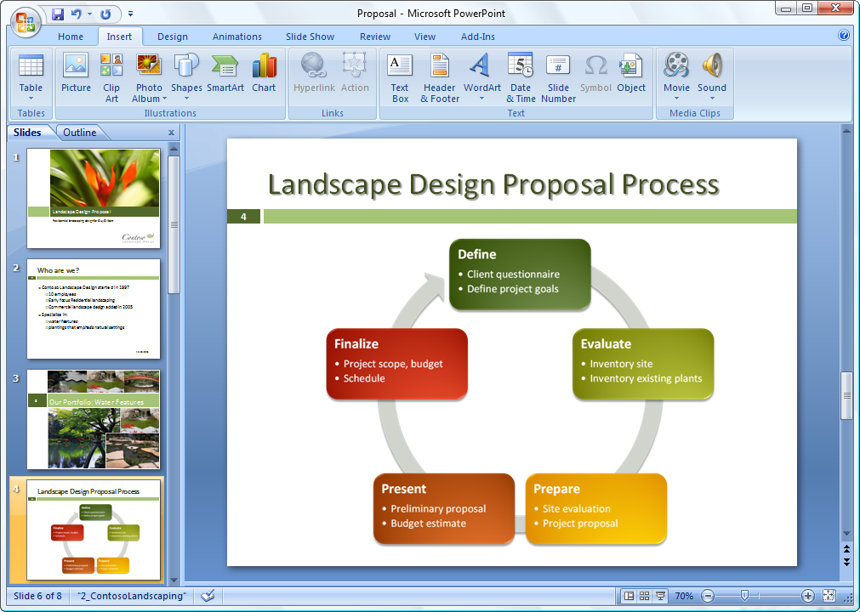
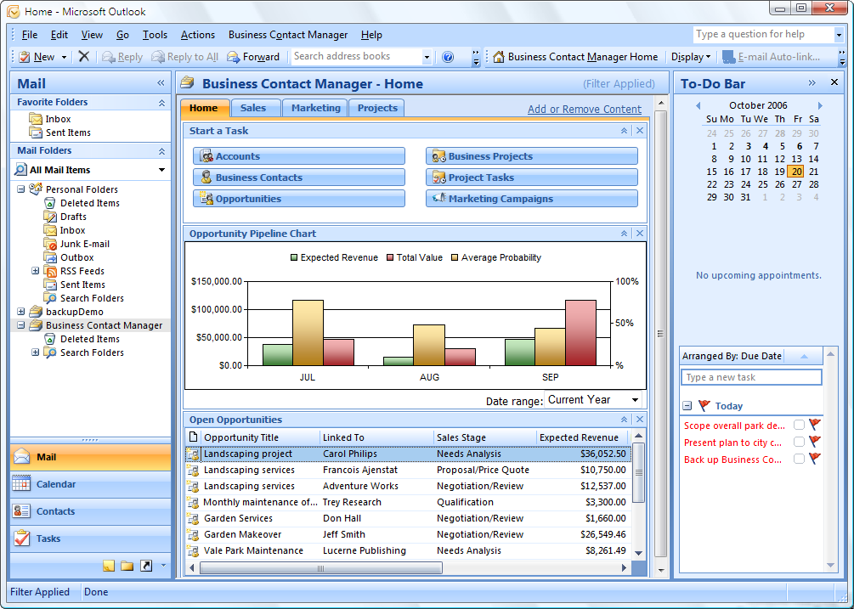
Microsoft Office Small Business 2007
Work more efficiently and effectively. New tools help you work faster and create more professional documents and presentations.
Get started with CRM capabilities. Microsoft Office Outlook with Business Contact Manager includes a complete contact management solution.
Produce professional marketing materials and campaigns in-house. Create impressive marketing materials and campaigns for print, e-mail, and the web.

Slide 16
Microsoft Office Small Business 2007
Demo
Next steps
Visit http://mslocalbiz.com to
Download free trial software
Try Outlook with BCM

Slide 17
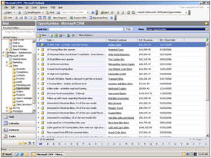
Microsoft Dynamics CRM Online
Get started fast. Dynamics CRM Online is a full-featured subscription CRM solution that you can get up and running quickly.
Maximize the value of your CRM solution. Optimize your campaigns and manage all your customer information online.
Enjoy simple and affordable pricing. Just $39 per user per month.
Smooth migration path. Easily migrate to the on-premise version as your business grows.
Notes:
Microsoft Dynamics CRM Online
Get started fast. Dynamics CRM Online is a full-featured subscription CRM solution. It’s the perfect choice for customers who want to get up and running quickly.
Leverage what you already know. Take advantage of rich CRM capabilities within a familiar Microsoft Office environment.
Maximize the value of your CRM solution. Optimize your marketing campaigns and promotions, gain new insights into your customers, and centrally manage all your customer information online. Flexible design and process automation make it easy.
Enjoy simple and affordable pricing. Just $39 per user per month.
Smooth migration path. You can start out with the Microsoft-hosted version and easily migrate to the on-premise version a your business grows.

Slide 18
Microsoft Dynamics CRM Online
Demo
Next steps
Visit http://mslocalbiz.com to
Try CRM Online FREE for a 30 day trial

Slide 19
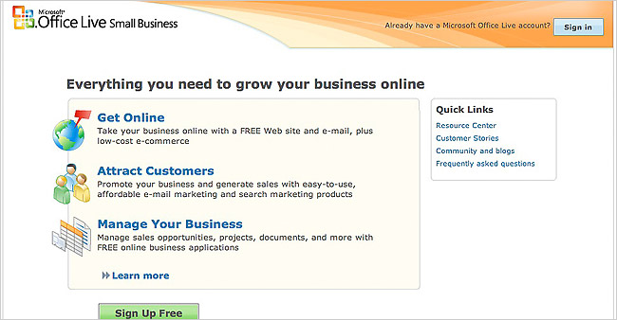
Microsoft Office Live
Get your company online. Set up a FREE web site & e-mail, plus low cost e-commerce - all by yourself.
Attract customers. Market your business with intuitive and affordable email marketing & search marketing products.
Manage your business. Manage sales opportunities, projects, documents, & more with FREE online business applications.
Notes:
Microsoft Office Live
Get your company online. Take your business online with a FREE Web site (with analysis tools) and e-mail, in company communications, plus low-cost e-commerce
Attract customers. Promote your business and generate sales with easy-to-use, affordable e-mail marketing and search marketing products (MSN, Ask.com).
Manage your business. Manage sales opportunities, projects, documents, and much more with FREE online business applications.

Slide 20
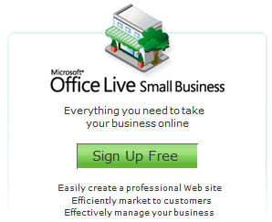
Microsoft Office Live
Next steps
Visit http://mslocalbiz.com to
Learn more at our Resource Center
See what people are saying about Microsoft Office Live

Slide 21
Microsoft adCenter
Live Demo
http://microsoft.com/adcenter

Slide 22
Additional Offers
[Partners – add your own offers here, related to the products you are demonstrating during the event]

Slide 23
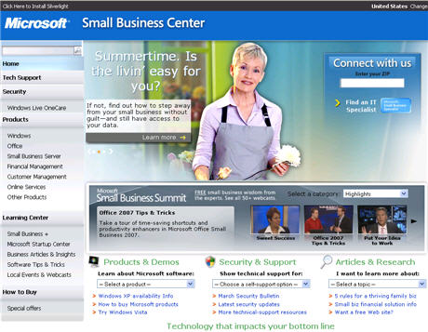
Take the Next Step
Go to http://mslocalbiz.com for complete information about Microsoft solutions for small businesses
Demo software
Download free trials

Slide 24
Notes:
Now you know how to get through the maze. Break down the walls…think retention…think exceeding expectations…think search marketing…think word of mouth. The shortest distance between two points is a straight line. “Straight line” your strategy….don’t get caught in the maze when you know the health of any business depends on new customers.

Slide 25
Insert Partner Logo
Insert Partner Logo
Insert Partner Logo
Insert Partner Logo

Slide 26
EXTRA SLIDES

Slide 27
Windows Vista Ultimate
Get started faster. Find the programs, business records, and emails you need quickly.
Work how you want, where you want. Keep ahead of changing business needs with powerful mobility and collaboration features.
Ensure your system’s versatility. Enjoy wide compatibility with software applications, peripherals, and services.
Be more secure. Protect your business from malicious software, data loss, and theft.
Notes:
Windows Vista Ultimate
Get started faster. Find the programs, business records, and emails you need to get things done in seconds, not minutes.
Work how you want, where you want. Keep ahead of changing business needs with powerful mobility and collaboration features that let you work from virtually anywhere.
Ensure your system’s versatility. Enjoy wide compatibility with software applications, peripherals, and services.
Be more secure. Protect your business from losing time and money due to malicious software, data loss, PC crashes, and theft.

Slide 28
Windows Vista Ultimate
Demo
Next steps
Visit http://mslocalbiz.com to
Take a test drive

Slide 29
Windows Small Business Server 2003 R2
Get remote access to the information you need from any PC. See your email, internal websites, network files and business applications.
Provide one central location to store and access business information. All employees can easily find and share documents.
Automatically back up your business data. Easily retrieve damaged or deleted files.
Cost-effectively share resources. Get the most value out of your printers, fax machines and phone lines.
Notes:
Windows Small Business Server 2003 R2
Get remote access to the information you need from any PC. Just log on and you can access email, internal websites, network files and business applications.
Provide one central location to store and access business information. Help your employees easily find, use and share the information they need. Integrates with Windows Mobile-based devices, too.
Automatically back up your business information. Prevent data loss and enable your employees to easily retrieve accidentally deleted files and restore previous versions.
Cost-effectively share resources. Get the most value out of your printers, fax machines and phone lines.

Slide 30
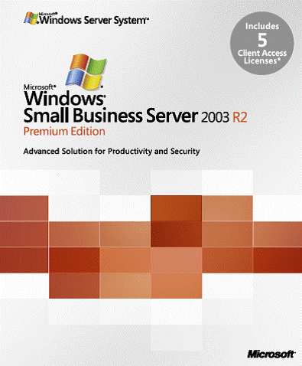
Windows Small Business Server 2003 R2
Demo
Next steps
Visit http://mslocalbiz.com to
Test drive Small Business Server
Get a FREE Technology Assessment

