Slide 1
Presentation Guidelines
You can and should customize this presentation to speak to your local business audience. Insert your information where there is currently red text and feel free to add or delete anything else as suits your needs.
Here are some suggestions:
Add your own products that are relevant to the customer issue you are discussing (Slide 26).
Add your own offers for your products or Microsoft products (Slide 27).
Update the next steps for each Microsoft product with the latest offers from www.mslocaloffers.com (Slides 17, 19, 21, 23, 25).
Remove any Microsoft product slides that you do not want to feature (Slides 16-25, 31-36).
This presentation is designed to be an interactive session between the speaker and attendees. Use the speaker notes to guide the discussion and encourage everyone to participate in sharing their experiences.

Slide 2
The best mistakes are the ones you don’t have to make.
Presenter’s Name
Partner Name
Date
Insert Partner Logo
Insert Partner Logo
Insert Partner Logo
Insert Partner Logo
Notes:
So I always say that my experience represents all the things I never want to do again! I learn from my mistakes, but the best kind of mistakes are the ones that you don’t have to make. So many mistakes, business judgment errors, and screw-ups happen because a business owner is juggling many responsibilities.

Slide 3
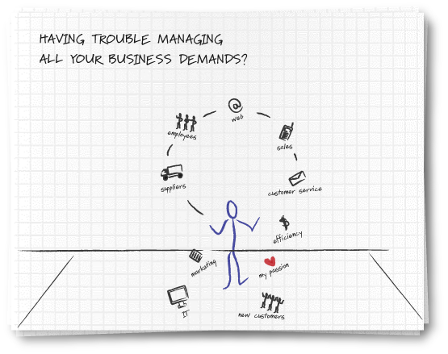
Notes:
Unfortunately, when you juggle all that you do, something will crash and break. You hope it’s something unimportant, but it always seems to be the most expensive piece of “business crystal” that breaks. It’s impossible to just stop juggling a few things. You can’t, you run the show. But can they be “orchestrated” better?

Slide 4
Welcome to your local team
Meet other small business people in your area
Share stories and insights
Find solutions to some of your biggest challenges
Tap into a local network full of resources
[List Presenters & Introduce them here]
Notes:
We are holding these meetings so you can learn from people like you. Learn from some experts and walk away with a better network of local people who can help you better orchestrate your juggling routine.
Anyone have a problem that was created by you not having enough time to concentrate on a solution? Show of hands? Does anyone have a solution or an idea where our volunteer can find a solution?

Slide 5
How the Local Engagement Team works
130,000+
Microsoft Partners
Non-Profit Organizations
Complementary Partners
Microsoft Partners, complementary companies, and organizations are brought together for engagements at a local level to cater to your needs.
Local Engagement Team Model

Slide 6
What challenges are you facing today?
Growing your business in a slow economy
Maintaining work/life balance
Playing so many different roles, you can’t master them all
Notes:
What’s keeping you awake at night?
Many businesses tell us it’s these challenges.
What do you think? Do you find it more difficult today to find new business opportunities? Are sales costs increasing, putting pressure on profitability? Is anybody in the audience spending more time with their families now than two years ago? Do you have to be a master of many different roles but you lack the tools?

Slide 7
It costs four to ten times as much to capture a new customer as it does to provide good services to an existing one.
Thompson Group Marketing
Walnut Creek, CA
Notes:
A common problem we’re hearing throughout the country is that the cost of acquiring new customers continues to increase. My question today is: isn’t it cheaper to retain more customers than to seek new ones? Think about this as “the first dollar” concept. If you have just one dollar to spend to acquire new business, should you spend that selling something else to an existing customer or generating a new customer?

Slide 8
How to grow a business in a slow economy?
Keep more current customers and use innovative methods to attract new customers
Nurture customer base by maximizing customer satisfaction and communicating on a regular basis
Generate more referrals by leveraging your excellent reputation
Through customers and your local business community
Find new customers by launching a search marketing program
Notes:
If you can keep more of your current customers, you will spend less acquiring new customers. Furthermore, there are many new, innovative approaches available to you to sell more productively.
First, do any of you in the audience have an example of how you’ve worked hard to retain existing customers? How about customer referrals? Do you capitalize on your loyal customer relationships by asking them for renewals? Have you initiated new relationships yourself by using search engines to find a vendor or supplier? Recognize that your customers rely on search as well. Have you explored how you can capitalize on local search? Anyone in the audience using search to create new business leads?

Slide 9
Forty-nine percent of small business owners say they make business calls and check e-mail while driving.
Reuters
Notes:
First, do any of you risk your life by doing this? Of course you do, we all do.
Doesn’t this demonstrate that you need to explore additional productivity tools? Doesn’t this mean that you should be freeing up some of your time to accomplish the business critical tasks you can’t ever seem to get to?

Slide 10
How to get more done and maintain work/life balance?
Good mobility solutions allow you to accomplish more while spending less time at your desk
Have customer information available anytime, so you can respond immediately to customer needs
Keep everyone in your company connected, so your team can stay on top of new business developments
Make sure your network is secure and stable
Notes:
Does “mobility” just mean a “bluetooth” device? No, mobility means expanding the productivity of your workforce. Mobility means not just connecting, but connecting securely. Can your workforce be just as productive working from home as the office? What do you think? We have many examples from very large companies where they encourage their experienced staff to work from home. Why? Frees up office space for growth, expands the work day, increases creative output. What about your business?

Slide 11
Two-thirds of small business owners work more than a standard 40-hour work week.
Reuters
Notes:
This doesn’t surprise anyone, does it? We’re all looking for ways to make things simpler so that they don’t take as long to accomplish, right?
Technology should enable simplicity, but selecting and installing the right technology can be a daunting challenge. How have you selected companies to assist you with IT decisions and counsel?

Slide 12
How to master many different roles?
Focus on your strengths and outsource as necessary
Use real-time insights to make smarter management decisions
Line up expert help for time-intensive tasks like IT management
Leverage web site and e-commerce templates to quickly get your online marketing program started
Notes:
Can technology allow you to be productive and play many different roles more efficiently? Can you increase the speed with which you receive monthly or weekly reports? Can you enable your customer service teams by giving them better and faster access to customer information? Can a better website mean fewer customer service calls, thereby freeing up a human touch where it could lead to follow on business?

Slide 13
Notes:
So, will you continue to try to juggle everything at once OR…

Slide 14
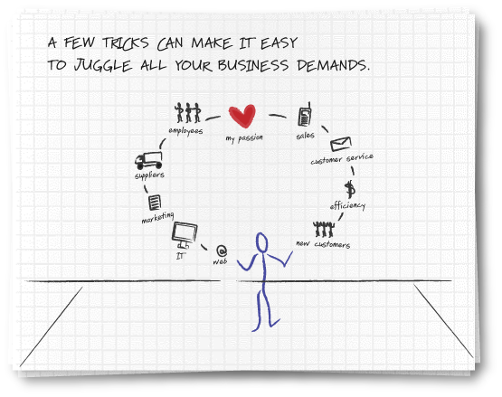
Notes:
Will you use the technology advances, as well as input from this network of your peers here today, to help you best orchestrate your juggling act? One where nothing falls and you have more time for your passion.

Slide 15
The best mistakes are the ones you don’t have to make.
Microsoft Solutions

Slide 16
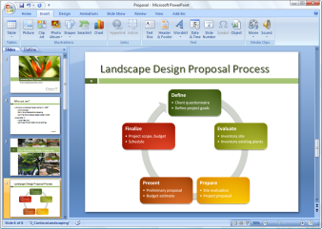
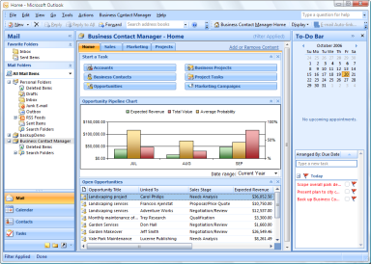
Microsoft Office Small Business 2007
Work more efficiently and effectively. New tools help you work faster and create more professional documents and presentations.
Get started with CRM capabilities. Microsoft Office Outlook with Business Contact Manager includes a complete contact management solution.
Produce professional marketing materials and campaigns in-house. Create impressive marketing materials and campaigns for print, e-mail, and the web.

Slide 17
Microsoft Office Small Business 2007
Next steps
Download a FREE 60-day trial
www.mslocaloffers.com

Slide 18
Windows Vista Ultimate with Service Pack 1
Get started faster. Find the programs, business records, and emails you need quickly.
Work how you want, where you want. Keep ahead of changing business needs with powerful mobility and collaboration features.
Ensure your system’s versatility. Enjoy wide compatibility with software applications, peripherals, and services.
Be more secure. Protect your business from malicious software, data loss, and theft.
Notes:
Get started faster. Find the programs, business records, and emails you need to get things done in seconds, not minutes.
Work how you want, where you want. Keep ahead of changing business needs with powerful mobility and collaboration features that let you work from virtually anywhere.
Ensure your system’s versatility. Enjoy wide compatibility with software applications, peripherals, and services.
Be more secure. Protect your business from losing time and money due to malicious software, data loss, PC crashes, and theft.

Slide 19
Windows Vista Ultimate with Service Pack 1
Next steps
Take a test drive
www.mslocaloffers.com

Slide 20
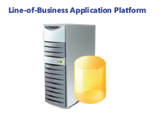
Windows Small Business Server 2008
Use an affordable, integrated solution. SBS 2008 brings together the Microsoft® technologies that small businesses need most into a single solution.
Protect your business data. Automatically back up the PCs and servers in your network and recover accidentally deleted files.
Grow your business capacity. Get secure access to important desktop resources from any Internet-connected PC, from virtually anywhere at any time, so you can be productive while you’re away from the office or on the road.
Notes:
Get remote access to the information you need from any PC. Just log on and you can access email, internal websites, network files and business applications.
Provide one central location to store and access business information. Help your employees easily find, use and share the information they need. Integrates with Windows Mobile-based devices, too.
Automatically back up your business information. Prevent data loss and enable your employees to easily retrieve accidentally deleted files and restore previous versions.
Cost-effectively share resources. Get the most value out of your printers, fax machines and phone lines.

Slide 21
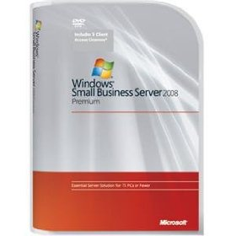
Windows Small Business Server 2008
Next steps
Download the demo
www.mslocaloffers.com

Slide 22
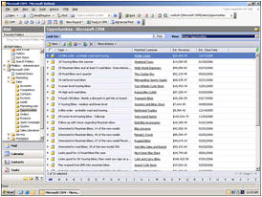
Microsoft Dynamics CRM Online
Get started fast. Dynamics CRM Online is a full-featured subscription CRM solution that you can get up and running quickly.
Maximize the value of your CRM solution. Optimize your campaigns and manage all your customer information online.
Enjoy simple and affordable pricing. Just $39 per user per month.
Smooth migration path. Easily migrate to the on-premise version as your business grows.
Notes:
Get started fast. Dynamics CRM Online is a full-featured subscription CRM solution. It’s the perfect choice for customers who want to get up and running quickly.
Leverage what you already know. Take advantage of rich CRM capabilities within a familiar Microsoft Office environment.
Maximize the value of your CRM solution. Optimize your marketing campaigns and promotions, gain new insights into your customers, and centrally manage all your customer information online. Flexible design and process automation make it easy.
Enjoy simple and affordable pricing. Just $39 per user per month.
Smooth migration path. You can start out with the Microsoft-hosted version and easily migrate to the on-premise version a your business grows.

Slide 23
Microsoft Dynamics CRM Online
Next steps
Get a free 30 day trial
www.mslocaloffers.com

Slide 24
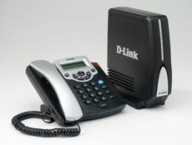
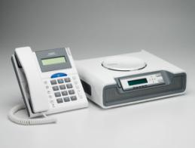
Microsoft Response Point
Fully integrate your phone system with your computer network. Have your voice mail delivered via email, and see Caller-ID on your screen.
Use your phone as a tool for customer satisfaction. Assign special phone numbers to your most important customers.
Create a local presence. Set up unique phone numbers in different locations, so you look local.
Enjoy complete flexibility. Includes a customizable voice attendant and automatic forwarding to your cell or home phone.
Notes:
Fully integrate your phone system with your computer network. Have your voice mail delivered via email, and see notifications of incoming calls on your screen with Caller-ID.
Use your phone as a tool for customer satisfaction. You can assign a specific phone number to your most important customer. And it’s possible to see call history at a glance, including the number of times in and out. Importing contacts from Outlook and other solutions is easy, too.
Create a local presence. By having different phone numbers in different locations, you can look local.
Enjoy complete flexibility. Response Point comes with voice activation for FAQ, a customizable voice attendant and on-hold music, and automatic forwarding to your cell or home phone.

Slide 25
Microsoft Response Point
Next steps
Get a Microsoft Response Point phone system for as little as $12/month through Microsoft Financing
www.mslocaloffers.com

Slide 26
Additional Products
[Partners – add your own products here, related to the customer issues you are addressing at this event]

Slide 27
Additional Offers
[Partners – add your own offers here, related to the products you are featuring during the event]

Slide 28
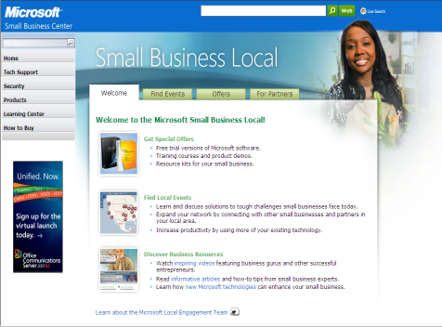
Take the Next Step
Go to www.mslocalbiz.com for complete information about Microsoft solutions for small businesses
Demo software
Download free trials

Slide 29
Insert Partner Logo
Insert Partner Logo
Insert Partner Logo
Insert Partner Logo

Slide 30
EXTRA SLIDES

Slide 31
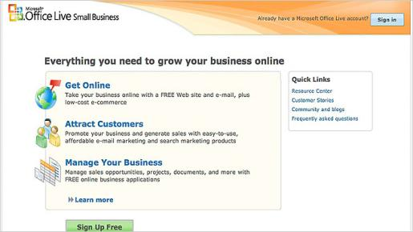
Microsoft Office Live Small Business
Get your company online. Set up a FREE web site & e-mail, plus low cost e-commerce - all by yourself.
Attract customers. Market your business with intuitive and affordable email marketing & search marketing products.
Manage your business. Manage sales opportunities, projects, documents, & more with FREE online business applications.
Notes:
Get your company online. Take your business online with a FREE Web site (with analysis tools) and e-mail, in company communications, plus low-cost e-commerce
Attract customers. Promote your business and generate sales with easy-to-use, affordable e-mail marketing and search marketing products (MSN, Ask.com).
Manage your business. Manage sales opportunities, projects, documents, and much more with FREE online business applications.

Slide 32
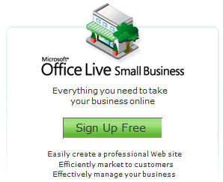
Microsoft Office Live Small Business
Next steps
Get a free website plus hosting and email addresses
www.mslocaloffers.com

Slide 33
Microsoft adCenter
Target the right consumers. Connect with the right consumers by aiming for specific demographics. Target your audience by choosing up to 100 keywords as well as negative keywords.
Manage and customize your search campaign. Get helpful performance data that you can use to optimize and improve your search advertising campaign. Customize your online campaign by specifying date ranges, improving report charts, and choosing how you want to sort your results.

Slide 34
Microsoft adCenter
Next Steps
Start your search advertising with Microsoft® adCenter for only $5
www.mslocaloffers.com

Slide 35
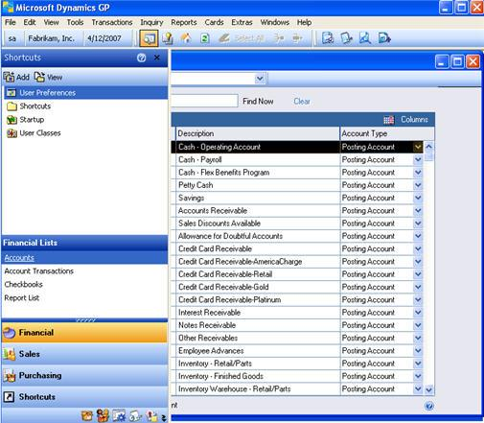
Microsoft Dynamics GP
Peace of Mind. Dynamics GP provides accountability by tracking every change made by every person.
Instant Knowledge. Dynamics GP will instantly alert you of pertinent financial situations.
Freedom to Grow. Dynamics GP supports over 1,000 simultaneous users vs. QuickBooks Pro’s 5.
Notes:
Peace of Mind. Dynamics GP provides a secure audit trail that shows every change made by every person. However, it is possible for someone to make changes to the general ledger or subsidiary journal in QuickBooks without any record of who made the change or what was changed.
Instant Knowledge. Dynamics GP will alert you of financial situations that you want to know about immediately.
Freedom to Grow. Dynamics GP supports more than 1,000 simultaneous users; QuickBooks Pro only 5.

Slide 36
Microsoft Dynamics GP
Next steps
Get a free QuickBooks Replacer Kit and learn how Microsoft Dynamics® can help you meet your growing business needs
www.mslocaloffers.com

