Slide 1
Dynamic Desktop with Microsoft Desktop Optimization Pack
Sudhir Rao
Technology Specialist | Microsoft Corporation

Slide 2
What is MDOP?
Microsoft Desktop Operation Pack for Software Assurance
6 innovative technologies that will help you simplify your desktop and application management
Address the common IT operational challenges faced by customers…

Slide 3
Enterprise Desktop Management
Challenges
IT staff spends too much time and resources deploying, upgrading, supporting, and terminating applications
Regression testing is a major pain…
Application-to-Application compatibility issues
  Version 1 and version 2 cannot run on the same machine

Slide 4










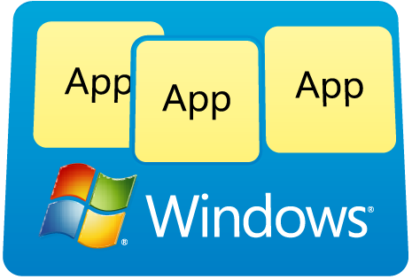
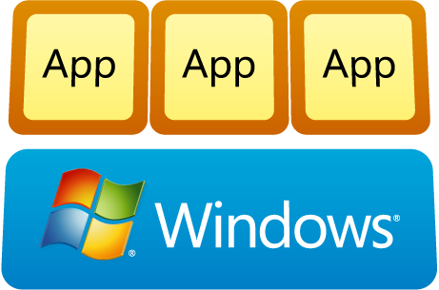
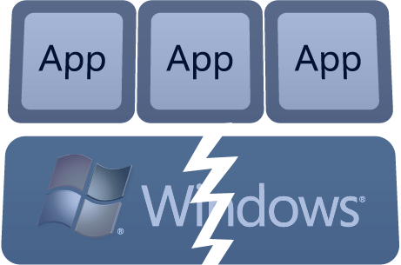

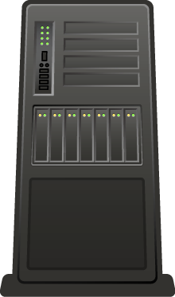

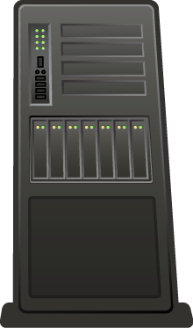
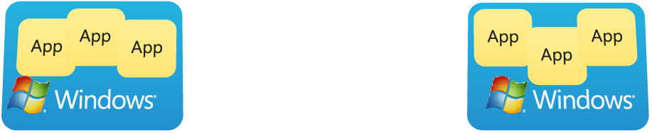
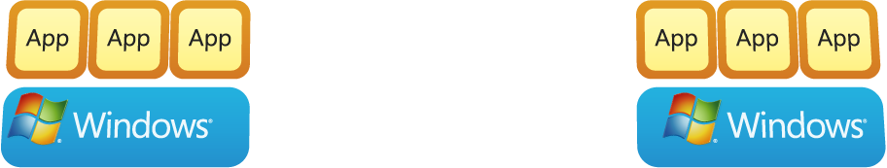


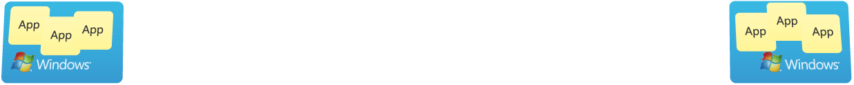








Manage
Group Policies
Virtualize and Stream Apps
Inventory
Assets
Monitor Crashes
Repair
Desktops
NEW!
Simplifying deployment and management of Virtual PCs
ALERT:
Application X
has failed
App
App
App
App
App
App
App
App
App
App
App
System Center
DEM Operations
Manager 2007
System Center
Virtual App
Server
Translating software inventory
into business intelligence
Enhancing group policy through
change management
Dynamically streaming software as a centrally managed service
Proactively managing application and operating system failures
Powerful tools to accelerate desktop repair
Notes:
The Microsoft Desktop Optimization Pack helps you every step of the way in accelerating and managing your desktop deployments. First, you need to understand what software you have in your desktop environment, that’s what Asset Inventory Service does. It scans and analyzes all the applications on your desktops by translating inventory data into useful and actionable information.
Then, you need make sure that your users and computers on your network aren’t affected by Group Policy changes that may have an unexpected adverse impact. Advanced Group Policy Management helps you with this to easily manage Group Policy through a change management and role-based delegation system ensuring less downtime and a better user experience.
Managing applications enterprise-wide is complex and costly. With SoftGrid Application Virtualization , you can manage applications in a more centrally controlled way that benefits both end users and IT. Because applications are transformed into virtual services that are never installed, they are available instantly to users anywhere. Desktop administration for deploying, patching, updating and terminating applications is simpler and requires much fewer IT resources.
One of the more difficult things for IT to resolve is when a system or application crashes or hangs. End-users typically don’t typically notify IT, because of this, IT has limited visibility to these issues and can’t proactively resolve them. Through agentless crash monitoring, System Center Desktop Error Monitoring identifies the probable cause and resolution for failures.
And lastly, Diagnostics and Recovery Toolset includes tools that help you repair and recover unbootable systems with minimal downtime for the end-user.
All these technologies work together to help you manage your desktop environment, lower TCO and be more responsive to users everywhere.

Slide 5

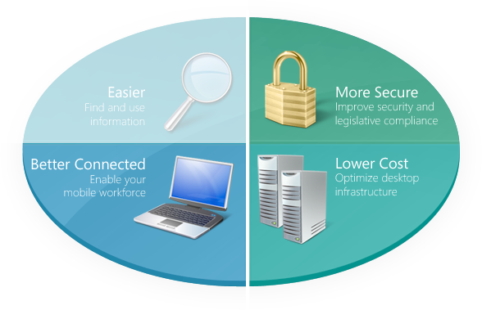

Microsoft SoftGrid Application Virtualization*
Dynamically streaming software as a centrally managed service
Life without traditional software installation
Applications to users at log on
Centralized permissions
Sandboxed applications
Accelerated desktop deployment
Minimize App to App compatibility testing
Run real-time usage reports
Enable device roaming
Application compatibility
PC manageability
Flexible computing models
Software asset management
*SoftGrid Application Virtualization CAL for Terminal Services is available and sold separately from MDOP
Notes:
SoftGrid changes the face of application lifecycle management. It enables a world without traditional software installation where users can access their applications from any licensed machine in seconds and where the user no longer has to be concerned with new software installation because nothing is installed locally – New patches and new versions can be provided to the user the moment they click on their desktop icon and when the session terminates, the code, settings, and profiles are saved on the PC in a virtual “sandbox”. This enables the employee to use the program even when they are not connected to the network.
This has several benefits to IT:
It accelerates desktop deployment and enables IT to take control of the desktop
It minimizes application conflicts through application isolation at streaming server
It minimizes significant application compatibility testing and scripting, multi-platform packaging, or significant regression testing
It enables IT to run real time usage reports on any application that is streamed
And it enables device roaming
Let’s take a look at the top 7 pain points and see what SoftGrid Application Virtualization does to address them.
Between the BDD, the ACT, the Virtual OS’ in Vista Enterprise and SoftGrid Application Virtualization rounds out the equation for addressing application compatibility by minimizing the application to application compatibility issues through the application isolation.
SoftGrid Application Virtualization simplifies corporate image management by separating the application layer from the OS and enabling. It also controls access and centralizes application permissions and policy based management with AD integration
It enables customers to run a mixed environment of rich and thin clients with a centralized mechanism to manage the applications for both
And it helps with software asset management by enabling real time usage reporting on those applications that are administered via SoftGrid Application Virtualization
But that software asset management capability is only a small portion of what customers need so we also added…(flip slide) the asset inventory services

Slide 6
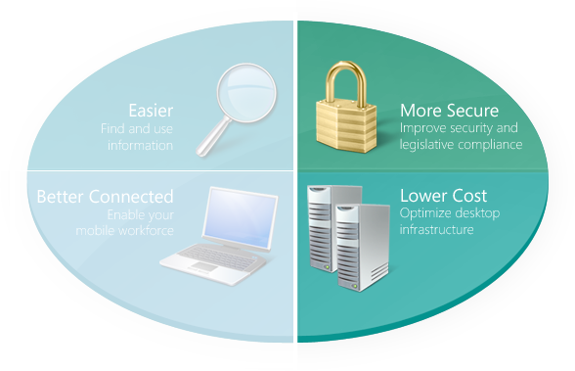
Microsoft Enterprise Desktop Virtualization
Simplifying deployment and management of Virtual PCs
Eliminate application to OS compatibility concerns
Centrally manage Virtual PCs
Apply policy to Virtual PCs
Simplify Virtual PC image delivery and update
Provision virtual OS on demand
Accelerate OS migrations
Eliminate Application compatibility concerns
Drive Business continuity
Application compatibility
PC manageability
Flexible computing models
Notes:
The Microsoft Diagnostic and recovery toolset enables IT to repair and recover an unbootable PC. IT can recover instead of reloading Windows even in an offline environment when Safe Mode will not function.
It Reduces downtime and enables flexible recovery with Locksmith, file restore and system repair.
It provides tools to enable diagnostics with system compare, event log and crash analyzer
Ad Explorer is another new feature that lets you find, modify, add, and delete Active Directory objects and attributes. AD Explorer displays information in two panes. The Object Pane, which is the left-hand pane, displays Active Directory objects. The Attribute Pane, which is the right-hand pane, displays attributes of the object selected in the Object Pane. You can use this tool to Browse, view, add, edit or delete any Active Directory Object
These utilities reduce the length of helpdesk calls and enable the recovery of critical data in a timely fashion. This improves PC Manageability, provides better diagnostics and helps make PCs safer to use.

Slide 7
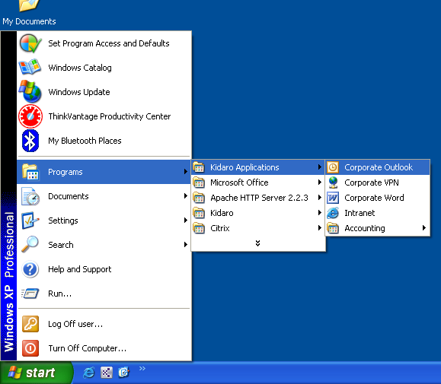
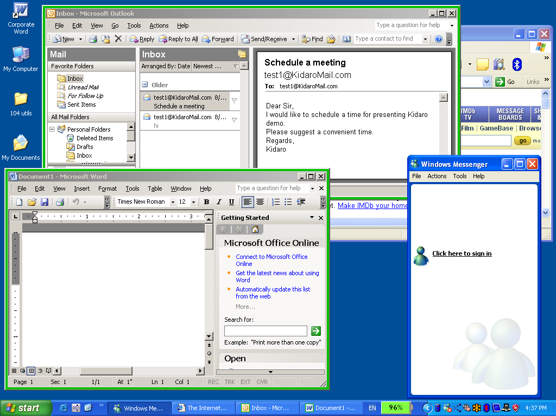
Microsoft Enterprise Desktop Virtualization
client communicates with server for user settings and policy enforcement
Virtualized applications seamlessly integrated into any node in the start menu.
Virtualized applications share the desktop with non-virtual applications. Optional colored borders differentiate virtual from non-virtual.
7

Slide 8
Microsoft Asset Inventory Service
Translating software inventory into business intelligence
Easily-administered service
Scans desktops
Checks against central host: 430K titles
Assigns intelligent naming to software
Simplifies compliance and disaster recovery
Application compatibility
Software asset management
Notes:
The Asset Inventory Service scans the customers desktops with intelligent and comprehensive scanning of a machine including 6 key areas: program Files scanning, MSI History, PIDs, Add/Remove, Programs, Link scanning, Referral chasing – to ensure that all applications that may be locally installed or running on a machine are captured.
It then takes that information back to the centrally hosted database that contains over 430K known and categorized software titles to turn back to the customer intelligent reporting and analysis that can help the customer manage their software assets. This helps simplify compliance and accelerate disaster recovery.
It simplifies machine restoration by understanding the software that is loaded on each machine
You can enable import & compare license entitlement information with deployed/installed software
And it enables compliance against key industry standards (SOX, HIPAA)
This assists with application compatibility by helping the customer to understand what applications a user might be running that may be out of compliance with corporate policy and may potentially be causing application conflicts
It also rounds out the software asset management challenge

Slide 9
Microsoft Advanced Group Policy Management
Enhancing group policy through change management
Enable effective group policy change management
Role-based administration & templates
Flexible delegation model
Versioning, history & rollback
Accelerate management with granular administrative control
Reduce risk of widespread failure
PC Manageability
Diagnostics & Help Desk
Notes:
The Advanced Group Policy management (AGPM) enables change control process through native integration and acting as an extension to the AD management console. It enables granular administrative controls – whereas the MMC has a binary delegation, the AGPM enables IT to delegate group policy object management for edit only , create, delete and approval for all different individuals at different levels. It also creates a version history of the changes made and routes the change requests.
The AGPM enables role based administration and the ability for IT to create templates so that if a certain group within the AD is assigned a given set of permissions that template can be saved and then assigned to anyone that is added to that group within the AD.
It also enables IT to rollback changes if they find that the changes applied to the group policy objects created some sort of conflict or were not functioning properly – the difference reporting and audit logging will help IT diagnose the issue and then roll the changes back out.
It also helps IT to edit group policy objectives offline, recover deleted group policy objects and repair live group policy objects which helps reduce the risk of widespread failures.
This technology provides a much richer level of PC manageability for IT and enables IT to lock the desktop down especially when used in conjunction with SoftGrid
It provides better diagnostics to IT with the difference reporting and audit logging and reduces help desk costs frequently associated with permissions control at the user level.

Slide 10
Microsoft Diagnostics & Recovery Toolset
Powerful tools to accelerate desktop repair
Accelerate TCO savings by minimizing recovery time
Recover deleted files, manipulate services, devices, passwords, more
Recover instead of reloading Windows
Make PCs safe to use
Accelerates desktop management and responsiveness
PC manageability
Diagnostics & Help Desk
Notes:
The Microsoft Diagnostic and recovery toolset enables IT to repair and recover an unbootable PC. IT can recover instead of reloading Windows even in an offline environment when Safe Mode will not function.
It Reduces downtime and enables flexible recovery with Locksmith, file restore and system repair.
It provides tools to enable diagnostics with system compare, event log and crash analyzer
Ad Explorer is another new feature that lets you find, modify, add, and delete Active Directory objects and attributes. AD Explorer displays information in two panes. The Object Pane, which is the left-hand pane, displays Active Directory objects. The Attribute Pane, which is the right-hand pane, displays attributes of the object selected in the Object Pane. You can use this tool to Browse, view, add, edit or delete any Active Directory Object
These utilities reduce the length of helpdesk calls and enable the recovery of critical data in a timely fashion. This improves PC Manageability, provides better diagnostics and helps make PCs safer to use.

Slide 11
Microsoft System Center Desktop Error Monitoring
Proactively manage application and operating system failures
Accelerates desktop stability and reduces Windows desktop TCO
Agentless crash monitoring
Crash/hang data captured and stored in central server
Rich SQL DB for data analysis
Direct access to troubleshooting and resolution knowledgebase
Accelerate desktop management and IT responsiveness
Improve desktop stability & end-user productivity
Diagnostics & Help Desk
PC Manageability
Notes:
Microsoft System Center Desktop Error Monitoring helps IT proactively manage problems with application and system components that crash or cause live PCs to hang. Desktop problems are difficult to resolve when operating system or applications stop responding. In 90% of cases, users don’t tell IT which means that IT has limited visibility into the problems and cannot proactively manage them.
Through agentless crash monitoring technology, IT can identify the cause and resolution of failures - this makes desktops more reliable and stable which increases end-user productivity and reduces desktop TCO. This happens through:
Identifying the highest-occurring crashes, reducing resolution time via crash details and responses, assisting in triaging patch deployments and updates and providing metrics for monitoring post-deployment effects.
Providing IT with real-time information on critical errors so that they can proactively address them in pre-production
There are 3 components included in the technology:
Agentless monitoring that captures errors from Windows Error Reporting technology already on Windows Desktops and forwards them to IT.
Rich SQL database that stores crash and hang data and provides it in actionable information to IT
Troubleshooting and resolution knowledgebase that contains Microsoft and 3rd party solutions to resolve issues that cause clients and applications to fail.

Slide 12
References
Desktop Optimization
http://www.microsoft.com/mdop

