Slide 1
Device Emulator Automation
Building Real World-Ready Applications
Bijoy Singhal
Microsoft India
Jadeja Dushyantsinh A
Microsoft India

Slide 2
Agenda
What?
Why?
How?
Summary

Slide 3
Agenda
What?
Why?
How?
Summary

Slide 4
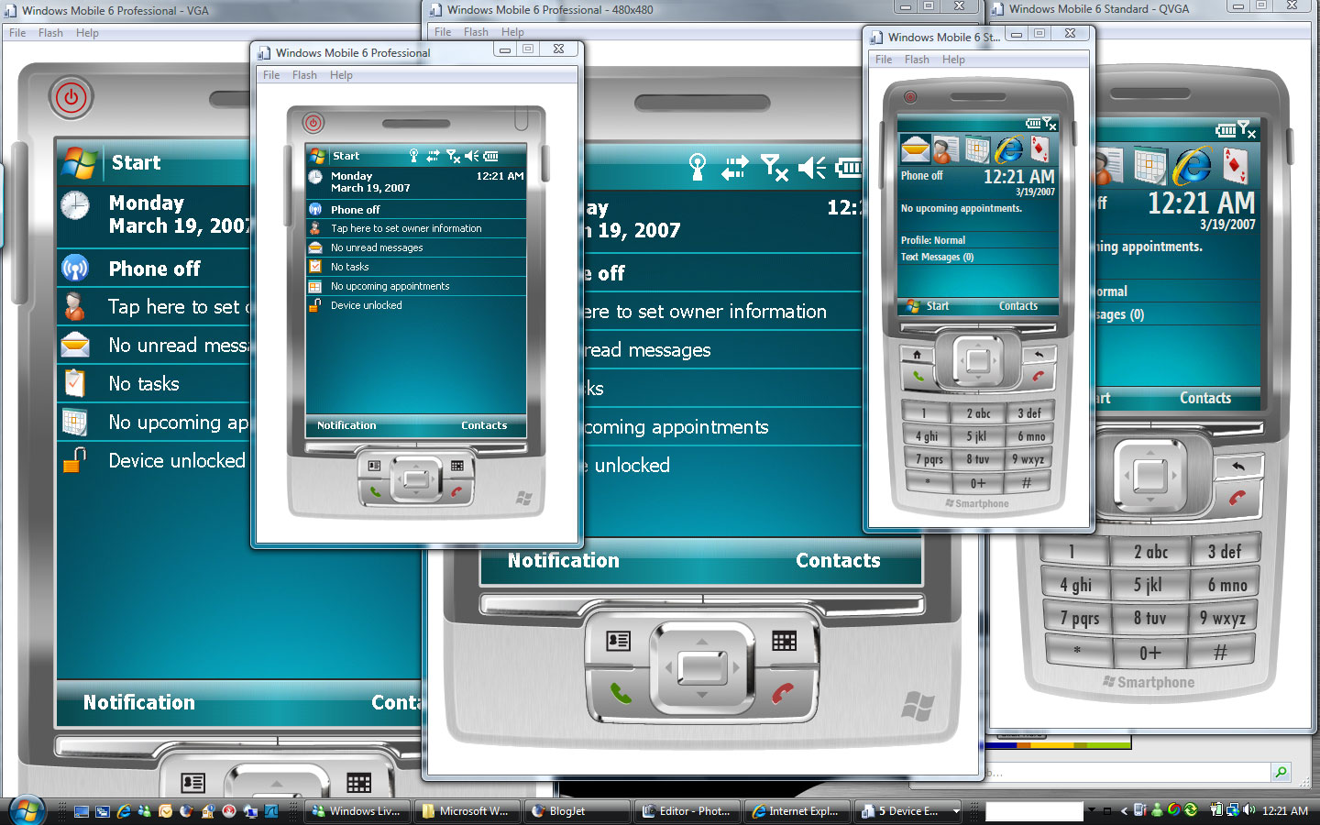
Device Emulator [DE]

Slide 5
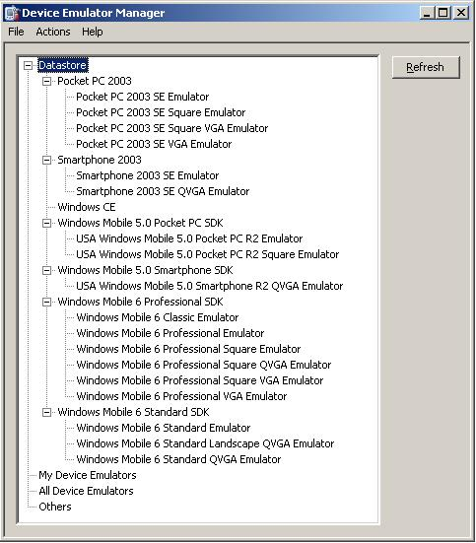
Device Emulator Manager [DEM]

Slide 6
Agenda
What?
Why?
How?
Summary

Slide 7
Why do we need DE/DEM?
Device Emulator [DE] does not ONLY mimics the behaviour of a Windows Mobile/Windows Embedded CE–based hardware platform.
It is also an important tool for testing Windows Mobile applications.
  The Device Emulator Manager [DEM] allows you to interactively perform many common tasks such as starting the Device Emulator, saving the Device Emulator state, cradling the Device Emulator, and so on.

Slide 8
Agenda
What?
Why?
How?
Summary

Slide 9
How To: Programmatically control the Windows Mobile Device Emulator.
DEMO

Slide 10
Agenda
What?
Why?
How?
Summary

Slide 11
Summary
The Device Emulator Manager API provides the features necessary to perform automated application testing with the Device Emulators.
Using the Device Emulator Manager API, you can programmatically manage the entire life cycle of the Device Emulators allowing you to easily create reproducible tests.

Slide 12
References
Device Emulator
http://msdn.microsoft.com/en-us/library/aa188174.aspx
Device Emulator Manager
http://msdn.microsoft.com/en-us/library/aa188185.aspx
Automating Device Emulator Manager Using the IDeviceEmulatorManager Interface
http://msdn.microsoft.com/en-us/library/bb887543.aspx
How To: Programmatically Control the Windows Mobile Device Emulators from .NET
http://msdn.microsoft.com/en-us/library/bb936678.aspx

Slide 13
Feedback / QnA
Your Feedback is Important!
  Please take a few moments to fill out our online feedback form
  For detailed feedback, use the form at http://www.connectwithlife.co.in/vtd/helpdesk.aspx
  Or email us at vtd@microsoft.com
Use the Question Manager on LiveMeeting to ask your questions now!

Slide 14
Contact
Email Addresses:
  Bijoy Singhal: bijoy.singhal@microsoft.com
  Jadeja Dushyantsinh A: i-jdushy@microsoft.com

