Slide 1
Unit Testing Silverlight Applications with Visual Studio 2008
Pandurang Nayak
Client Platform Evangelist | Microsoft Corporation
www.thinkingMS.com/pandurang | pandurang.nayak@microsoft.com

Slide 2
Good Developers Code. Great Developers Test!

Slide 3
Unit Testing Basics
What is a Unit Test?
What is NOT a Unit Test?
Simple
Quick to run
Independent and self-contained: Should not rely on any previous test results or any particular execution order
Doesn’t cross any unit test boundaries (as defined by Phil Haack)
Easy to maintain over time. Documented. Not archaic
Lacking variability: a valid unit test should always consistently pass
Positive or negative: They can validate exceptions and error conditions as well as expected results and states
A test that validates integration (your database and your class library)
A test that interacts with UI, network resources, or the file system
Something that takes a long while to run
An end-to-end test of a user scenario
A performance, stress, load test, security, or other advanced test
Complex

Slide 4
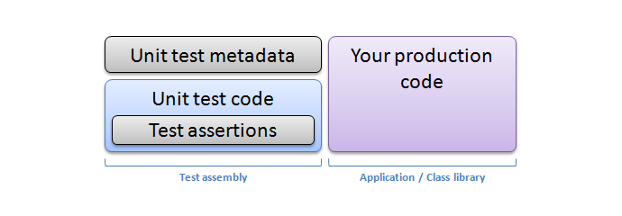
VS Unit Test Basics
http://msdn.microsoft.com/en-us/library/ms243147.aspx

Slide 5
VS Unit Test Basics
using System;
using System.Collections.Generic;
using Microsoft.VisualStudio.TestTools.UnitTesting;
namespace Test2
{
[TestClass]
public class Test
{
[TestMethod]
public void TestMethod()
{
Assert.Inconclusive();
}
}
}

Slide 6
Silverlight and Unit Testing
Silverlight Controls
Full Source Code and more than 4000 test cases for the controls!!
Silverlight Unit Test VS Templates
Silverlight Unit Test Harness
http://code.msdn.microsoft.com/silverlightut/
http://www.jeff.wilcox.name/2008/03/31/silverlight2-unit-testing/

Slide 7
Silverlight Unit Testing Features
DEMO

Slide 8
Testing with Silverlight
Works cross-browser
UI Events should be raised in test case
Make call to event handler with expected parameters input

Slide 9
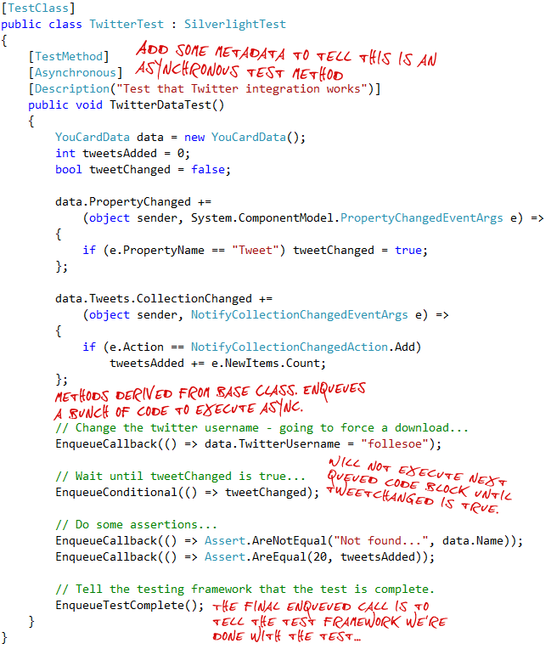
Asynchronous "Enqueue-ing"

Slide 10
Future of Silverlight Testing
Updated, easy-to-discover APIs
User interface improvements, including a progress bar and basic run statistics
Simplified extensibility points and logging concept
Command line and continuous integration support

Slide 11
References
Silverlight Unit Testing Framework
http://code.msdn.microsoft.com/silverlightut/
Bloggers
http://www.jeff.wilcox.name/
http://jonas.follesoe.no/

Slide 12
Contact
Blog Address
www.thinkingMS.com/pandurang
Email Address
pandurang.nayak@microsoft.com

