Slide 1
Advanced Silverlight
Learn the tricks of the masters!
Pandurang Nayak
Client Platform Evangelist | Microsoft Corporation
www.thinkingMS.com/pandurang | pandurang.nayak@microsoft.com

Slide 2
Why Advanced Silverlight?
Finding out what happens under the hood
  Always good to know!!
  Useful in debugging and optimization
  Fixing somebody else’s code!
Optimizing
  Profiling applications
  Identifying bottlenecks
  Large-scale (read: high traffic) solutions

Slide 3
Information Sources
Silverlight Performance Team
Silverlight Product Team
Top Silverlight Bloggers and Experts
Internal MS Silverlight Communities
My Own Experience with Customers

Slide 4
Silverlight Architecture
Controls
User Code
Gfx
Media
Deep Zoom
Image
Layout
Text
Property System
Managed Interop
CoreCLR
Interaction between pipelines via brushes

Slide 5
Graphics Pipeline
Cross-Platform
  Develop once, run anywhere
Retained Mode Graphics System
dirty rectangle

Slide 6
The UI Thread
On The UI Thread
On the Non-UI Thread
  User Code
  Control Code
  Animations
  Layout
  Frame Rasterization
  Media Decoding
Master Tip
Silverlight is hosted in the browser.
So, the (single) UI Thread belongs to the browser!

Slide 7
The Animate Loop
Tick
Layout
Queue up Rendering Changes
Rasterize in back buffer
Ask browser to show frame
Any Property Changes?
Event Handlers
By default, 60fps

Slide 8
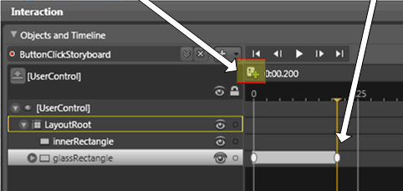
Animation Basics
Frequency is the plugin’s framerate
Real-Time Animation (vs. Frame-based)
Types of animations:
  Interpolation Animations
    ColorAnimation, PointAnimation, DoubleAnimation
  Splines, KeyFrames
  ObjectAnimation
http://silverlight.net/quickstarts/ blend_quickstart/part3_animations.aspx

Slide 9
Knowing Animations
We only redraw the dirty rectangle
Avoid large scale animations
Text redraw triggers the font hinting algorithm
Master Tip
When in doubt, use:
agControl.settings.EnableRedrawRegions = true;

Slide 10
Using EnableRedrawRegions
DEMO

Slide 11
The Update Loop
Tick
Layout
Queue up Rendering Changes
Rasterize in back buffer
Ask browser to show frame
Any Property Changes?
Event Handlers

Slide 12
Layout and Draw
ListBox
Grid
ScrollBars
StackPanel
ListBoxItem
Some Stuff
ScrollViewer
Designed for Nesting
Two Passes:
  Measure & Arrange
Extensible
Master Tip
Nested flow layout that changes often is expensive.

Slide 13
The Update Loop
Tick
Layout
Queue up Rendering Changes
Rasterize in back buffer
Ask browser to show frame
Any Property Changes?
Event Handlers

Slide 14
Rasterization
All changes for a frame are drawn at once
Identify what causes a framerate drop
Master Tip
Measure maximum framerate to tune your application:
sender.settings.EnableFramerateCounter = true;
sender.settings.MaxFrameRate = 1000;
Integrate codepaths via Brushes

Slide 15
Brushes
A brush maps a screen position to a color
Brushes in Silverlight
  SolidColorBrush
  LinearGradientBrush
  RadialGradientBrush
  ImageBrush
  VideoBrush
Master Tip
When mixing pipelines, brushes are cheap!

Slide 16
Image and Video Brushes in Silverlight
DEMO

Slide 17

Rasterization and Anti-Aliasing
Vector Graphics - Anti-aliased
Animation - Anti-aliased

Slide 18

Rasterization and Anti-Aliasing
Blurry Image Rendering
  Cause: Interpolation

Slide 19




Rasterization and Anti-Aliasing
Blurry Thin Lines
  Cause: non-int positions

Slide 20

Rasterization and Anti-Aliasing
Seaming
  Cause: non-int positions
  c = .5(.5*c_{bkgrd} + .5*c_{top}) + .5(.5*c_{bkgrd} + .5*c_{bottom})

Slide 21
Rasterization and Anti-Aliasing
In Silverlight 2 RTM,
Vector Graphics
Already Correct Behavior
Animation
Already Correct Behavior
Image Rendering
Layout Rounding NEW!!!
Sharp Lines
Layout Rounding NEW!!!
Seaming
Overlap edges
Change Background Color
Non-Integer positioning mainly arises from Text and “Center”

Slide 22
Media Rendering
halo.wmv is 300x400. Which is least expensive?
  <MediaElement Source=“halo.wmv”
  Width= "225" Height="300" />
  Width="300" Height="400" />
  Width="303" Height="404" />
  Width="450" Height="600" />

Slide 23
Media: Every Pixel, Every frame!
Decode
YUV Convert
Resize (opt)
Blend (opt)
Draw
Rinse & Repeat, at the video framerate
Encode at the minimum framerate that you need.
Encode at the desired size
Blending with media is expensive
Master Tip
Let the media pipeline decide the best framerate
Notes:
YUV to ARGB – Y (luminance), UV (chrominance)

Slide 24
Media Rendering
halo.wmv is 300x400. Which is least expensive?
  <MediaElement Source=“halo.wmv”
  Width= "225" Height="300" />
  Width="300" Height="400" />
  Width="303" Height="404" />
  Width="450" Height="600" />

Slide 25
Media Rendering
halo.wmv is 300x400. Which is least expensive?
  <MediaElement Source=“halo.wmv”
  Width= "225" Height="300" />
  Width="300" Height="400" />
  Width="303" Height="404" />
  Width="450" Height="600" />

Slide 26
Shrinking video causes
(Ex: 300x400 to 225x300)
Extra bandwidth for extra 75x100px
Decoding extra 75x100px
Interpolation of every pixel in the 225x300 grid
  Pretty awesome interpolation, but never as good as native rendering

Slide 27
Profiling Silverlight Applications
Steps:
  Observe
  Hypothesize
  Develop Testing Protocol
  Experiment
  Make Conclusion

Slide 28
Debugging Settings
Sys.Silverlight.createObjectEx({
source: "xaml/Scene.xaml",
parentElement: document.getElementById("SilverlightControlHost"),
id: "SilverlightControl",
properties: {
width: "500", height: "500",
isWindowless: false,
background: "FF000000",
framerate: "10000" },
events: { onLoad:onLoadHandler} });
function onLoadHandler() {
agControl = document.getElementById("SilverlightControl");
/* To see the framerate displayed in the browser status bar */
agControl.settings.EnableFrameRateCounter = true;
/* To see the redraw regions*/
agControl.settings.EnableRedrawRegions= true;
}

Slide 29
Your Animation is stuttering
What is the first step to debug?
Decrease the framerate
Identify the resource constraint
Turn on Redraw Regions
Master Tip
While debugging render issues, always try to identify what is blocking the UI thread.

Slide 30
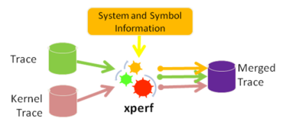
xperf
ETW – Event Tracing for Windows
  Tracing mechanism for both user-mode & kernel-mode apps
  Silverlight & CLR have embedded ETW events
Analyzes unmanaged callstack
Describes CPU cycles over time

Slide 31
xperf
Install from here:
http://msdn.microsoft.com/en-us/library/cc305218.aspx
Admin-level CMD prompt
xperf -on base
Run scenario try to make all parts fully visible.
xperf -d myprofile.etl
xperfview myprofile.etl
set _NT_SYMBOL_PATH= srv*C:\symbols*http://msdl.microsoft.com/downloads/symbols
Trace → Load Symbols
Select Graph, right click: Summary Table
Run again, make sure your results are correct

Slide 32
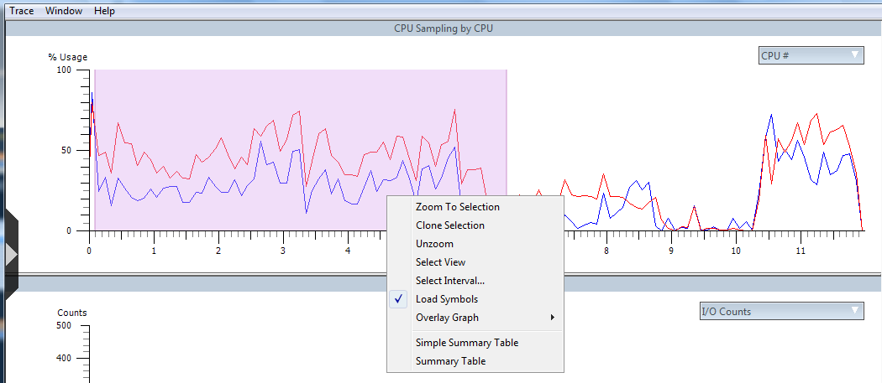
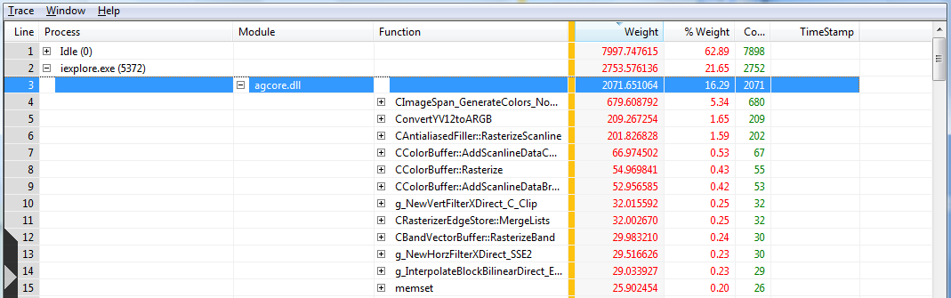
xperf
DEMO

Slide 33

What happens on Navigation
Download HTML
Download JS
Control.Source is XAP
Create
Plug-in
Navigate
Launch CLR
Extract Manifest
Load Assemblies
Create App Object
Object Creates Tree
Set Visual Root

Slide 34
XAML Parsing Uncovered!
URI-based resources are loaded when added to tree
  Asynch
  Cached via Browser
Build unique tree for each Control
Pull in Text Stack

Slide 35

Text Stack
TextBlock & TextBox
Glyph Capabilities
Text Stack
  Cross-OS consistency
  Glyph rendering is optimized for reading
  Anti-aliasing, H/V dropout, Gamma Correction
  These paths can be hit each tick if one is not careful
Accepted Fonts
  Cross-OS, common set already on OS
  EA fonts, only if installed on machine
Notes:
Silverlight provides a second lower level Glyphs element for advanced typography.
A glyph is terminology indicating a graphical representation of a letter or sequence of letters.

Slide 36
Silverlight Spy
View Visual Tree for Silverlight applications
Along with .NET Reflector, can show you entire structure and code of Silverlight applications
Master Tip
Confidential stuff should always reside on server! ANYTHING on the client can be exposed.

Slide 37
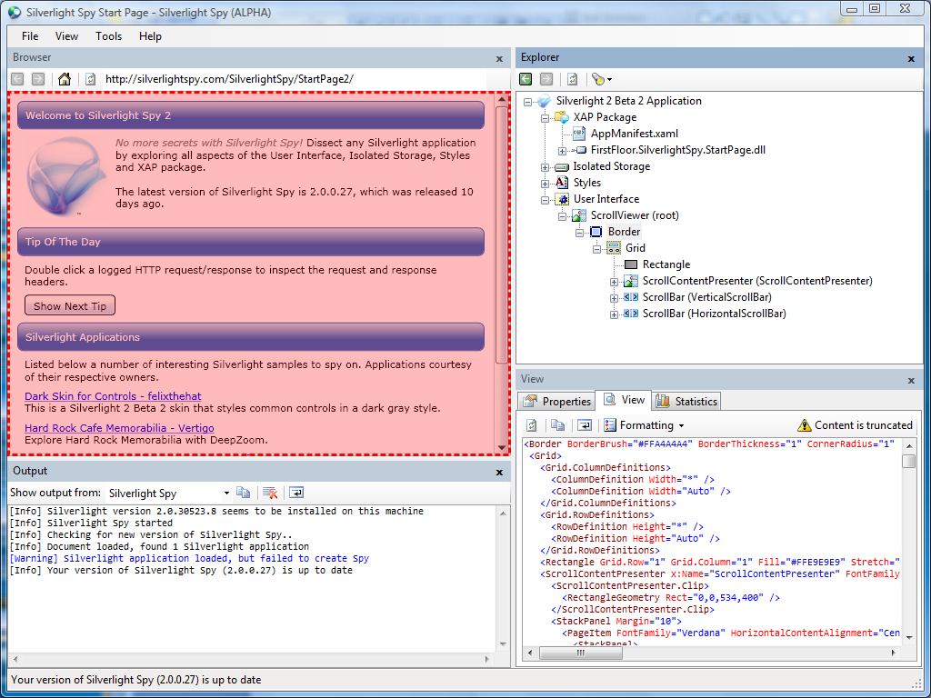
Silverlight Spy
DEMO

Slide 38
References
Performance Bloggers
http://blogs.msdn.com/seema
http://blogs.microsoft.co.il/sasha
http://blogs.msdn.com/tess/
http://blogs.technet.com/markrussinovich/
Silverlight Spy
http://silverlightspy.com/

Slide 39
Contact (optional slide)
Blog Address
www.thinkingMS.com/pandurang
Email Address
pandurang.nayak@microsoft.com

