Slide 2
Hyper-V Deployment And Best Practices
Dhanasekaran Vadivelan
IT Infrastructure Architect
Tata Consultancy Services
Notes:
Good Day Everyone, Firstly I would like to thank u all for joining this webcast
My name is Dhanasekaran Vadivelan and am working as a technical architect for Infrastructure services practice in TCS.
In this session, I am going to talk about Server and Desktop virtualization deployment using Microsoft Hyper-V. I will also talk about the best practices to be followed for deploying Hyper-V based virtualization solution

Slide 3


Objectives And Takeaways
Objective(s):
  Windows Server 2008 Hyper-V
  System Requirements
  Architecture
  Capabilities
  Hyper-V in Production
  Hyper-V Networking
  Best Practices
  Hyper-V Systems and VM Creation
  Virtualization Comparison
Notes:
The key takeaways of this webcast are
What is Hyper-V?
What are the system requirements for deploying Hyper-V?
How does Windows Server 2008 Hyper-V, how does the architecture look like and what are its capabilities?
What are the requirements from Hyper-V networking aspects
From the deployment perspective, what are the best practices to be considered
Will also touch upon the HA using Windows failover clustering
I will show you a demo on how to create virtual machines
Also I will touch upon the comparison of Virtual server 2005 and WS 2008 Hyper-V
Finally will keep some time for Q&A before completing this webcast

Slide 4
Windows Server 2008 Hyper-V
Notes:
Windows Server 2008 Hyper-V is a hypervisor based virtualization feature included in Windows Server 2008.
and Hyper-V is installed and managed as a role under Windows server 2008, just like DHCP, DNS and print services

Slide 5
Windows Hyper-V Requirements
Description
  Hypervisor based virtualization platform
  Windows Server 2008 x64 Edition technology
  Standard, Enterprise and Datacenter Editions
Hardware Requirements
  x64 server with hardware assisted virtualization
  AMD AMD-V or Intel VT
  Hardware enabled Data Execution Prevention (DEP) required
  AMD (NX no execute bit)
  Intel (XD execute disable)
  Note: Enabling these BIOS features requires powering down (not rebooting) the server to take effect
Notes:
Hypervisor is a thin layer of software that makes it possible for multiple operating systems to run on a host computer at the same time
Hyper-V feature is available in Windows Server 2008 x64 edition - Standard, Enterprise and Data Center
HW Requirements:
Virtualization is a prime candidate for the expanded memory and processing facilities that 64-bit platform offers. To ensure these expanded facilities are available, Hyper-V only runs on x64-bit editions of Windows Server 2008
Hyper-V requires specific processor enhancements from either Intel or AMD.
Hardware enabled DEP – it is a technology used in CPUs to segregate areas of memory for use by either storage of processor instructions or for storage of data

Slide 6
Architecture

Slide 7
Hyper-V Architecture
Provided by:
  OS
Parent Partition
  ISV / IHV / OEM
  Microsoft Hyper-V
  Applications
User Mode
  Windows Server 2008
  Windows Kernel
  IHV Drivers
Kernel Mode
  Windows hypervisor
Ring -1
  “Designed for Windows” Server Hardware
Notes:
Let us look at the architecture of Hyper-V
The bottom most layer is the server hardware layer which is designed for Windows Hyper-V.
The second layer just above server hardware is the Windows Hypervisor
The hypervisor is a very thin layer of software which resides below the operating system, and directly above the hardware
The hypervisor requires no drivers of its own, and takes advantages of virtualization aware processors, such as the AMD-V and Intel VT enabled processors. This model ensures the hypervisor remains very small and efficient
The hypervisor manages hardware resources by dividing the system into partitions – Parent and Child
The parent partition, also known as root partition running Windows server 2008, creates and manages child partitions and it has a virtualization stacks to control child partitions
This parent partition owns all resources not owned by the hypervisor and is responsible for Power management, PnP, management of hardware failure events and loading and booting the Hypervisor

Slide 8
Hyper-V Architecture
Provided by:
  OS
Parent Partition
Child Partitions
  ISV / IHV / OEM
  Microsoft Hyper-V
  Applications
  Applications
  Applications
  Microsoft / XenSource
  VM Worker Process
  Applications
  WMI Provider
  VM Service
User Mode
  Windows Server 2008
  Windows Server 2003, 2008
  Non-Hypervisor Aware OS
  Xen-Enabled Linux Kernel
  Windows Kernel
  VSP
  Windows Kernel
  VSC
  Linux VSC
  IHV Drivers
  VMBus
  Hypercall Adapter
Kernel Mode
  VMBus
  VMBus
  Emulation
  Windows hypervisor
Ring -1
  “Designed for Windows” Server Hardware
Notes:
Inside the parent partition:
you will find Windows kernel, VSP-Virtual Service Provider, VM Bus present in the kernel mode
The key role of VSP is to communicate with the device drivers and offer hardware services to the virtual machines(child partition).
The Virtual Service client VSC is a client component that runs within a child partition and consumes hardware services for a particular task.
For every virtual machine there will be one pair of VSP/VSC. VSP and VSC will communicate with each other through VM Bus
Microsoft has provided VSP/VSC pairs for hardware devices such as storage, networking, video and input devices for Hyper-V. Third-party Independent Hardware Vendors (IHV) are also providing additional VSP/VSC pairs to support additional hardware devices
WMI Provider
Microsoft Hyper-V is managed through WMI provider. The WMI Providers contain objects that control all aspects of Microsoft Hyper-V including:
Managing server settings.
Creating and configuring virtual machines.
Creating and configuring virtual switches.
Controlling running virtual machines.
In addition, the WMI provider allows external management tools such as Windows PowerShell, System Center Virtual Machine Manager, and other 3rd party tools to manage a Microsoft Hyper-V server.
Inside of Child Partition:
We have new component known as integration services which allows us to run an enlightened OS - Win server 2008, Win server 2003 SP2, Vista SP1, Win XP SP3 and later version of are considered as enlightened OS which mean these operating systems are hypervisor aware OS, hence these operating systems can make a hypervisor API call right directly down to hypervisor aware hardware so we don't face any additional overheads like virtual server 2005.
If you look at closely how it was handled in virtual server 2005, the virtual machines hosted on the virtual server 2005 had to talk to the virtual server software first and then to the server hardware
But now with the help of INTEGRATION components, virtual machines can talk directly to the hardware which really speeds up the VMs performance. You can find the detailed list of hypervisor aware guest operating systems in the Microsoft website
Now lets talk about Non-hypervisor aware operating systems. Some of the examples of non-hypervisor aware Oss are Windows NT, Win 2000 server with SP3 and older OS. These operating systems doesn’t understand the integration components available in Windows Hypervisor therefore these operating systems will still have to talk to the server hardware through the parent partition. These Oss are called as non-hypervisor OS. Microsoft Hyper-V allows non hypervisor aware guests to run side by side with hypervisor aware guests. The non hypervisor aware virtual operating systems/machines still rely on the hardware emulation to function correctly.
The non-hypervisor aware OS is still efficient but not fast as compared to an enlightened OS.
The Hypercall adapter is a thin layer of software that translates the XenServer-specific virtualization function calls to Microsoft Hyper-V hypercalls.
Microsoft is working with third party OS vendors like SUN Microsystems for developing integration components for Solaris OS
Microsoft is trying to work with more third parties to get their operating systems enlightened so that you can get full benefits in your
environments

Slide 9
Hyper-V
Capabilities
  32-bit (x86) & 64-bit (x64) VMs
  Large memory support (64 GB) per VM
  SMP VMs (up to 4 cores)
  Integrated cluster support for HA & Quick Migration
  BitLocker: Seamless, secure data encryption
  Live Backup: Volume Shadow Service integration
  Pass-through disk access for VMs
  New hardware sharing architecture (VSP/VSC/VMBus)
  Disk, networking, input, video
  Robust networking: VLANs and NLB
  DMTF standard for WMI management interface
  Support for Full or Server Core installations
Notes:
Hyper-V supports both 32-bit and 64-bit guest operating systems
Hyper-V provides large memory support – upto 64 GB of RAM per Virtual Machines
You can assign either single processor or multiple processors for the Virtual Machines. In Hyper-V Management console, you will get a option to select either 1 CPU, 2 CPU or 4 CPU processors for each VM
One of the key differentiator in the Microsoft Virtualization solution is the High Availability. Hyper-V includes support for host-to-host connectivity and enables you to cluster upto 16 virtual machines running on a host through windows failover clustering. This is supported in Windows Server 2008 enterprise and datacenter editions
Hyper-V is capable of migrating a running virtual machine across Hyper-V hosts with minimal downtime, leveraging familiar high-availability capabilities in Windows Server 2008
Just to give you an idea, using Quick Migration, migrating a VM which is using 1 GB memory takes approximately 4 seconds. Off course the VHD file needs should be stored on a shared storage and you would need the same processor architecture across the nodes, in order get the high performance benefits
Bitlocker, which provides hard disk encryption facility, now-a-days most of the OEMs are shipping their hardware with TPM chips
Volume Shadow Copy Services (VSS) is one of out-of box feature in Win srv 2008, this feature would enable you to take Live Backups of running virtual machines
Pass-through disk access for VMs: You can assign the each physical disk individually to every Virtual Machines, which will results in high read/write performance
From the Hyper-V Management console, now you can take a snapshots of the Virtual machines
in the earlier slides we discussed about integration components
Robust networking – let us say you are running 4 VMs in the host machine and you want to group first 2 VMs into 1 group and rest 2 VMs in another group and finally want to isolate both the groups. This can be achieved by Virtual LAN feature present in Windows server 2008
Microsoft Hyper-V provides full scripting interface which is available through Windows Management Instrumentation. This WMI management interface is aligned with DMTF standard which is a standard that allows developer’s to build custom applications that interact with Microsoft Hyper-V and also allow administrators to build automation scripts using tools such as Windows Script Host or Windows PowerShell
The Hyper-V role can be a full role within Win SRV 2008 or can be enabled as a role within Server Core.

Slide 10
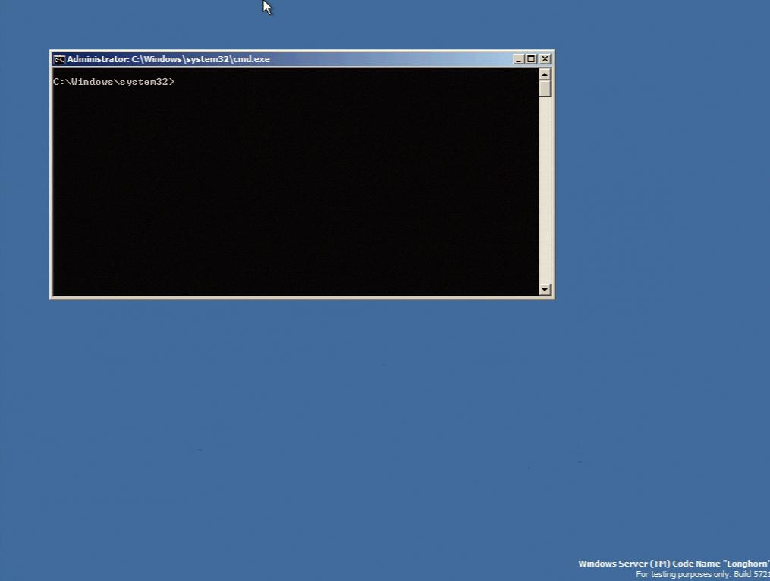
Windows Server Core
  Server Core: new minimal
  installation option
  Provides essential server functionality
  Command Line Interface only, no GUI Shell
  Benefits
  Less code results in fewer patches and reduced servicing burden
  Low surface area server for targeted roles
  More secure and reliable with less management
Notes:
Windows Server Core is a new installation option available in Windows Server 2008
- Which is a stripped version of the full server installation
- The server core installation provides all the essential functionality of the Windows server
- No GUI shell is available in the server core instead, you will see a command line interface for doing all the administration activities
- Use OCSETUP command line tool for enabling Microsoft Hyper-V role
- For managing the Hyper-V server which is enabled on a server core OS you would need to connect to this server remotely from your desktop either through RDP console or Hyper-V management console
The key benefits of using Windows Server Core is – 1) highly secure and 2) very reliable
Threats that arise due to the desktop applications and Internet surfing do not exist on Server Core
Since Server Core only runs a subset of the Windows operating system therefore only few components that may require patching. This results in reduced downtime

Slide 11
Security
Isolation
  No sharing of virtualized devices
  Separate VMBus instance per vm to the parent
  No sharing of memory
  Each has its own address space
  VMs cannot communicate with each other, except through traditional networking
  Guests can’t perform DMA attacks because they’re never mapped to physical devices
  Guests cannot write to the hypervisor
  Parent partition cannot write to the hypervisor
Notes:
Security is a very important aspect as we get into more and more virtualization.
As an IT Professional you will be interested to know what are various security features available in Hyper-V and how do I leverage them in order create a secured virtual environment
Hyper-V has the capability to isolate child partitions and make them to communicate to the external network or only the parent partition
For every child partition, Hyper-v creates 1 pair of VSP and VSC, where these components communicate with each other through a dedicated VM bus (I/O Bus) – which provides complete isolation between the child partition
VMs cannot communicate with each other expect through virtual network switch

Slide 12
Hyper-V In Production
Hyper-V Powering Microsoft Internet Properties
TechNet: 100% Hyper-V
  http://technet.microsoft.com
  ~1 million hits a DAY
MSDN:
  http://msdn.microsoft.com
  ~3 million hits a DAY
Virtualizing TechNet & MSDN Whitepaper
  http://download.microsoft.com/download/6/C/5/6C559B56-8556-4097-8C81-2D4E762CD48E/MSCOM_Virtualizes_MSDN_TechNet_on_Hyper-V.docx
Notes:
Presently 25% of the web servers hosting Microsoft.com websites are running in Hyper-V
100% of the TechNet and MSDN web servers are virtualized and running in Windows server 2008 Hyper-V
Almost 4 million hits per day

Slide 13
Hyper-V Networking
Notes:
Before we get into Hyper-V networking concepts, let me explain you how the networking was handled previously in the virtual server management software. (VS 2005)
Microsoft Virtual server 2005 allowed administrators to create virtual networks, however it was similar to a network hub. Each virtual network could be connected to a single physical network adapter, allowing virtual machines to communicate on the physical network.
Whereas Today, Microsoft Hyper-V enhances this concept and makes use of virtual switches. Virtual switches provide additional functionality, including the ability to communicate with VLAN’s on the physical network. A computer running Microsoft Hyper-V can run multiple virtual machines, each connected to a different physical NIC, with each physical NIC being connected to a different VLAN on the same physical switch
This enhancement significantly contributes to the performance improvement

Slide 14

Hyper-V Networking
Two physical network adapters at minimum
  One for management
  One (or more) for VM networking
  Dedicated NIC(s) for iSCSI
  Connect parent to back-end management network
  Only expose guests to internet traffic
Parent Partition
Child Partitions
  Applications
  VM Worker Process
  Applications
  WMI Provider
  VM Service
  Windows Server
  2008
  Windows Server 2003, 2008
  Windows Kernel
  VSP
  Windows Kernel
  VSC
  IHV Drivers
  VMBus
  VMBus
  Windows hypervisor
  “Designed For Windows”
  Server Hardware
Notes:
Now let us see how we can leverage the enhancement made in Hyper-V networking
You would need minimum of 2 Ethernet cards for configuring Hyper-V server
first Ethernet card will be used to connect the parent partition so that you can perform all the administration activities such as creating & modifying child partitions
Second Ethernet card is for Virtual Machine networking
If you have third Ethernet card in the physical server then you can dedicate 3rd one for connecting to the storage device
This would give you a very high performance virtualization solution
For a better understanding, let me walk you through few examples

Slide 15
Hyper-V Network Configurations
Example 1:
  Physical Server has 4 network adapters
  NIC 1: Assigned to parent partition for management
  NICs 2/3/4: Assigned to virtual switches for virtual machine networking
  Storage is non-iSCSI such as:
  Direct attach
  SAS or Fibre Channel
Notes:
Example:1
Lets say we have a Hyper-V server hosting 3 child partitions (virtual machines).
The host machine has 4 Ethernet cards (NIC) and Direct Attached storage, where the VHDs of the child partitions are stored
So, in this given scenario how do we configure the Hyper-V Networking
To have a best possible performance,
- I will assign the first Ethernet card to the parent partition for doing management activities
- then, I will assign the 2nd, 3rd and 4th Ethernet cards to individual child partitions

Slide 16
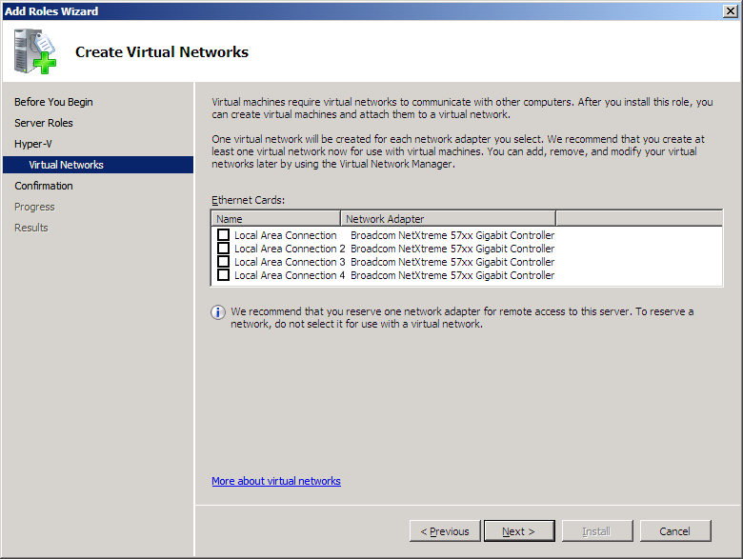
Hyper-V Setup & Networking 1
Notes:
Let us a have quick look at the networking setup
This slide shows available Ethernet cards

Slide 17
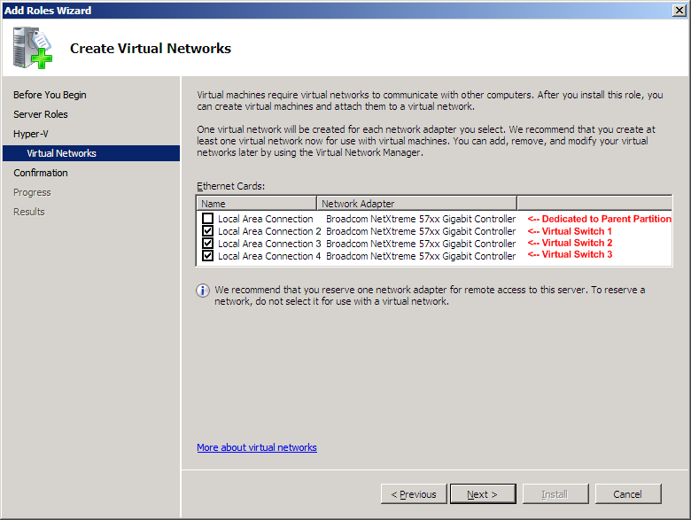
Hyper-V Setup & Networking 2
Notes:
As I said earlier 1st ethernet card is connected to the parent partition
And remaining 3 ethernet cards are connected to 3 different Ethernet cards and each of them are tagged under 3 different virtual switches

Slide 18
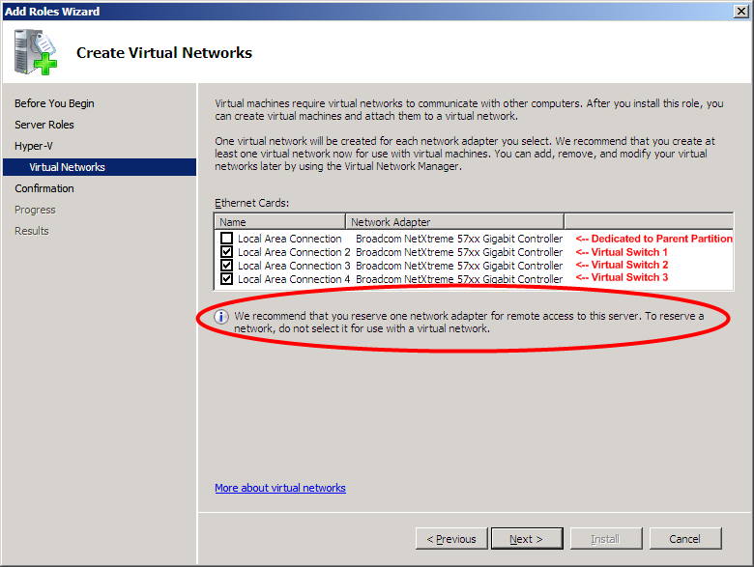
Hyper-V Setup & Networking 3

Slide 19
Each VM On Its Own Switch…
Parent Partition
Child Partitions
  Applications
  Applications
  Applications
  VM Worker Process
  WMI Provider
User Mode
  VM Service
  Windows Server 2008
  VM1
  VM2
  VM3
  VSP
  Windows Kernel
  VSC
  Windows Kernel
  VSC
  Linux Kernel
  VSC
  VMBus
  VMBus
  VMBus
  VMBus
Kernel Mode
  Windows hypervisor
Ring -1
  “Designed for Windows” Server Hardware
  Mgmt NIC 1
  VSwitch 1 NIC 2
  VSwitch 2 NIC 3
  VSwitch 3 NIC 4
Notes:
This slide shows the logical connectivity of the parent and child partitions to the respective Ethernet cards

Slide 20
Hyper-V Network Configurations
Example 2:
  Server has 4 physical network adapters
  NIC 1: Assigned to parent partition for management
  NIC 2: Assigned to parent partition for iSCSI
  NICs 3/4: Assigned to virtual switches for virtual machine networking
Notes:
Let us consider another example.
This scenario is similar to the previous example, the only difference is that in the previous example we have taken direct attached storage device for storing VHDs, whereas in this example let us say we have SAN storage device for storing VHDs and it is connected the hyper-V server hardware using iSCSI

Slide 21
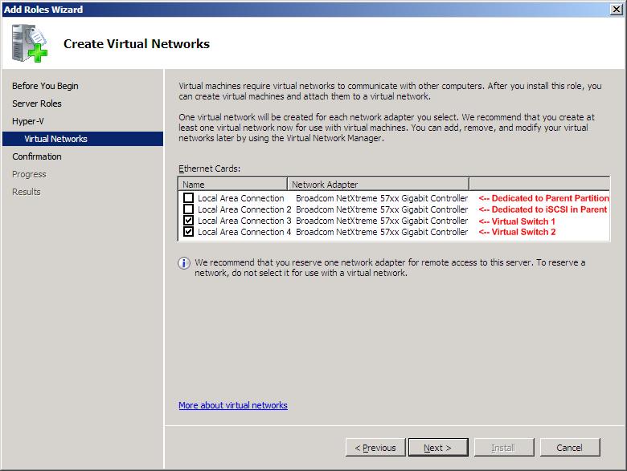
Hyper-V Setup, Networking & iSCSI
Notes:
To achieve the best possible performance in this given scenario
- Assign 1st Ethernet card to the parent partition for management activates
- Assign 2nd Ethernet card to the parent partition for iSCSI
- and assign 3rd and 4th Ethernet cards to the child partitions

Slide 22
Now With iSCSI…
Parent Partition
Child Partitions
  Applications
  Applications
  Applications
  VM Worker Process
  WMI Provider
User Mode
  VM Service
  Windows Server 2008
  VM1
  VM2
  VM3
  VSP
  Windows Kernel
  VSC
  Windows Kernel
  VSC
  Linux Kernel
  VSC
  VMBus
  VMBus
  VMBus
  VMBus
Kernel Mode
  Windows hypervisor
Ring -1
  “Designed for Windows” Server Hardware
  Mgmt NIC 1
  VSwitch 1 NIC 2
  VSwitch 2 NIC 3
  VSwitch 3 NIC 4
Notes:
This slide shows the logical configuration of the Hyper-V networking with iSCSI
In the bottom of the slide you can see 1st NIC is dedicated to the parent partition, 2nd NIC is dedicated for iSCSI, 3rd NIC is dedicated to VM2 and VM3 and 4th NIC dedicated for VM1

Slide 23
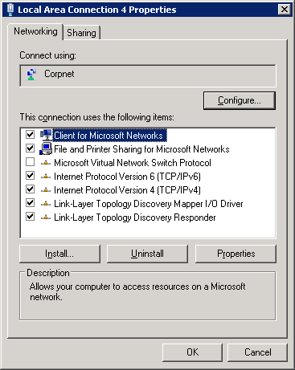
Networking: Parent Partition
Notes:
One important point that you should note down here is: In the host machine, when you go to the Local area connection properties of the Ethernet card which is connected to parent partition, you will see the “Microsoft Virtual Network Switch” protocol, by default this checkbox will be unchecked. Please do not select this checkbox leave this configuration as it is

Slide 24
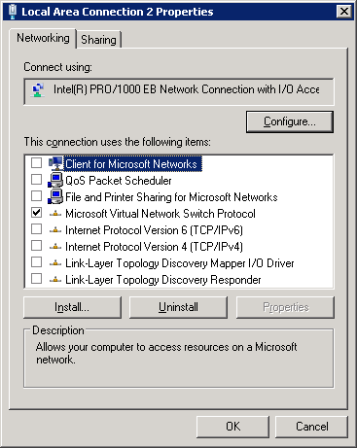
Networking: Virtual Switches
Notes:
When you go to the local area connection properties of any other Ethernet cards which are connected to the child partitions, you would see only “Microsoft Virtual Network Switch” protocol is selected and the TCP/IP v4/6 is unchecked. Please do not panic after seeing this configuration, how come TCP/IP setting are not selected. this is the default configuration, please do not alter the setting.

Slide 25
Best Practices &
Tips And Tricks
Notes:
Let us look at some of the best practices to be followed when installing and configuring Hyper-V

Slide 26
Deployment Considerations
Minimize risk to the Parent Partition
  Use Server Core
  Don’t run arbitrary apps, no web surfing
  Run your apps and services in guests
  Moving VMs from Virtual Server to Hyper-V
  FIRST: Uninstall the VM Additions
Two physical network adapters at minimum
  One for management (use a VLAN too)
  One (or more) for vm networking
  Dedicated NIC(s) for iSCSI
  Connect parent to back-end management network
  Only expose guests to internet traffic
Notes:
Use server core and do not install and run applications. Host your applications in the virtual machines
When you are migrating a VMs from the VS 2005 to Hyper-V, you would need to uninstall the VM additions before you migrate them to hyper-V
If you are using DAS for storing the virtual hard disk files, then preferably place virtual hard disk files on dedicated disks to get the maximum performance benefits
Other important consideration is the physical network cards consideration, as we discussed in the previous slides
Another best practice is to expose only the child partitions to the external network, keep the parent partition connected only to the internal network for management

Slide 27
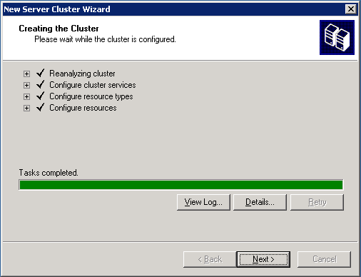
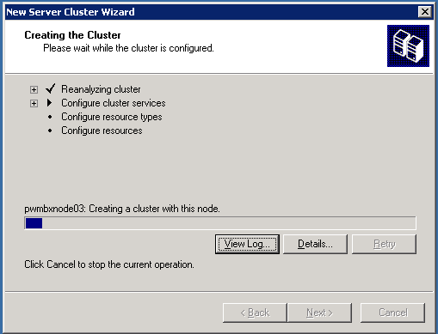
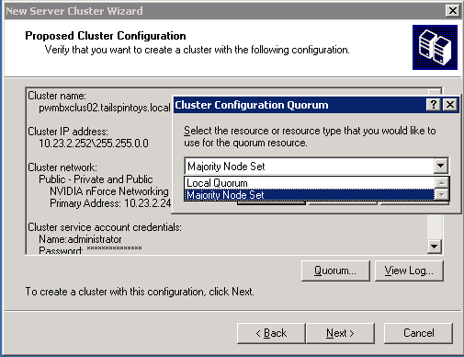
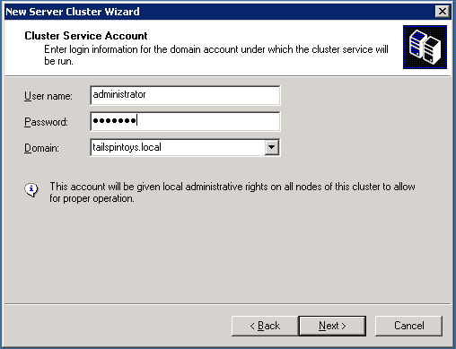
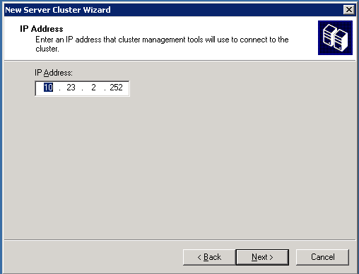
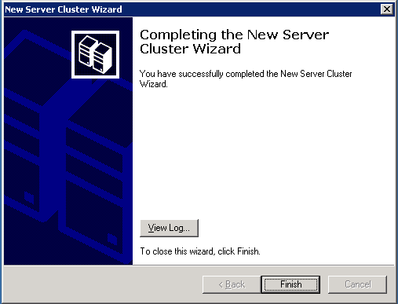
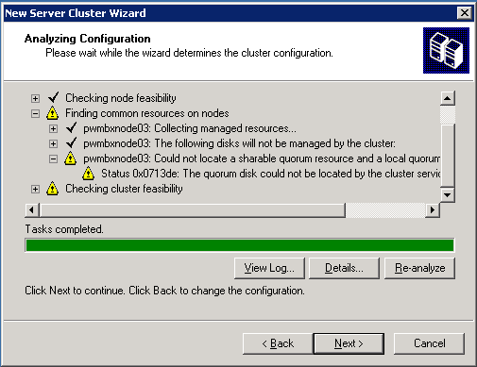
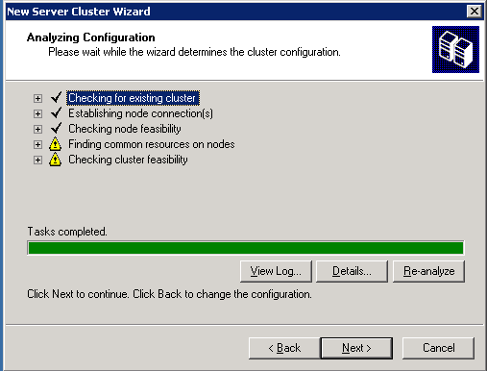
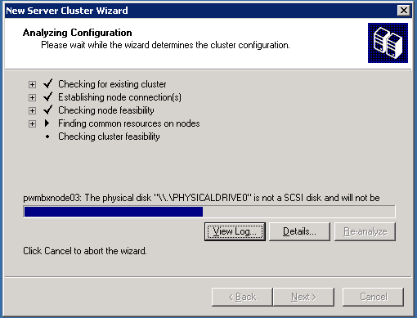
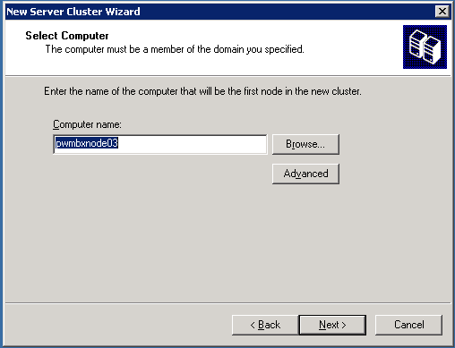
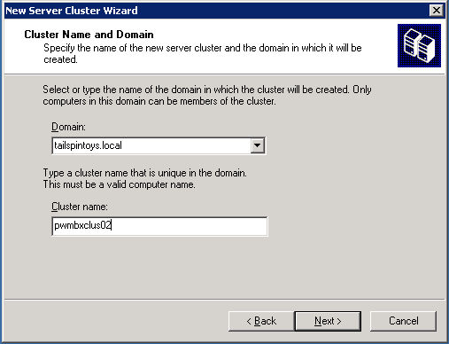
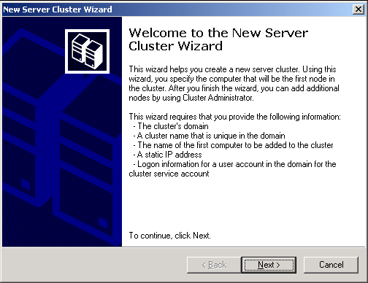
Windows Server 2003
Cluster creation
Notes:
Let us say you need to provide high availability for Virtual Server 2005, you would need to go perform multiple steps to configure a windows clustering services for Virtual Server 2005. You have to provide details like disk quorm, IP address, host name, domain details, cluster name etc
- This time consuming process is just because the virtual server 2005 is not a cluster aware virtualization solution
Today, Microsoft has made enhancements in Hyper-V, which is integrated with Windows Failover clustering services to ensure high availability of virtual machines running on Microsoft Hyper-V.

Slide 28
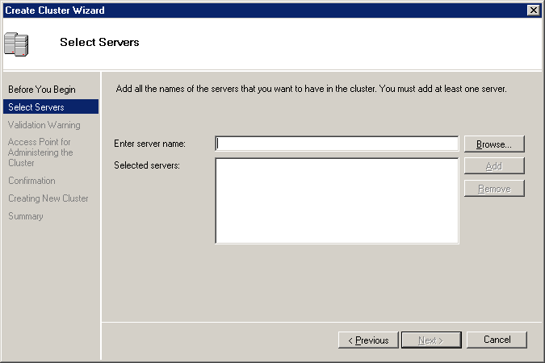
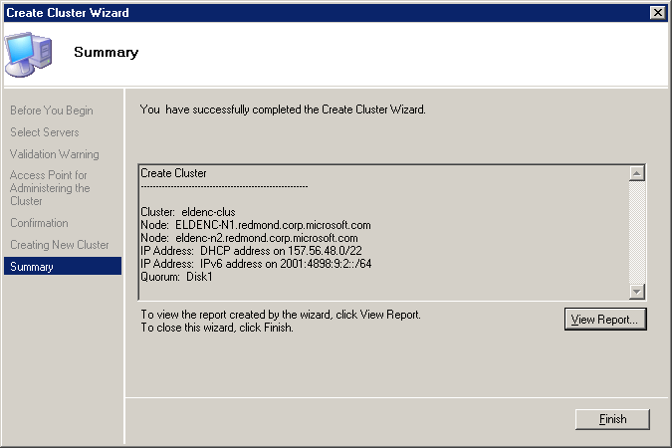
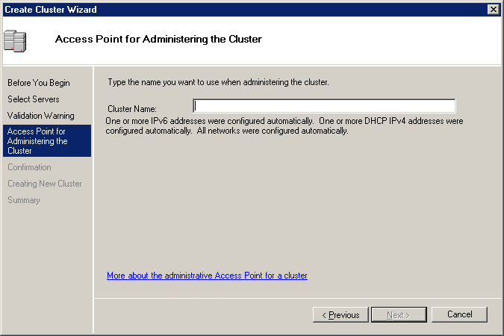
Cluster Hyper-V Servers
Notes:
It is a very simple process to setup a high available solution in Hyper-V
– you just have to select the Hyper-V servers which you want them to be part of cluster and provide cluster name. That’s all you need to do for configuring failover clustering in Hyper-V
Microsoft Hyper-V is a cluster aware role, and can transfer service between nodes in a cluster, in the event of a single node failure. Failover clustering can be achieved by clustering the Microsoft Hyper-V server itself, or by clustering the individual virtual machines running in Microsoft Hyper-V
To design a high availability solution for Hyper-V server, keep all the virtual machines in the shared storage area, with the running virtual machine state being managed by one of the Microsoft Hyper-V nodes. In the event of planned downtime, virtual machines can be saved, and then restored on the operational Microsoft Hyper-V node. In the event of unplanned downtime, virtual machines can be restarted on the operational node with minimum service interruption. Depending on the speed of the storage subsystem, this downtime could be as little as a few second

Slide 29
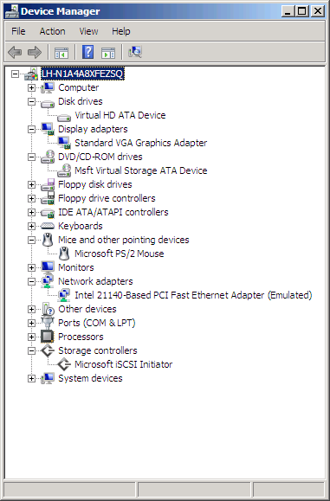
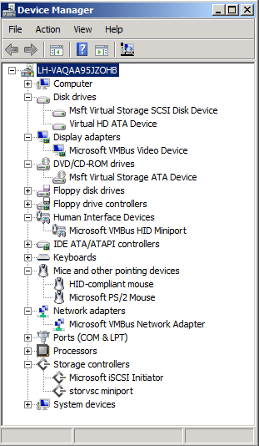
Don't Forget The ICs!
Emulated vs. VSC
Notes:
Integrations components (ICs) are sets of drivers and services that help your Virtual Machines to have more consistent state and provide better performance by enabling the guest to use synthetic devices. Some ICs that come with Hyper-V are VMBUS (transport for Synthetic devices), Time Sync (used to keep VM clocks in sync with the parent partition), Video Driver, Network Driver and Storage Driver.
Hypervisor aware OS such as Windows Server 2008 will come with the integration components pre-installed. For other operating systems, like Windows Server 2003 and Linux you can install ICs.
For non-hypervisor aware Oss, the virtual machines emulates a real piece of hardware

Slide 30
Anti-Virus & BitLocker…
Parent partition
  Run AV software and exclude .vhd
Child partitions
  Run AV software within each VM
BitLocker
  Great for branch office
  Still testing with Hyper-V; More to come…
Notes:
Install and run anti-virus software both in Parent and child partitions but importantly exclude the .vdh files in your anti-virus software
BitLocker is a great solution for protecting the hard disk by means of encrypting the hard disk. There are still some testing happening with Hyper-V, please visit microsoft.com/windowsserver2008 for the updates

Slide 31
Creating Virtual Machines
  Use SCVMM Library
  Steps:
  Create virtual machine
  Install guest operating system
  Install integration components
  Install anti-virus
  Install management agents
  SYSPREP
  Add it to the VMM Library
Notes:
Let us go through the high-level guidelines for creating Virtual Machines
Leverage System Center Virtual Machine Manager software for managing your Hyper-V servers
Create and store the base virtual machines in the SCVMM Library
These are the few high level steps to be followed while creating the virtual machines
Create VM
Install Guest OS
Install the integration components
Install anti-virus
Install management agents such as SCCM agent
Run SYSPREP – to clean up the unique identification values
And add it to the VMM library
The above readiness would enable administrators to provision virtual machines quickly and more efficiently, be it a desktop or Server machine to the end-users

Slide 32
Demo

Slide 33
Virtualization Comparison

Slide 34
Virtual Server 2005 vs. Hyper-V
Virtualization Feature | Virtual Server 2005 R2 | Hyper-V
32-bit Virtual Machines | Yes | Yes
64-bit Virtual Machines | No | Yes
Multi Processor Virtual Machines | No | Yes, 4 core VMs
Virtual Machine Memory Support | 3.6 GB per VM | 64 GB per VM
Managed by System Center Virtual Machine Manager | Yes | Yes
Support for Microsoft Clustering Services | Yes | Yes
Host side backup support (VSS) | Yes | Yes
Scriptable / Extensible | Yes, COM | Yes, WMI
User Interface | Web Interface | MMC 3.0 Interface

Slide 35
Microsoft Roadmap
2008
  System Center Virtual Machine Manager 2008
  Adds support for managing Hyper-V
  Adds support for managing VMware
NOW
  System Center Virtual Machine Manager 2008 Beta
  Windows® Server 2008 Hyper-V RTM
  System Center Virtual Machine Manager 2007
  Support for Virtual Server
  System Center Operations Manager 2007
  System Center Configuration Manager 2007
  System Center Data Protection Manager 2007
  Virtual Server R2 SP1

Slide 36
Microsoft Virtualization APIs
Virtual Server COM Interface
  http://msdn2.microsoft.com/en-us/library/bb309134(VS.85).aspx
Virtual Hard Disk Format
  http://www.microsoft.com/windowsserversystem/virtualserver/techinfo/vhdspec.mspx
Beta Hyper-V WMI Provider APIs
  http://msdn2.microsoft.com/en-us/library/cc136992(VS.85).aspx
Beta Hyper-V Hypercall Interface
  http://www.microsoft.com/downloads/details.aspx?FamilyId=91E2E518-C62C-4FF2-8E50-3A37EA4100F5&displaylang=en

Slide 37
Online Resources
Microsoft Virtualization Home:
  http://www.microsoft.com/virtualization
Windows Server Virtualization Blog Site:
  http://blogs.technet.com/virtualization/default.aspx
Windows Server Virtualization TechNet Site:
  http://technet2.microsoft.com/windowsserver2008/en/servermanager/virtualization.mspx
Windows Server 2008 Hyper-V Release Candidate:
  http://support.microsoft.com/kb/949219
Windows Server 2008 Hyper-V RC Installation Guide:
  http://www.microsoft.com/windowsserver2008/en/us/hyperv-install.aspx
System Center Virtual Machine Manager 2008 Beta:
  http://connect.microsoft.com
Notes:
Microsoft Hyper-V plays a key role at all levels of IT. Many of today’s servers that require physical hardware can be installed, deployed, and managed as a virtual machine in an environment like Microsoft Hyper-V. Microsoft Hyper-V offers benefits such as reduced operational cost, increased utilization of server hardware, and increased availability and reliability of services and applications.
System Center Virtual Machine Manager can be used to create automated managed solutions for virtual machines.
Microsoft Hyper-V is designed to address four key scenarios in your organization:
Dynamic Data Center
Hosted Desktop Virtualization (VDI)
Test and Development
Server Consolidation and Branch Office Consolidation

Slide 38

© 2008 Microsoft Corporation. All rights reserved. Microsoft, Windows, Windows Vista and other product names are or may be registered trademarks and/or trademarks in the U.S. and/or other countries.
The information herein is for informational purposes only and represents the current view of Microsoft Corporation as of the date of this presentation. Because Microsoft must respond to changing market conditions, it should not be interpreted to be a commitment on the part of Microsoft, and Microsoft cannot guarantee the accuracy of any information provided after the date of this presentation. MICROSOFT MAKES NO WARRANTIES, EXPRESS, IMPLIED OR STATUTORY, AS TO THE INFORMATION IN THIS PRESENTATION.
Notes:
38
Time for questions and answers
Thank you for joining this webcast.

