Slide 1
Prism
Composite Application Guidance for WPF
Francis Cheung
Developer
Microsoft
http://blogs.msdn.com/francischeung
Blaine Wastell
Program Manager
Microsoft
http://blogs.msdn.com/blaine

Slide 2
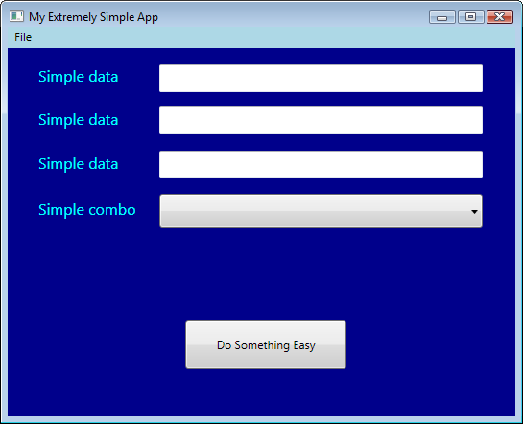
Are you building this?
Notes:
Did you come here to build this?
A few textboxes and a combo?
If so, this is the wrong talk for you – Put this on the slide

Slide 3
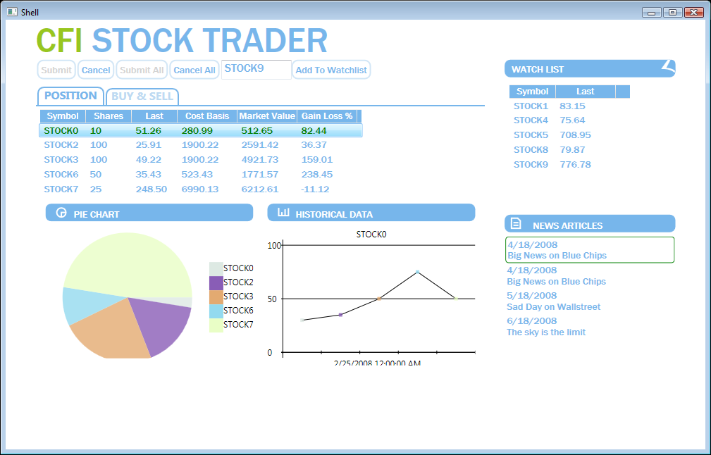
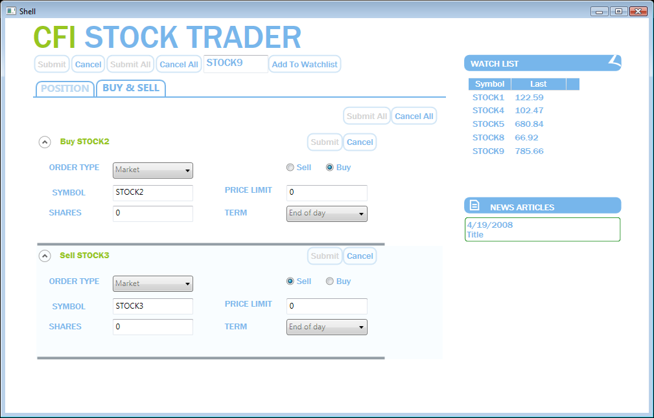
Or something like this?
Notes:
If you have an enterprise app
Data-oriented
Rich interactions with different visual experiences
Complex Screens
Separately evolving
You are in the right place – Put that on the slide!
User controls could be dragged and dropped
Wired together with events
Falls apart very quickly

Slide 4


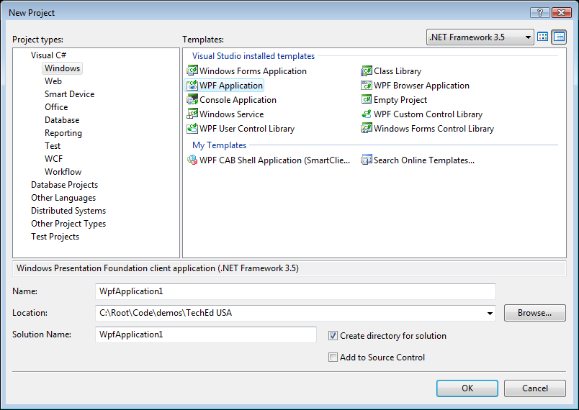




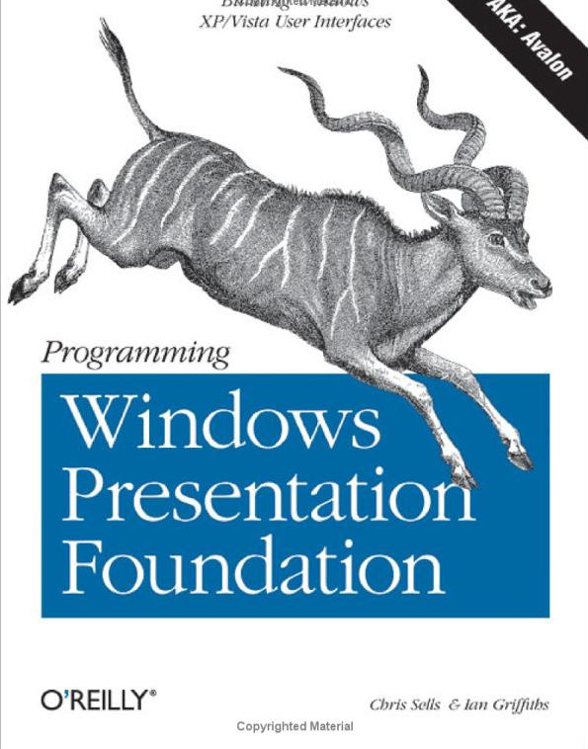

What options do you have?
Consider Prism
Notes:
Is there a magic VS template to help you?
Can you simply drag and drop a complex app?
Sounds good…doesn’t work
You need a composite
Have a better notion of
You need more

Slide 5
Agenda
What you can produce with Prism
Key concepts of a Prism application
How you can find out more?

Slide 6
Stock Trader
Reference Implementation
demo

Slide 7
Inside Prism

Slide 8
Core Concepts
Events/Commands
Regions
Modules
Bootstrapper
Views
Services and Container
Notes:
Fade out the concepts we are not covering
Allow them to unfold

Slide 9

Modules

Slide 10
Static Module Loading
public class MyBootstrapper : UnityPrismBootstrapper
{
...
protected override IModuleEnumerator GetModuleEnumerator()
{
return new StaticModuleEnumerator()
.AddModule(typeof(SomeModule))
.AddModule(typeof(AnotherModule), "SomeModule")
.AddModule(typeof(YetAnotherModule),
"AnotherModule","SomeModule");
}
}
Locates modules
Returns statically
referenced modules
Module type
Module Dependencies

Slide 11
Module Initialization
public class SomeModule : IModule
public SomeModule(SomeDependency myDependency) {...}
public void Initialize() {
RegisterViewsAndServices();
//Show views here;
}
}
Dependency injected
Initialization logic
"Have it your way"
Notes:
Modules have dependencies that are injected
Container handles the details

Slide 12
Breaking up an app with static modules
demo

Slide 13
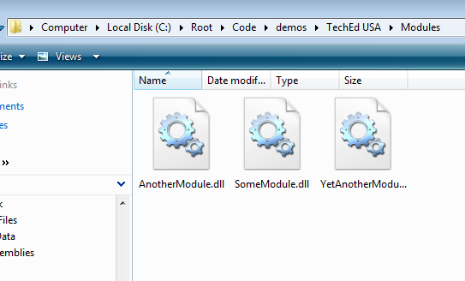
Dynamic Module Loading
public class MyBootstrapper : UnityPrismBootstrapper
{
...
protected override IModuleEnumerator GetModuleEnumerator()
{
return new DirectoryLookupModuleEnumerator(@".\Modules");
}
}
public class MyBootstrapper : UnityPrismBootstrapper
{
...
protected override IModuleEnumerator GetModuleEnumerator()
{
return new StaticModuleEnumerator()
.AddModule(typeof(SomeModule))
.AddModule(typeof(AnotherModule), new[] {"SomeModule")
.AddModule(typeof(YetAnotherModule), new[] { "AnotherModule"
})
}
}
Scans folders for modules

Slide 14
Flexibility with Dynamic Module Loading
demo
Notes:
Put a picture of training wheels

Slide 15
Views and Regions
Notes:
http://www.flickr.com/photos/kikisdad/82233873/

Slide 16
Region Registration
Most Regions are ItemsControls
MyShell.xaml
<TabControl x:Name="OrderTab"
ItemContainerStyle="..."
prism:RegionManager.RegionName="OrderRegion" />
RegionName attached property

Slide 17
One Way to Show views…
Region manager is needed
public class MyModule : IModule
{
public void Initialize (IRegionManager manager)
{
RegisterViewsAndServices();
IRegion orderRegion =
manager.GetRegion("OrderRegion");
var myOrderView = new OrderView(myOrder);
orderRegion.Add(myOrderView);
}
}
Region is retrieved
View is created
View is shown

Slide 18
Or, try the "WPFy" template way
The WPFy way…Templates
public class MyModule : IModule
{
public void Initialize(IRegionManager manager)
{
RegisterViewsAndServices();
IRegion orderRegion =
manager.GetRegion("OrderRegion");
orderRegion.Add(myOrder);
}
}
Order is added directly
Notes:
What is myOrder?
A Model which is typically a PresentationModel.
Ultimately a data object that provides data

Slide 19
Composing your UI with
Views and Regions
demo

Slide 20

Commands and Events

Slide 21
Composition Commands
Submit All
Composite
Command
OrderDetails
OrderDetails
OrderDetails
Submit
Submit
Submit
Delegate Commands
Notes:
Problem: How do I support this structure with native WPF
You can't because:
WPF Commands invoke a single target
Only supports participants that part of the visual tree
Commands support enabling / disabling
Composite commands determines enabled / disabled by the child command
Fade in Composite Command and Delegate Commands

Slide 22
Binding a Composite Command
<StackPanel Orientation="Horizontal">
<Button Name="SubmitAllToolbarButton"
Command="{x:Static inf:Commands.SubmitOrdersCommand}">
Submit All
</Button>
</StackPanel
Wire up the Command

Slide 23
Registering a Child Command
public class OrderDetailsPresenter : IOrderDetailsPresenter
{
private ICommand orderSubmitCommand;
public OrderDetailsPresenter(...)
{
orderSubmitCommand = …
// Register the command
Commands.SubmitOrdersCommand.RegisterCommand(orderSubmitCommand);
}
}
Connecting the child
to the parent

Slide 24
Handling the command
public class OrderDetailsPresenter : IOrderDetailsPresenter
{
private ICommand orderSubmitCommand;
public OrderDetailsPresenter (IOrderDetailsView view,
{
orderSubmitCommand = new DelegateCommand(Submit, CanSubmit);
// Register the command
Commands.SubmitOrdersCommand.RegisterCommand(orderSubmitCommand);
}
public void Submit(object params) {...}
public bool CanSubmit(object params) {...}
}
Handling the canExecute and Execute

Slide 25
Tying UI actions with commands
demo

Slide 26
Event Aggregation
EventAggregator
Service
OrderReceived
Receives
Publishes
Subscribes
OrderModule
OrderManager
OrderService
OrderListPresenter
Notes:
1. Initially don't show event agg, or the bolt.
2. Then show the bolt – These two can't talk each other.
3. Highlight the Orders Service – What happpens when the service receives a new order notification
4. Then show the event agg.

Slide 27
Event Aggregation – The event
public class OrderReceivedEvent :
PrismEvent<Order>> {}
Decouples publisher and subscriber

Slide 28
Event aggregation - Subscription
public class SomePresenter {
public OrderListPresenter(IEventAggregator eventAggregator)
{
//subscribing to the event
eventAggregator.Get<OrderReceivedEvent>().
Subscribe(OnOrderReceived, ThreadOption.UIThread);
}
private void OnOrderReceived(Order order) {
...
}
}
Repository for events
Retrieving the event
Subscribing to the event
Dispatching to the correct thread
Notes:
Add pointing out the thread. We support three options
Publisher thread
Background
UI-Thread
Add filtered subscription

Slide 29
Event aggregation – Subscription 2
public class SomePresenter {
public OrderListPresenter(IEventAggregator eventAggregator)
{
//subscribing to the event
eventAggregator.Get<OrderReceivedEvent>().
Subscribe(OnOrderReceived, ThreadOption.UIThread,
false, o=>o.Priority == Priority.High);
);
}
private void OnOrderReceived(Order order) {
...
}
}
Keep the subscriber alive
Subscription filter Predicate<T>
Notes:
Add pointing out the thread. We support three options
Publisher thread
Background
UI-Thread
Add filtered subscription

Slide 30
Event aggregation - Publish
public class OrderService : IOrderService
{
public OrderService(IEventAggregator eventAggregator)
{...}
private void OrderReceived(Order)
{
//publish
EventAggregator.Get<OrderReceivedEvent>().
Publish(Order);
}
}
Publish the event

Slide 31
Event aggregation
demo

Slide 32
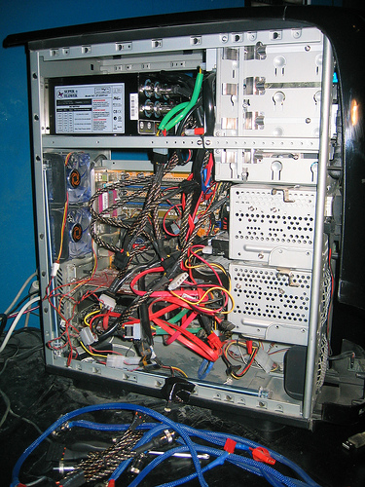
Upgrades

Slide 33
Adding Prism to Family Show
Family Show
Bootstrapper
Unity Container
PersonContent
Controller
Infrastructure
IPersonContentView
IPersonContentService
PersonContext
ChangedEvent
HistoricalFact
Module
FactsByYearContentView
MockPersonContentView
BirthdayContentService

Slide 34
Upgrading FamilyShow to use Prism
demo

Slide 35

All aboard!

Slide 36
In the box?
Stock Trader RI
Libraries
Documentation
Quickstarts
How-Tos

Slide 37
Capabilities and Features
Regions and Views
Region Manager
Region Attached Properties
Module Loading
Static
Communication
Event Aggregator
Directory Sweep
Configuration Driven
On-Demand
Composite Command
Delegate Command
Active Aware Composite Command
Active Aware Delegate Command
MVP / Presentation Model

Slide 38
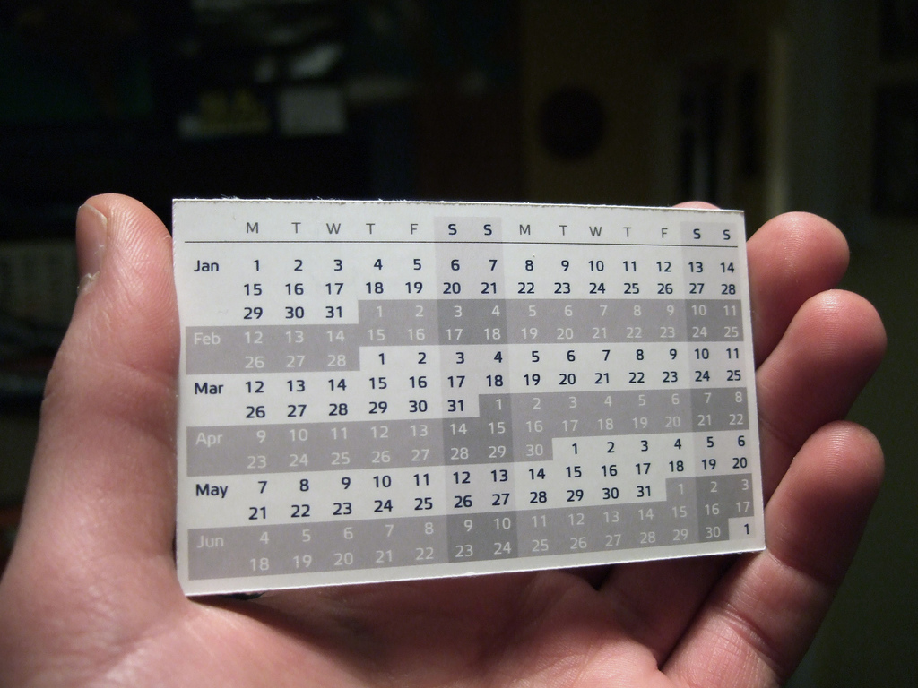
When – It shipped the end of June

Slide 39
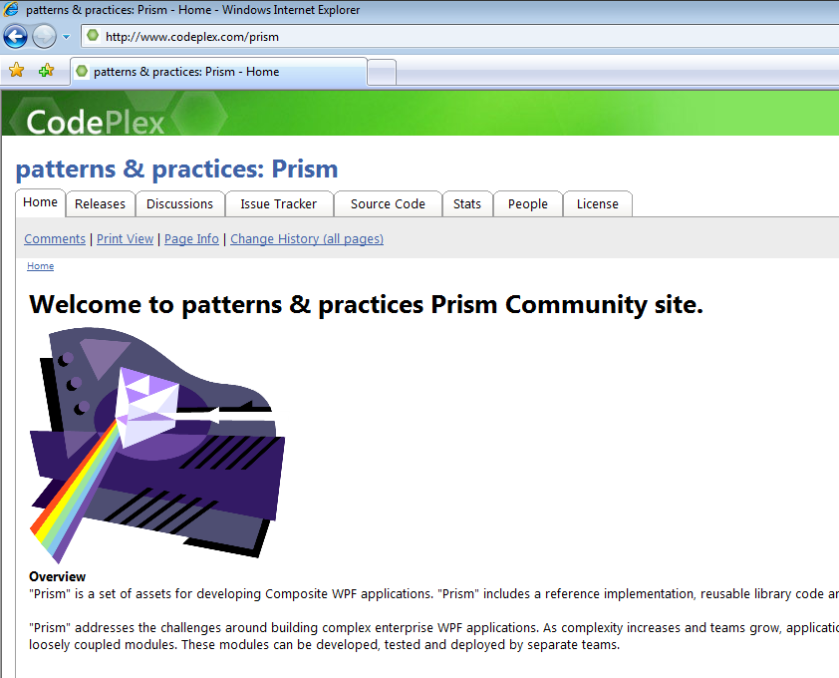
Where can you find it?
www.codeplex.com/prism
  For community support
Francis's blog: http://blogs.msdn.com/francischeung
Blaine's blog: http://blogs.msdn.com/blaine

Slide 40
Q&A

Slide 41
Feedback / QnA
Your Feedback is Important!
  Please take a few moments to fill out our online feedback form at:
  << Feedback URL – Ask your organizer for this in advance>>
  For detailed feedback, use the form at http://www.connectwithlife.co.in/vtd/helpdesk.aspx
  Or email us at vtd@microsoft.com
Use the Question Manager on LiveMeeting to ask your questions now!

Slide 42
Contact
Blog Address
http://blogs.msdn.com/blaine
  http://blogs.msdn.com/francischeung

