Slide 1
PLINQ Parallelize Your .NET Applications with Parallel Extensions
Bijoy Singhal
Developer Evangelist | Microsoft India

Slide 2
Session Objectives
Understand why we need parallelism?
How PLINQ integrates parallelism into .NET?
How does PLINQ work?
What are Coordination Data Structures?
Demo: PLINQExamples
NOTE: This presentation is based on June 2008 CTP of parallel extensions. Things may change in future.

Slide 3
The Manycore Shift
“[A]fter decades of single core processors, the high volume processor industry has gone from single to dual to quad-core in just the last two years. Moore’s Law scaling should easily let us hit the 80-core mark in mainstream processors within the next ten years and quite possibly even less.” -- Justin Ratner, CTO, Intel (February 2007)
“If you haven’t done so already, now is the time to take a hard look at the design of your application, determine what operations are CPU-sensitive now or are likely to become so soon, and identify how those places could benefit from concurrency.” -- Herb Sutter, C++ Architect at Microsoft (March 2005)

Slide 4
What's the Problem?
Multithreaded programming is “hard” today
Doable by only a subgroup of senior specialists
Parallel patterns are not prevalent, well known, nor easy to implement
So many potential problems
Races, deadlocks, livelocks, lock convoys, cache coherency overheads, lost event notifications, broken serializability, priority inversion, and so on…
Businesses have little desire to “go deep”
Best devs should focus on business value, not concurrency
Need simple ways to allow all devs to write concurrent code

Slide 5
Example: “Baby Names”
IEnumerable<BabyInfo> babies = ...;
var results = new List<BabyInfo>();
foreach (var baby in babies)
{
if (baby.Name == queryName &&
baby.State == queryState &&
baby.Year >= yearStart &&
baby.Year <= yearEnd)
{
results.Add(baby);
}
}
results.Sort((b1, b2) => b1.Year.CompareTo(b2.Year));

Slide 6
Manual Parallel Solution
Synchronization Knowledge
IEnumerable<BabyInfo> babies = …;
var results = new List<BabyInfo>();
int partitionsCount = Environment.ProcessorCount * 2;
int remainingCount = partitionsCount;
var enumerator = babies.GetEnumerator();
try {
using (ManualResetEvent done = new ManualResetEvent(false)) {
for (int i = 0; i < partitionsCount; i++) {
ThreadPool.QueueUserWorkItem(delegate {
var partialResults = new List<BabyInfo>();
while(true) {
BabyInfo baby;
lock (enumerator) {
if (!enumerator.MoveNext()) break;
baby = enumerator.Current;
}
if (baby.Name == queryName && baby.State == queryState &&
baby.Year >= yearStart && baby.Year <= yearEnd) {
partialResults.Add(baby);
}
}
lock (results) results.AddRange(partialResults);
if (Interlocked.Decrement(ref remainingCount) == 0) done.Set();
});
}
done.WaitOne();
results.Sort((b1, b2) => b1.Year.CompareTo(b2.Year));
}
}
finally { if (enumerator is Idisposable) ((Idisposable)enumerator).Dispose(); }
Inefficient locking
Lack of foreach simplicity
Manual aggregation
Tricks
Lack of thread reuse
Heavy synchronization
Non-parallel sort

Slide 7
LINQ Solution
.AsParallel()
var results = from baby in babies
where baby.Name == queryName &&
baby.State == queryState &&
baby.Year >= yearStart &&
baby.Year <= yearEnd
orderby baby.Year ascending
select baby;

Slide 8
Example: Matrix Multiplication
void MultiplyMatrices(int size, double[,] m1, double[,] m2, double[,] result)
{
for (int i = 0; i < size; i++) {
for (int j = 0; j < size; j++) {
result[i, j] = 0;
for (int k = 0; k < size; k++) {
result[i, j] += m1[i, k] * m2[k, j];
}
}
}
}

Slide 9
Manual Parallel Solution
Static Work Distribution
int N = size;
int P = 2 * Environment.ProcessorCount;
int Chunk = N / P;
ManualResetEvent signal = new ManualResetEvent(false);
int counter = P;
for (int c = 0; c < P; c++) {
ThreadPool.QueueUserWorkItem(o => {
int lc = (int)o;
for (int i = lc * Chunk;
i < (lc + 1 == P ? N : (lc + 1) * Chunk);
i++) {
// original loop body
for (int j = 0; j < size; j++) {
result[i, j] = 0;
for (int k = 0; k < size; k++) {
result[i, j] += m1[i, k] * m2[k, j];
}
}
}
if (Interlocked.Decrement(ref counter) == 0) {
signal.Set();
}
}, c);
}
signal.WaitOne();
Potential scalability bottleneck
Error Prone
Error Prone

Slide 10
Parallel Solution
void MultiplyMatrices(int size, double[,] m1, double[,] m2, double[,] result)
{
Parallel.For(0, size, i => {
for (int j = 0; j < size; j++) {
result[i, j] = 0;
for (int k = 0; k < size; k++) {
result[i, j] += m1[i, k] * m2[k, j];
}
}
});
}

Slide 11
Parallel Extensions Architecture
.NET Program
PLINQ Execution Engine
Declarative
Queries
Parallel Algorithms
Query Analysis
Data Partitioning
Chunk
Range
Hash
Striped
Repartitioning
Operator Types
Map
Filter
Sort
Search
Reduction
Merging
Async (pipeline)
Synch
Order Preserving
ForAll
C# Compiler
VB Compiler
Task Parallel Library
Coordination Data Structures
C++ Compiler
PLINQ
Loop replacements Imperative Task Parallelism
Scheduling
Thread-safe Collections
Synchronization Types
Coordination Types
F# Compiler
Other .NET Compiler
Threads + UMS
IL
TPL or CDS
Proc 1
…
Proc p

Slide 12
Parallel Extensions to the .NET Framework
What is it?
Library extensions to the .NET Framework
Lightweight, user-mode runtime
Supports imperative and declarative, data and task parallelism
Common exception handling model
Why do we need it?
Supports parallelism in any .NET language
Delivers reduced concept count and complexity, better time to solution
Begins to move parallelism capabilities from concurrency experts to domain experts

Slide 13
Parallel LINQ (PLINQ)
Enable LINQ developers to leverage parallel hardware
Supports all of the .NET Standard Query Operators
Plus a few PLINQ-specific extensions methods
Abstracts away parallelism details
Partitions and merges data intelligently (“classic” data parallelism)
Works for any IEnumerable<T>

Slide 14
Writing a PLINQ Query
Method 1: Comprehension syntax
Syntax extensions to C# and Visual Basic
Method 2: Method syntax on the APIs:
Used as extension methods on IParallelEnumerable<T>
System.Linq.ParallelEnumerable class
API implementation does the actual work
Compiler converts the former into the latter
var q = from x in Y.AsParallel() where p(x) orderby x.f1 select x.f2;
var q = Y.AsParallel().Where(x => p(x)). OrderBy(x => x.f1).Select(x => x.f2);
var q = ParallelEnumerable.Select(
ParallelEnumerable.OrderBy(
ParallelEnumerable.Where(Y.AsParallel(), x => p(x)),
x => x.f1),
x => x.f2);

Slide 15
Partitioning
Input to a single operator is partitioned into p disjoint subsets
Operators are replicated across the partitions
Example
(from x in D.AsParallel() where p(x) select x*x*x).Sum();
Each partition executes in (almost) complete isolation
… Task 1 …
D
where p(x)
select x³
Sum()
Sum()
… Task n …
where p(x)
select x³
Sum()

Slide 16
Partitioning, cont.
Types of partitioning
Chunk
Works with any IEnumerable<T>
Single enumerator shared; chunks handed out on-demand
Range
Works only with IList<T>
Input divided into contiguous regions, one per partition
Striped
Elements handed out round-robin to each partition
Hash
Works with any IEnumerable<T>
Elements assigned to partition based on hash code
Repartitioning sometimes necessary

Slide 17
Merging
Pipelined: separate consumer thread
Default for GetEnumerator()
And hence foreach loops
Access to data as its available
But more synchronization overhead
Stop-and-go: consumer helps
Minimizes context switches
But higher latency, more memory
Sorts, ToArray, ToList, etc.
Inverted: no merging needed
ForAll extension method
Most efficient by far
But not always applicable
Thread 2
Thread 1
Thread 3
Thread 1
Thread 4
Thread 1
Thread 1
Thread 2
Thread 1
Thread 3
Thread 1
Thread 1
Thread 2
Thread 1
Thread 3

Slide 18
Coordination Data Structures
Thread-safe collections
ConcurrentStack<T>
ConcurrentQueue<T>
ConcurrentLinkedList<T>
ConcurrentSet<T>
ConcurrentBag<T>
…
Work exchange
BlockingCollection<T>
…
Phased operation
CountdownEvent
…
Locks
ManualResetEventSlim
SemaphoreSlim
SpinLock
SpinWait
…
Initialization
LazyInit<T>
WriteOnce<T>
…

Slide 19
PLINQExamples
DEMO

Slide 20
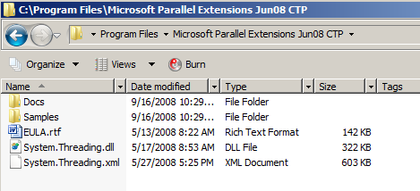
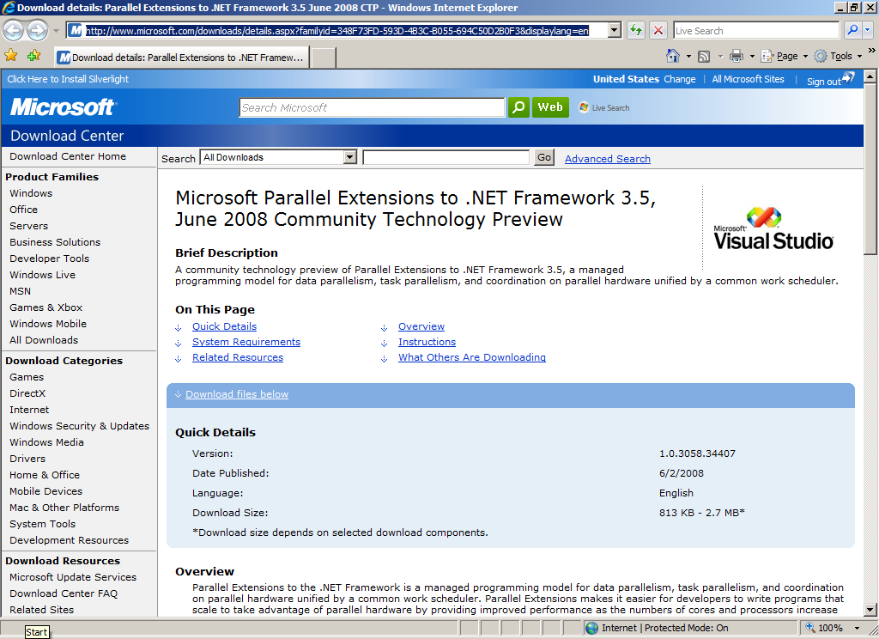
http://www.microsoft.com/downloads/details.aspx?familyid=348F73FD-593D-4B3C-B055-694C50D2B0F3&displaylang=en
SDK

Slide 21
References
Parallel Extensions Team Blog
http://blogs.msdn.com/pfxteam/
Parallel Extensions June 2008 CTP Help file

Slide 22
Feedback / QnA
Your Feedback is Important!
Please take a few moments to fill out our online feedback form
For detailed feedback, use the form at http://www.connectwithlife.co.in/vtd/helpdesk.aspx
Or email us at vtd@microsoft.com
Use the Question Manager on LiveMeeting to ask your questions now!

Slide 23
Contact
Blog Address
blogs.msdn.com/bsinghal
Email Address
bsinghal@microsoft.com

